Slide 1

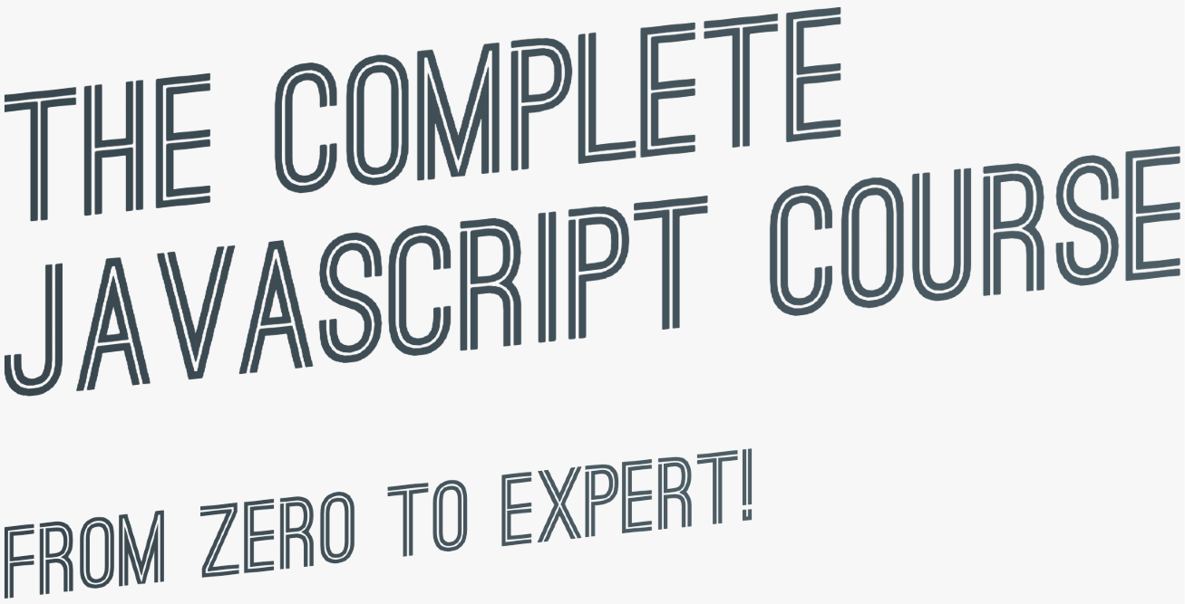

slides for
theory lectures

Slide 2

TABLE OF CONTENTS: THEORY LECTURES
 | 19 | Summary: Which Data Structure to Use? | 37 | How the Web Works: Requests and Responses
2 A Brief Introduction to JavaScript | 20 | First-Class and Higher-Order Functions | 38 | Promises and the Fetch API
3 Data Types | 21 | Closures | 39 | Asynchronous Behind the Scenes: The Event Loop
4 Boolean Logic | 22 | Data Transformations: map, filter, reduce | 40 | An Overview of Modern JavaScript Development
5 JavaScript Releases: ES5, ES6+ and ESNext | 23 | Summary: Which Array Method to Use? | 41 | An Overview of Modules in JavaScript
6 Functions Calling Other Functions | 24 | How the DOM Really Works | 42 | Modern, Clean and Declarative JavaScript Programming
7 Reviewing Functions | 25 | Event Propagation: Bubbling and Capturing | 43 | Forkify: Project Overview and Planning
8 Learning How to Code | 26 | Efficient Script Loading: defer and async | 44 | The MVC Architecture
9 How to Think Like a Developer | 27 | What is Object-Oriented Programming? | 45 | Event Handlers in MVC: Publisher-Subscriber Pattern
10 Debugging (Fixing Errors) | 28 | OOP in JavaScript | 46 | Forkify Project: Final Considerations
11 What's the DOM and DOM Manipulation | 29 | Prototypal Inheritance and The Prototype Chain
12 An high-level Overview of JavaScript | 30 | Object.create
13 The JavaScript Engine and Runtime | 31 | Inheritance Between "Classes": Constructor Functions
14 Execution Contexts and The Call Stack | 32 | Inheritance Between "Classes": Object.create
15 Scope and The Scope Chain | 33 | ES6 Classes summary
16 Variable environment: Hoisting and The TDZ | 34 | Mapty Project: How to Plan a Web Project
17 The this Keyword | 35 | Mapty Project: Final Considerations
18 Primitives vs. Objects (Primitive vs. Reference Types) | 36 | Asynchronous JavaScript, AJAX and APIs

Slide 3
WELCOME

Slide 4


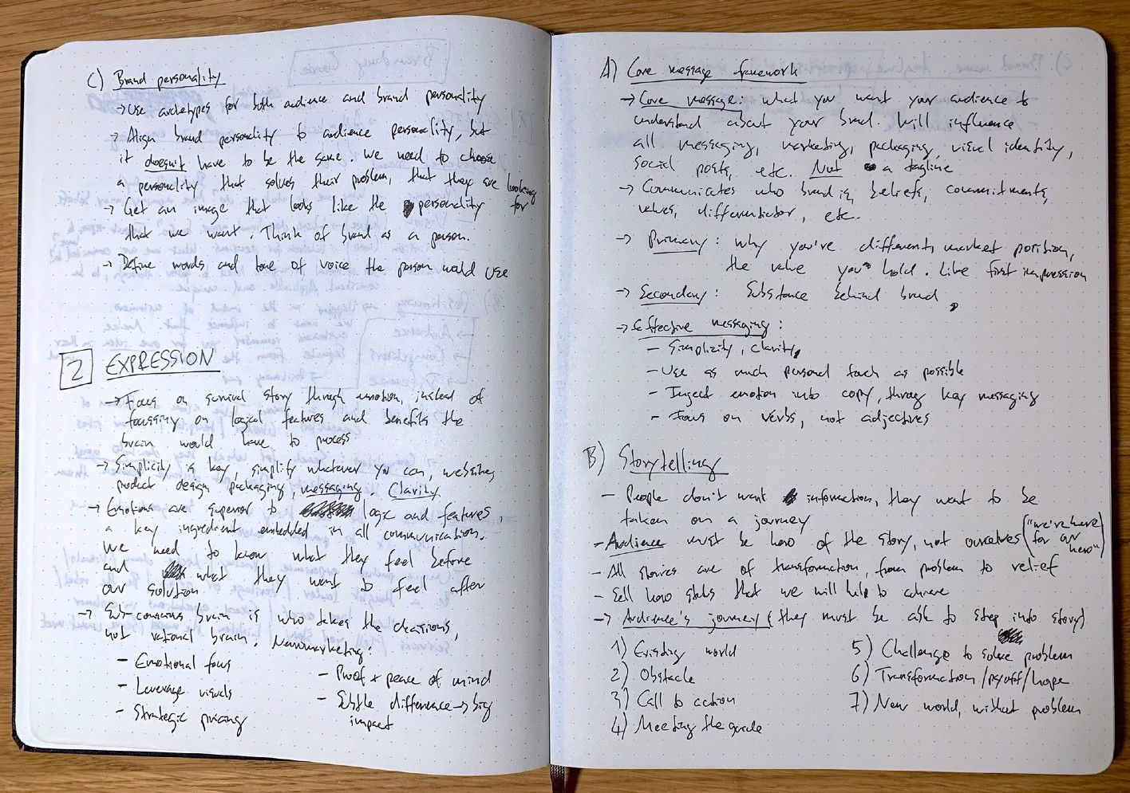

SOME QUICK CONSIDERATIONS BEFORE WE START...
If you want the course material to stick, take notes. Notes on code syntax, notes on theory concepts, notes on everything!
Totally non-coding... Try to understand a single word

Slide 5


SOME QUICK CONSIDERATIONS BEFORE WE START...
If this is your first time ever programming, please don’t get overwhelmed. It’s 100% normal that you will not understand everything at the beginning. Just don’t think “I guess coding is not for me”!

Slide 6

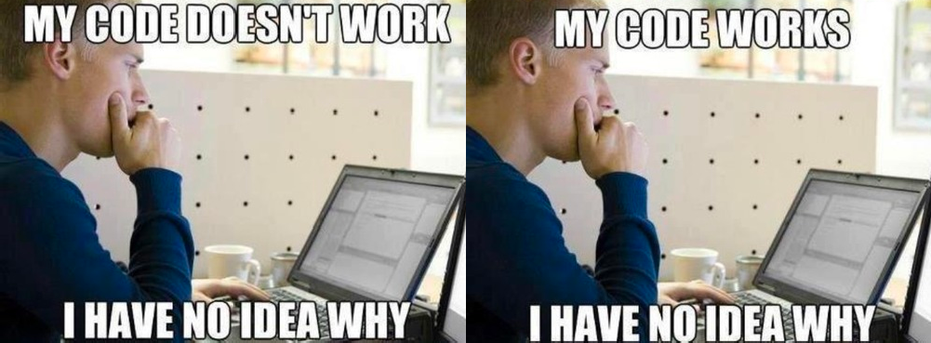
SOME QUICK CONSIDERATIONS BEFORE WE START...
In the first sections of the course, don’t bother understanding WHY things work the way they do in JavaScript. Also, don’t stress about efficient code, or fast code, or clean code. While learning, we just want to make things WORK. We will understand the WHY later in the course.

Slide 7

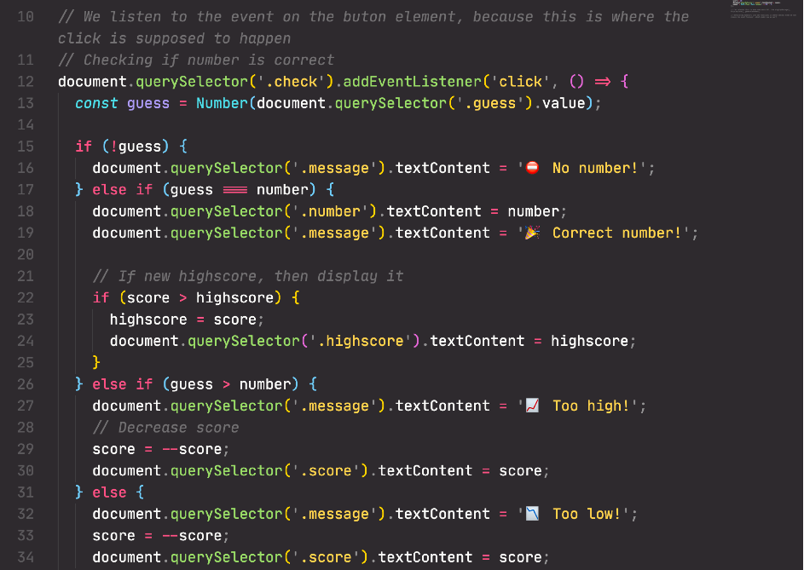
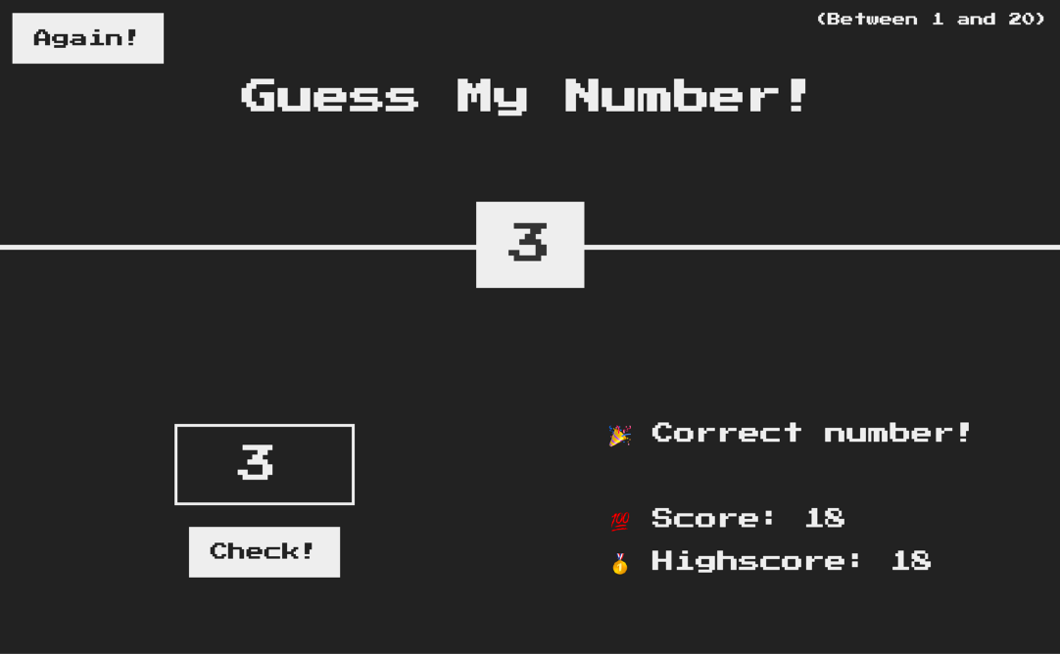

SOME QUICK CONSIDERATIONS BEFORE WE START...
Before moving on from a section, make sure that you understand exactly what was covered. Take a break, review the code we wrote, review your notes, review the projects we built, and maybe even write some code yourself.

Slide 8



SOME QUICK CONSIDERATIONS BEFORE WE START...
Most importantly, have fun! It’s so rewarding to see something that YOU have built YOURSELF! So if you’re feeling frustrated, stop whatever you’re doing, and come back later!
And I mean REAL fun

Slide 9
THANK YOU

