Slide 1
WORKING WITH ARRAYS

Slide 2

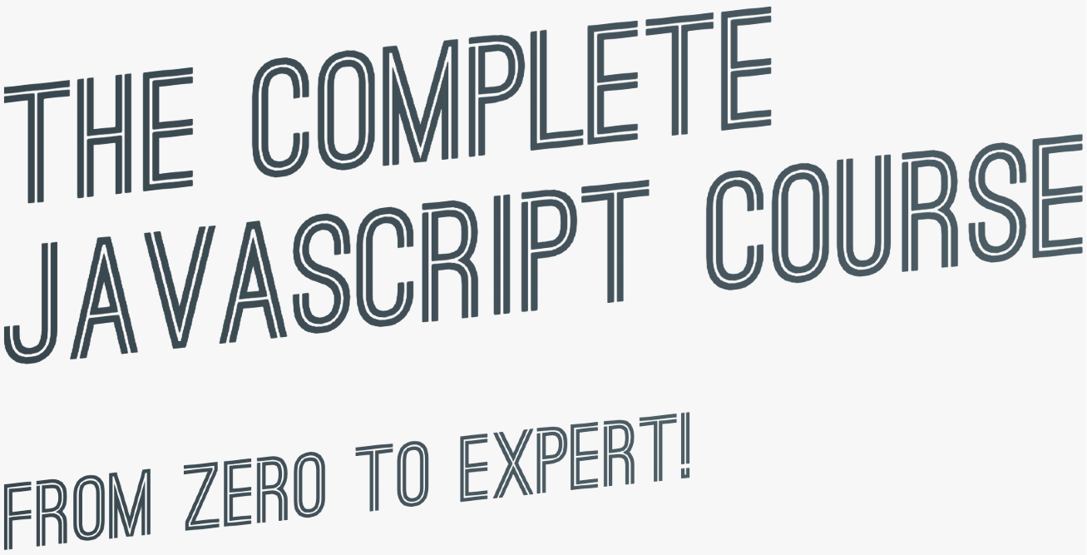

SECTION
WORKING WITH ARRAYS
LECTURE
DATA TRANSFORMATIONS: MAP, FILTER, REDUCE

Slide 3

DATA TRANSFORMATIONS WITH MAP, FILTER AND REDUCE
Original array
3
1
4
3
2
3
1
4
3
2
3
1
4
3
2
MAP
FILTER
REDUCE
current * 2
Example
current > 2
Accumulator
acc + current
1
2
6
2
8
6
4
3
4
3
13
11
348
Reduced value
Filtered array
map returns a new array containing the results of applying an operation on all original array elements
filter returns a new array containing the array elements that passed a specified test condition
reduce boils (“reduces”) all array elements down to one single value (e.g. adding all elements together)

Slide 4
SECTION
WORKING WITH ARRAYS
LECTURE
SUMMARY: WHICH ARRAY METHOD TO USE?

Slide 5

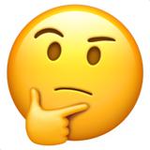
WHICH ARRAY METHOD TO USE?
“I WANT...:”
To mutate original array
Add to original:
A new array
An array index
Know if array includes
To transform to value
Computed from original:
Based on value:
Based on value:
Based on accumulator:
.push
(end)
.map
(loop)
.indexOf
.includes
.reduce
.unshift
(start)
(Boil down array to single value of any type: number, string, boolean, or even new array or object)
Filtered using condition:
Based on test condition:
Based on test condition:
.filter
.findIndex
.some
Remove from original:
.pop
(end)
.every
Portion of original:
.shift
(start)
.slice
.splice
(any)
An array element
Based on test condition:
A new string
Based on separator string:
To just loop array
Based on callback:
Adding original to other:
Others:
.concat
.reverse
.find
.join
.forEach
Flattening the original:
.sort
(Does not create a new array, just loops over it)
.flat
.fill
.flatMap

Slide 6
ADVANCED DOM AND EVENTS

Slide 7
SECTION
ADVANCED DOM AND EVENTS
LECTURE
HOW THE DOM REALLY WORKS

Slide 8





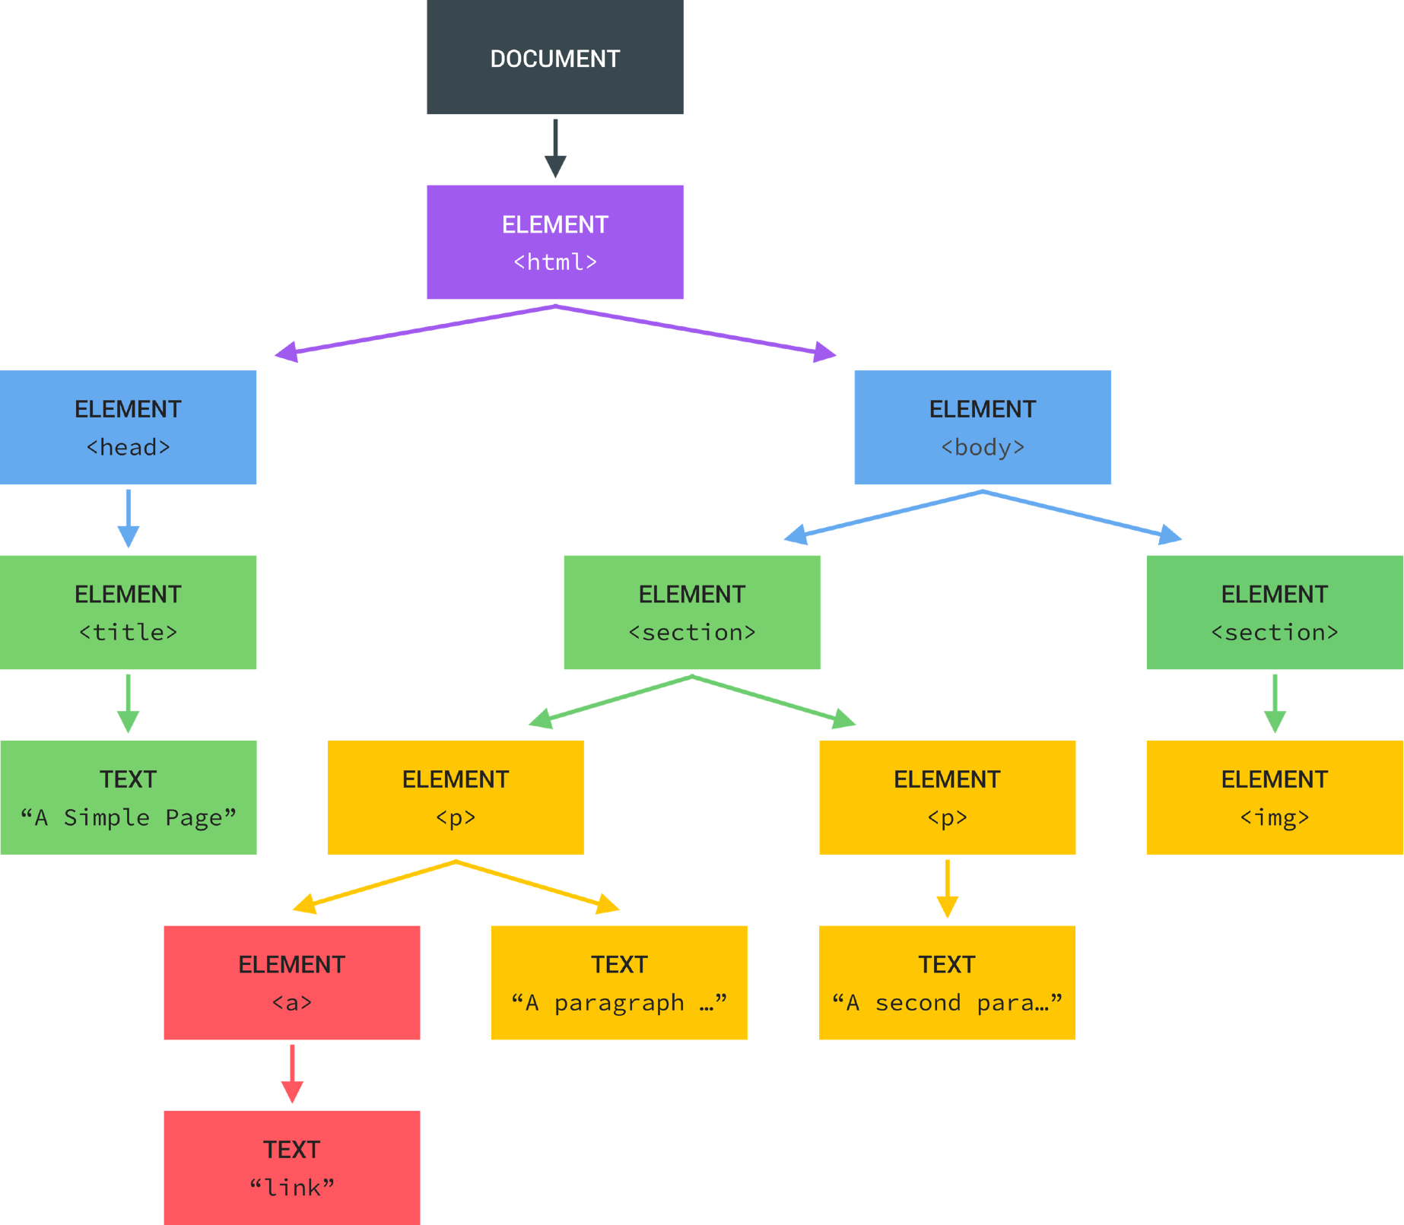
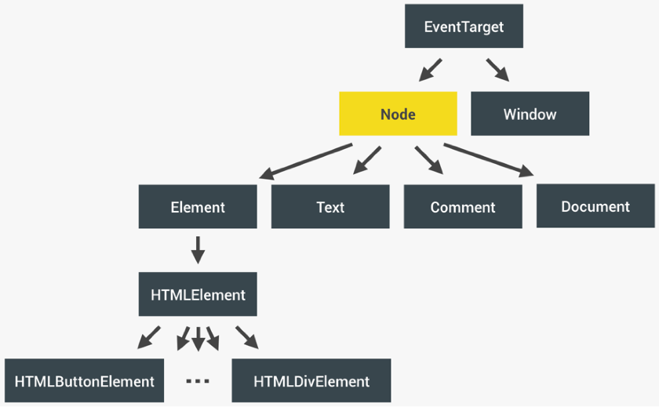
REVIEW: WHAT IS THE DOM?
BROWSER
DOM
INTERFACE
Allows us to make JavaScript interact with the browser;
Nodes
We can write JavaScript to create, modify and delete HTML elements; set styles, classes and attributes; and listen and respond to events;
DOM tree is generated from an HTML document, which we can then
interact with;
Application Programming Interface
DOM is a very complex API that contains lots of methods and properties to interact with the DOM tree
“Types” of DOM objects (next slide)
DOM tree
.querySelector() / .addEventListener() / .createElement() /
.innerHTML / .textContent / .children / etc ...

Slide 9

HOW THE DOM API IS ORGANIZED BEHIND THE SCENES
Represented by JavaScript object
.addEventListener()
.removeEventListener()
EventTarget
.innerHTML
.classList
.children
.parentElement
.append()
.remove()
.insertAdjacentHTML()
.querySelector()
.closest()
.matches()
.scrollIntoView()
.setAttribute()
.textContent
.childNodes
.parentNode
.cloneNode()
Node
Window
Global object, lots of methods and properties, many unrelated to DOM
INHERITANCE OF METHODS AND PROPERTIES
<p>Paragraph<p>
Element
Text
Comment
Document
Example:
Any HTMLElement will have access to
.addEventListener(),
.cloneNode()
or .closest() methods.
<p>Paragraph<p>
<!--Comment-->
.querySelector()
.createElement()
.getElementById()
HTMLElement
HTMLButtonElement
...
HTMLDivElement
(One different type of HTMLElement per HTML element...)
(THIS IS NOT A DOM TREE)

