Slide 1

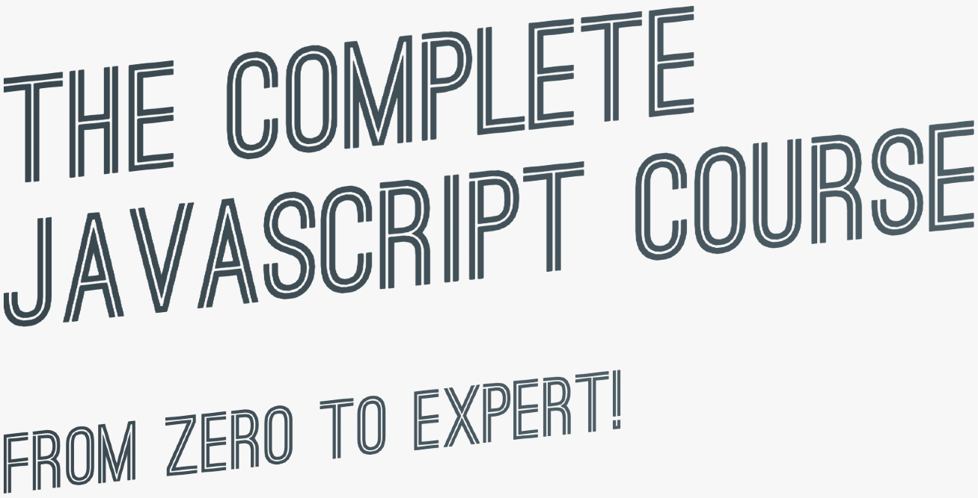

SECTION
ADVANCED DOM AND EVENTS
LECTURE
EVENT PROPAGATION: BUBBLING AND CAPTURING

Slide 2
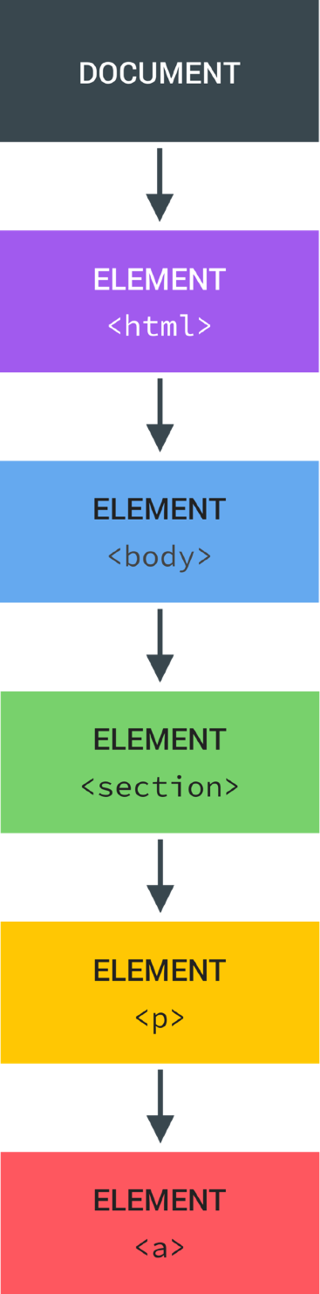
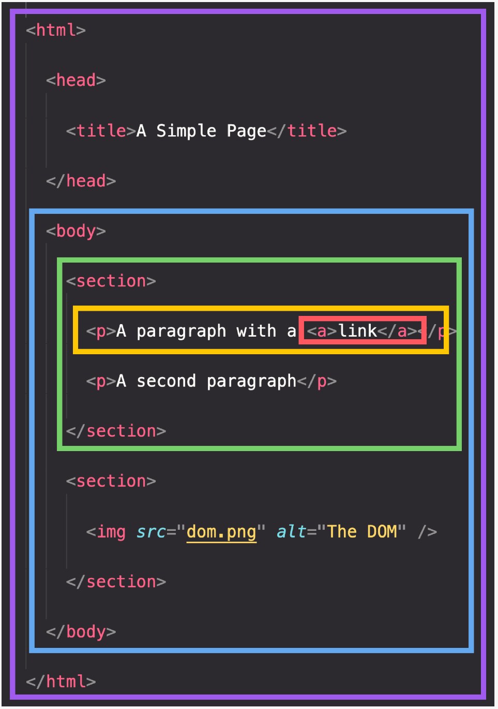
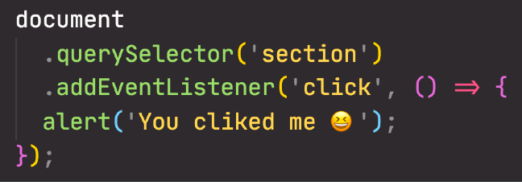


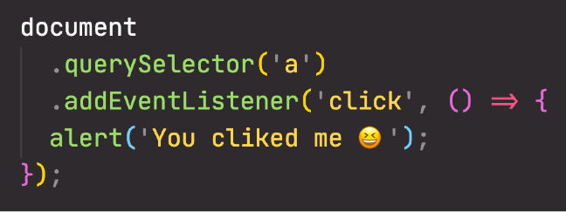
BUBBLING AND CAPTURING
Click event
1
3
CAPTURING PHASE
BUBBLING PHASE
(THIS DOES NOT HAPPEN ON ALL EVENTS)
2
TARGET PHASE

Slide 3
SECTION
ADVANCED DOM AND EVENTS
LECTURE
EFFICIENT SCRIPT LOADING: DEFER AND ASYNC

Slide 4





DEFER AND ASYNC SCRIPT LOADING
HEAD
BODY END
REGULAR
Parsing HTML
Waiting...
Finish parsing HTML
Parsing HTML | Fetch script | Execute
DOMContentLoaded
Time
Fetch script
Execute
DOMContentLoaded
ASYNC
Parsing HTML
Waiting
Finish parsing HTML
Makes no sense
Fetch script
Execute
DOMContentLoaded
DEFER
Parsing HTML
Execute
Makes no sense
Fetch script
DOMContentLoaded

Slide 5
REGULAR VS. ASYNC VS. DEFER
END OF BODY
ASYNC IN HEAD
DEFER IN HEAD
Parse HTML | Fetch | Run
DOMContentLoaded
Parse HTML Wait
Fetch Run
Parse HTML
Parse HTML
Run
DOMContentLoaded
Fetch
DOMContentLoaded
Scripts are fetched and executed after the HTML is completely parsed
Use if you need to support old browsers
Scripts are fetched asynchronously and executed immediately
Usually the DOMContentLoaded event waits for all scripts to execute, except for async scripts. So, DOMContentLoaded does not wait for an async script
Scripts not guaranteed to execute in order
Use for 3rd-party scripts where order doesn’t matter (e.g. Google Analytics)
Scripts are fetched asynchronously and executed after the HTML is completely parsed
DOMContentLoaded event fires after
defer script is executed
Scripts are executed in order
This is overall the best solution! Use for your own scripts, and when order matters (e.g. including a library)
You can, of course, use different strategies for different scripts. Usually a complete web applications includes more than just one script
Parse HTML
Parse HTML
Fetch
Run
Fetch
Run
DOMContentLoaded
DOMContentLoaded

Slide 6
OBJECT ORIENTED
PROGRAMMING (OOP) WITH JAVASCRIPT

Slide 7
SECTION
OBJECT ORIENTED PROGRAMMING (OOP) WITH JAVASCRIPT
LECTURE
WHAT IS OBJECT-ORIENTED PROGRAMMING?

Slide 8


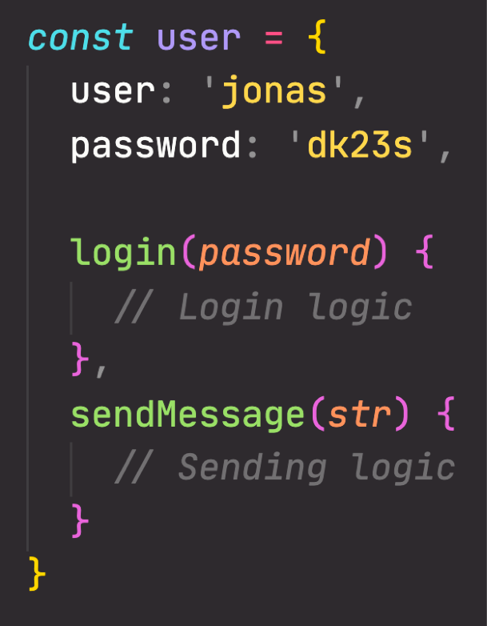


WHAT IS OBJECT-ORIENTED PROGRAMMING? (OOP)
Style of code, “how” we write and organize code
OOP
Object-oriented programming (OOP) is a programming paradigm based on the
concept of objects;
E.g. user or todo list item
Data
We use objects to model (describe) real-world or abstract features;
E.g. HTML component or data structure
Objects may contain data (properties) and code (methods). By using objects, we pack data and the corresponding behavior into one block;
In OOP, objects are self-contained pieces/blocks of code;
Objects are building blocks of applications, and interact with one another; Interactions happen through a public interface (API): methods that the code
outside of the object can access and use to communicate with the object;
Behaviour
OOP was developed with the goal of organizing code, to make it more flexible and easier to maintain (avoid “spaghetti code”).

Slide 9



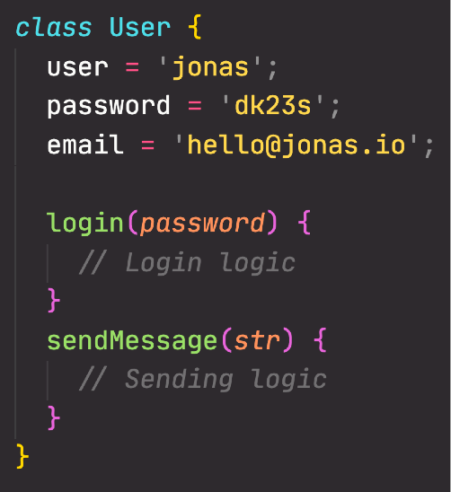

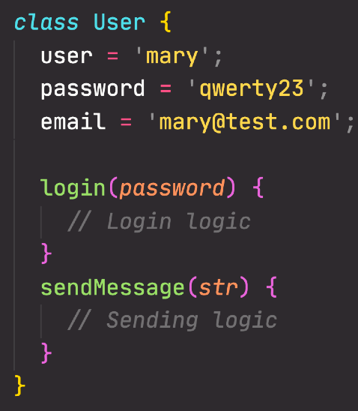


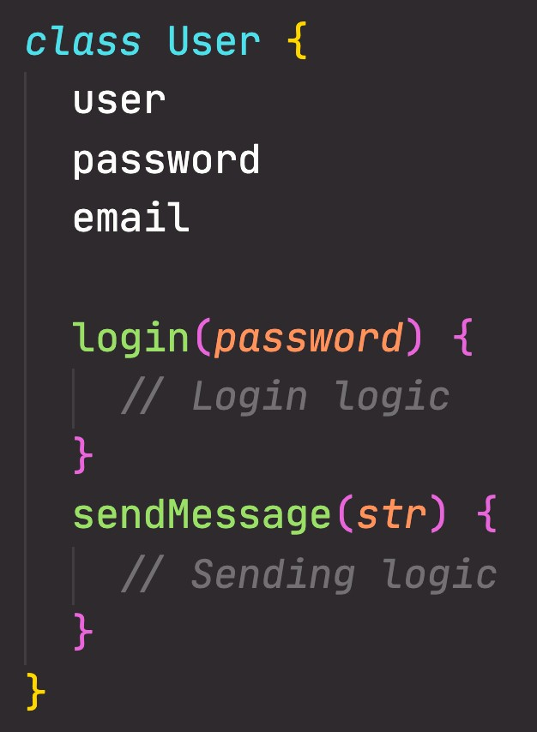
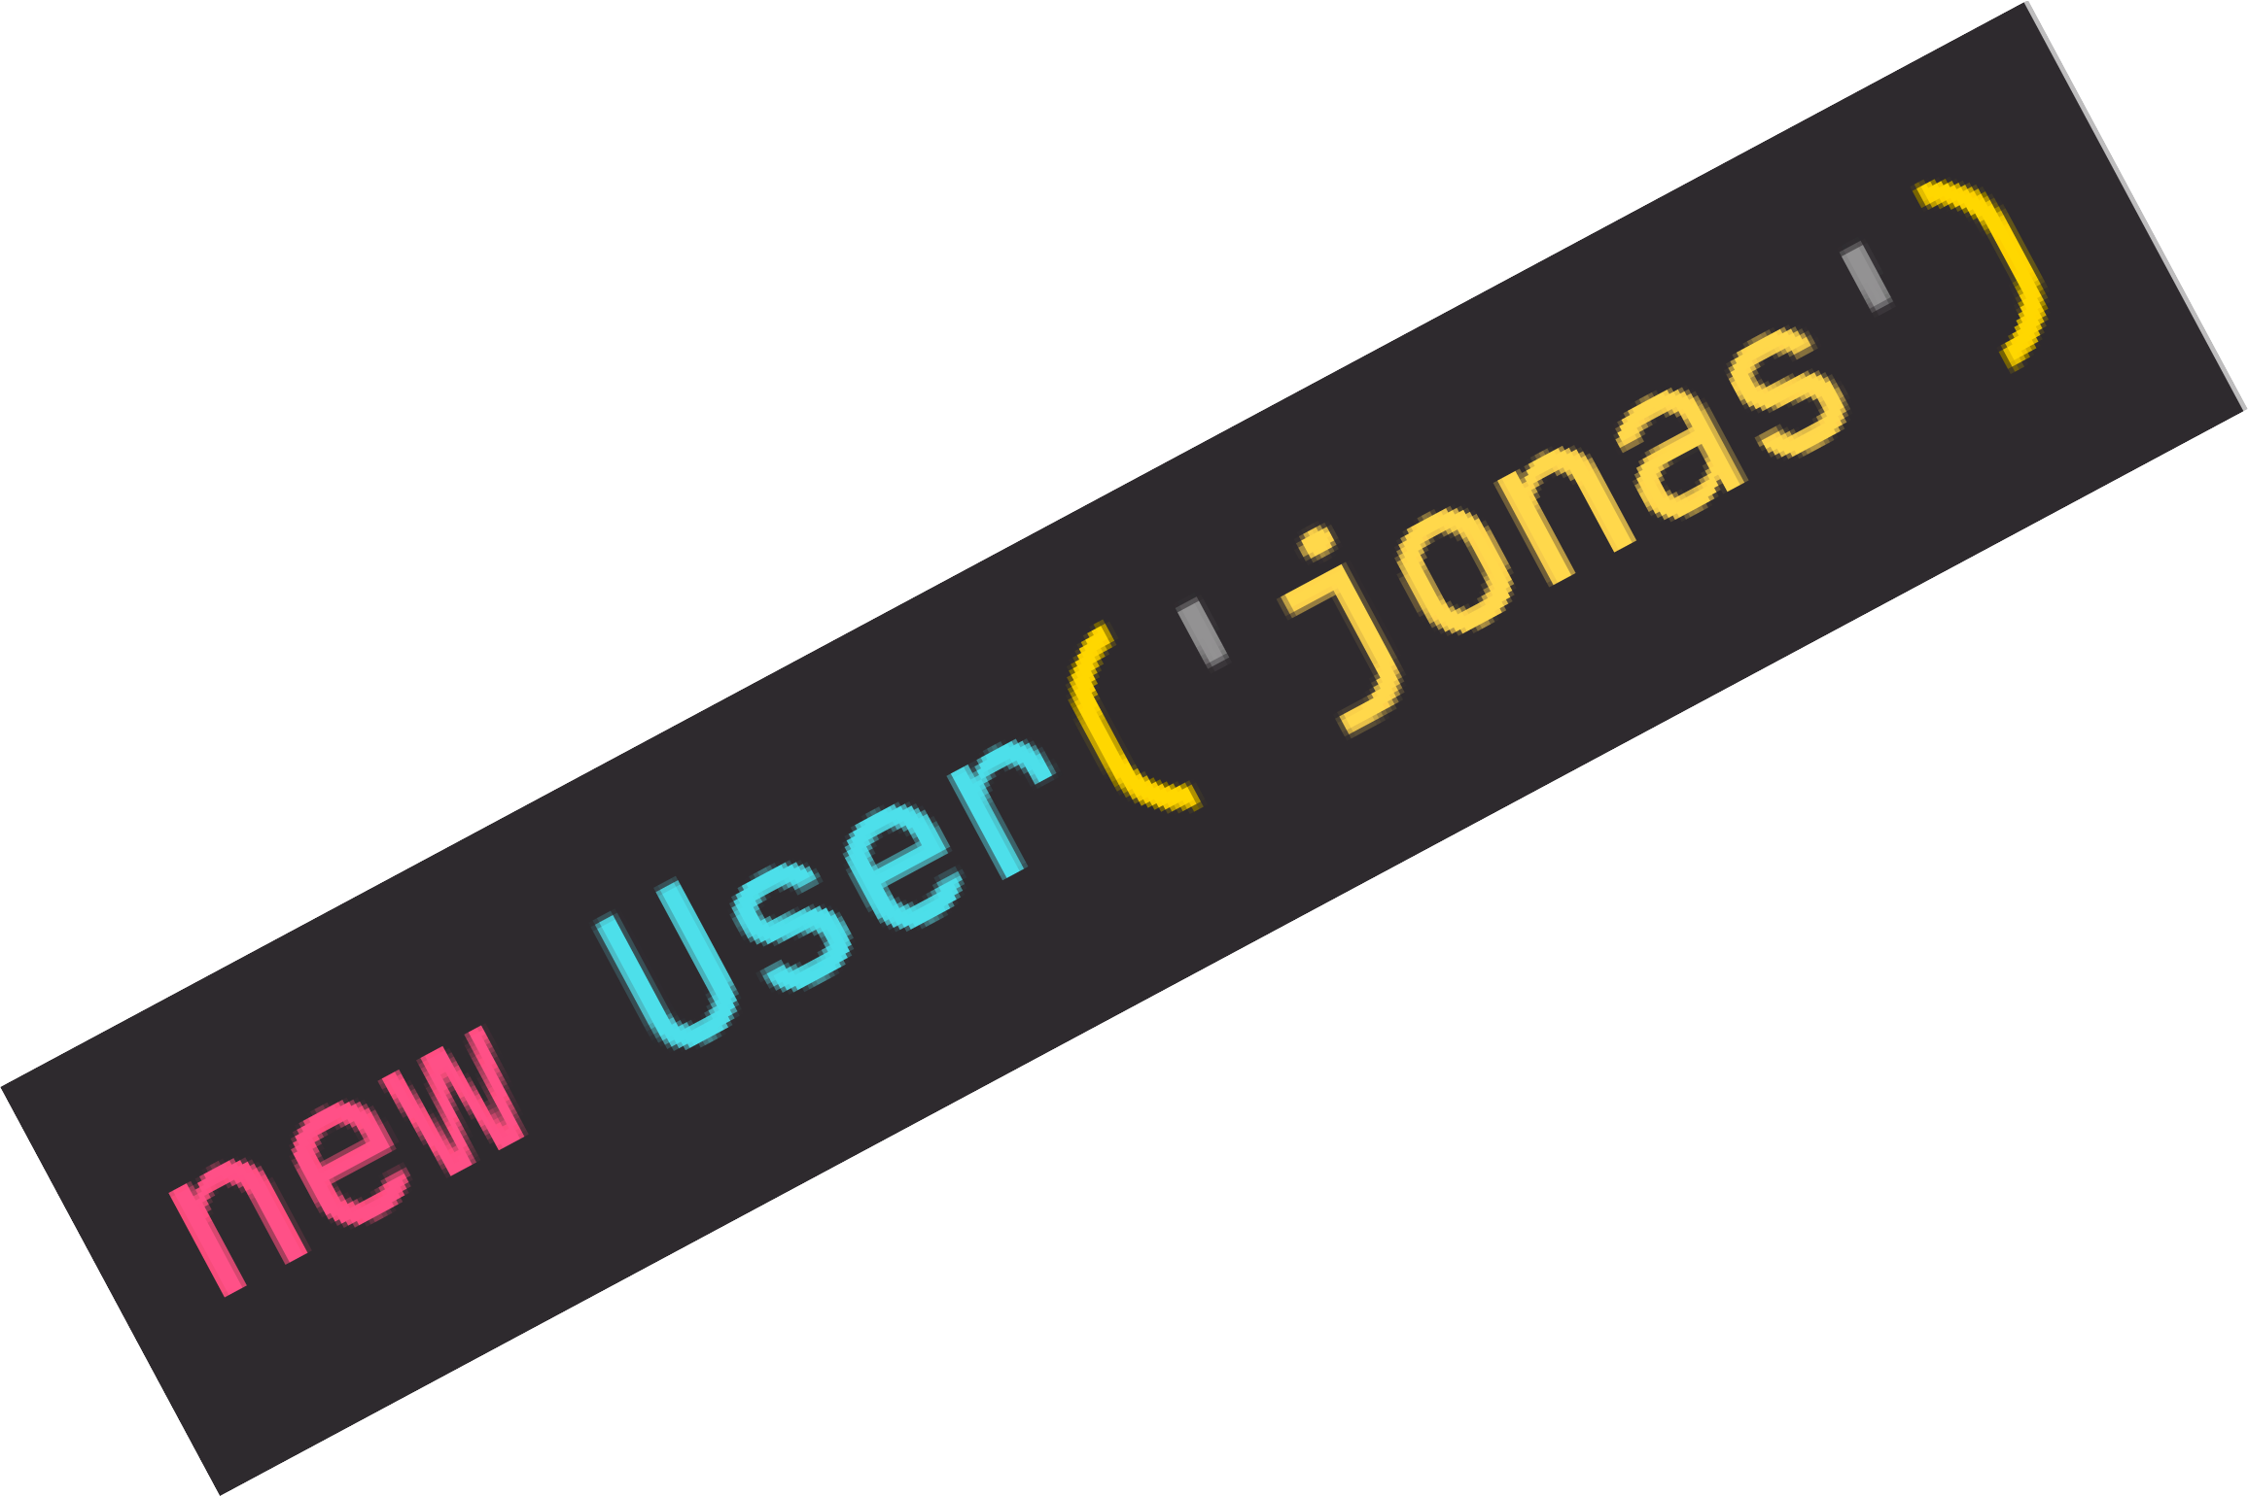

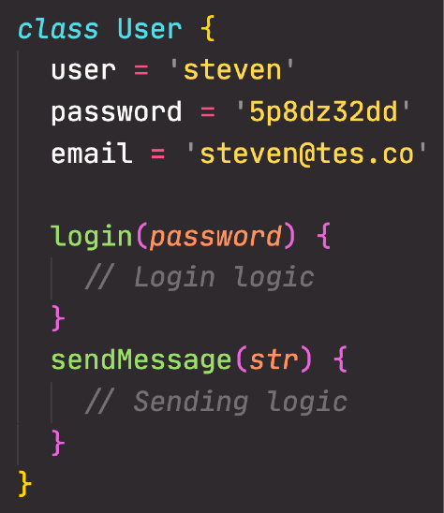


CLASSES AND INSTANCES (TRADITIONAL OOP)
Conceptual overview: it works a bit differently in JavaScript. Still important to understand!
Like a blueprint from which we can create new objects
Instance
New object created from the class. Like a
real house created from an abstract blueprint
CLASS
Instance
Instance
Just a representation, NOT actual JavaScript syntax!
JavaScript does NOT support real classes like represented here

Slide 10

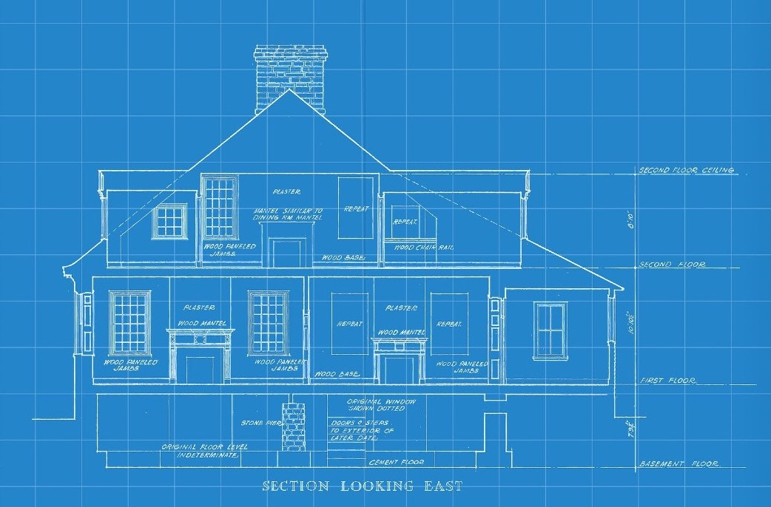
THE 4 FUNDAMENTAL OOP PRINCIPLES
The 4 fundamental principles of Object- Oriented Programming
Abstraction
Encapsulation
“How do we actually design classes? How do we model real-world data into classes?”
Inheritance
Polymorphism

Slide 11
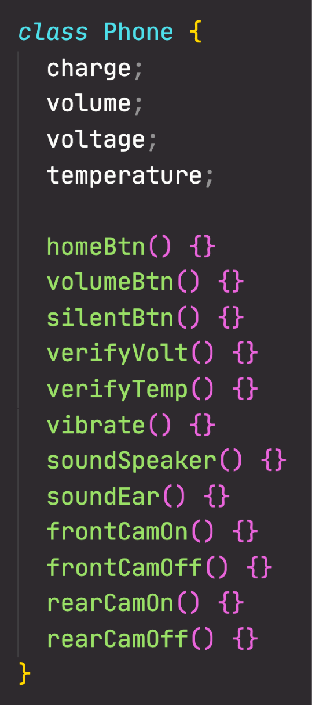


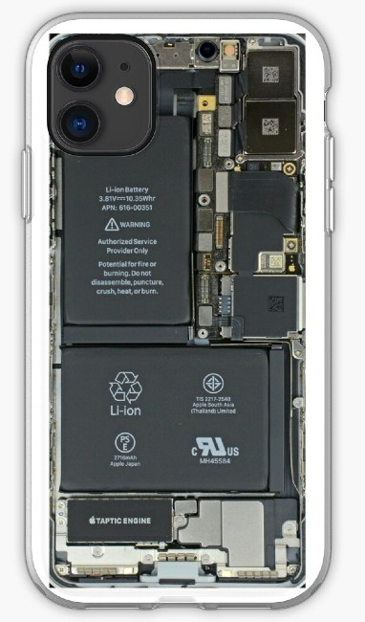
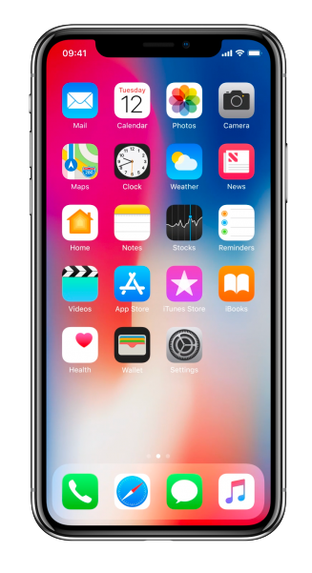
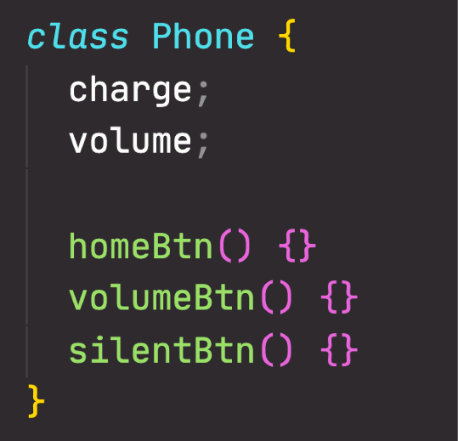

PRINCIPLE 1: ABSTRACTION
Real phone
Abstracted phone
Abstraction
Encapsulation
Inheritance
Polymorphism
Details have been abstracted away
Do we really need all these low-level details?
Abstraction: Ignoring or hiding details that don’t matter, allowing us to get an overview perspective of the thing we’re implementing, instead of messing with details that don’t really matter to our implementation.

Slide 12
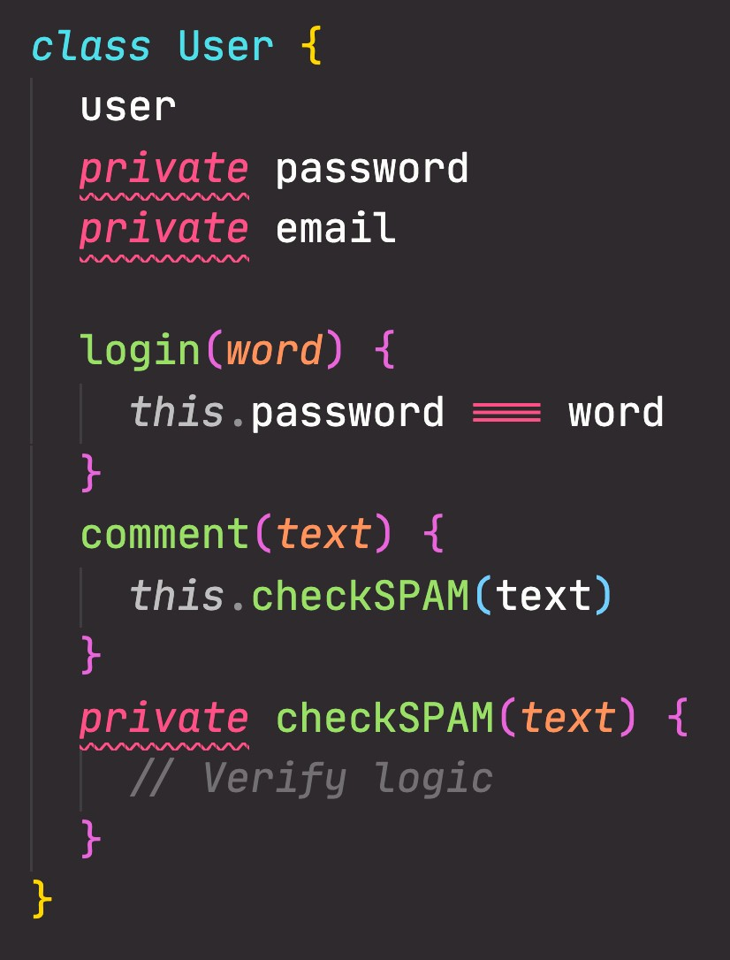

PRINCIPLE 2: ENCAPSULATION
Again, NOT actually JavaScript syntax (the private keyword doesn’t exist)
NOT accessible from
outside the class!
Abstraction
STILL accessible from
within the class!
WHY?
Encapsulation
STILL accessible from
within the class!
NOT accessible from
outside the class!
Prevents external code from accidentally manipulating internal properties/state
Inheritance
Allows to change internal implementation without the risk of breaking external code
Polymorphism
Encapsulation: Keeping properties and methods private inside the class, so they are not accessible from outside the class. Some methods can be exposed as a public interface (API).

Slide 13
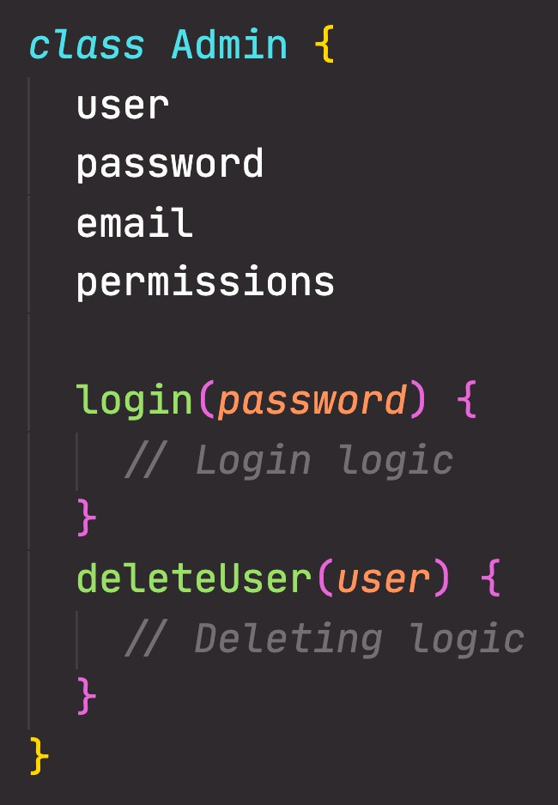

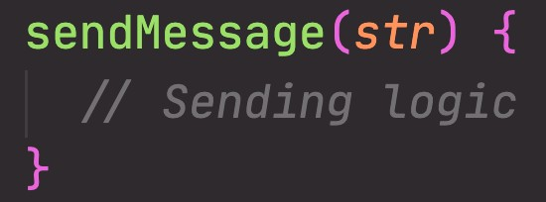
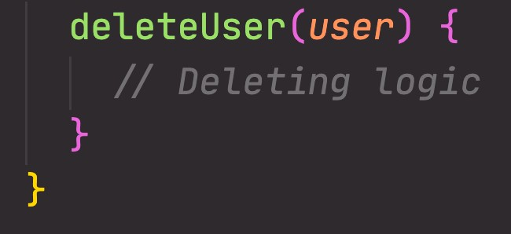
PRINCIPLE 3: INHERITANCE
CHILD CLASS
Inherited
Abstraction
INHERITANCE
CHILD CLASS EXTENDS PARENT CLASS
Encapsulation
Inherited
Inheritance
PARENT CLASS
OWN methods and properties
Polymorphism
Inheritance: Making all properties and methods of a certain class available to a child class, forming a hierarchical relationship between classes. This allows us to reuse common logic and to model real-world relationships.

Slide 14
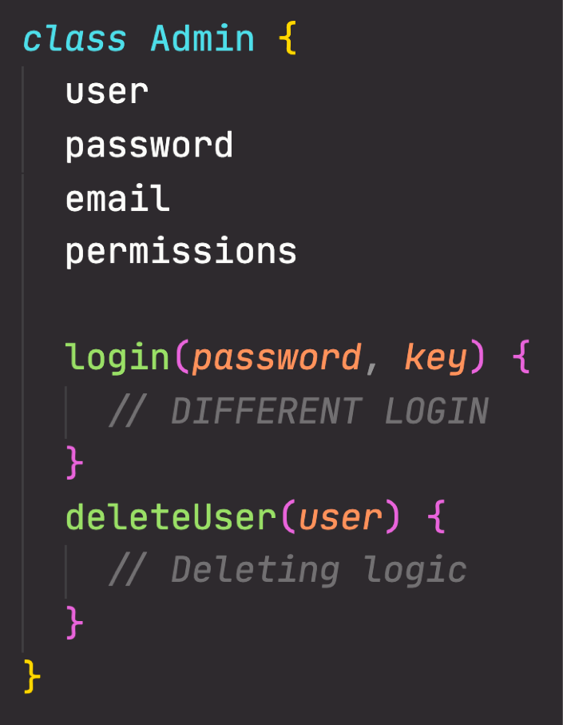

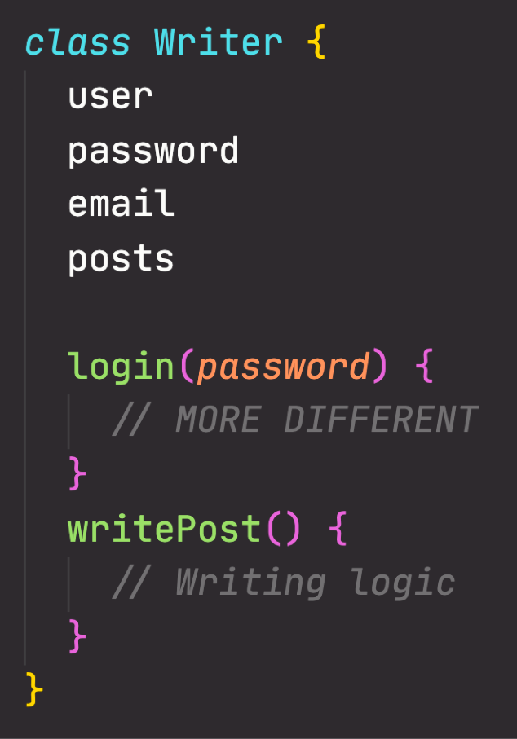


PRINCIPLE 4: POLYMORPHISM
INHERITANCE
INHERITANCE
Abstraction
Encapsulation
Inheritance
PARENT CLASS
Polymorphism
Own login method, overwriting login method inherited from User
CHILD CLASS CHILD CLASS
Polymorphism: A child class can overwrite a method it inherited from a parent class [it’s more complex that that, but enough for our purposes].

