Slide 1



SECTION
OBJECT ORIENTED PROGRAMMING (OOP) WITH JAVASCRIPT
LECTURE
OOP IN JAVASCRIPT

Slide 2

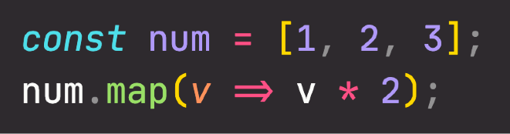


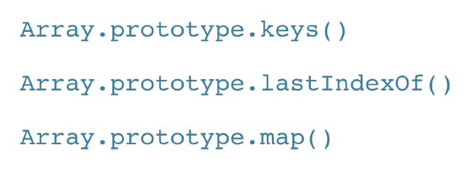
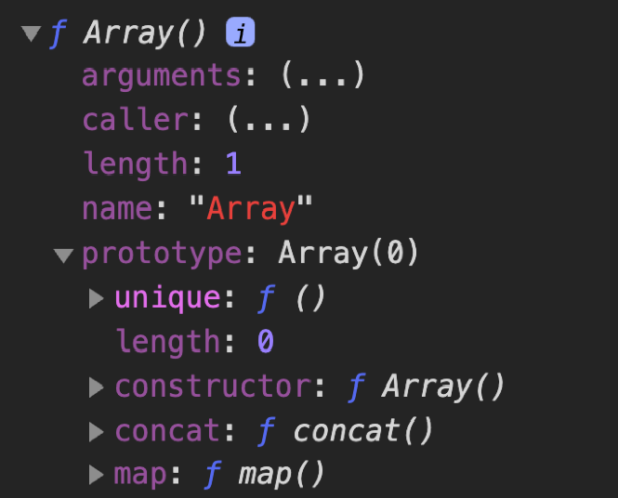
OOP IN JAVASCRIPT: PROTOTYPES
“CLASSICAL OOP”: CLASSES
OOP IN JS: PROTOTYPES
Example: Array
Class
Prototype
Contains methods
INSTANTIATION
PROTOTYPAL INHERITANCE/ DELEGATION
Instance
Object
Array.prototype is the prototype of all array objects we create in JavaScript
Therefore, all arrays have access to the map method!
Can access methods
Objects (instances) are instantiated from a class, which functions like a blueprint;
Behavior (methods) is copied from class to all instances.
Objects are linked to a prototype object;
Prototypal inheritance: The prototype contains methods (behavior) that are accessible to all objects linked to that prototype;
Behavior is delegated to the linked prototype object.

Slide 3


3 WAYS OF IMPLEMENTING PROTOTYPAL INHERITANCE IN JS
“How do we actually create prototypes? And how do we link objects to prototypes? How can we create new objects, without having classes?”
The 4 pillars of OOP are still valid!
Abstraction Encapsulation Inheritance Polymorphism
1
Constructor functions
Technique to create objects from a function;
This is how built-in objects like Arrays, Maps or Sets are actually implemented.
2
ES6 Classes
Modern alternative to constructor function syntax;
“Syntactic sugar”: behind the scenes, ES6 classes work exactly like constructor functions; ES6 classes do NOT behave like classes in “classical OOP” (last lecture).
3
Object.create()
The easiest and most straightforward way of linking an object to a prototype object.

Slide 4
SECTION
OBJECT ORIENTED PROGRAMMING (OOP) WITH JAVASCRIPT
LECTURE
PROTOTYPAL INHERITANCE AND THE PROTOTYPE CHAIN

Slide 5

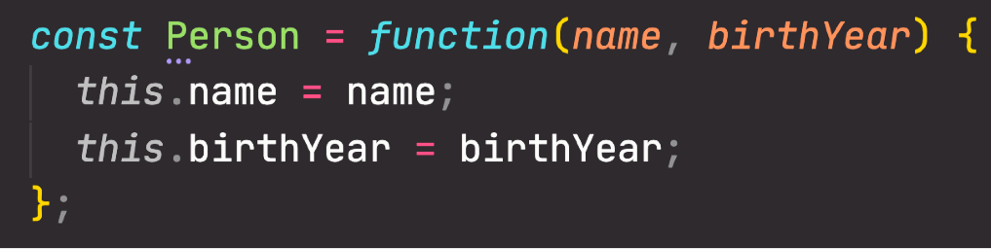
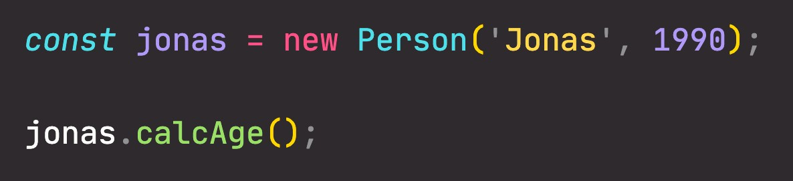

HOW PROTOTYPAL INHERITANCE / DELEGATION WORKS
NOT of Person, but objects created by Person
Constructor function
[Person()]
.prototype
Prototype
[Person.prototype]
The new operator:
.constructor
1 An empty object is created
calcAge: function
2 this keyword in constructor function call is set to the new object
PROTOTYPE CHAIN
PROTOTYPAL INHERITANCE/ DELEGATION
.__proto__
3 The new object is linked (__proto__ property) to the constructor function’s prototype property
Object
[jonas]
4
The new object is returned from the constructor function call
name: ‘Jonas’
Can’t find calcAge here!
birthYear: 1990
This is how it works with function constructors and ES6 classes
proto : Person.prototype
Always points to an object’s prototype

Slide 6
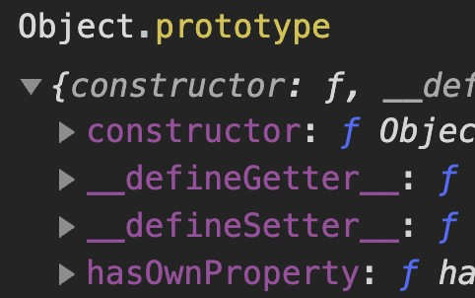
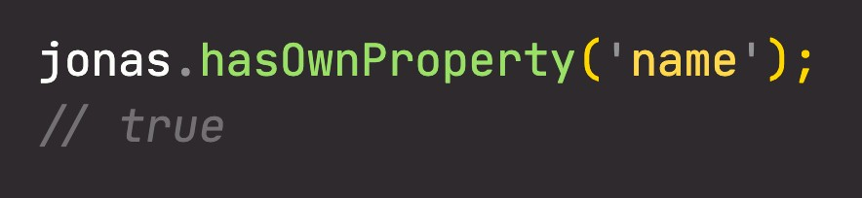


THE PROTOTYPE CHAIN
null
Prototype
[Object.prototype]
Constructor function
[Object()]
proto : null
PROTOTYPE CHAIN
Series of links between objects, linked through prototypes
(Similar to the scope chain)
Here it is!
.__proto__
This is an OBJECT itself! Remember, every object in JavaScript has a prototype!
Prototype
[Person.prototype]
Constructor function
[Person()]
proto : Object.prototype
Can’t find hasOwnProperty here!
.__proto__
Built-in constructor function for objects. This is used when we write an object literal:
{…} === new Object(…)
Object
[jonas]
proto :
Person.prototype
Can’t find hasOwnProperty here!

Slide 7
SECTION
OBJECT ORIENTED PROGRAMMING (OOP) WITH JAVASCRIPT
LECTURE
OBJECT.CREATE

Slide 8

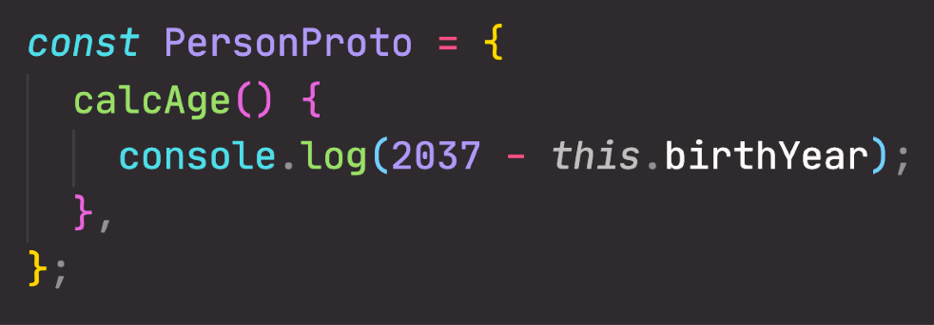
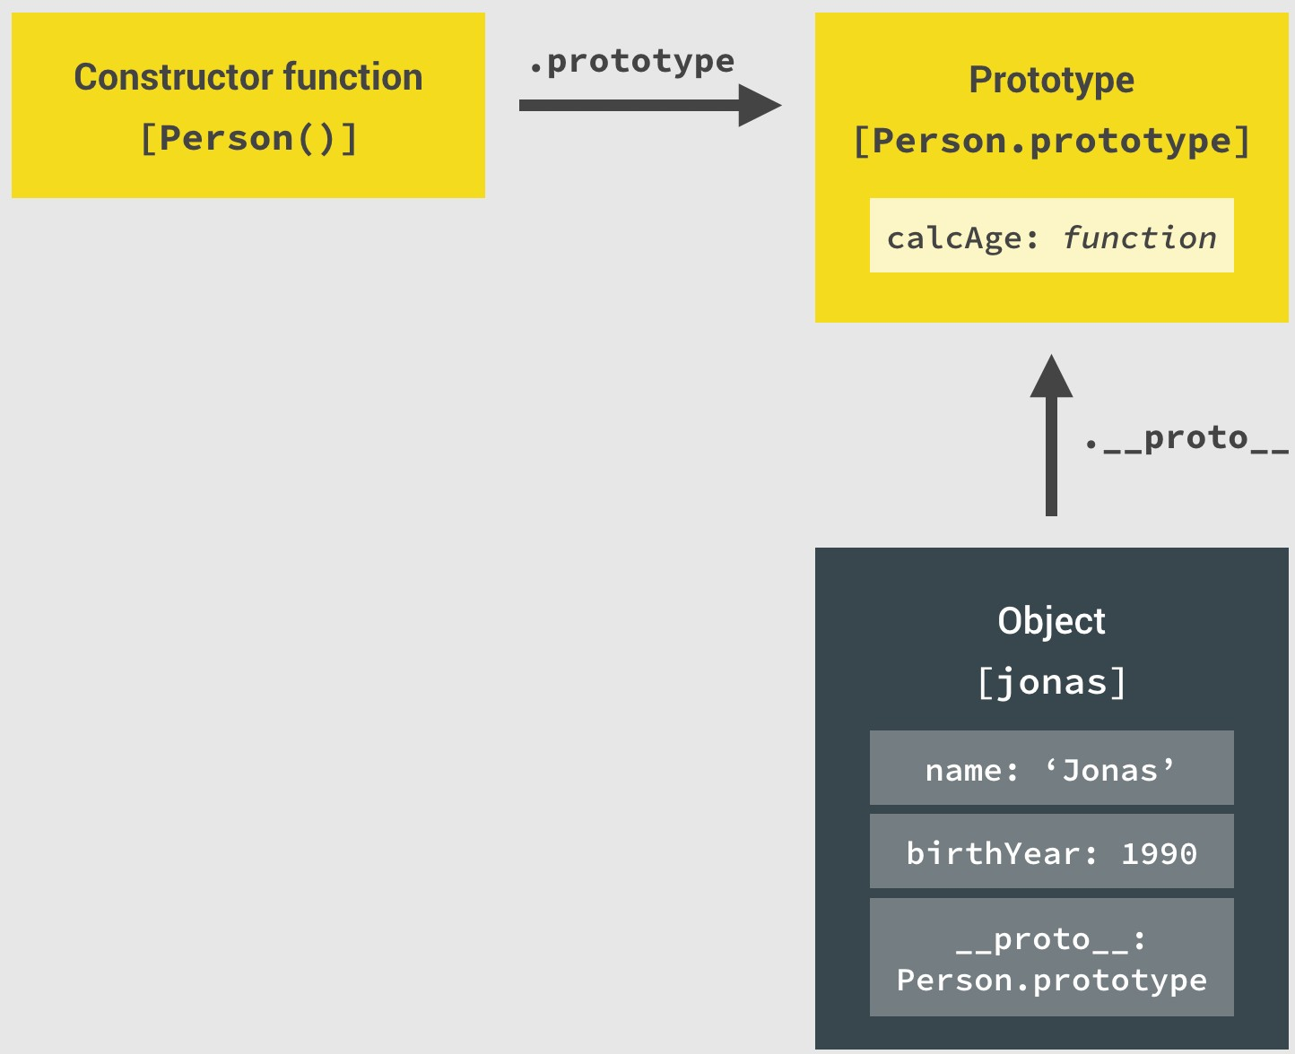

HOW OBJECT CREATE WORKS
Prototype
CONSTRUCTOR FUNCTIONS
[PersonProto]
calcAge: function
.__proto__
AUTOMATIC
Object
[steven]
OBJECT.CREATE
name: ‘Steven’
birthYear: 2002
proto :
PersonProto

Slide 9
SECTION
OBJECT ORIENTED PROGRAMMING (OOP) WITH JAVASCRIPT
LECTURE
INHERITANCE BETWEEN "CLASSES": CONSTRUCTOR FUNCTIONS

Slide 10
INHERITANCE BETWEEN “CLASSES”
Parent
“CLASS” 2
PERSON
Constructor Function
Prototype
1
Constructor functions
INHERITANCE BETWEEN “CLASSES”
2
ES6 Classes
Child
Constructor Function
Prototype
“CLASS” 1
3
Object.create()
STUDENT
More specific type of person, ideal as child class
Object
Using class terminology here to make it easier to understand.

Slide 11
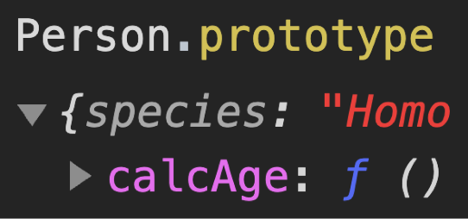

INHERITANCE BETWEEN “CLASSES”
Prototype
[Person.prototype]
Constructor function
[Person()]
.__proto__
Prototype
[Student.prototype]
Create connection manually using Object.create()
Constructor function
[Student()]
PROTOTYPE CHAIN
proto : Person.prototype
.__proto__
Object
[mike]
proto :
Student.prototype

Slide 12
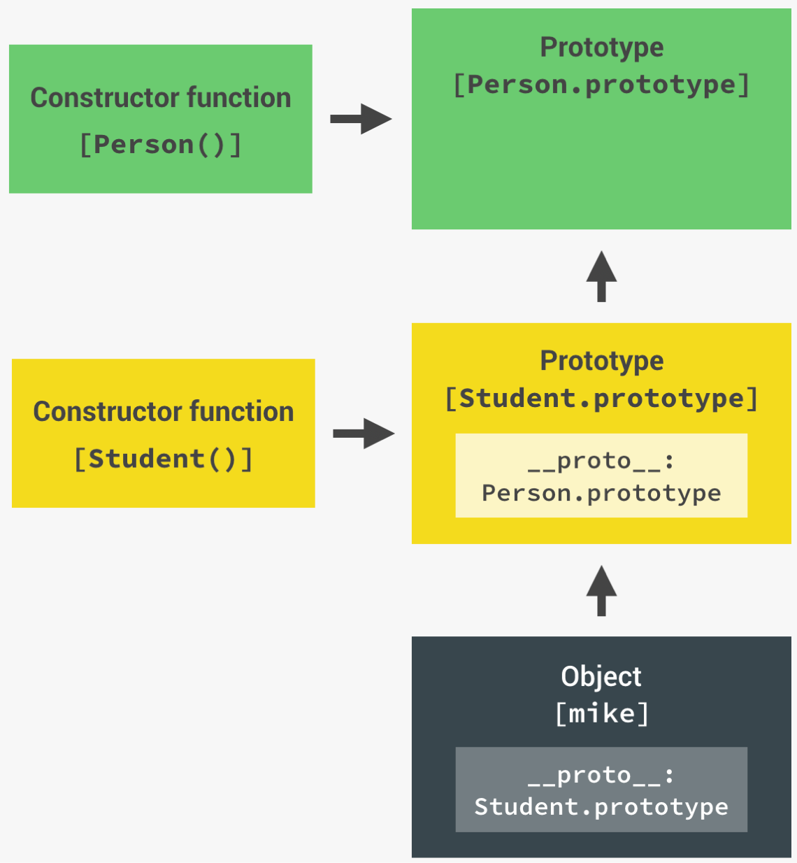


INHERITANCE BETWEEN “CLASSES”
Prototype
[Person.prototype]
Constructor function
[Person()]
Constructor function
[Student()]
Object
[mike]
GOOD
BAD
proto :
Student.prototype

Slide 13
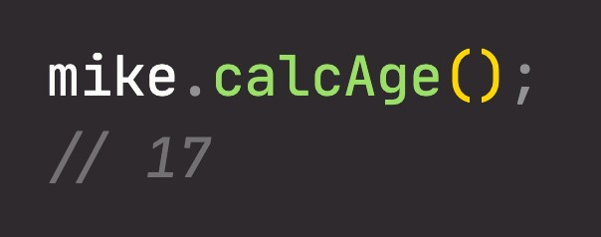
INHERITANCE BETWEEN “CLASSES”
Prototype
[Object.prototype]
Prototype
[Person.prototype]
null
Constructor function
[Person()]
proto : Object.prototype
.__proto__
Here it is!
Prototype
[Student.prototype]
Constructor function
[Student()]
PROTOTYPE CHAIN
proto : Person.prototype
Can’t find
calcAge here!
.__proto__
Object
[mike]
proto :
Student.prototype
Can’t find calcAge here!

