Slide 1

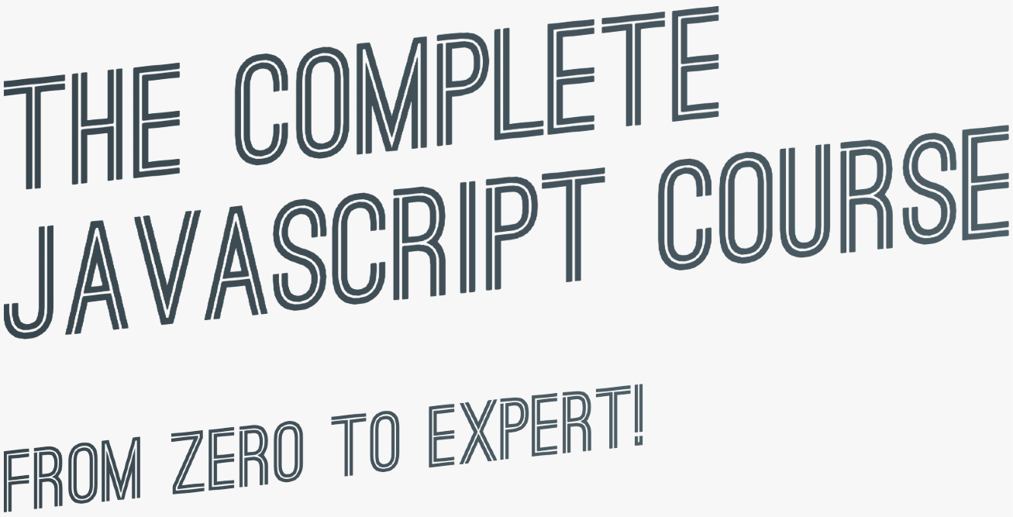

SECTION
OBJECT ORIENTED PROGRAMMING (OOP) WITH JAVASCRIPT
LECTURE
INHERITANCE BETWEEN "CLASSES": OBJECT.CREATE

Slide 2

INHERITANCE BETWEEN “CLASSES”: OBJECT.CREATE
Prototype
[PersonProto]
calcAge: function
Student inherits from Person
.__proto__
Prototype
[StudentProto]
PROTOTYPE CHAIN
proto :
PersonProto
.__proto__
Object
[jay]
proto :
StudentProto

Slide 3
SECTION
OBJECT ORIENTED PROGRAMMING (OOP) WITH JAVASCRIPT
LECTURE
ES6 CLASSES SUMMARY

Slide 4
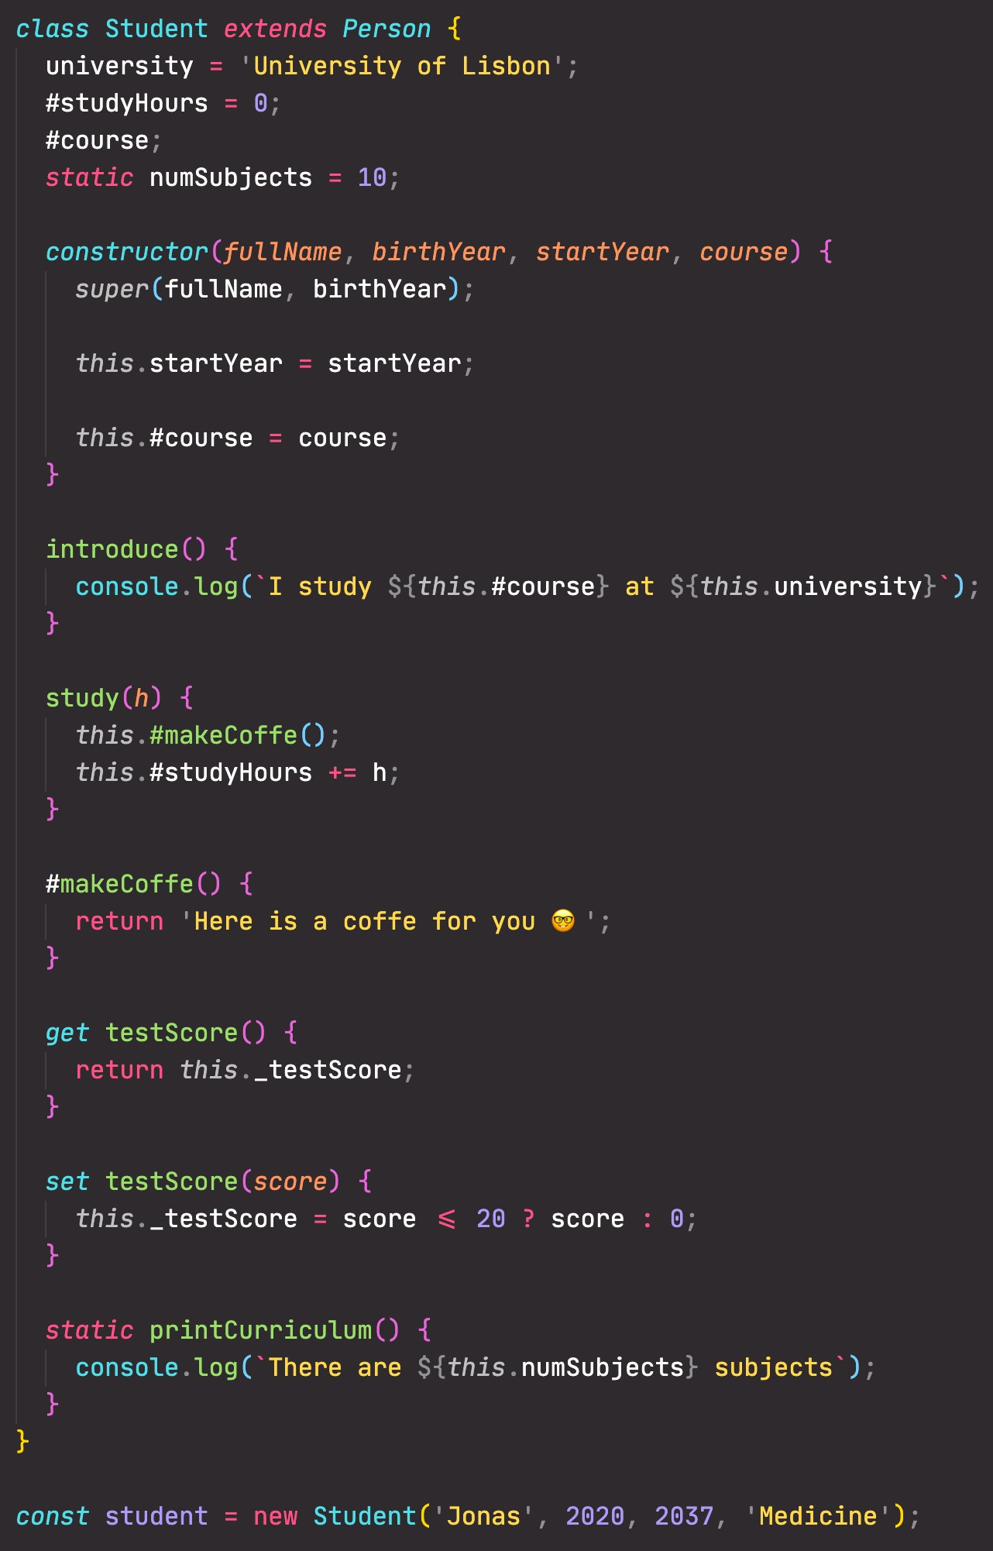


Public field (similar to property, available on created object) Private fields (not accessible outside of class) Static public field (available only on class)
Call to parent (super) class (necessary with
extend). Needs to happen before accessing this
Instance property (available on created object)
Redefining private field
Public method
Parent class
Inheritance between classes, automatically sets prototype
Child class
Constructor method, called by new operator. Mandatory in regular class, might be omitted in a child class
Referencing private field and method
Private method ( Might not yet work in your browser. “Fake” alternative: _ instead of #)
Getter method
Classes are just “syntactic sugar” over constructor functions
Classes are not hoisted Classes are first-class
citizens
Class body is always executed in strict mode
Setter method (use _ to set property with same name as method, and also add getter)
Static method (available only on class. Can not access instance properties nor methods, only static ones)
Creating new object with new operator

Slide 5
MAPTY APP: OOP, GEOLOCATION,
EXTERNAL LIBRARIES, AND MORE!

Slide 6
SECTION
MAPTY APP: OOP, GEOLOCATION, EXTERNAL LIBRARIES, AND MORE!
LECTURE
HOW TO PLAN A WEB PROJECT

Slide 7
PROJECT PLANNING
Description of the application’s functionality from the user’s perspective. All user stories put together describe the entire application.
WHAT we will build
HOW we will build it
1.
USER STORIES
2.
FEATURES
3.
FLOWCHART
4.
ARCHITECTURE
DEVELOPMENT STEP
PLANNING STEP
Implementation of our plan using code

Slide 8

1. USER STORIES
User story: Description of the application’s functionality from the user’s perspective.
Common format: As a [type of user], I want [an action] so that [a benefit]
Who? What? Why?
Example: user, admin, etc.
As a user, I want to log my running workouts with location, distance, time, pace and steps/minute, so I can keep a log of all my running
1
As a user, I want to log my cycling workouts with location, distance, time, speed and elevation gain, so I can keep a log of all my cycling
2
As a user, I want to see all my workouts at a glance, so I can easily track my progress over time
3
As a user, I want to also see my workouts on a map, so I can easily check where I work out the most
4
As a user, I want to see all my workouts when I leave the app and come back later, so that I can keep using there app over time
5

Slide 9
2. FEATURES
USER STORIES
FEATURES
Log my running workouts with location, distance, time, pace and steps/minute
Map where user clicks to add new workout (best way to get location coordinates)
Geolocation to display map at current location (more user friendly)
Form to input distance, time, pace, steps/minute
1
Log my cycling workouts with location, distance, time, speed and elevation gain
2
Form to input distance, time, speed, elevation gain
3
See all my workouts at a glance
Display all workouts in a list
4
See my workouts on a map
Display all workouts on the map
Store workout data in the browser using local storage API
On page load, read the saved data from local storage and display
See all my workouts when I leave the app and come back later
5

Slide 10
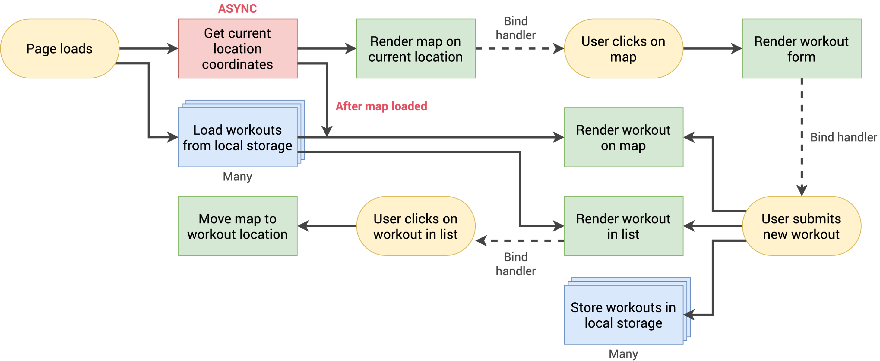

3. FLOWCHART
FEATURES
Geolocation to display map at current location
Map where user clicks to add new workout
Form to input distance, time, pace, steps/minute
Form to input distance, time, speed, elevation gain
Display workouts in a list
Display workouts on the map
Store workout data in the browser
On page load, read the saved data and display
Move map to workout location on click
1
2
3 4
5
8
6
9
7
In the real-world, you don’t have to come with the final flowchart right in the planning phase. It’s normal that it changes throughout implementation!
Added later

Slide 11

4. ARCHITECTURE
FOR NOW, LET’S JUST START CODING

