Slide 1

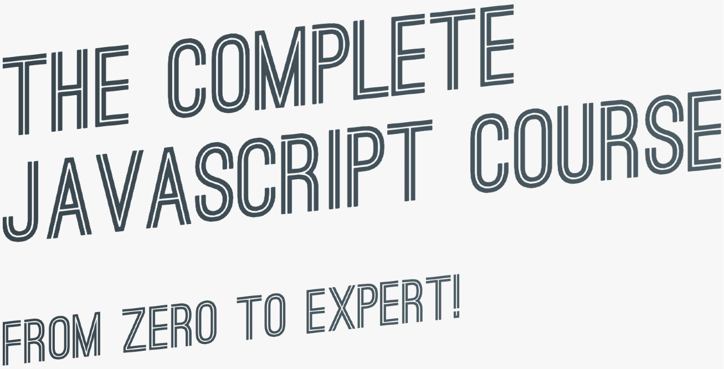

SECTION
MAPTY APP: OOP, GEOLOCATION, EXTERNAL LIBRARIES, AND MORE!
LECTURE
FINAL CONSIDERATIONS

Slide 2




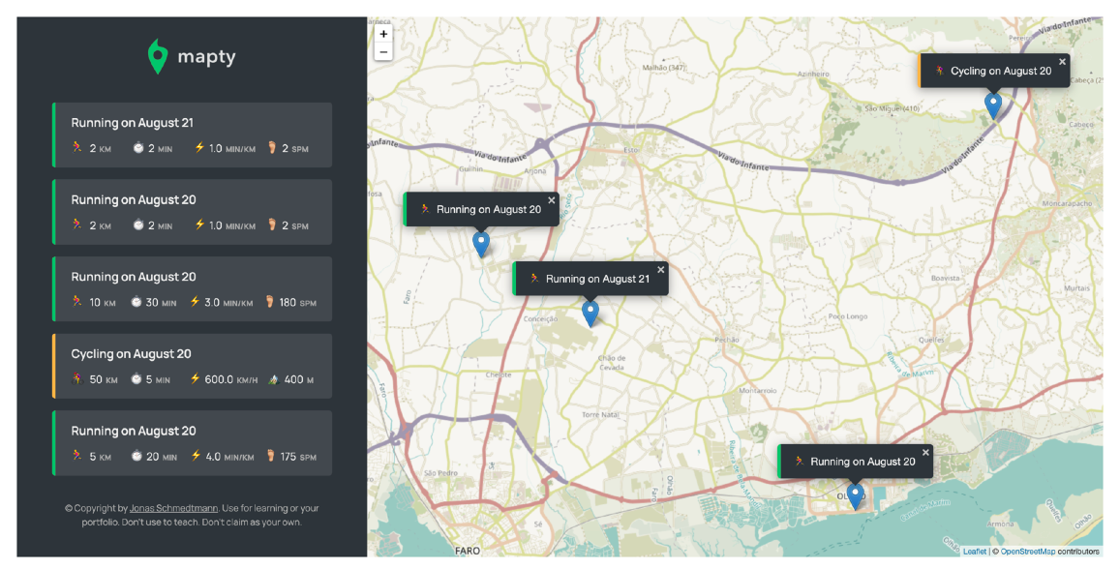
10 ADDITIONAL FEATURE IDEAS: CHALLENGES
Ability to edit a workout;
Ability to delete a workout; Ability to delete all workouts;
Ability to sort workouts by a certain field (e.g. distance);
Re-build Running and Cycling objects coming from Local Storage; More realistic error and confirmation messages;
Ability to position the map to show all workouts [very hard]; Ability to draw lines and shapes instead of just points [very hard];
Geocode location from coordinates (“Run in Faro, Portugal”) [only after asynchronous JavaScript section];
Display weather data for workout time and place [only after asynchronous JavaScript section].

Slide 3
ASYNCHRONOUS JAVASCRIPT:
PROMISES, ASYNC/ AWAIT AND AJAX

Slide 4
SECTION
ASYNCHRONOUS JAVASCRIPT:
PROMISES, ASYNC/AWAIT AND AJAX
LECTURE
ASYNCHRONOUS JAVASCRIPT, AJAX AND APIS

Slide 5
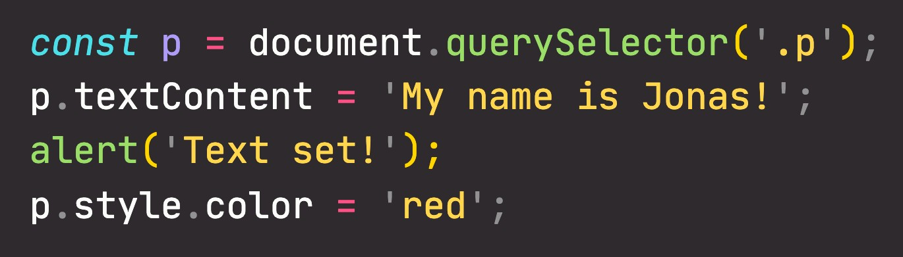

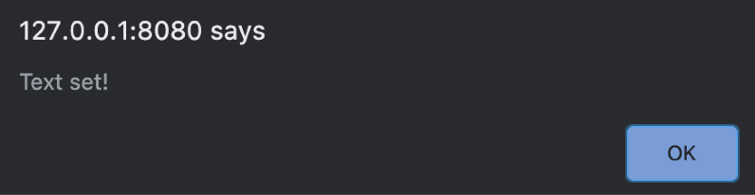

SYNCHRONOUS CODE
THREAD OF EXECUTION
BLOCKING
Most code is synchronous;
Synchronous code is executed line by line;
Each line of code waits for previous line to finish; Long-running operations block code execution.
Part of execution context that actually executes the code in computer’s CPU
SYNCHRONOUS

Slide 6
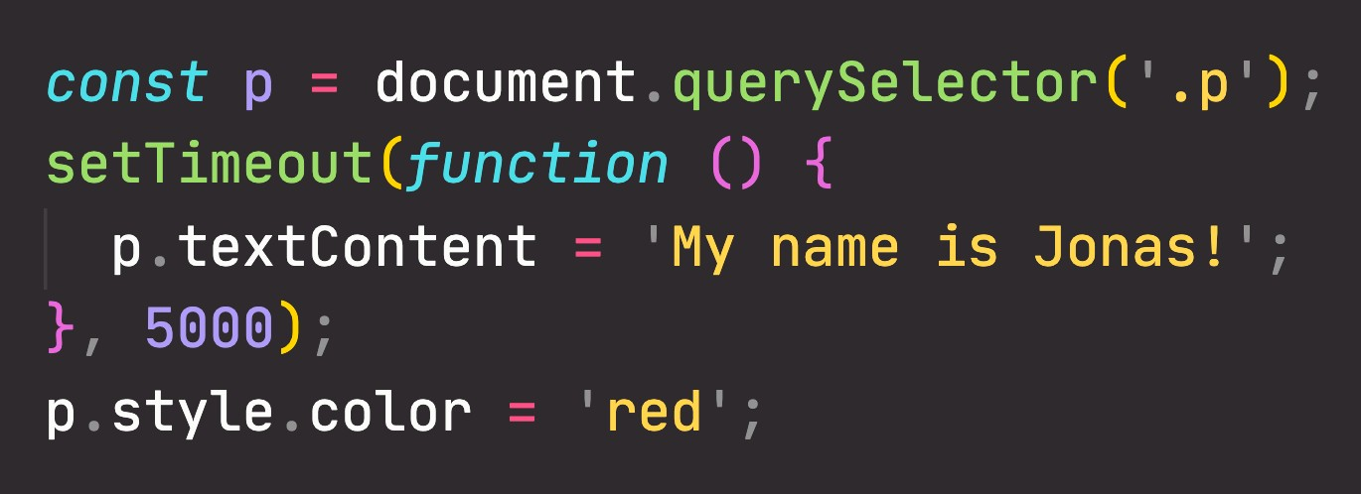

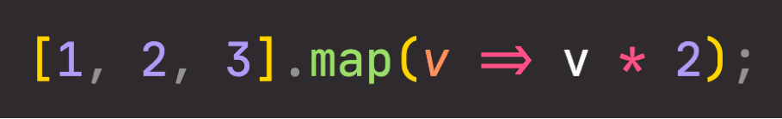

ASYNCHRONOUS CODE
Asynchronous
“BACKGROUND”
Timer running
(More on this in the lecture on Event Loop)
THREAD OF EXECUTION
CALLBACK WILL RUN AFTER TIMER
Example: Timer with callback
Executed after all other code
Callback does NOT automatically make code asynchronous!
Asynchronous code is executed after a task that runs in the “background” finishes;
Asynchronous code is non-blocking;
Execution doesn’t wait for an asynchronous task to finish its work; Callback functions alone do NOT make code asynchronous!
ASYNCHRONOUS
Coordinating behavior of a program over a period of time

Slide 7
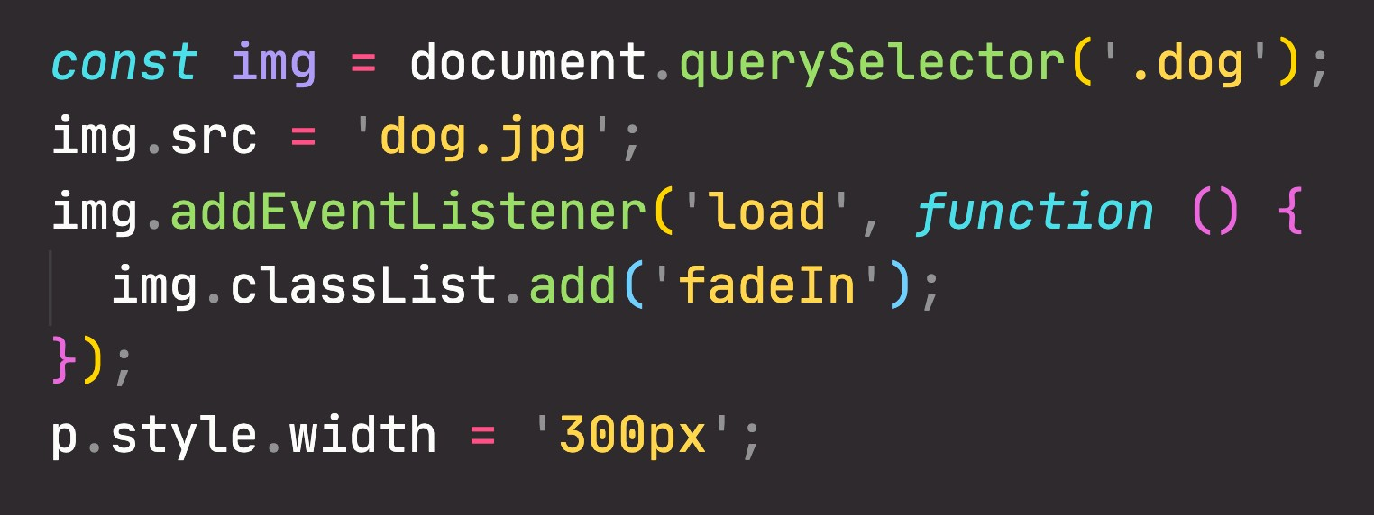
ASYNCHRONOUS CODE
Asynchronous
THREAD OF EXECUTION
“BACKGROUND”
Image loading
(More on this in the lecture on Event Loop)
CALLBACK WILL RUN AFTER IMAGE LOADS
Example: Asynchronous image loading with event and callback
Other examples: Geolocation API or AJAX calls
addEventListener does NOT automatically make code asynchronous!
Asynchronous code is executed after a task that runs in the “background” finishes;
Asynchronous code is non-blocking;
Execution doesn’t wait for an asynchronous task to finish its work; Callback functions alone do NOT make code asynchronous!
ASYNCHRONOUS
Coordinating behavior of a program over a period of time

Slide 8







WHAT ARE AJAX CALLS?
AJAX
Asynchronous JavaScript And XML: Allows us to communicate with remote web servers in an asynchronous way. With AJAX calls, we can request data from web servers dynamically.
Usually a web API
Asking for some data
CLIENT
(e.g. browser)
REQUEST
(GET / POST / etc.)
WEB SERVER
RESPONSE
Sending data back

Slide 9



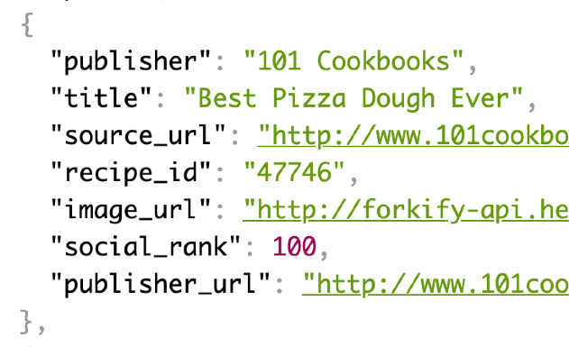



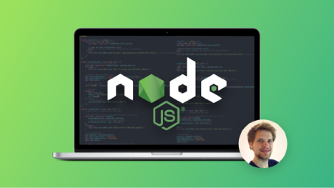
WHAT IS AN API?
AJAX
API
Application Programming Interface: Piece of software that can be used by another piece of software, in order to allow applications to talk to each other;
XML data format
JSON data format
There are be many types of APIs in web development:
DOM API
Geolocation API
Own Class API
“Online” API
Most popular API data format
Just “API”
“Online” API: Application running on a server, that receives requests for data, and sends data back as response;
Weather data
Data about countries Flights data
Currency conversion data APIs for sending email or SMS Google Maps
Millions of possibilities...
We can build our own web APIs (requires back-end development, e.g. with node.js) or use 3rd-party APIs.
There is an API for
everything

Slide 10
SECTION
ASYNCHRONOUS JAVASCRIPT:
PROMISES, ASYNC/AWAIT AND AJAX
LECTURE
HOW THE WEB WORKS: REQUESTS AND RESPONSES

Slide 11
WHAT HAPPENS WHEN WE ACCESS A WEB SERVER
Request-response model or Client-server architecture
CLIENT
(e.g. browser)
REQUEST
WEB SERVER
RESPONSE

Slide 12



WHAT HAPPENS WHEN WE ACCESS A WEB SERVER
GET /rest/v2/alpha/PT HTTP/1.1
Start line: HTTP method + request target + HTTP version
DNS
Host: www.google.com User-Agent: Mozilla/5.0 Accept-Language: en-US
h"ps://104.27.142.889:443
HTTP request headers (many different possibilities)
DNS LOOKUP
1
<BODY>
Request body (only when sending data to server, e.g. POST)
HTTP REQUEST
3
CLIENT
(e.g. browser)
WEB SERVER
2
TCP/IP socket connection
h"ps://restcountries.eu/rest/v2/alpha/
HTTP RESPONSE
4
HTTP/1.1 200 OK
Start line: HTTP version + status code + status message
Protocol
(HTTP or HTTPS)
Domain name
Resource
Date: Fri, 18 Jan 2021 Content-Type: text/html Transfer-Encoding: chunked
HTTP response headers (many different possibilities)
<BODY>
Response body (most responses)

