Slide 1

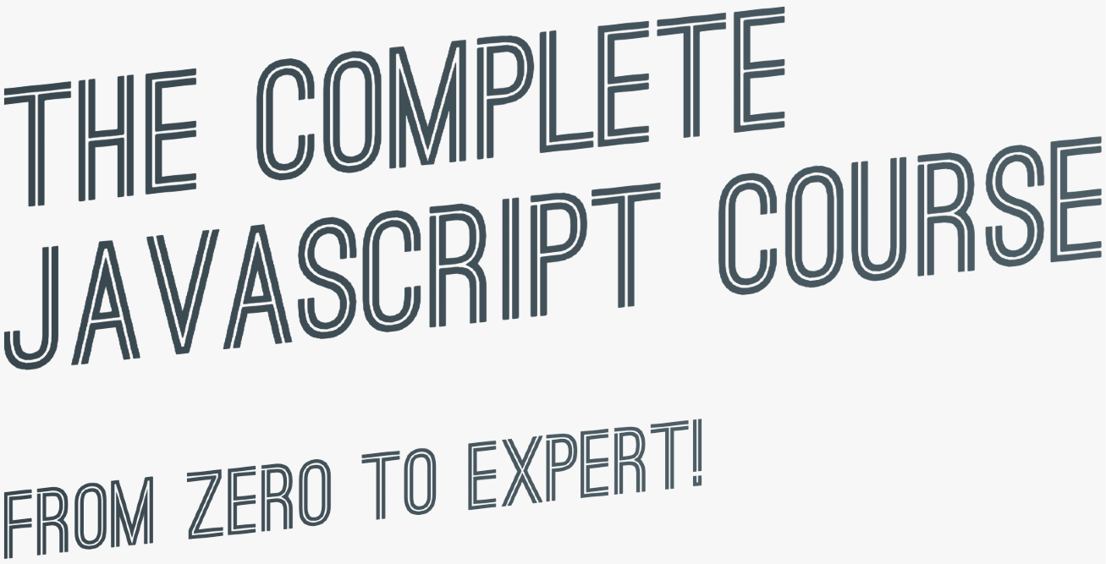

SECTION
ASYNCHRONOUS JAVASCRIPT:
PROMISES, ASYNC/AWAIT AND AJAX
LECTURE
PROMISES AND THE FETCH API

Slide 2








WHAT ARE PROMISES?
PROMISE
Promise: An object that is used as a placeholder for the future result of an asynchronous operation.
Promise that I will receive money if I guess correct outcome
I buy lottery ticket (promise) right now
Lottery draw happens asynchronously
If correct outcome, I receive money, because it was promised
LOTTERY TICKET
Less formal
Promise: A container for an asynchronously delivered value.
Less formal
Promise: A container for a future value.
Example: Response from AJAX call
We no longer need to rely on events and callbacks passed into asynchronous functions to handle asynchronous results;
Instead of nesting callbacks, we can chain promises for a sequence of asynchronous operations: escaping callback hell

Slide 3

THE PROMISE LIFECYCLE
Before the future value is available
Asynchronous task
has finished
E.g. Fetch API returns promise
PENDING
ASYNC TASK
SETTLED
BUILD PROMISE
LOTTERY TICKET
FULFILLED
REJECTED
CONSUME PROMISE
Success! The value is now available
An error
happened
When we already have a promise. E.g. promise returned from Fetch API
We are able handle these different states in our code!

Slide 4
SECTION
ASYNCHRONOUS JAVASCRIPT:
PROMISES, ASYNC/AWAIT AND AJAX
LECTURE
ASYNCHRONOUS BEHIND THE SCENES: THE EVENT LOOP

Slide 5
REVIEW: JAVASCRIPT RUNTIME
Concurrency model: How JavaScript handles multiple tasks happening at the same time.
“Container” which includes all the pieces necessary to execute JavaScript code
“Heart” of the runtime
APIs provided to the engine
Sends callbacks from queue to call stack
Ready-to-be-executed callback functions (coming from events)
Where object are stored in memory
Where code is actually executed
Only ONE thread of execution. No multitasking!

Slide 6
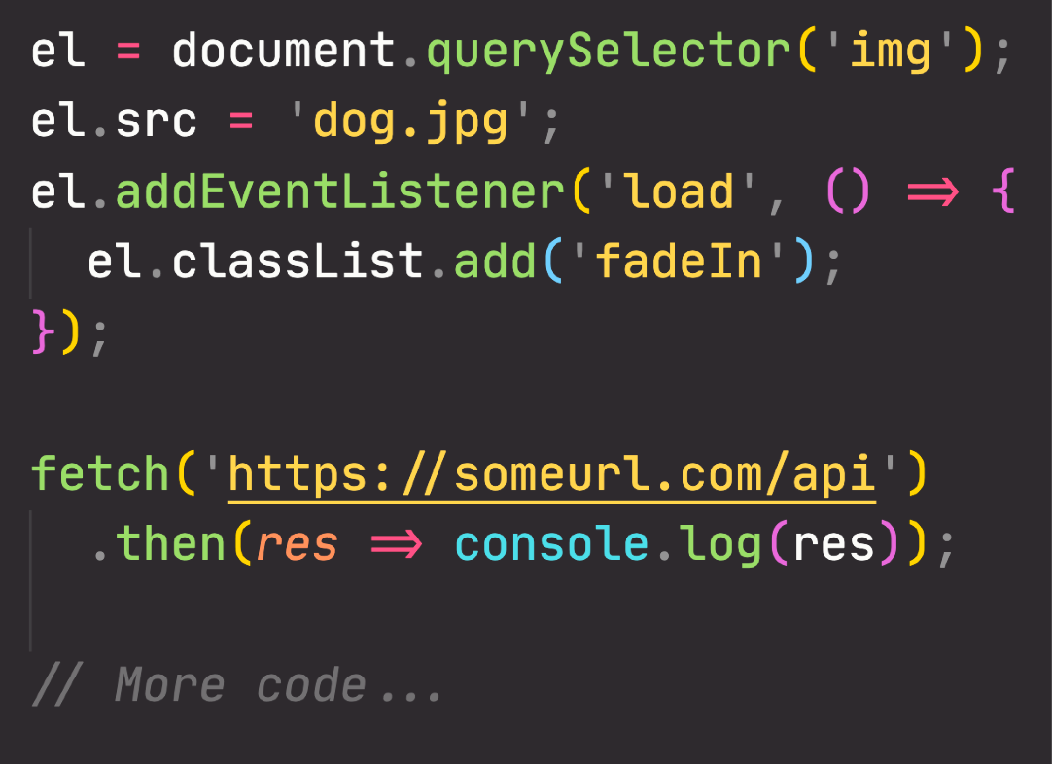





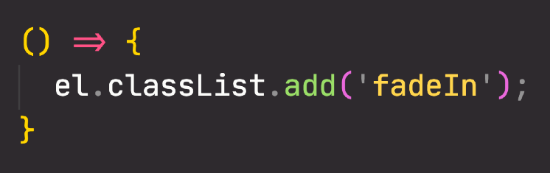




HOW ASYNCHRONOUS JAVASCRIPT WORKS BEHIND THE SCENES
Where asynchronous tasks run
WEB APIs
fetch()
setTimeout()
Execution context
log()
Loading image
DOM()
Execution context
add()
...
Fetching data
Execution context
querySelector()
Execution context
addEventListener()
Execution context
fetch()
Execution context
then()
Execution context
el.src callback
Execution context
fetch callback
Like callback queue, but for callbacks related to promises. Has priority over callback queue!
MICROTASKS QUEUE
Loading image
Global Execution context
How can asynchronous code be executed in a non-blocking way, if there is only one thread of execution in the engine?
Some callback
Another callback
CALLBACK QUEUE
CALL STACK
Decides when each callback
EVENT LOOP
is executed: orchestration

Slide 7
MODERN JAVASCRIPT DEVELOPMENT:
MODULES AND TOOLING

Slide 8
SECTION
MODERN JAVASCRIPT DEVELOPMENT: MODULES AND TOOLING
LECTURE
AN OVERVIEW OF MODERN JAVASCRIPT DEVELOPMENT

Slide 9
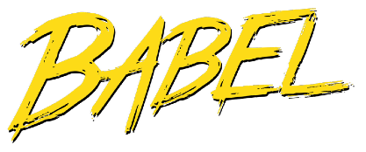




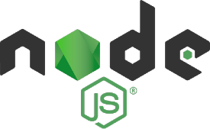
MODERN JAVASCRIPT DEVELOPMENT
Join all modules into one file
Convert modern JavaScript back to ES5
MODULE
MODULE
BUNDLING
TRANSPILING/ POLYFILLING
JAVASCRIPT BUNDLE
3RD-PARTY PACKAGE
BUILD PROCESS
PRODUCTION
DEVELOPMENT
or
3rd party modules
Development tools
Contains open-source packages to include 3rd-party code in our own code (e.g React, jQuery, Leaflet, etc.)
Contains development tools that help build our applications (e.g. live-server, Parcel, Babel, etc.)
NODE PACKAGE MANAGER
Both repository and software

