Slide 1



SECTION
MODERN JAVASCRIPT DEVELOPMENT: MODULES AND TOOLING
LECTURE
AN OVERVIEW OF MODULES IN JAVASCRIPT

Slide 2



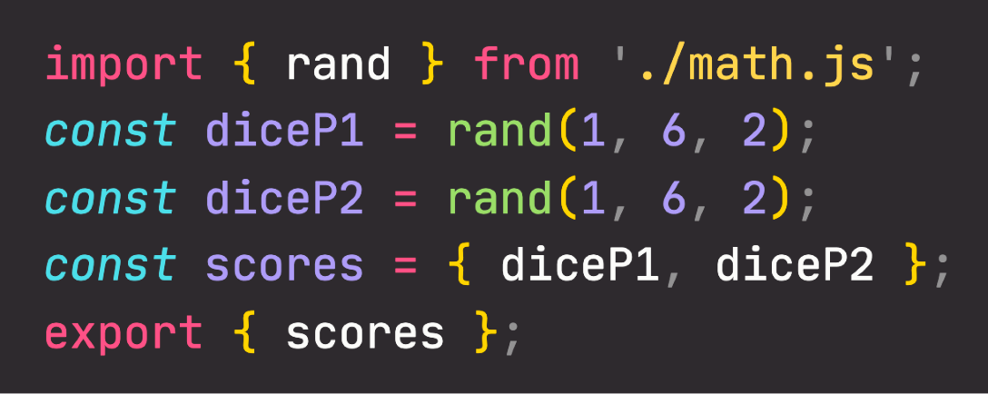
AN OVERVIEW OF MODULES
MODULE
Compose software: Modules are small building blocks that we put together to build complex applications;
Isolate components: Modules can be developed in isolation without thinking about the entire codebase;
Abstract code: Implement low-level code in modules and import these abstractions into other modules;
Organized code: Modules naturally lead to a more organized codebase;
Reuse code: Modules allow us to easily reuse the same code, even across multiple projects.
Reusable piece of code that
encapsulates implementation details;
WHY
MODULES?
Usually a standalone file, but it doesn’t have to be.
MODULE
IMPORT
(DEPENDENCY)
Module code
EXPORT
(PUBLIC API)

Slide 3





NATIVE JAVASCRIPT (ES6) MODULES
ES6 MODULE
SCRIPT
ES6 MODULES
Top-level variables
Scoped to module
Global
Modules stored in files, exactly one module per file.
Default mode
Strict mode
“Sloppy” mode
Top-level this
undefined
window
Imports and exports
YES
NO
HTML linking
<script type="module">
<script>
File downloading
Asynchronous
Synchronous
import and export
syntax
Need to happen at top-level Imports are hoisted!

Slide 4
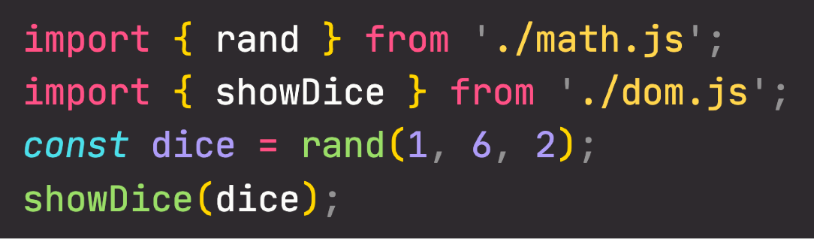
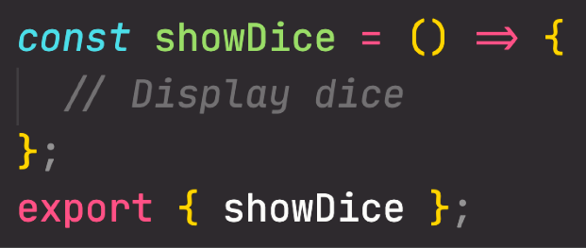
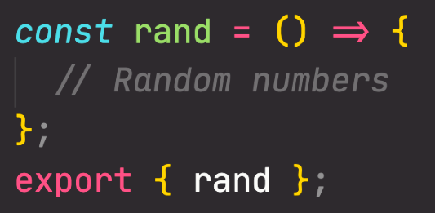
HOW ES6 MODULES ARE IMPORTED
Live connection, NOT copies
Parsing index.js
index.js
Asynchronous downloading math.js
Asynchronous downloading dom.js
Live connection, NOT copies
dom.js
math.js
IMPORTING MODULES
BEFORE EXECUTION
Linking imports to
math.js exports
Linking imports to
dom.js exports
Modules are imported synchronously
Possible thanks to top-level (“static”) imports, which make imports known before execution
This makes bundling and dead code elimination possible
Execution math.js
Execution dom.js
Execution index.js

Slide 5
SECTION
MODERN JAVASCRIPT DEVELOPMENT: MODULES AND TOOLING
LECTURE
REVIEW: WRITING CLEAN AND MODERN JAVASCRIPT

Slide 6
REVIEW: MODERN AND CLEAN CODE
READABLE CODE
Write code so that others can understand it
Write code so that you can understand it in 1 year Avoid too “clever” and overcomplicated solutions Use descriptive variable names: what they contain Use descriptive function names: what they do
FUNCTIONS
Generally, functions should do only one thing Don’t use more than 3 function parameters Use default parameters whenever possible Generally, return same data type as received
Use arrow functions when they make code more readable
GENERAL
Use DRY principle (refactor your code)
Don’t pollute global namespace, encapsulate instead Don’t use var
Use strong type checks (=== and !==)
OOP
Use ES6 classes
Encapsulate data and don’t mutate it from outside the class Implement method chaining
Do not use arrow functions as methods (in regular objects)

Slide 7
REVIEW: MODERN AND CLEAN CODE
AVOID NESTED CODE
Use early return (guard clauses)
Use ternary (conditional) or logical operators instead of if
Use multiple if instead of if/else-if Avoid for loops, use array methods instead Avoid callback-based asynchronous APIs
ASYNCHRONOUS CODE
Consume promises with async/await for best readability Whenever possible, run promises in parallel (Promise.all) Handle errors and promise rejections

