Slide 1

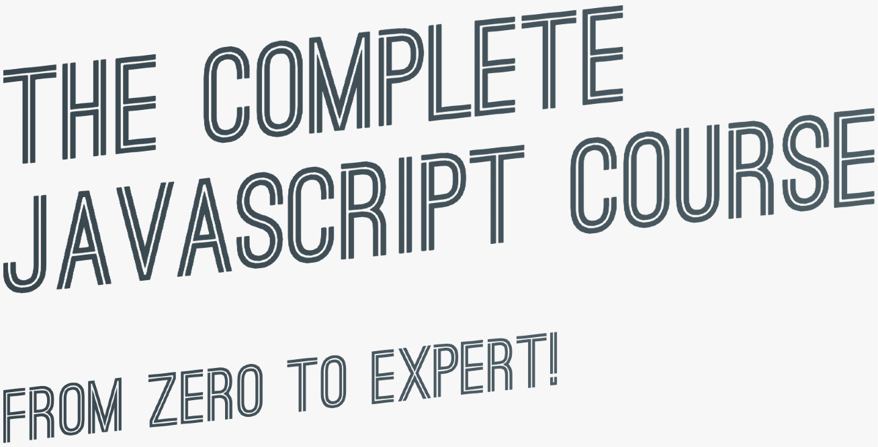

SECTION
MODERN JAVASCRIPT DEVELOPMENT: MODULES AND TOOLING
LECTURE
DECLARATIVE AND FUNCTIONAL JAVASCRIPT PRINCIPLES

Slide 2

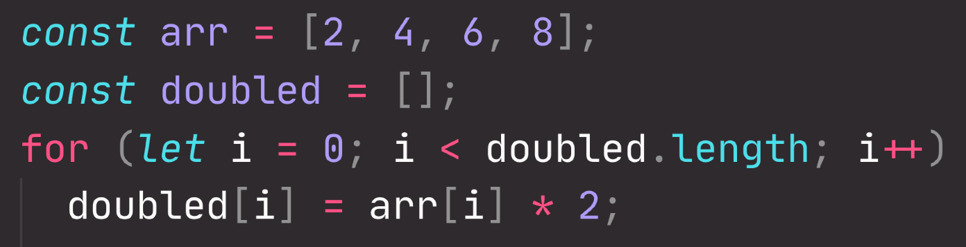
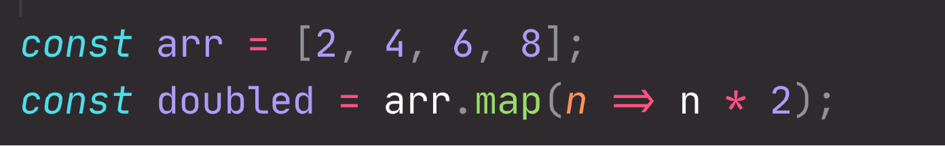



IMPERATIVE VS. DECLARATIVE CODE
Two fundamentally different ways of writing code (paradigms)
IMPERATIVE
DECLARATIVE
Programmer explains “HOW to do things”
We explain the computer every single step it has to follow to achieve a result
Example: Step-by-step recipe of a cake
Programmer tells “WHAT do do”
We simply describe the way the computer should achieve the result
The HOW (step-by-step instructions) gets abstracted away
Example: Description of a cake

Slide 3


FUNCTIONAL PROGRAMMING PRINCIPLES
FUNCTIONAL PROGRAMMING
FUNCTIONAL PROGRAMMING TECHNIQUES
Try to avoid data mutations
Use built-in methods that don’t produce side effects Do data transformations with methods such
as .map(), .filter() and .reduce()
Try to avoid side effects in functions: this is of course not always possible!
DECLARATIVE SYNTAX
Use array and object destructuring Use the spread operator (...)
Use the ternary (conditional) operator Use template literals
Declarative programming paradigm
Based on the idea of writing software by combining many
pure functions, avoiding side effects and mutating data
Side effect: Modification (mutation) of any data outside of the function (mutating external variables, logging to console, writing to DOM, etc.)
Pure function: Function without side effects. Does not depend on external variables. Given the same inputs, always returns the same outputs.
Immutability: State (data) is never modified! Instead, state is copied and the copy is mutated and returned.
Examples:

Slide 4
FORKIFY APP:
BUILDING A MODERN APPLICATION

Slide 5
SECTION
FORKIFY APP: BUILDING A MODERN APPLICATION
LECTURE
PROJECT OVERVIEW AND PLANNING

Slide 6

PROJECT PLANNING
LATER
1.
USER STORIES
2.
FEATURES
3.
FLOWCHART
4.
ARCHITECTURE
DEVELOPMENT STEP
PLANNING STEP

Slide 7

1. USER STORIES
User story: Description of the application’s functionality from the user’s perspective.
Common format: As a [type of user], I want [an action] so that [a benefit]
1
As a user, I want to search for recipes, so that I can find new ideas for meals
As a user, I want to be able to update the number of servings, so that I can cook a meal for different number of people
2
3
As a user, I want to bookmark recipes, so that I can review them later
As a user, I want to be able to create my own recipes, so that I have them all organized in the same app
4
As a user, I want to be able to see my bookmarks and own recipes when I leave the app and come back later, so that I can close the app safely after cooking
5

Slide 8
2. FEATURES
USER STORIES
FEATURES
Search functionality: input field to send request to API with searched keywords
Display results with pagination
Display recipe with cooking time, servings and ingredients
1
Search for recipes
2
Update the number of servings
Change servings functionality: update all ingredients according to current number of servings
3
Bookmark recipes
Bookmarking functionality: display list of all bookmarked recipes
4
Create my own recipes
User can upload own recipes
User recipes will automatically be bookmarked
User can only see their own recipes, not recipes from other users
See my bookmarks and own recipes when I leave the app and come back later
5
Store bookmark data in the browser using local storage
On page load, read saved bookmarks from local storage and display

Slide 9
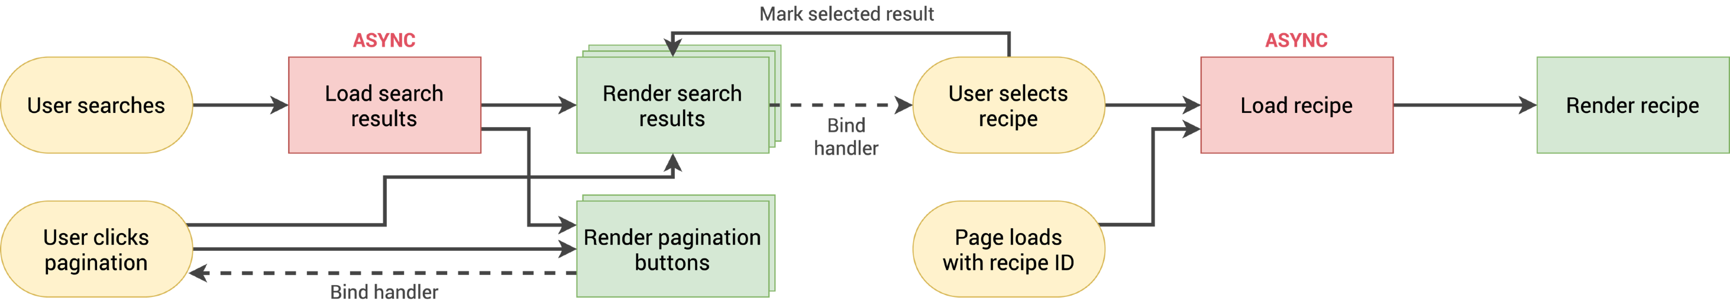
3. FLOWCHART (PART 1)
FEATURES
Search functionality: API search request
Results with pagination
Display recipe
1
3
Other features later
2

