Slide 1



SECTION
FORKIFY APP: BUILDING A MODERN APPLICATION
LECTURE
THE MVC ARCHITECTURE

Slide 2





WHY WORRY ABOUT ARCHITECTURE?
Like a house, software needs a structure: the way we organize our code
The perfect architecture
We can create our own architecture (Mapty project)
STRUCTURE
We can use a well-established architecture pattern like MVC, MVP, Flux, etc. (this project)
We can use a framework like React, Angular, Vue, Svelte, etc.
MAINTAINABILITY
EXPANDABILITY
A project is never done!
We need to be able to easily
change it in the future
We also need to be able to easily add new features

Slide 3


COMPONENTS OF ANY ARCHITECTURE
BUSINESS LOGIC
STATE
HTTP LIBRARY
APPLICATION LOGIC (ROUTER)
PRESENTATION LOGIC (UI LAYER)
Code that solves the actual business problem;
Directly related to what business does and what it needs;
Example: sending messages, storing transactions, calculating taxes, …
Essentially stores all the data about the application
Should be the “single source of truth”
UI should be kept in sync with the state
State libraries exist
Responsible for making and receiving AJAX requests
Optional but almost always necessary in real-world apps
Code that is only concerned about the implementation of application itself;
Handles navigation and UI events
Code that is concerned about the visible part of the application
Essentially displays application state
Keeping in sync

Slide 4
THE MODEL-VIEW-CONTROLLER (MVC) ARCHITECTURE
1
3
2
2
0
USER
WEB
MODEL
CONTROLLER
VIEW
5
4
4
BUSINESS LOGIC
APPLICATION LOGIC
PRESENTATION LOGIC
STATE
Bridge between model and views (which don’t know about one another)
Handles UI events and dispatches tasks to model and view
HTTP LIBRARY
Connected by function call and import Data flow

Slide 5

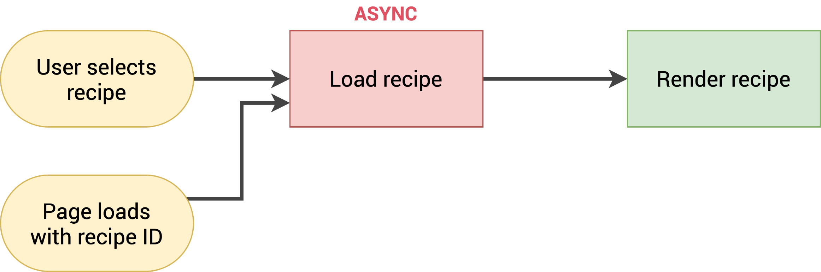
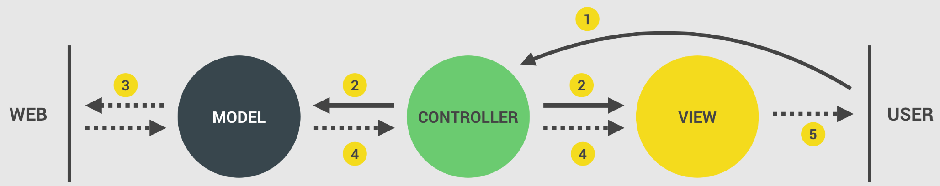
MODEL, VIEW AND CONTROLLER IN FORKIFY (RECIPE DISPLAY ONLY)
CONT- ROLLER
MODEL
TO REMOVE
VIEW
0

Slide 6
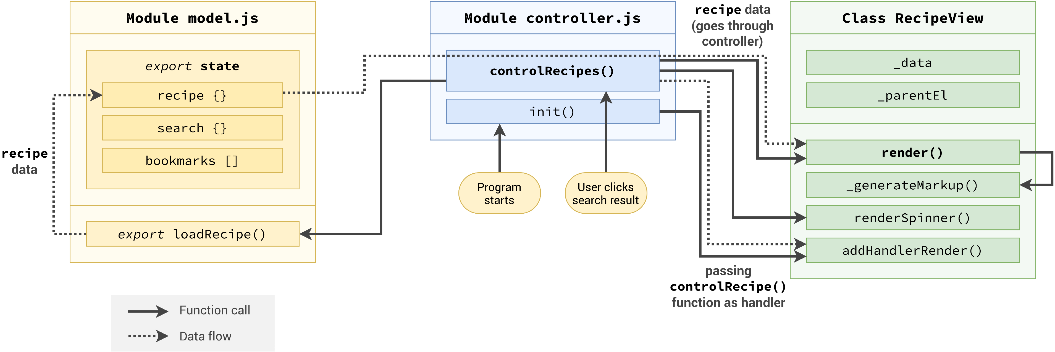
MVC IMPLEMENTATION (RECIPE DISPLAY ONLY)
1
4
4
5
2
0
3
2
0

Slide 7
SECTION
FORKIFY APP: BUILDING A MODERN APPLICATION
LECTURE
EVENT HANDLERS IN MVC:
PUBLISHER-SUBSCRIBER PATTERN

Slide 8
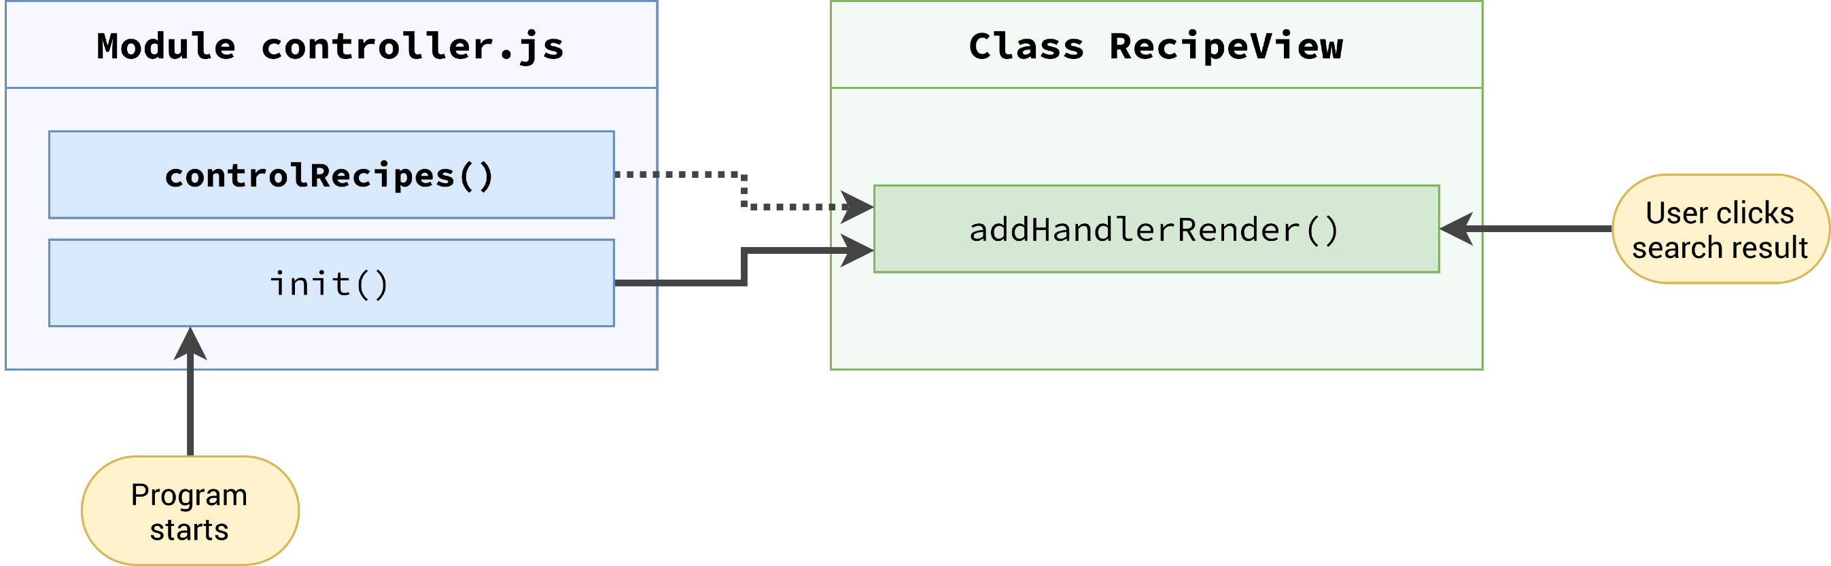
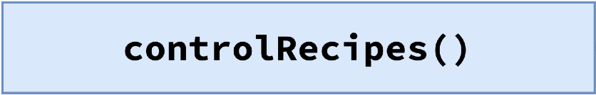
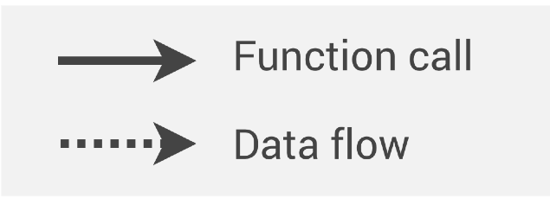
EVENT HANDLING IN MVC: PUBLISHER-SUBSCRIBER PATTERN
Code that wants to react: SUBSCRIBER
Code that knows when
to react: PUBLISHER
2
3
1
4
A() B
≠ B
C
A(X) X
Subscribe to publisher by passing in the subscriber function
0
controlRecipes will be passed into addHandlerRender when program starts
addHandlerRender listens for events (addEventListener), and uses
controlRecipes as callback
Events should be handled in the controller (otherwise we would have application logic in the view) Events should be listened for in the view (otherwise we would need DOM elements in the controller)

Slide 9
SECTION
FORKIFY APP: BUILDING A MODERN APPLICATION
LECTURE
WRAPPING UP: FINAL CONSIDERATIONS

Slide 10


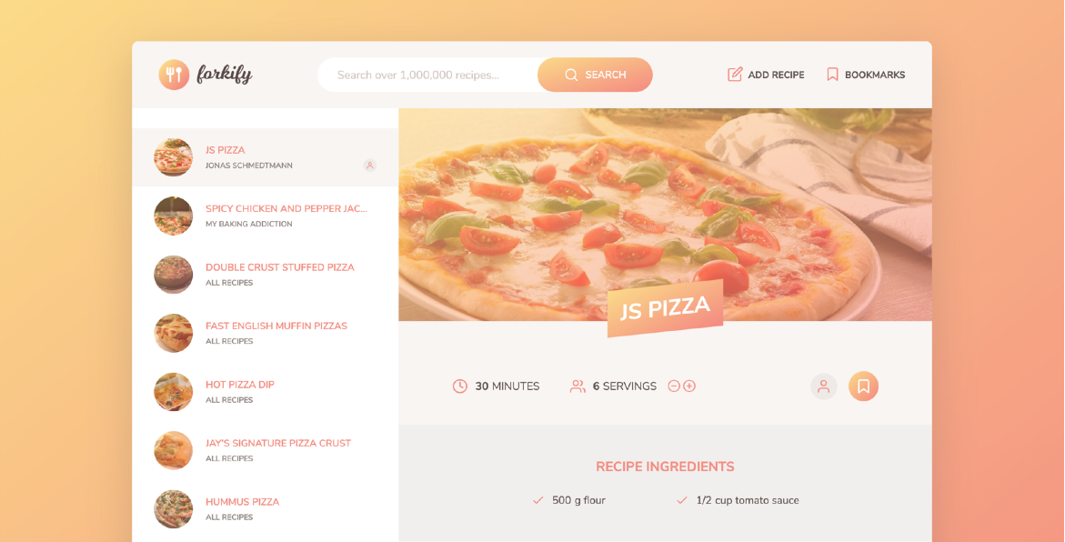
IMPROVEMENT AND FEATURE IDEAS: CHALLENGES
Display number of pages between the pagination buttons;
Ability to sort search results by duration or number of ingredients; Perform ingredient validation in view, before submitting the form;
Improve recipe ingredient input: separate in multiple fields and allow more than 6 ingredients;
Shopping list feature: button on recipe to add ingredients to a list;
Weekly meal planning feature: assign recipes to the next 7 days and show on a weekly calendar;
Get nutrition data on each ingredient from spoonacular API (https:// spoonacular.com/food-api) and calculate total calories of recipe.

Slide 11
END

