Slide 1
JAVASCRIPT
FUNDAMENTALS – PART 1

Slide 2

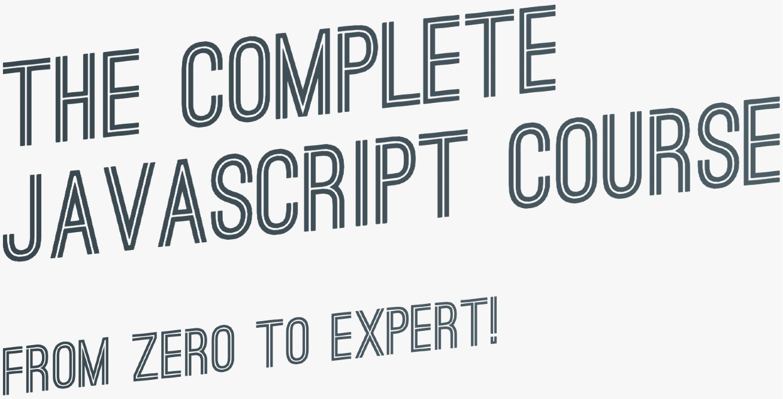

SECTION
JAVASCRIPT FUNDAMENTALS – PART 1
LECTURE
A BRIEF INTRODUCTION TO JAVASCRIPT

Slide 3




WHAT IS JAVASCRIPT?
We don’t have to worry about complex stuff like memory management
JAVASCRIPT
JAVASCRIPT IS A HIGH-LEVEL, OBJECT-ORIENTED, MULTI-PARADIGM PROGRAMMING LANGUAGE.
We can use different styles of programming
Based on objects, for storing most kinds of data
Instruct computer to do things

Slide 4


THE ROLE OF JAVASCRIPT IN WEB DEVELOPMENT
NOUNS
<p></p>
means “paragraph”
CONTENT
ADJECTIVES
p {color: red}
means “the paragraph text is red”
VERBS
p.hide();
means “hide the paragraph”
PRESENTATION
PROGRAMMING LANGUAGE: BUILDING WEB APPLICATIONS

Slide 5
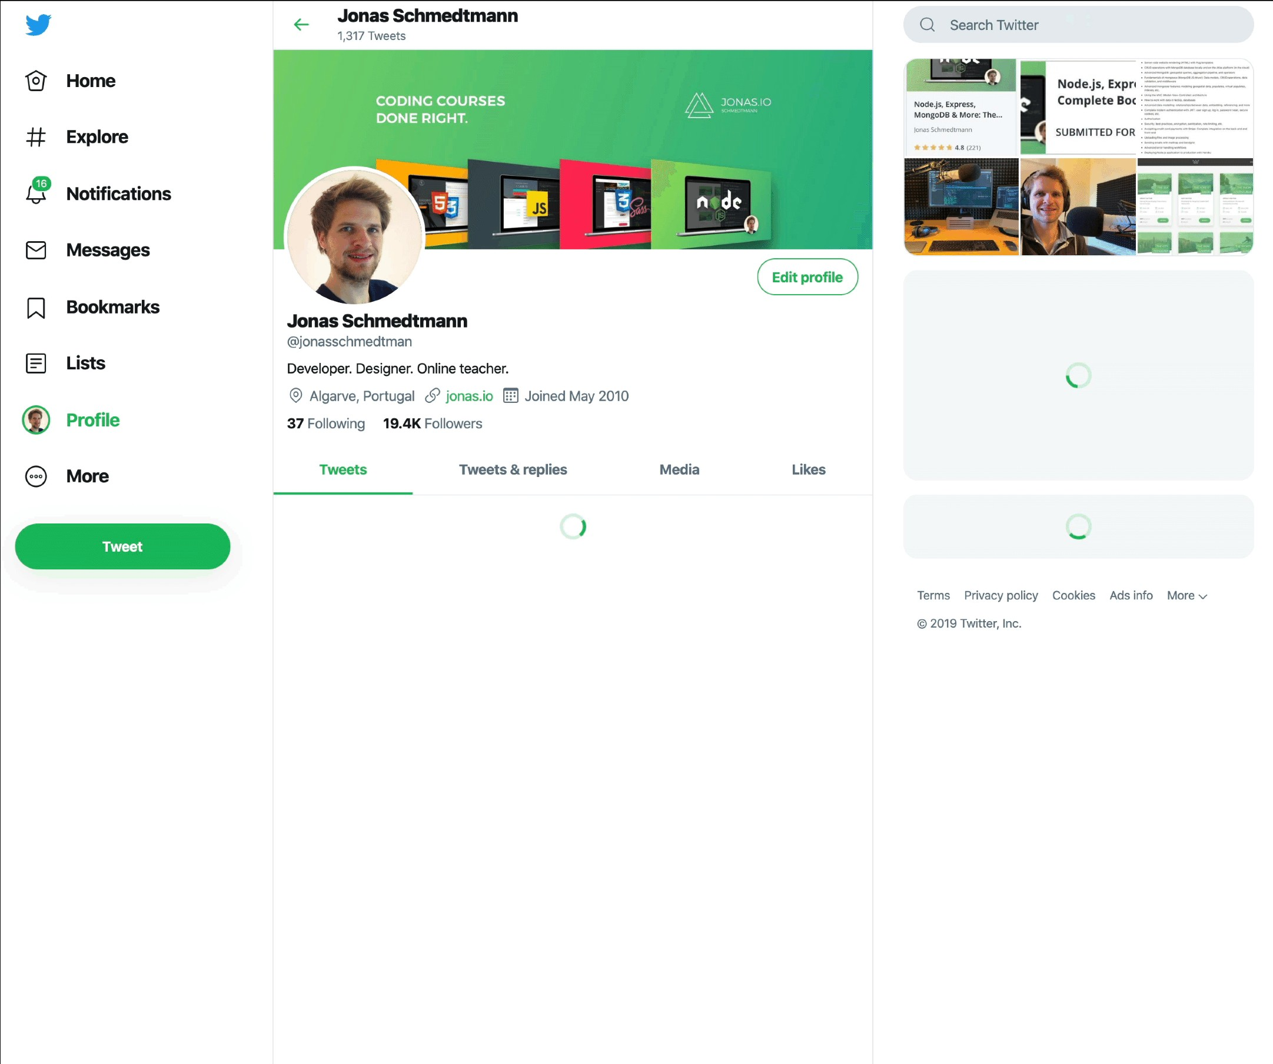
EXAMPLE OF DYNAMIC EFFECTS / WEB APPLICATION
Display user info on hover
Show spinner + loading data in the background
Show spinner + loading data in the background
Show data after loading
Show tweet box after clicking
Display tweets after loading data

Slide 6







THERE IS NOTHING YOU CAN’T DO WITH JAVASCRIPT (WELL, ALMOST…)
Front-end apps
Back-end apps
Dynamic effects and web applications in the
browser
Web applications on web servers
THIS COURSE
100% based on JavaScript. They might go away, but JavaScript won’t!
Native mobile applications
Native desktop applications

Slide 7


JAVASCRIPT RELEASES... (MORE ABOUT THIS LATER)
Biggest update to the language EVER
New updates to JS every single year
ES6/ ES2015
ES7/ ES2016
ES8/ ES2017
ES9/ ES2018
ES10/ ES2019
ES11/ ES2020
...
ES5
...
Modern JavaScript
ECMAScript
Learn modern JavaScript from the beginning, but without forgetting the older parts!
Let’s finally get started!

Slide 8
SECTION
JAVASCRIPT FUNDAMENTALS – PART 1
LECTURE
DATA TYPES

Slide 9
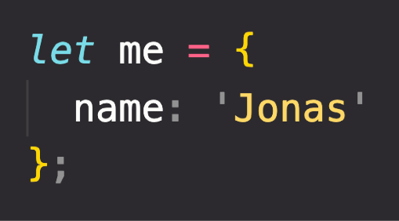
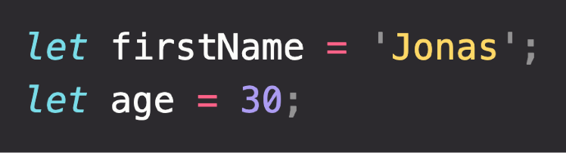
OBJECTS AND PRIMITIVES
VALUE
EVERYTHING ELSE
OBJECT
OR
PRIMITIVE

Slide 10

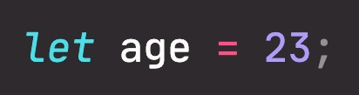

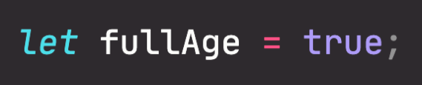
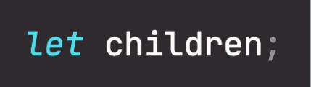

THE 7 PRIMITIVE DATA TYPES
Number: Floating point numbers
String: Sequence of characters
Used for decimals and integers
Used for text
Boolean: Logical type that can only be true or false Used for taking decisions
Undefined: Value taken by a variable that is not yet defined (‘empty value’)
Null: Also means ‘empty value’
Symbol (ES2015): Value that is unique and cannot be changed [Not useful for now]
BigInt (ES2020): Larger integers than the Number type can hold
JavaScript has dynamic typing: We do not have to manually define the data type of the value stored in a variable. Instead, data types are determined automatically.
Value has type, NOT variable!

