Slide 1

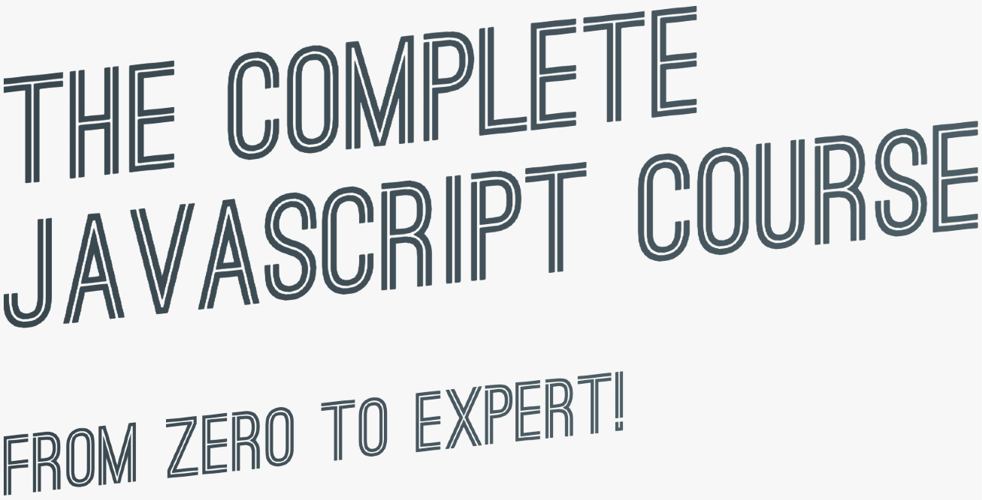

SECTION
JAVASCRIPT FUNDAMENTALS – PART 1
LECTURE
BOOLEAN LOGIC

Slide 2


BASIC BOOLEAN LOGIC: THE AND, OR & NOT OPERATORS
A AND B A OR B
NOT A, NOT B
“Sarah has a driver’s license
AND good vision”
“Sarah has a driver’s license
OR good vision”
Possible values
Inverts true/false value
A
A
OR | TRUE | FALSE
TRUE | TRUE | TRUE
FALSE | TRUE | FALSE
AND TRUE
FALSE
B
TRUE
TRUE
FALSE
Results of
B
operation,
depending on
EXAMPLE:
A: Sarah has a driver’s license
B: Sarah has good vision
FALSE FALSE FALSE
2 variables
true when ALL are true
true when ONE is true
Boolean variables that can be either TRUE or FALSE
No matter how many variables

Slide 3

AN EXAMPLE
A
BOOLEAN VARIABLES
A: Age is greater or equal 20
B: Age is less than 30
age = 16
false
AND TRUE
FALSE
true
B
TRUE
TRUE
FALSE
LET’S USE OPERATORS!
FALSE FALSE FALSE
!A
true
false
A
A AND B
false
false
true
OR TRUE
FALSE
A OR B
true
false
true
!A AND B
true
B
TRUE
TRUE
TRUE
true
true
A OR !B
false
FALSE
TRUE
FALSE
false
false

Slide 4
SECTION
JAVASCRIPT FUNDAMENTALS – PART 1
LECTURE
JAVASCRIPT RELEASES: ES5, ES6+ AND ESNEXT

Slide 5







A BRIEF HISTORY OF JAVASCRIPT
1995
Brendan Eich creates the very first version of JavaScript in just 10 days. It was called Mocha, but already had many fundamental features of modern JavaScript!
1996
Mocha changes to LiveScript and then to JavaScript, in order to attract Java developers. However, JavaScript has almost nothing to do with Java
Microsoft launches IE, copying JavaScript from Netscape and calling it JScript;
1997
With a need to standardize the language, ECMA releases ECMAScript 1 (ES1), the first official standard for JavaScript (ECMAScript is the standard, JavaScript the language in practice);
2009
ES5 (ECMAScript 5) is released with lots of great new features;
2015
ES6/ES2015 (ECMAScript 2015) was released: the biggest update to the language ever!
ECMAScript changes to an annual release cycle in order to ship less features per update
2016 – ∞
Release of ES2016 / ES2017 / ES2018 / ES2019 / ES2020 / ES2021 / … / ES2089

Slide 6
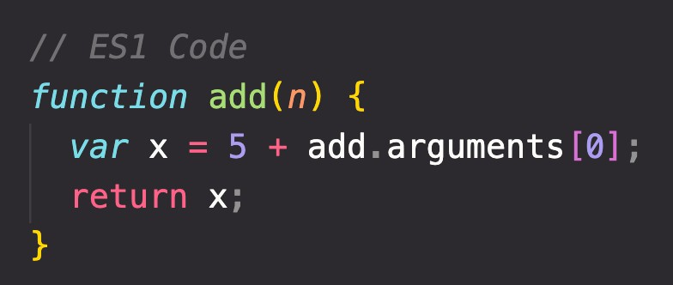



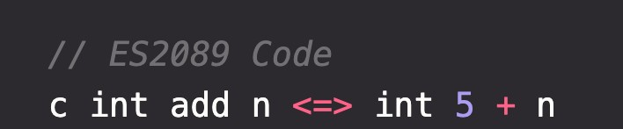

BACKWARDS COMPATIBILITY: DON’T BREAK THE WEB!
Modern JavaScript Engine
BACKWARDS COMPATIBLE
1997
2020
Old features are never removed; Not really new versions, just
incremental updates (releases)
Websites keep working forever!
DON’T BREAK THE WEB!
Modern JavaScript Engine
NOT FORWARDS COMPATIBLE
2020
2089

Slide 7

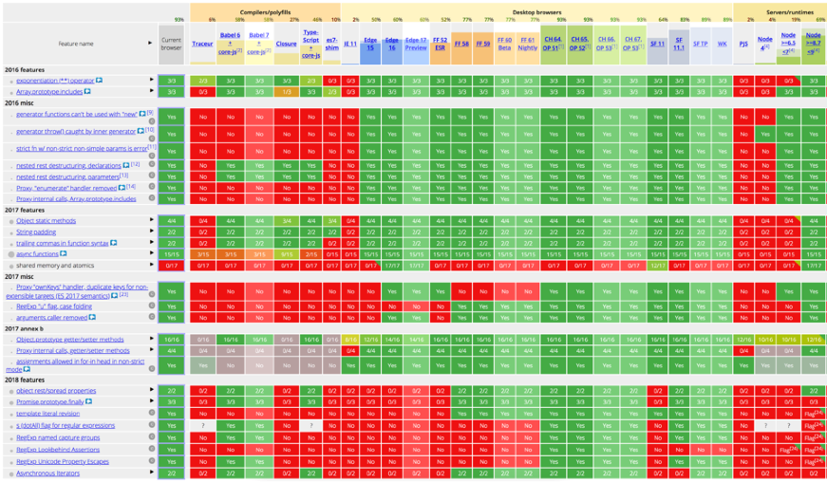



HOW TO USE MODERN JAVASCRIPT TODAY
During development: Simply use the latest Google Chrome!
During production: Use Babel to transpile and polyfill your code (converting back to ES5 to ensure browser compatibility for all users).
http://kangax.github.io/compat-table
Fully supported in all browsers (down to IE 9 from 2011);
Ready to be used today
ES5
ES6/ES2015
↓
ES2020
ES6+: Well supported in all modern browsers; No support in older browsers;
Can use most features in production with transpiling and polyfilling
ESNext: Future versions of the language (new feature proposals that reach Stage 4);
Can already use some features in production with transpiling and polyfilling.
ES2021 – ∞
Will add new videos
(As of 2020)

Slide 8

MODERN JAVASCRIPT FROM THE BEGINNING
Learn modern JavaScript from the beginning!
But, also learn how some things used to be done before modern JavaScript (e.g. const & let vs var and function constructors vs ES6 class).
3 reasons why we should not forget the Good Ol’ JavaScript:
You will better understand how JavaScript actually works; Many tutorials and code you find online today are still in ES5; When working on old codebases, these will be written in ES5.

Slide 9
JAVASCRIPT
FUNDAMENTALS – PART 2

Slide 10
SECTION
JAVASCRIPT FUNDAMENTALS – PART 2
LECTURE
FUNCTIONS CALLING OTHER FUNCTIONS

Slide 11
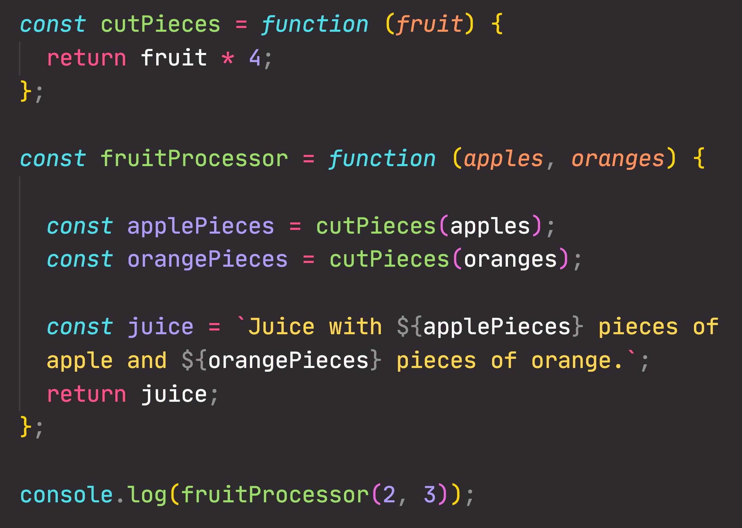

CALLING A FUNCTION INSIDE A FUNCTION: DATA FLOW
2
2
8
2
8
3
8
2

Slide 12
SECTION
JAVASCRIPT FUNDAMENTALS – PART 2
LECTURE
REVIEWING FUNCTIONS

Slide 13
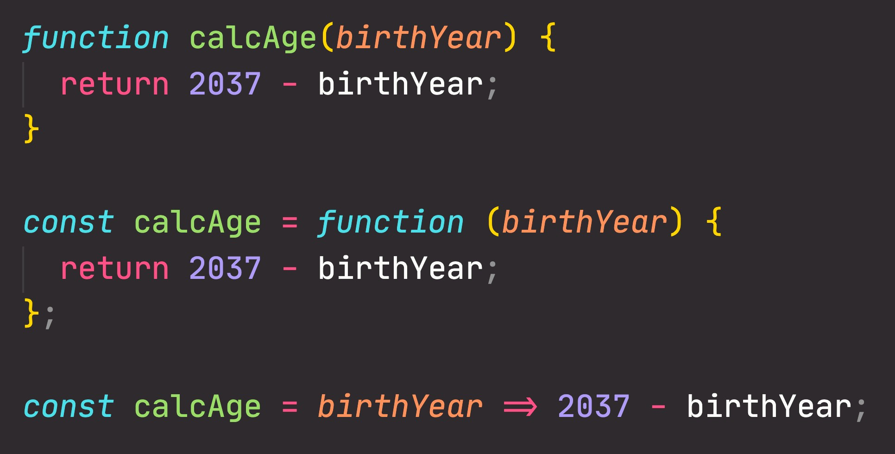
FUNCTIONS REVIEW; 3 DIFFERENT FUNCTION TYPES
Function declaration
Function that can be used before it’s declared
Function expression
Essentially a function
value stored in a variable
Arrow function
Great for a quick one-line functions. Has no this keyword (more later...)
Three different ways of writing functions, but they all work in a similar way: receive input data, transform data, and then output data.

Slide 14
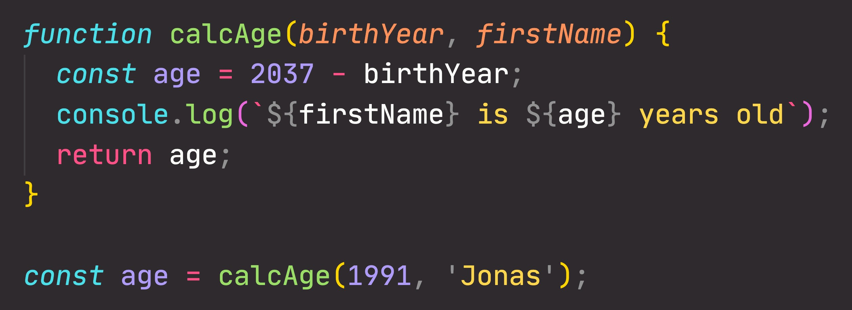
FUNCTIONS REVIEW: ANATOMY OF A FUNCTION
Parameters: placeholders to receive input
values. Like local variables of a function
Function body: block of code that we want to reuse. Processes the function’s input data
Function name
return statement to output a value from the function and terminate execution
Calling, running or invoking the function, using ()
Variable to save returned value (function output)
Arguments: actual values of function parameters, to input data

