Slide 1
DEVELOPER SKILLS & EDITOR SETUP

Slide 2

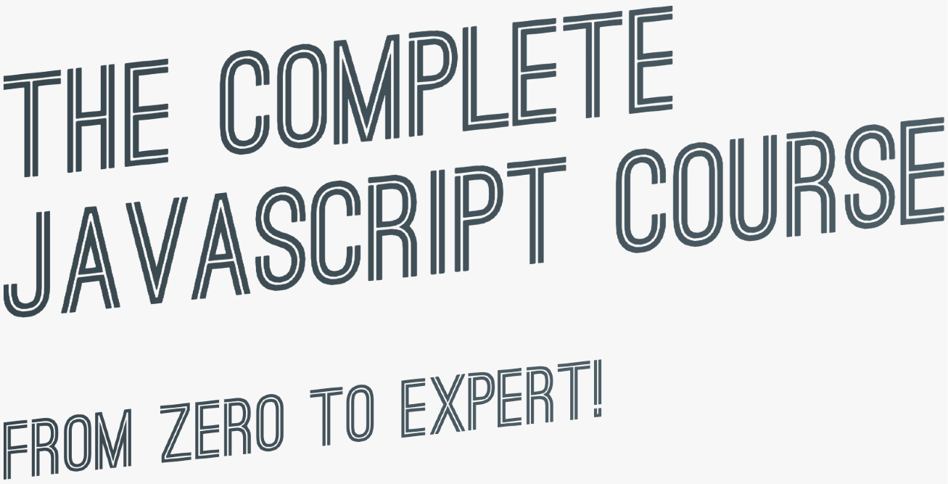

SECTION
DEVELOPER SKILLS & EDITOR SETUP
LECTURE
LEARNING HOW TO CODE

Slide 3




HOW TO FAIL
AT LEARNING HOW TO CODE
He didn’t have a clear goal at the beginning of his journey
He started by watching courses and reading tutorials, but he would just copy the code without caring how it works. Sometimes he would just copy and paste code!
He didn’t reinforce what he was learning by doing small challenges or taking notes He didn’t practice coding, and didn’t come up with his own project ideas
He quickly became frustrated when his code was not perfectly clean or efficient He lost motivation because he thought he could never know everything
He was learning in isolation
John
(not actually…)
After finishing a couple of courses, he thought he now was a web developer and could start applying to jobs. But he couldn’t even build an app on his own!

Slide 4








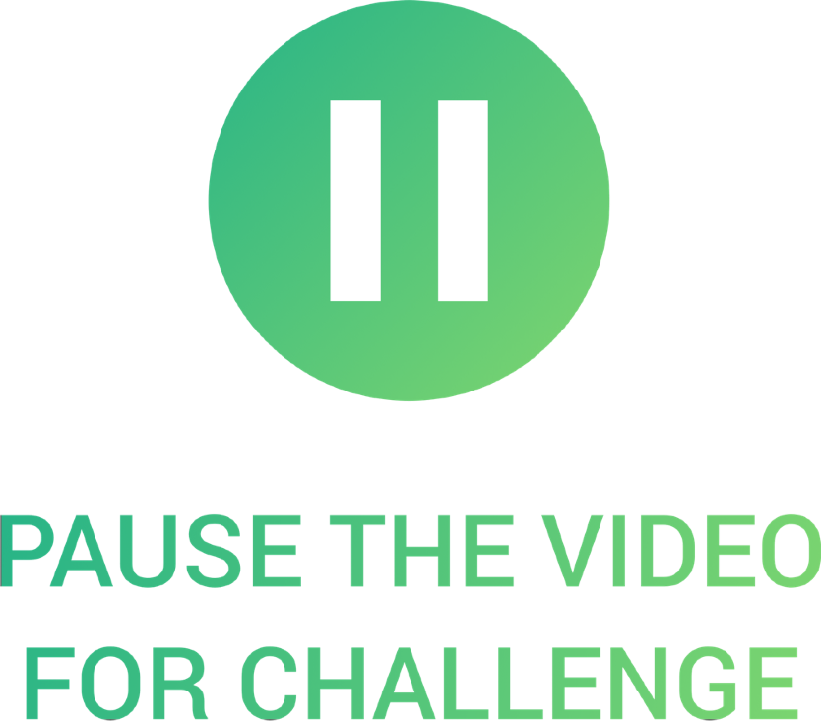

HOW TO SUCCEED AT LEARNING HOW TO CODE
He didn’t have a clear goal at the beginning of his journey
He would just copy the code without caring how it works. Sometimes he would just copy and paste code!
He didn’t reinforce what he was learning by doing small challenges or taking notes
FIX
FIX
Set a specific, measurable, realistic and time-based goal
Know exactly why you are learning to code: Switching careers? Finding a better job?
Imagine a big project you want to be able to build!
Research technologies you need and then learn them
FIX
After you learn a new feature or concept, use it immediately
Understand the code that you’re studying and typing
Take notes
Always type the code, don’t copy-paste!
Challenge yourself and practice with small coding exercises and challenges
Don’t be in a hurry to complete the course fast!

Slide 5

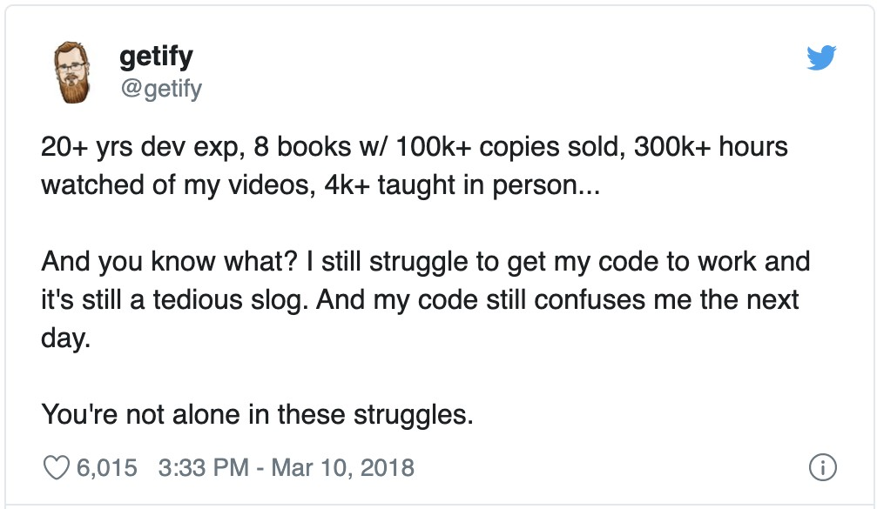
HOW TO SUCCEED AT LEARNING HOW TO CODE
He didn’t practice coding, and didn’t come up with his own project ideas
He quickly became frustrated when his code was not perfectly clean or efficient
He lost motivation because he thought he could never know everything
FIX
FIX
FIX
Practicing on your own is the most important thing to do
Don’t get stuck trying to write the perfect code!
Embrace the fact that you will never you know everything
This is NOT optional! Without practice outside of courses, you won’t go anywhere!
Just write tons of code, no matter the quality!
Just focus on what you need to achieve your goal!
Clean and efficient code will come with time
Come up with your own project ideas or copy popular sites or applications, or just parts of them in the beginning
You can always refactor code later
Don’t be stuck in “tutorial hell”

Slide 6

HOW TO SUCCEED AT LEARNING HOW TO CODE
He was learning in isolation
After finishing a couple of courses, he thought he now was a web developer and could start applying to jobs
FIX
Explain new concepts to other people. If you can explain it, you truly understand it!
Share your goals to make
yourself accountable
Share your learning progress with the web dev community (#100DaysOfCode, #CodeNewbie, #webdev, etc.)
FIX
The biggest misconception
that people have!
Courses are an amazing starting point, but are only the beginning of your journey!
NEXT SLIDE

Slide 7
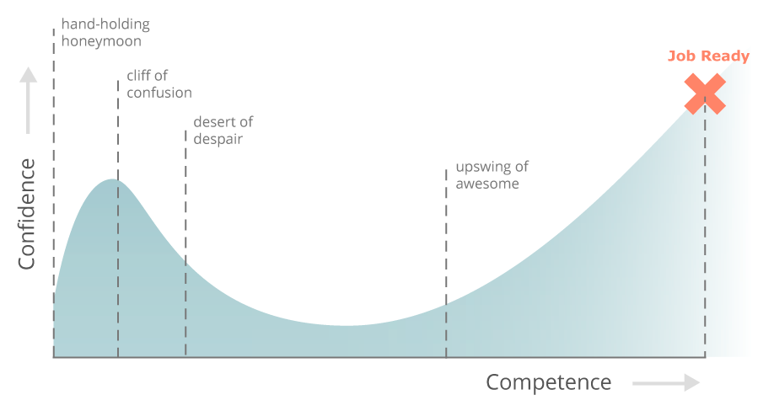

LEARNING HOW TO CODE IS HARD, BUT YOU CAN DO IT!
Study courses: understand code, take challenges and notes
Everything is awesome
Stay motivated! Keep writing lots of code on your own, no matter how bad
JOB READY
Cliff of confusion
Pit of
Learn with other people, devs and beginners, and share progress
despair
Confidence
Back to awesome
Keep challenging yourself, run into lots of problems, and fix them
Round up your skillset with best practices and tools (git, testing, …)
Competence
You’re probably somewhere here
JOB READY
(But the learning never stops )
Source: https://www.thinkful.com/blog/why-learning-to-code-is-so-damn-hard/

Slide 8
SECTION
DEVELOPER SKILLS & EDITOR SETUP
LECTURE
HOW TO THINK LIKE A DEVELOPER: BECOME A PROBLEM SOLVER!

Slide 9


HOW TO FAIL
AT SOLVING PROBLEMS
Example: In an array of GPS coordinates, find the two closest points
WHENEVER JOHN ENCOUNTERS A PROBLEM:
He jumps at the problem without much thinking
He implements his solution in an unstructured way
He gets stressed out when things don’t work He is too proud to research solutions
FIX
Stay calm and slow down, don’t just jump at a problem without a plan
Take a very logical and rational approach (programming is just logic, in the end…)
John can code now
Use my 4-step framework to solve any problem
NEXT SLIDE

Slide 10

4 STEPS TO SOLVE ANY PROBLEM
Make sure you 100% understand the problem. Ask the right questions to get a clear picture of the problem
EXAMPLE
1
Project Manager: “We need a function
that reverses we pass into it”
whatever
1
What does “whatever” even mean in this context? What should be reversed? Answer: Only strings, numbers, and arrays make sense to reverse...
What to do if something else is passed in?
What should be returned? Should it always be a string, or should the type be the same as passed in?
How to recognize whether the argument is a number, a string, or an array?
How to reverse a number, a string, and an array?

Slide 11
4 STEPS TO SOLVE ANY PROBLEM
Make sure you 100% understand the problem. Ask the right questions to get a clear picture of the problem
EXAMPLE
1
Project Manager: “We need a function that reverses whatever we pass into it”
Divide and conquer: Break a big problem into smaller sub-problems.
2
SUB-PROBLEMS:
Check if argument is a number, a string, or an array
2
Implement reversing a number
Implement reversing a string
Implement reversing an array
Return reversed value
Looks like a task list that we need to implement

Slide 12



4 STEPS TO SOLVE ANY PROBLEM
Make sure you 100% understand the problem. Ask the right questions to get a clear picture of the problem
EXAMPLE
1
Project Manager: “We need a function that reverses whatever we pass into it”
Divide and conquer: Break a big problem into smaller sub-problems.
3
How to check if a value is a number in JavaScript?
2
How to check if a value is a string in JavaScript?
How to check if a value is an array in JavaScript?
Don't be afraid to do as much
research as you have to
How to reverse a number in JavaScript?
3
How to reverse a string in JavaScript?
How to reverse an array in JavaScript?

Slide 13
4 STEPS TO SOLVE ANY PROBLEM
Make sure you 100% understand the problem. Ask the right questions to get a clear picture of the problem
EXAMPLE
1
Project Manager: “We need a function that reverses whatever we pass into it”
Divide and conquer: Break a big problem into smaller sub-problems.
4
function reverse(value)
if value type !string && !number && !array
return value
2
if value type == string reverse string
if value type == number reverse number
if value type == array reverse array
Don't be afraid to do as much
research as you have to
3
For bigger problems, write pseudo-code
before writing the actual code
4
return reversed value

