Slide 1

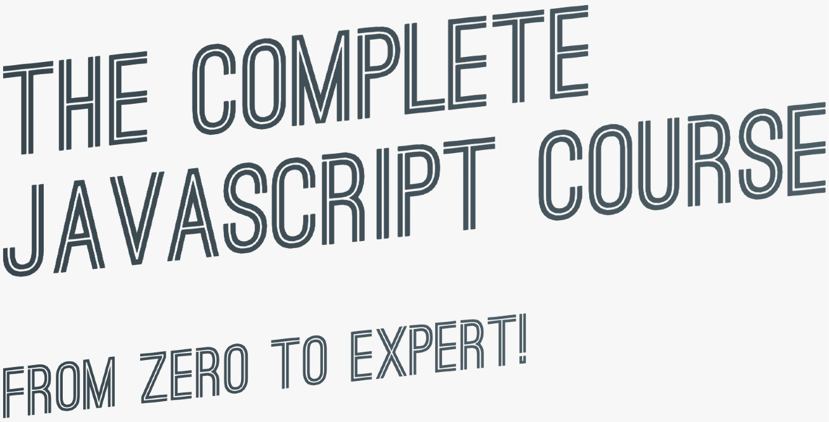

SECTION
DEVELOPER SKILLS & EDITOR SETUP
LECTURE
DEBUGGING (FIXING ERRORS)

Slide 2

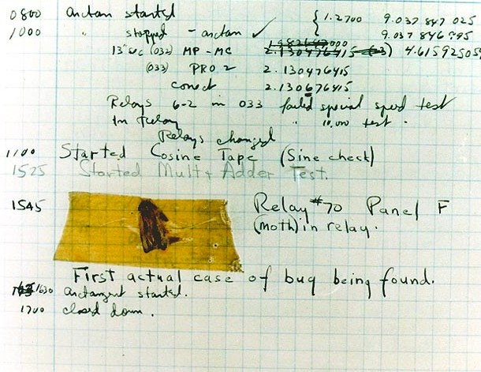

WHAT IS A SOFTWARE BUG?
Software bug: Defect or problem in a computer program. Basically, any unexpected or unintended behavior of a computer program is a software bug.
Bugs are completely normal in software development!
Previous example: “We need a function that reverses whatever we pass into it”
reverse([1, 3, 5, 7])
Unexpected result: the array is scrambled, NOT reversed. So there is a bug in the reverse function
A real bug which was causing an error in Harvard’s computer in the 1940s
[5, 1, 7, 3]
Debugging: Process of finding, fixing and preventing bugs.

Slide 3
THE DEBUGGING PROCESS
Becoming aware that there is a bug
Isolating where exactly the bug is happening in code
Preventing it from happening again
Correct the bug
IDENTIFY
FIND
FIX
PREVENT
During development
Developer console (simple code)
Replace wrong solution with new correct solution
Searching for the same bug in similar code
Testing software
Debugger (complex code)
User reports during production
Writing tests using testing software
Context: browsers, users, etc.

Slide 4
JAVASCRIPT IN THE BROWSER: DOM AND EVENTS
FUNDAMENTALS

Slide 5
SECTION
JAVASCRIPT IN THE BROWSER: DOM AND EVENTS FUNDAMENTALS
LECTURE
WHAT'S THE DOM AND DOM MANIPULATION

Slide 6


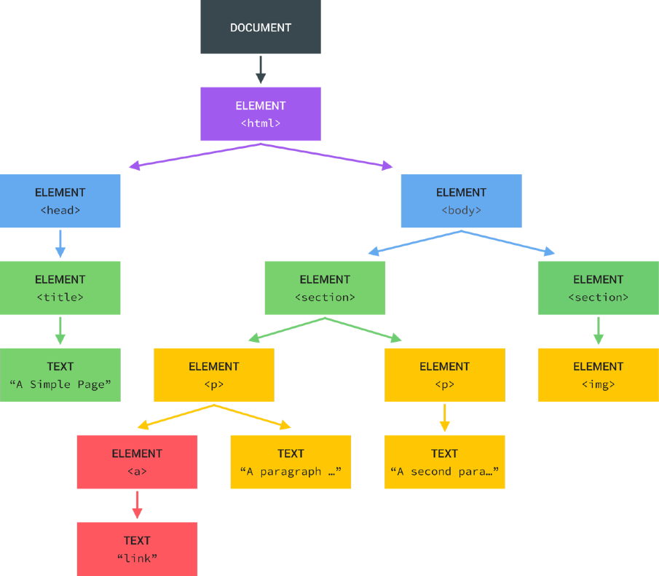
WHAT IS THE DOM?
Tree structure, generated by browser on HTML load
DOM
DOCUMENT OBJECT MODEL: STRUCTURED REPRESENTATION OF HTML DOCUMENTS. ALLOWS JAVASCRIPT TO ACCESS HTML ELEMENTS AND STYLES TO MANIPULATE THEM.
Change text, HTML attributes, and even CSS styles

Slide 7
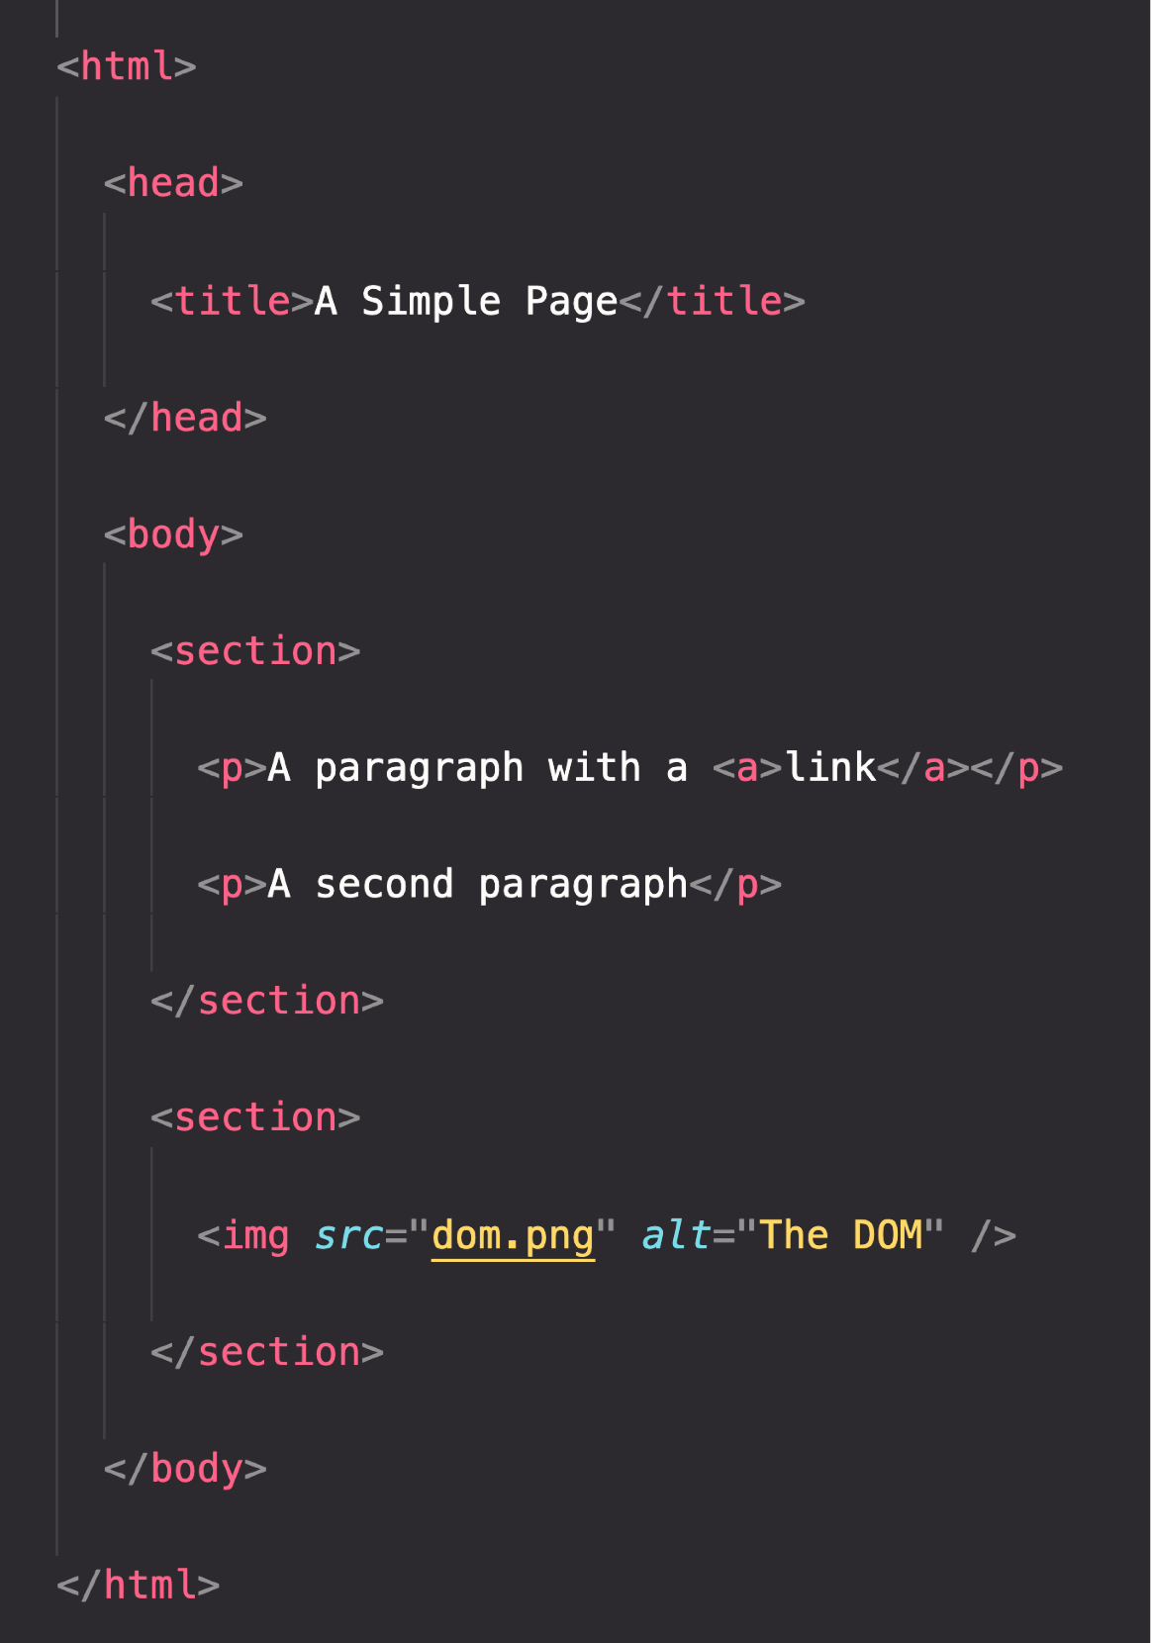

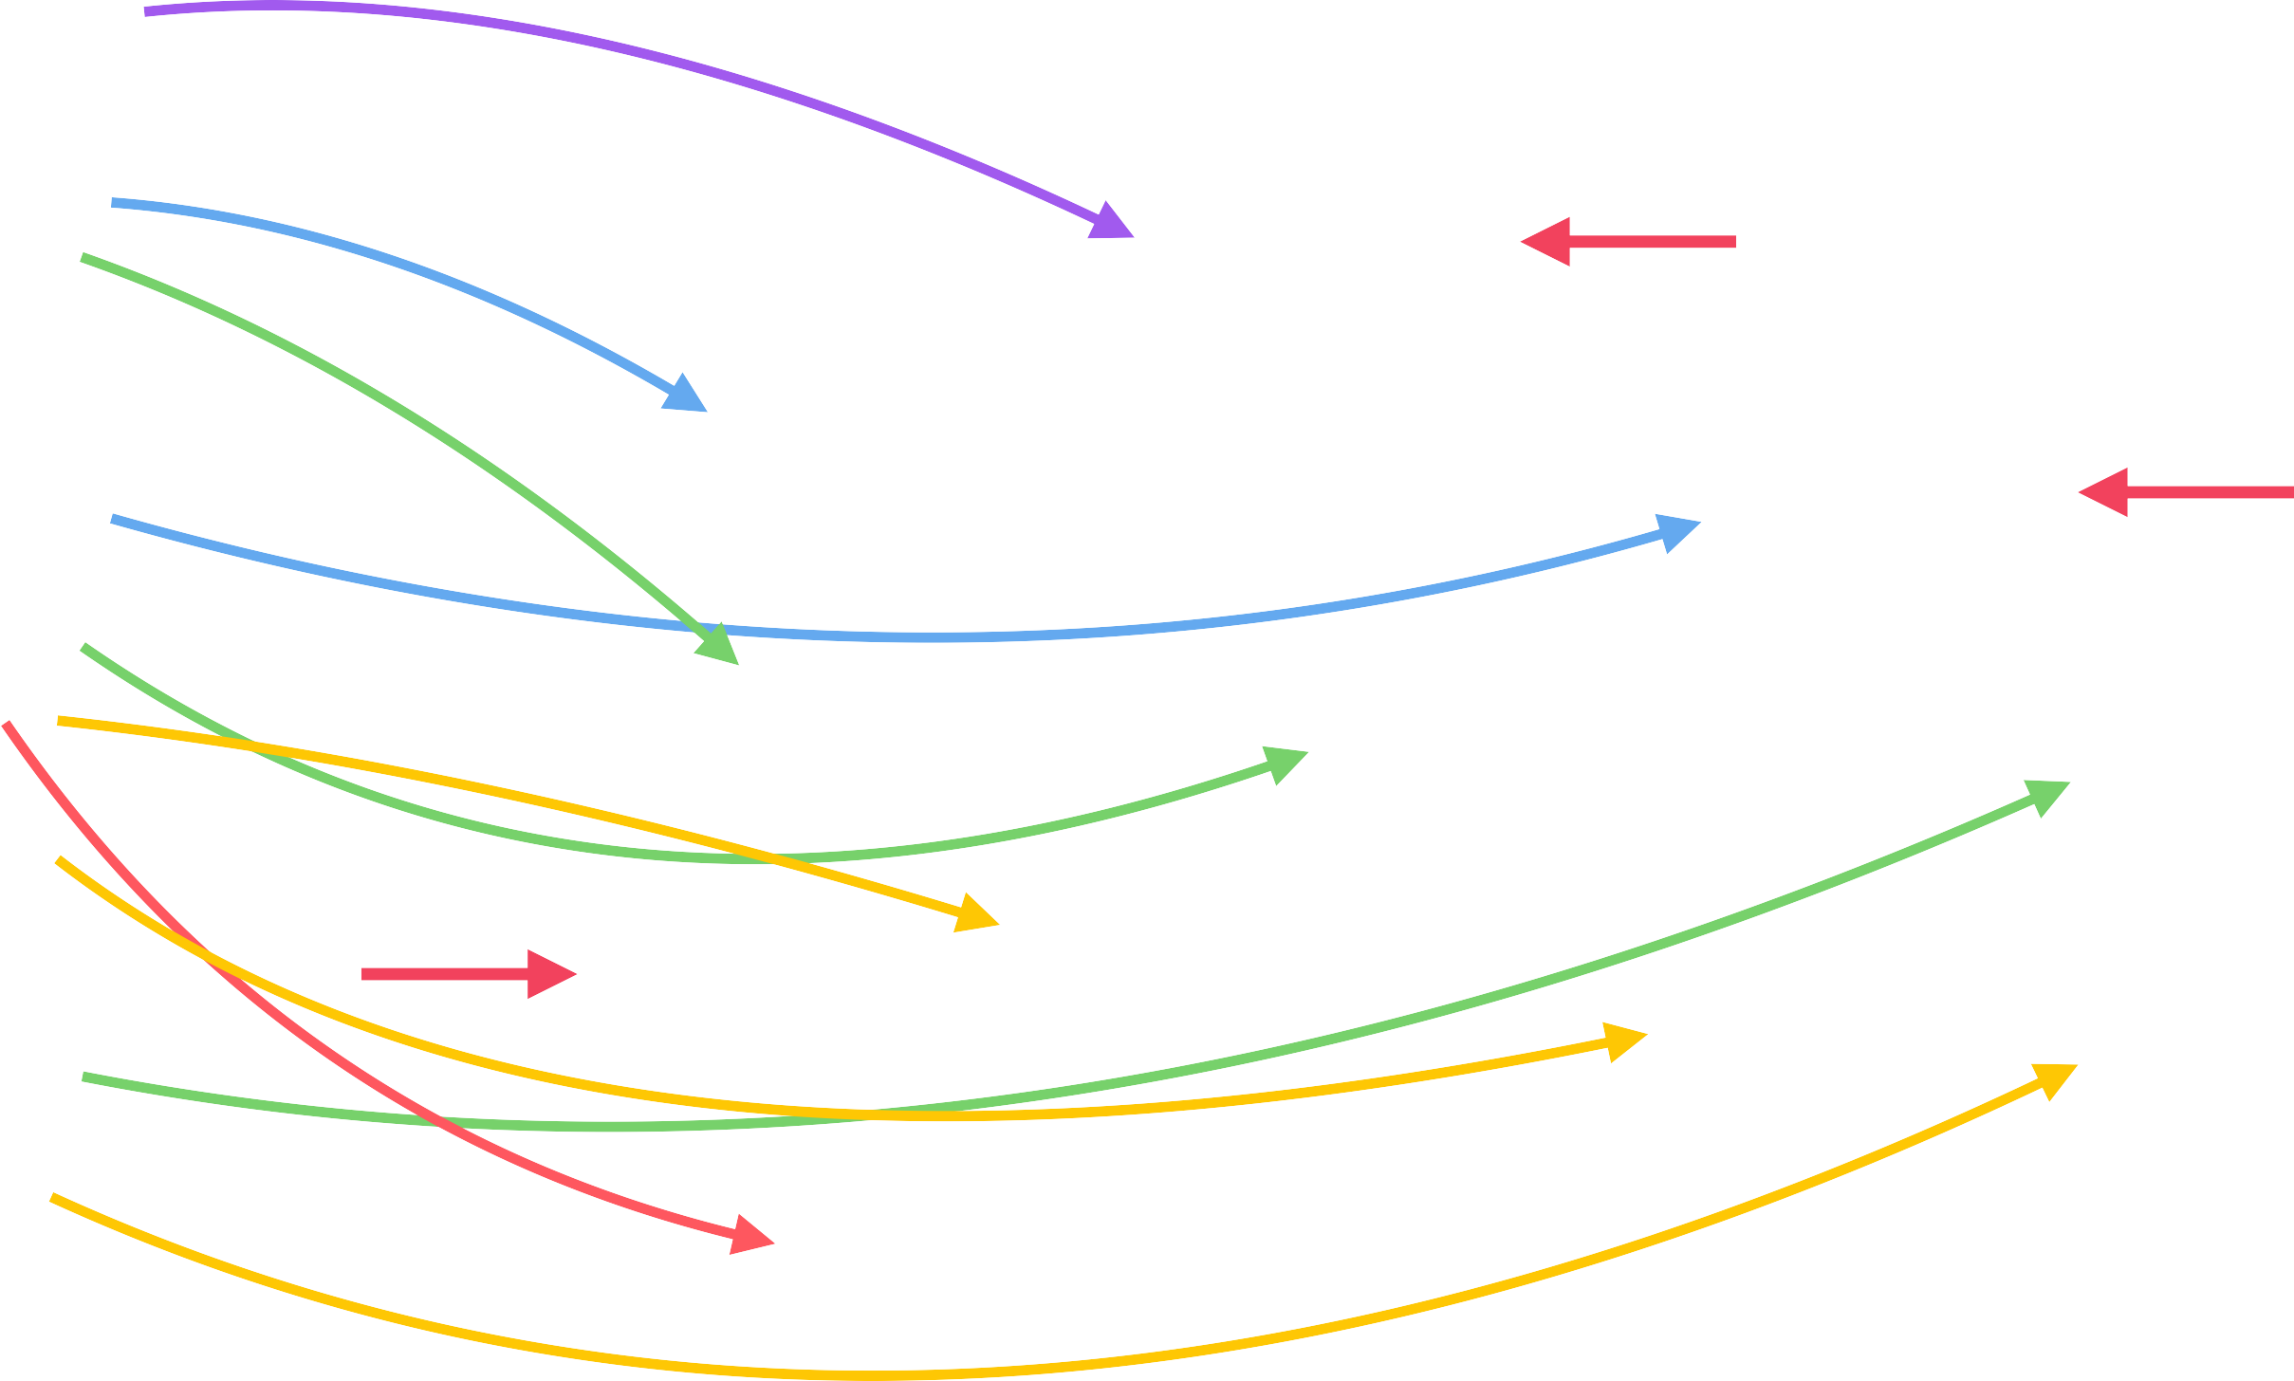
THE DOM TREE STRUCTURE
Special object that is the entry point to the DOM. Example: document.querySelector()

Slide 8
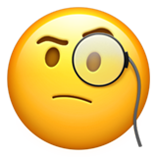

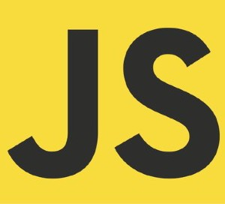






DOM ! ==JAVASCRIPT
DOM Methods and Properties for DOM Manipulation
NOT PART OF
For example
document.querySelector()
API: Application Programming Interface
WEB APIs
DOM Methods and Properties
Timers
CAN INTERACT WITH
Fetch

