Slide 1
HOW JAVASCRIPT WORKS BEHIND THE
SCENES

Slide 2

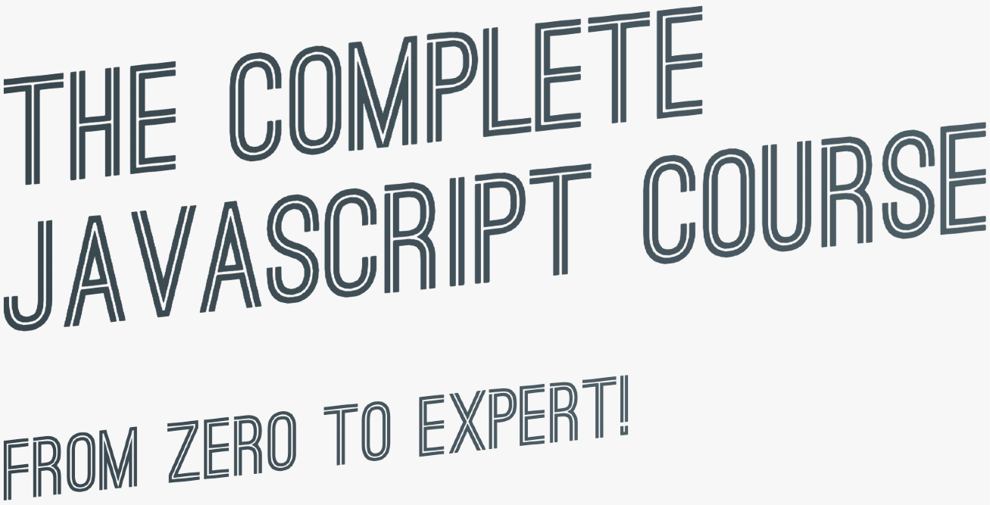

SECTION
HOW JAVASCRIPT WORKS BEHIND THE SCENES
LECTURE
AN HIGH-LEVEL OVERVIEW OF JAVASCRIPT

Slide 3


WHAT IS JAVASCRIPT: REVISITED
JAVASCRIPT
JAVASCRIPT IS A HIGH-LEVEL, OBJECT-ORIENTED, MULTI-PARADIGM PROGRAMMING LANGUAGE.

Slide 4



WHAT IS JAVASCRIPT: REVISITED
JAVASCRIPT
JAVASCRIPT IS A HIGH-LEVEL, PROTOTYPE-BASED OBJECT-ORIENTED, MULTI-PARADIGM, INTERPRETED OR JUST-IN-TIME COMPILED,
DYNAMIC, SINGLE-THREADED,
GARBAGE-COLLECTED
PROGRAMMING
LANGUAGE WITH
FIRST-CLASS FUNCTIONS
AND A NON-BLOCKING
EVENT LOOP CONCURRENCY MODEL.

Slide 5
DECONSTRUCTING THE MONSTER DEFINITION
High-level
Garbage-collected
Interpreted or just-in-time compiled
Multi-paradigm
Prototype-based object-oriented
First-class functions
Dynamic
Single-threaded
Non-blocking event loop

Slide 6







DECONSTRUCTING THE MONSTER DEFINITION
High-level
Any computer program needs resources:
Garbage-collected
Interpreted or just-in-time compiled
+
Multi-paradigm
Prototype-based object-oriented
First-class functions
Dynamic
LOW-LEVEL
HIGH-LEVEL
Single-threaded
Developer has to manage resources manually
Developer does NOT have to worry, everything happens automatically
Non-blocking event loop

Slide 7


DECONSTRUCTING THE MONSTER DEFINITION
High-level
Garbage-collected
Interpreted or just-in-time compiled
Multi-paradigm
Cleaning the memory so we don’t have to
Prototype-based object-oriented
First-class functions
Dynamic
Single-threaded
Non-blocking event loop

Slide 8

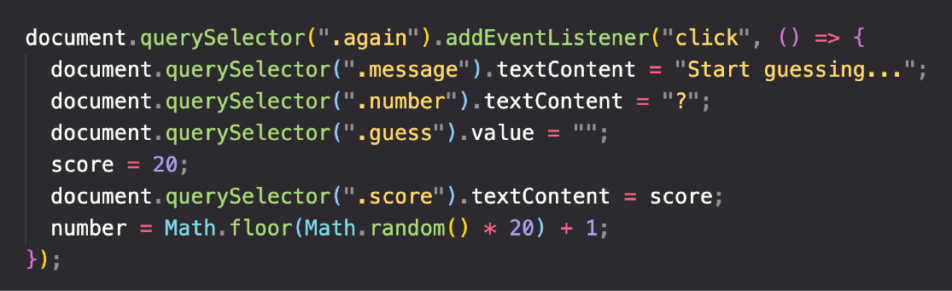



DECONSTRUCTING THE MONSTER DEFINITION
High-level
Garbage-collected
Abstraction over 0s and 1s
Interpreted or just-in-time compiled
Multi-paradigm
CONVERT TO MACHINE CODE = COMPILING
Prototype-based object-oriented
Happens inside the JavaScript engine
First-class functions
Dynamic
Single-threaded
More about this Later in this Section
Non-blocking event loop

Slide 9


DECONSTRUCTING THE MONSTER DEFINITION
High-level
Paradigm: An approach and mindset of structuring code, which will direct your coding style and technique.
Garbage-collected
Interpreted or just-in-time compiled
The one we’ve been using so far
Multi-paradigm
1 Procedural programming
Imperative vs.
Declarative
2
Object-oriented programming (OOP)
Prototype-based object-oriented
3
Functional programming (FP)
First-class functions
Dynamic
Single-threaded
More about this later in Multiple Sections
Non-blocking event loop

Slide 10
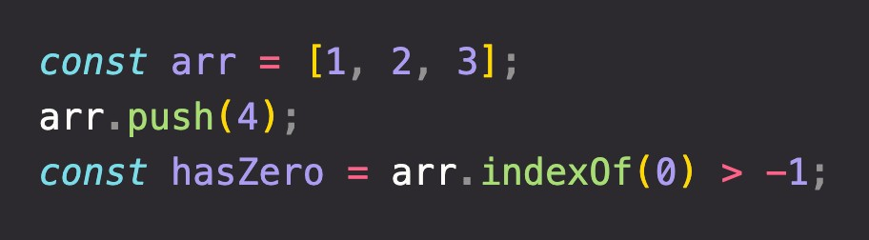
DECONSTRUCTING THE MONSTER DEFINITION
High-level
Prototype
Garbage-collected
Array
Array.prototype.push
(Oversimplification!)
Interpreted or just-in-time compiled
Array.prototype.indexOf
Multi-paradigm
Our array inherits methods from prototype
Built from prototype
Prototype-based object-oriented
First-class functions
Dynamic
Single-threaded
More about this in Section Object Oriented Programming
Non-blocking event loop

Slide 11

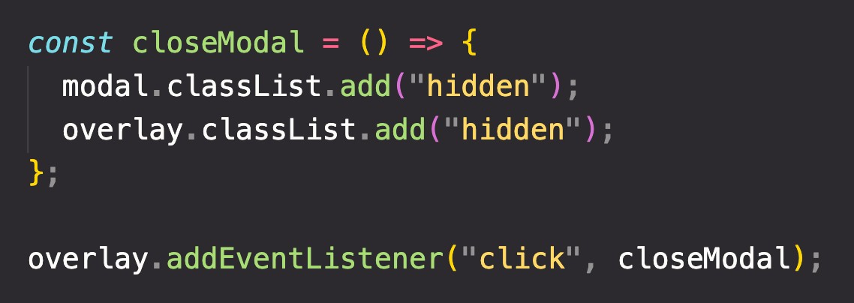
DECONSTRUCTING THE MONSTER DEFINITION
High-level
In a language with first-class functions, functions are simply treated as variables. We can pass them into other functions, and return them from functions.
Garbage-collected
Interpreted or just-in-time compiled
Multi-paradigm
Passing a function into another function as an argument:
First-class functions!
Prototype-based object-oriented
First-class functions
Dynamic
Single-threaded
More about this in Section A Closer Look at Functions
Non-blocking event loop

Slide 12

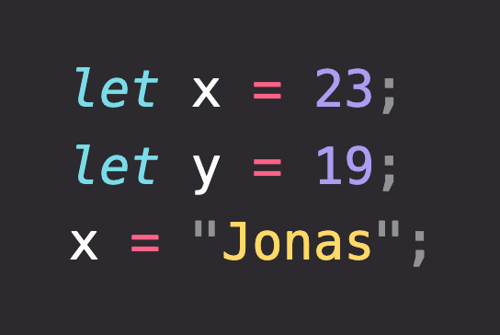



DECONSTRUCTING THE MONSTER DEFINITION
High-level
Garbage-collected
Dynamically-typed language:
Interpreted or just-in-time compiled
No data type definitions. Types becomes known at runtime
Multi-paradigm
Prototype-based object-oriented
Data type of variable is automatically changed
First-class functions
Dynamic
Single-threaded
Non-blocking event loop

Slide 13
DECONSTRUCTING THE MONSTER DEFINITION
High-level
Concurrency model: how the JavaScript engine handles multiple tasks happening at the same time.
Garbage-collected
Why do we need that?
Interpreted or just-in-time compiled
JavaScript runs in one single thread, so it can only do one thing at a time.
Multi-paradigm
So what about a long-running task?
Sounds like it would block the single thread. However, we want non-blocking behavior!
Prototype-based object-oriented
First-class functions
How do we achieve that?
(Oversimplification!)
Dynamic
By using an event loop: takes long running tasks, executes them in the “background”, and puts them back in the main thread once they are finished.
Single-threaded
More about this Later in this Section
Non-blocking event loop

