Slide 1

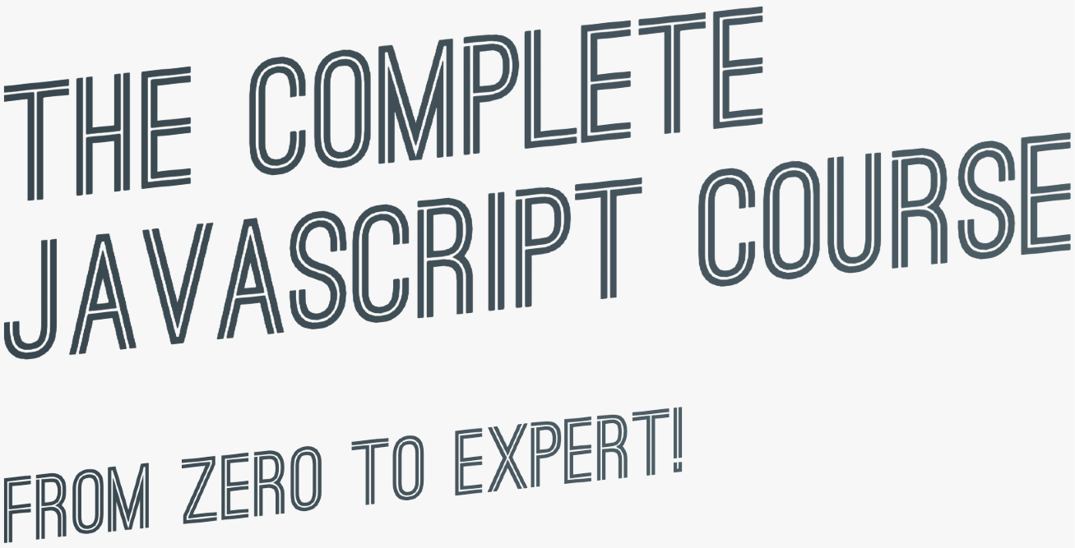
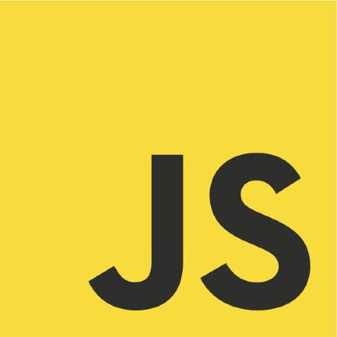
SECTION
HOW JAVASCRIPT WORKS BEHIND THE SCENES
LECTURE
THE JAVASCRIPT ENGINE AND RUNTIME

Slide 2





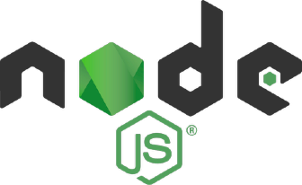



WHAT IS A JAVASCRIPT ENGINE?
JS ENGINE
ENGINE
PROGRAM THAT EXECUTES
JAVASCRIPT CODE.
Object in memory
Execution context
Example: V8 Engine
CALL STACK
HEAP
How is it compiled?
Where our code is executed
Where objects are stored

Slide 3


COMPUTER SCIENCE SIDENOTE: COMPILATION VS. INTERPRETATION
Compilation: Entire code is converted into machine code at once, and written to a binary file that can be executed by a computer.
Source code
STEP 1
Portable file:
machine code
STEP 2
Program running
COMPILATION
EXECUTION
Can happen way after compilation
Interpretation: Interpreter runs through the source code and executes it line by line.
Source code
STEP 1
Program running
EXECUTION LINE BY LINE
Code still needs to be converted to machine code
Just-in-time (JIT) compilation: Entire code is converted into machine code at once, then executed immediately.
Source code
STEP 1
Machine code
STEP 2
Program running
COMPILATION
EXECUTION
NOT a portable file
Happens immediately

Slide 4
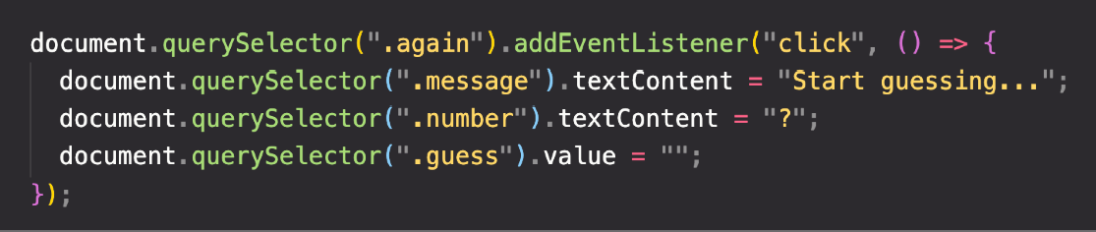
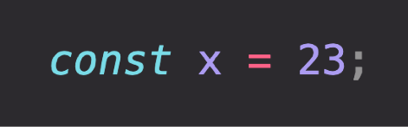
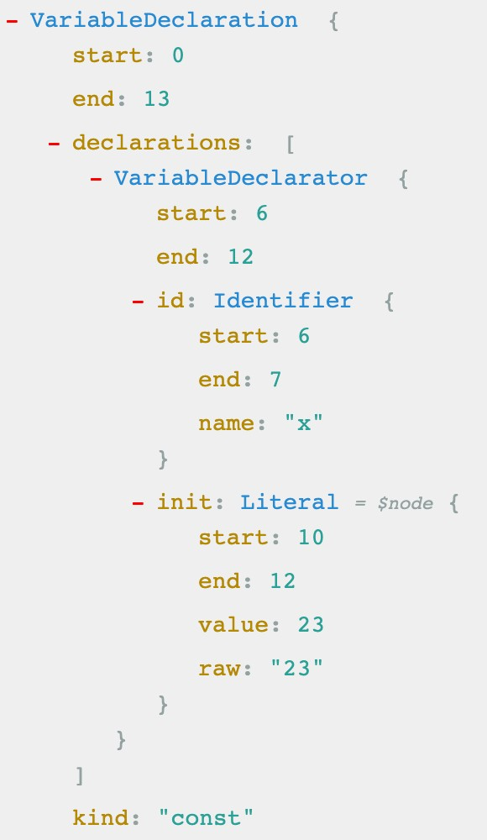


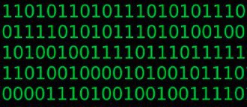

MODERN JUST-IN-TIME COMPILATION OF JAVASCRIPT
“JavaScript is an interpreted language”
ENGINE
AST Example
Happens in special threads that we can’t access from code
Parsing
Example
AST
Compilation
Just-in-time compilation
Optimization
Execution
Happens in Call Stack
During execution!

Slide 5


THE BIGGER PICTURE: JAVASCRIPT RUNTIME
RUNTIME IN THE BROWSER
Functionalities provided to
Container including all the things
the engine, accessible on
ENGINE
that we need to use Jav_{W}aS_{E}cr_{B}ipt_{APIs}
window object
(in this case in the browser)
DOM
Timers
...
Fetch API
EVENT LOOP
Essential for non-blocking concurrency model
CALLBACK QUEUE
click
timer
data
...
onClick
HEAP
CALL STACK
Example: Callback function from DOM event listener

Slide 6
THE BIGGER PICTURE: JAVASCRIPT RUNTIME
RUNTIME IN NODE.JS
WEB APIs
C++ BINDINGS & THREAD POOL
ENGINE
EVENT LOOP
CALLBACK QUEUE
click
timer
data
...
HEAP
CALL STACK

Slide 7
SECTION
HOW JAVASCRIPT WORKS BEHIND THE SCENES
LECTURE
EXECUTION CONTEXTS AND THE CALL STACK

Slide 8

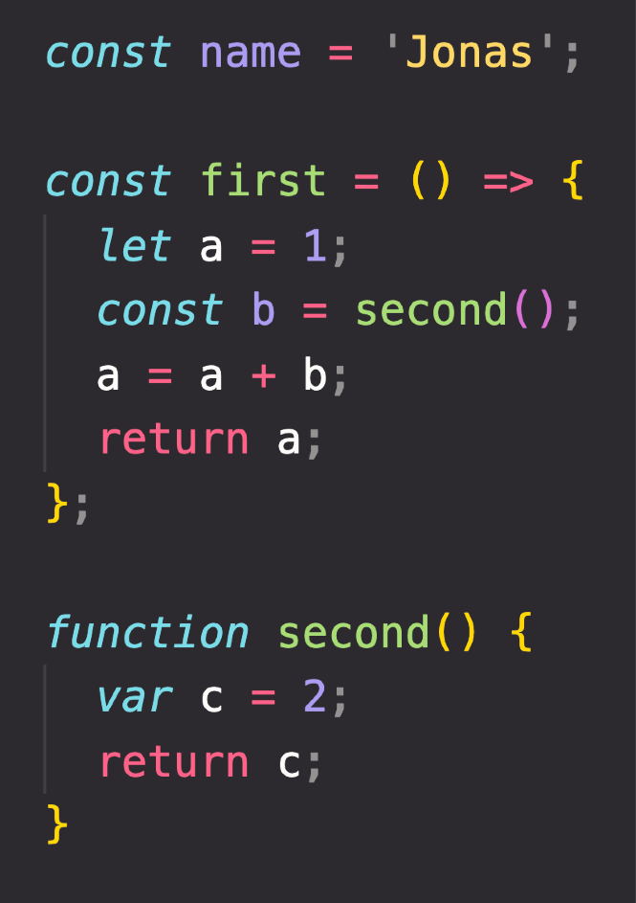



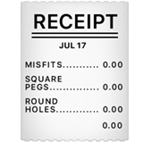


WHAT IS AN EXECUTION CONTEXT?
Compilation
EXECUTION CONTEXT
Human-readable code:
Environment in which a piece of JavaScript is executed. Stores all the necessary information for some code to be executed.
“JavaScript code"
Creation of global execution context (for top-level code)
NOT inside a function
+ +
EXECUTION
Execution of top-level code
(inside global EC)
Pizza “execution context”
Exactly one global execution context (EC): Default context, created for code that is not inside any function (top-level).
Function body only executed when called!
Execution of functions and waiting for callbacks
One execution context per function: For each function call, a new execution context is created.
All together make the call stack
Example: click event callback

Slide 9
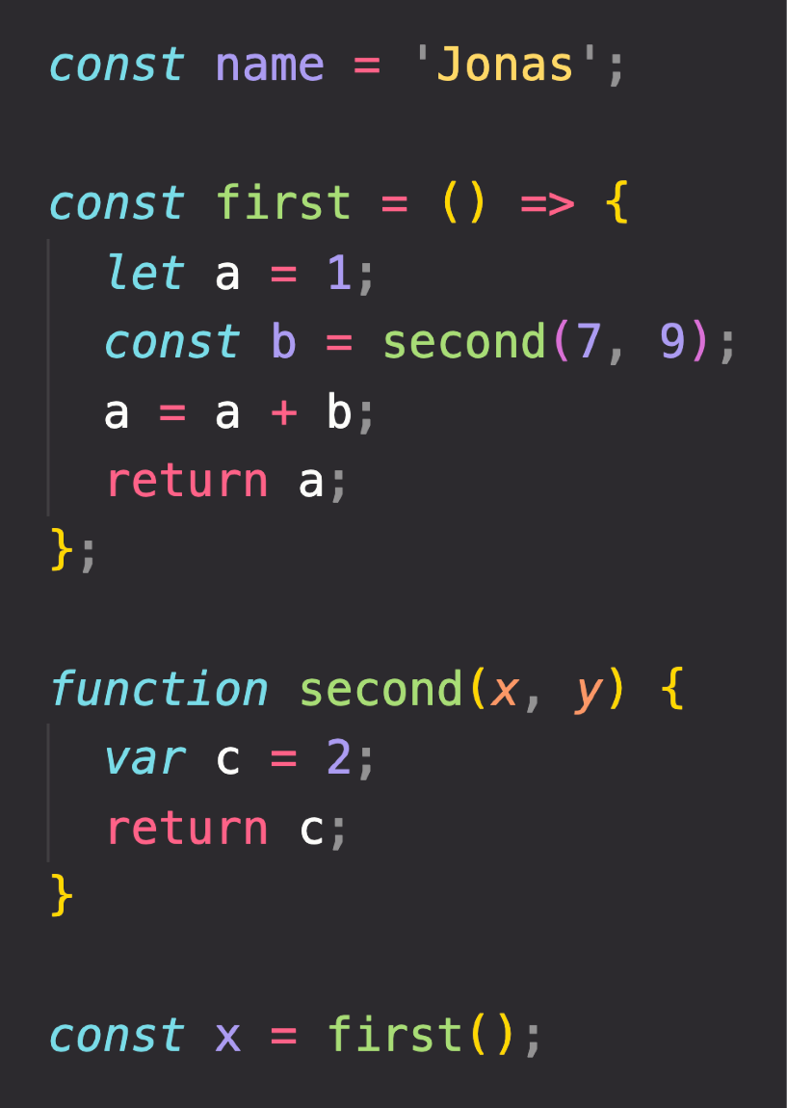
EXECUTION CONTEXT IN DETAIL
Global
Literally the function code
WHAT’S INSIDE EXECUTION CONTEXT?
name = ‘Jonas’ first = <function> second = <function> x = <unknown>
1
Variable Environment
let, const and var declarations Functions
arguments object
Need to run
first() first
first()
a = 1
b = <unknown>
Need to run
second() first
2
Scope chain
NOT in arrow functions!
3
this keyword
second()
c = 2
arguments = [7, 9]
Generated during “creation phase”, right before execution
Array of passed arguments. Available in all “regular” functions (not arrow)
(Technically, values only become known during execution)

Slide 10
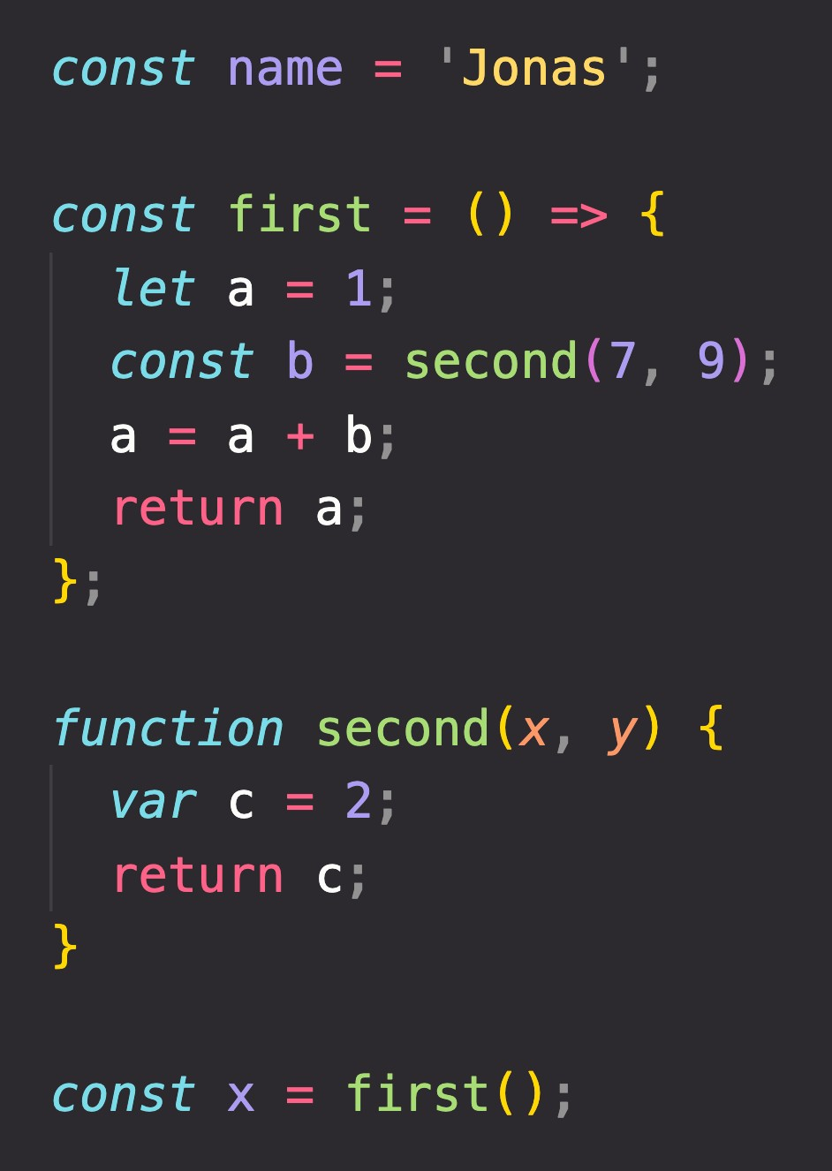


THE CALL STACK
Compiled code starts execution
second()
first()
ENGINE
Global
“Place” where execution contexts get
CALL STACK
stacked on top of each other, to keep
track of where we are in the execution

Slide 11
SECTION
HOW JAVASCRIPT WORKS BEHIND THE SCENES
LECTURE
SCOPE AND THE SCOPE CHAIN

Slide 12



SCOPING AND SCOPE IN JAVASCRIPT: CONCEPTS
EXECUTION CONTEXT
Variable environment
this keyword
Scope chain
SCOPE CONCEPTS
Scoping: How our program’s variables are organized and accessed. “Where do variables live?” or “Where can we access a certain variable, and where not?”;
Lexical scoping: Scoping is controlled by placement of functions and blocks in the code;
Scope: Space or environment in which a certain variable is declared (variable environment in case of functions). There is global scope, function scope, and block scope;
Scope of a variable: Region of our code where a certain variable can be accessed.

Slide 13
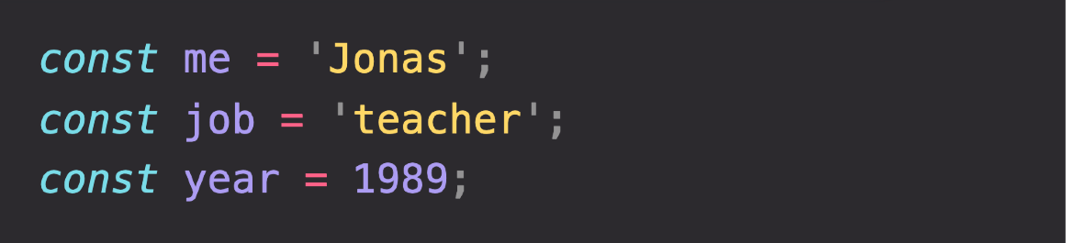
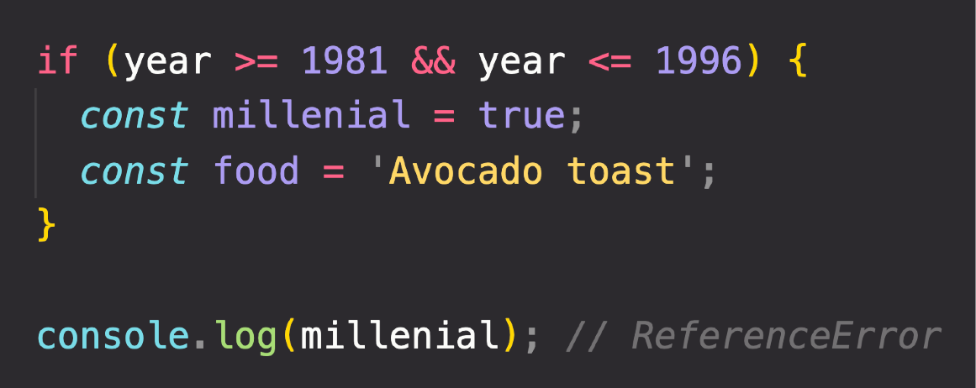

THE 3 TYPES OF SCOPE
FUNCTION SCOPE
Variables are accessible only
inside function, NOT outside
Also called local scope
GLOBAL SCOPE
BLOCK SCOPE (ES6)
Example: if block, for loop block, etc.
Outside of any function or block
Variables declared in global scope are accessible everywhere
Variables are accessible only
inside block (block scoped)
HOWEVER, this only applies to
let and const variables!
Functions are also block scoped
(only in strict mode)

Slide 14
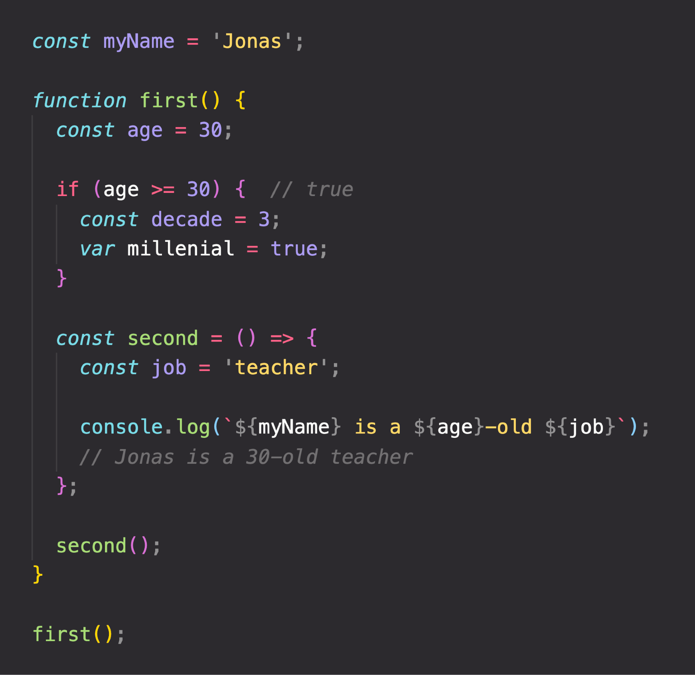


THE SCOPE CHAIN
(Considering only variable declarations)
Global scope
Global variable
myName = “Jonas”
CHAIN
SCOPE CHAIN
let and const are block-scoped
SCOPE
first() scope
Variables not in current scope
age = 30
millennial = true
var is function-scoped
IN
myName = “Jonas”
Scope has access to variables from all outer scopes
LOOKUP
VARIABLE
if block scope
second() scope
decade = 3
job = “teacher”
age = 30
millennial = true
age = 30
millennial = true
myName = “Jonas”
myName = “Jonas”

Slide 15
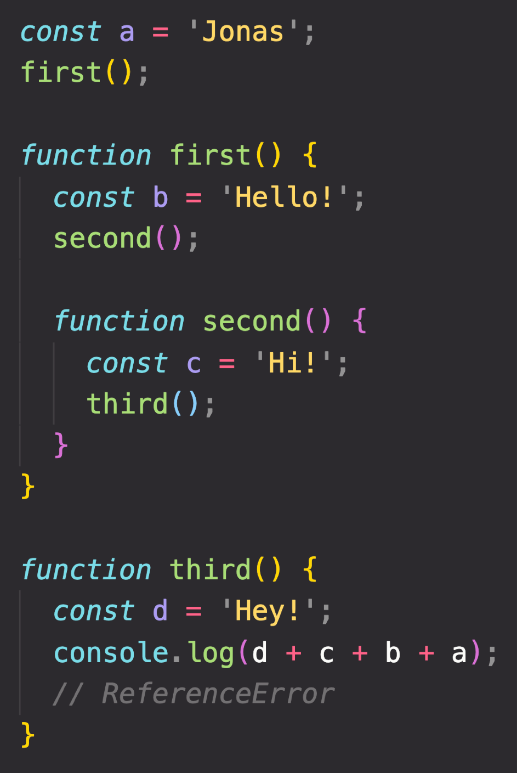

SCOPE CHAIN VS. CALL STACK
Global scope
a = “Jonas”
first = <function>
third = <function>
third() EC
d = “Hey!”
second() EC
first() scope
b = “Hello!” second = <function>
a = “Jonas” first = <function> third = <function>
third() scope
d = “Hey!”
a = “Jonas” first = <function> third = <function>
c = “Hi!”
first() EC
b = “Hello!”
second = <function>
SCOPE CHAIN
Order in which functions are written in the code
Global EC
second() scope
c = “Hi!”
b = “Hello!” second = <function>
a = “Jonas” first = <function> third = <function>
a = “Jonas”
first = <function>
third = <function>
CALL STACK
Order in which functions were called
Has nothing to do with order in which functions were called!
c and b can NOT be found in third() scope!
Variable environment (VE)

Slide 16

SUMMARY
Scoping asks the question “Where do variables live?” or “Where can we access a certain variable, and where not?”;
There are 3 types of scope in JavaScript: the global scope, scopes defined by functions, and scopes defined by blocks; Only let and const variables are block-scoped. Variables declared with var end up in the closest function scope;
In JavaScript, we have lexical scoping, so the rules of where we can access variables are based on exactly where in the code functions and blocks are written;
Every scope always has access to all the variables from all its outer scopes. This is the scope chain!
When a variable is not in the current scope, the engine looks up in the scope chain until it finds the variable it’s looking for. This is called variable lookup;
The scope chain is a one-way street: a scope will never, ever have access to the variables of an inner scope;
The scope chain in a certain scope is equal to adding together all the variable environments of the all parent scopes;
The scope chain has nothing to do with the order in which functions were called. It does not affect the scope chain at all!

