Slide 1

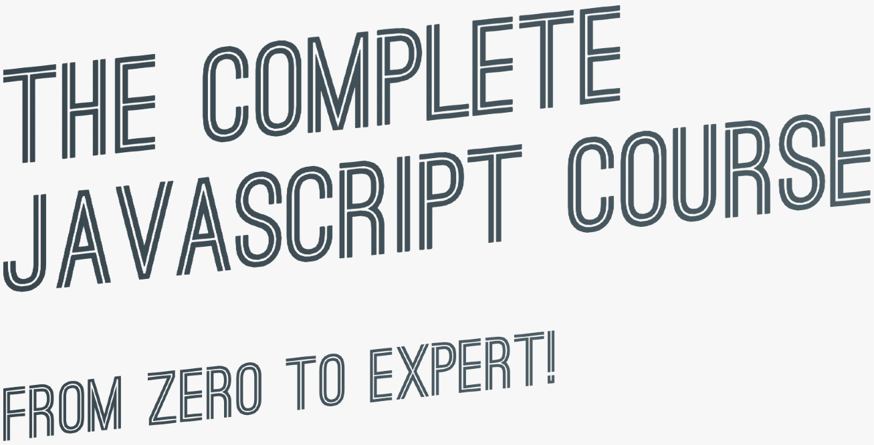

SECTION
HOW JAVASCRIPT WORKS BEHIND THE SCENES
LECTURE
VARIABLE ENVIRONMENT: HOISTING AND THE TDZ

Slide 2





HOISTING IN JAVASCRIPT
Hoisting: Makes some types of variables accessible/usable in the code before they are actually declared. “Variables lifted to the top of their scope”.
EXECUTION CONTEXT
Scope chain
this keyword
Variable environment
BEHIND THE SCENES
Before execution, code is scanned for variable declarations, and for each variable, a new property is created in the variable environment object.
HOISTED?
INITIAL VALUE
SCOPE
In strict mode.
Otherwise: function!
function declarations
YES
Actual function
Block
var variables
YES
undefined
Function
Technically, yes. But not in practice
let and const variables
NO
<uninitialized>, TDZ
Block
function expressions and arrows
Depends if using var or let/const
Temporal Dead Zone

Slide 3
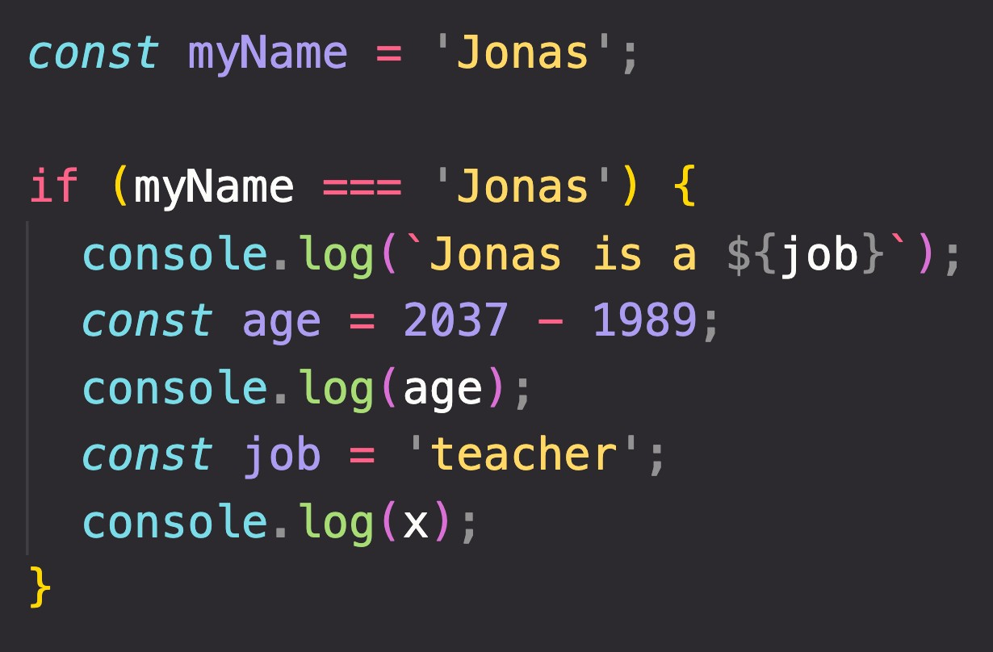
TEMPORAL DEAD ZONE, LET AND CONST
TEMPORAL DEAD ZONE FOR job VARIABLE
Different kinds of error messages:
ReferenceError: Cannot access 'job' before initialization ReferenceError: x is not defined
WHY HOISTING?
WHY TDZ?
Using functions before actual declaration;
var hoisting is just a byproduct.
Makes it easier to avoid and catch errors: accessing variables before declaration is bad practice and should be avoided;
Makes const variables actually work

Slide 4
SECTION
HOW JAVASCRIPT WORKS BEHIND THE SCENES
LECTURE
THE THIS KEYWORD

Slide 5

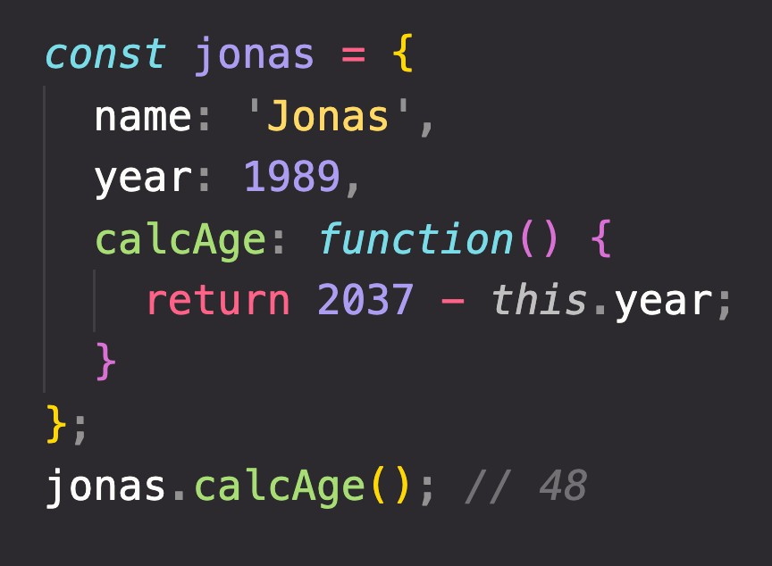

HOW THE THIS KEYWORD WORKS
this keyword/variable: Special variable that is created for every execution context (every function). Takes the value of (points to) the “owner” of the function in which the this keyword is used.
EXECUTION CONTEXT
Variable environment Scope chain
this is NOT static. It depends on how the function is called, and its value is only assigned when the function is actually called.
this keyword
Method example:
Method this = <Object that is calling the method>
Simple function call this = undefined
In strict mode! Otherwise:
window (in the browser)
Don’t get own this
Arrow functions this = <this of surrounding function (lexical this)>
Event listener this = <DOM element that the handler is attached to>
new, call, apply, bind <Later in the course... >
calcAge
is method
jonas
1989
this does NOT point to the function itself, and also NOT the its variable environment!
Way better than using
jonas.year!

Slide 6
GOT QUESTIONS? FEEDBACK?

Slide 7
SECTION
HOW JAVASCRIPT WORKS BEHIND THE SCENES
LECTURE
PRIMITIVES VS. OBJECTS (PRIMITIVE VS. REFERENCE TYPES)

Slide 8
REVIEW: PRIMITIVES, OBJECTS AND THE JAVASCRIPT ENGINE
PRIMITIVES
Number String Boolean Undefined Null Symbol BigInt
OBJECTS
Object literal Arrays Functions Many more…
ENGINE
STORED IN
STORED IN
REFERENCE TYPES
CALL STACK
HEAP
PRIMITIVE TYPES

Slide 9
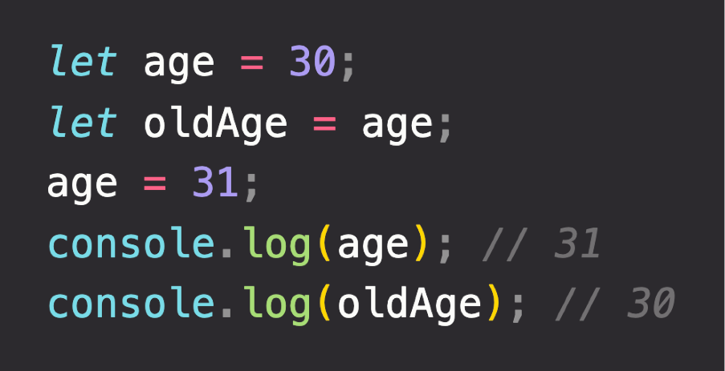


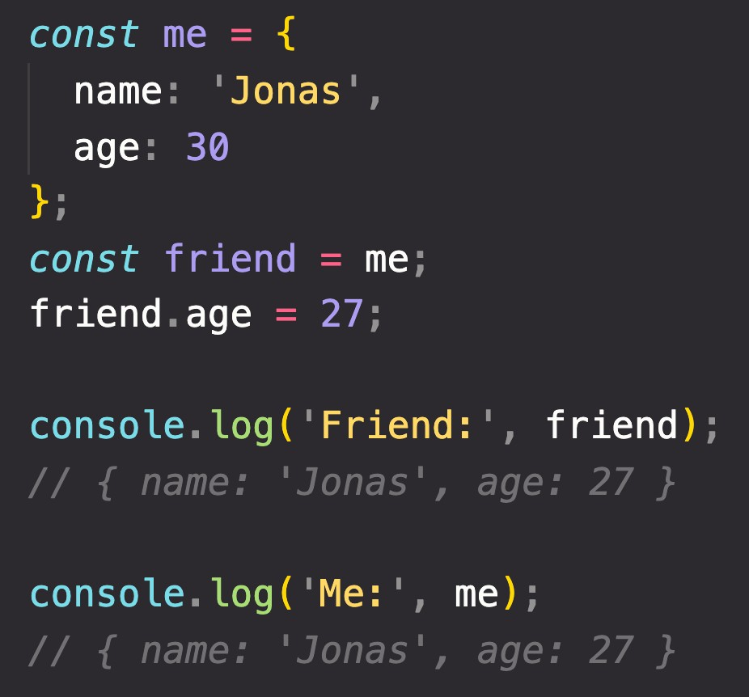
PRIMITIVE VS. REFERENCE VALUES
Primitive values example:
Identifier
Address
Value
Address
Value
age
0001
30 31
{
name: ‘Jonas’; age: 30;
}
D30F
Reference values example:
oldAge
0002
31
Reference to memory address in Heap
27
me
0003
D30F
No problem, because we’re NOT changing the value at address 0003!
friend
CALL STACK
HEAP

Slide 10
“HOW JAVASCRIPT WORKS BEHIND THE SCENES” TOPICS FOR LATER...
1
Prototypal Inheritance
Object Oriented Programming (OOP) With JavaScript
2
Event Loop
Asynchronous JavaScript: Promises, Async/Await and AJAX
3
How the DOM Really Works
Advanced DOM and Events

