Slide 1
DATA STRUCTURES, MODERN OPERATORS AND STRINGS

Slide 2



SECTION
DATA STRUCTURES, MODERN OPERATORS AND STRINGS
LECTURE
SUMMARY: WHICH DATA STRUCTURE TO USE?

Slide 3
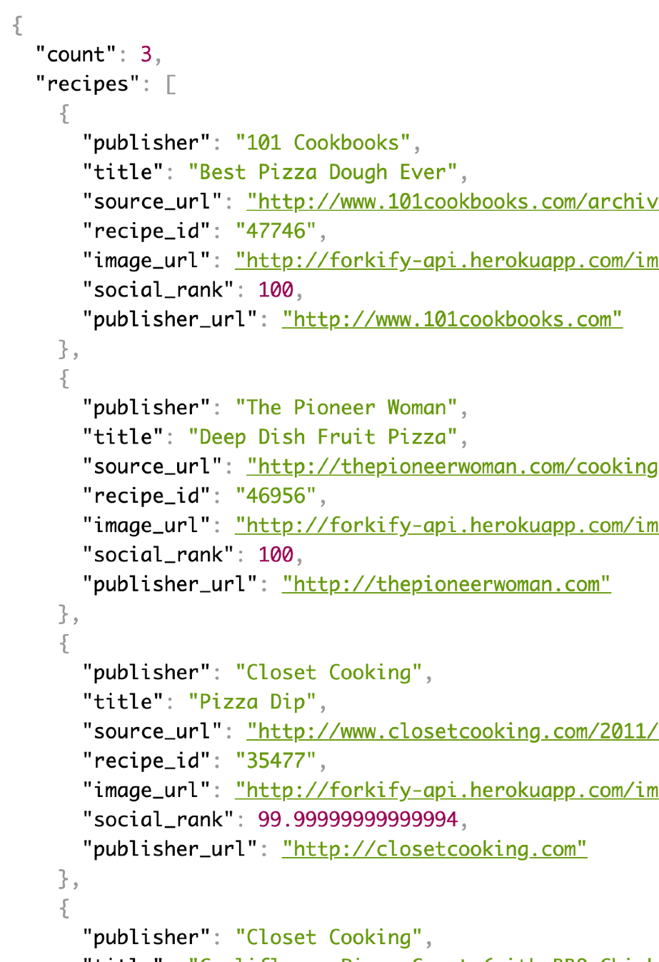

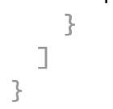

DATA STRUCTURES OVERVIEW
SOURCES OF DATA
From the program itself: Data written directly in source code (e.g. status messages)
From the UI: Data input from the user or data written in DOM (e.g tasks in todo app)
From external sources: Data fetched for example from web API (e.g. recipe objects)
“Object”
Array
Application Programming Interface
“Object”
Collection of data
OTHER BUILT-IN:
WeakMap WeakSet
NON-BUILT IN:
Stacks Queues Linked lists Trees
Hash tables
Data structure
SIMPLE LIST?
KEY/VALUE PAIRS?
Arrays or Sets
Objects or Maps
Keys allow us to
describe values
JSON data format example

Slide 4
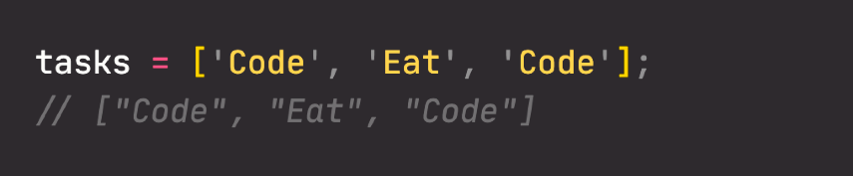
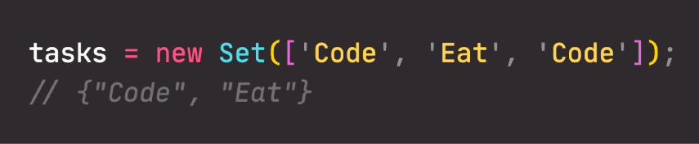
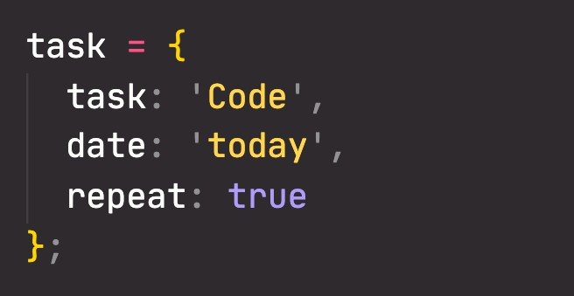
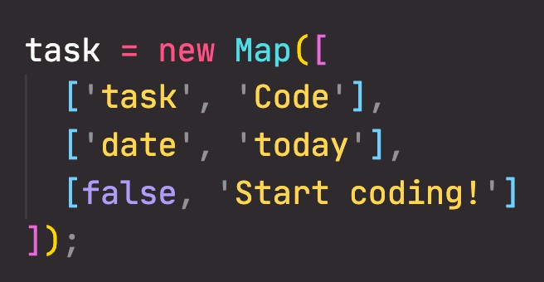
ARRAYS VS. SETS AND OBJECTS VS. MAPS
ARRAYS
VS.
SETS
OBJECTS
VS.
MAPS
Use when you need ordered list of values (might contain duplicates)
Use when you need to
manipulate data
Use when you need to work with unique values
Use when high-performance
is really important
Use to remove duplicates
from arrays
More “traditional” key/value store (“abused” objects)
Easier to write and access values with . and []
Better performance
Keys can have any data type Easy to iterate
Easy to compute size
Use when you need to include functions (methods)
Use when working with JSON (can convert to map)
Use when you simply need to map key to values
Use when you need keys that are not strings

Slide 5
A CLOSER LOOK AT FUNCTIONS

Slide 6
SECTION
A CLOSER LOOK AT FUNCTIONS
LECTURE
FIRST-CLASS AND HIGHER-ORDER FUNCTIONS

Slide 7
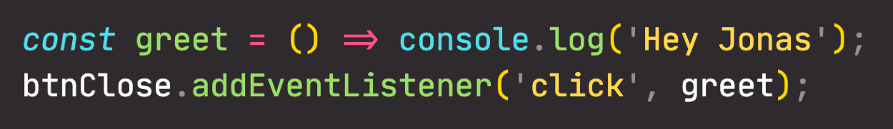
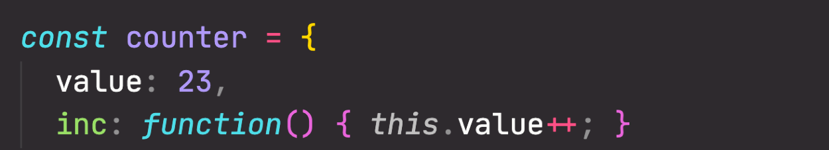



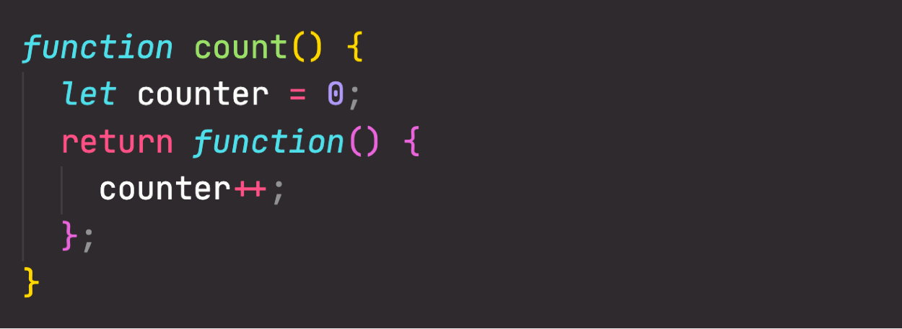

FIRST-CLASS VS. HIGHER-ORDER FUNCTIONS
FIRST-CLASS FUNCTIONS
HIGHER-ORDER FUNCTIONS
JavaScript treats functions as first-class citizens
This means that functions are simply values
Functions are just another “type” of object
Store functions in variables or properties:
A function that receives another function as an argument, that returns a new function, or both
This is only possible because of first-class functions
Function that receives another function
1
Higher-order function
Callback function
Pass functions as arguments to OTHER functions:
2
Function that returns new function
Higher-order function
Returned function
Return functions FROM functions
Call methods on functions:

Slide 8
SECTION
A CLOSER LOOK AT FUNCTIONS
LECTURE
CLOSURES

Slide 9
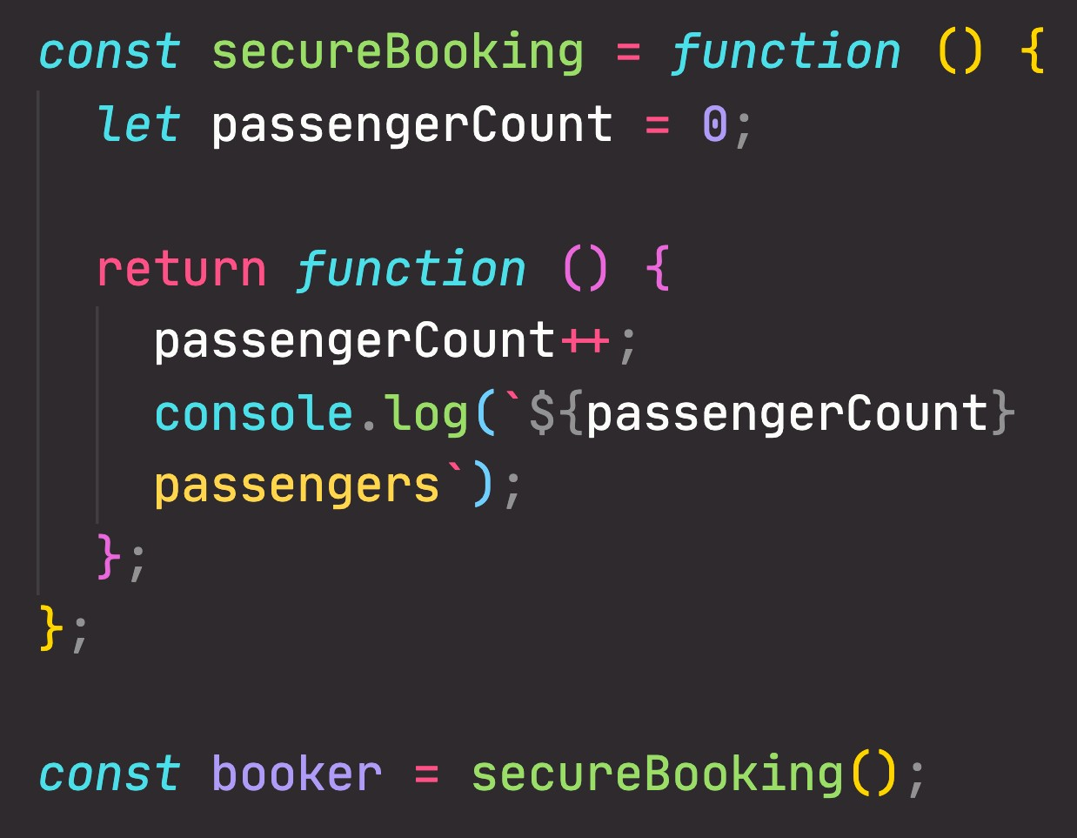
“CREATING” A CLOSURE
Global scope
secureBooking = <f>
booker = <f>
Variable Environment
secureBooking() scope
passengerCount = 0
secureBooking = <f> booker = <f>
secureBooking() EC
passengerCount = 0
Global EC
secureBooking = <f>
booker = <f>
CALL STACK
Order in which functions were called
Order in which functions are written in the code
SCOPE CHAIN

Slide 10
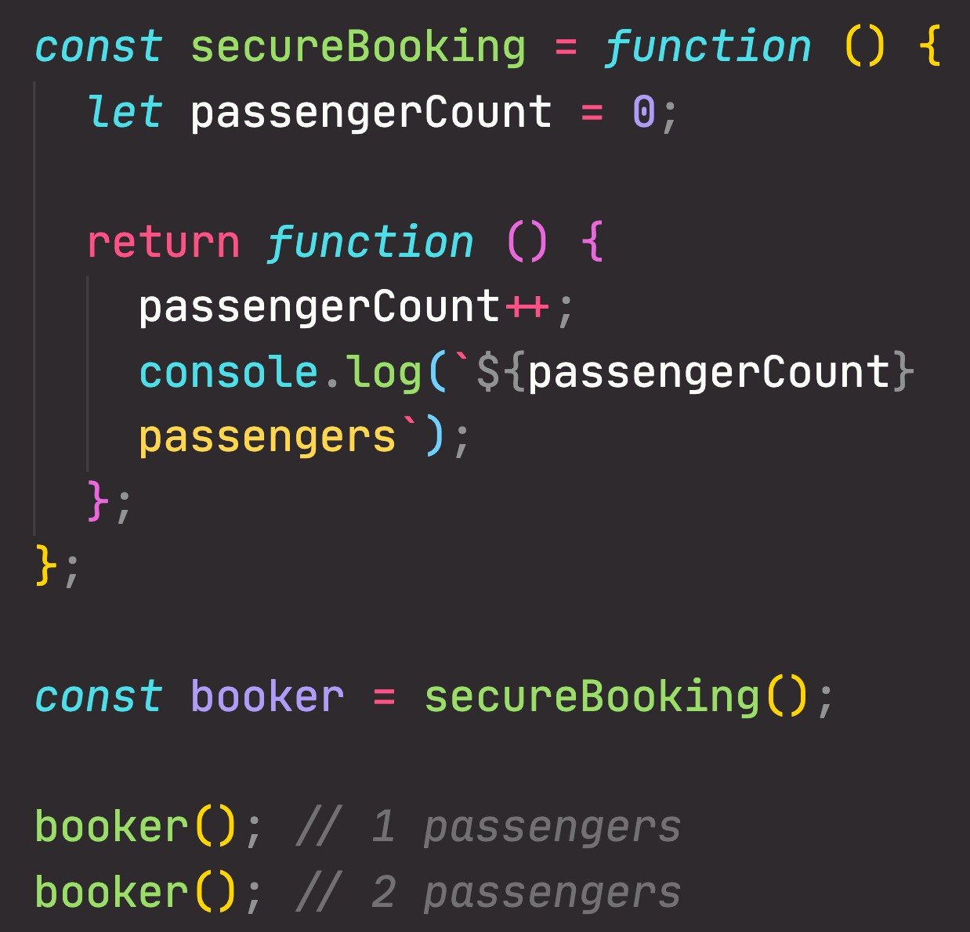

UNDERSTANDING CLOSURES
secureBooking() EC
Variable Environment of Execution Context in which booker was created
Global scope
passengerCount = 0
passengerCount = 0
secureBooking = <f>
booker = <f>
secureBooking() scope
passengerCount = 0
secureBooking = <f> booker = <f>
booker() EC
<empty>
This is the function
booker() scope
<empty>
secureBooking = <f> booker = <f>
Global EC
secureBooking = <f>
booker = <f>
CALL STACK
How to access
passengerCount?
SCOPE CHAIN

Slide 11
UNDERSTANDING CLOSURES
A function has access to the variable environment (VE) of the execution context in which it was created
Closure: VE attached to the function, exactly as it was at the time and place the function was created
Global scope
secureBooking = <f>
booker = <f>
secureBooking() scope
passengerCount = 0
secureBooking = <f> booker = <f>
booker() EC
(Priority over scope chain)
CLOSURE
<empty>
This is the function
booker() scope
<empty>
secureBooking = <f> booker = <f>
Global EC
01
secureBooking = <f>
booker = <f>
passengerCount = 2
CALL STACK
How to access
passengerCount?
SCOPE CHAIN

Slide 12


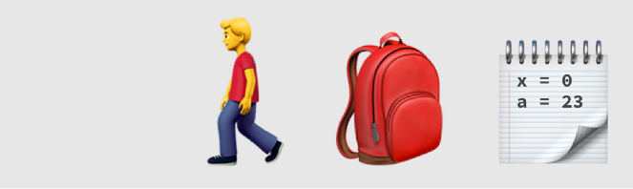

CLOSURES SUMMARY
A closure is the closed-over variable environment of the execution context in which a function was created, even after that execution context is gone;
Less formal
A closure gives a function access to all the variables of its parent function, even after that parent function has returned. The function keeps a reference to its outer scope, which preserves the scope chain throughout time.
Less formal
A closure makes sure that a function doesn’t loose connection to variables that existed at the function’s birth place;
Less formal
Function Connection Parent scope Variables
A closure is like a backpack that a function carries around wherever it goes. This backpack has all the variables that were present in the environment where the function was created.
Function
Closure
Variables
We do NOT have to manually create closures, this is a JavaScript feature that happens automatically. We can’t even access closed-over variables explicitly. A closure is NOT a tangible JavaScript object.

