Slide 1


NAVIGATION
NGUYEN TRONG TIEN

Slide 2
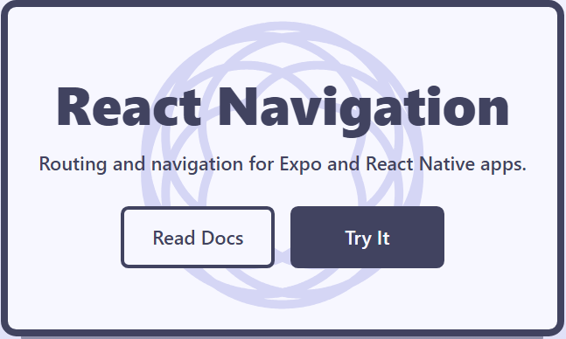
https://reactnavigation.org/

Slide 3
npm
npm install @react-navigation/native
npx expo install react-native-screens react-native-safe-area-context

Slide 4
Navigation
Stack Navigation
Tab Navigation
Drawer Navigation

Slide 5
Wrapping your app in NavigationContainer
import * as React from 'react';
import { NavigationContainer } from '@react-navigation/native';
export default function App() {
return (
<NavigationContainer>{/* Rest of your app code */}
</NavigationContainer>
);
}

Slide 6
Hello React Navigation
npm install @react-navigation/native-stack

Slide 7
Creating a native stack navigator
function HomeScreen() {
return (
<View style={{ flex: 1, alignItems: 'center', justifyContent: 'center' }}>
<Text>Home Screen</Text>
</View>
);
}

Slide 8
Creating a native stack navigator
import * as React from 'react';
import { View, Text } from 'react-native';
import { NavigationContainer } from '@react-navigation/native';
import { createNativeStackNavigator } from '@react-navigation/native-stack';

Slide 9
Creating a native stack navigator
const Stack = createNativeStackNavigator();
function App() {
return (
<NavigationContainer>
<Stack.Navigator>
<Stack.Screen name="Home" component={HomeScreen} />
</Stack.Navigator>
</NavigationContainer>
);
}
export default App;

Slide 10
Creating a native stack navigator
function DetailsScreen() {
return (
<View style={{ flex: 1, alignItems: 'center', justifyContent: 'center' }}>
<Text>Details Screen</Text>
</View>
);
}

Slide 11
const Stack = createNativeStackNavigator();
function App() {
return (
<NavigationContainer>
<Stack.Navigator>
<Stack.Screen name="Home" component={HomeScreen} />
<Stack.Screen name="DetailsScreen" component={DetailsScreen} />
</Stack.Navigator>
</NavigationContainer>
);
}

Slide 12
Specifying options
function DetailsScreen() {
return (
<View style={{ flex: 1, alignItems: 'center', justifyContent: 'center' }}>
<Text>Details Screen</Text>
</View>
);
}
npm install @react-navigation/native
npx expo install react-native-screens react-native-safe-area-context

Slide 13
Passing additional props
We can do that with 2 approaches:
Use React context and wrap the navigator with a context provider to pass data to the screens (recommended).
Use a render callback for the screen instead of specifying a component prop:
<Stack.Screen name="Home">
{(props) => <HomeScreen {...props} extraData={someData} />}
</Stack.Screen>

Slide 14
Navigating to a
new screen
function HomeScreen({ navigation }) {
return (
<View style={{ flex: 1, alignItems: 'center', justifyContent: 'center' }}>
<Text>Home Screen</Text>
<Button
title="Go to Details"
onPress={() => navigation.navigate('Details')}
/>
</View>
);
}

Slide 15
Passing
parameters to routes
function HomeScreen({ navigation }) {
return (
<View style={{ flex: 1, alignItems: 'center', justifyContent: 'center' }}>
<Text>Home Screen</Text>
<Button
title="Go to Details"
onPress={() => {
/* 1. Navigate to the Details route with params */
navigation.navigate('Details', {
itemId: 86,
otherParam: 'anything you want here',
});
}}
/>
</View>
);
}

Slide 16
Passing
parameters
to routes
function DetailsScreen({ route, navigation }) {
/* 2. Get the param */
const { itemId, otherParam } = route.params;
return (
<View style={{ flex: 1, alignItems: 'center', justifyContent: 'center' }}>
<Text>Details Screen</Text>
<Text>itemId: {JSON.stringify(itemId)}</Text>
<Text>otherParam: {JSON.stringify(otherParam)}</Text>
<Button
title="Go to Details... again"
onPress={() =>
navigation.push('Details', {
itemId: Math.floor(Math.random() * 100),
})
} />
<Button title="Go to Home" onPress={()=> navigation.navigate('Home')}/>
<Button title="Go back" onPress={() => navigation.goBack()} />
</View>
);
}

Slide 17
Initial params
<Stack.Screen
name="Details"
component={DetailsScreen}
initialParams={{ itemId: 42 }}
/>

Slide 18
Updating params
<Button
title="Update param"
onPress={() =>
navigation.setParams({
itemId: Math.floor(Math.random() * 100),
})
}
/>

Slide 19
Passing
params
to a
previous
screen
function HomeScreen({ navigation, route }) {
React.useEffect(() => {
if (route.params?.post) {
// Post updated, do something with `route.params.post`
// For example, send the post to the server
}
}, [route.params?.post]);
return (
<View style={{ flex: 1, alignItems: 'center', justifyContent: 'center' }}>
<Button ="Create post"
onPress={() => navigation.navigate('CreatePost')}
/>
<Text style={{ margin: 10 }}>Post: {route.params?.post}</Text>
</View>
);
}

Slide 20
Passing
params
to a
previous
screen
function CreatePostScreen({ navigation, route }) {
const [postText, setPostText] = React.useState('');
return (
<TextInput multiline
placeholder="What's on your mind?"
style={{ height: 200, padding: 10, backgroundColor: 'white' }}
value={postText}
onChangeText={setPostText}/>
<Button title="Done"
onPress={() => {
// Pass and merge params back to home screen
navigation.navigate({
name: 'Home',
params: { post: postText },
merge: true,
});
}}
/>
</>
);
}

Slide 21
Passing
params
to nested navigators
If you have nested navigators, you need to pass params a bit differently. For example, say you have a navigator inside the Account screen, and want to pass params to the Settings screen inside that navigator. Then you can pass params as following:
navigation.navigate('Account', {
screen: 'Settings',
params: { user: 'jane' },
});

Slide 22
What should be in params?

Slide 23
Configuring the header bar

Slide 24
Setting the header title
function StackScreen() {
return (
<Stack.Navigator>
<Stack.Screen
name="Home"
component={HomeScreen}
options={{ title: 'My home' }}
/>
</Stack.Navigator>
);
}

Slide 25
Using params
in the title
function StackScreen() {
return (
<Stack.Navigator>
<Stack.Screen
name="Home"
component={HomeScreen}
options={{ title: 'My home' }}
/>
<Stack.Screen
name="Profile"
component={ProfileScreen}
options={({ route }) => ({ title: route.params.name })}
/>
</Stack.Navigator>
);
}

Slide 26
Updating options with setOptions
<Button
title="Update the title"
onPress={() => navigation.setOptions({ title: 'Updated!' })}
/>

Slide 27
Adjusting header styles
function StackScreen() {
return (
<Stack.Navigator>
<Stack.Screen name="Home" component={HomeScreen}
options={{ title: 'My home',
headerStyle: {
backgroundColor: '#f4511e',
},
headerTintColor: '#fff',
headerTitleStyle: {
fontWeight: 'bold',
},
}}
/>
</Stack.Navigator>
);
}

Slide 28
Sharing common options across screens
function StackScreen() {
return (
<Stack.Navigator
screenOptions={{
headerStyle: {
backgroundColor: '#f4511e',
},
headerTintColor: '#fff',
headerTitleStyle: {
fontWeight: 'bold',
},
}} >
<Stack.Screen name="Home" component={HomeScreen}
options={{ title: 'My home' }}
/>
</Stack.Navigator>
);
}

Slide 29
Replacing
the title with a custom component
function LogoTitle() {
return ( <Image style={{ width: 50, height: 50 }} source={require('@expo/snack-static/react-native-logo.png')} /> );}
function StackScreen() {
return (
<Stack.Navigator>
<Stack.Screen
name="Home"
component={HomeScreen}
options={{ headerTitle: (props) => <LogoTitle {...props} /> }}
/>
</Stack.Navigator>
);
}

Slide 30
Header buttons

Slide 31
Adding
a button
to the
header
function StackScreen() {
return ( <Stack.Navigator>
<Stack.Screen name="Home"
component={HomeScreen}
options={{
headerTitle: (props) => <LogoTitle {...props} />,
headerRight: () => (
<Button
onPress={() => alert('This is a button!')}
title="Info"
color="#fff"
/>
),
}}
/>
</Stack.Navigator>
);}

Slide 32
Header interaction with its screen component
In some cases, components in the header need to interact with the screen component. For this use case, we need to use navigation.setOptions to update our options. By using navigation.setOptions inside the screen component, we get access to screen's props, state, context etc.

Slide 33
Nesting navigators

Slide 34
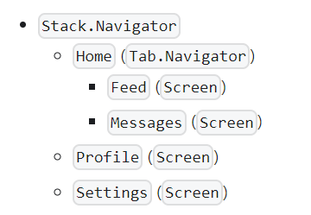
Nesting navigators
Nesting navigators means rendering a navigator inside a screen of another navigator

Slide 35
The next of Navigator in Slide Advanced…

Slide 36
Tab Navigation

Slide 37
Tab Navigation

Slide 38
Drawer Navigation

Slide 39
THANK YOU!

