Slide 1


REDUX

Slide 3
intro useReducer() hook
https://react.dev/reference/react/useReducer

Slide 4
implement Redux in js
Notes:
https://www.npmjs.com/package/redux
import reactRedux from 'https://cdn.skypack.dev/redux';
https://www.skypack.dev/view/react-redux
https://redux.js.org/introduction/getting-started

Slide 5
What is Redux?
Redux is a predictable state container for JavaScript apps.
Redux allows you to manage your app's state in a single place and keep changes in your app more predictable and traceable, making it easier to understand the changes happening in your app

Slide 6
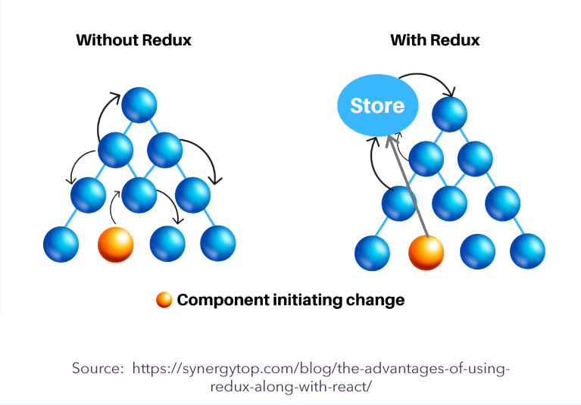
Why Redux?

Slide 7
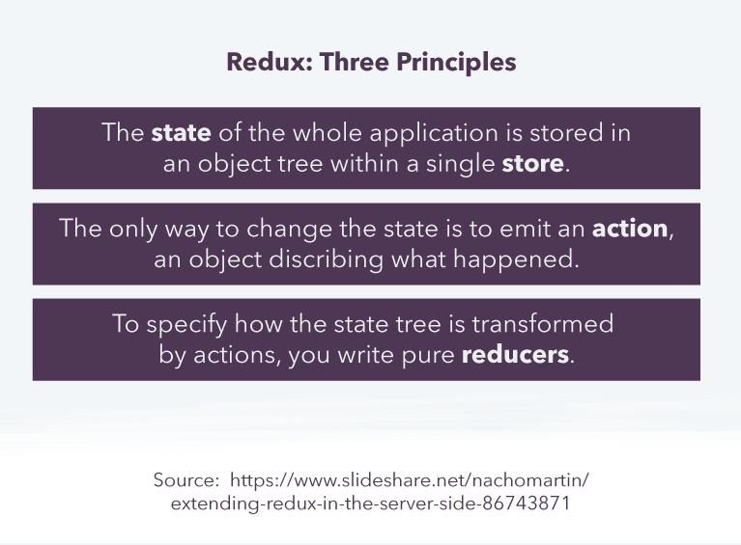
Why Redux?

Slide 8
When you should use Redux?
When multiple components need to access the same application state. For example, once a user logs in to a personal account on an application, the information about that user needs to be shared with a range of components that may not interact directly. In this case, Redux’s single store is an optimized way to map a state across components.
When you’re working on a large application with several other people. Again, the Redux single store becomes more beneficial as the complexity of an application increases. If many people are working on it (and you don’t have an alternative system for sharing information), then Redux can also help keep everyone on the same page.
When application state is updated frequently. This often implies consumer-facing applications, where there is a lot of user interaction (for example, adding goods to a basket, then removing some, going through the payment process, etc).

Slide 9
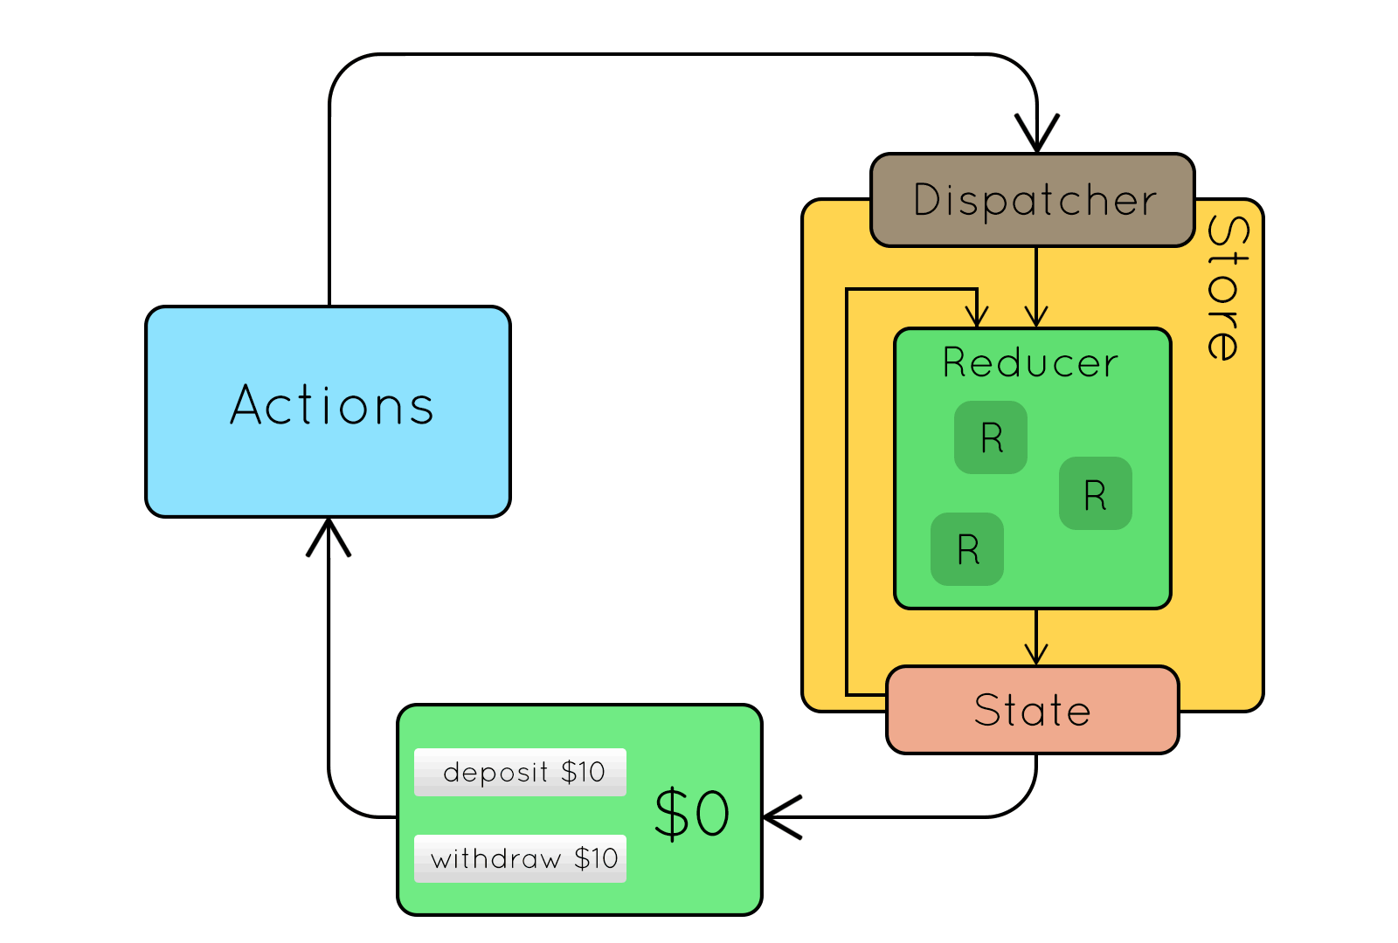
Redux Core

Slide 10
Redux Core
npm install redux react-redux --save

Slide 11
Redux Core
Actions: events
Reducers: pure function
Store: object

Slide 12
Action Code Example
Actions: events
Reducers: pure function
Store: object
Dispatch: function

Slide 13
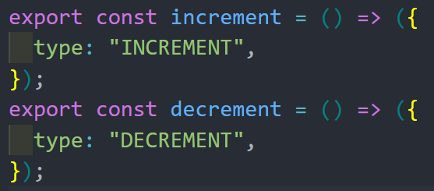
Action Example: object or function return object

Slide 14
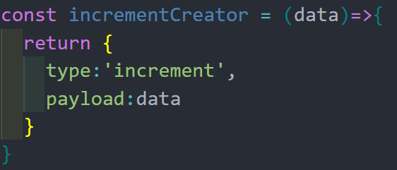
Action Example: object or function return object

Slide 15
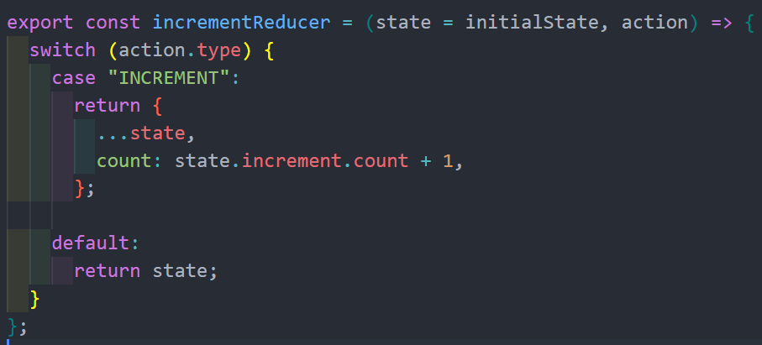
Reducer Example: function(s) switch case

Slide 16
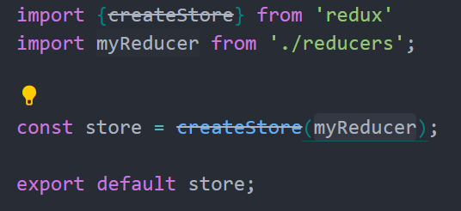
store
createStore(reducer, initValue, enhencers)

Slide 17
dispatch()
dispatch(action)

Slide 18
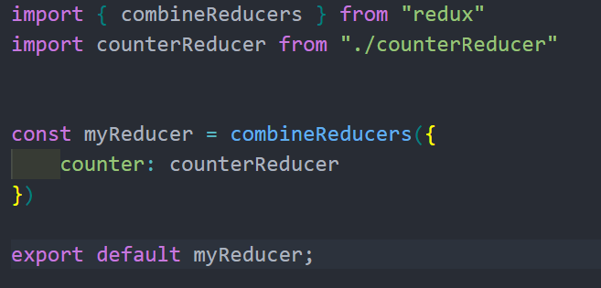
combine reducers

Slide 19
connect function

Slide 20
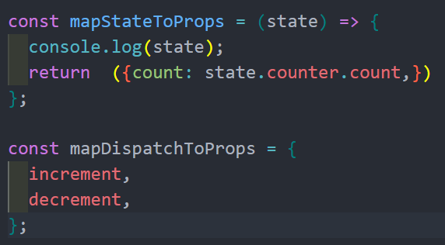
mapStateToProps function

Slide 21
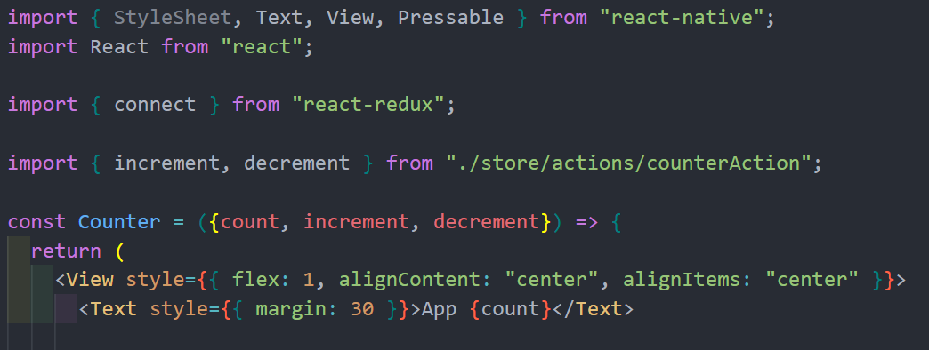
more

Slide 22
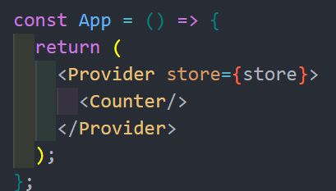
Provider

Slide 23
Example-Counter-Todo App

Slide 24
Redux Thunk

Slide 25
Redux Saga

Slide 26
Redux DevTool

Slide 27
Redux Toolkit

Slide 28
THANK YOU!

