Slide 1


REACT FLEXBOX
https://reactnative.dev/docs/flexbox
NGUYEN TRONG TIEN

Slide 2
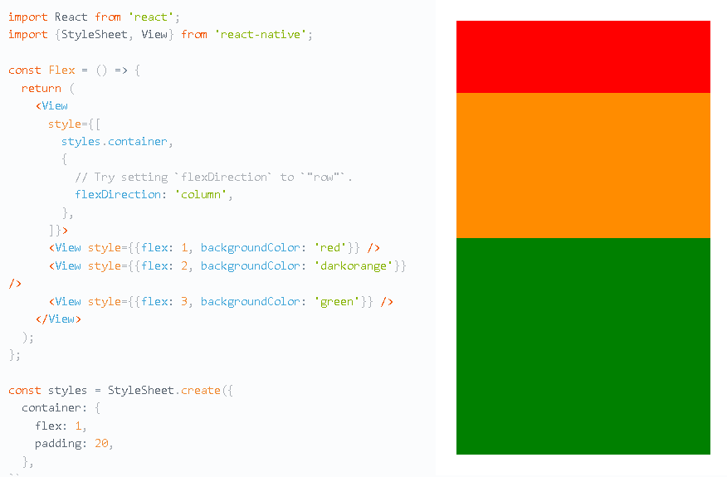

Slide 3
Flex Direction-flexDirection
column (default value)
row Align children from left to right.
column-reverse
row-reverse

Slide 4
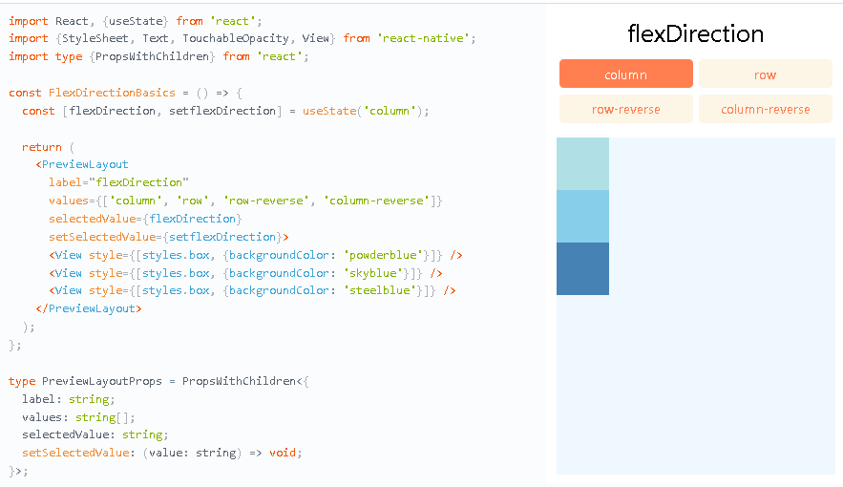

Slide 5
Justify Content-justifyContent
flex-start(default value)
flex-end
center
space-between
space-around
space-evenly

Slide 6
Align Items-alignItems
stretch (default value)
flex-start
flex-end
center
baseline

Slide 7
Align Self-alignSelf
alignSelf has the same options and effect as alignItems but instead of affecting the children within a container, you can apply this property to a single child to change its alignment within its parent. alignSelf overrides any option set by the parent with alignItems.

Slide 8
Align Content-alignContent
alignContent defines the distribution of lines along the cross-axis. This only has effect when items are wrapped to multiple lines using flexWrap.
flex-start (default value)
flex-end
stretch (default value when using Yoga on the web) S
center
space-between
space-around

Slide 9
Flex Wrap-flexWrap
The flexWrap property is set on containers and it controls what happens when children overflow the size of the container along the main axis. By default, children are forced into a single line (which can shrink elements). If wrapping is allowed, items are wrapped into multiple lines along the main axis if needed.
When wrapping lines, alignContent can be used to specify how the lines are placed in the container.

Slide 10
Flex Basis, Grow, and Shrink
flexBasis is an axis-independent way of providing the default size of an item along the main axis.
flexGrow describes how much space within a container should be distributed among its children along the main axis.
flexGrow accepts any floating point value >= 0, with 0 being the default value.
flexShrink describes how to shrink children along the main axis in the case in which the total size of the children overflows the size of the container on the main axis.
flexShrink accepts any floating point value >= 0, with 0 being the default value (on the web, the default is 1). A container will shrink its children weighted by the children’s flexShrink values.

Slide 11
Width and Height
Absolute & Relative Layout
The width property specifies the width of an element's content area. Similarly, the height property specifies the height of an element's content area.
Both width and height can take the following values:
auto (default value) React Native calculates the width/height for the element based on its content, whether that is other children, text, or an image.
pixels Defines the width/height in absolute pixels. Depending on other styles set on the component, this may or may not be the final dimension of the node.
percentage Defines the width or height in percentage of its parent's width or height, respectively.

Slide 12
Absolute & Relative Layout
The position type of an element defines how it is positioned within its parent.
relative (default value) By default, an element is positioned relatively. This means an element is positioned according to the normal flow of the layout, and then offset relative to that position based on the values of top, right, bottom, and left. The offset does not affect the position of any sibling or parent elements.
absolute When positioned absolutely, an element doesn't take part in the normal layout flow. It is instead laid out independent of its siblings. The position is determined based on the top, right, bottom, and left values.

Slide 13
THANK YOU!

