Slide 1


Function Components vs Class Components
NGUYEN TRONG TIEN
Notes:
https://www.freecodecamp.org/news/function-component-vs-class-component-in-react/
https://snack.expo.dev/@nguyentrongtiencntt/6_function_class_component

Slide 2
What are React Component?
In React, components are the building blocks of a user interface. They are reusable, self-contained pieces of code that represent a part of the UI. React allows you to break down your UI into smaller components, which makes it easier to manage and maintain your codebase.

Slide 3
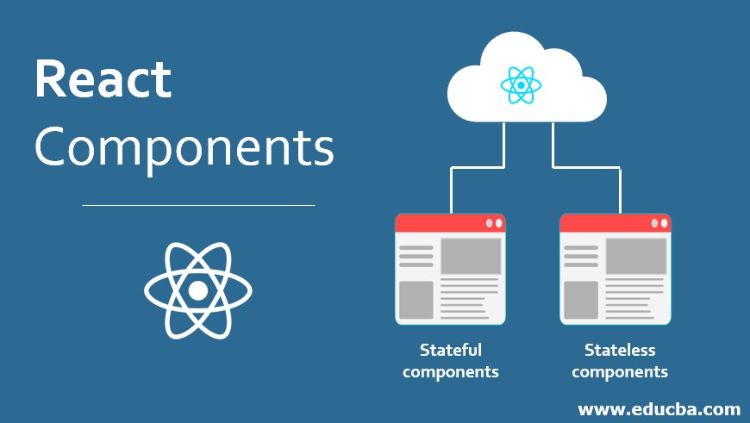
Component
There are two primary ways to create components: function and class components.
Each has its own syntax and use cases, although with the introduction of React Hooks, the gap between them has narrowed significantly. But the selection of appropriate component types is still very crucial for building efficient and maintainable React applications.

Slide 4
Function Component
Function Component: These are simple JavaScript functions that take props as input and return JSX elements. They are often used for presentational or stateless components.

Slide 5
Class Component
These are ES6 classes that extend from React.Component or React.PureComponent. They have a render() method where you define the structure of your component's UI using JSX. Class components are used for components that need to manage state or have lifecycle methods.

Slide 6
State Management
Traditionally, function components were stateless and couldn't hold their own state. However, with the introduction of React Hooks (like useState), function components can now manage state using Hooks.
Notes:
https://reactnative.dev/docs/state

Slide 7
Lifecycle Methods
Function components don't have lifecycle methods.
However, with React Hooks, you can use the useEffect Hook to replicate lifecycle behavior (like componentDidMount, componentDidUpdate, componentWillUnmount, and so on).

Slide 8
componentDidMount
This method is invoked immediately after a component is mounted (that is, inserted into the DOM tree). It is commonly used to perform initial setup, such as fetching data from an API or setting up event listeners.

Slide 9
componentDidUpdate
This method is invoked immediately after updating occurs.
It is triggered whenever the component's props or state changes. It is commonly used to perform actions based on the updated state or props, such as making additional API calls.

Slide 10
componentWillUnmount
This method is invoked immediately before a component is unmounted and destroyed.
It is commonly used to perform cleanup, such as removing event listeners or cancelling any ongoing tasks.

Slide 11
Class Component
Syntax: Class components are ES6 classes that extend from React.Component or React.PureComponent. They have a render() method where you define the structure of your component's UI using JSX.

Slide 12
State Management
Class components can hold and manage local state using the this.state property. They can also update state using this.setState().

Slide 13
Lifecycle Methods
Class components have access to various lifecycle methods like componentDidMount, componentDidUpdate, and componentWillUnmount, which allow you to hook into different stages of a component's lifecycle.

Slide 14
Explain
componentDidMount is used to fetch initial data when the component mounts.
componentDidUpdate is used to log a message whenever the data state changes.
componentWillUnmount is used to log a message before the component is unmounted.

Slide 15
Instance Methods
You can define custom methods directly on the class, which can be helpful for organizing your component's logic.

Slide 16
THANK YOU!

