Slide 1


State and Props
NGUYEN TRONG TIEN
Notes:
https://kungfutech.edu.vn/bai-viet/react-native/props-trong-react-native
https://reactnative.dev/docs/state
https://snack.expo.dev/@nguyentrongtiencntt/7_props_state
https://medium.com/@sp20-bse-041/state-and-props-in-react-native-dc4abfb8e34b
https://reactnative.dev/docs/props

Slide 2
What is State?
State in React Native is a built-in feature that allows you to manage and store data that can change over time.
It represents the current condition or data within a component and is usually used for rendering dynamic content. State is declared within a component and can be modified to trigger re-renders.
Notes:
https://reactnative.dev/docs/state
https://kungfutech.edu.vn/bai-viet/react-native/state-trong-react-native
https://snack.expo.dev/@nguyentrongtiencntt/dea058
https://medium.com/@sp20-bse-041/state-and-props-in-react-native-dc4abfb8e34b

Slide 3
What is State?
In general, you should initialize state in the constructor, and then call setState when you want to change it.
Notes:
https://reactnative.dev/docs/state

Slide 4
State
State in Class Component
useState hook
Notes:
https://snack.expo.dev/@nguyentrongtiencntt/7_props_state

Slide 5
What are Props?
Props, short for properties, are a way to pass data from a parent component to a child component in React Native. Props are read-only and help to make your components reusable and dynamic. They allow you to customize and configure child components based on the parent’s data.

Slide 6
Props
Props in Functional Component
Use Props in Class Component
Pass Props in Components
PropTypes
Default Props
Pass function over Props
Props with component built-in
Notes:
https://snack.expo.dev/@nguyentrongtiencntt/7_props_state

Slide 7
State in Complex App
NGUYEN TRONG TIEN
Notes:
https://reactnative.dev/docs/state
https://snack.expo.dev/@nguyentrongtiencntt/7_props_state
https://medium.com/@sp20-bse-041/state-and-props-in-react-native-dc4abfb8e34b
https://reactnative.dev/docs/props

Slide 8
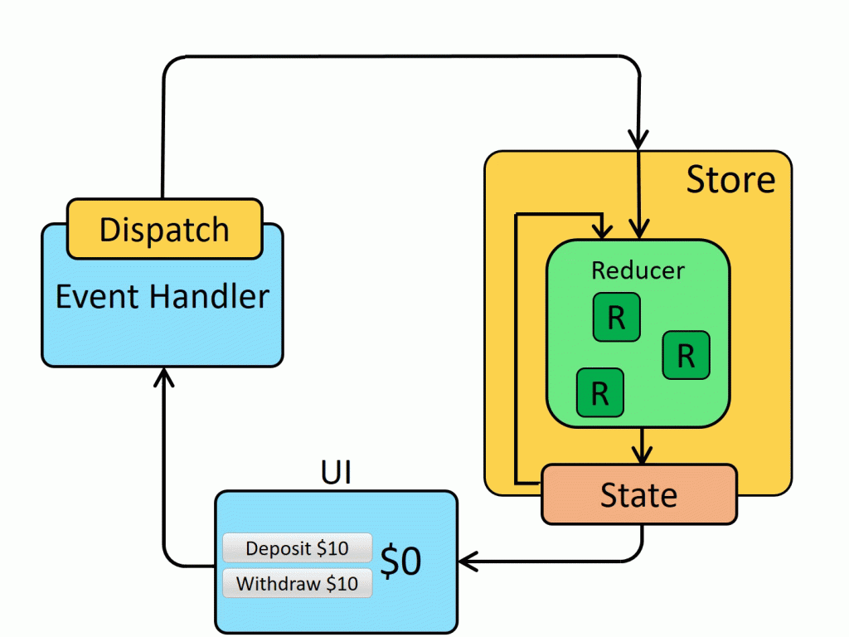
Redux
Notes:
https://redux.js.org/
https://kungfutech.edu.vn/bai-viet/react-native/state-trong-react-native
https://itech.edu.vn/hoc-react-redux-trong-15-phut/

Slide 9
THANK YOU!

