Slide 1


React Hooks
NGUYEN TRONG TIEN
Notes:
https://snack.expo.dev/@nguyentrongtiencntt/9_react_hooks

Slide 2
useState
useState is a React Hook that lets you add a state variable to your component.
The useState hook takes a single argument, our initial state, and returns an array containing two elements:
state - the current state
setState - a function to update our state
const [state, setState] = useState(initialState);

Slide 3
useState
How useState Works
Initialization: When you call useState, you provide an initial value for your state variable.
State Value: useState returns two things:
The current state value.
A function to update the state.
Re-rendering: When the state is updated using the provided function, the component re-renders to reflect the new state.

Slide 4
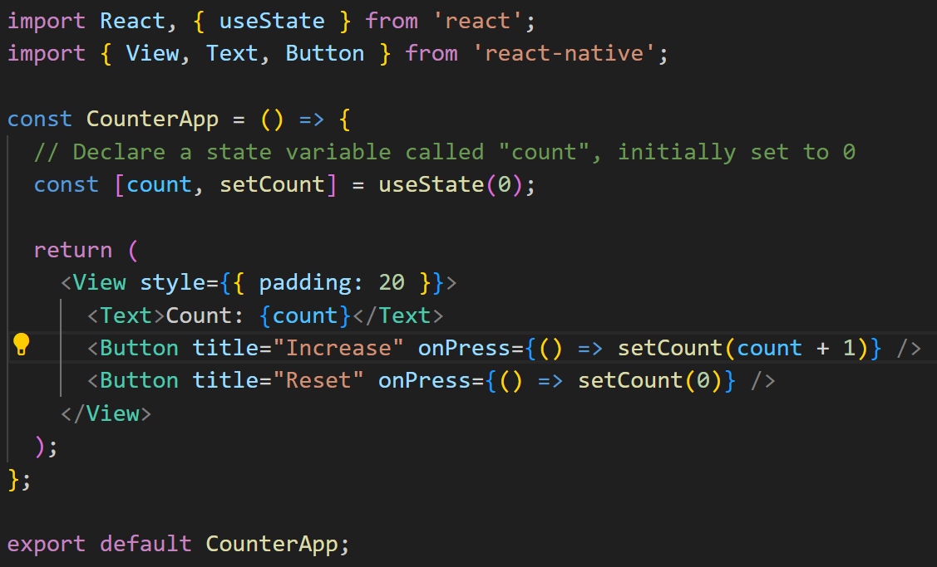
useState
Notes:
import React, { useState } from 'react';
import { View, Text, Button } from 'react-native';
const CounterApp = () => {
// Declare a state variable called "count", initially set to 0
const [count, setCount] = useState(0);
return (
<View style={{ padding: 20 }}>
<Text>Count: {count}</Text>
<Button title="Increase" onPress={() => setCount(count + 1)} />
<Button title="Reset" onPress={() => setCount(0)} />
</View>
);
};
export default CounterApp;

Slide 5
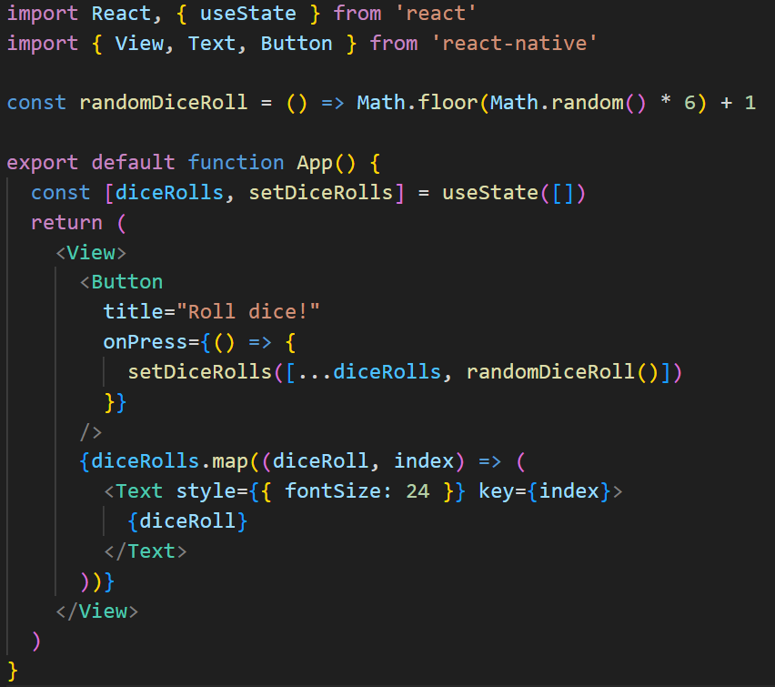
useState
Notes:
import React, { useState } from 'react'
import { View, Text, Button } from 'react-native'
const randomDiceRoll = () => Math.floor(Math.random() * 6) + 1
export default function App() {
const [diceRolls, setDiceRolls] = useState([])
return (
<View>
<Button
title="Roll dice!"
onPress={() => {
setDiceRolls([...diceRolls, randomDiceRoll()])
}}
/>
{diceRolls.map((diceRoll, index) => (
<Text style={{ fontSize: 24 }} key={index}>
{diceRoll}
</Text>
))}
</View>
)
}

Slide 6
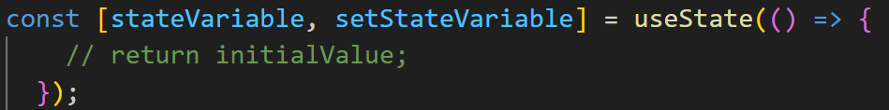
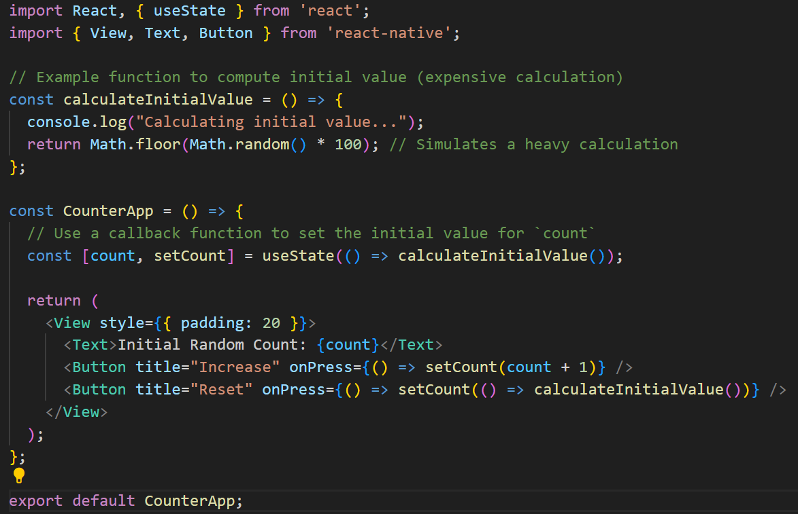
useState
initialValue: callback function
Notes:
import React, { useState } from 'react';
import { View, Text, Button } from 'react-native';
// Example function to compute initial value (expensive calculation)
const calculateInitialValue = () => {
console.log("Calculating initial value...");
return Math.floor(Math.random() * 100); // Simulates a heavy calculation
};
const CounterApp = () => {
// Use a callback function to set the initial value for `count`
const [count, setCount] = useState(() => calculateInitialValue());
return (
<View style={{ padding: 20 }}>
<Text>Initial Random Count: {count}</Text>
<Button title="Increase" onPress={() => setCount(count + 1)} />
<Button title="Reset" onPress={() => setCount(() => calculateInitialValue())} />
</View>
);
};
export default CounterApp;

Slide 7
useState
In React Native (and React), when you pass a callback function to useState, it's typically used when the initial state requires some heavy computation or when you only want to run the function once (on the first render) to calculate the initial value.
This is useful for optimizing performance by preventing the function from being executed on every render.

Slide 8
Use Case
When you need to compute an initial value only once and avoid re-running the calculation on every render.
For example, if you need to fetch data from an API or calculate a large value, using a callback ensures it only happens when necessary (during initial rendering).
This approach is helpful for performance optimization, especially in scenarios where the initial state requires some heavy computation.

Slide 9
useEffect
The useEffect hook takes 2 arguments:
callback - a function with side effects
dependencies - an optional array containing dependency values
When our component function runs, the callback will be called if any dependencies have changed since the last time the component function ran.
Notes:
https://www.w3schools.com/react/react_useeffect.asp

Slide 10
useEffect
useEffect(callback)
useEffect(callback, [])
useEffect(callback, [deps])
callback call after Component finish render

Slide 11
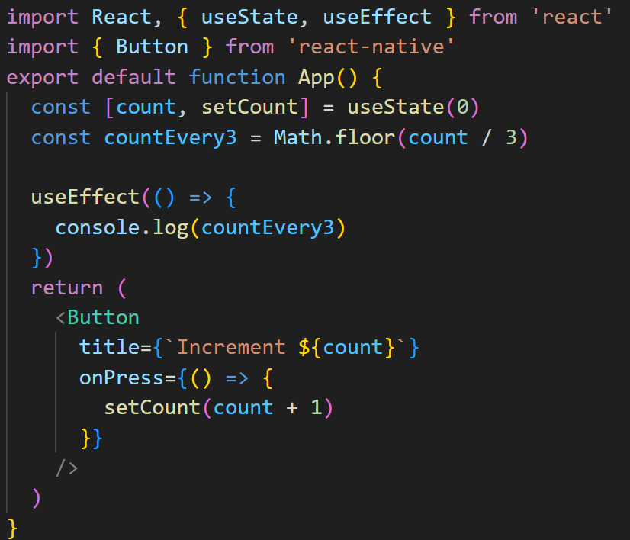
useEffect(callback)
callback call after Component finish render
Notes:
import React, { useState, useEffect } from 'react'
import { Button } from 'react-native'
export default function App() {
const [count, setCount] = useState(0)
const countEvery3 = Math.floor(count / 3)
useEffect(() => {
console.log(countEvery3)
})
return (
<Button
title={`Increment ${count}`}
onPress={() => {
setCount(count + 1)
}}
/>
)
}

Slide 12
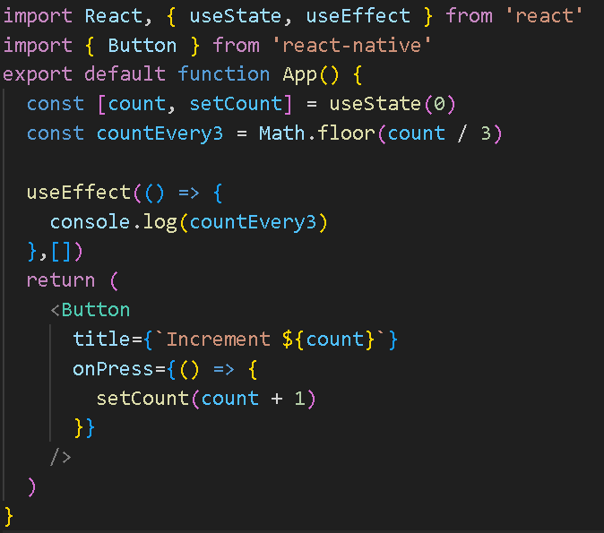
useEffect(callback, [])
callback call only 1 time after Component finish render
Notes:
import React, { useState, useEffect } from 'react'
import { Button } from 'react-native'
export default function App() {
const [count, setCount] = useState(0)
const countEvery3 = Math.floor(count / 3)
useEffect(() => {
console.log(countEvery3)
},[])
return (
<Button
title={`Increment ${count}`}
onPress={() => {
setCount(count + 1)
}}
/>
)
}

Slide 13
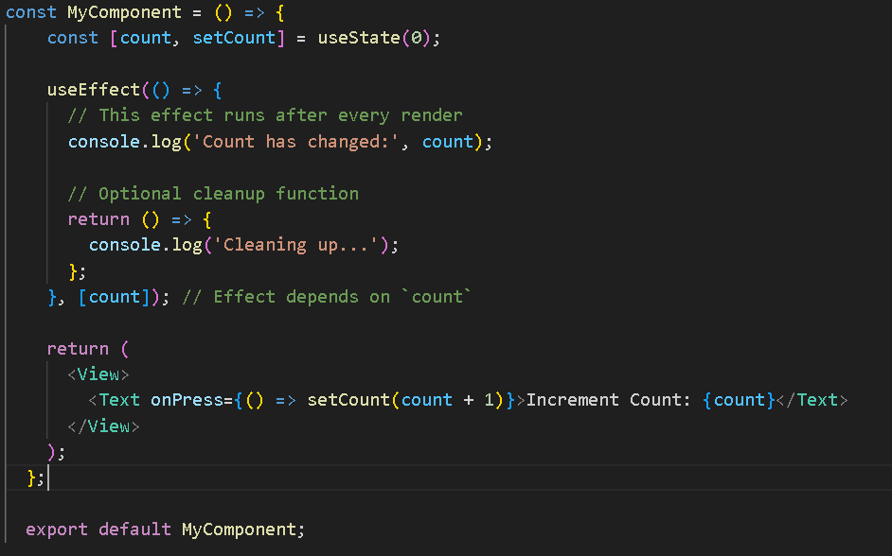
useEffect(callback, [deps])
Notes:
const MyComponent = () => {
const [count, setCount] = useState(0);
useEffect(() => {
// This effect runs after every render
console.log('Count has changed:', count);
// Optional cleanup function
return () => {
console.log('Cleaning up...');
};
}, [count]); // Effect depends on `count`
return (
<View>
<Text onPress={() => setCount(count + 1)}>Increment Count: {count}</Text>
</View>
);
};
export default MyComponent;

Slide 14
useEffect-explanation
Effect Function: The function you provide will run after the component renders. In this example, it logs the count value whenever it changes.
Cleanup Function: If your effect creates subscriptions or timers, you can return a cleanup function. This function will run before the component unmounts or before the effect runs again.
Dependency Array: The effect only runs when the specified dependencies change. If you pass an empty array ([]), the effect runs only once after the initial render, similar to componentDidMount.

Slide 15
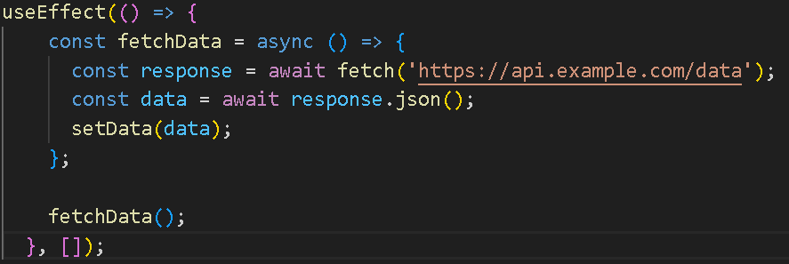
useEffect
Fetching Data
Notes:
useEffect(() => {
const fetchData = async () => {
const response = await fetch('https://api.example.com/data');
const data = await response.json();
setData(data);
};
fetchData();
}, []);

Slide 16
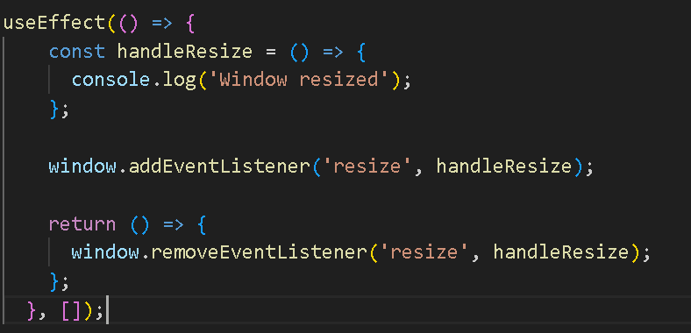
useEffect
Event Listeners
Notes:
useEffect(() => {
const fetchData = async () => {
const response = await fetch('https://api.example.com/data');
const data = await response.json();
setData(data);
};
fetchData();
}, []);

Slide 17
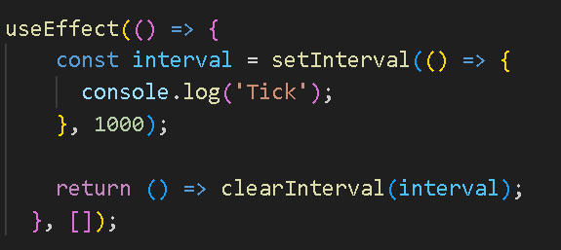
useEffect
Animation and Timers
Notes:
useEffect(() => {
const interval = setInterval(() => {
console.log('Tick');
}, 1000);
return () => clearInterval(interval);
}, []);

Slide 18
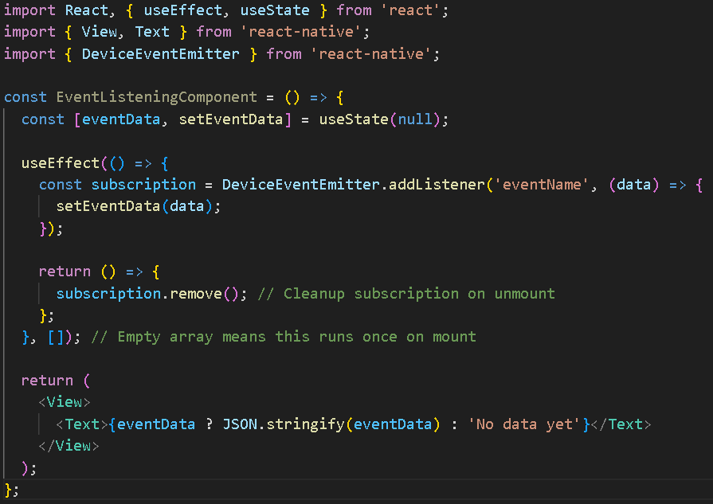
useEffect

Slide 19
useEffect vs Class Component
NGUYEN TRONG TIEN

Slide 20
Class Component
Let's break down the differences and similarities between useEffect in functional components and the lifecycle methods in class components:
componentDidMount
componentDidUpdate
componentWillUnmount.

Slide 21

componentDidMount
When It Runs: After the component has been rendered for the first time.
UseCase: Ideal for fetching data, setting up subscriptions, or manipulating the DOM.

Slide 22
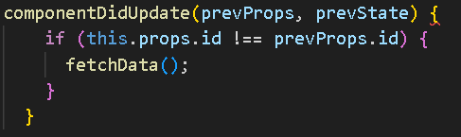
componentDidUpdate
When It Runs: After the component updates (i.e., re-renders due to state or prop changes).
Use Case: Good for responding to prop changes or state updates.

Slide 23

componentWillUnmount
When It Runs: Right before the component is removed from the DOM.
Use Case: Useful for cleaning up subscriptions or timers.

Slide 24
Functional Components with useEffect
When It Runs: Runs after the render, similar to componentDidMount and componentDidUpdate. It can also be configured to run only on mount, only on updates, or only on unmount.
Use Case: Covers all use cases for the three lifecycle methods in one API.

Slide 25
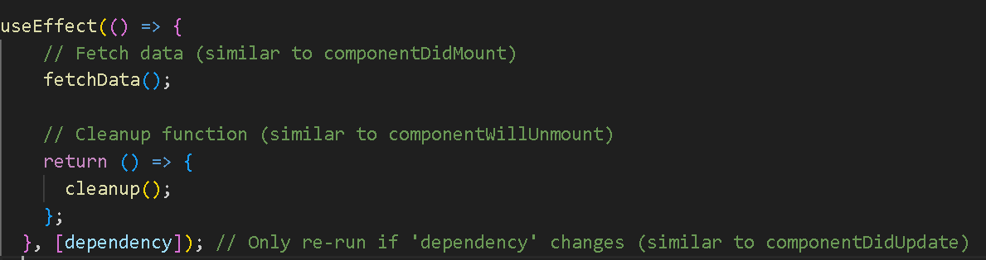
Example

Slide 26
Key Differences
Conciseness: useEffect consolidates multiple lifecycle methods into a single hook, making it easier to manage effects.
Dependencies: With useEffect, you specify dependencies that determine when the effect should re-run, allowing for more granular control.
Cleanup: The cleanup logic is returned from the effect function, streamlining the process of handling side effects.
Less Boilerplate: Functional components are generally simpler and require less boilerplate code compared to class components.
Notes:
https://viblo.asia/p/useref-va-forwardref-trong-react-1VgZv6dYZAw
https://medium.com/@tyliang/react-power-of-useref-input-focus-enabling-read-more-and-animating-in-viewport-elements-ef173f0bab11

Slide 27
What is useRef?
With useRef we can create and update a single mutable value that exists for the lifetime of the component instance.
After assigning the ref to a variable, we use .current to access the mutable value.
It can be used to hold a reference to a DOM element, or any mutable value that you want to keep around without causing a re-render when updated.

Slide 28
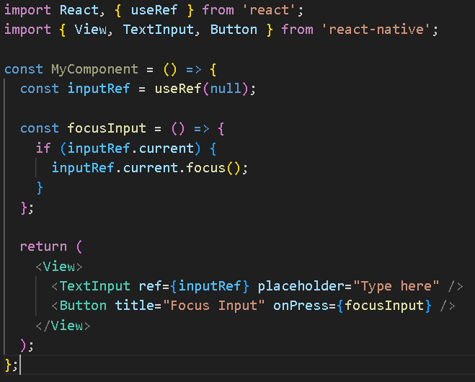
Common Use Cases
Accessing DOM Elements:
You can use useRef to directly reference a component or a DOM element in your React Native application.
This is useful for focus management, measuring elements, or integrating with third-party libraries.
Notes:
import React, { useRef } from 'react';
import { View, TextInput, Button } from 'react-native';
const MyComponent = () => {
const inputRef = useRef(null);
const focusInput = () => {
if (inputRef.current) {
inputRef.current.focus();
}
};
return (
<View>
<TextInput ref={inputRef} placeholder="Type here" />
<Button title="Focus Input" onPress={focusInput} />
</View>
);
};

Slide 29
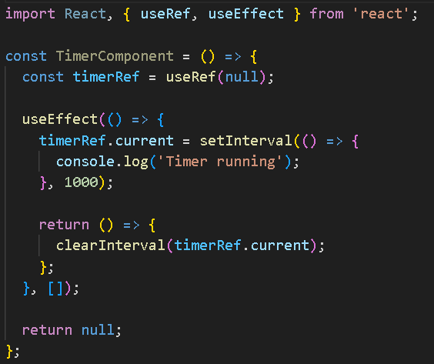
Common Use Cases
Storing Mutable Values:
You can store any mutable value (like timers or intervals) that doesn’t require re-rendering the component when updated.
Notes:
import React, { useRef, useEffect } from 'react';
const TimerComponent = () => {
const timerRef = useRef(null);
useEffect(() => {
timerRef.current = setInterval(() => {
console.log('Timer running');
}, 1000);
return () => {
clearInterval(timerRef.current);
};
}, []);
return null;
};

Slide 30
Common Use Cases
Avoiding Re-renders:
Since updating the .current property of a useRef does not trigger a re-render, it's useful for holding values that you want to keep updated without affecting the rendering cycle.
Notes:
import React, { useRef, useEffect } from 'react';
const TimerComponent = () => {
const timerRef = useRef(null);
useEffect(() => {
timerRef.current = setInterval(() => {
console.log('Timer running');
}, 1000);
return () => {
clearInterval(timerRef.current);
};
}, []);
return null;
};

Slide 31
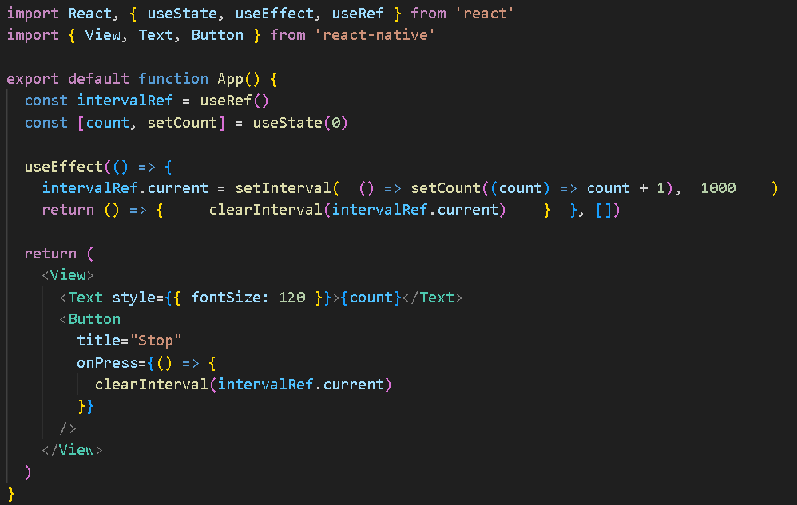
useRef
Notes:
https://www.reactnative.express/react/hooks/useref
import React, { useState, useEffect, useRef } from 'react'
import { View, Text, Button } from 'react-native'
export default function App() {
const intervalRef = useRef()
const [count, setCount] = useState(0)
useEffect(() => {
intervalRef.current = setInterval( () => setCount((count) => count + 1), 1000 )
return () => { clearInterval(intervalRef.current) } }, [])
return (
<View>
<Text style={{ fontSize: 120 }}>{count}</Text>
<Button
title="Stop"
onPress={() => {
clearInterval(intervalRef.current)
}}
/>
</View>
)
}

Slide 32
Differences from Other Hooks
Unlike useState: Changing a state variable causes a component re-render. In contrast, changing a ref does not trigger a re-render, which can be advantageous for performance in certain situations.
Unlike useEffect: useRef does not execute effects when its value changes; it's a way to hold references or values between renders without side effects.
Notes:
import React, { useRef, useEffect } from 'react';
const TimerComponent = () => {
const timerRef = useRef(null);
useEffect(() => {
timerRef.current = setInterval(() => {
console.log('Timer running');
}, 1000);
return () => {
clearInterval(timerRef.current);
};
}, []);
return null;
};

Slide 33
useContext
The useContext hook in React Native (and React in general) provides a way to access context values in a functional component.
Context is a feature that allows you to share values (like themes, user information, or other global data) across your component tree without having to pass props down manually at every level.

Slide 34
What is Context?
Context API: The Context API in React allows you to create global data that can be accessed by any component in the component tree, regardless of how deep it is nested.
Provider and Consumer: You create a context with React.createContext(), and you provide values using a Provider component. Components that need access to these values can consume them using useContext.

Slide 35
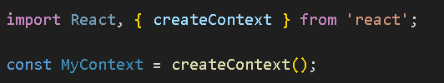
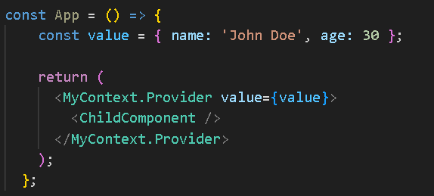
Using useContext
Creating a Context
Providing Context Values

Slide 36
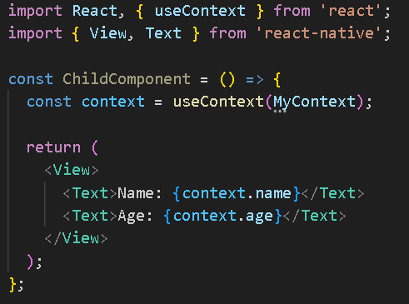
Using useContext
Consuming Context Values with useContext

Slide 37
Benefits of useContext
Cleaner Code: It avoids "prop drilling," where you have to pass props through many layers of components. Instead, you can access the data directly where it's needed.
Simplified State Management: useContext is often used alongside useReducer for state management, providing a way to manage complex state in a more organized way.
Dynamic Updates: When the context value changes, all components that consume the context will automatically re-render with the new value.

Slide 38
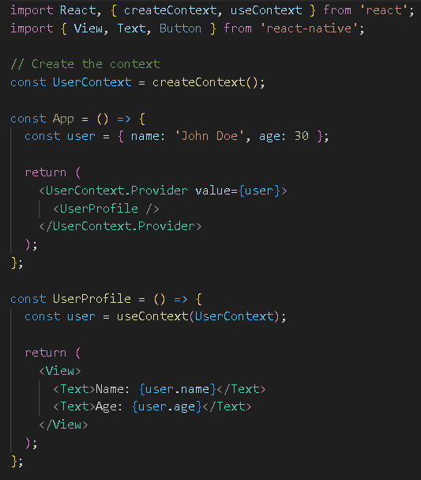
Example of Full Usage
The useContext hook is a powerful feature in RN that simplifies state management and allows for easy access to global data without prop drilling. It works seamlessly with the Context API to create a more maintainable and scalable application structure.
Notes:
import React, { createContext, useContext } from 'react';
import { View, Text, Button } from 'react-native';
// Create the context
const UserContext = createContext();
const App = () => {
const user = { name: 'John Doe', age: 30 };
return (
<UserContext.Provider value={user}>
<UserProfile />
</UserContext.Provider>
);
};
const UserProfile = () => {
const user = useContext(UserContext);
return (
<View>
<Text>Name: {user.name}</Text>
<Text>Age: {user.age}</Text>
</View>
);
};

Slide 39
useReducer
The useReducer hook in RN (and React in general) is a powerful tool for managing complex state in functional components.
It’s particularly useful when you have multiple state variables that depend on each other or when you need to handle complex state transitions, similar to how you would with Redux.

Slide 40
useReducer
The useReducer hook requires 2 arguments, and has an optional 3rd argument:
reducer - a pure function that takes a state and an action, and returns a new state value based on the action
initialState - any initial state value, just like useState
initializer (optional) - this is uncommon, but we'll briefly introduce it later.
The useReducer hook returns the current state, and a dispatch function to update the state.

Slide 41
What is useReducer?
State Management: useReducer provides a way to manage state with a reducer function, similar to how Redux manages state. It allows you to update state based on actions, making it easier to handle complex updates in a predictable manner.

Slide 42
Basic Usage of useReducer
The useReducer hook takes two arguments:
A reducer function that defines how the state updates in response to actions.
An initial state.
It returns the current state and a dispatch function to send actions to the reducer.

Slide 43
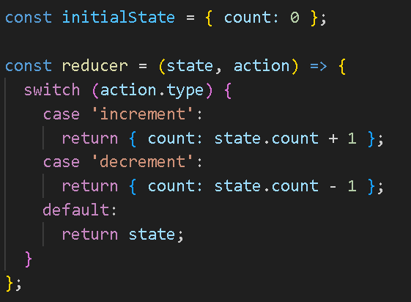
Step-by-Step Example
Define the Reducer Function:
The reducer function takes two parameters: the current state and an action. Based on the action type, it returns a new state.
Notes:
const initialState = { count: 0 };
const reducer = (state, action) => {
switch (action.type) {
case 'increment':
return { count: state.count + 1 };
case 'decrement':
return { count: state.count - 1 };
default:
return state;
}
};

Slide 44
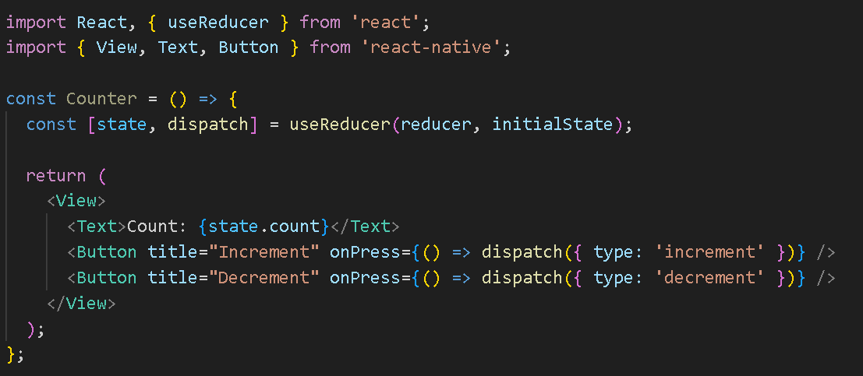
Step-by-Step Example
2. Use useReducer in Your Component
Initialize state with useReducer and use the dispatch function to update the state.

Slide 45
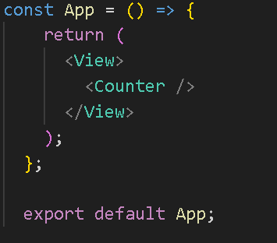
Step-by-Step Example
3. Render Your Component
You can now use the Counter component in your application.
Notes:
const App = () => {
return (
<View>
<Counter />
</View>
);
};
export default App;

Slide 46
Benefits of useReducer
Centralized State Logic: It allows you to centralize state logic in one place, making it easier to understand and manage complex state transitions.
Predictable State Updates: The use of actions and a reducer function makes state updates predictable, similar to how Redux works.
Better for Complex State: It’s ideal for components with complex state logic, such as forms with multiple input fields or components that need to track multiple related values.

Slide 47
When to Use useReducer vs. useState
Use useState: When you have simple state logic or a few state variables that don’t depend on each other.
Use useReducer: When managing more complex state logic, especially if state transitions depend on previous state values or involve multiple sub-values.

Slide 48
Conclusion
The useReducer hook in RN is a powerful tool for managing complex state in functional components.
By using a reducer function to handle state updates, you can create more predictable and maintainable state management logic, similar to that of Redux, without the need for additional libraries.
This makes it an excellent choice for applications with intricate state requirements.

Slide 50
What is useMemo?
In React Native, useMemo works in exactly the same way as it does in React for web development.
Since React Native shares many concepts with React, including its core hooks, the purpose and usage of useMemo remain consistent.

Slide 51
What is useMemo?
useMemo in RN is a hook used to optimize performance by memoizing the result of an expensive computation so that the result is only recalculated when its dependencies change.
Without memoization, computations inside components may be recalculated unnecessarily on every render, potentially leading to performance bottlenecks, especially on mobile devices where resources are often more constrained than on desktop environments.

Slide 52
Syntax
computeExpensiveValue(a, b): The function that performs a potentially costly operation.
[a, b]: The dependency array. When the values of a or b change, useMemo will recompute the value. If they don’t change, the memoized value is returned without re-executing the function.

Slide 53
Why Use useMemo in React Native?
Mobile devices often have limited CPU and memory resources, so unnecessary recalculations can impact app performance.
For example, performing complex calculations, sorting or filtering lists, or computing values in large datasets could lead to poor user experiences. useMemo helps to avoid these issues by caching values and recalculating them only when necessary.

Slide 54
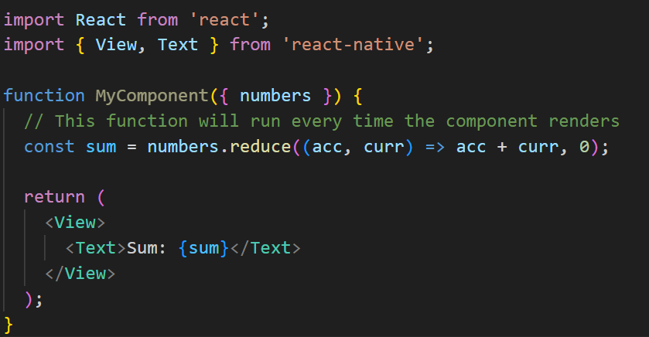
Example in React Native-Without useMemo
Here, the sum is recalculated on every render, which can be inefficient for large arrays.
Notes:
import React from 'react';
import { View, Text } from 'react-native';
function MyComponent({ numbers }) {
// This function will run every time the component renders
const sum = numbers.reduce((acc, curr) => acc + curr, 0);
return (
<View>
<Text>Sum: {sum}</Text>
</View>
);
}

Slide 55
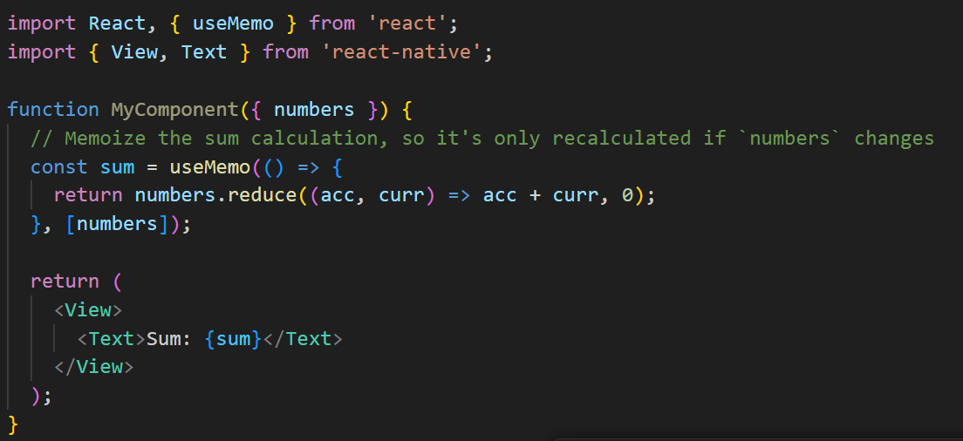
Example in React Native-With useMemo
In this example, the sum calculation will only run when the numbers array changes, preventing unnecessary recalculations and improving performance.
Notes:
import React from 'react';
import { View, Text } from 'react-native';
function MyComponent({ numbers }) {
// This function will run every time the component renders
const sum = numbers.reduce((acc, curr) => acc + curr, 0);
return (
<View>
<Text>Sum: {sum}</Text>
</View>
);
}

Slide 56
Example in React Native-With useMemo
In this example, the sum calculation will only run when the numbers array changes, preventing unnecessary recalculations and improving performance.
Notes:
import React from 'react';
import { View, Text } from 'react-native';
function MyComponent({ numbers }) {
// This function will run every time the component renders
const sum = numbers.reduce((acc, curr) => acc + curr, 0);
return (
<View>
<Text>Sum: {sum}</Text>
</View>
);
}

Slide 57
When to Use useMemo in React Native
Expensive calculations: Use it when your component has computations that are resource-heavy, like processing large datasets, filtering, sorting, etc.
Re-render optimizations: If certain parts of your component rely on derived values that don’t change often, useMemo can prevent re-renders from triggering unnecessary recalculations.

Slide 58
When to Use useMemo in React Native
Expensive calculations: Use it when your component has computations that are resource-heavy, like processing large datasets, filtering, sorting, etc.
Re-render optimizations: If certain parts of your component rely on derived values that don’t change often, useMemo can prevent re-renders from triggering unnecessary recalculations.

Slide 59
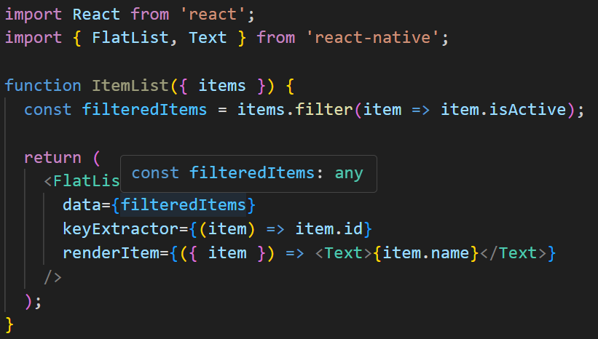
Example: Optimizing a FlatList-Without useMemo
Imagine you're rendering a large list of items using FlatList, and you need to filter the list before rendering it.
Here, the filtering operation runs on every render, even when the items array hasn’t changed.

Slide 60
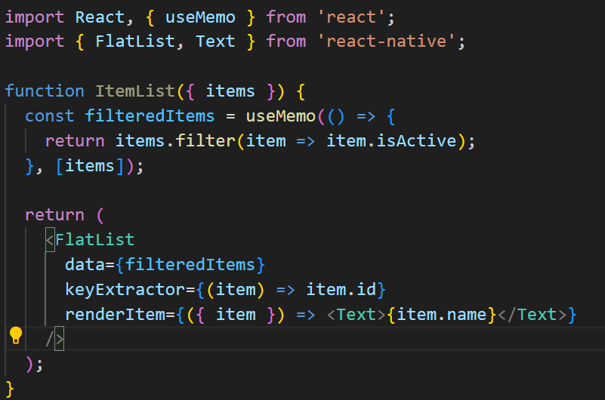
Example: Optimizing a FlatList-With useMemo
Now, filteredItems is recalculated only when the items array changes, optimizing the list rendering.

Slide 61
When to Use useMemo in React Native
Expensive calculations: Use it when your component has computations that are resource-heavy, like processing large datasets, filtering, sorting, etc.
Re-render optimizations: If certain parts of your component rely on derived values that don’t change often, useMemo can prevent re-renders from triggering unnecessary recalculations.

Slide 62
When Not to Use useMemo in React Native
Avoid premature optimization: If the calculation is simple and doesn’t have a noticeable performance impact, adding useMemo can make the code more complex without benefits.
Overuse: Overusing useMemo across a RN project can add unnecessary complexity. Reserve it for scenarios where performance is noticeably impacted.
In summary, useMemo is a useful tool in RN to ensure efficient recalculations, especially in resource-intensive operations. Its purpose and behavior are identical to how it's used in React for web, with the added emphasis on mobile performance.

Slide 63
useCallback
In React Native, useCallback is a hook similar to useMemo, but instead of memoizing the result of a computation, it memoizes a function. It ensures that the same function reference is used across renders, which can be crucial for preventing unnecessary re-renders of components or for optimizing performance when passing callbacks down to child components.

Slide 64
What is useCallback?
useCallback returns a memoized version of a callback function that only changes if one of its dependencies changes. This can be useful when you need to pass a stable function reference to child components, preventing them from re-rendering unnecessarily.

Slide 65

Syntax
Callback function: The function to be memoized.
[dependencies]: An array of dependencies. The callback will only be updated when one or more of these dependencies change.

Slide 66
Why Use useCallback in React Native?
React Native's rendering system is similar to React's, where unnecessary re-renders of components or unnecessary re-execution of functions can impact performance, particularly in mobile environments where resources are constrained. useCallback helps to:
Prevent unnecessary re-renders by ensuring that the same function reference is passed to child components or event handlers.
Optimize performance by caching the function reference unless the dependencies change.

Slide 67
When to Use useCallback
When passing functions as props to child components: Child components may re-render unnecessarily if the parent passes a new function reference on every render. useCallback ensures the same function reference is used unless dependencies change.
Expensive callback functions: If the function is computationally expensive or affects rendering performance, useCallback helps reduce recalculations.

Slide 68
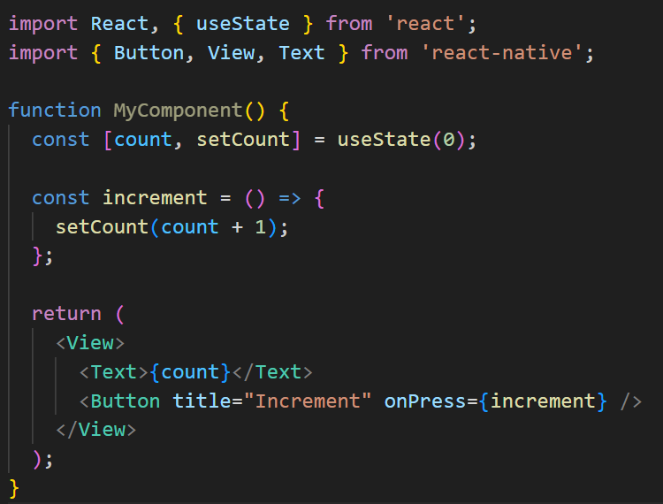
Example Use Case in React Native-Without useCallback
In this case, every time the component re-renders, the increment function is recreated, even though the logic hasn't changed.
Notes:
import React, { useState } from 'react';
import { Button, View, Text } from 'react-native';
function MyComponent() {
const [count, setCount] = useState(0);
const increment = () => {
setCount(count + 1);
};
return (
<View>
<Text>{count}</Text>
<Button title="Increment" onPress={increment} />
</View>
);
}

Slide 69
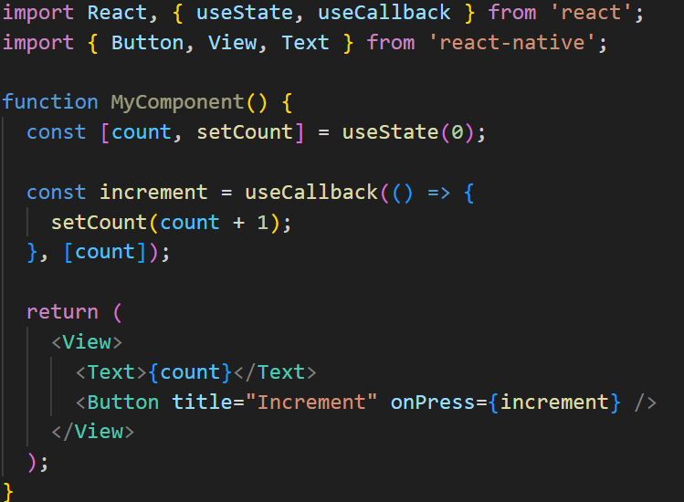
Example Use Case in React Native-With useCallback
Now, the increment function is memoized and only recreated when the count state changes. This is especially useful when passing the increment function as a prop to child components.
Notes:
import React, { useState } from 'react';
import { Button, View, Text } from 'react-native';
function MyComponent() {
const [count, setCount] = useState(0);
const increment = () => {
setCount(count + 1);
};
return (
<View>
<Text>{count}</Text>
<Button title="Increment" onPress={increment} />
</View>
);
}

Slide 70
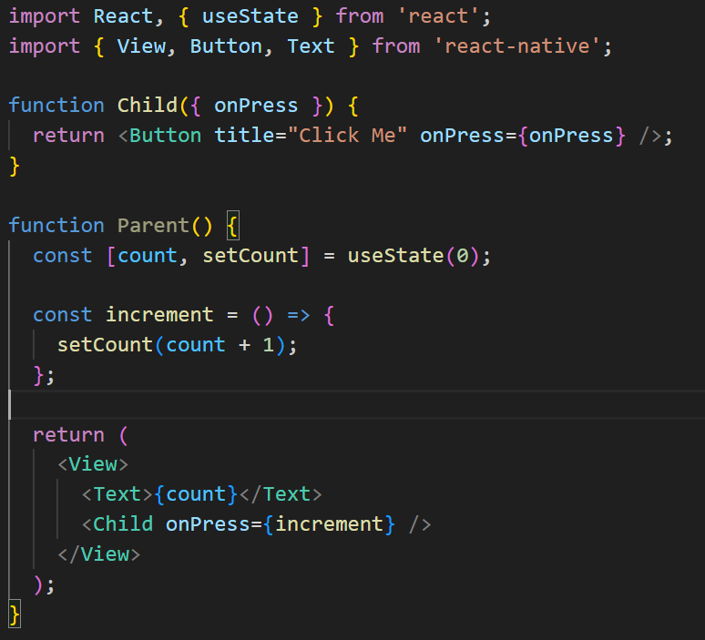
Optimizing Child Components-Without useCallback
In this example, every time Parent re-renders, the increment function is recreated, causing the Child component to re-render even if it doesn’t need to.
Notes:
import React, { useState } from 'react';
import { Button, View, Text } from 'react-native';
function MyComponent() {
const [count, setCount] = useState(0);
const increment = () => {
setCount(count + 1);
};
return (
<View>
<Text>{count}</Text>
<Button title="Increment" onPress={increment} />
</View>
);
}

Slide 71
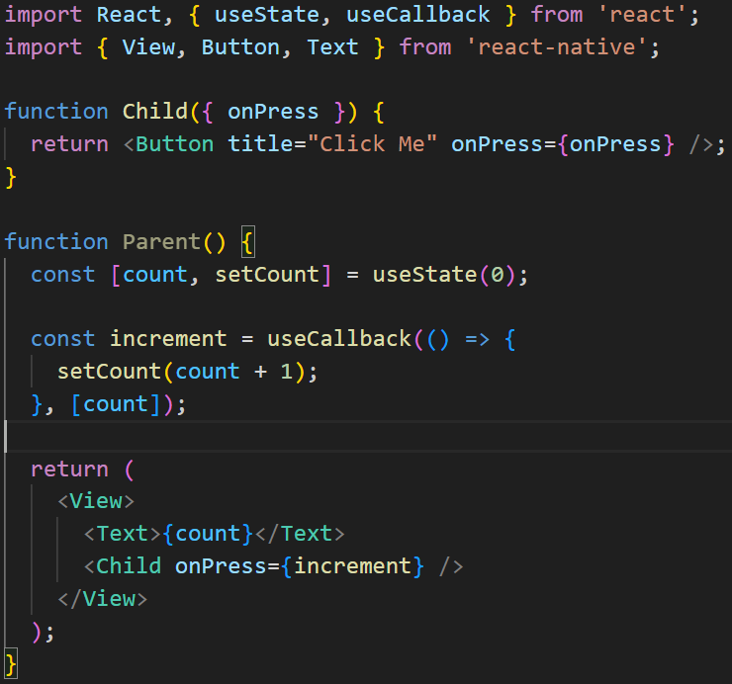
Example Use Case in React Native-With useCallback
Now, the Child component will only re-render when the increment function reference changes, improving performance by avoiding unnecessary renders
Notes:
import React, { useState } from 'react';
import { Button, View, Text } from 'react-native';
function MyComponent() {
const [count, setCount] = useState(0);
const increment = () => {
setCount(count + 1);
};
return (
<View>
<Text>{count}</Text>
<Button title="Increment" onPress={increment} />
</View>
);
}

Slide 72
When Not to Use useCallback
Premature optimization: If the function you're memoizing is not causing performance problems, useCallback might add unnecessary complexity.
Simple event handlers: For basic event handlers (like onClick or onPress), the performance gains might be negligible.

Slide 73
Conclusion
useCallback in React Native is particularly useful for:
Optimizing performance: When functions are passed as props or used in event handlers, useCallback helps ensure that the same function reference is used across renders unless the dependencies change.
Preventing unnecessary re-renders: It works well when combined with components that only re-render when the props or state changes, such as React.memo or similar optimization techniques in React Native.

Slide 75
React Custom Hooks
A custom hook in React Native (or React in general) is a reusable function that encapsulates logic and state, allowing you to share it across different components.
Custom hooks allow you to abstract complex logic out of components, making your code cleaner and more maintainable.

Slide 76
What is a Custom Hook?
A custom hook is a JavaScript function whose name starts with use (to follow React’s hook convention) and can call other hooks inside it. It allows you to reuse stateful logic across multiple components without needing to duplicate code.
Custom hooks can use any of the built-in hooks like useState, useEffect, useCallback, etc., to implement shared behavior that can then be reused in different components.

Slide 77
Syntax of a Custom Hook
A custom hook is just a regular function that:
Always starts with use (e.g., useCustomHook).
Can call other React hooks inside it.
Encapsulates reusable logic that multiple components can use.

Slide 78
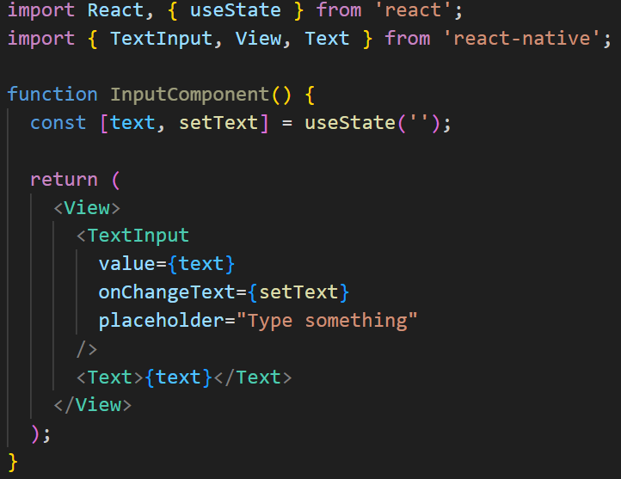
Example: Simple Custom Hook for Managing Input
Without a Custom Hook
If you have multiple input fields, you'll end up duplicating the state management logic in each component. This is where a custom hook comes in handy.

Slide 79
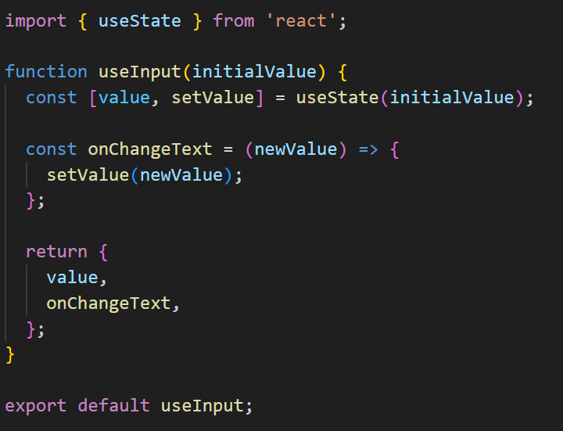
Example: Simple Custom Hook for Managing Input
With a Custom Hook
You can create a custom hook called useInput to encapsulate the state and the logic for handling text inputs.
Now, you can reuse this custom hook in multiple components.

Slide 80
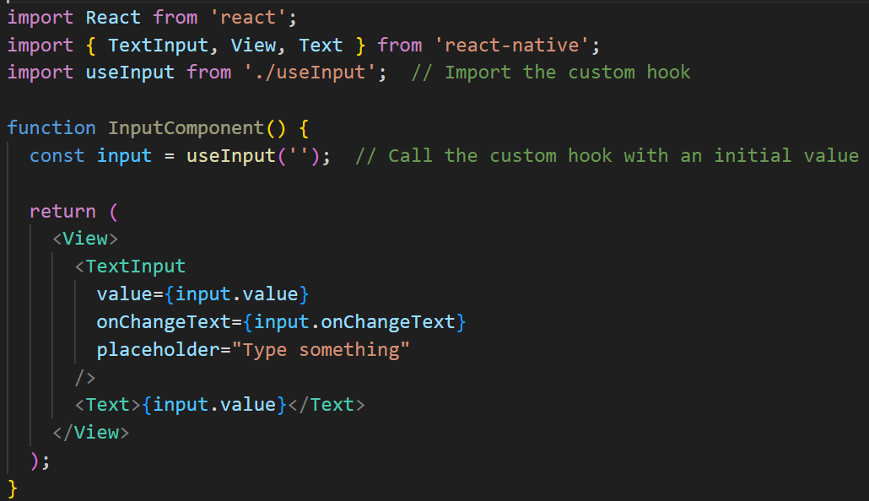
Using the Custom Hook in Components
Now, the useInput hook encapsulates all the input logic, allowing you to reuse it across multiple components. Each instance of the useInput hook is independent, so you can manage the state for different inputs without duplicating code.

Slide 81
Benefits of Custom Hooks
Reusability: You can extract commonly used logic (like fetching data, managing form inputs, or managing local state) into a custom hook, which can be reused in multiple components.
Cleaner Components: By moving logic out of the components and into custom hooks, components can focus more on UI, making them easier to read and maintain.
Encapsulation: Custom hooks encapsulate logic, keeping your components clean and reducing code duplication.
Composability: Hooks are composable, meaning you can create more complex custom hooks by combining multiple custom or built-in hooks.

Slide 82
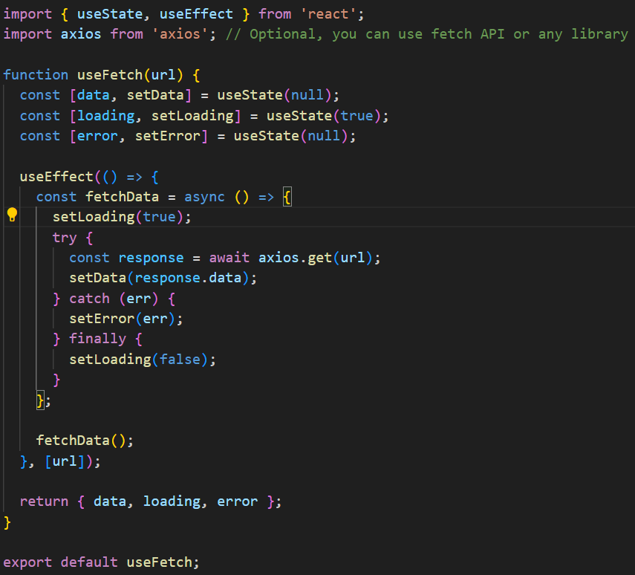
Example: Custom Hook for Fetching Data
Let’s create a custom hook that fetches data from an API and returns the loading state, error, and the data itself. This can be reused in any component that needs to fetch data.

Slide 83
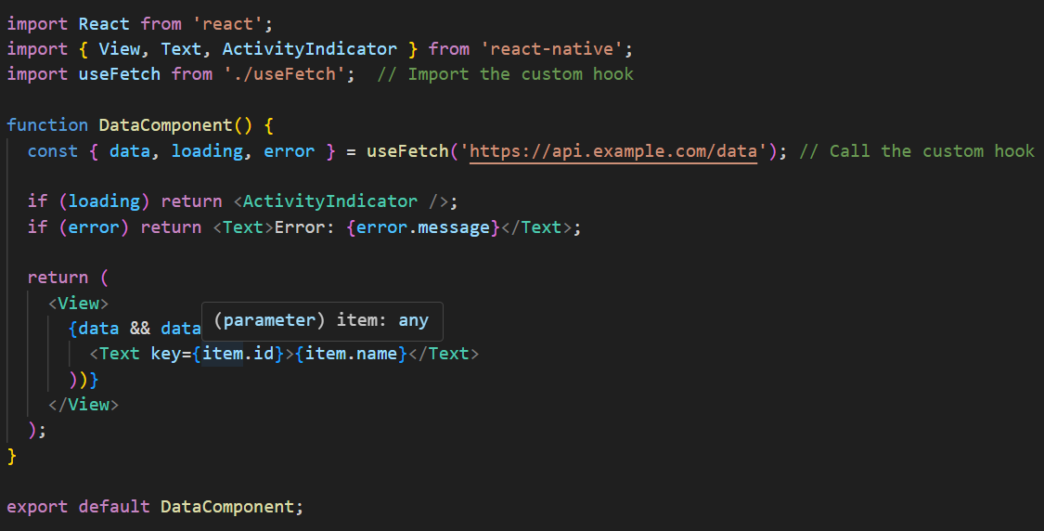
Using the Custom Hook in a Component
Explanation:
useFetch custom hook encapsulates the logic for fetching data from an API.
It handles loading, error states, and stores the fetched data.
The custom hook is reusable and can be used with any API endpoint.

Slide 84
Guidelines for Creating Custom Hooks
Start with use: Always name custom hooks starting with use to follow React’s convention and ensure that React can understand and enforce hook rules (like only calling hooks inside function components or other hooks).
Encapsulate Reusable Logic: Move logic that is used across multiple components (like state management, API calls, or side effects) into a custom hook to avoid duplication.
Combine Other Hooks: Custom hooks can use other hooks like useState, useEffect, useContext, etc. This allows you to compose and reuse logic effectively.
Return Values: A custom hook can return any value (state, functions, etc.), which can then be destructured or accessed in the components where it’s used.

Slide 85
THANK YOU!

