Slide 1


API
LOCAL DATA
CONTROLLER
DATA PROVIDER
LOG COMPOSER
=> Log
STATE COMPOSER
=> State
.apply(event: ) ===================> behavior
BEHAVIOR HANDLER
.handle(behavior: ) => void

Slide 2
function
request
Functional
User
User
Functional
Solution
Lead
Dev
print(“Holy shit solution”)
print(“What the hell of Spec !”)
architecture
Solution
product
Dev
Lead
plan
code

Slide 3
3 primary reponsibility
Collaborate with team
Use Tool
High level Specification

Slide 4
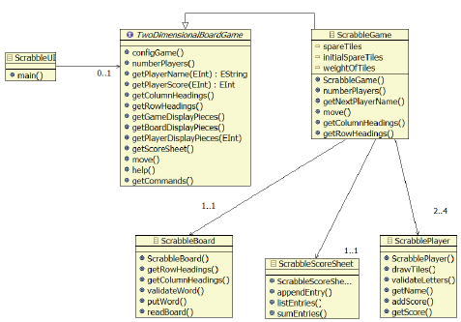
CACHING LAYER
PRESENTATION LAYER
SYSTEM LAYER
COMPONENT
COMPONENT
COMPONENT
COMPONENT
COMPONENT
COMPONENT
COMPONENT
COMPONENT
COMPONENT
COMPONENT
COMPONENT
COMPONENT
DOMAIN LAYER
COMPONENT
COMPONENT
COMPONENT
COMPONENT
COMPONENT
COMPONENT
COMPONENT
DATA LAYER
COMPONENT
COMPONENT
COMPONENT
COMPONENT
COMPONENT
COMPONENT
COMPONENT

Slide 5
business_func_1()
utility_func_1()
utility_func_2()
utility_func_3()
utility_func_4()
utility_func_5()

