Slide 1
Mobile Application?
MobileApp trong mô hình BackEnd-FrontEnd?

Slide 2
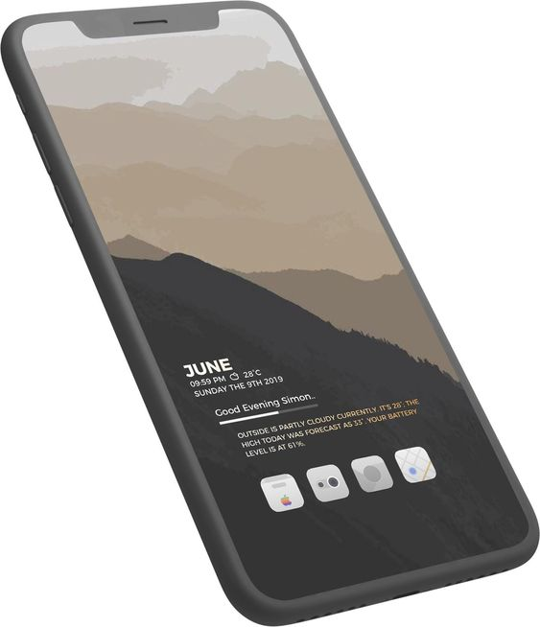
MOBILE APPLICATION ?

Slide 3
Software == Application?
Software
Application
Set of instructions or data that operates the hardware.
An all encompassing term for computer data.
May executable or may not be.
Not often operating system based.
Not need user interaction for functioning.
Used as mediator between user and hardware.
All the software are not applications.
Is a package to perform a specific task.
Is a type of software that does a certain task.
Is always executable.
Is operation system based.
Need user interaction for functioning.
Used only by end users.
All the application are software.
https://www.geeksforgeeks.org/difference-between-software-and-application/

Slide 4
Mobile Application?
Là Application base trên Mobile OS, hoặc trên 1 SDK mà Device hỗ trợ.
Cung cấp chức năng, giao diện cho end-user tương tác.
Tập trung vào trải nghiệm user.
Phần cứng hạn chế (Ram, CPU)

Slide 5
MobileApp & Mô hình BackEnd-FrontEnd?
Mô hình BackEnd-FrontEnd
So sánh BackEnd-FrontEnd
So sánh MobileApp-MobileWeb

Slide 6







Mô hình BackEnd-FrontEnd
service
ENTERPRISE
USERS
Giúp Doanh Nghiệp (Enterprise) cung cấp Service đến với User.
Tách EnterpriseBusiness Doanh Nghiệp độc lập với ApplicationBussiness User.
Database
Enterprise Business
Sercurity + Performance
User Interface
Application Business
Memory + Performance
Users
Enterprise
PHP, Node.JS, JavaSpring, Ruby, Python,…
iOSApp, AndroidApp, WebApp,…

Slide 7
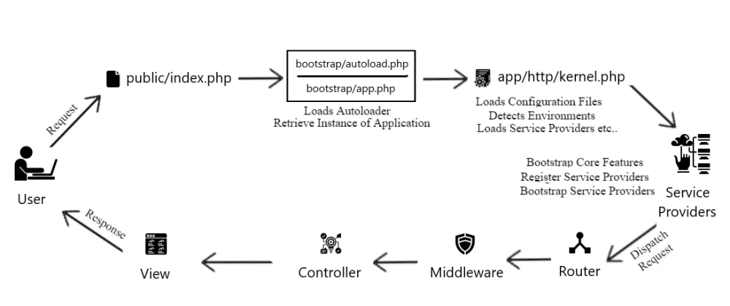
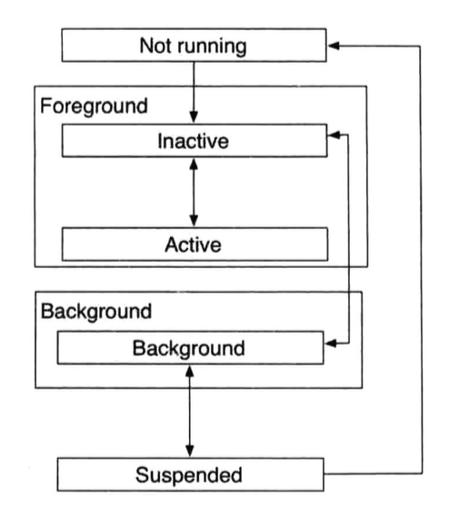
[khác nhau] Life Cycle
Request Life Cycle (BackEnd)
- Phụ thuộc vào Framework
- Chú trọng cycle mỗi phiên xử lý request
Application Life Cycle (MobileApp)
- Phụ thuộc vào OS (Android, iOS)
- Chú trọng cycle mỗi khi app được active/deactive, foreground, background

Slide 8

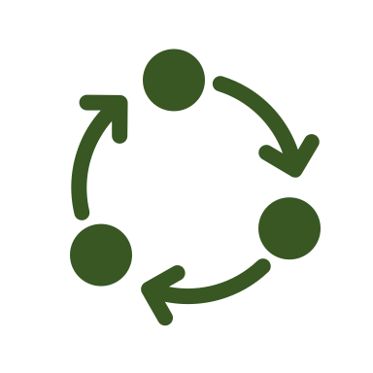
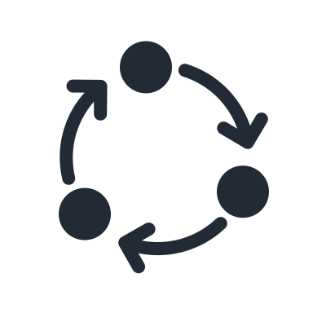

[Giống nhau] Mô hình 3 lớp
Business Logic
Business Logic
Repository
ApiClient, DB, Session, File
ApiClient, DB, UserDefault, File
Repository
DTO
View vs Form
DTO

