Slide 1
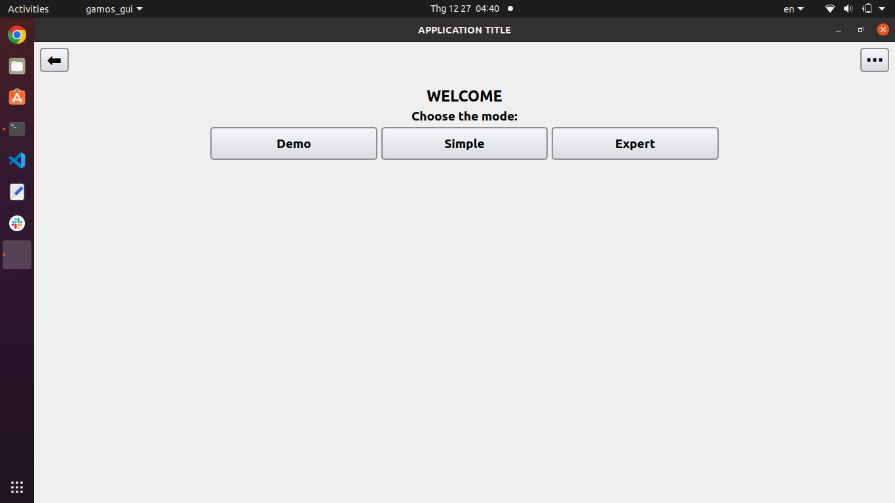
1
2
The row of buttons above will appear throughout the app usage.
1) Go back to the previous screen.
2) Open the Settings Dialog.

Slide 2
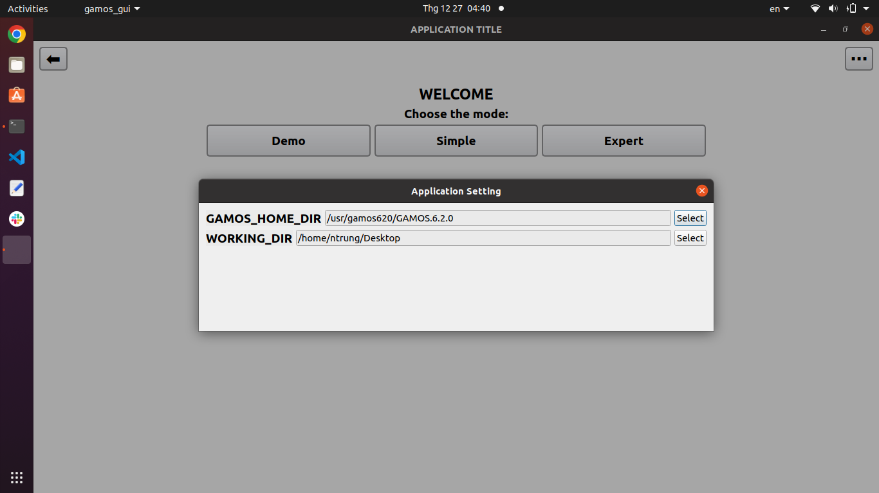
Setting Dialog, allows changing the following configurations:
- GAMOS_HOME_DIR: Path to the Gamos installation directory. Note: select the GAMOS.X.X.X folder located beside to the "external" folder.
- WORKING_DIR: This is the path to which the Terminal will execute the "cd" command before running the "gamos" command. Input files will also be created in this directory.

Slide 3
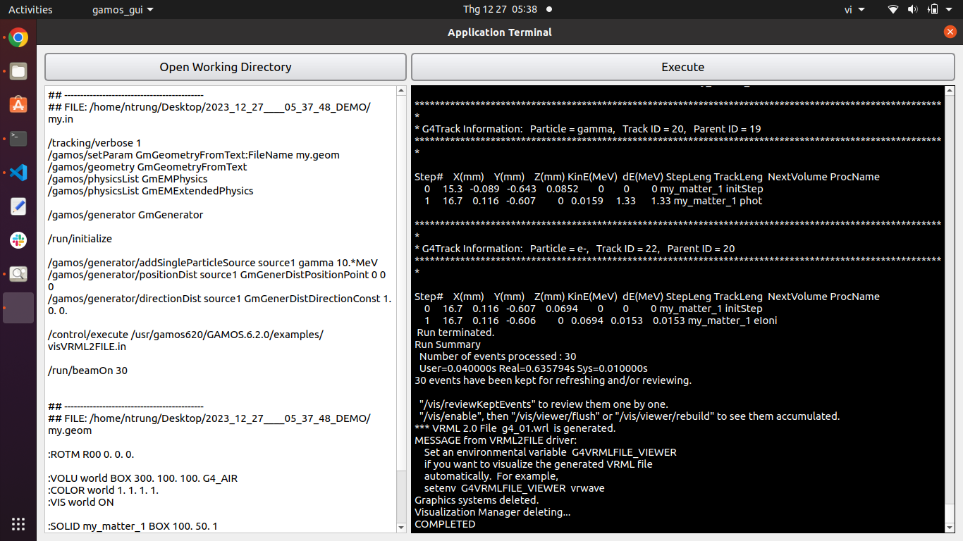
Open the folder containing the input files.
The Terminal will execute the "cd" command to this directory before performing the "gamos" command.
Execute the command in the Terminal window.

