Slide 1
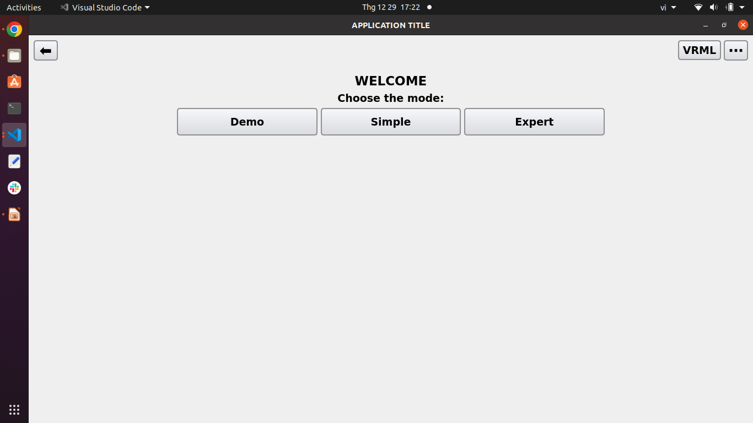
1
3
2
The row of buttons above will appear throughout the app usage.
1) Go back to the previous screen.
2) Open the Settings Dialog.
3) Open VrmlViewer, by default it will open the WORKING_DIR folder (users can find the VRML file in another folder)

Slide 2
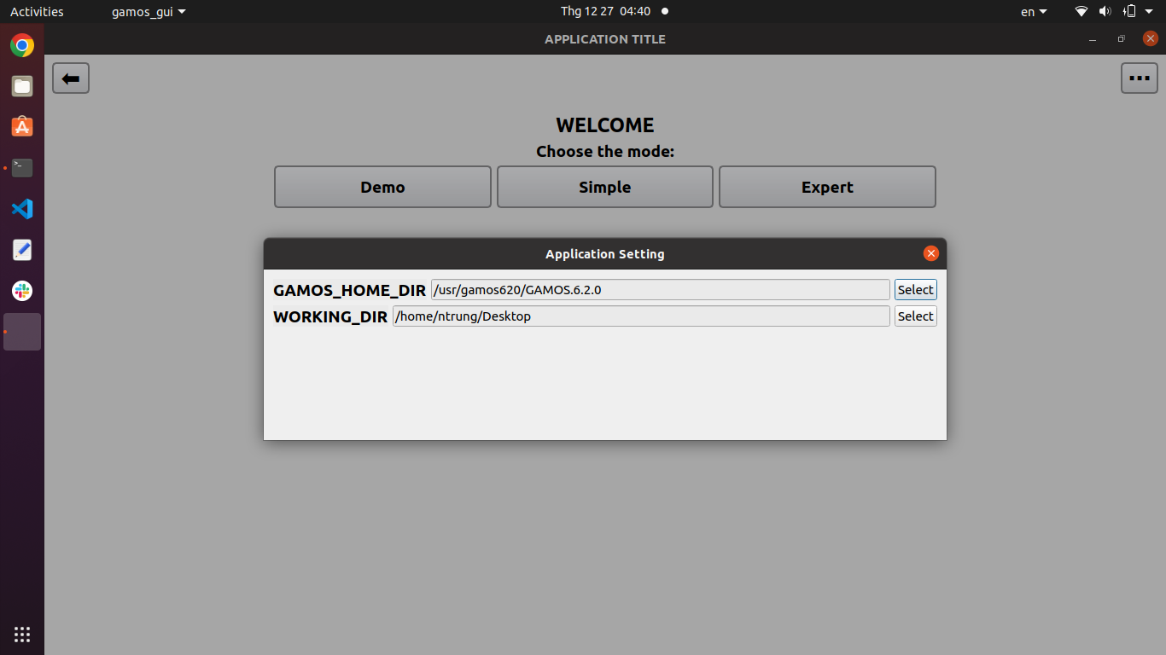
Setting Dialog, allows changing the following configurations:
- GAMOS_HOME_DIR: Path to the Gamos installation directory. Note: select the GAMOS.X.X.X folder located beside to the "external" folder.
- WORKING_DIR: This is the path to which the Terminal will execute the "cd" command before running the "gamos" command. Input files will also be created in this directory.

Slide 3
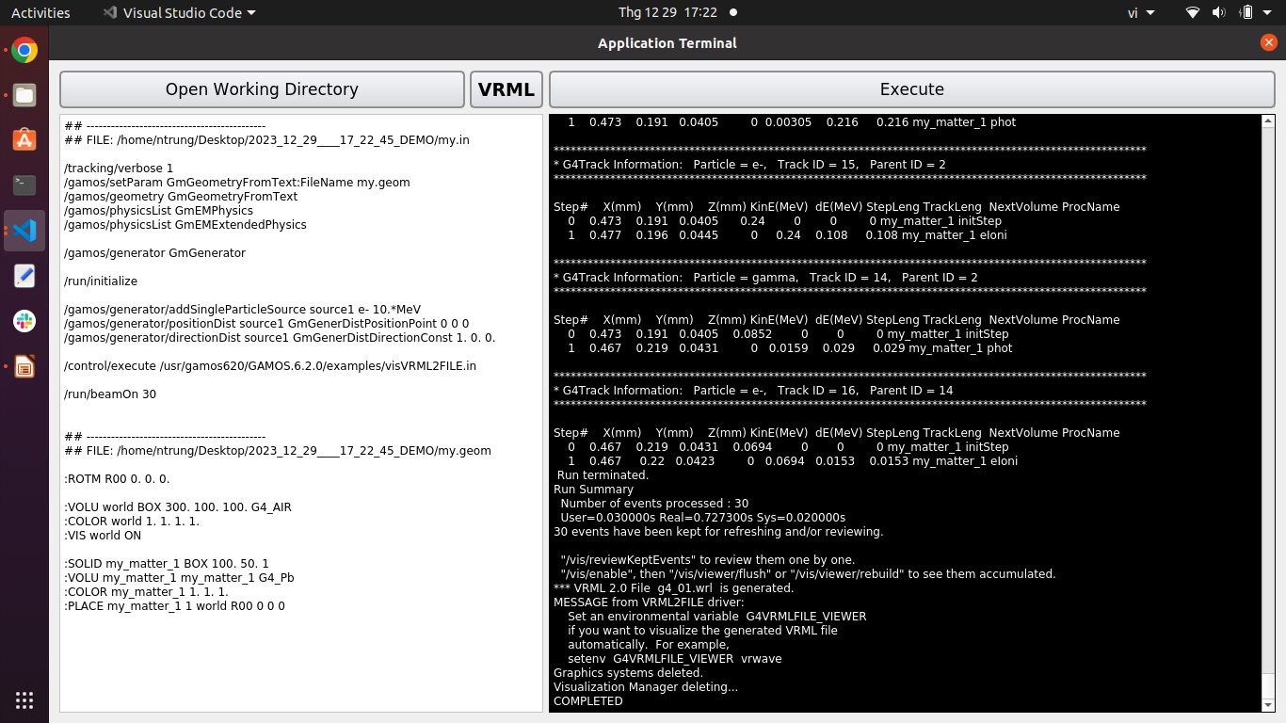
Open the folder containing the input files.
The Terminal will execute the "cd" command to this directory before performing the "gamos" command.
Execute the command in the Terminal window.
Open VrmlViewer in the folder containing the Input and Output files.

Slide 4
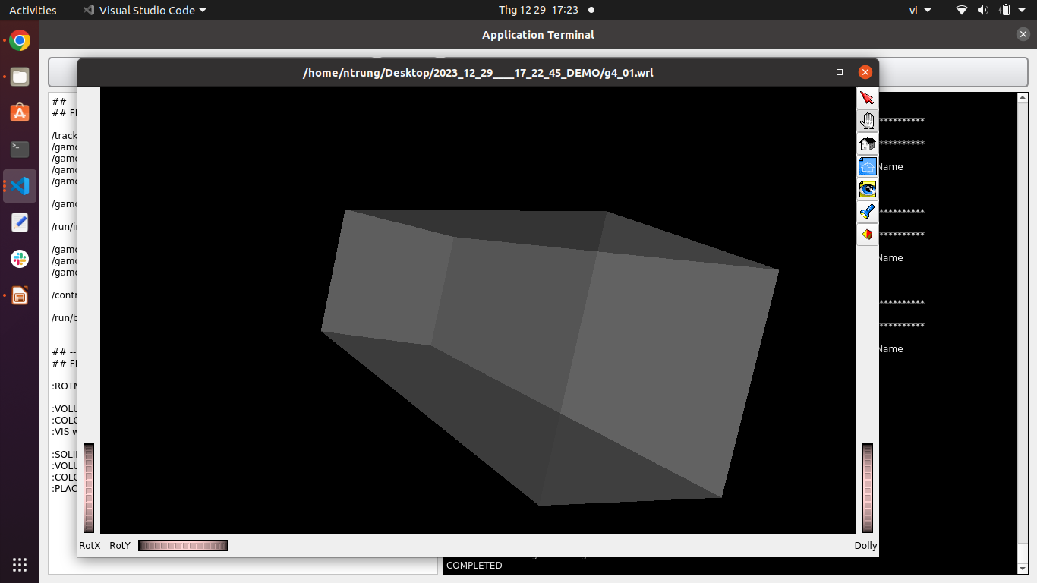
VrmlViewer
Currently supporting *.WRL, *.VRML file formats

