Slide 1
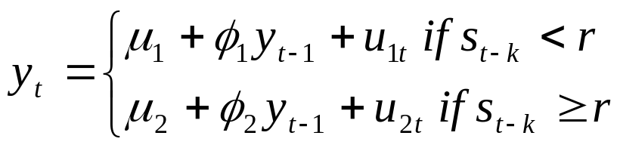
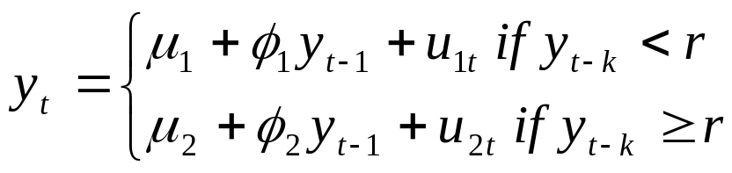
Threshold Autoregressive (TAR) Models
Movements between regimes governed by an observed variable.
TAR model:
Where s_{t-k} is the state determining variable.
The integer k determines with how many lags does the state-determining variable influences the regime in time t.
When s_{t-k} = y_{t-k} we have a self-exciting TAR (SETAR) model:
There are many possible variations of this simple model.

Slide 2
Threshold Autoregressive (TAR) Models
Example: when s_{t-k} = y_{t-k} we have a self-exciting TAR (SETAR) model:
Consider k = 1. Parameters to be estimated:
  μ₁, μ_{2,} σ_{1,} σ_{2,}
  r
Estimation method: least squares with r estimated by a grid search.
There are many possible variations of this simple model:
    Switching in only some of the parameters
    More than 2 regimes
    Different threshold variables
    Alternative dynamic specifications
Can use AIC or other information criteria to select models

Slide 3
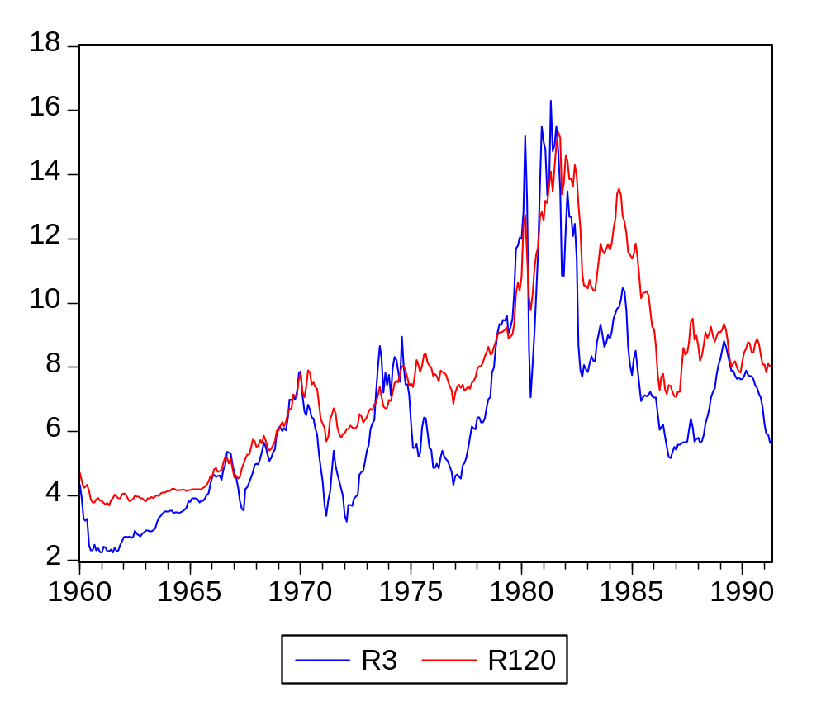
EXAMPLE: Threshold error correction (cointegration) model

Slide 4
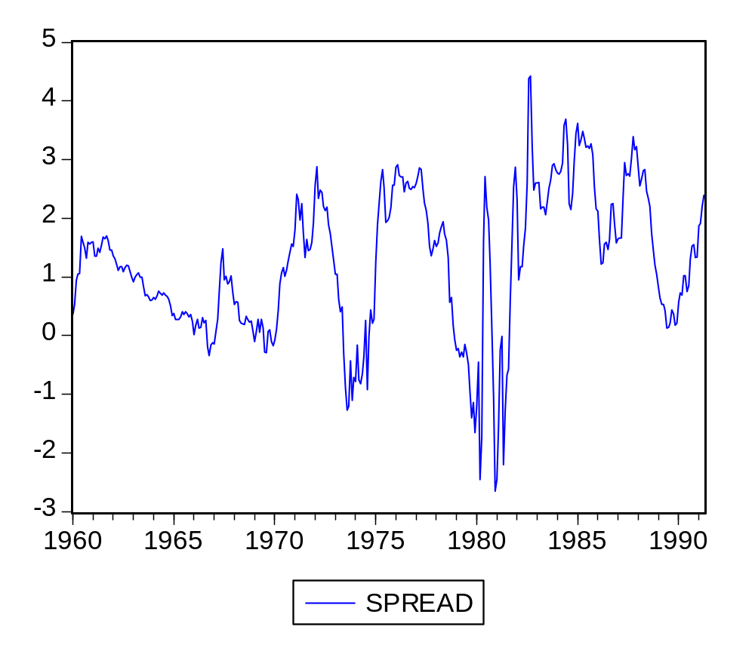
EXAMPLE: Threshold error correction (cointegration) model

Slide 5
EXAMPLE: Threshold error correction (cointegration) model
EVIEWS program:
series y = d(r120)
series x = d(r3)
series spread = r120 - r3
scalar th = 3.22
series _d = ( spread(-1) < th )
equation tar.ls y c y(-1) y(-2) x(-1) x(-2) _d*spread(-1) (1-_d)*spread(-1)

Slide 6
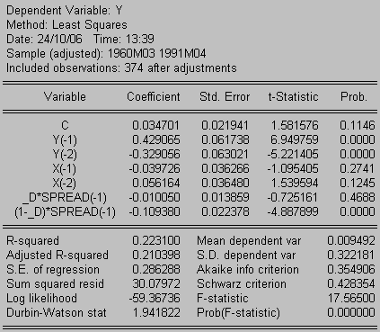
EXAMPLE: Threshold error correction (cointegration) model

