Slide 1
GIT COMMAND INTRO
Indicator

Slide 2
1. init
Meaning: use to create a new repo
Syntax: git init <repo-name>
If you write only: git init. Git will understand that current folder is new repo
A repo is a repository, where contain your working file and something special
Use when need to create a new remote repo
Example:

Slide 3
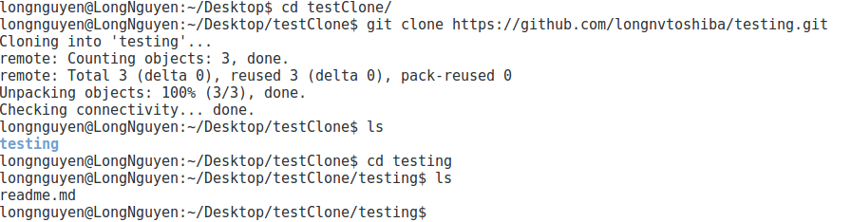
2. clone
Meaning: clone a repository into a new directory
Syntax: git clone <url>
Example:

Slide 4
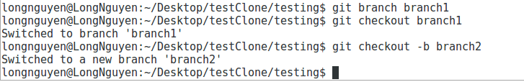
3. checkout
Meaning: switch branches or restore working tree files
Syntax: git checkout <branch-name>
A branch is one of branch on working tree, you can create a new branch “git branch <new-branch-name>” and checkout
“git checkout <new-branch-name>” or do the both of that “git checkout -b
<new-branch-name>. To delete a branch: git branch –d <branch-name> and
continue with git branch –D <branch-name>
You can checkout to a commit earlier: git checkout <option> <head>. After that, you are standing on some virtual branch and it will be deleted when you checkout to another branch. The option can be: --soft to save file off that head,
--hard to remove change
Example:

Slide 5
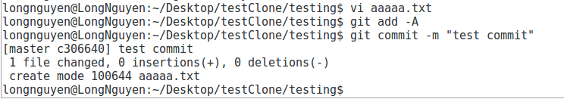
4. commit
Meaning: report changes to the repository
Syntax: git commit –m <commit-comment>
-m<msg> that mean use <msg> as the commit message.
You should add a clearly comment message just to know what did you really do
If you only write “git commit”, git system still commit your change with no comment
You must add your change before commit anything “git add -A”
To commit a multi line message, we use: git commit –m “line1
>line2
>linen” or commit –m “line1” –m “line2” … -m “line~n”
To edit a commit, we use: git commit --amend
Example:

Slide 6
5.1. pull/push
Meaning:
pull: fetch from and integrate with another repository or a local branch
push: update remote with new change, commit along
Syntax:
pull: git pull
push: git push <remote-name> <branch-name>
Before push, you should pull first.
You have to add new change file “git add <file-name>” or “git add *” and commit “git commit –m <commit-comment>” with a comment before push action

Slide 7
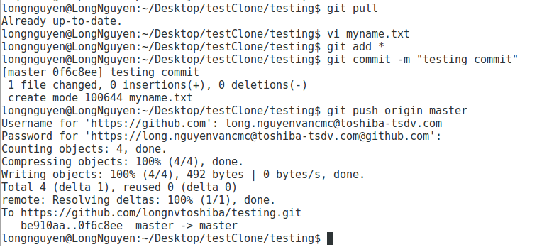
5.2. pull/push
Example:

Slide 8

6.1. rebase
Meaning: forward port local commits to the updated upstream head
Syntax: git rebase <branch-name>
I’m stand on branch master and checkout to branch rebase: “git checkout –b rebase”. Then I add a new file rebase.txt, commit with message “rebase.txt”, then push on. I turn back to branch master, edit README.txt and commit “README.txt” then push on. Next, I checkout to branch rebase and run script “git rebase master”. Now, the commit diagram we have look like:
Use rebase to combine commits and modify history of a branch.

Slide 9
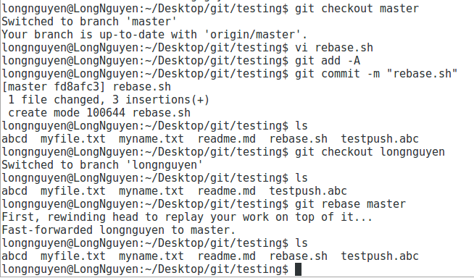
6.2. rebase
Example:

Slide 10
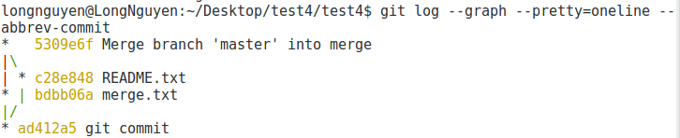
7.1. merge
Meaning: Join two or more development histories together
Syntax: git merge <branch-name>
I’m stand on branch master and checkout to branch merge: “git checkout –b merge”. Then I add a new file merge.txt, commit with message “merge.txt”, then push on. I turn back to branch master, edit README.txt and commit “README.txt” then push on. Next, I checkout to branch merge and run script “git merge master”. Now, the commit diagram we have look like:

Slide 11
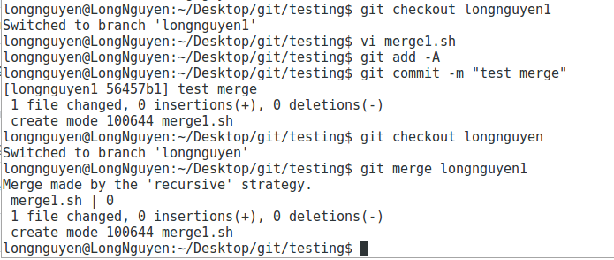
7.2. merge
Example:

Slide 12

8. fetch
Meaning: Download objects and refs from another repository
Syntax: git fetch –all
Fetch only get the new history of remote repository. That commit will be entered as a branch without names. You can checkout by name FETCH_HEAD
Use git-fetch when you need to check changes before pull
Example:

Slide 13
9.1. format-patch/apply/am
Meaning:
format-path: prepare patches for e-mail submission
apply: apply a patch to files and/or to the index
am: apply a series of patches from a mailbox
Syntax:
format-path: git format-patch -<number-file>, git format-patch <head>~<number-file>
apply: git apply <options> <file-patch>
am: git am <options> <file-patch>
Some git-app option:
--stat: check what is the change of patch file
--check: check patch can apply to source code
Some git-am option:
--signoff: add all patch commit to current branch
Git-apply and git-am are both apply a patch to your branch. But git-am will apply include the head/index and git-apply will not
Use format-patch/apply/am when you need to get the commit earlier to your current job

Slide 14
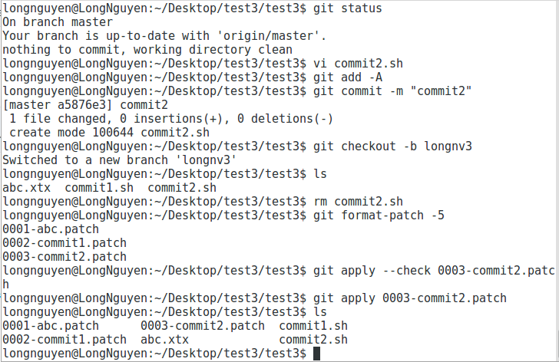
9.2. format-patch/apply/am
Example:

Slide 15

10. log
Meaning: show commit logs
Syntax: git log
Some option:
--since: git log --since=2.weeks. Show log since 2 weeks ago
--stat: git log --stat. Show log with change
--pretty: git log –pretty=format:”%h - %an, %ar : %s”. Show log with format
Use log when you need to see commit earlier on your branch
Example:

Slide 16
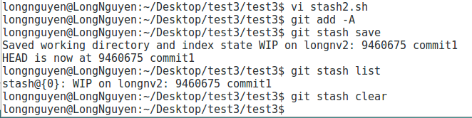
11. stash
Meaning: stash the changes in a dirty working directory away
Syntax:
To temporarily save the current job: git stash save
Displays the saved stash list: git stash list
Return to the stash saved: git stash pop stash@{<stash-number>}
Delete temporarily saved stash: git stash drop stash@{<stash-number>}
Clear all saved stash: git stash clear
Use stash when you need to save your working to take another job
Example:

Slide 17


