Slide 1
QV Production line :
SSMC system
Jig Network
Check sheet less system
1. Flow system
Database
Check sheet
Final Packing check result all station, printer outline
Result
Result
Result
Result
Check result
Check result
Voltage
printing
Paper
Label
Part
Result
Stratify
(Input)
Hioki
Blanca
Comet
Camera
BM Check
(Output/Outside)
Final Packing
Shipment
Scan body
Scan body
Scan body
Scan body
Scan body
Scan body
Scan body
Scan body
Result
Result
Database
SSMC
Check result input, output
Purpose:
Keep data on server.
Prevent to skip manipulation.
LOG
HoanKiem

Slide 2
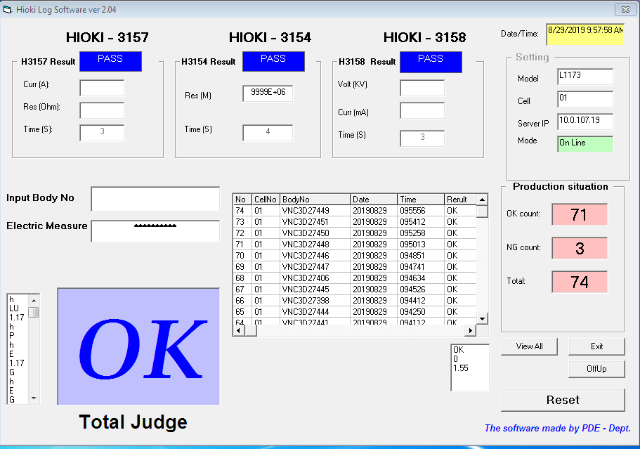
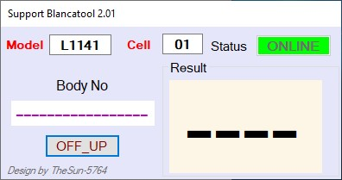
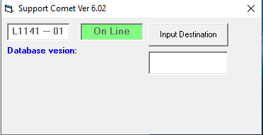
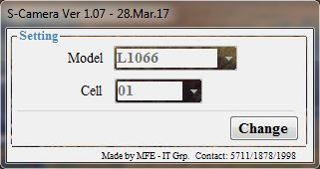
2. Details flow Station
Hioki:
Function: Check (Voltage, Am, Ω , Time)
Setup database, software connect Jig Hioki.
VNC3D27449
Blanca tool (Final Packing not check)
Function : check printer’s print function
Setup support software
Comet:
Function : check print accuracy
Setup database, support software.
Camera:
Function : check label, part
Setup support software.

