Slide 1

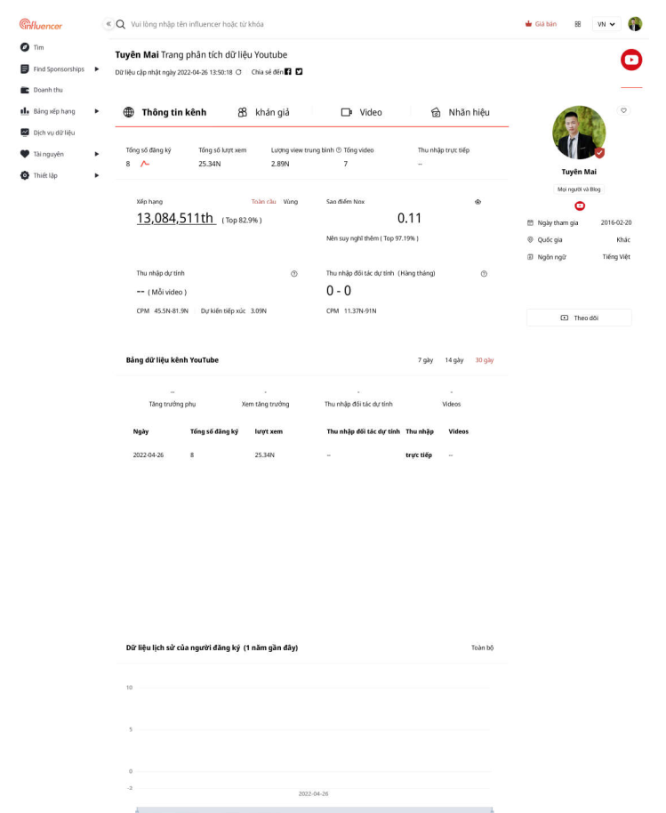
Noxinfluencer
Youtube
Cloud
(3th)
Register account
(User)
Sync data by day
Noxinfluencer
Cloud
System
(Noxinfluencer)
#about 1 day
Analysis & Statistic
(Noxinfluencer)

