Slide 1

COIN DOCUMENT
Date: 2021/12/01

Slide 2
Information
...
Chain data
Hash
PreHash
Data
...
Hash
PreHash
Data
...
Hash
PreHash
Data
...
Coin information
Base: Geth version 1.10.+
Core: Golang
Logic: PoW
Config Node:
- Host: 192.168.1.17
- RPC port: 8090
- p2p port: 30330
- Chain ID: 1996
- API: eth, net, web3
Network status page
Core: NodeJS
API: eth-net-api
View: eth-netstats
Link: http://192.168.1.17:3000
Blockchain Explorer
Core: php
Libs: Web3js
Link: http://192.168.1.17/explorer
Node 0
(Peer)
async
async
Blockchain
Network
Node 1
(Peer)
Node 2
(Peer)
async
Chain data
Chain data

Slide 3
Node detail
Nodes
- Node 0: {
DB: ../node0/geth/chaindata
ChainID: 1996
...
p2p port: 30330
seft: enode://....@localhost:30330
idNetstats: node0:tuyen@localhost:3000
}
- Node 1: {
DB: ../node1/geth/chaindata
ChainID: 1996
...
p2p port: 30331
seft: enode://....@localhost:30331
idNetstats: node1:tuyen@localhost:3000
}
- Node 2: {
DB: ../node2/geth/chaindata
ChainID: 1996
...
p2p port: 30332
seft: enode://....@localhost:30332
idNetstats: node1:tuyen@localhost:3000
}
Node 1 information

Slide 4
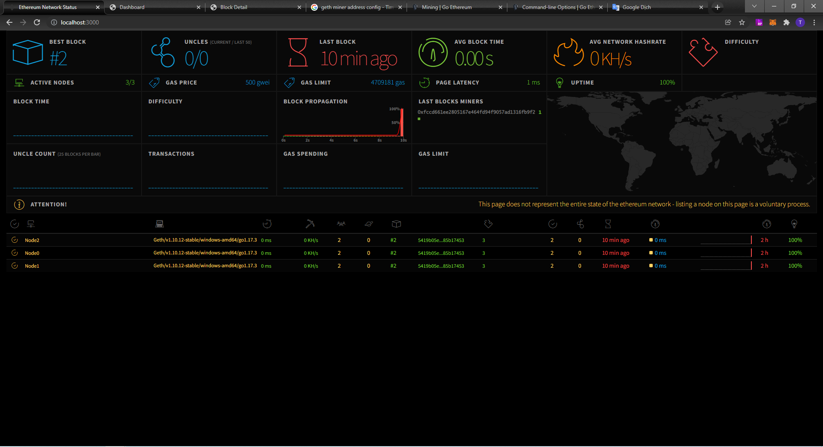
Network status
This page use checking status of node in network, every node in network will work and sync data.
Network status
Node [Peer] status
http://192.168.1.17:3000

Slide 5
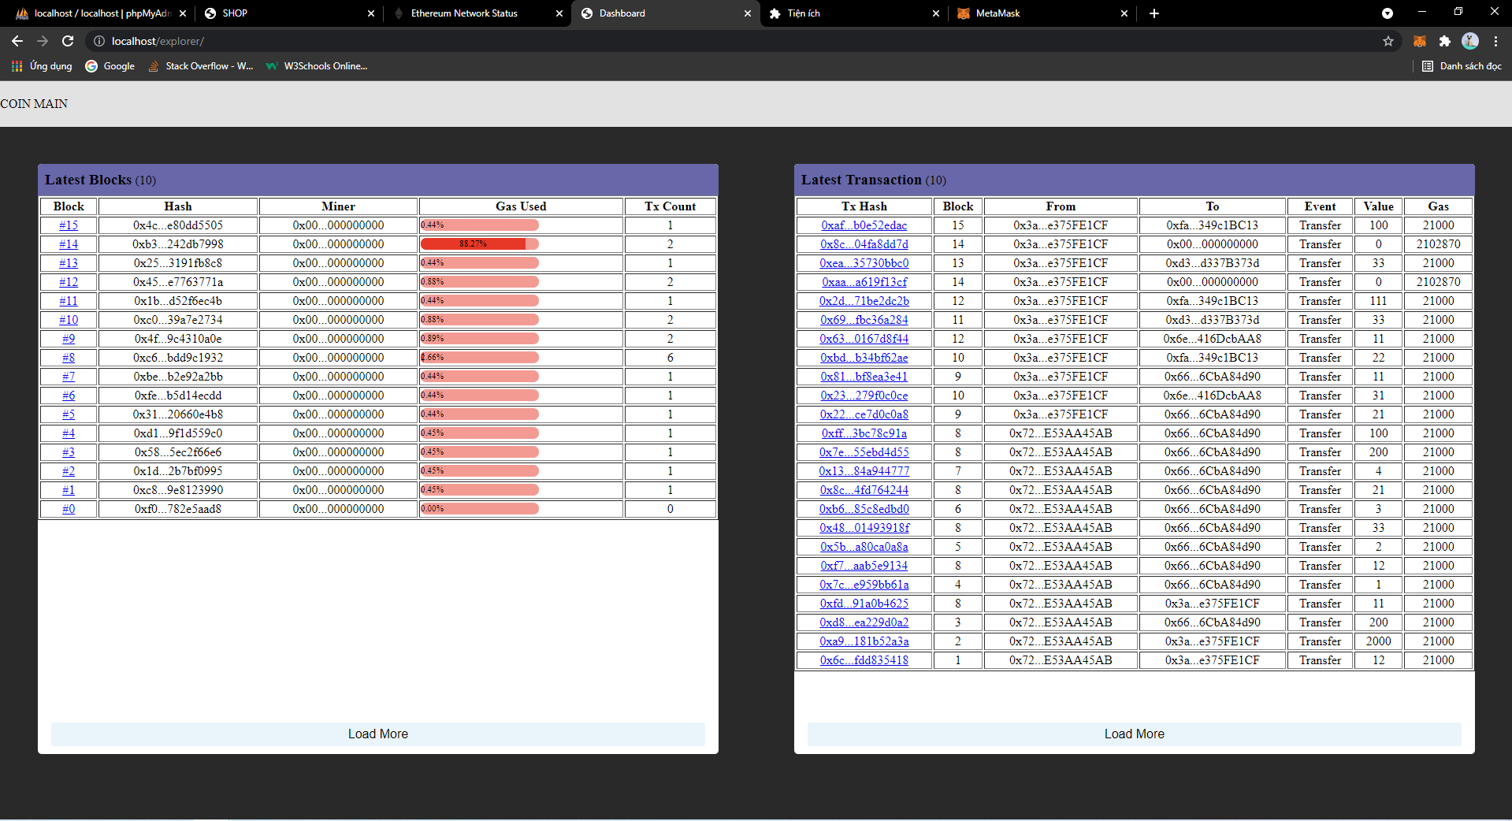
Blockchain explorer
This page use checking detail data transaction and block in network
Network information:
Network Name: Testnet
RPC URL: http://192.168.1.17:8090
ChainID: 1996
Symbol: VKC
http://192.168.1.17/explorer

Slide 6
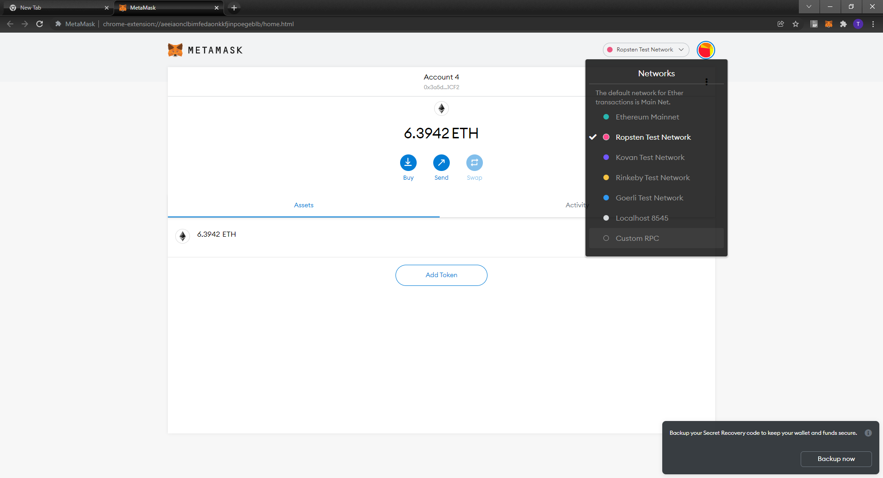
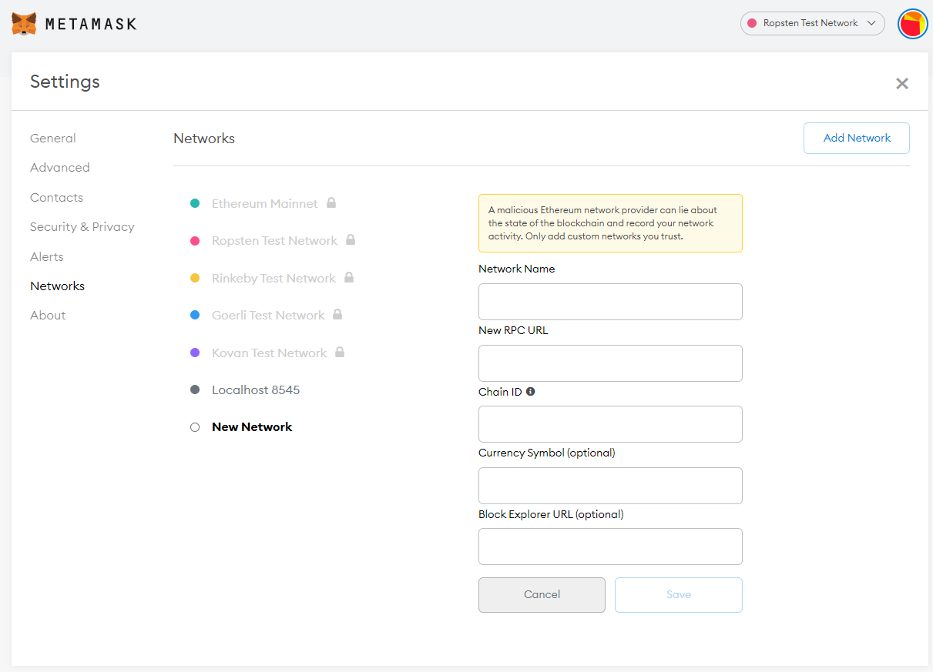
SOP Add Coin
Step 1: Open Metamask / Custom RPC
Step 2: Fill information network
2
1
3
Network name: Vietko Network
RPC URL: http://192.168.1.17:8090
Chain ID: 1996
Symbol: VKC
Explorer URL: http://192.168.1.17/explorer
4

Slide 7
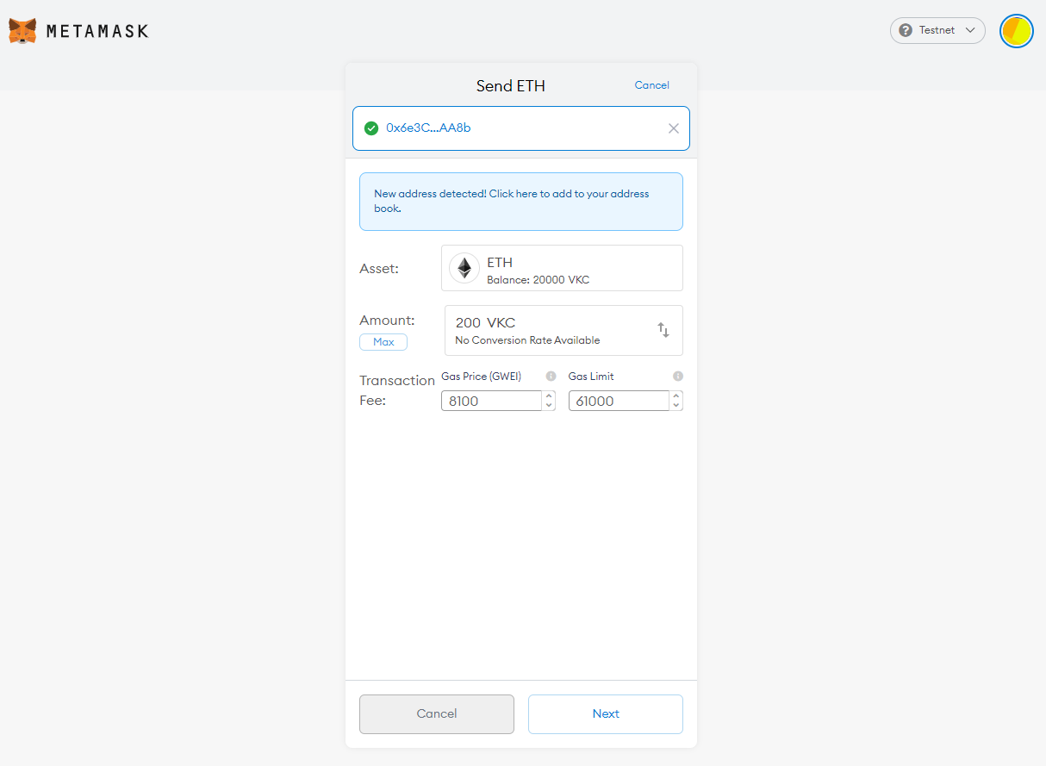
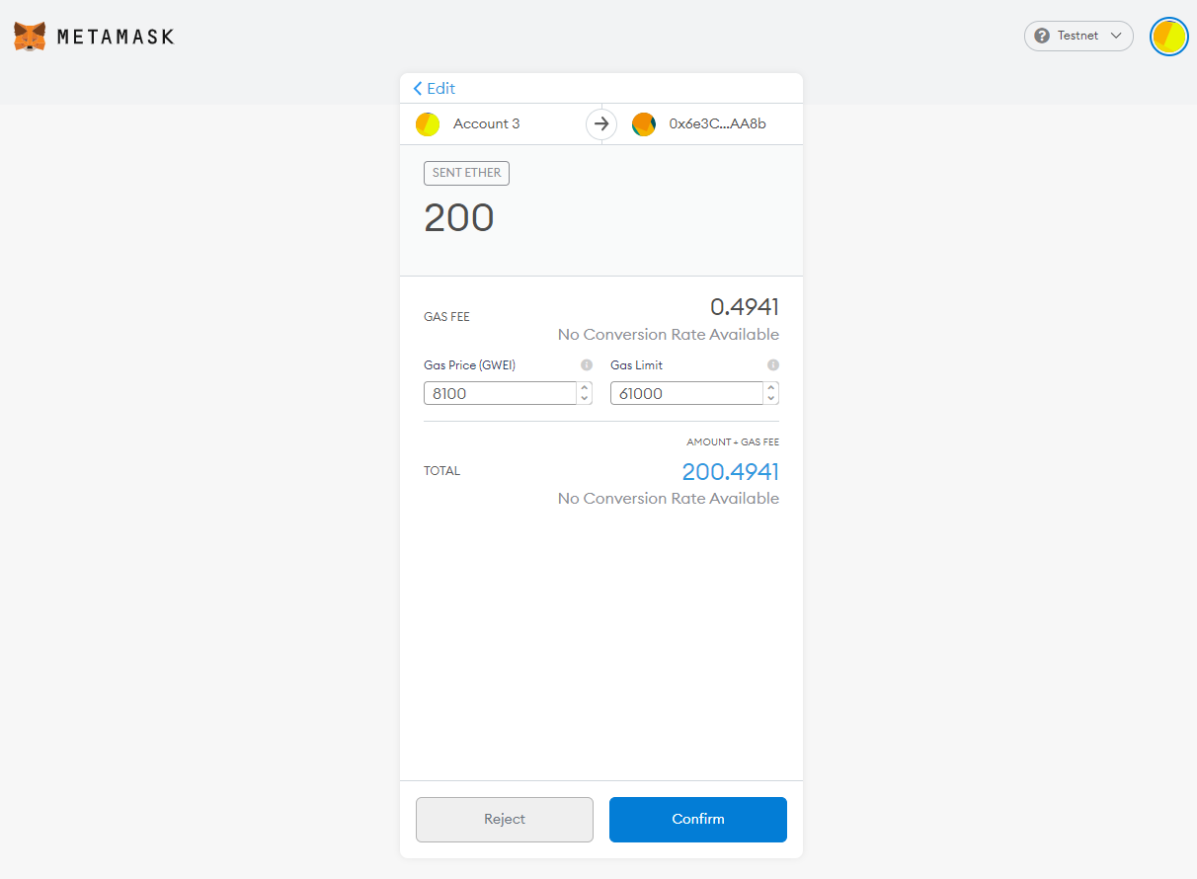
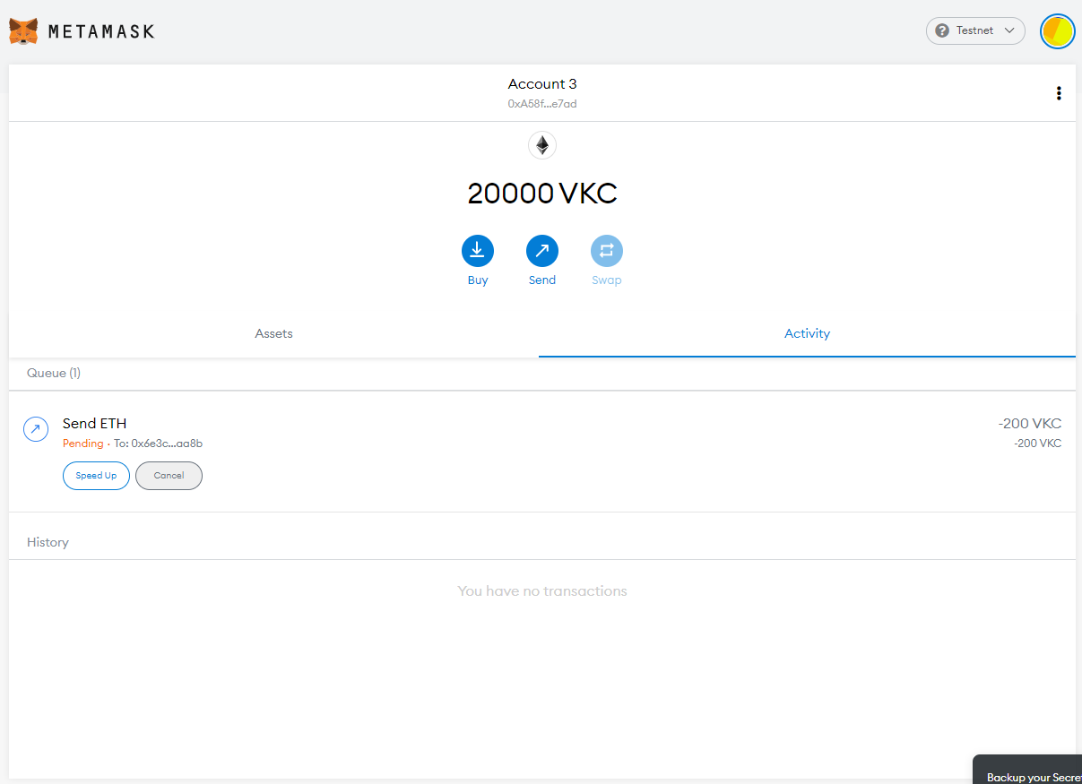
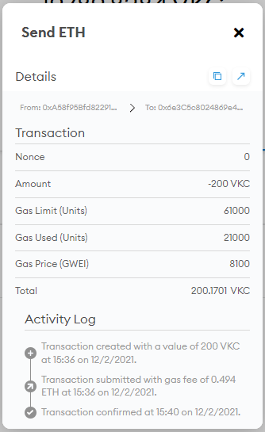

Example
1, Send COIN
2, Confirm amount + Gas
3, Created transaction -> pending
Finish
Transaction information
4, Miner will mining in queue transaction

