Slide 1

TOKEN DOCUMENT
Date: 2021/12/01

Slide 2
Information
Contract Information
- Blockchain network (testnet):
+, Ethereum: https://ropsten.etherscan.io/
+, Binance: https://testnet.bscscan.com/
- Api: Infura
- Token structure: ERC-20
- Contract language: Solidity v0.8.0
Token Service Information
- Core: NodeJS
- Library: Web3, Express, Solc
Application Information
- Core: Java
- Framework: Spring MVC
CONTRACT
<Token>
2, call request
3, res message
Token Service
<Rest API>
1, call request
4, res message
Application

Slide 3

System structure
Application
Token Service
Controller
+ Service
API
Web3
Token service
USER
Application service
View
Blockchain network
Database
Model
(DAO/DTO)

Slide 4
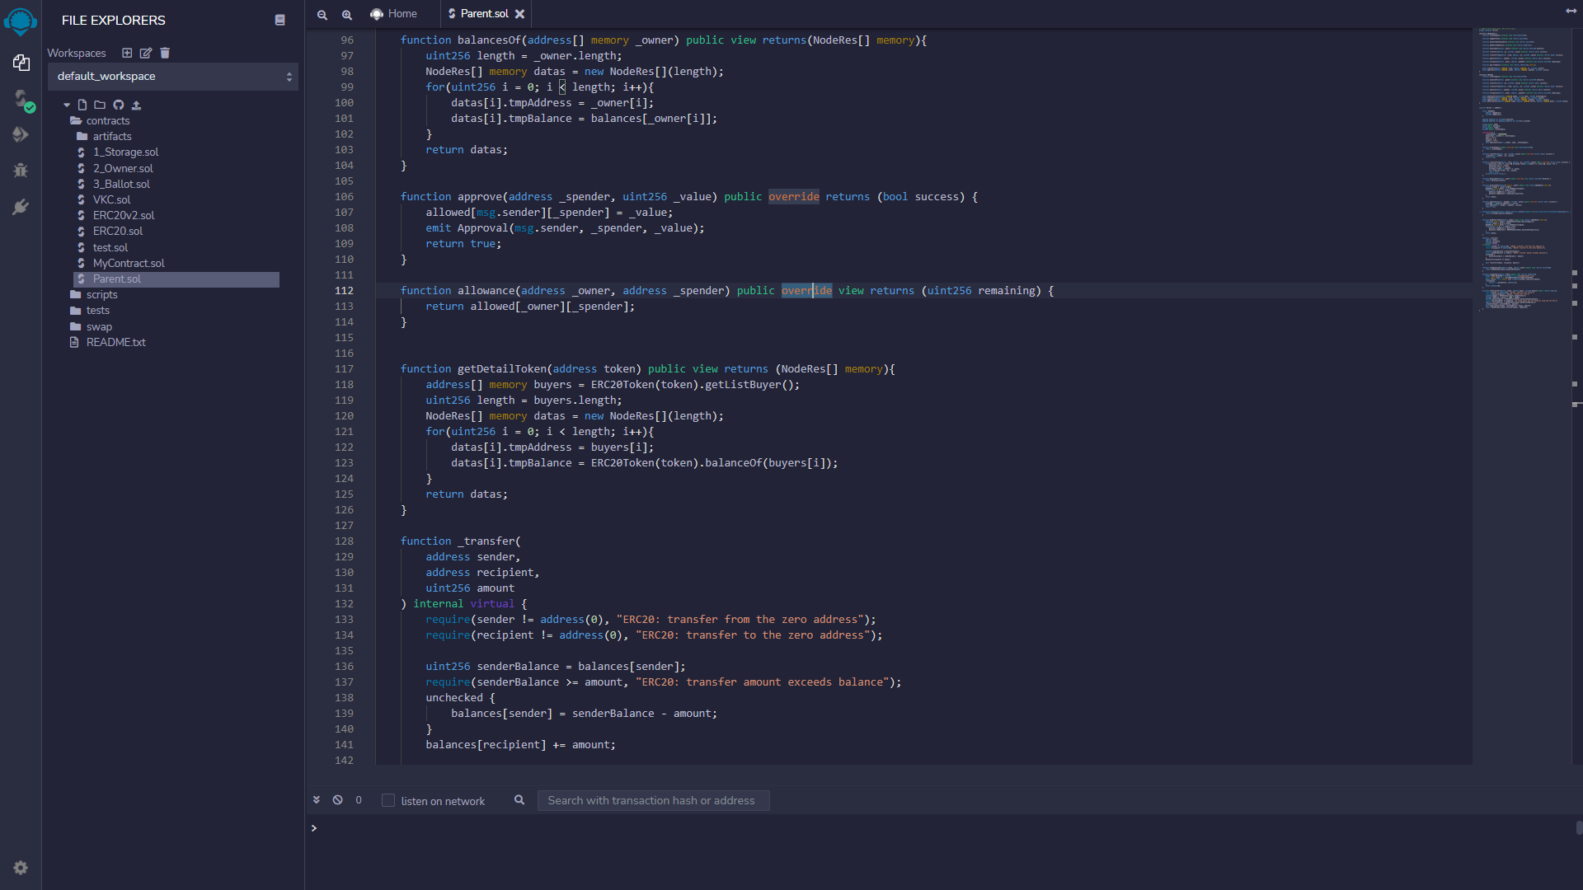
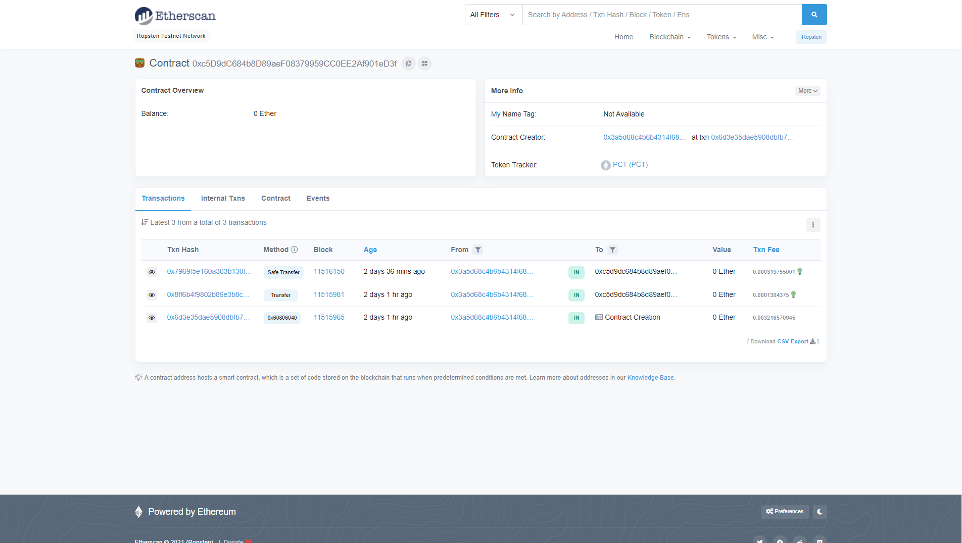
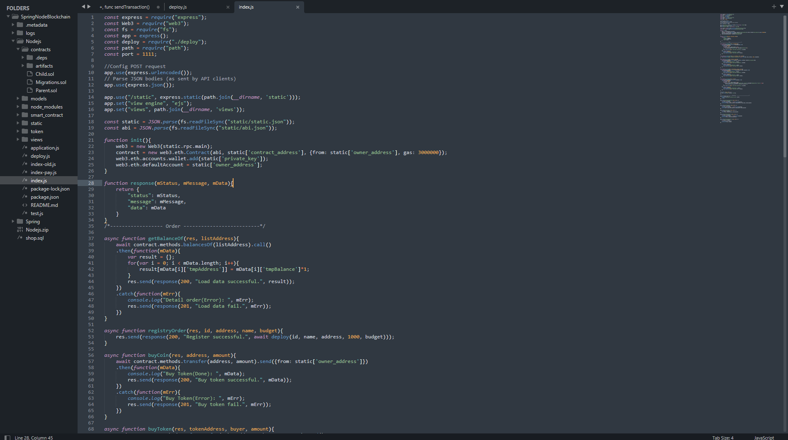
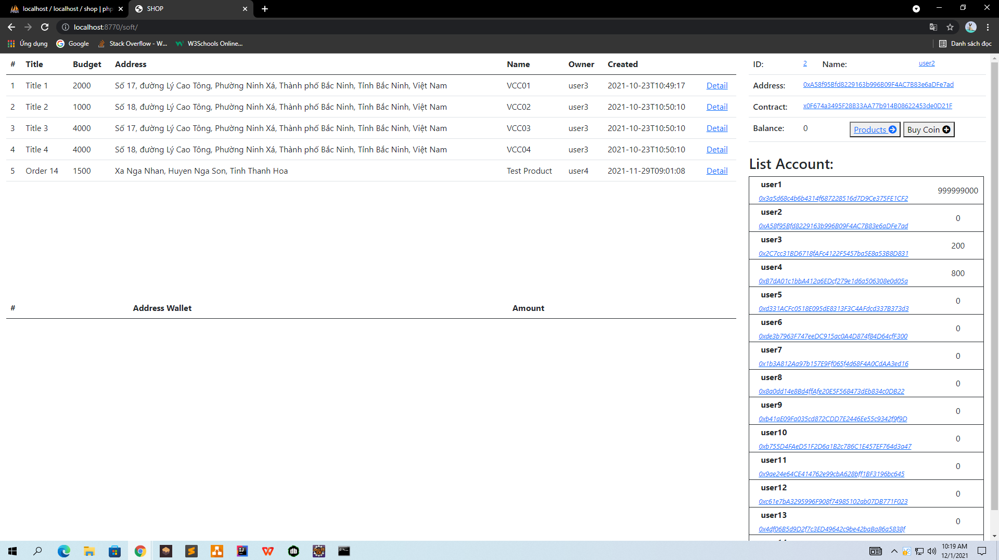
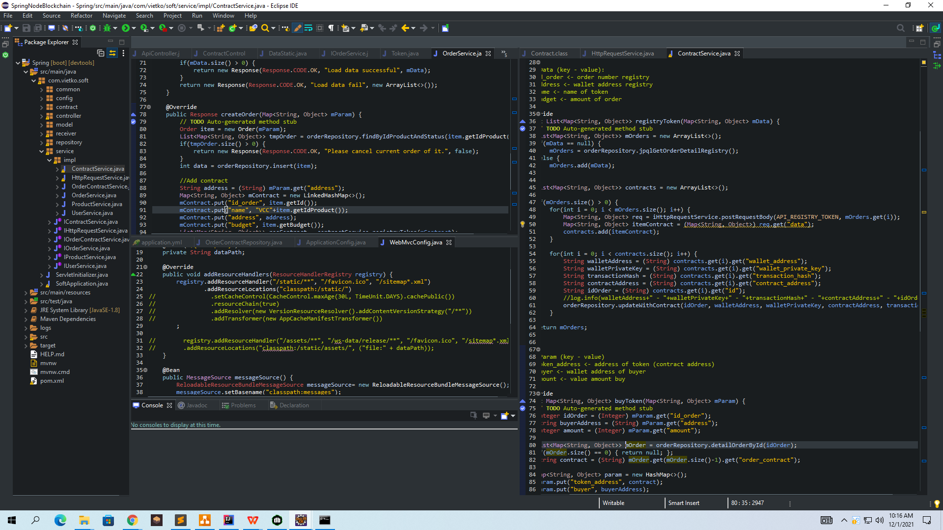
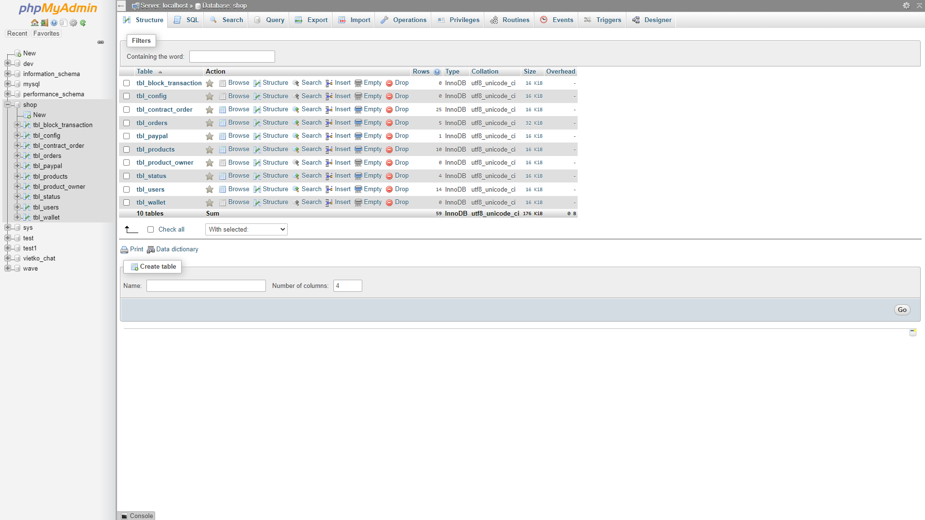
Work follow (Demo Token)
Done
1, Write contract
Done
2, Deploy Contract
Done
3, Build Token API
Done
6, Application Demo
Done
5, Develop Application
Done
4, Build DB for application
Link demo: http://192.168.1.17:8770/soft
Network: ropsten test net / Ganache local

