Slide 1

System Integration
Mini Case Studies © 2010
Nguyễn Minh Nhật -Mob:0905125143
Email :nhatnam06@gmail.com
Shawn A. Butler, Ph.D.
Senior Lecturer, Executive Education Program
Institute for Software Research
Carnegie Mellon University

Slide 2

SYSTEM INTEGRATION
LECTURE 3
Integration Models
Shawn A. Butler, Ph.D.
Nhat Nguyen Minh, Ms.
Senior Lecturer, Executive Education Program
Institute for Software Research
Carnegie Mellon University
© 2010 CMU-ISR

Slide 3
SYSTEM INTEGRATION
Lecture Objectives
Understand three different types of integration models
Understand the characteristics of these models
Understand the advantages and disadvantages of each model
© 2010 CMU-ISR

Slide 4
SYSTEM INTEGRATION
What does it mean to Integrated?
An integration model is a prescribed approach and configuration used to integrate software. It provides a range of different options for the approach and configuration as well as set requirements and limitations, and it emphasizes one or two of the following attributes:
  Simplicity of performing the integration
  Reusability of integration for different configurations
  Breadth of possible approaches to integration
  Expertise required in performing integration
© 2010 CMU-ISR

Slide 5
SYSTEM INTEGRATION
What does it mean to Integrated?
Several models have appeared along with supporting tools that each aimed to reduce the time and cost or increase the reusability and flexibility of integration.
There are 3 Models of Integration for Software
Presentation integration: information is integrated through the user interface component
Data integration: information is integrated through a middleware layer that has business intelligence
Functional integration: information is integrated among databases or data sources
© 2010 CMU-ISR

Slide 6
SYSTEM INTEGRATION
What does it mean to Integrated?
Whenever two software components are integrated together several factors heavily influence the quality and utility of the integration. The factors are these:
  The integration model that is applied
  The tools that are used
  The designer's choices
Coupling : defines the degree of integration.
  Loose coupling is where the integration is dependent on a few discrete interfaces
  Strong coupling is usually where implementation dependencies occur.
© 2010 CMU-ISR

Slide 7
SYSTEM INTEGRATION
Presentation Integration
is one of the simplest forms of integration.
allows the integration of new software through the existing presentations of the legacy software.
used to create a new user interface but may be used to integrate with other applications.
© 2010 CMU-ISR

Slide 8
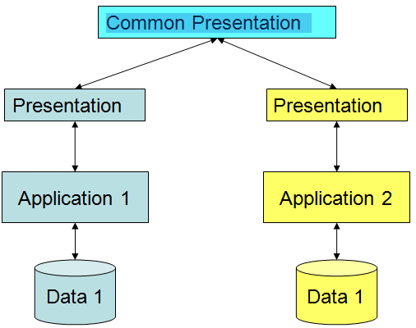

SYSTEM INTEGRATION
Presentation Integration
The presentation integration model integrates through the user interface of applications.
© 2010 CMU-ISR

Slide 9
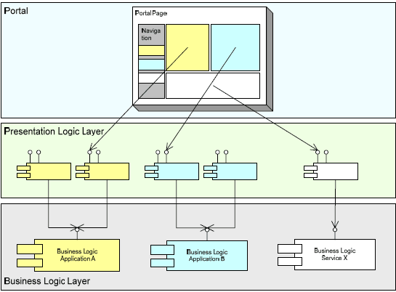
SYSTEM INTEGRATION
Presentation Integration
Presentation-level integration in web portals
© 2010 CMU-ISR

Slide 10
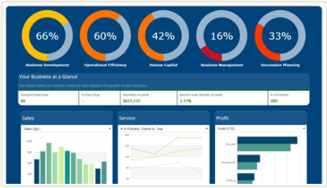
SYSTEM INTEGRATION
  Executive dashboards
  (http://www.mrc-productivity.com/solutions/dashboards.html)
© 2010 CMU-ISR

Slide 11
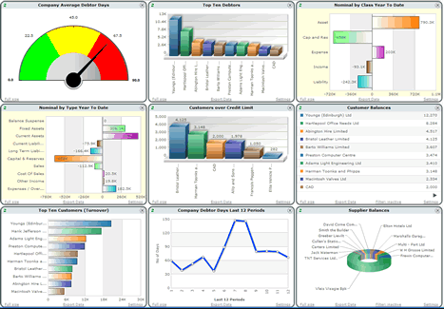
SYSTEM INTEGRATION
  Operational status displays
© 2010 CMU-ISR

Slide 12
SYSTEM INTEGRATION
Characteristics of Presentation Integration
Databases are independent – No coupling!
Information presentation is through application API’s
Databases may have inconsistent information
Primarily a display (i.e., read only)
Examples of Presentation Integration models:
  Executive dashboards
  Operational status displays
© 2010 CMU-ISR

Slide 13
SYSTEM INTEGRATION
When is it Appropriate to use the Presentation Integration Model ?
Put a PC-based user interface on an existing terminal-based application in order to provide an easier-to-use application for an end user
Present and interface that the user perceives to be a single application
Integrate with an application whose only useful and implementable integration is through its presentation
Cannot access databases directly
© 2010 CMU-ISR

Slide 14
SYSTEM INTEGRATION
Presentation Model Advantages
Easiest to implement of all the models
Information presentation often meets user need for information
Reuse is maximized, Web-based technologies useful
Legacy applications unaffected
© 2010 CMU-ISR

Slide 15
SYSTEM INTEGRATION
Presentation Model Disadvantages
Maintenance can be difficult
• Changes in underlying databases may affect GUI
• Data sources may not be able to change to meet requirements
Data may be inconsistent
Inability to access underlying applications may constrain functionality
API’s may not fully support information requirements
© 2010 CMU-ISR

Slide 16
SYSTEM INTEGRATION
Data Integration Model
The data integration model goes directly into the databases or data structures of an application, bypassing the presentation and business logic to create the integration.
A variety of tools and data access middleware has been used to access and integrate information from databases
  Batch file transfer : allow files to be moved between systems and applications
  Open Database Connectivity (ODBC) : A standard application programming interface that abstracts access to heterogeneous relational databases
  Database access middleware : A form of middleware that focuses on providing connectivity to distributed databases
  Data transformation : A tool that usually complements middleware
© 2010 CMU-ISR

Slide 17
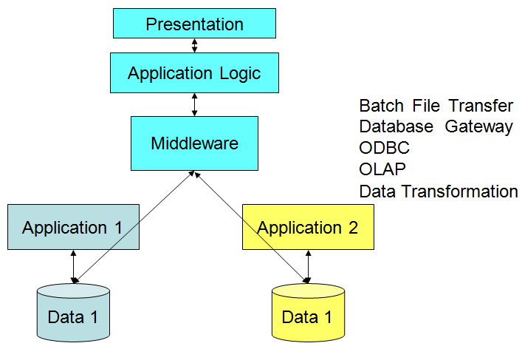
SYSTEM INTEGRATION
Data Integration Model
© 2010 CMU-ISR

Slide 18
SYSTEM INTEGRATION
Characteristics of the Data Integration
Data is accessed directly from all data sources
Middleware technology is used to facilitate data services – increasingly coupled
Business intelligence application is often used to retrieve/update and present information
Information can be updated in both data sources
Existing application interfaces are not used
© 2010 CMU-ISR

Slide 19
SYSTEM INTEGRATION
When is the data Integration Model Appropriate?
Combine data from multiple sources for analysis and decision making
Provide multiple applications with a common source of information
Allows data to be extracted from one source and reformatted and updated in another database
© 2010 CMU-ISR

Slide 20
SYSTEM INTEGRATION
Data Model Advantages
Can access all data elements in the DB
Increase customization over presentation model
Can update data if necessary
Legacy applications unaffected

Slide 21
SYSTEM INTEGRATION
Data Model Disadvantages
Maintenance can be difficult
Data may be inconsistent
Inability to access business logic in legacy applications may constrain available functionality
Redundant code possible
© 2010 CMU-ISR

Slide 22
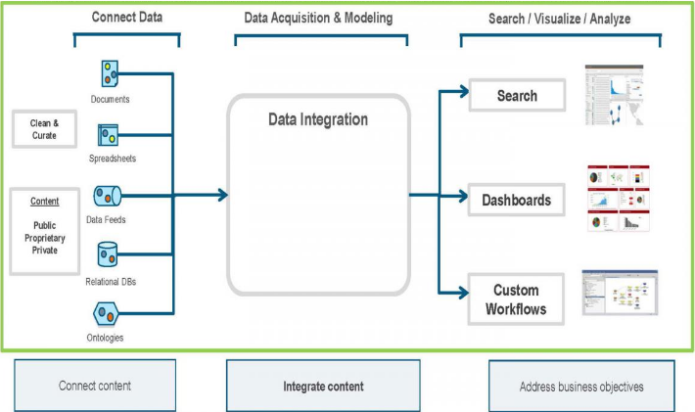
SYSTEM INTEGRATION
Anatomy of a Data Integration Application
(http://stateofinnovation.com/why-is-data-integration-so-hard)
© 2010 CMU-ISR

Slide 23
SYSTEM INTEGRATION
Functional Integration Model
The functional integration model integrates at the business logic level, as opposed to the presentation or data levels.
Requires that the point of integration be in the code of the application
© 2010 CMU-ISR

Slide 24
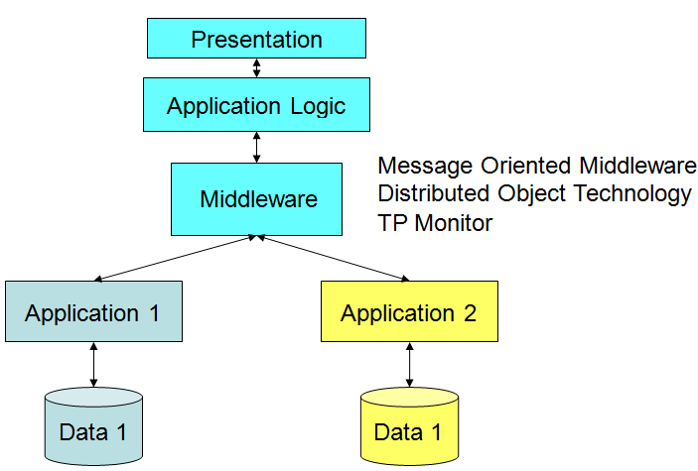
SYSTEM INTEGRATION
SYSTEM INTEGRATION
Functional Integration Model

Slide 25
SYSTEM INTEGRATION
Functional Integration Model
Distributed processing middleware
  is a type of software that facilitates the communication
  of requests between software components through the use of
  defined interfaces or messages
  it provides the runtime environment to manage the requests between software components
The three categories of distributed processing middleware are as follows :
  Message Oriented Middleware (MOM)
  Distributed object technology
  Transaction processing monitors (TPMs)
© 2010 CMU-ISR

Slide 26
SYSTEM INTEGRATION
Functional Integration Model
  Message Oriented Middleware (MOM)
Provides integration by passing messages between applications. Similar to the concept of the Post Office, a message is placed into the MOM.
Examples of products include IBM's MQSeries and Talarian's Smart Sockets.
Distributed object technology
The software then can be accessed by other applications across a network through the object interfaces (CORBA, Microsoft COM+, .NET remoting, RMI in Sun's Java 2 Enterprise Edition (J2EE) environment)
© 2010 CMU-ISR

Slide 27
SYSTEM INTEGRATION
SYSTEM INTEGRATION
Functional Integration Model
TP monitor (TeleProcessing monitor or Transaction Processing monitor) A control program that manages the transfer of data between multiple local and remote terminals and the application programs that serve them.

Slide 28
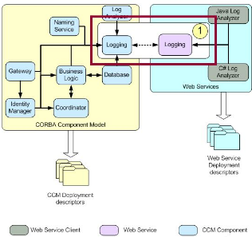
SYSTEM INTEGRATION
SYSTEM INTEGRATION
Functional Integration Model

Slide 29
SYSTEM INTEGRATION
Characteristics of Functional Integration Model
Application Logic is available to the presentation layer from legacy applications
Data consistency
Update capability with the integrated applications
Some sort of middleware is necessary to manage all integrated applications
The most coupled of integration styles
© 2010 CMU-ISR

Slide 30
SYSTEM INTEGRATION
SYSTEM INTEGRATION
Functional Model Advantages
Complete access to all data and business logic
Can create the most customized solution
Can update legacy applications if necessary
Data is consistent in the system
© 2010 CMU-ISR

Slide 31
SYSTEM INTEGRATION
SYSTEM INTEGRATION
Functional Model Disadvantages
Maintenance task increases in complexity
The most difficult to implement
Data may be inconsistent
Legacy applications may be affected
© 2010 CMU-ISR

Slide 32
SYSTEM INTEGRATION
SYSTEM INTEGRATION
Heuristic 2
Build and maintain options as long as possible in the design
and implementation of complex systems. You will need them.
© 2010 CMU-ISR

Slide 33
SYSTEM INTEGRATION
Heuristic 3
Simplify, Simplify, Simplify
© 2010 CMU-ISR

Slide 34
SYSTEM INTEGRATION
Summary
Three types of integration models:
• Presentation Model
• Data Model
• Functional Model
These models do not constitute a rigid integration design model, rather many integrated systems are a combination of styles
Each model has advantages and disadvantages
The integration style should be selected based on the user requirements and constraints
Think about the heuristics when selecting an integration style
© 2010 CMU-ISR

Slide 35
SYSTEM INTEGRATION
QUIZ – EXAM
Subject: SE445 – Class: SE445G
Time: 90’ – (4:05pm-5:05pm)
Name: ………………………..Code:………………….
1. Use the table below to compare and contrast the three different types of integration, Presentation, Data and Functional Integration four criterias behind: Integration Focus Applicability, Technology, Standards (6.0 points).
 | Presentation | Data | Functional
Integration Focus
Applicability | - Dash board, …
Technology | - API, Java Script,
Standards
© 2010 CMU-ISR

Slide 36
SYSTEM INTEGRATION
QUESTION
2.What does “Coupling” mean with respect to system integration? For each coupling let's give an example (4.0 points)
...o0o…
© 2010 CMU-ISR

Slide 37
SYSTEM INTEGRATION
The end
© 2010 CMU-ISR

