Slide 1

System Integration
Mini Case Studies © 2010
Nguyễn Minh Nhật -Mob:0905125143
Email :nhatnm2010@gmail.com
Shawn A. Butler, Ph.D.
Nhat,NguyenMinh. Msc.
Senior Lecturer, Executive Education Program
Institute for Software Research
Carnegie Mellon University

Slide 2

SYSTEM INTEGRATION
Lecture 08
Integration Types
(Các loại tích hợp)
Shawn A. Butler, Ph.D.
Senior Lecturer, Executive Education Program
Institute for Software Research
Carnegie Mellon University
Mentor Nguyen Minh Nhat
© 2010 CMU-ISR

Slide 3
SYSTEM INTEGRATION
OBJECTIVES
Be able to identify the four different styles of application integration
Understand the elements of a messaging system
Become familiar with some of the problems associated with senders and receivers
© 2010 CMU-ISR

Slide 4
SYSTEM INTEGRATION
Assumptions
The application developers may not have designed with integration in mind
Even if they did, they probably wouldn’t have anticipated your requirements
The documentation is perfectly understandable in the minds of the original developers
The interface documents long ago disappeared
© 2010 CMU-ISR

Slide 5
SYSTEM INTEGRATION
Application A Application B
How to Integrate Two (or more) Applications ?
Application A
Application B
© 2010 CMU-ISR

Slide 6
SYSTEM INTEGRATION
Integration Guidelines
Application Coupling – Minimize dependencies
  • Tightly coupled applications have known and unknown assumptions
  • Applications can evolve independently without
  problems
Intrusiveness – Minimize changes in each application
  • Changes are often necessary (adds - in)
  • Tradeoff between intrusiveness and best integration design
© 2010 CMU-ISR

Slide 7
SYSTEM INTEGRATION
Integration Guidelines (cont)
Technology Selection – A variety of HW (Hard Ware) and SW(Soft Ware) integration tools
  •Expensive
  •Vendor Lock-in
  •Tradeoff between tools and reinventing
Data Format – Agree on format of data exchange
  •Change the application or create a translator
  •How will the data change over time?
Data timeliness – When does the exchange take place
  •Tradeoff large chunks versus small chunks of data
  •Real time - near real time – in time
© 2010 CMU-ISR

Slide 8
SYSTEM INTEGRATION
Integration Guidelines (cont)
Data or Functionality – functionality provides a better abstraction between applications
• Local versus remote invocation
Remote Communication
  • Synchronous and Asynchronous
  • Slower than local
Reliability – Communication across networks is not as reliable as inter- application communication
© 2010 CMU-ISR

Slide 9
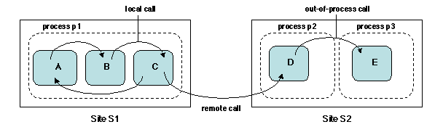
SYSTEM INTEGRATION
Integration Guidelines (cont)
Local call – Remote Call
© 2010 CMU-ISR

Slide 10
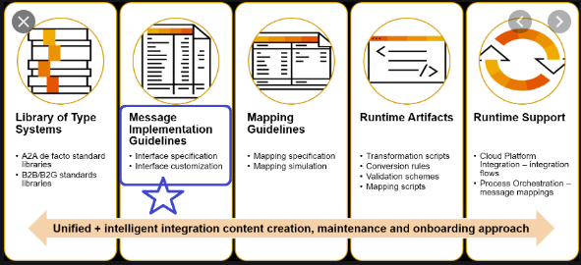
SYSTEM INTEGRATION
Integration Guidelines (cont)
The key concepts of the Message Implementation Guideline (MIG)
© 2010 CMU-ISR

Slide 11
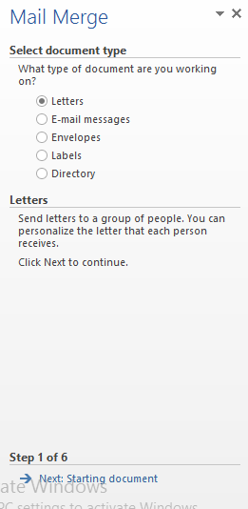
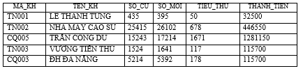
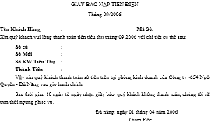
SYSTEM INTEGRATION
Integration Guidelines (cont)
Example for Mail Merge in MS.Word
© 2010 CMU-ISR

Slide 12
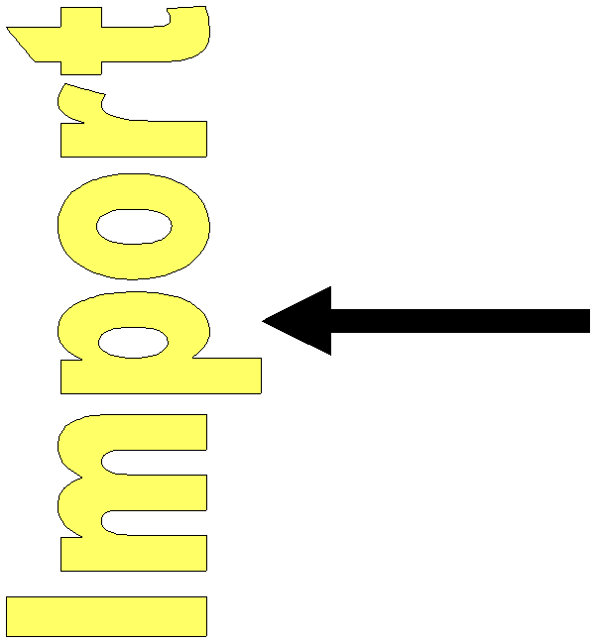

SYSTEM INTEGRATION
File Integration
File Transfer
Application A
Application B
© 2010 CMU-ISR

Slide 13


SYSTEM INTEGRATION
File Integration (cont)
Application A Application B
File Transfer
MS.Excel, ….
© 2010 CMU-ISR

Slide 14
SYSTEM INTEGRATION
File Integration (cont)
Application A Application B
Advantages
  •Almost all applications use/produce files
  •Standard formats often available
  •No knowledge of the internal application
  •No special tools necessary
  •Receiving application can manipulate file data
© 2010 CMU-ISR

Slide 15
SYSTEM INTEGRATION
File Integration (cont)
Application A Application B
Disadvantages
•Integrator workload
        Formats
        File management
        Freshness/staleness
        Timing and locking mechanisms
        Bad data
•Update latency
•Computing resources (available for support or not etc.)
© 2010 CMU-ISR

Slide 16
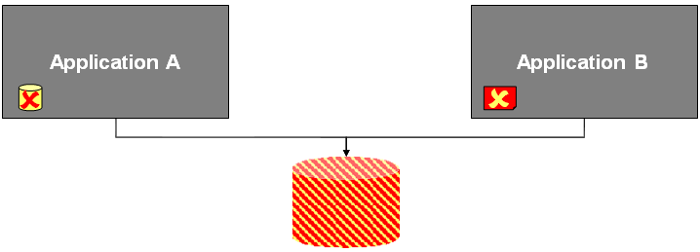
SYSTEM INTEGRATION
File Integration (cont)
Application A Application B
© 2010 CMU-ISR

Slide 17
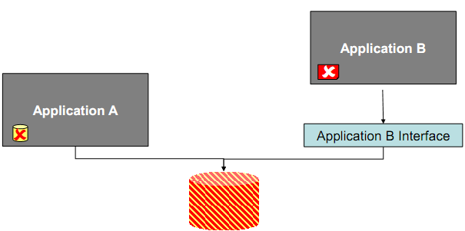
SYSTEM INTEGRATION
File Integration (cont)
Application A Application B
How do other system should be updated automatically after old data entered into system?
© 2010 CMU-ISR

Slide 18
SYSTEM INTEGRATION
Shared Databases
Application A Application B
Advantages
  •Consistency
  •Standard Query Language (SQL)
  •No multiple file formats
  •Single technology
  •Semantic Dissonance resolved
© 2010 CMU-ISR

Slide 19
SYSTEM INTEGRATION
Shared Databases (cont)
Disadvantages
  •Semantic Dissonance hard to resolve
  •Finding a workable schema difficult
  •Changed schemas break COTS applications
  •Database may become a performance bottle-neck
  •Database changes impact performance
  •Not-so-standard SQL
  •Ripple effect of changes
  COTS : Commercial Off-The-Shelf
© 2010 CMU-ISR

Slide 20
SYSTEM INTEGRATION
Shared Databases (cont)
  COTS : Commercial Off-The-Shelf
  A COTS product is usually a computer hardware or software product tailored for specific uses and made available to the general public. Such products are designed to be readily available and user friendly. A typical example of a COTS product is Microsoft Office or antivirus software. A COTS product is generally any product available off-the-shelf and not requiring custom development before installation.
© 2010 CMU-ISR

Slide 21
SYSTEM INTEGRATION
RPC ( Remote Procedure Call) – Thủ tục triệu gọi từ xa
How to Integrate Two (or more) Applications -RPC
Application A
Stub Skeleton
Application
Application A
Application B
© 2010 CMU-ISR

Slide 22
SYSTEM INTEGRATION
RPC ( Remote Procedure Call)
An application uses remote objects organized in a Client-Server model:
The client sends a request to the server to execute the methods on the objects.
The server provides its services through a set of Remote Procedure Call (RPC) through invocation methods on a remote object: Stub and Skeleton
© 2010 CMU-ISR

Slide 23
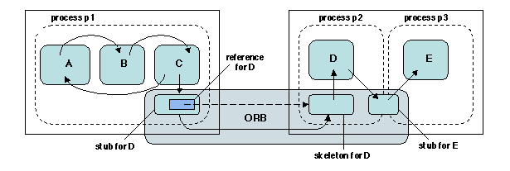
SYSTEM INTEGRATION
RPC ( Remote Procedure Call)
© 2010 CMU-ISR

Slide 24
SYSTEM INTEGRATION
RPC (Remote Procedure Call)
RPC systems
1st generation // hỗ trợ ngôn ngữ lập trình hướng thủ tục
Sun RPC
DCE RPC
2nd generation //hỗ trợ ngôn ngữ lập trình hướng đối tượng
Microsoft DCOM (COM, COM++)
CORBA
JAVA RMI
3rd generation//hỗ trợ ngôn ngữ lập trình Web
XML RPC
SOAP
Web Services and WSDL
Microsoft .NET Remoting
.NET Web Services
Web Service
AJAX
REST etc
© 2010 CMU-ISR

Slide 25
SYSTEM INTEGRATION
RPC ( Remote Procedure Call)
Advantages
  Data changes can trigger other changes
  • Many existing tools
  • Easier to deal with semantic dissonance
  • Applications are less coupled than with Data Sharing style
Disadvantages
  • Co-applications have to negotiate exchange interface
  • Interfaces evolve and grow
© 2010 CMU-ISR

Slide 26
SYSTEM INTEGRATION
Messaging Systems
Channels – Logical addresses
  •Different logical addresses for different purposes
  •How does the application find the relevant addresses?
Messages
  •Headers – type of data, origin, destination…
  •Body – the data
Pipes and Filters – preprocesses data
Routing – broadcast, point to point, context based, publish subscribe…
© 2010 CMU-ISR

Slide 27
SYSTEM INTEGRATION
Messaging Systems // Middleware
Transformation
  •Aggregation // tổng hợp
  •Data types
  •Data Representations (XML, ASCII..)
  •Transport (HTTP, SOAP, JMS…)
Endpoints – Message endpoints interface between the application and the messaging system
© 2010 CMU-ISR

Slide 28
SYSTEM INTEGRATION
How to integrate two( or more ) Applications - Messaging
Application A
Application B
Messaging System
© 2010 CMU-ISR

Slide 29
SYSTEM INTEGRATION
How to integrate two( or more ) Applications - Messaging
Application A
Application B
Event Manager
Event Manager
Messaging System
© 2010 CMU-ISR

Slide 30
SYSTEM INTEGRATION
Messaging
Advantages
  •Asynchronous data transfer
  •Decoupled applications
  •Choice among topologies
  •Applications have different conceptual models
  •Timeliness
  •Reliability
Disadvantages
  •Asynchronous learning curve
  •Testing and debugging more difficult
  •Semantic dissonance still there
© 2010 CMU-ISR

Slide 31
SYSTEM INTEGRATION
How to think about Messaging ?
How is data transferred between applications?
How does an application know where to send the data?
How or when does the data get transformed?
What happens when an application isn’t sending
(receiving)?
How do we know if the system is working appropriately?
etc..
© 2010 CMU-ISR

Slide 32
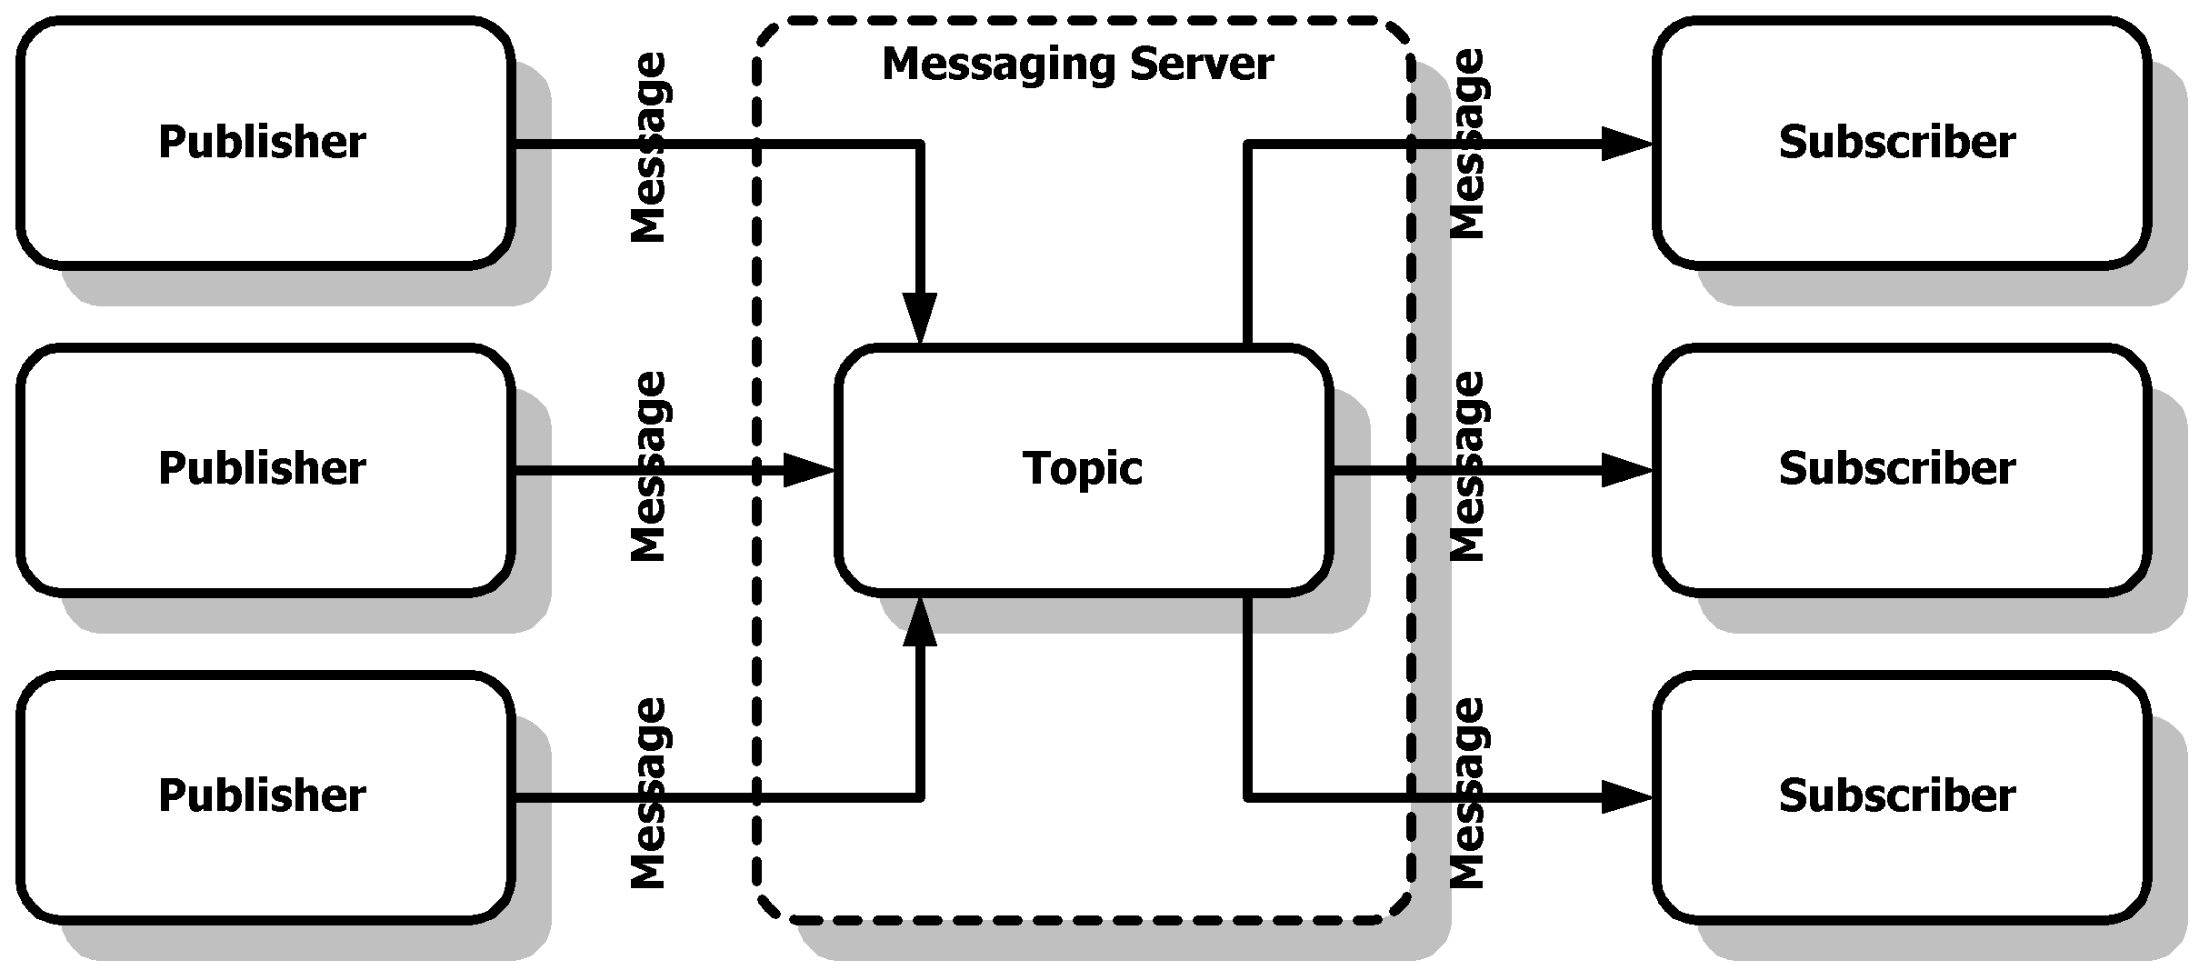
Figure 1: Publish-Subscribe Based Messaging System
SYSTEM INTEGRATION
How to think about Messaging ?
The Java Message Service (JMS) provides a standard Java-based interface to the message services of a MOM of some other provider
© 2010 CMU-ISR

Slide 33
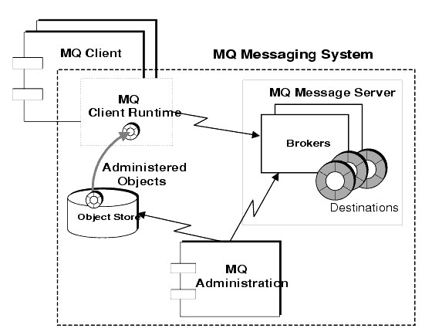
SYSTEM INTEGRATION
How to think about Messaging ?
MQ Message Server
MQ Client Runtime
MQ Administered Objects
MQ Administration
© 2010 CMU-ISR

Slide 34
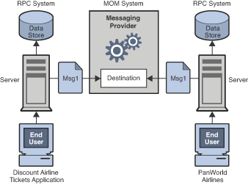
SYSTEM INTEGRATION
How to think about Messaging ?
© 2010 CMU-ISR

Slide 35
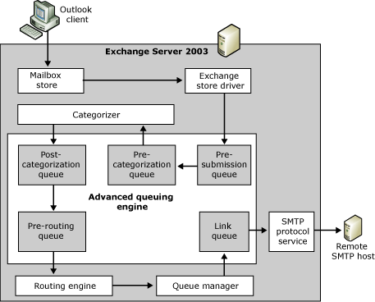
SYSTEM INTEGRATION
How to think about Messaging ?
© 2010 CMU-ISR

Slide 36
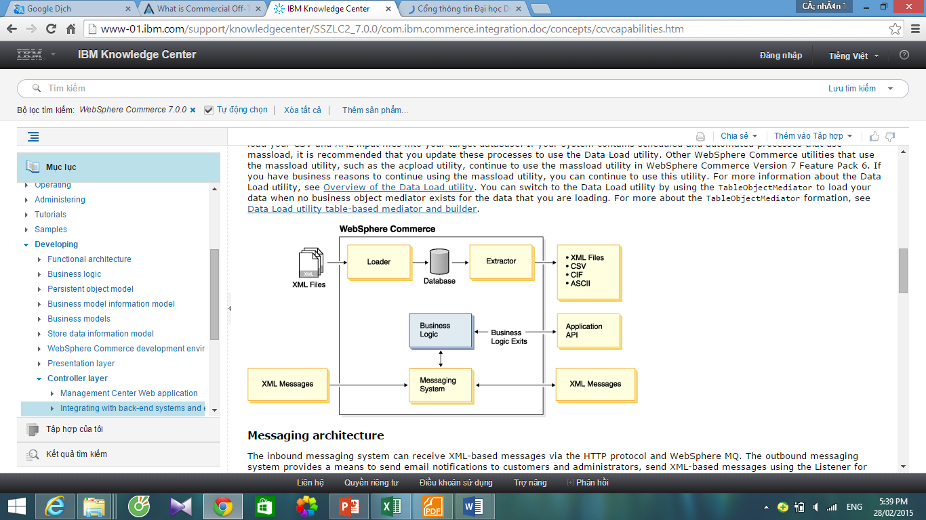
SYSTEM INTEGRATION
How to think about Messaging ?
© 2010 CMU-ISR

Slide 37
SYSTEM INTEGRATION
Summary
System integration would be easier if applications
were designed to be integrated, had similar formats, and had complete and understandable documentation
Each integration style has advantages and disadvantages
Messaging systems have become the preferred method of integration, but it isn’t the only method of integration
Messaging products provide the foundation, but
there is still a lot of design to be done
© 2010 CMU-ISR

Slide 38
SYSTEM INTEGRATION
Summary
How many ways to integrate 2 applications each other? Please tell about the advantages and disadvantages of each type?
Explain why messaging systems are widely used in integrated applications today
© 2010 CMU-ISR

Slide 39
SYSTEM INTEGRATION
NEW WORDS
familiar /fə'miljə/a. thuộc gia đình, thân thuộc, thân; quen thuộc
associate /ə'souʃiit/, a.v kết giao, kết hợp liên hợp; liên đới
anticipate /æn'tisipeit/ v. lường trước, đoán trước
perfectly /'pə:fiktli/adv. hoàn toàn, hoàn hảo,a. perfect
Original /ə'ridʤənl/ a. ban đầu, nguyên gốc, nguyên bản
guideline n. hướng dẫn, nguyên tắc chỉ đạo, đường lối chỉ đạo,
intrusiveness /in'tru:sivnis/n. xâm phạm, xâm nhập a. intrusive
n intrusion
variety /və'raiəti/n. nhiều thứ, muôn màu muôn vẻ
versus /'və:səs/pre. chống, chống lại, đấu với
© 2010 CMU-ISR

Slide 40
SYSTEM INTEGRATION
NEW WORDS
envent /in'vent/ n,v: sáng tạo, phát minh, n: enventing
chunk /tʃʌnk/ n. khối, mảng, miếng
synchronous /'siɳkrənəs/a. đồng thời; đồng bộ
asynchronous /æ'siɳkrənəs/a. không đồng thời, không đồng thời
manipulate /mə'nipjuleit/v. thao tác, n.manipulating
Latency /'leitənsi/ n. độ trễ
ripple /'ripl/n. sự gợn sóng lăn tăn, v. làm cho gợn sóng
dissonance /'disənəns/n. sự không hoà hợp, sự bất hoà
© 2010 CMU-ISR

