Slide 1

COMMENT GENERATING FOR OUTFIT
FACULTY FOR HIGH QUALITY TRAINING
HCMC UNIVERSITY OF TECHNOLOGY AND EDUCATION
GRADUATE THESIS
Instructor: T.S Nguyễn Thiên Bảo
Members: Đỗ Quốc Hùng - 16110097
Phạm Thanh Trung - 16110232

Slide 2
CONTENT
Introduction
Architecture
Experiment
Summary

Slide 3
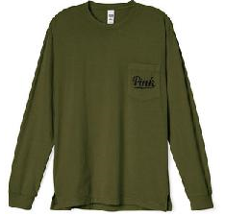
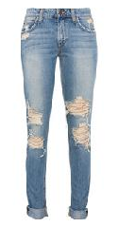
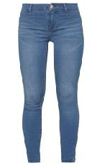

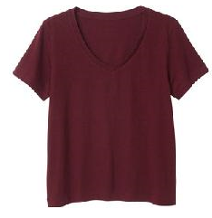
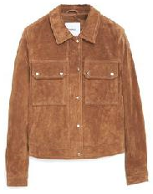
1. INTRODUCE

Slide 4
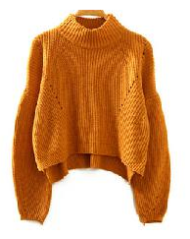
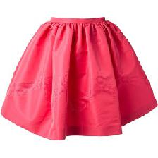
1. INTRODUCE
+
COMMENT GENERATING
This is darling ! : ).

Slide 5
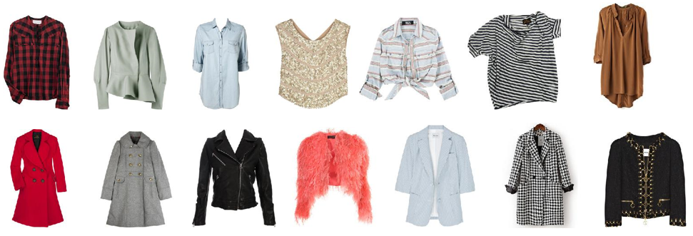
1. INTRODUCE
SCOPE:
- Experiment model comment generating for a pair of fashion image
- A pair of fashion image include a top image (ex: t-shirt, jacket, coat,…) and bottom image (trousers, skirt, shorts...)
+ Size of image: 224 x 224 x 3
+ RGB color.
+ Background: white.

Slide 6
2. ARCHITECTURE
NFR (Neural Fashion Recommendation)
RNN (Recurrent Neural Network)
GRU (Gated Recurrent Unit)

Slide 7
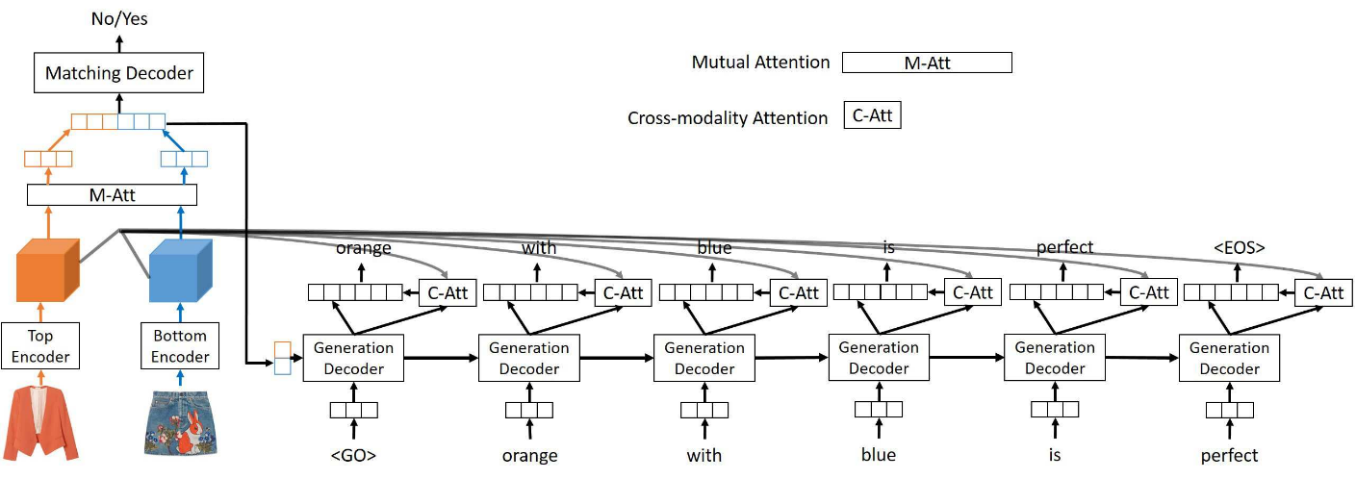
NFR (Neural Fashion Recommendation)
Neural Fashion Recommendation (NFR)
(Yujie Lin et al, 5 Mar 2019)

Slide 8
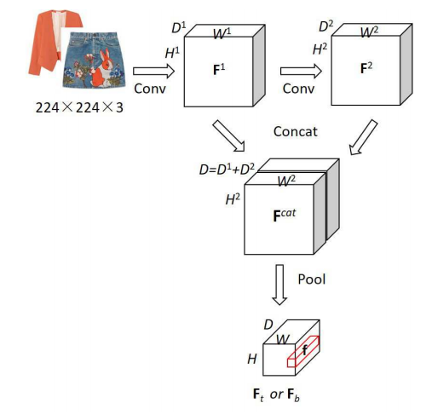
Top and bottom image encoder

Slide 9
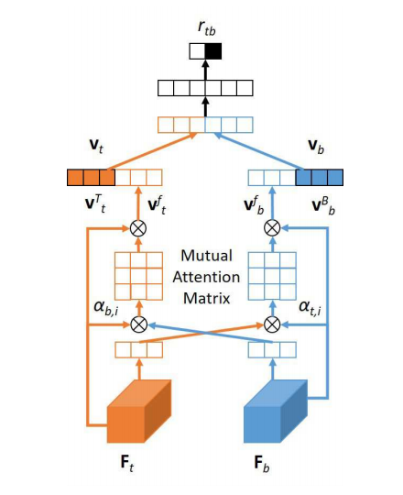
Mutual attention and matching decoder

Slide 10
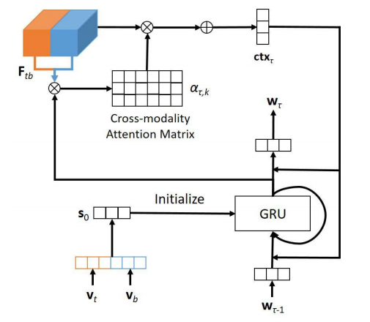
Cross-modality attention & generation decoder

Slide 11
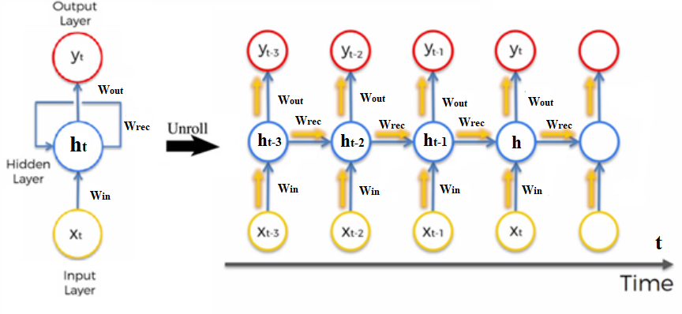
RNN (Recurrent Neural Network)
Architectural model RNN

Slide 12
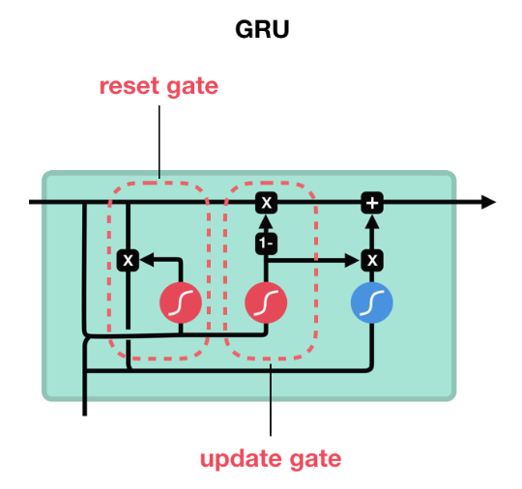

GRU (Gated Recurrent Unit)
Architectural model GRU

Slide 13
3. EXPERIMENT
DATASET:
- Number of images: 50,015 ( 29,113 top + 20,902 bottom).
- Vocabolary set: 92,295 , experiment: 16,519 (frequency of occurrence above 5)
Dataset | Top | Bottom | Pair | Comment
ExpFashion | 29,113 | 20,902 | 200,745 | 1,052,821

Slide 14
3. EXPERIMENT
ENVIRONMENT:
Google Colab Service, RAM 12 GB, disk 358.27 GB.

Slide 15
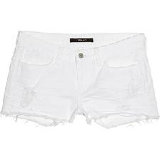
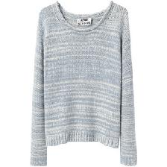
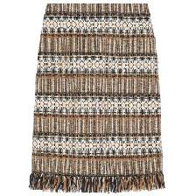
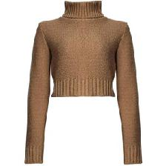

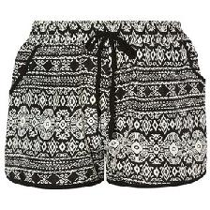
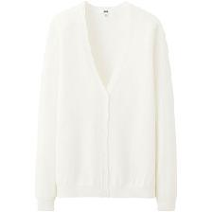
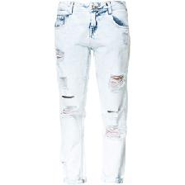

3. EXPERIMENT
RESULT:
Wow ! this is fabulous dear, love it all very much- well done :)). | Stylish fashion such a nice combo for this season
Hey, thanks for following us ! | Thanks girl.

Slide 16

3. EXPERIMENT
EVALUATION:
 | NFR
 | Top - Down | Down - Top
BLEU-1 | 0.357 | 0.408

Slide 17
4. SUMMARY
WORKS DONE:
- Research models to handle image and text processing problems in Deep Learning, Machine Learning.
- Learn the app that solves problems with suggestions and generates commentary for outfits.
- Researching models and techniques to apply them to solving models generating comments from still images.
- Re-implement the model “Automatically generate comments for fashion photos”.

Slide 18
4. SUMMARY
RESTRICTIONS:
- Facilities are not good enough.
- Not familiar with the Google Colab Service.
- Experience when conducting experiments is limited.
- The results in experiments were not really as expected.

Slide 19
4. SUMMARY
DEVELOPMET DIRECTION:
- Collect or revise the entire training data.
- Perform retraining of the model with large dataset.
- Empirically apply higher techniques to develop models based on attributes to give more reliable and sensible comments to users.

Slide 20
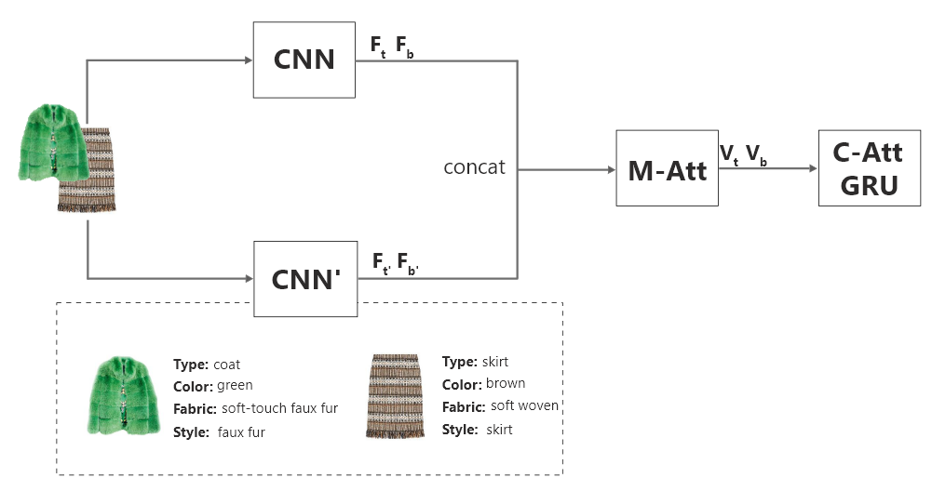
4. SUMMARY
DEVELOPMET :

Slide 21
REFERENCES
Yujie Lin, “Explainable Outfit Recommendation with Joint Outfit Matching and Comment Generation”, 5 Mar 2019.
“Understanding of RECURRENT NEURAL NETWORKS (LSTM, GRU)”, Sep 30 2018.
Junyoung Chung, Caglar Gulcehre, KyungHyun Cho, Yoshua Bengio, “Empirical Evaluation of Gated Recurrent Neural Networks on Sequence Modeling”, 11 Dec 2014.

Slide 22
THANKS FOR WATCHING!

Slide 23
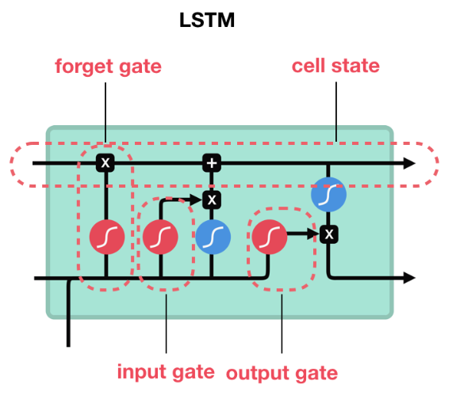
LSTM

