Slide 1
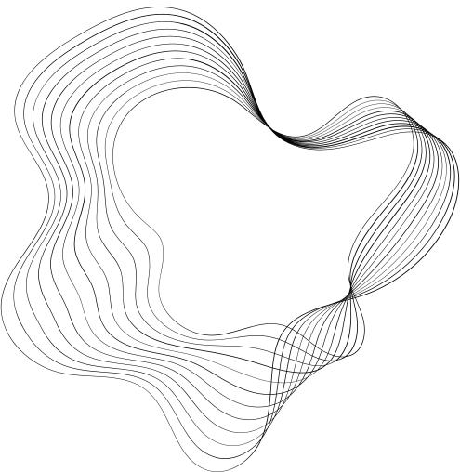

LUCKY NUMBER GAME
MODULE: MOCK C
NGO TAN TRUNG

Slide 2

CONTENT
01
PLAN AND IMPLEMENTATION PROCESS
02
RESULT
03
RUNNING PROGRAM

Slide 3

01
02
03
04
RESEARCH AND PLANNING
DESIGN
DEVELOPMENT
TESTING

Slide 4
RESEARCH AND PLANNING
Study existing games to gain insights into various game mechanics.
Identify the basic components of the program including generating random numbers, entering name, guessed numbers, comparing and printing results.
Determine the algorithm to calculate the lucky ratio.
Can draw flow charts, sequence diagram

Slide 5
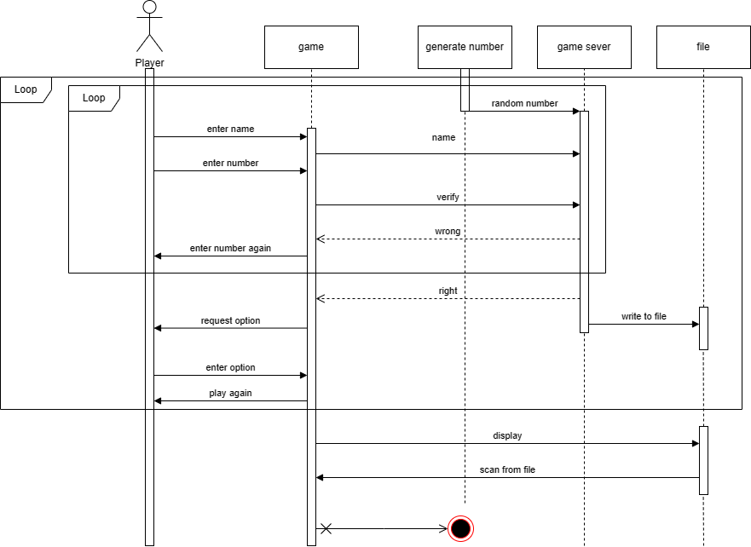
CONSEQUENCE DIAGRAM

Slide 6
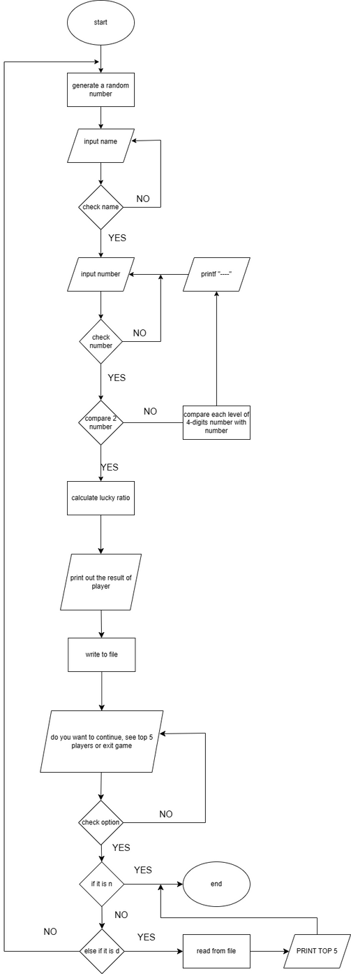
FLOW CHART

Slide 7
DESIGN
Determine how to display player information and lucky ratio history.
Format to show on screen when they have a wrong number: Unlucky. Try again.
Then show the format:---- if the player doesn't have a matched number on each position.
Or show the format: --right_number- if they have a right number at 3 position
Format to show on screen when they have the right number: Right.
Format to show top 5 players on screen: name_right number_Lucky ratio.

Slide 8
DEVELOPMENT
Handle cases where players enter incorrectly: name, guessed number, options.
Enhance interface by rewriting the output shown on the screen in 3D format and corlor
Optimize code.

Slide 9
TESTING
Running the program and testing all functions in this game to confirm this game can be run accurately

Slide 10
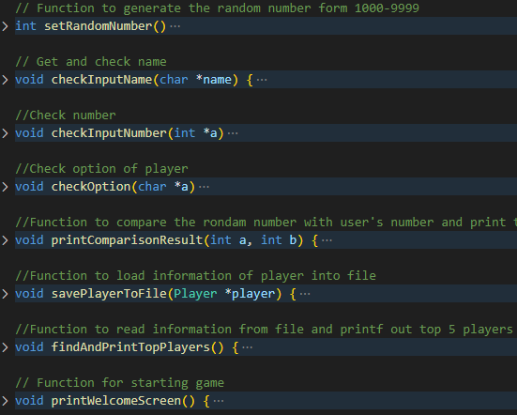
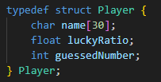
RESULT
Functions
Struct of a player

Slide 11
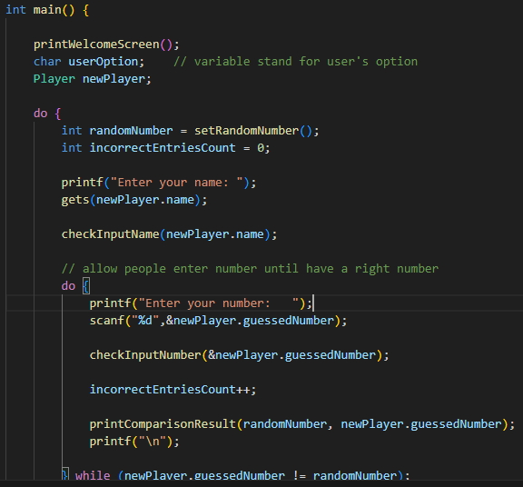
Show welcome screen
Get name, number
Compare this number with random number

Slide 12
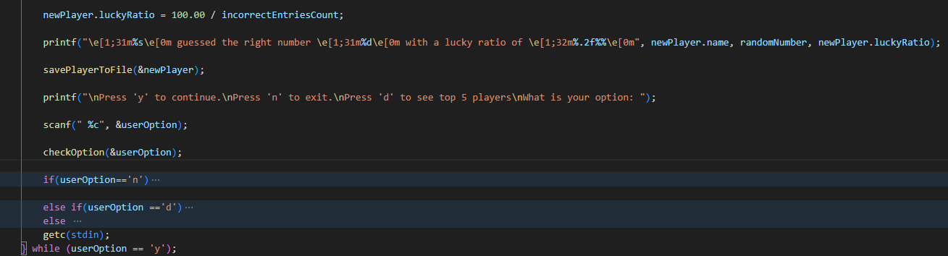
Calculate lucky ratio
Save to file
Ask player:
Press n to Exit
Press d to see top 5 player
Press y to continue

Slide 13
RUN THE PROGRAM
WHO PLAY WITH LUCKY RATIO >15% WILL GIVE BONUS POINT FROM MR.NHA
Instruction:
Enter the player's name.
If the number of characters exceeds 30 or has space, an error will be notified, prompting the player to re-enter their name until they have the right name.
Enter the guessed number.
The guessed number must be in the range of 1000 to 9999. If the entered number falls outside this range, the program will notify an error and request re-entry.
If the guessed number is incorrect, the program allows the player to enter a new number until the correct one is found.
Once the player discovers the lucky number, the program will display the player's name, the lucky number, and the lucky ratio.
The program will then prompt the player to choose whether to continue:
Press 'y' to continue playing.
Press 'n' to stop.
Press 'd' print out the top 5 players with the highest lucky ratios.
If the player makes a choice that is not in the above table, the program will notify an error and let the user re-enter

