Slide 1
Beyond the Grade Book
Spotting students at risk of failing Portuguese — before it is too late
[Team name / Group number] · [Member names]
36103 Statistical Thinking for Data Science · AT2B Presentation · 3 October 2026
Notes:
[Presentation Lead | ~0:30] Good morning everyone. We are [team name]. Today we will show you how schools can spot students who are at risk of failing Portuguese, and how early they can do it. We used real records from 649 secondary school students. Our audience today is school leaders, so we will keep the statistics simple and focus on what the results mean for decisions.

Slide 2
One in seven students fails Portuguese
15%
2
Too late
of 649 students failed the course (final grade below 10 out of 20)
public secondary schools in Portugal (GP and MS), school year 2005–06
schools usually learn who is struggling only when final grades are released
Why it matters: Portuguese is a core subject. Failing it blocks progression and is a strong early sign of leaving school. Support staff and tutoring time are limited, so schools need to know where to focus them — early.
2
Notes:
[Research Lead | ~1:00] Let's start with the problem. In our data, about fifteen percent of students — roughly one in seven — failed Portuguese. That means their final grade was below ten out of twenty. The data comes from two public schools in Portugal. The real issue is timing. Schools usually find out who is struggling only when final grades come out, and by then it is too late to help. Portuguese is a core subject, and failing it is an early sign that a student may leave school. Support staff and tutoring time are limited, so schools need to know where to focus — and they need to know early.

Slide 3
Three questions for school leaders
1
2
3
What lowers final grades?
Who is at risk of failing?
When is the warning reliable?
Which things a school knows at enrolment go with a higher or lower final grade?
Can the same information pick out the students most likely to fail?
How much better is the warning after the first-term grade is known?
3
Notes:
[Research Lead | ~1:00] So we asked three simple questions. First: what lowers final grades? In other words, which information that a school already has at enrolment goes with a higher or lower grade? Second: who is at risk of failing? Can the same information pick out the students most likely to fail? And third: when is the warning reliable? How much better does the warning become once we know the first-term grade? We used a linear regression model for question one, a logistic regression model for question two, and we compared models for question three.

Slide 4
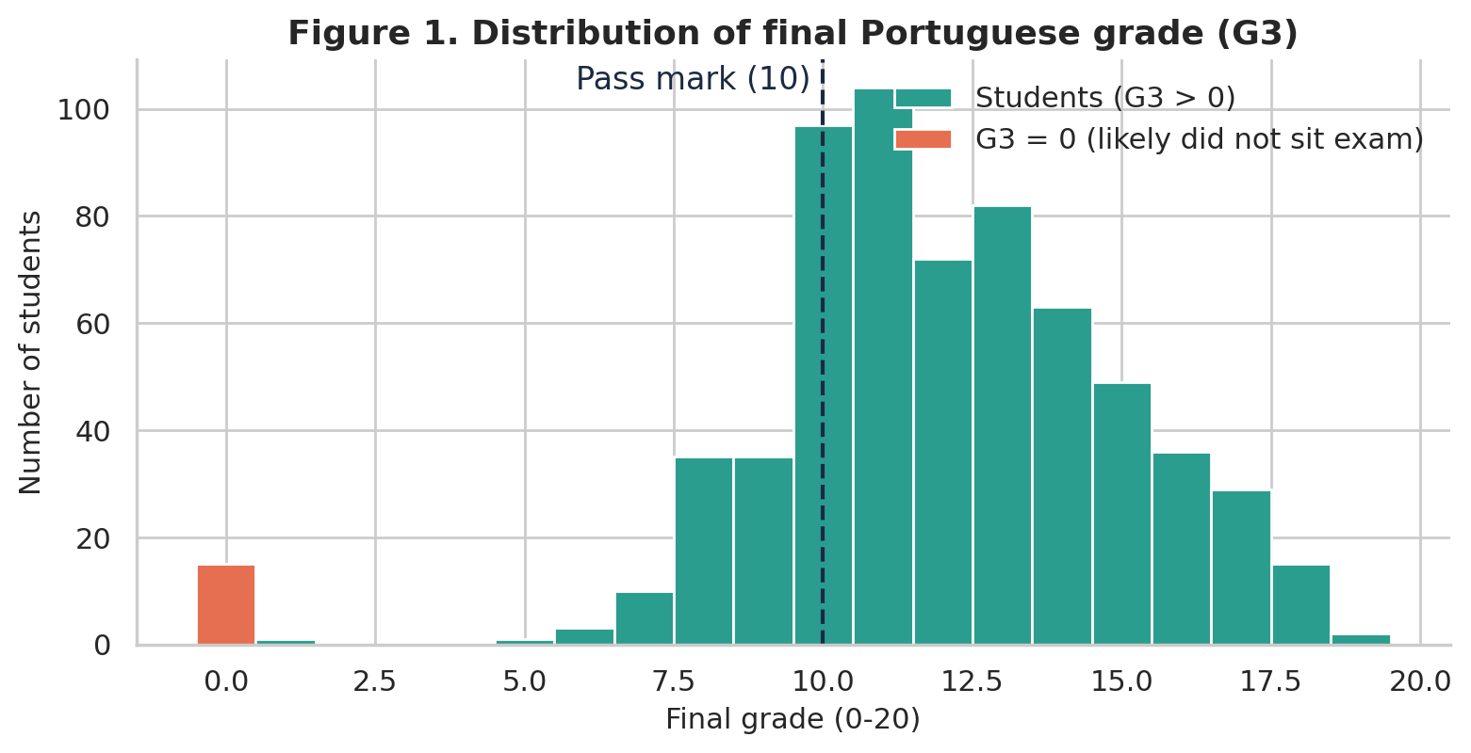
The data: 649 students, 33 pieces of information each
Source
Public school records and student questionnaires (Cortez & Silva, 2008; Kaggle, CC0)
Quality
No missing values, no duplicates, all values in valid ranges
One issue
15 students scored 0 but had no absences — they most likely did not sit the final exam
Our decision
Left out of grade models, but counted as ‘fail’ in the risk model
Most students score 10–14 out of 20. The pass mark is 10.
4
Notes:
[Data Lead | ~1:15] Here is our data. We have 649 students and 33 pieces of information for each one — for example age, family background, study time, past failures, and three grades during the year. The data was collected from school reports and questionnaires, and it is public on Kaggle. The data was clean: no missing values and no duplicates. But we found one important issue. Fifteen students had a final grade of zero, but they had zero absences and passing marks earlier in the year. This looks like they did not sit the final exam, not that they scored zero. So we left them out of the grade model, but we counted them as fails in the risk model, because a school would want to flag them too. As you can see in the chart, most students score between ten and fourteen.

Slide 5
Three warning signs stand out
Past failures
Students who failed a class before are 5× more likely to fail again (49% vs 9%).
University plans
Students without plans for higher education fail 4× as often (48% vs 12%).
School
MS students fail 4× as often as GP students (30% vs 8%).
5
Notes:
[Report Lead (EDA) | ~1:30] Our exploration showed three clear warning signs. The chart shows the share of students who failed in each group. First, past failures. Students who had failed a class before failed again forty-nine percent of the time, compared with only nine percent for students with no past failures. That is more than five times higher. Second, university plans. Students who do not plan to go to university failed four times as often. Third, the school. Students at the MS school failed thirty percent of the time, compared with eight percent at GP. These three signs are easy for a school to know at the start of the year.

Slide 6
What moves the final grade? (out of 20 points)
About one third
of the differences in grades are explained by enrolment information alone.
* Support does not cause lower grades — weaker students are the ones who receive it. This is a link, not a cause.
Model: multiple linear regression, 634 students, 12 factors; all shown effects are statistically significant.
6
Notes:
[Modelling & Code Lead | ~1:45] Next, we built a multiple linear regression model. It looks at twelve factors at the same time, so each bar shows the effect of one factor while the others stay the same. Green bars raise the grade, orange bars lower it. Planning to go to university goes with almost two extra points out of twenty. Each past failure goes with about 1.3 points lower. The MS school is about one point lower. Mother's education and study time help a little, and weekday alcohol lowers grades a little. One surprising result: students who get extra school support have lower grades. This does not mean support is harmful. It means schools already give support to weaker students. This is a link, not a cause. Overall, the enrolment information explains about one third of the differences in grades.

Slide 7
Can we spot who will fail? Yes — fairly well
84%
3 in 4
1 in 3
chance the model ranks a student who fails above one who passes (AUC 0.84)
students who fail would be flagged at enrolment (74%)
students would be flagged in total — a manageable list for support staff
Biggest risk factors (logistic regression, 649 students)
School MS: odds of failing about 7× higher · Each past failure: odds 3× higher · Each extra absence: +7%
Planning to go to university: odds almost 4× lower (protective)
7
Notes:
[Modelling & Code Lead | ~1:30] For the second question, we used logistic regression, which estimates the chance of failing. We tested it on students it had not seen. The result is good. If you pick one student who failed and one who passed, the model gives the higher risk to the right student eighty-four percent of the time. If a school flags every student with a risk above the average, it would catch three out of four students who later fail, while flagging about one third of all students. That is a list support staff can actually work with. The biggest risk factors are the MS school, past failures, and absences. Planning to go to university is protective.

Slide 8
The first-term grade makes the warning much sharper
±1.7
points typical error at enrolment
±1.0
points after term 1
±0.7
points after term 2
Message: start with a background check at enrolment, then re-check after the first term.
8
Notes:
[Modelling & Code Lead | ~1:15] Our third question was about timing. With background information only, we predict about thirty-two percent of the differences in grades. When we add the first-term grade, this jumps to seventy-seven percent. With two term grades it reaches eighty-eight percent. The typical error falls from about 1.7 points to 1 point, and then to 0.7 points. So our message is simple: start with a background check at enrolment, and then re-check the list after the first term.

Slide 9
Can we trust these results?
✓
Tested on unseen students
✓
Model checks passed
10-fold cross-validation: results hold on data the model did not see
Straight-line patterns, no overlapping factors (VIF ≤ 1.2), no single student drives results
✓
Protected against uneven spread
!
Some caution
Used robust standard errors (HC3), so conclusions stay valid
Grade is a whole number 0–20, so residuals are slightly non-normal; large sample limits the impact
9
Notes:
[Report Lead (Technical Report) | ~1:00] You may ask: can we trust these results? We did four things. First, we tested our models on students they had not seen, using ten-fold cross-validation. Second, we checked the standard model assumptions: the relationships are close to straight lines, the factors do not overlap too much, and no single student drives the results. Third, the spread of errors was not perfectly even, so we used robust standard errors to keep conclusions valid. One small caution: grades are whole numbers from zero to twenty, so the errors are not perfectly normal. With more than six hundred students, this has little impact.

Slide 10
What our study cannot tell you
1
Link ≠ cause
We observed patterns. We cannot say that changing one factor will change grades.
2
Old, local data
Two schools in one region of Portugal, 2005–06. Other schools or today’s students may differ.
3
Self-reported answers
Study time and alcohol use come from questionnaires, so students may under- or over-report.
4
Small fail group
Only 100 students failed, so the risk model should be re-checked on new data before use.
10
Notes:
[Report Lead (Technical Report) | ~1:00] We also want to be honest about limits. First, a link is not a cause. We cannot say that changing one factor will change a grade. Second, the data is old and local — two schools in Portugal in 2005 and 2006 — so results may be different in other schools or today. Third, study time and alcohol use are self-reported, so students may not answer accurately. And fourth, only one hundred students failed, so the risk model should be checked again on new data before a school uses it.

Slide 11
Our recommendations
1
2
3
Flag at enrolment
Re-check after term 1
Support, don’t label
Use past failures, university plans and school to build a first support list.
Update the list with first-term grades — accuracy more than doubles.
Use the list to start conversations and offer tutoring, never to limit a student’s options.
Ethics: any future data about Aboriginal and Torres Strait Islander students should follow Indigenous data sovereignty (CARE, Maiam nayri Wingara): co-design with community, collective consent, community control and strengths-based reporting.
11
Notes:
[Presentation Lead | ~1:15] So, what should a school do? We have three recommendations. One: flag students at enrolment using past failures, university plans and school. Two: re-check the list after the first term, because accuracy more than doubles. Three: support, don't label. The list should start a conversation and open access to tutoring. It should never limit a student's options. Finally, on ethics: if this approach were used with data about Aboriginal and Torres Strait Islander students, it must follow Indigenous data sovereignty principles — co-design with the community, collective consent, community control of the data, and strengths-based reporting.

Slide 12
Thank you
Questions?
Data: Cortez, P., & Silva, A. (2008). Using data mining to predict secondary school student performance. FUBUTEC 2008. Kaggle mirror: Student Performance Data Set (CC0).
Notes:
[Presentation Lead | ~0:15] Thank you for listening. We are happy to take your questions.

