Slide 1
STDS ASSESSMENT TASK 2B · GROUP PRESENTATION
What goes along with a student's final grade?
Findings from real school data, for a school leader deciding where to focus student support
[Team name] · [Presenter names]
Notes:
About 30 seconds. Introduce the team and the one-line story: we used real school data to see what goes along with final grades, so a school leader can decide where to put support. Replace [Team name] and [Presenter names]. The timing plan across all 13 slides comes to about 13 minutes, inside the 10 to 15 minute limit.

Slide 2



CONTEXT
The problem we are solving
A school has limited time, budget and staff for student support, so it has to choose who to help first.
Who decides
The decision
What we offer
A principal or student-support lead
Where to direct tutoring and support first
Evidence on which factors go along with final grades
STDS 2B · [Team name] · Data: UCI Student Performance (Cortez and Silva, 2008)
Notes:
About 1 minute. Speak to a non-technical audience. Say who the decision-maker is (a principal), what they must decide (where to put limited support) and how our analysis helps. Do not use any statistics on this slide.

Slide 3
CONTEXT
Our question
AIM
1
Which factors (study time, past failures, absences, family) go with higher or lower grades?
Find which student, family and lifestyle factors are most strongly associated with final grade (G3).
2
Do alcohol use and going out go with lower grades, after allowing for study time?
G3 is the final grade, scored out of 20.
Does school and family support go with better grades, or flag students already struggling?
3
STDS 2B · [Team name] · Data: UCI Student Performance (Cortez and Silva, 2008)
Notes:
About 1 minute. Read the aim once in plain words, then the three questions. Say associated with, never causes. If the team changes the research questions, update this slide first, then the findings slide so the two match.

Slide 4
DATA
The data
Group | Examples of what is recorded
Student | age, sex, absences, past class failures
Study and school | study time, school support, wants higher education
Family | parents' education, family support, family relationships
Lifestyle | free time, going out, alcohol use, health
Outcome | G3, the final grade (0 to 20)
33
attributes recorded per student
0 to 20
scale of the final grade, G3
649
students (Portuguese course file)
STDS 2B · [Team name] · Data: UCI Student Performance (Cortez and Silva, 2008)
Notes:
About 1 minute. Real survey and school-report data from two Portuguese secondary schools, published by Cortez and Silva in 2008. Fill in the number of students in the file you used and say whether it is the Maths or the Portuguese language file. Mention that the data is about minors and that we only look at group patterns, never individuals.

Slide 5
DATA
Preparing the data
Checked for gaps and duplicates
Left out earlier grades
Result: 0 duplicate rows and 0 missing values
G1 and G2 are earlier grades that almost give away the final grade (G3), so we excluded them.
Checked zero grades
Handled skewed answers
15 students had G3 = 0 with no absences (did not sit the exam), so we left them out: 634 remain
Absences are skewed (most 0 to 6, max 32); kept as counts and checked no student drives results
STDS 2B · [Team name] · Data: UCI Student Performance (Cortez and Silva, 2008)
Notes:
About 1 minute. Keep it short: the audience cares that the data was checked, not about the code. Fill in the counts from the cleaning notebook. Explain why G1 and G2 were left out: they are earlier grades that almost give away the final grade, so keeping them would make the question trivial. Confirm this decision as a team before presenting. Also mention that the 1 to 5 ratings (study time, alcohol, going out) are treated as ordered ratings, not exact measurements.

Slide 6
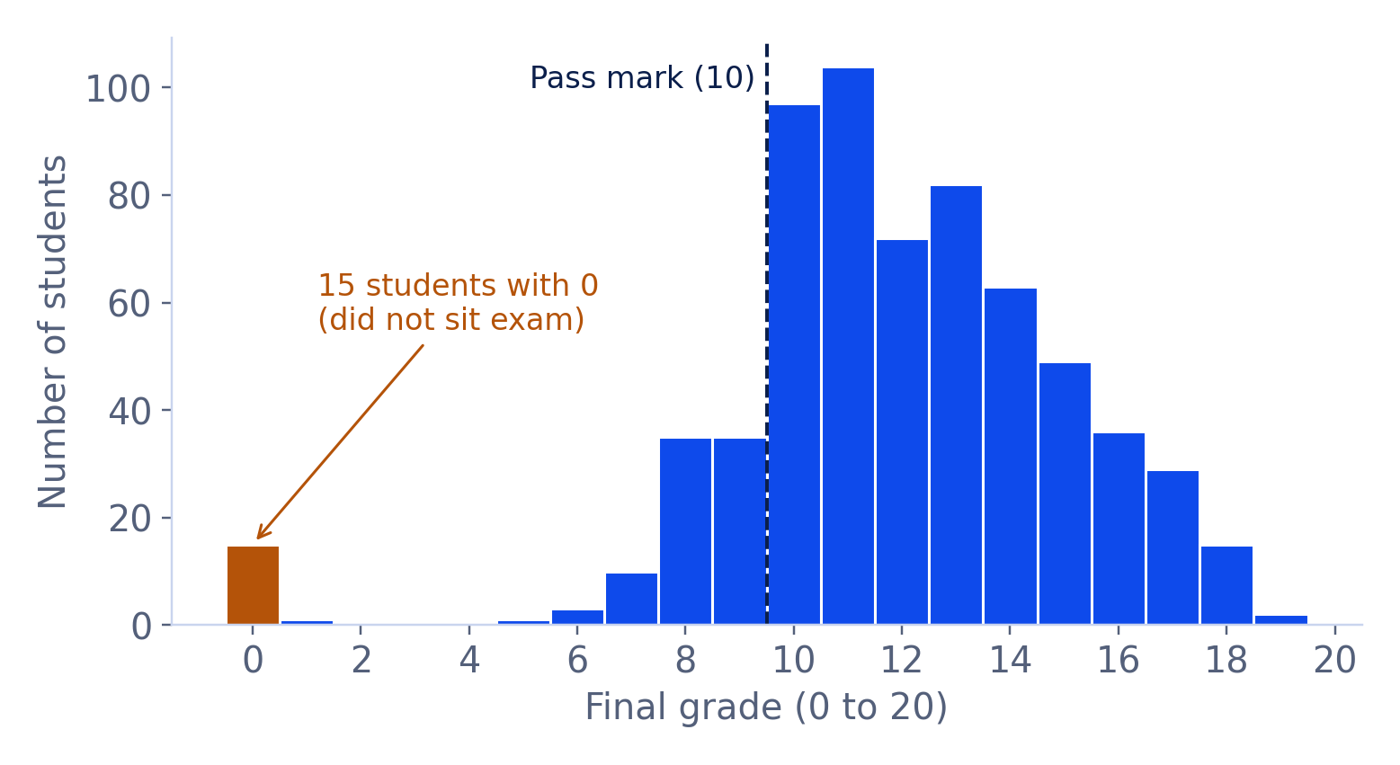
EXPLORATION
How final grades are spread
KEY TAKEAWAY
Most students score 10 to 14; a typical grade is 12.
15 zeros = students who did not sit the exam
STDS 2B · [Team name] · Data: UCI Student Performance (Cortez and Silva, 2008)
Notes:
About 1 minute. Insert the histogram of G3 from the EDA notebook. Say what a typical grade looks like, how spread out grades are, and mention any spike at zero. One message only. Use large fonts and plain axis labels, for example Final grade (0 to 20) and Number of students.

Slide 7
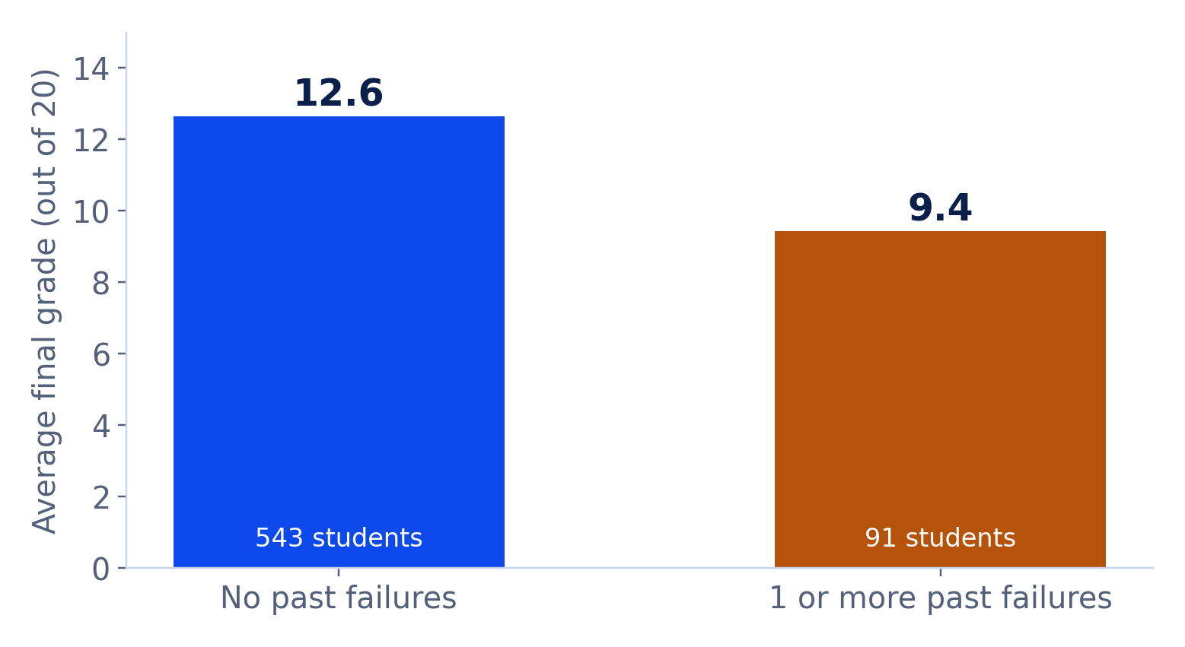
EXPLORATION
Study habits versus grades
KEY TAKEAWAY
Past failures: about 3 points lower (9.4 vs 12.6).
Links to Question 1: yes, the strongest warning sign.
STDS 2B · [Team name] · Data: UCI Student Performance (Cortez and Silva, 2008)
Notes:
About 1 minute. Insert one simple chart, for example average final grade by study time, or by number of past failures. Label the axes in plain words. Say which direction the pattern goes and how big it looks, then link back to Question 1.

Slide 8
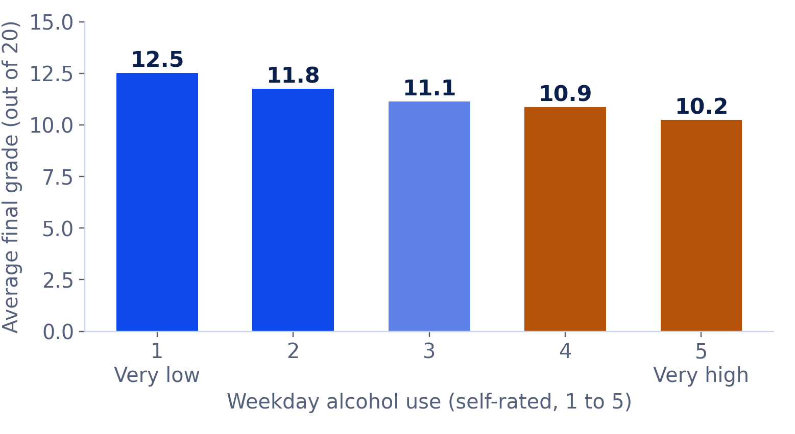
EXPLORATION
Lifestyle versus grades
KEY TAKEAWAY
More weekday alcohol, lower grades: 12.5 down to 10.2.
Links to Question 2. This shows association only.
STDS 2B · [Team name] · Data: UCI Student Performance (Cortez and Silva, 2008)
Notes:
About 1 minute. Insert one simple chart, for example average final grade by alcohol use or by how often students go out. Say clearly that this shows association only, not cause. Link back to Question 2.

Slide 9

MODEL
The model
What goes in
The model
What comes out
Study time, past failures, absences, family and lifestyle answers
Linear regression compares students who are alike in everything else
How many grade points each factor goes with
HOW WELL DOES IT FIT?
ASSUMPTIONS WE CHECKED
R² = 0.36
Residuals near normal, no outlier drives results, little overlap (VIF ≤ 1.2); used robust errors
the share of differences in grades the model explains
STDS 2B · [Team name] · Data: UCI Student Performance (Cortez and Silva, 2008)
Notes:
About 1.5 minutes. Explain regression in one sentence: it compares students who are alike in everything else and asks how much the grade changes when one factor differs. Fill in R squared in plain words, meaning the share of differences in grades the model explains. Mention the assumption checks the modelling lead ran and any problems found. Keep jargon out; this audience is non-technical.

Slide 10
MODEL
What we found
FINDING 1
FINDING 2
FINDING 3
Past failures
Lifestyle
Support
−1.3 points for each past failure (study time: +0.3 per level)
−0.2 per level of alcohol or going out, after study time
School support −1.1 (flags strugglers); family: no link
Association, not cause: these factors go along with grades, but we cannot say they cause them.
STDS 2B · [Team name] · Data: UCI Student Performance (Cortez and Silva, 2008)
Notes:
About 1.5 minutes. Replace each card with one of the three strongest factors from the model: the factor's name, and the size and direction of its effect in grade points out of 20, holding the other factors equal. Answer the three research questions directly. Say again that this is association, not cause.

Slide 11
MEANING
What this means for a school leader
Each past failure: about 1.3 points lower
Offer early tutoring to students who have failed before
Alcohol and going out: slightly lower grades
Add lifestyle advice to wellbeing programs
Supported students still score 1.1 lower
Re-check the support list after term 1
These are options supported by association, not proof that an action will raise grades.
STDS 2B · [Team name] · Data: UCI Student Performance (Cortez and Silva, 2008)
Notes:
About 1 minute. For each finding, give one practical option for a school leader. Be careful with wording: these are options supported by association, not proof that an action will raise grades. Think about what a principal could actually do with a small budget.

Slide 12
LIMITS
Limitations
Limitation | What it means for our conclusion
Sample of 649 students (634 in the model) | Estimates are imprecise; small gaps may be noise
Two Portuguese schools, about 2005 to 2006 | May not apply to Australian students today
Self-reported 1 to 5 ratings | Answers may be biased or inconsistent
Observational data | We show association, not cause
Earlier grades (G1, G2) left out | We explain grades from background, not past results
The data is about minors, so we use it only to look at group patterns.
STDS 2B · [Team name] · Data: UCI Student Performance (Cortez and Silva, 2008)
Notes:
About 1 minute. Be honest and specific, because clearly stated limitations carry marks. For each row, say what it does to our conclusion. Update the sample-size row with the exact number of students you used, and the two-schools row if you combine both files.

Slide 13
TAKE-HOME MESSAGE
Past failures, study habits and lifestyle go along with final grades, so support is best directed early at students who have failed before.
Thank you. Questions?
[Team name] · [Member names]
Notes:
About 30 seconds, then questions. Give one sentence a non-technical listener could repeat. Likely questions to prepare for: Why is the fit only moderate? What should a school actually do with this? Why did you leave out earlier grades? Can this apply to Australian students? Decide in advance who answers which.

