Slide 1
Student Performance
Data Analysis
Assessment Task 2 – Data Analysis Project
Exploratory analysis of 649 Portuguese secondary-school students
Prepared for: the Parents’ Association and school leaders

Slide 2
1. Problem and Research Question
Why it matters: about 1 in 7 students (100 of 649) failed the final grade (below 10 out of 20). Families and schools want to know where to act.
Research question: Which student habits and circumstances are associated with final grades, and which findings may help families and schools identify areas for support?
Q1. When can we spot a student at risk? → when to act
Q2. Which habits are linked to higher grades? → what to encourage
Q3. Who needs extra support? → where to focus resources
Important: associations in this analysis should not be interpreted as proof that one factor causes another.
Student Performance Data Analysis | Assessment Task 2 2

Slide 3
2. Dataset & Analysis Approach
Source: UCI Student Performance dataset; uploaded file: student-por.csv
649
students
33
variables
0–20
G3 scale
0
missing values
The Portuguese-language dataset covers students from two Portuguese secondary schools.
Variables include demographics, study habits, family/social factors, absences and academic grades.
G3 is the final-period grade and is the main outcome analysed.
Sample: 383 female, 266 male students aged 15–22.
Approach: clean → explore → visualise → simple regression → interpret
Source: Cortez (2008), UCI Machine Learning Repository. The UCI documentation notes that G1 and G2 are earlier-period grades and G3 is the final grade.
Student Performance Data Analysis | Assessment Task 2 3

Slide 4
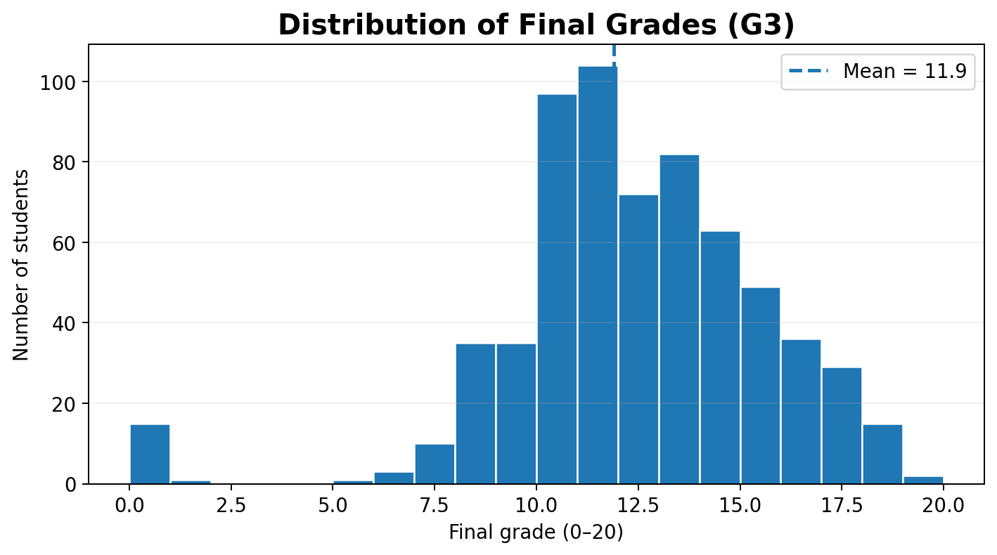
3. Final Grade: About 1 in 7 Students Fail
11.9
mean G3
12
median G3
1 in 7
failed (below 10)
19
maximum
The average final grade is 11.9 out of 20, but 100 students (15%) scored below the pass mark of 10. Lowest 0, highest 19.
Student Performance Data Analysis | Assessment Task 2 4

Slide 5
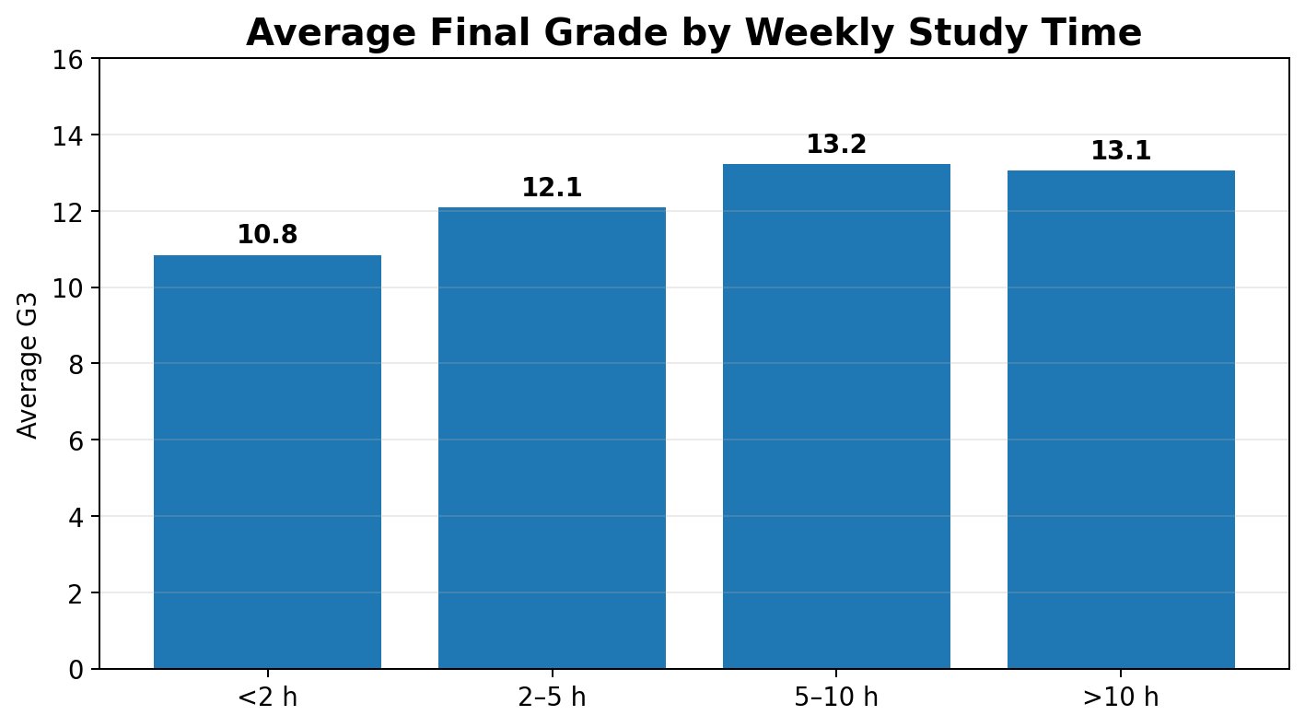
4. Students Reporting More Study Time Had Higher Average Grades
Students reporting 5–10 hours of weekly study had an average G3 of 13.2.
Students reporting less than 2 hours had an average G3 of 10.8.
Observed difference between these two groups: 2.4 points.
Average grades were higher among students reporting more study time, but this does not establish that increasing study time would cause grades to rise.
Student Performance Data Analysis | Assessment Task 2 5

Slide 6
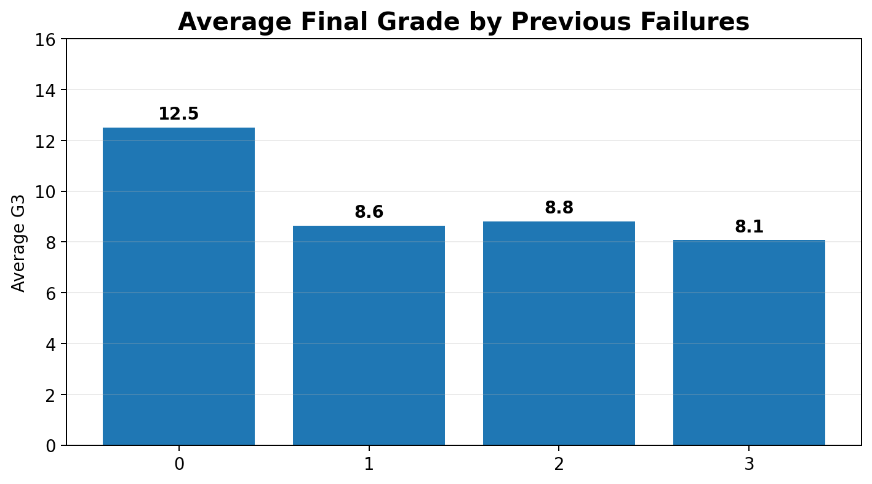
5. Students with One Past Failure Averaged About 4 Points Lower
Students with no previous failures averaged 12.5.
Students with one previous failure averaged 8.6.
The correlation between failures and G3 is −0.39.
Previous failure history is associated with lower final grades in this sample.
This is an association: the data cannot establish that previous failures themselves caused lower final grades.
Student Performance Data Analysis | Assessment Task 2 6

Slide 7
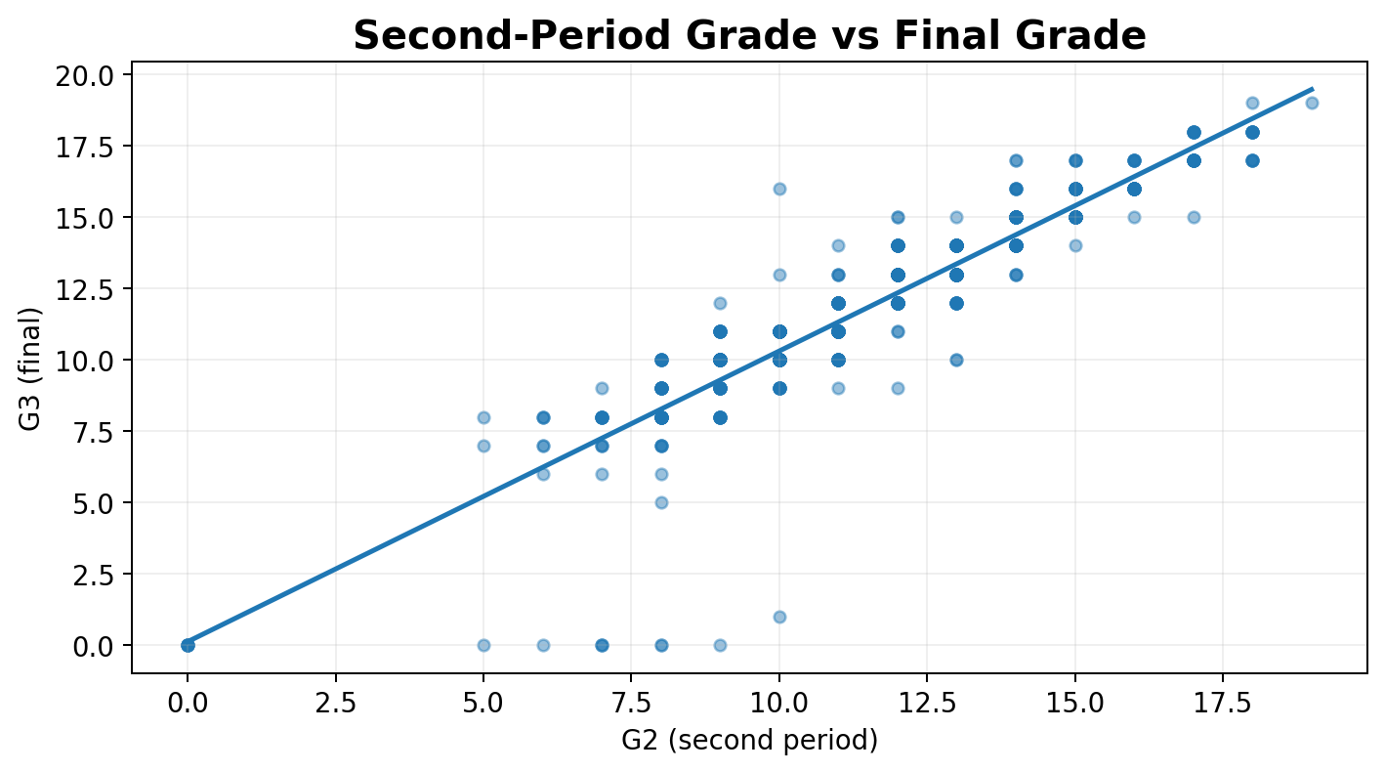
6. Term Grades Are an Early Warning Sign
56%
below 10 in term 1 → failed
88%
of fails visible in term 1
Term grades are strongly linked with the final grade (G1: r = 0.83; G2: r = 0.92).
Only 2% of students who passed term 1 failed the year, vs 56% of those below 10.
Use term-1 results as an early warning to offer support, not as an explanation.
Term grades are useful for early warning, but because G1 and G2 are earlier academic grades, they should not be treated as explanations of why students perform differently.
Student Performance Data Analysis | Assessment Task 2 7

Slide 8
7. Other Factors Show Weaker Relationships
Not every intuitive factor has a strong relationship with final grades.
Previous failures
No previous failures averaged 12.5; one previous failure averaged 8.6
r = −0.39
moderate negative association
Study time
<2 hours averaged 10.8; 5–10 hours averaged 13.2
r = 0.25
weak-to-moderate positive association
Absences
0–5 absences averaged 12.0; 11–20 absences averaged 10.6
r = −0.09
weak negative association
Correlation ranges from −1 to +1. It measures association, not causation. Full correlation table in backup.
Student Performance Data Analysis | Assessment Task 2 8
Notes:
Not every factor that seems intuitive has a strong relationship with final grades. Previous failures show a moderate negative association (r = -0.39). Study time shows a weak-to-moderate positive association (r = 0.25). Absences show only a weak negative association (r = -0.09): students with 0-5 absences averaged 12.0 and those with 11-20 averaged 10.6. These are associations, not causes. The full correlation table, including G1 and G2, is in the backup slides.

Slide 9
8. Findings That Surprised Us
Both very low and very high reported social activity were associated with higher failure rates in this sample
15% vs 15%
% failing, by how often the student reports going out with friends. The pattern is non-linear and deserves further investigation.
Parents living apart vs together: no real difference in observed failure rates
25%
25%
23% vs 15%
average 15%
15%
11%
11%
Students receiving paid extra classes had a higher observed failure rate. This may reflect selection: students already struggling may be more likely to receive tutoring. The dataset cannot determine whether tutoring improves outcomes.
Very rarely
Rarely
Sometimes
Often
Very often
% failing = share of students with a final grade below 10 out of 20. Observed differences in this sample, not causal effects.
Student Performance Data Analysis | Assessment Task 2 9
Notes:
Three findings surprised us. First, both very low and very high reported social activity were associated with higher failure rates in this sample: about 25% in both groups, versus around 11% in the middle. The pattern is non-linear and deserves further investigation; the dataset does not measure social isolation. Second, whether parents live apart or together showed no real difference: 15% in both groups. Third, students receiving paid extra classes had a higher observed failure rate, 23% versus 15%. This may reflect selection, because students who are already struggling may be more likely to receive tutoring. The dataset cannot tell us whether tutoring improves outcomes.

Slide 10





9. Regression: Factors Associated with Higher or Lower Predicted Grades
The model estimates how predicted G3 differs across these factors while holding the other included variables constant.
lower predicted G3
higher predicted G3
University aspiration
wants to go to university (yes vs no)
+1.7
Each higher study-time category
<2 h → 2–5 h → 5–10 h → >10 h
+0.5
Each higher school-day drinking category
very little (1) → very much (5)
−0.4
Very low/high going-out pattern
goes out very rarely or very often
−0.8
Each previous failure
number of classes failed before (0–3)
−1.4
These are adjusted associations, not causal effects. 11.2 is the model intercept, not the average starting grade for every student (class average = 11.9).
Student Performance Data Analysis | Assessment Task 2 10
Notes:
This linear regression estimates how predicted final grades differ across factors while holding the other included variables constant. In the fitted model, students reporting a university goal had an estimated 1.7-point higher predicted G3. Each higher study-time category was associated with a 0.5-point higher predicted grade. Each higher school-day drinking category was associated with a 0.4-point lower predicted grade, and a very low or very high going-out pattern with 0.8 points lower. Each previous failure was associated with 1.4 points lower. These are adjusted associations, not causal effects, and the variables are on different scales, so the bar lengths should not be read as a ranking of importance. 11.2 is the model intercept, not the average starting grade (the class average is 11.9).
[If asked: backward elimination kept 9 of 39 survey factors (G1/G2 excluded); forward selection kept 10, 8 shared; R-squared 0.33; cross-validated R-squared 0.275; prediction error about 2.7 points. Full coefficients in backup.]

Slide 11
10. What These Findings Mean for Families and Schools
FINDING
POSSIBLE SUPPORT RESPONSE
Term-1 grades identified many students who later failed.
→
Schools: use term-1 results as an early-warning signal, not as a permanent label.
Previous failures were strongly associated with lower grades.
→
Schools: offer early support to students with a history of academic difficulty.
University aspirations were associated with higher grades.
→
Families: discuss future goals. Schools: explore goal-setting and career guidance as support strategies.
Higher reported study time was associated with higher grades.
→
Families: help protect regular study time. Schools: evaluate whether study-support programs improve outcomes.
School-day drinking and very low/high going out were associated with lower grades.
→
Families: encourage balanced routines and avoid school-night drinking.
These are possible support responses based on observed associations. They should be evaluated before being scaled up.
Student Performance Data Analysis | Assessment Task 2 11
Notes:
Here is what these findings may mean in practice, framed as finding and possible response. Term-1 grades identified many students who later failed, so schools could use term-1 results as an early-warning signal, never as a permanent label. Previous failures were strongly associated with lower grades, so early support for students with a history of difficulty makes sense. University aspirations and higher reported study time were associated with higher grades: families can discuss goals and protect regular study time, while schools could explore goal-setting, career guidance and study-support programs. School-day drinking and very low or very high going out were associated with lower grades, so families can encourage balanced routines. Because these are associations, schools should investigate which strategies actually improve outcomes and evaluate interventions before scaling them.

Slide 12
11. Limitations
Sample scope: students from two Portuguese secondary schools; findings may not generalise to Australia or other populations.
Observational data: associations do not establish cause and effect.
The regression model explains about one third of grade differences (R² = 0.33); an individual prediction can be off by about ±3 points.
Some groups are small, especially the 21+ absence group and students with multiple previous failures.
Several variables are self-reported, so reporting error is possible.
G1 and G2 are earlier grades, so their strong relationship with G3 partly reflects the structure of the grading process.
The UCI documentation specifically warns that G1 and G2 are strongly correlated with G3 because they are earlier-period grades.
Student Performance Data Analysis | Assessment Task 2 12

Slide 13
12. Responsible Use & Next Steps
Responsible use
Next steps
Protect student privacy; never report information that could identify individuals.
Do not turn statistical patterns into labels for individual students.
Findings come from two Portuguese schools and may not generalise to other settings.
When working with Aboriginal and Torres Strait Islander communities, respect community authority, cultural protocols and data sovereignty. This dataset contains no such community data.
Test the findings and the model on local, more recent data.
Follow students over time to understand how outcomes change.
Evaluate support interventions before scaling them up.
Investigate why students with previous failures and very low/high social activity have lower outcomes.
Use the analysis to guide support, not to label individual students.
Student Performance Data Analysis | Assessment Task 2 13
Notes:
Using this analysis responsibly means protecting student privacy and never turning statistical patterns into labels for individual students. The findings come from two Portuguese schools and may not generalise. Any work with Aboriginal and Torres Strait Islander communities must respect community authority, cultural protocols and data sovereignty; this dataset contains no such community data. Next steps: test the findings on local, recent data; follow students over time; evaluate support interventions before scaling them; and investigate the groups with lower outcomes.

Slide 14
13. Conclusion
Many students who later fail already show warning signs in term 1, while several study and lifestyle factors are associated with final grades.
These patterns can help schools and families identify where support may be needed, but they do not prove which interventions will improve grades.
Use the analysis to guide support, not to label individual students.
Student Performance Data Analysis | Assessment Task 2 14

Slide 15
14. References
Cortez, P. (2008). Student Performance [Dataset]. UCI Machine Learning Repository. https://doi.org/10.24432/C5TG7T
Cortez, P., & Silva, A. M. G. (2008). Using data mining to predict secondary school student performance. Proceedings of 5th FUture Business Technology Conference.
UCI Machine Learning Repository. Student Performance dataset documentation and variable definitions.
Kaggle. Student Performance dataset (uploaded dataset used for this analysis).
Data source used for calculations: uploaded student-por.csv (649 records, 33 columns).
Student Performance Data Analysis | Assessment Task 2 15

Slide 16
Backup: Illustrative Model Comparison
The model gives different predicted grades for two hypothetical profiles. This illustrates association, not what would necessarily happen if one student changed these behaviours.
Profile A
9.5
no university goal · <2 h study · goes out very often · moderate school-day drinking
Profile B
13.8
university goal · 5–10 h study · moderate going out · very little school-day drinking
pass mark (10)
Both profiles: school GP, no previous failures, father’s education level 2, health 4, no extra school support. Predicted values from the regression model.
Student Performance Data Analysis | Assessment Task 2 B1
Notes:
Backup only. The model gives different predicted grades for two hypothetical profiles: 9.5 and 13.8. This illustrates association, not what would necessarily happen if one student changed these behaviours. Exact predicted values: 9.47 and 13.76.

Slide 17
Backup: Full Regression Model
Intercept
11.17
Selection
Backward elimination kept 9 of 39 survey factors (forward selection: 10; 8 shared)
University aspiration (yes = 1)
+1.71
Study-time category (1–4)
+0.50
R²
0.33
School-day drinking (1–5)
−0.40
Very low/high going out (yes = 1)
−0.78
Cross-validated R²
0.275 (all 39 factors: 0.25)
Previous failures (0–3)
−1.43
School MS (vs GP)
−1.36
Typical prediction error
about 2.7 points
Extra school support (yes = 1)*
−1.29
Father's education (0–4)
+0.28
*Note
Extra support may be received mainly by students already struggling (selection)
Self-rated health (1–5)
−0.20
Linear regression on G3, 649 students. G1 and G2 excluded. Coefficients are adjusted associations, not causal effects.
Student Performance Data Analysis | Assessment Task 2 B2
Notes:
Backup only, for questions about the model. Coefficients from the backward-elimination linear regression. Variables are on different scales, so coefficient sizes should not be used to rank importance.

Slide 18
Backup: Correlation Overview
G2
r = 0.92
strong positive association
G1
r = 0.83
strong positive association
Failures
r = -0.39
moderate negative association
Study time
r = 0.25
weak-to-moderate positive association
Absences
r = -0.09
weak negative association
Correlation ranges from −1 to +1. It measures association, not causation.
Student Performance Data Analysis | Assessment Task 2 B3

Slide 19
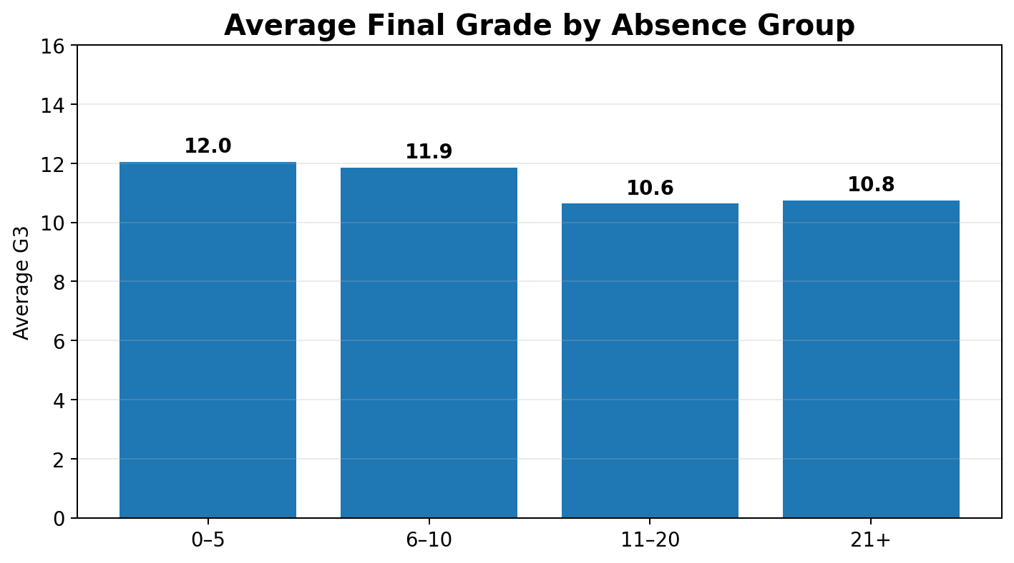
Backup: Absences and Final Grade
Students with 0–5 absences averaged 12.0.
Students with 11–20 absences averaged 10.6.
The correlation between absences and G3 is weakly negative (r = −0.09).
The 21+ group is very small (8 students), so its mean is unstable.
Student Performance Data Analysis | Assessment Task 2 B4

Slide 20
Backup: Who Is in the Dataset?
383
female students
266
male students
15–22
age range
The dataset includes more female than male students.
The analysis describes this sample only; it should not be treated as representative of all students.
Background variables provide context but should not be used to stereotype individual students.
Student Performance Data Analysis | Assessment Task 2 B5

