Slide 1



Predicting student performance
36100 Data Science for Innovation · Group 8 · Stage 3 presentation
Three datasets, three models, one shared protocol
Ngoc An Nguyen
Quang Trung Nguyen
Akil Venkateshkumar
ID 26507564
ID 26643559
ID 26244259
UCI student performance
395 students, earlier grades
Student study habits (Kaggle)
1,000 students, behaviour
Exam scores and demographics (Kaggle)
1,000 students, background
Notes:
Speaker: Quang Trung Nguyen (about 0:16)
Hello, we are Group 8. I am Quang Trung Nguyen, and my teammates are Ngoc An Nguyen and Akil Venkateshkumar. Our project predicts student exam performance with three models on three different datasets.

Slide 2
Schools find struggling students too late
SPEAKER QUANG TRUNG NGUYEN
Problem
76.6%
Students at risk are often found after the final grade, when it is too late to help them.
of the variance in student success explained by earlier academic performance
What Stage 1 showed
Performance depends on earlier grades, study behaviour and family background. No single model or variable explains it in every setting.
6.0%
Objective
explained by socioeconomic status
Find which factors are linked to the final score, then test which of three models predicts it best on three kinds of data.
Source: El Jihaoui et al. (2025), from our Stage 1 literature review
Notes:
Speaker: Quang Trung Nguyen (about 0:35)
Schools often find struggling students too late, after the final grade is in. Our Stage 1 reading showed that performance depends on earlier grades, study behaviour and family background. One study we reviewed found that earlier results explain 76.6% of the variance in success. No model wins in every setting, so in Stage 2 we tested which model predicts the final score best, and whether that changes with the data.

Slide 3
Stage 1: three datasets, three kinds of predictor
SPEAKER QUANG TRUNG NGUYEN
Ngoc An Nguyen
Quang Trung Nguyen
Akil Venkateshkumar
Academic history
Study behaviour
Demographics
UCI, 395 students, 33 variables
Target: final grade G3 (0 to 20)
Kaggle, 1,000 students, 12 columns
Target: final exam score (0 to 100)
Kaggle, 1,000 students, 8 columns
Target: mean of three test scores
STAGE 1 FINDING
STAGE 1 FINDING
STAGE 1 FINDING
r = 0.905
r = 0.57
+8.6 points
G2 vs final grade G3
study time vs exam score
standard vs free or reduced lunch
Past failures: ρ = −0.361
Internet access +5.0 points; part-time job −3.3 points
Parental education: 63.1 (high school) to 73.6 (master's)
Stage 2 question: can these factors predict the score, and which model does it best?
Notes:
Speaker: Quang Trung Nguyen (about 0:42)
Each of us brought one dataset with a different type of predictor. Ngoc An's has 395 students with earlier grades, and in Stage 1 she found that G2 and the final grade correlate at 0.905. Mine has 1,000 students and their study habits, and study time had the strongest link with the exam score, at r equal to 0.57. Akil's has 1,000 students with demographic data only, where a standard lunch meant 8.6 points more. Ngoc An will now explain our Stage 2 design.

Slide 4



Why these three models
SPEAKER NGOC AN NGUYEN
What the literature says
Linear regression
Namoun & Alshanqiti (2021)
Regression used in 51.6% of 62 studies
Transparent baseline with readable coefficients
Tuning: none (ordinary least squares)
Cortez & Silva (2008)
Random forest best in 8 cases, decision tree in 4; RMSE 1.75 with G1, G2 and 3.90 without
Decision tree
Shows if-then thresholds between high and low scores
Tuning: max_depth, min_samples_leaf
Falát & Piscová (2022)
Random forest had the lowest error for university GPA
Sonkhanani et al. (2026)
Linear regression best (R² 0.705) when earlier grades are available
Random forest
Averages many trees to lower variance (Breiman, 2001)
Tuning: n_estimators, max_depth, max_features
No single winner, so we test all three under one protocol.
Notes:
Speaker: Ngoc An Nguyen (about 0:42)
Thank you, Trung. We based our model choice on the literature. Namoun and Alshanqiti reviewed 62 studies and found regression in about half of them. Cortez and Silva found random forest best in 8 cases, against 4 for the decision tree. But Sonkhanani and colleagues found linear regression best when earlier grades were available. With no single winner, we chose three models: linear regression as a transparent baseline, a decision tree for readable rules, and a random forest to test whether averaging many trees helps.

Slide 5




One protocol for all three datasets
SPEAKER NGOC AN NGUYEN
RQ1 Which model predicts the final score best on each dataset?
RQ2 Does the ranking change with prior grades, predictor type or sample size?
1. Split 80/20
2. Tune with 5-fold CV
3. Refit on training set
4. Test once
random_state = 42; test set kept aside
GridSearchCV on the training set, scored by R²
Encoding and scaling inside a Pipeline
R², MAE, RMSE and RMSE / SD
H1
Random forest has the highest test R² on most datasets.
H2
Linear regression is within 1 SD of random forest on Ngoc An's data with G1, G2 (G2 to G3: r = 0.905).
H3
All three models score lowest on the demographic dataset.
Tie rule: a cross-validated R² gap smaller than one fold SD counts as a tie.
Notes:
Speaker: Ngoc An Nguyen (about 0:42)
We asked which model predicts best on each dataset, and whether the ranking changes with the type of data. Our main hypothesis was that random forest would win on most datasets. All three of us used one protocol: an 80/20 split, 5-fold cross-validation on the training set to tune the trees, and one final run on the test set. Encoding and scaling sit inside a pipeline, so nothing leaks from the test set. A gap smaller than one cross-validation standard deviation counts as a tie.

Slide 6
Ngoc An: earlier grades, with and without
SPEAKER NGOC AN NGUYEN
395
33
Scenario A: with G1 and G2
Scenario B: without G1 and G2
Earlier period grades included
Closer to an early warning, before any grades exist
students
variables
Tree: depth 5, leaf 5
Forest: 300 trees, depth 10, 0.5 features
Tree: depth 3, leaf 10
Forest: 300 trees, depth 5, 0.5 features
G3
80 / 20
final maths grade, 0 to 20
split: 316 train, 79 test students
Preprocessing decisions
No missing values or duplicates, so all 395 records were kept
One-hot encoding for categories; scaling for linear regression only
G3 kept out of the predictors to avoid leakage
Same student indices in both scenarios, so results are comparable
Notes:
Speaker: Ngoc An Nguyen (about 0:42)
Now my own work. I used the UCI dataset, with 395 students and 33 variables, and the final maths grade G3, from 0 to 20, as the target. There were no missing values or duplicates, so I kept every record. My key decision was to run two scenarios: A with the earlier grades G1 and G2, and B without them. Scenario B is closer to a real early warning. Both use the same 316 training and 79 test students, so the comparison is fair.

Slide 7
Ngoc An: random forest wins in both scenarios
SPEAKER NGOC AN NGUYEN
0.829
test R² of random forest with G1, G2 (MAE 1.14 on a 0 to 20 scale)
0.883 to 0.232
random forest CV R² when G1 and G2 are removed
G2
top predictor in A; past failures and absences lead in B
Linear regression CV R² in scenario B: −0.092 (worse than predicting the mean).
Notes:
Speaker: Ngoc An Nguyen (about 0:44)
Random forest was my best model in both scenarios. With G1 and G2, it reached a test R² of 0.829, with an average error of about 1.1 points out of 20. Without them, R² fell to 0.242, and linear regression even had a negative cross-validated R². Feature importance explains this. In scenario A, G2 dominates. In scenario B, past failures and absences lead, but they carry much less signal. So random forest works well on my data, mainly when earlier grades are available. Trung will now present his dataset.

Slide 8
Quang Trung: study habits of 1,000 students
SPEAKER QUANG TRUNG NGUYEN
1,000
83.5
Three data decisions
1
Dropped final_grade
It is a letter band computed from the score, so it would leak the target.
students, 12 columns
mean exam score (SD 10.3)
2
Loaded with keep_default_na = False
Pandas read the category None in parental_education as missing (102 rows).
7.8%
80 / 20
score exactly 100 (ceiling)
split: 800 train, 200 test students
Kept the raw features
effective_study and sleep_gap changed CV R² by −0.003, 0.018 and 0.006, below one fold SD (0.034, 0.080, 0.025).
3
Scenario A
six behaviour predictors: study hours, attendance, sleep, internet, extracurricular, part-time job
Scenario B
Scenario A plus previous_grade
Notes:
Speaker: Quang Trung Nguyen (about 0:46)
I worked on the study habits dataset in both stages. The target is the final exam score, with a mean of 83.5. I made three main decisions. I dropped final_grade, because it is a letter band computed from the score and would leak the target. I set keep_default_na to False, because pandas reads the category None as missing. And I tested two new features, but neither passed my one standard deviation rule, so I kept the raw features. Like Ngoc An, I ran two scenarios: behaviour only, and with the previous grade.

Slide 9
Quang Trung: linear regression wins both scenarios
SPEAKER QUANG TRUNG NGUYEN
19 of 20
random 80/20 splits where linear regression was best in A (20 of 20 in B)
0.84 vs 0.34
random forest train vs test R² in A: the forest overfits
+5.85 points
per SD of study hours; a part-time job −4.00 (linear regression)
CV R² (mean): linear regression 0.480 (A) and 0.659 (B); random forest 0.443 (A) and 0.594 (B).
Notes:
Speaker: Quang Trung Nguyen (about 0:45)
Linear regression won in both scenarios. With behaviour only, the test R² is 0.386, and adding the previous grade lifts it to 0.619. The lead over random forest is small, so I repeated the split 20 times. Linear regression was best in 19 of 20 splits for scenario A and in all 20 for scenario B. The forest overfits, with a training R² of 0.84 but a test R² of 0.34. The effects look close to additive: one standard deviation of study hours adds about 6 points. Akil will continue.

Slide 10
Akil: demographic predictors only
SPEAKER AKIL VENKATESHKUMAR
1,000
5
gender
race/ethnicity
parental education
lunch
test preparation
students, 8 columns
categorical predictors
1
Removed the maths, reading and writing scores
The target is their mean, so keeping them would leak it.
67.8
80 / 20
2
One-hot encoding inside the Pipeline
Unseen levels ignored; no scaling, since there are no numeric predictors.
mean composite score (SD 14.3)
split: 800 train, 200 test students
3
Shallow models chosen by tuning
Tree: depth 3, leaf 10. Forest: 300 trees, depth 5, sqrt features.
Stage 1: scores rose from 63.1 (high school) to 73.6 (master's) with parental education; ANOVA F = 10.75, p < 0.001.
Notes:
Speaker: Akil Venkateshkumar (about 0:40)
Thanks, Trung. My dataset has 1,000 students and five categorical predictors: gender, ethnicity group, parental education, lunch type and test preparation. The target is the mean of the maths, reading and writing scores. I removed the three subject scores from the predictors, because they would reveal the target, and I one-hot encoded the five features inside the pipeline. Tuning chose a shallow tree of depth 3 and a forest of depth 5, which fits a dataset with so few inputs.

Slide 11
Akil: linear regression best, but R² is low
SPEAKER AKIL VENKATESHKUMAR
0.162
best test R² (linear regression); random forest ties within 1 SD in CV
10.5 points
mean absolute error; RMSE is 91% of the target SD
+4.6 and +3.9
points for standard lunch and a completed test preparation course
Random forest importance: lunch type (0.175, 0.160) and test preparation (0.134, 0.128) lead.
Notes:
Speaker: Akil Venkateshkumar (about 0:44)
All three models explain only a small part of the variance. Linear regression is best, with a test R² of 0.162. Random forest is within one standard deviation in cross-validation, so it is a tie under our rule. The decision tree is weakest at 0.068. The average error is still about 10.5 points. Lunch type and test preparation drive the predictions: a standard lunch adds 4.6 points and a completed preparation course adds 3.9. These factors show group differences, but they cannot predict one student's score well.

Slide 12
No single winner across datasets
SPEAKER AKIL VENKATESHKUMAR
Setting | Linear regression | Decision tree | Random forest | Best
Ngoc An, with G1 and G2 395 students | 0.724 CV 0.804 ± 0.035 | 0.704 CV 0.852 ± 0.059 | 0.829 CV 0.883 ± 0.036 | Random forest
Ngoc An, without G1 and G2 395 students | 0.141 CV −0.092 ± 0.250 | 0.058 CV 0.128 ± 0.207 | 0.242 CV 0.232 ± 0.097 | Random forest
Quang Trung, behaviour only 1,000 students | 0.386 CV 0.480 ± 0.032 | 0.269 CV 0.328 ± 0.080 | 0.338 CV 0.443 ± 0.025 | Linear regression
Akil, demographics 1,000 students | 0.162 CV 0.228 ± 0.037 | 0.068 CV 0.157 ± 0.060 | 0.118 CV 0.194 ± 0.033 | Linear (RF tie)
Mean rank of test R² (4 settings) | 1.5 | 3.0 | 1.5 | Tie
Extra: Quang Trung + previous grade 1,000 students, not in the rank | 0.619 CV 0.659 ± 0.047 | 0.492 CV 0.446 ± 0.065 | 0.585 CV 0.594 ± 0.055 | Linear regression
Cells: test R² (bold) and 5-fold CV R² mean ± SD. Shaded cell = best test R² in that row.
0.24 to 0.83
0.39 to 0.62
4 of 4
test R² of random forest without and with G1, G2 (Ngoc An)
test R² of linear regression without and with previous grade (Quang Trung)
settings where the decision tree ranks last
Notes:
Speaker: Akil Venkateshkumar (about 0:36)
This table puts the four group settings side by side. Random forest wins both of Ngoc An's settings. Linear regression wins on Trung's dataset and on mine. The decision tree is last in every setting. On mean rank, random forest and linear regression tie at 1.5. The data matter more than the model: earlier grades lift R² from 0.24 to 0.83 in Ngoc An's data, and from 0.39 to 0.62 in Trung's data.

Slide 13
Hypotheses: two not supported, one partly
SPEAKER AKIL VENKATESHKUMAR
Random forest has the highest test R² on most datasets.
Best in 2 of 4 settings, both on Ngoc An's data. Linear regression is best on both 1,000-student datasets.
H1
Not supported
Linear regression is within 1 SD of random forest on Ngoc An's data with G1, G2.
CV R² 0.804 vs 0.883: a gap of 0.079, more than twice the SD (0.036).
H2
Not supported
All three models score lowest on the demographic dataset.
Lowest for random forest (0.118). Ngoc An's setting without G1, G2 is lower for linear regression (0.141) and the tree (0.058).
H3
Partly supported
RQ1: random forest on Ngoc An's data; linear regression on the other two.
RQ2: yes. Prior grades and the type and number of predictors change the ranking; sample size alone does not explain it.
Notes:
Speaker: Akil Venkateshkumar (about 0:25)
Now our hypotheses. H1 is not supported, because random forest wins only two of the four settings. H2 is not supported either: with G1 and G2, linear regression sits more than two standard deviations below the forest. H3 is partly supported, because both settings without earlier grades are the weakest.

Slide 14
What we recommend
SPEAKER AKIL VENKATESHKUMAR
Linear regression
Start here
Random forest
Use with many mixed features
Decision tree
Use to explain, not to predict
Best on both 1,000-student datasets; coefficients explain each effect.
Best on Ngoc An's 33 variables (test R² 0.829 with G1, G2).
Last in all four settings, but its thresholds are easy to show to teachers.
Limits
One 80/20 split per dataset (79 or 200 test students). One synthetic and one undocumented Kaggle dataset. Results are associations, not causes.
Next step
Run the same protocol on one institutional dataset that holds prior grades, behaviour and demographics for the same students.
Thank you
Notes:
Speaker: Akil Venkateshkumar (about 0:34)
Our recommendation is to start with linear regression. It is simple, easy to explain and best on both 1,000-student datasets. Use random forest when the data has many mixed features, like Ngoc An's 33 variables. Keep the decision tree for explaining rules to teachers. Our main limits are one test split per dataset and two Kaggle datasets, one synthetic and one with an undocumented source. Thank you for watching.

Slide 15
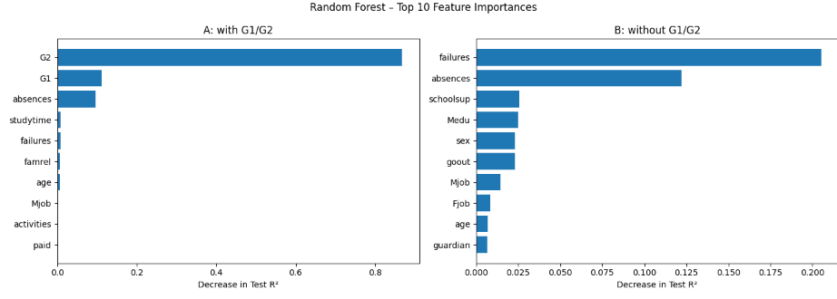
Appendix A: Ngoc An, full results
Scenario | Model | CV R² mean ± SD | Test R² | MAE | RMSE | RMSE / SD
A: with G1, G2 | Linear regression | 0.804 ± 0.035 | 0.724 | 1.647 | 2.378 | 0.522
A: with G1, G2 | Decision tree | 0.852 ± 0.059 | 0.704 | 1.413 | 2.462 | 0.540
A: with G1, G2 | Random forest | 0.883 ± 0.036 | 0.829 | 1.135 | 1.873 | 0.411
B: without G1, G2 | Linear regression | −0.092 ± 0.250 | 0.141 | 3.395 | 4.196 | 0.921
B: without G1, G2 | Decision tree | 0.128 ± 0.207 | 0.058 | 3.541 | 4.394 | 0.964
B: without G1, G2 | Random forest | 0.232 ± 0.097 | 0.242 | 3.188 | 3.943 | 0.865
Notes:
Backup slide for markers. Not presented in the video.

Slide 16
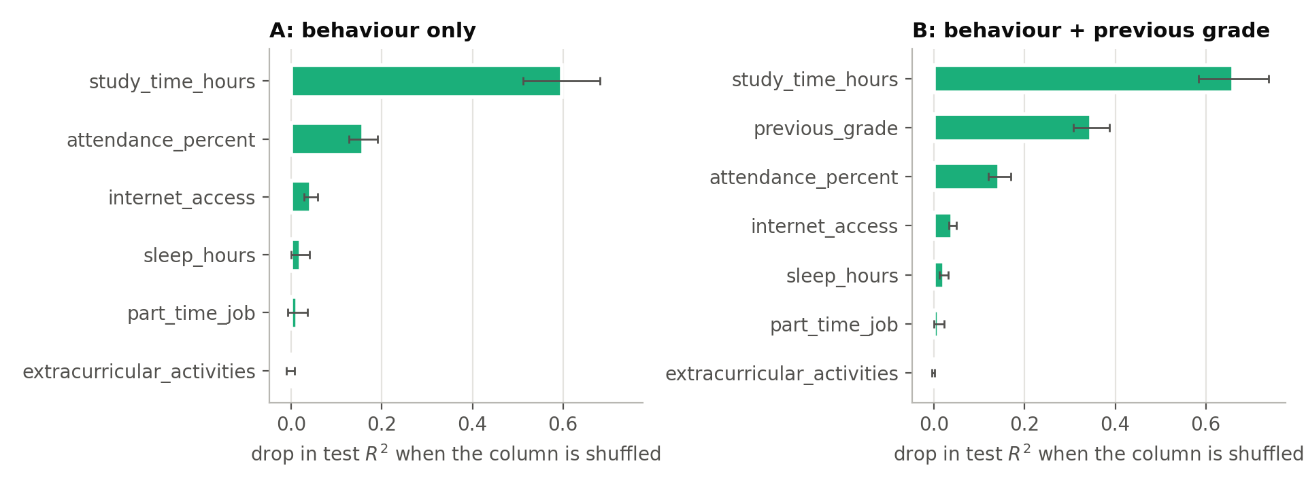
Appendix B: Quang Trung, full results
Scenario | Model | CV R² mean ± SD | Test R² | MAE | RMSE | RMSE / SD
A: behaviour only | Linear regression | 0.480 ± 0.032 | 0.386 | 6.58 | 8.13 | 0.786
A: behaviour only | Decision tree | 0.328 ± 0.080 | 0.269 | 7.23 | 8.87 | 0.858
A: behaviour only | Random forest | 0.443 ± 0.025 | 0.338 | 6.80 | 8.44 | 0.816
B: + previous grade | Linear regression | 0.659 ± 0.047 | 0.619 | 4.97 | 6.40 | 0.619
B: + previous grade | Decision tree | 0.446 ± 0.065 | 0.492 | 5.75 | 7.39 | 0.715
B: + previous grade | Random forest | 0.594 ± 0.055 | 0.585 | 5.24 | 6.68 | 0.646
Tuned: tree depth 5 / leaf 10 (A), depth None / leaf 10 (B); forest 300 trees, depth 10, sqrt (A) and depth 10, 0.5 (B). Source: main.ipynb.
Notes:
Backup slide for markers. Not presented in the video.

Slide 17
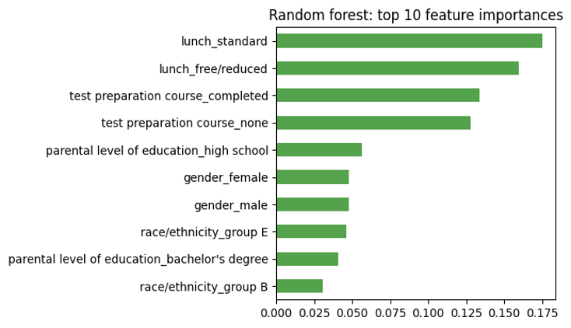
Appendix C: Akil, full results
Model | CV R² mean ± SD | Test R² | MAE | RMSE | RMSE / SD
Linear regression | 0.228 ± 0.037 | 0.162 | 10.49 | 13.40 | 0.913
Decision tree | 0.157 ± 0.060 | 0.068 | 10.97 | 14.14 | 0.963
Random forest | 0.194 ± 0.033 | 0.118 | 10.72 | 13.75 | 0.937
Tuned hyperparameters
Decision tree: max_depth 3, min_samples_leaf 10
Random forest: 300 trees, max_depth 5, max_features sqrt
Linear regression effects
Standard lunch +4.6 points vs free or reduced
Completed test preparation +3.9 points
Parental education: −4.1 (high school) to +4.1 (bachelor's)
Notes:
Backup slide for markers. Not presented in the video.

Slide 18
References
Batool, S., et al. (2023). Educational data mining to predict students' academic performance: A survey study. Education and Information Technologies, 28(1), 905–971.
Breiman, L. (2001). Random forests. Machine Learning, 45(1), 5–32.
Breiman, L., Friedman, J. H., Olshen, R. A., & Stone, C. J. (1984). Classification and regression trees. Wadsworth.
Cortez, P., & Silva, A. M. G. (2008). Using data mining to predict secondary school student performance. EUROSIS-ETI.
El Jihaoui, M., Abra, O. E. K., & Mansouri, K. (2025). Factors affecting student academic performance. IEEE Access, 13, 13197–13214.
Falát, L., & Piscová, T. (2022). Predicting GPA of university students with supervised regression machine learning models. Applied Sciences, 12(17), 8403.
Kohavi, R. (1995). A study of cross-validation and bootstrap for accuracy estimation and model selection. IJCAI, 1137–1143.
Namoun, A., & Alshanqiti, A. (2021). Predicting student performance using data mining and learning analytics techniques. Applied Sciences, 11(1), 237.
Pedregosa, F., et al. (2011). Scikit-learn: Machine learning in Python. JMLR, 12, 2825–2830.
Sonkhanani, M., Chibaya, S., & Nyirenda, C. N. (2026). Machine learning grade prediction using students' grades and demographics [Preprint]. arXiv:2603.00608.
Yağcı, M. (2022). Educational data mining: Prediction of students' academic performance using machine learning algorithms. Smart Learning Environments, 9, 11.
Notes:
Backup slide for markers. Not presented in the video.

