Slide 1

OCH
O N E C A P I T A L H O S P I T A L I T Y
CUSTOMER DATA PLATFORM
Unified customer data for a multi-brand hospitality group
Live demo: och-aicdp.aipower.vn
Developed by
System introduction · 2026
Leadvisors Tower — OCH headquarters

Slide 2
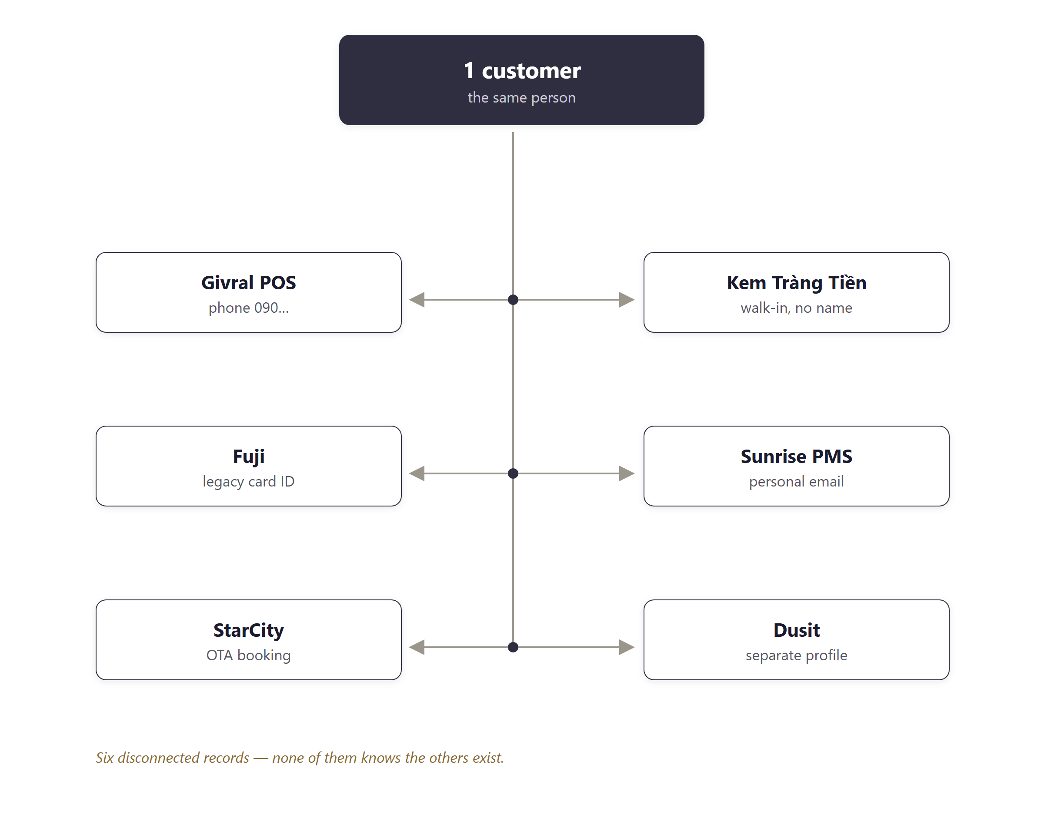
THE CURRENT STATE OF CUSTOMER DATA
One customer, six disconnected records
Ms. Vy buys pastries at Givral with her phone number, eats at Trang Tien as an anonymous walk-in, and stays at Sunrise under a personal email. To the group, she is six strangers.
WHAT THIS COSTS
● Duplicate discounts — two brands discount the same person in the same week.
● Missed cross-sell — F&B customers never receive a hotel offer.
● Blind marketing — no way to tell who is worth keeping and who is about to leave.
Six disconnected records — none knows the others exist.
OCH · Customer Data Platform — Developed by AIPOWER
2

Slide 3
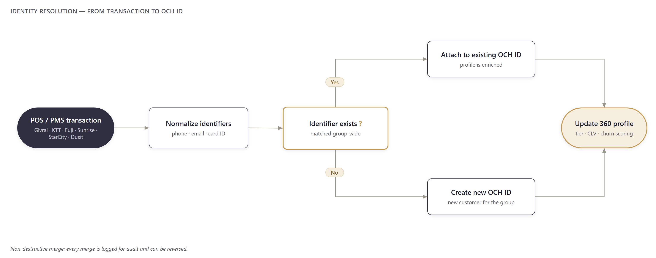
THE SOLUTION
Identity resolution: six records merged into a single OCH ID
Every identifier — phone, email, card ID — is matched and merged into a single OCH ID. Non-destructive merge: every merge is logged for audit and can be reversed if wrong.
In the demo:
335 unified profiles
15 cases where the system detected two records belonging to one person
From POS receipt to 360 profile — four automated steps.
OCH · Customer Data Platform — Developed by AIPOWER
3

Slide 4
BUSINESS VALUE
Unified data — four direct outcomes
🆔
🎁
ONE OCH ID
ONE POINTS BALANCE
Customers are recognized at every counter and every hotel.
Earn at Givral, redeem at Sunrise.
🤖
🧠
AUTOMATED MARKETING
AI RECOMMENDS
Right person, right time, right channel.
The system computes, people decide.
OCH · Customer Data Platform — Developed by AIPOWER
4

Slide 5
THE BIG PICTURE
Data flows in from every touchpoint, decisions flow out to every channel
DATA SOURCES
CDP CORE — UNIFY & DECIDE
ACTIVATION CHANNELS
F&B POS (Givral, KTT, Fuji)
Email / SMS
① Identity resolution
Hotel PMS (Sunrise, StarCity, Dusit)
Zalo ZNS
② 360° profile
Website / App / E-commerce
Google / Meta ads
③ Segmentation
Customer service (CS)
BI / Data warehouse
④ Activation
In one sentence: fragmented data from every brand → 360° profiles → segments → the right message on the right channel.
OCH · Customer Data Platform — Developed by AIPOWER
5

Slide 6
INTEGRATION MODEL
Integrates with existing systems — POS/PMS keep operating as they do today
INBOUND · Data in
OUTBOUND · Data out
F&B POS — Givral · KTT · Fuji
Email · SMS
OCH
CDP
Hotel PMS — Sunrise · StarCity · Dusit
Zalo ZNS (Vietnam channel)
Web · App · E-commerce
Google · Meta ads
Unify · 360° profiles · Segment · Activate
Signup forms · CS · Call center
Data warehouse · BI · Loyalty/CRM
Two connection modes: realtime and batch — POS/PMS keep working as they do. Consent gate at activation: nothing is sent without permission. Duplicate-proof revenue: every transaction carries a unique key — resends never double revenue.
OCH · Customer Data Platform — Developed by AIPOWER
6

Slide 7
TECH STACK
Open source, running on OCH servers — customer data never leaves Vietnam
RudderStack OSS
Real-time, CDP-grade data pipeline, Segment-compatible, 200+ connectors. Role: backbone for the channel-integration phase — the demo ingests directly through core-api using the same event schema, so no format change when RudderStack is plugged in.
PostgreSQL 18
The world’s most trusted open-source relational database, voted “most loved” for years in Stack Overflow surveys; strict ACID for money and points.
ClickHouse
Among the fastest columnar analytics databases in the world — the engine behind analytics at Cloudflare, Uber and Spotify; billions of rows in under a second.
NestJS
The leading enterprise Node.js framework for large backends — modular architecture, strict transaction control.
Redis
The industry-standard cache — customer profiles served in milliseconds at the POS counter.
MinIO
Amazon S3-compatible object storage, self-operated — no cloud fees, data stays in Vietnam.
Docker
The industry standard for packaging and deployment — repeatable installs, low-risk upgrades.
All industry-standard technology, proven at global scale — OCH owns it outright: no license fees, no data sent abroad.
OCH · Customer Data Platform — Developed by AIPOWER
7

Slide 8
TECHNICAL ARCHITECTURE
Four-layer architecture: sources → ingestion → storage → activation
DATA SOURCES
INGESTION
STORAGE
ACTIVATION
POS (F&B)
PMS (Hotels)
Web/App SDK
E-commerce
Forms / CS
RudderStack OSS
(event capture + routing)
core-api / NestJS
REST/HTTP + SDK
PostgreSQL 18
(system of record, ACID)
ClickHouse (OLAP)
MinIO (object store)
Redis (cache)
Reverse-ETL
(RudderStack)
→ Email / SMS
→ Zalo ZNS
→ Google / Meta / BI
Duplicate protection (idempotency): each POS transaction carries a unique key — resend it any number of times, it is recorded ONCE.
core-api (NestJS) handles identity + loyalty + consent + ingestion in ONE ACID transaction — correct money, correct identity at the point of sale.
OCH · Customer Data Platform — Developed by AIPOWER
8

Slide 9
SYNC PATTERNS
Six data synchronization patterns — chosen per use case
Pattern
When to use
Example at OCH
Real-time streaming
Data needed the moment an event occurs
POS transactions, web/app events → ingested immediately
Batch / scheduled
Large volumes, no real-time need
Product catalogs, nightly sync from files/DB
CDC (Change Data Capture)
Capture changes from source databases
Customer profile updates from legacy systems
Reverse-ETL
Push from the warehouse to SaaS tools
Push audiences to Zalo ZNS / Ads
Webhook
Sources call in when events occur
Payment gateways / partner notifications
REST API
Flexible two-way integration
Other OCH systems read/write data
OCH · Customer Data Platform — Developed by AIPOWER
9

Slide 10
DATA PIPELINE
ELT: load raw first, transform later — no source data lost
ETL — transform before load
ELT — load raw, transform in place
Data is transformed before loading. Rigid — hard to adapt when new analyses are needed.
Raw data lands first, then is standardized and computed in the warehouse. Flexible, source preserved.
The OCH system uses ELT + streaming ingestion:
Extract
Load (raw)
Transform
Serve
From POS, PMS, web/app, forms
Raw data lands in PostgreSQL / MinIO
Standardized into canonical models + features
Analytics in ClickHouse + Profile API
Result: fast raw ingestion, canonical modeling, OLAP analytics in ClickHouse. dbt can be added as the stack grows.
OCH · Customer Data Platform — Developed by AIPOWER
10

Slide 11
PLATFORM OVERVIEW
Eleven workspaces, organized by business role
🗼 Control Tower
👤 Customer 360
🎁 Loyalty
🗄️ Data Ops
Real-time group-wide dashboard
Unified 360° customer profiles
Earn & redeem across brands
Master data: brands, stores, products
📊 Insights
🎯 Audiences
🧭 Journeys
💬 AI Assistant
Revenue, lifecycle, synergy
Criteria-based customer segments
Automated customer journeys
Ask your data in natural language
🛡️ AI & Governance
✅ Governance (Consent)
⚙️ Platform
One platform —
11 workspace
for every role
Govern & audit AI parameters
Consent & privacy
Users, roles, API keys
OCH · Customer Data Platform — Developed by AIPOWER
11

Slide 12
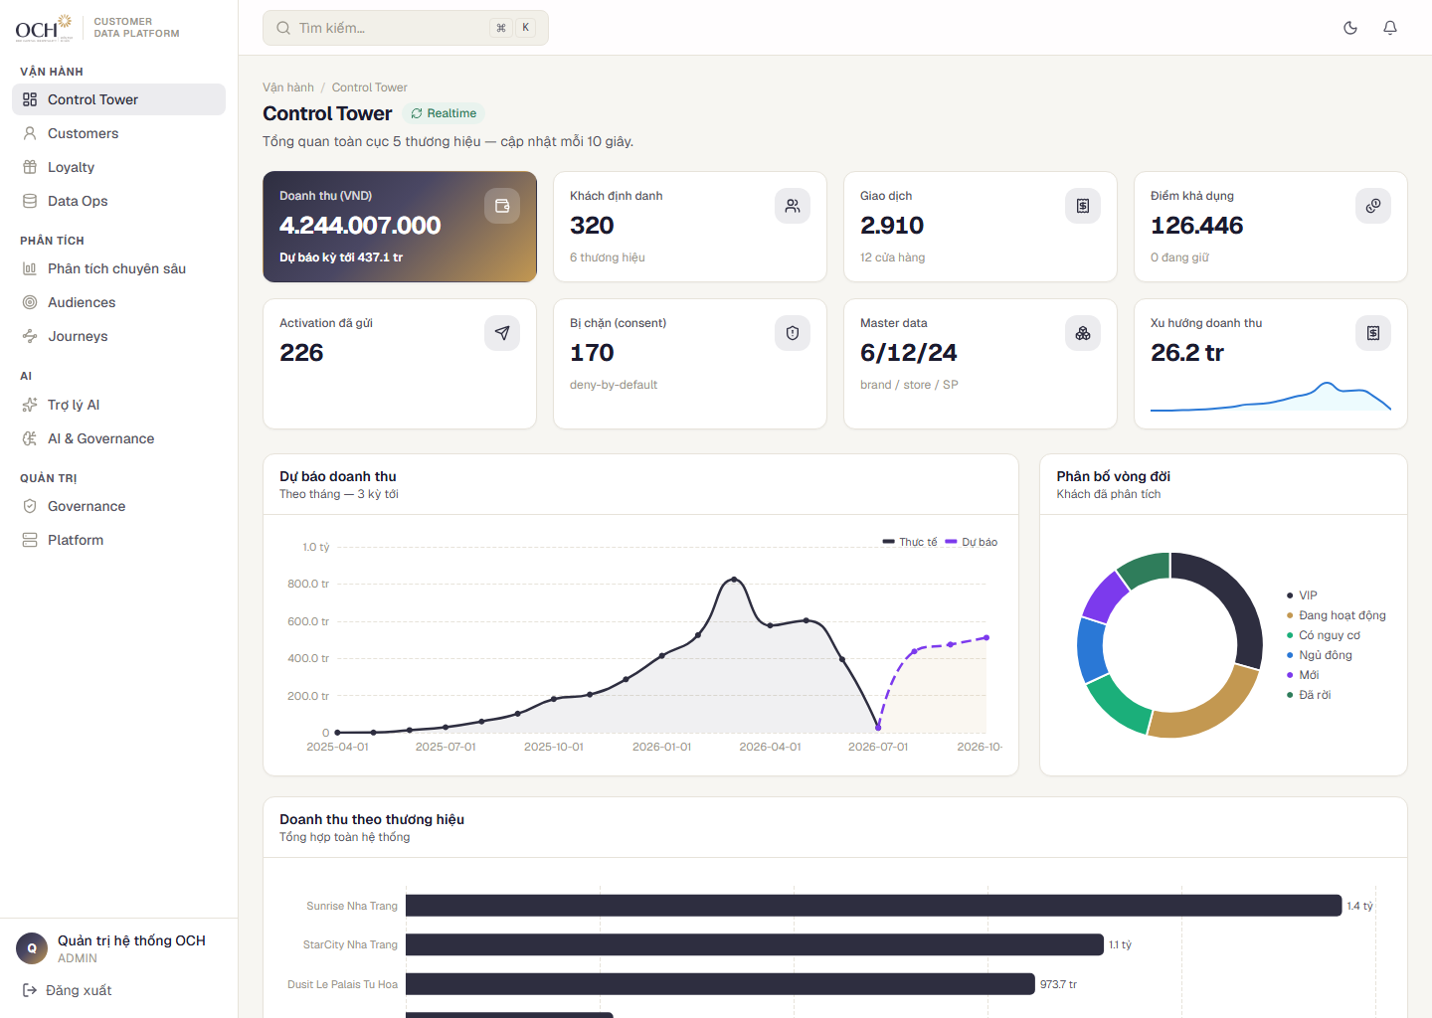
WORKSPACE · CONTROL TOWER
Control Tower: group-wide numbers on one screen, in real time
WHAT IT IS
A unified real-time dashboard: revenue, customers and data health for all six brands on one screen.
WHY IT MATTERS
Running a multi-brand group cannot wait for month-end reports stitched from six sources.
IMPACT
One source of truth for management; anomalies surface the same day.
Control Tower — real-time group overview. Product UI shown in Vietnamese (system language for OCH operations).
OCH · Customer Data Platform — Developed by AIPOWER
12

Slide 13
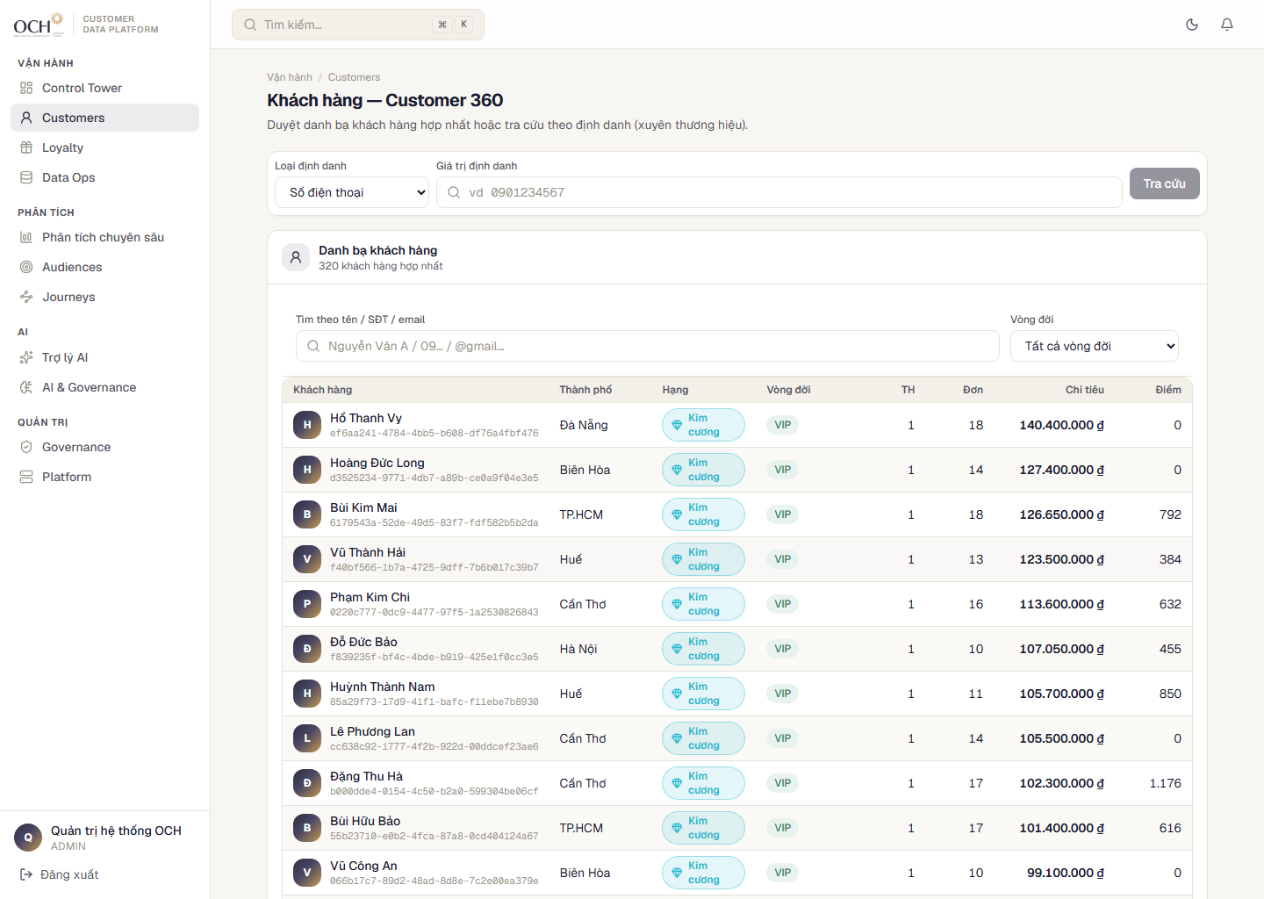
CUSTOMER 360 · 1/4
Look up any customer across six brands in seconds
WHAT IT IS
A group-wide directory: search by name, phone or email; filter by lifecycle, tier and brand.
WHY IT MATTERS
Customer service needs the answer while the customer is still at the counter.
IMPACT
335 customers across 6 brands on one screen; one click opens the full history.
Unified directory — the entry point to the Customer 360 profile.
OCH · Customer Data Platform — Developed by AIPOWER
13

Slide 14
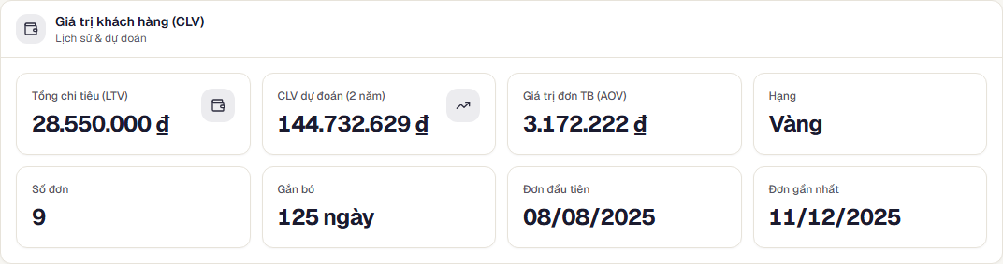
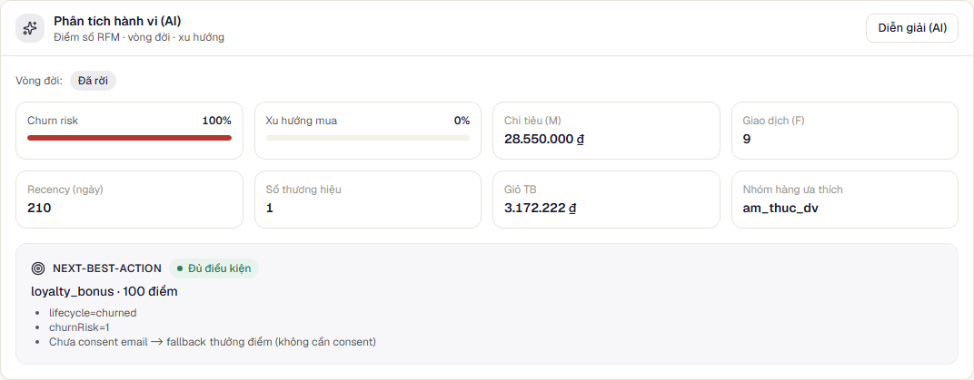
CUSTOMER 360 · 2/4
Customer tiers from group-wide spend — the 8% Diamond segment to protect
WHAT IT IS
Diamond / Gold / Silver / Bronze tiers from cumulative group-wide spend — not per brand.
WHY IT MATTERS
Care resources are finite — they must go to the small group driving most of the revenue.
Customer value — LTV, predicted CLV, AOV.
IMPACT
Predicted CLV shows how much is worth investing to keep each customer.
Purchase behavior — brands, categories, timing.
OCH · Customer Data Platform — Developed by AIPOWER
14

Slide 15
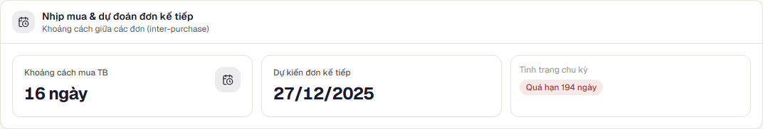
CUSTOMER 360 · 3/4
Purchase cadence: predicted return dates and overdue alerts
WHAT IT IS
Each customer’s average purchase interval → a predicted return date; off-schedule customers get flagged.
WHY IT MATTERS
Keeping a customer on cycle costs far less than winning back one who has left.
Purchase cadence — cycle, predicted return date, overdue alerts.
IMPACT
“37 days overdue” is a signal for customer service to reach out the same day.
Purchase behavior — the basis for each customer’s cadence.
OCH · Customer Data Platform — Developed by AIPOWER
15

Slide 16
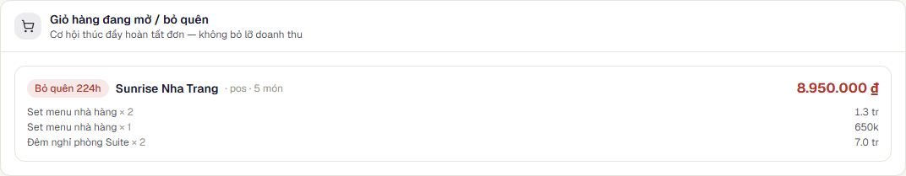
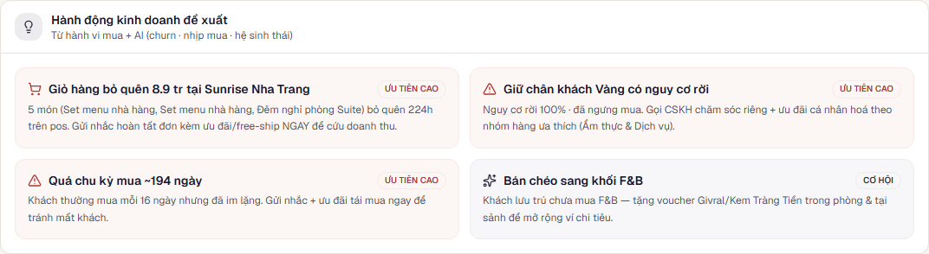
FORGOTTEN SALES OPPORTUNITIES
86 open or abandoned carts — the largest worth VND 8.95M
WHAT IT IS
The CDP keeps every unpaid cart and booking, and queues them for the sales team by priority.
WHY IT MATTERS
No other system in the group can see this cart.
Abandoned carts — value and idle time per cart.
IMPACT
86 open or abandoned carts, pre-sorted into a call-back list with a playbook — remind first, add an incentive if needed.
Recommended actions — a prioritized to-do list.
OCH · Customer Data Platform — Developed by AIPOWER
16

Slide 17
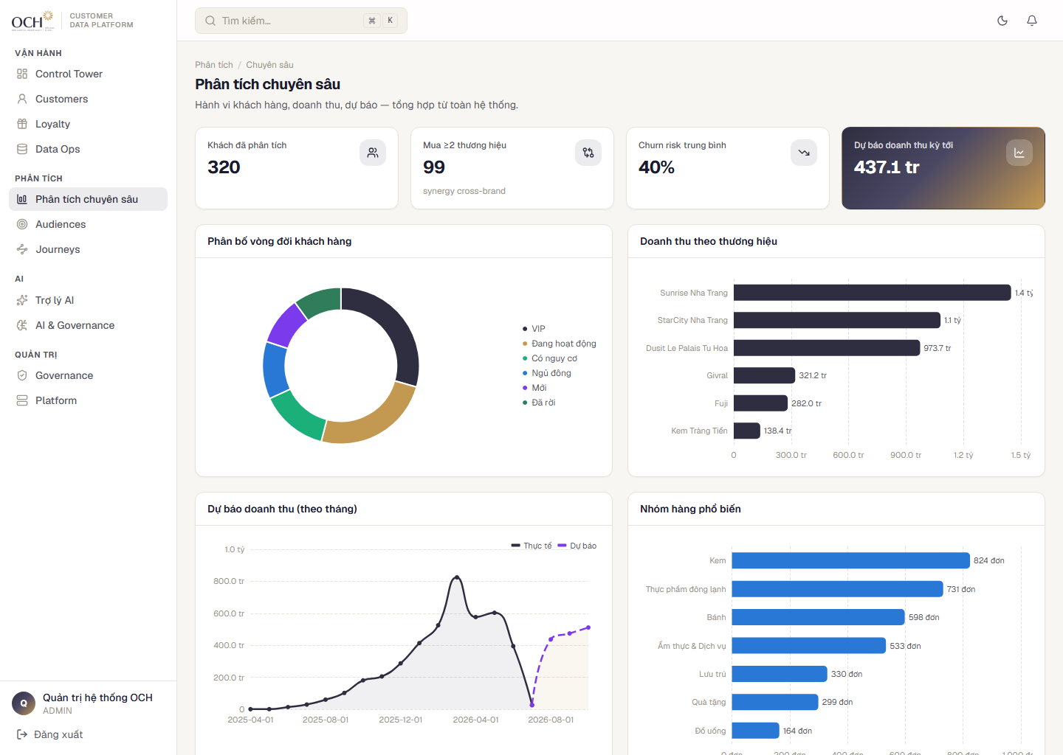
WORKSPACE · INSIGHTS
Insights: revenue, forecasts and synergy across six brands
WHAT IT IS
Monthly revenue with forecasts; customer lifecycle mix (VIP / active / at-risk / dormant); cross-brand usage.
WHY IT MATTERS
A rising at-risk share is an earlier warning than any revenue report.
IMPACT
Customer-base health and cross-sell potential on a single page.
Insights — revenue, forecasts, customer lifecycle.
OCH · Customer Data Platform — Developed by AIPOWER
17

Slide 18
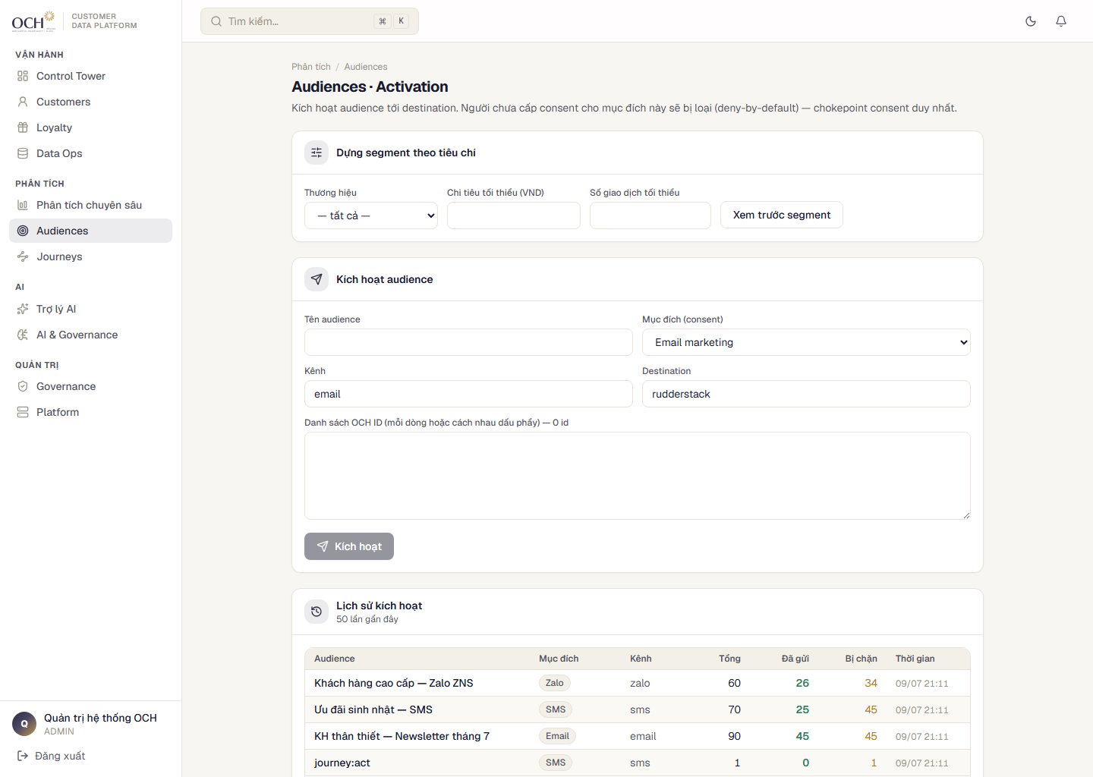
WORKSPACE · AUDIENCES
179 activations, fully logged: who was sent, who was suppressed, and why
WHAT IT IS
Build audiences from criteria, then activate to Email / SMS / Zalo ZNS / Ads.
WHY IT MATTERS
A campaign without logs is a campaign that cannot be verified.
IMPACT
Every activation logs sends and consent suppressions — auditable down to the individual customer.
Audiences — segments, criteria and activation history.
OCH · Customer Data Platform — Developed by AIPOWER
18

Slide 19
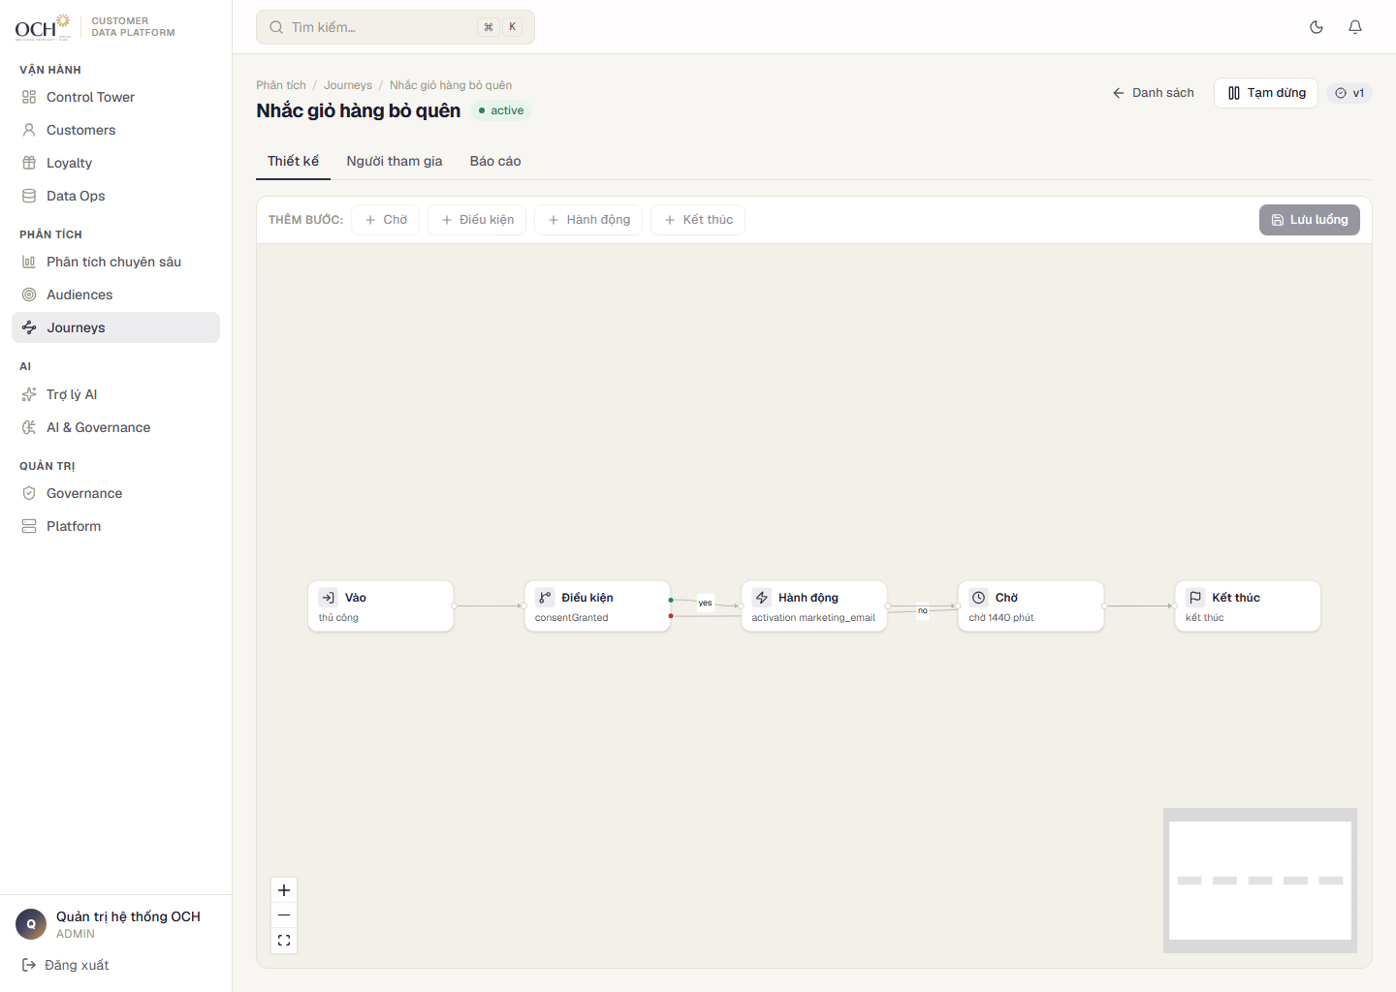
WORKSPACE · JOURNEYS · 1/2
Journeys: marketers build care scenarios with drag-and-drop
WHAT IT IS
Drag-and-drop journey flows: Entry → Condition → Action → Wait → End, with Yes/No branches.
WHY IT MATTERS
If every scenario waits for engineering, marketing can only move at release speed.
IMPACT
Each customer is touched EXACTLY ONCE per step — even if the system fails mid-run.
Journey canvas — drag-and-drop flow with condition branches.
OCH · Customer Data Platform — Developed by AIPOWER
19

Slide 20
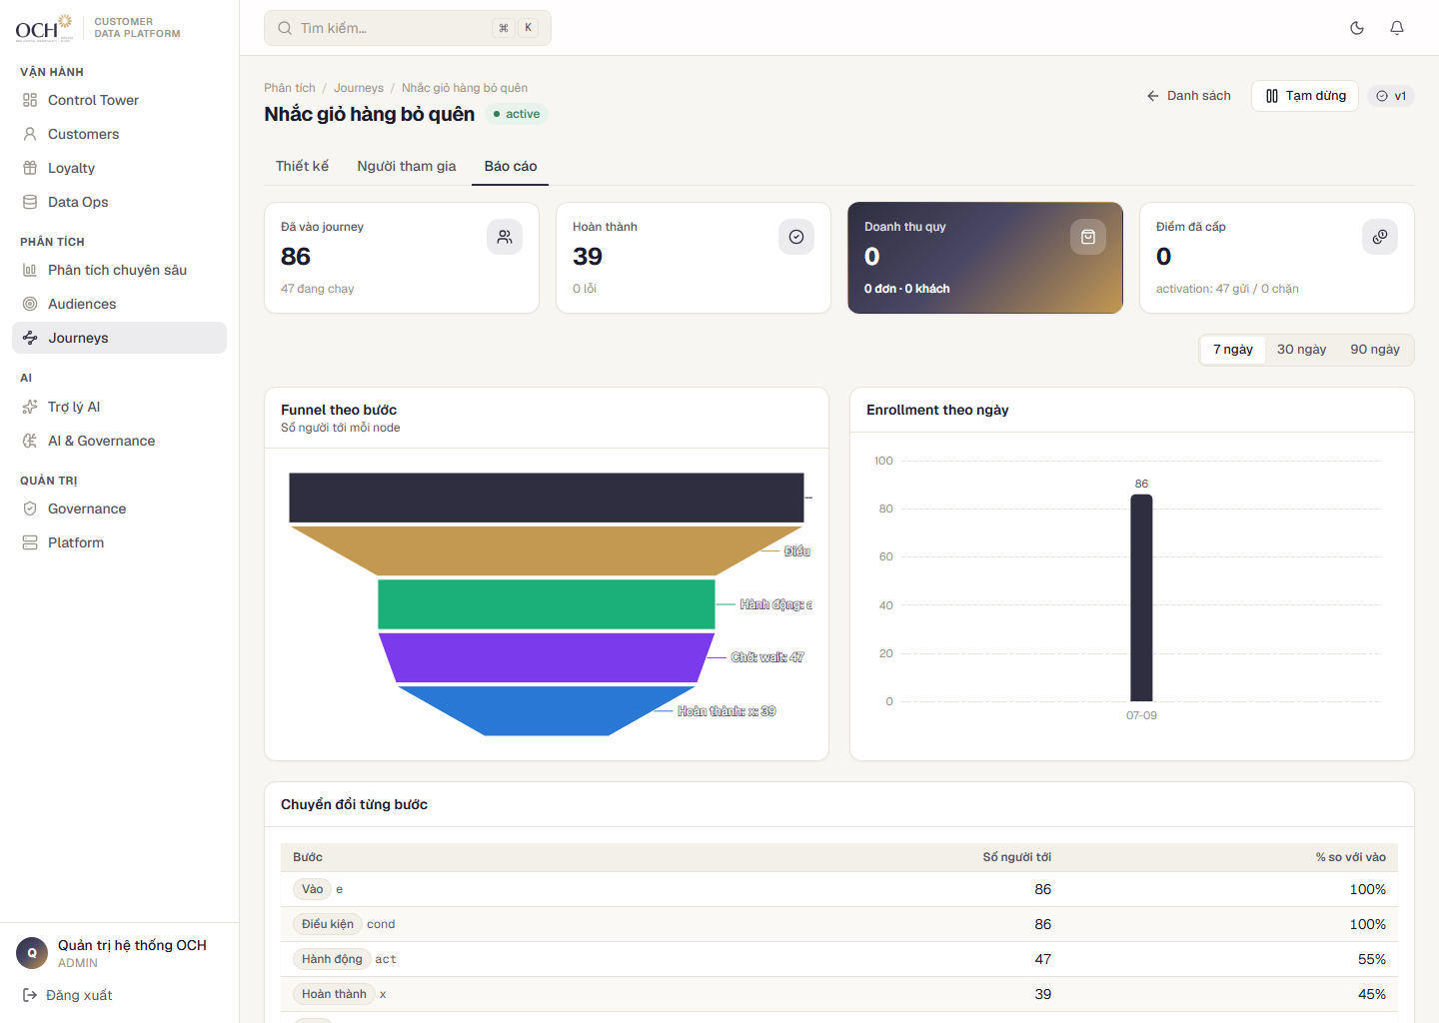
WORKSPACE · JOURNEYS · 2/2
Funnel report: 38 entered → 22 reached → 16 completed
WHAT IT IS
Every journey has a funnel: how many entered and how many remain at each step.
WHY IT MATTERS
Without a funnel you only know a campaign “ran” — not where customers dropped.
IMPACT
7 journeys running in the demo; the funnel shows exactly which step loses customers.
Journey report — funnel and per-step conversion.
OCH · Customer Data Platform — Developed by AIPOWER
20

Slide 21
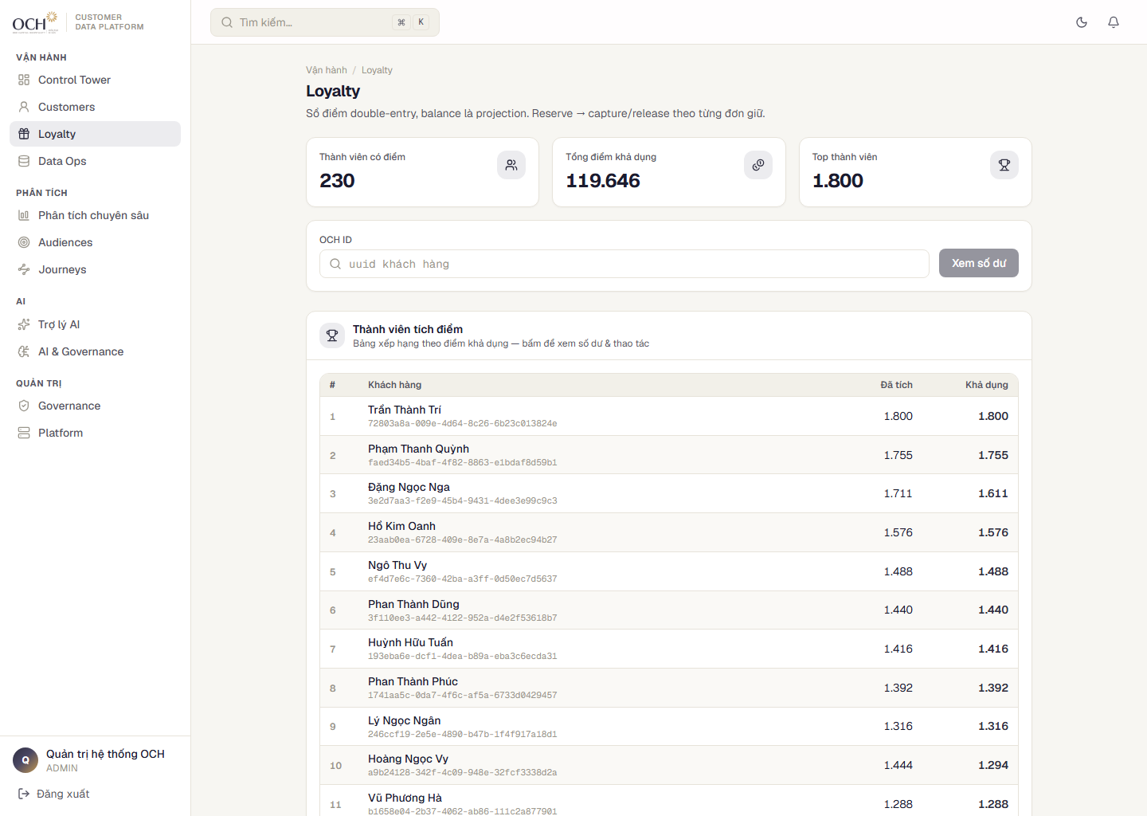
WORKSPACE · LOYALTY
Double-entry loyalty: 119,646 points in circulation, every movement has a matching entry
WHAT IT IS
One shared points fund: earn at one brand, redeem at another. Every movement is a ledger entry with a counterpart.
WHY IT MATTERS
Points are a liability — without double-entry bookkeeping, leakage goes unnoticed.
IMPACT
230 members earning and redeeming across brands; the fund can never go negative or double-credit.
Loyalty — member leaderboard and points fund.
OCH · Customer Data Platform — Developed by AIPOWER
21

Slide 22
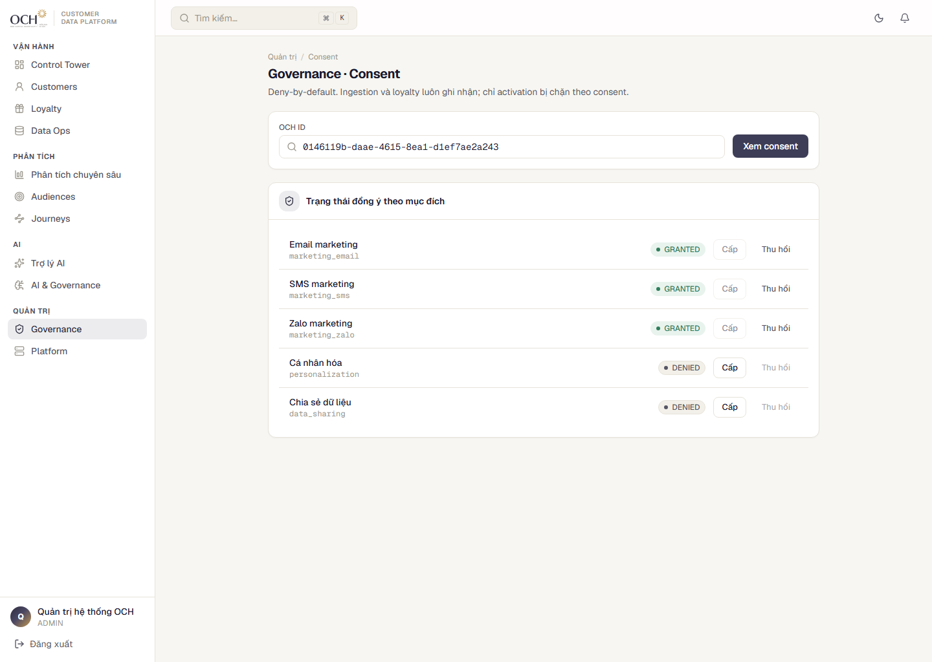
WORKSPACE · GOVERNANCE
Consent enforced at the system layer: no consent, no send
WHAT IT IS
Consent is recorded per purpose (email, SMS, advertising…), defaults to DENY, and every change is logged.
WHY IT MATTERS
Compliance cannot rely on the discipline of whoever runs the campaign.
IMPACT
All activations pass one consent gate; suppression lists live in the logs — provable under audit.
Governance — per-purpose consent with a full audit trail.
OCH · Customer Data Platform — Developed by AIPOWER
22

Slide 23
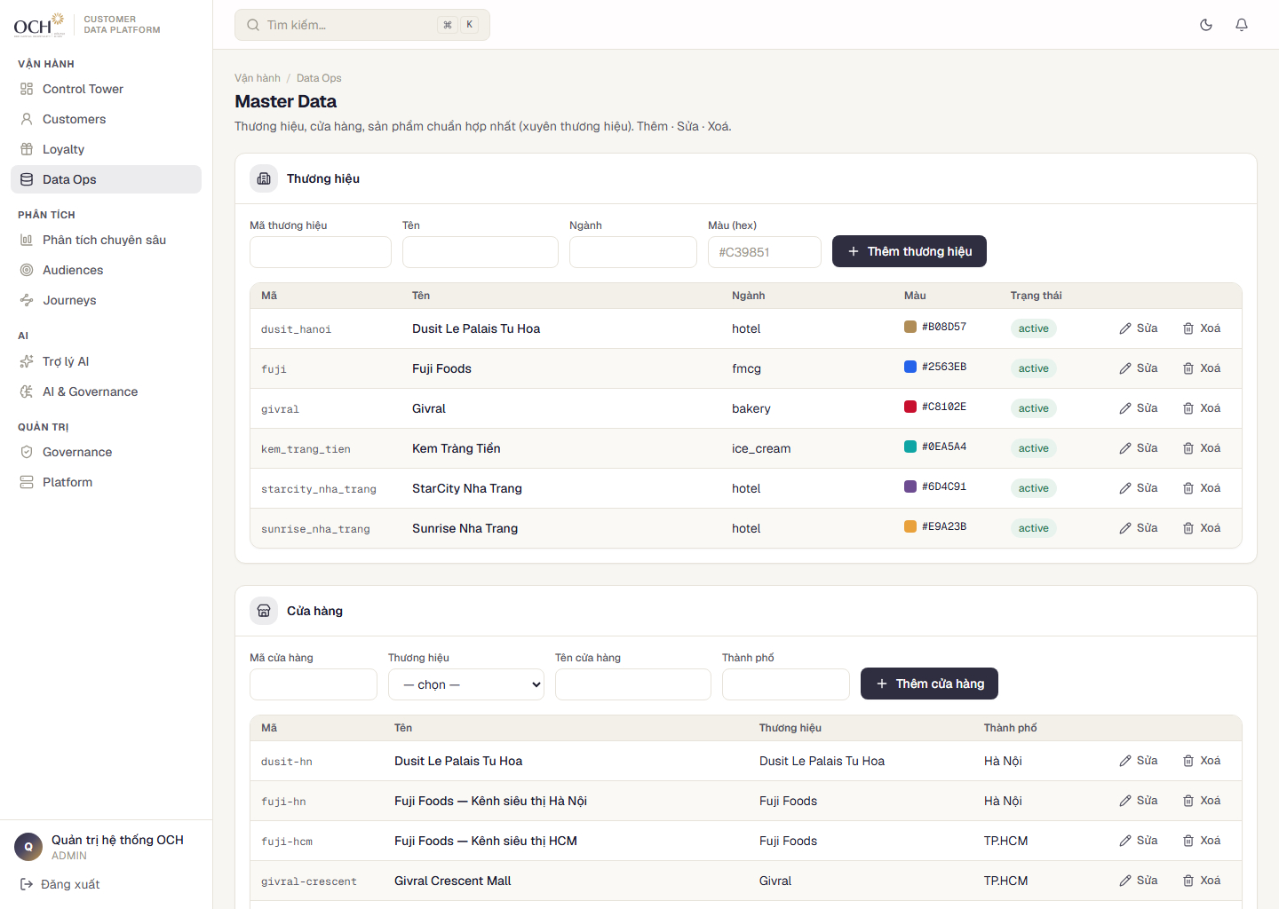
WORKSPACE · DATA OPS & PLATFORM
Data Ops & Platform: one master catalog, seven permission roles
WHAT IT IS
Data Ops maintains the group-wide master catalog; Platform manages users across 7 roles and API keys.
WHY IT MATTERS
Wrong reports start with mismatched catalogs; security incidents start with unclear accounts.
IMPACT
Fix once — updated everywhere; external connections use scoped API keys.
Data Ops — brand / store / product catalogs.
OCH · Customer Data Platform — Developed by AIPOWER
23

Slide 24
AI IN THE DEMO
Six AI capabilities running on demo data — 335 customers scored
Customer scoring (RFM)
CLV & next purchase date
VIP / active / at-risk / dormant / churned lifecycle, churn risk, purchase trends — with clear reasons for every score.
How much is worth investing to keep a customer, and WHEN to reach out.
Cross-sell suggestions
Next-Best-Action
What similar customers also bought; prioritizes variety and cross-brand.
The system proposes the next action per customer, with stated grounds; people approve and execute.
Action rule engine
Revenue forecasting
Abandoned carts, retention, F&B ↔ hotel cross-sell — pre-sorted by priority.
Monthly forecasts directly in Insights.
AI scores computed on the demo’s live data.
OCH · Customer Data Platform — Developed by AIPOWER
24

Slide 25
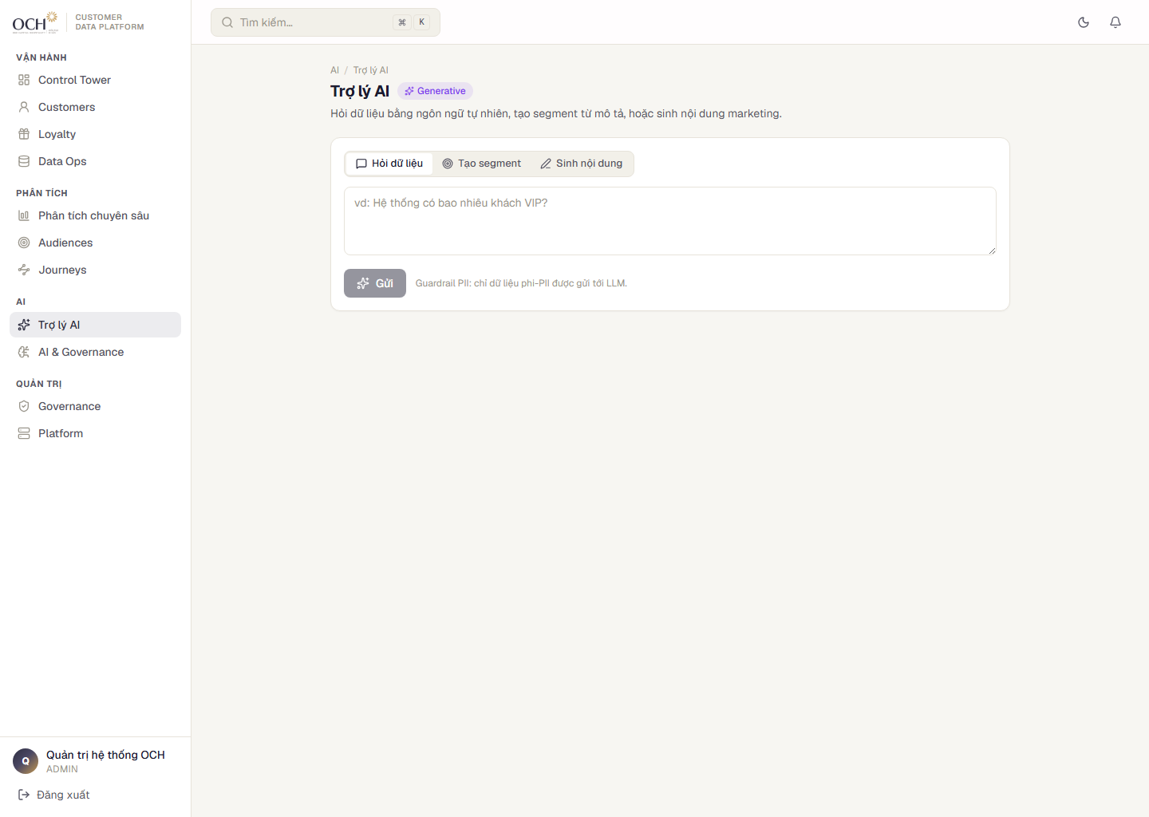
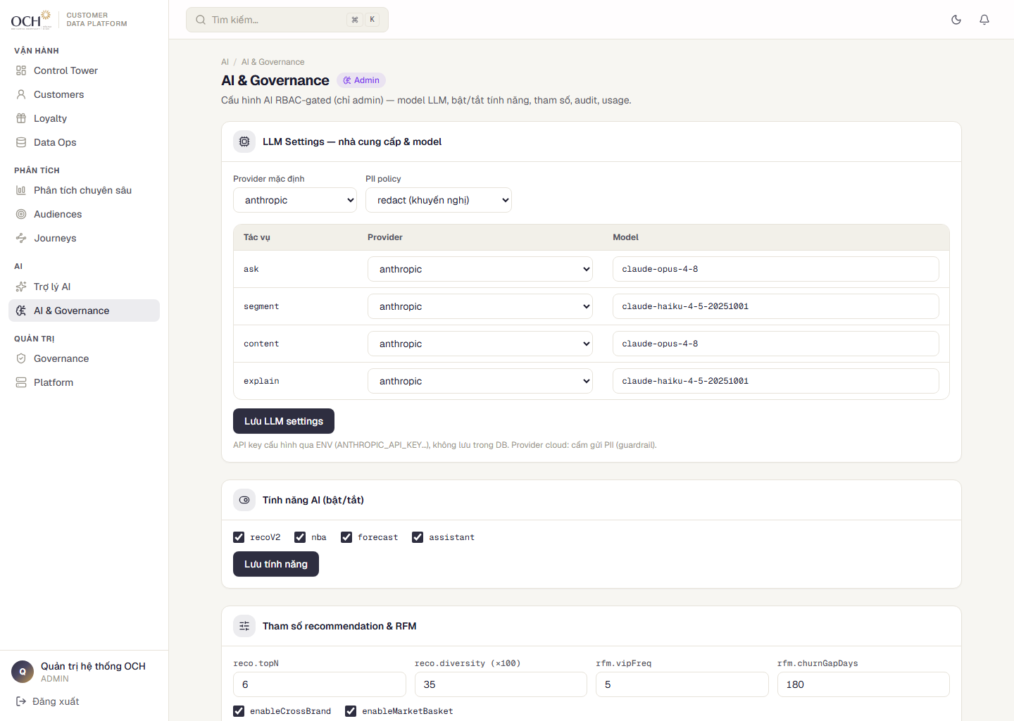
GENERATIVE AI, UNDER CONTROL
AI Assistant: ask your data in plain language, governed and logged
LLM assistant (built on Anthropic’s Claude): data Q&A, segments generated from plain descriptions, marketing copy drafting.
① PII guardrail
Personally identifiable data is never sent to the LLM.
AI Assistant — Q&A on live data.
② AI Governance
Admins set thresholds and switch features on or off.
③ Audit + usage log
Every AI call is recorded.
AI Governance — thresholds, toggles, audit.
OCH · Customer Data Platform — Developed by AIPOWER
25

Slide 26
MARKET COMPARISON
Compared with commercial CDPs: data, cost and Vietnam channels — 1/2
Criteria
AICDP / OCH
Segment
Adobe RTCDP
Tealium
Hightouch
Treasure Data
Deployment model
Self-hosted at OCH
Cloud SaaS
Cloud SaaS
Cloud SaaS
Cloud (ELT)
Cloud SaaS
Data residency in Vietnam
Yes — sovereign
Foreign infra
Foreign
Foreign
Foreign
Foreign
Tailored for F&B + hotels
Purpose-built
Generic
Generic
Generic
Generic
Generic
Identity resolution (OCH ID)
Core capability
Yes
Yes
Yes
Reverse-ETL
Yes
OCH · Customer Data Platform — Developed by AIPOWER
26

Slide 27
MARKET COMPARISON
Compared with commercial CDPs: data, cost and Vietnam channels — 2/2
Criteria
AICDP / OCH
Segment
Adobe RTCDP
Tealium
Hightouch
Treasure Data
Built-in loyalty
Yes — double-entry
Integration
Integration
Integration
No
Integration
Explainable AI
Yes — transparent
Limited
Yes (black box)
Limited
No
Yes
Vietnam channels (Zalo ZNS)
Native
Via integration
Via integration
Via integration
Via integration
Via integration
License cost (qualitative)
No per-customer fee
High, MTU-based
Very high
High
Per synced row
High
Bottom line: AICDP fits OCH better on data sovereignty in Vietnam, F&B + hotel fit, total cost of ownership, and Vietnam channels (Zalo). Competitor entries are qualitative — no invented numbers.
OCH · Customer Data Platform — Developed by AIPOWER
27

Slide 28
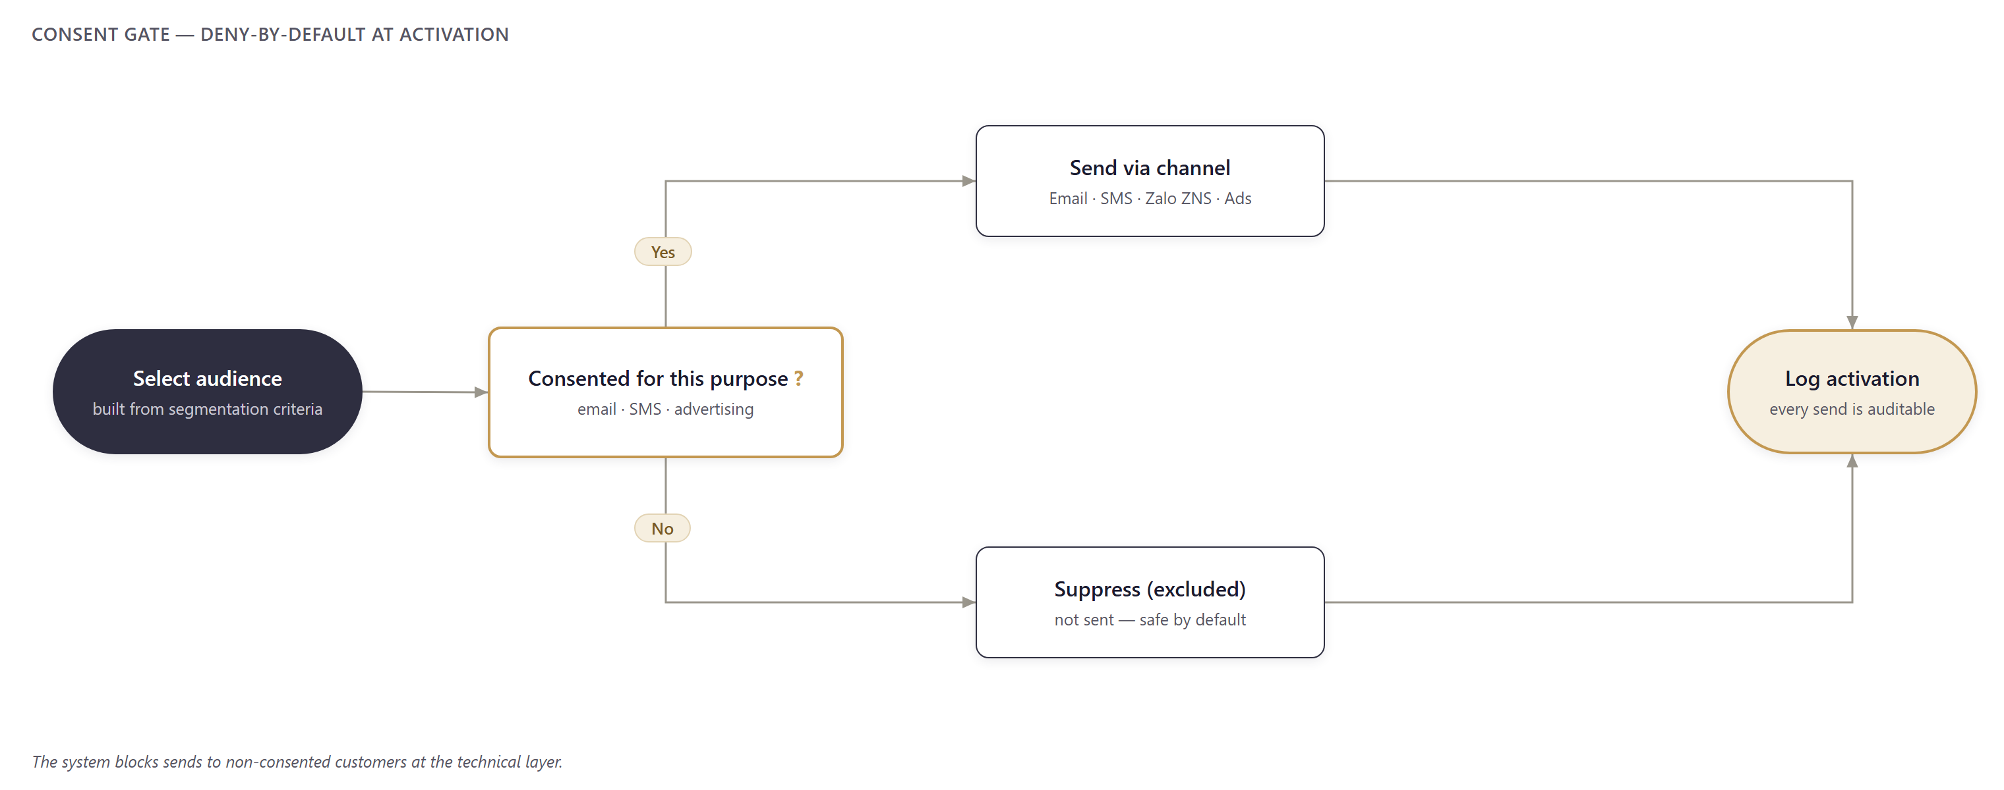
OPERATING FLOW · 1
Consent → activation: all data comes in, sends go out only with permission
Audiences pass the consent gate before sending; non-consented customers are suppressed and logged.
OCH · Customer Data Platform — Developed by AIPOWER
28

Slide 29
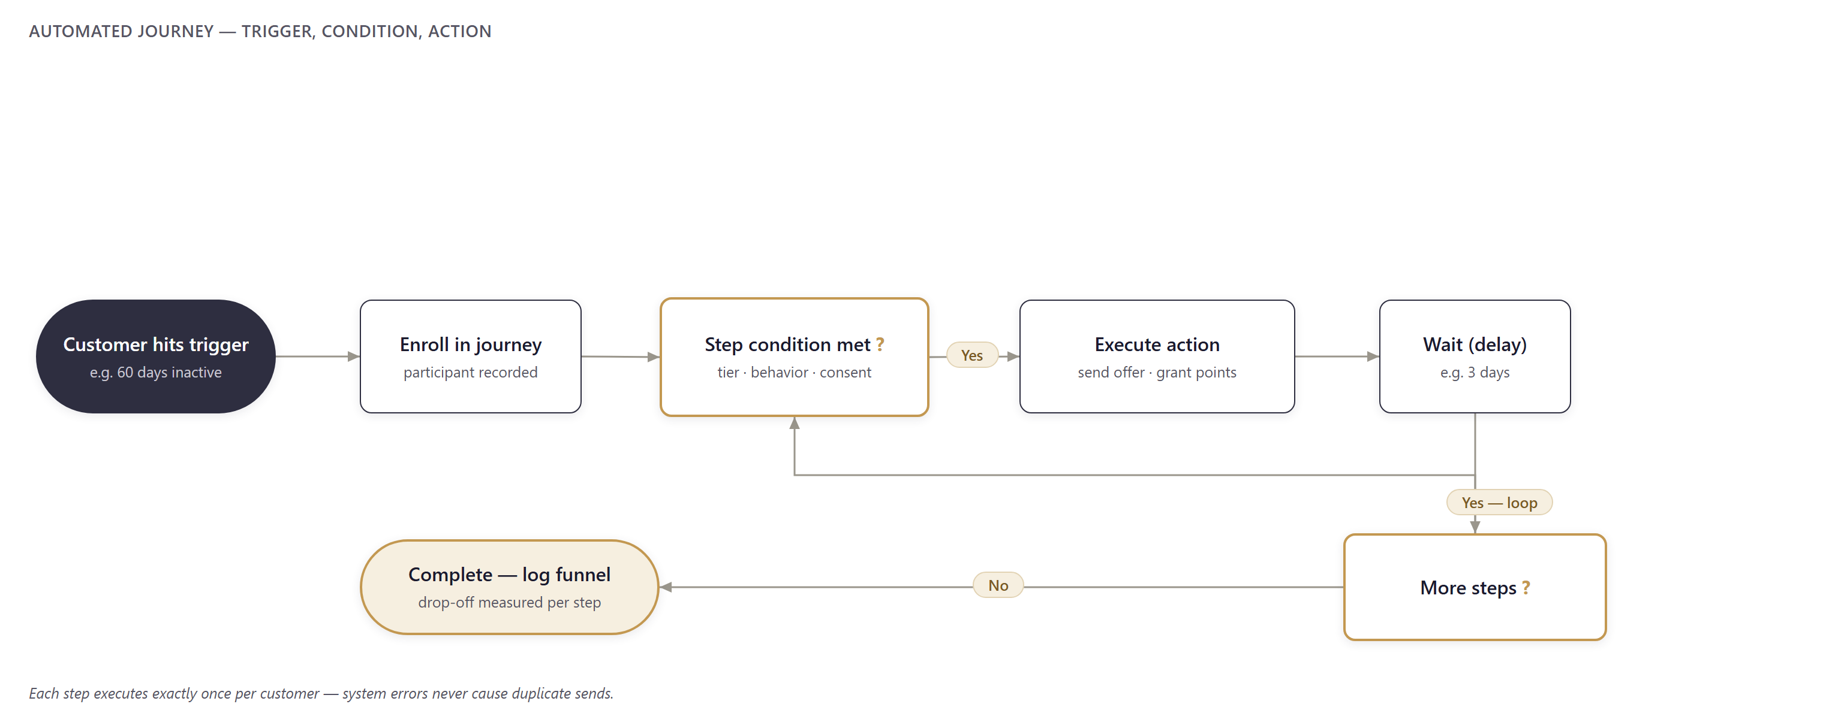
OPERATING FLOW · 2
Automated journey flow: enroll → condition → action → complete
Trigger → condition → action → wait → loop; completion writes the funnel for drop-off analysis.
OCH · Customer Data Platform — Developed by AIPOWER
29

Slide 30
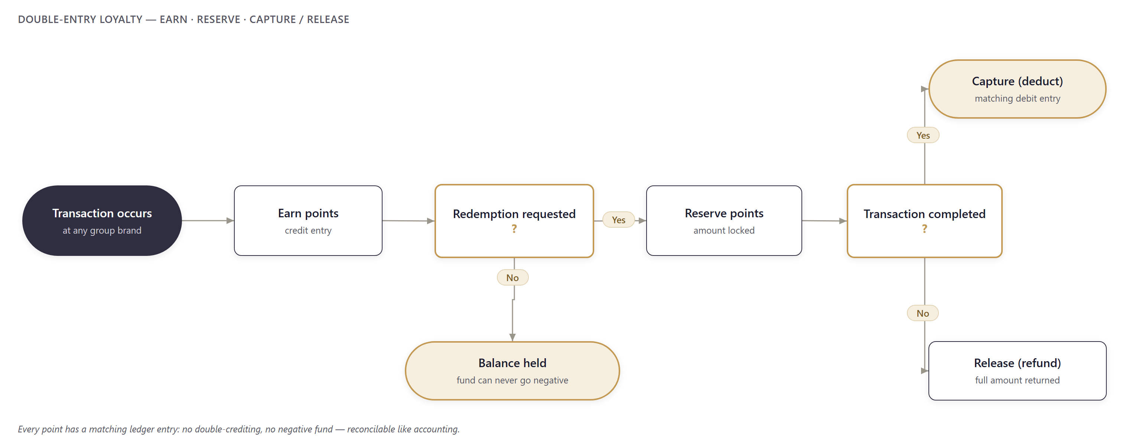
OPERATING FLOW · 3
Loyalty flow: earn → reserve → capture/release, a ledger entry at every step
Points are locked at redemption and deducted only on completion — cancellations refund in full.
OCH · Customer Data Platform — Developed by AIPOWER
30

Slide 31
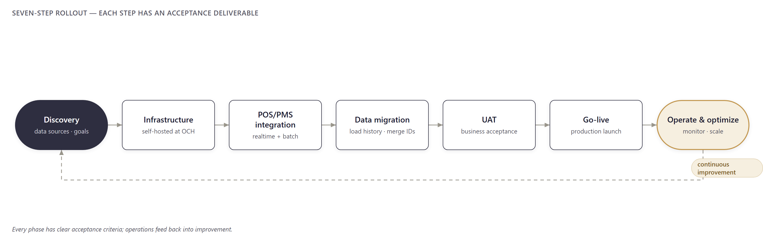
ROLLOUT & OPERATIONS
Seven-step rollout — each step has an acceptance deliverable
Each phase has acceptance milestones; operations feed back into improvement.
OCH · Customer Data Platform — Developed by AIPOWER
31

Slide 32
CONCLUSION — FIVE MECHANISMS BUILT INTO THE CORE
No duplicated revenue, no leaked points, no wrong sends
Duplicate-proof revenue
Every POS transaction carries a unique key — resends are recorded once.
Double-entry loyalty
Every point has a matching ledger entry: no double-crediting, the fund can never go negative.
Technical consent gate
Without consent the system blocks the send — it does not rely on campaign discipline.
Exactly-once customer touch
Each journey step executes exactly once — system errors never cause spam.
Self-hosted in Vietnam
Customer data never leaves OCH infrastructure; no per-event license fees.
The system is running on live data — try it at och-aicdp.aipower.vn (admin / Och@2026)
OCH · Customer Data Platform — Developed by AIPOWER
32

Slide 33
Thank you
OCH · Customer Data Platform
Explore the live demo:
https://och-aicdp.aipower.vn (login: admin / Och@2026)
Developed by AIPOWER · aipower.vn
OCH · Customer Data Platform — Developed by AIPOWER
33

Slide 34
APPENDIX · Reference material
APPENDIX
CDP market data with sources, integration security, and references.
OCH · Customer Data Platform — Developed by AIPOWER
34

Slide 35
MARKET APPENDIX · 1/10
The CDP market — context
CDP is among the fastest-growing categories of marketing infrastructure.
📈
🧩
🤖
Fastest-growing martech
Key driver: fragmented data
AI accelerates demand
Demand for unified customer data is rising across industries.
Most companies lack complete customer profiles — the exact problem at OCH.
AI personalization requires unified, clean, real-time data foundations.
Sources: Compiled from Grand View Research, MarketsandMarkets, CDP Institute, Twilio Segment (2024–2025).
OCH · Customer Data Platform — Developed by AIPOWER
35

Slide 36
MARKET APPENDIX · 2/10 · MULTIPLE SOURCES
CDP market size
Research firm
Current
Forecast
CAGR
Grand View Research
USD 8.26B (2025)
USD 58.41B (2033)
27.8%
MarketsandMarkets
USD 9.72B (2025)
USD 37.11B (2030)
30.7%
Fortune Business Insights
USD 3.28B (2025)
USD 17.03B (2034)
19.6%
Data Bridge Market Research
USD 8.34B (2024)
USD 85.18B (2032)
33.7%
CDP Institute
USD 2.4B (2024)
USD 28.2B (2028)
39.9%
Figures differ by methodology and definitions — but every source projects double-digit growth.
Sources: grandviewresearch.com · marketsandmarkets.com (Report 94223554) · fortunebusinessinsights.com · databridgemarketresearch.com · cdpinstitute.org (2024–2025).
OCH · Customer Data Platform — Developed by AIPOWER
36

Slide 37
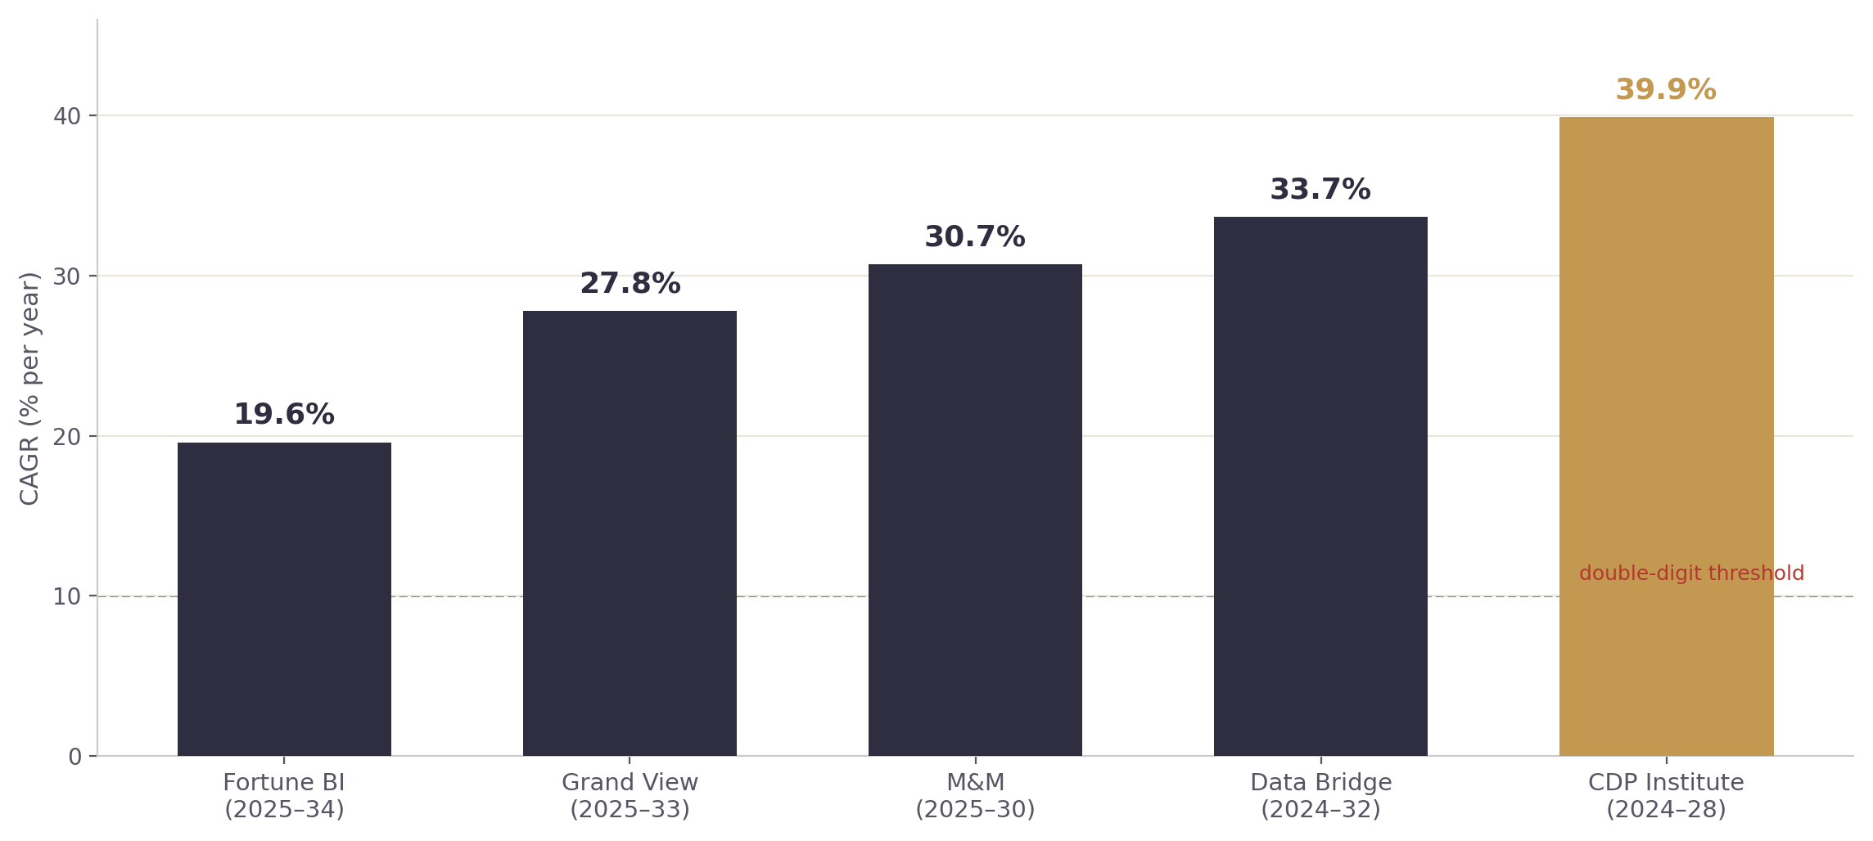
MARKET APPENDIX · 3/10
Growth rates (CAGR)
Forecast CAGR by research firm — all in double digits (19.6%–39.9%).
Takeaway: every source projects double-digit growth.
Sources: Grand View Research; MarketsandMarkets; Fortune Business Insights; Data Bridge Market Research; CDP Institute (2024–2025).
OCH · Customer Data Platform — Developed by AIPOWER
37

Slide 38
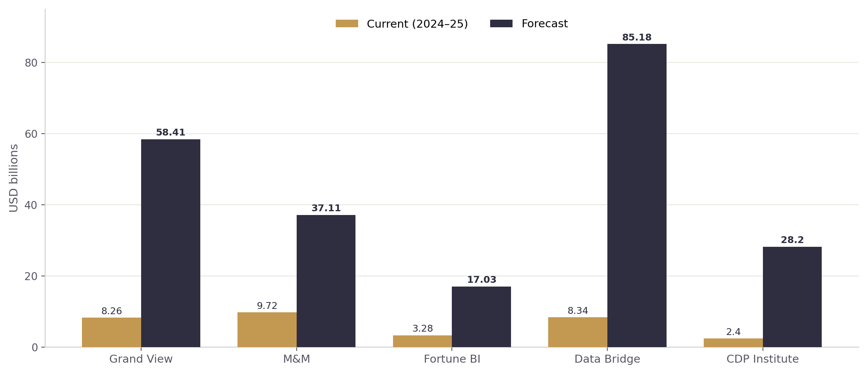
MARKET APPENDIX · 4/10
Market size — current vs forecast
CDP market size (USD billions): current (2024–25) vs forecast, by source.
Sources: grandviewresearch.com · marketsandmarkets.com · fortunebusinessinsights.com · databridgemarketresearch.com · cdpinstitute.org.
OCH · Customer Data Platform — Developed by AIPOWER
38

Slide 39
MARKET APPENDIX · 5/10 · GARTNER 2024
CDP adoption
41%
36%
22%
of enterprises have already deployed a CDP
are evaluating deployment
of marketers report high CDP utilization
The deploy-but-underuse gap:
many companies own a CDP but underuse it. The advantage goes to those who turn data into ACTION — the exact design focus of AICDP for OCH.
Sources: Gartner — CDP adoption survey, 2024.
OCH · Customer Data Platform — Developed by AIPOWER
39

Slide 40
MARKET APPENDIX · 6/10 · STATISTA / CDP INSTITUTE, JUNE 2024
The CDP vendor landscape
194 CDP vendors worldwide (+5% vs December 2023)
BY COUNTRY
BY FUNCTION
United States
89 vendor
Campaign
34%
United Kingdom
14 vendor
Delivery
33%
India
13 vendor
Analytics
18%
Sources: Statista / CDP Institute — Industry Update, June 2024.
OCH · Customer Data Platform — Developed by AIPOWER
40

Slide 41
MARKET APPENDIX · 7/10 · TWILIO SEGMENT 2024
Pain point #1 — fragmented data
16%
19%
of brands “strongly agree” they have enough data to understand customers
“strongly agree” they have complete customer profiles
More than 80% of brands lack a complete customer data foundation — the single biggest barrier, and the reason CDPs exist.
Sources: Twilio Segment — The State of Personalization 2024 (segment.com/state-of-personalization-report).
OCH · Customer Data Platform — Developed by AIPOWER
41

Slide 42
MARKET APPENDIX · 8/10
The value of personalization
+54%
72%
more spent on average when personalization is AI-driven
of consumers EXPECT personalized experiences
Sources: Twilio Segment — State of Personalization 2024 (+54%); McKinsey & Company (72%, cited via Twilio’s report).
OCH · Customer Data Platform — Developed by AIPOWER
42

Slide 43
MARKET APPENDIX · 9/10 · TWILIO SEGMENT 2024
Trends — AI and predictive personalization
7/10
86%
89%
businesses already use AI for personalization
expect to move from reactive to PREDICTIVE personalization
believe ethical AI use is a competitive advantage
Sources: Twilio Segment — The State of Personalization 2024 (twilio.com · segment.com).
OCH · Customer Data Platform — Developed by AIPOWER
43

Slide 44
MARKET APPENDIX · 10/10 · SUMMARY
Implications for OCH
A fast-growing market; fragmented data is barrier #1 — OCH already has a working platform.
⏳
🧩
🚀
A growing market
The barrier is fragmented data
OCH with AICDP
Early deployment compounds the data advantage.
Exactly the problem at OCH — a CDP addresses it at the root.
Self-hosted in Vietnam, tailored for F&B + hotels, action-oriented AI.
Sources: Compiled from the sources above (2024–2025).
OCH · Customer Data Platform — Developed by AIPOWER
44

Slide 45
TECHNICAL APPENDIX · PROTOCOLS & SAFETY
Integration standards & security
🔌
📨
🔑
REST/HTTP API + SDK
Webhook
Role-scoped API keys (RBAC)
Standard connectivity for web, app and server — easy to integrate any system.
Sources call the system when events occur — real-time, low latency.
Each connection has its own key with role-based permissions.
✅
🚫
🇻🇳
Consent gate (deny-by-default)
Idempotent ingestion
Data residency in Vietnam
At activation: no consent, no send — safe by default.
Unique transaction keys — resends are recorded once.
Data stored and processed in-country — sovereignty and legal compliance.
OCH · Customer Data Platform — Developed by AIPOWER
45

Slide 46
FULL CITATIONS
References
• Grand View Research — Customer Data Platform Market: grandviewresearch.com/industry-analysis/customer-data-platform-market
• MarketsandMarkets — Customer Data Platform Market (Report 94223554): marketsandmarkets.com
• Fortune Business Insights — Customer Data Platform Market: fortunebusinessinsights.com
• Data Bridge Market Research — Customer Data Platform Market: databridgemarketresearch.com
• CDP Institute — Industry Update / Member Report 2024: cdpinstitute.org
• Statista — Customer Data Platform vendors: statista.com
• Gartner — CDP adoption survey 2024: gartner.com
• Twilio Segment — The State of Personalization 2024: segment.com/state-of-personalization-report · twilio.com
• McKinsey & Company — Next in Personalization (72%, cited via Twilio’s report).
Note: market figures are taken directly from the research firms; competitor entries in the comparison are qualitative only.
OCH · Customer Data Platform — Developed by AIPOWER
46

