Slide 1

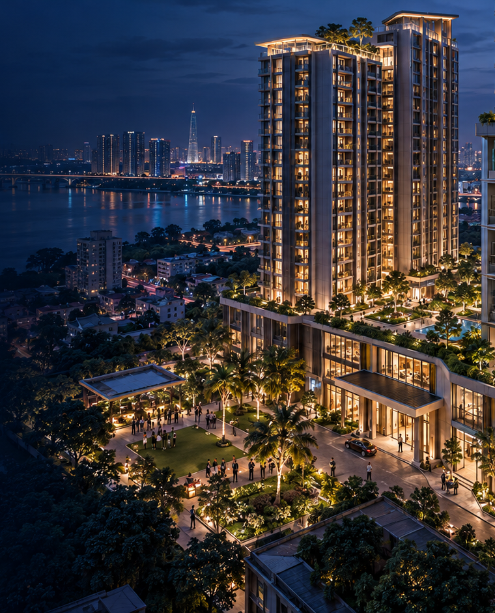
SOLUTION PROPOSAL
SmartAlarm
CONNECTED SAFETY & RESCUE PLATFORM
SmartAlarm
From alerts to
rescue action
One platform connecting people, equipment
and responders — across industries and regions.
BEFORE • DURING • AFTER
AIPOWER | SmartAlarm solution proposal | International • Multi-industry
1
Notes:
SmartAlarm retains FireEscape's detection–guidance–SOS–confirmation cycle and extends it to multiple hazards and proactive rescue. Full product scope is designed from the outset, supporting Vietnamese, English and Japanese. The cover retains the source photograph, logo, master and visual identity.
SmartAlarm design proposal — revision 1.0, 23 October 2026. Scenarios, interfaces and numerical examples are illustrative, not evidence of a deployed product. Source: the FireEscape proposal and product-owner requirements. Pictorial scenes were created with imagegen; text, flows, architecture and UI are editable PowerPoint objects.

Slide 2
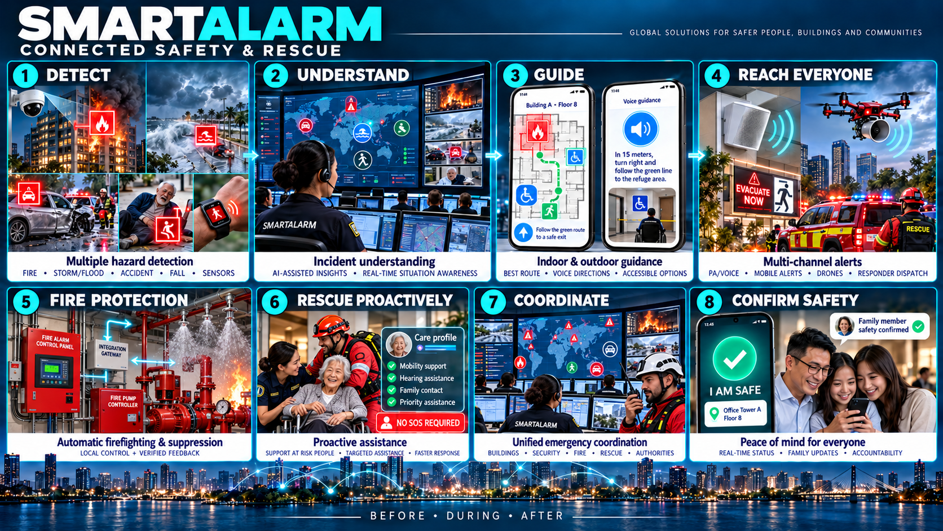
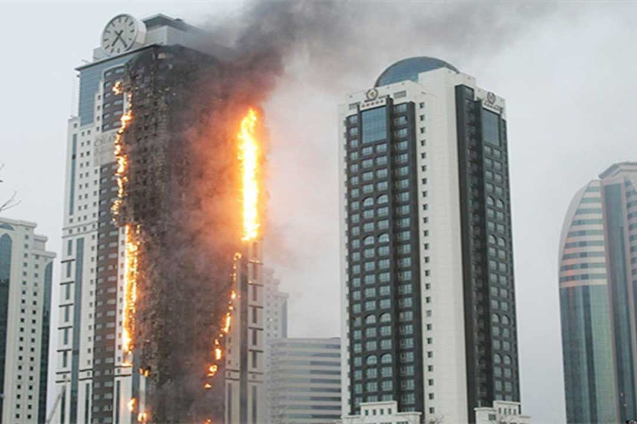
SOLUTION VISION
SmartAlarm
See the threat. See who needs help.
An alert creates value when it leads to the right action, for the right person, in the right place.
People at risk
Where should I go? Who can help?
Control center
What is happening? Who is not yet safe?
Rescue teams
Where should we go? What skills are needed?
Family & caregivers
Has someone reached my loved one?
No SOS ≠ No need for rescue
AIPOWER | SmartAlarm solution proposal | International • Multi-industry
2
Notes:
The business problem is connecting detection, situational understanding, guidance, personal contact and confirmation. People without a phone, unable to operate it or unable to self-evacuate must still be considered for assistance. Unknown status remains distinct from confirmed safety.
SmartAlarm design proposal — revision 1.0, 23 October 2026. Scenarios, interfaces and numerical examples are illustrative, not evidence of a deployed product. Source: the FireEscape proposal and product-owner requirements. Pictorial scenes were created with imagegen; text, flows, architecture and UI are editable PowerPoint objects.

Slide 3
THE COMPLETE SOLUTION • Detect → Understand → Guide → Reach → Rescue → Coordinate → Confirm
3
Notes:
The all-in-one illustration connects detection, understanding, guidance, outreach, proactive rescue, coordination and safety confirmation. Inputs include fire, natural disasters, falls, collisions, sensors and SOS. The platform unifies context. Apps and speakers provide area-specific guidance. People with assistance needs receive proactive checks. Command coordinates teams and confirms each person. Arrows represent business relationships, not automatic control authority. Physical fire protection is explicitly added in this revision.
SmartAlarm design proposal — revision 1.0, 23 October 2026. Scenarios, interfaces and numerical examples are illustrative, not evidence of a deployed product. Source: the FireEscape proposal and product-owner requirements. Pictorial scenes were created with imagegen; text, flows, architecture and UI are editable PowerPoint objects.

Slide 4
VALUE FLOW
SmartAlarm
One coordinated response, seven checkpoints.
Each step answers a question so information stays connected across systems.
1
DETECT
What signal was received?
Camera • IoT • wearable • SOS
2
UNDERSTAND
Who? Where? How severe?
Evidence • location • time
3
GUIDE
Where to go? What to do?
Maps • voice • accessible options
4
REACH
Who remains unreached?
App • PA • SMS • vehicles
5
PROACTIVE RESCUE
Who needs help?
Presence • assistance needs
6
COORDINATE
Who is responsible?
Assign • accept • hand over
7
CONFIRM
Who is actually safe?
Self-report • team verification • family
AIPOWER | SmartAlarm solution proposal | International • Multi-industry
4
Notes:
Separate acknowledgments: platform event receipt; provider message acceptance; a person reading it; a team accepting a task; arrival on site; and the person's safety confirmation. These statuses are not interchangeable. Record time and source for traceability.
SmartAlarm design proposal — revision 1.0, 23 October 2026. Scenarios, interfaces and numerical examples are illustrative, not evidence of a deployed product. Source: the FireEscape proposal and product-owner requirements. Pictorial scenes were created with imagegen; text, flows, architecture and UI are editable PowerPoint objects.

Slide 5
INTERNATIONAL • MULTI-INDUSTRY
SmartAlarm
One safety core. Many operating environments.
Organizations and sites share the platform; each industry has its own data, workflows and integrations.
01
Buildings & campuses
02
Industry & logistics
03
Care & communities
Fire, evacuation and people accountability.
Hazardous areas and lone workers.
Falls, assistance needs and caregivers.
04
Transport & fleets
05
Schools & events
06
Cities & disasters
Collisions, road location and coordination.
Groups, assembly and guardians.
Affected areas, shelters and multiple agencies.
AIPOWER | SmartAlarm solution proposal | International • Multi-industry
5
Notes:
Tenant, partner organization, site, zone, person, asset, event, incident, task and connector models are industry-independent from the outset. Vertical packs add versioned taxonomies, message templates, forms, rules and SOPs. International deployments configure language, time zone, residency and local agencies.
SmartAlarm design proposal — revision 1.0, 23 October 2026. Scenarios, interfaces and numerical examples are illustrative, not evidence of a deployed product. Source: the FireEscape proposal and product-owner requirements. Pictorial scenes were created with imagegen; text, flows, architecture and UI are editable PowerPoint objects.

Slide 6
OPERATING MODEL
SmartAlarm
Prepare before. Coordinate during. Confirm after.
A continuous lifecycle, from site surveys to exercises and improvement.
01 BEFORE
02 DURING
03 AFTER
Maps & equipment
Care profiles
Duty teams & exercises
Verify & alert
Guide & rescue
Track every task
Confirm each person
Hand over & close
Learn from the response
Every status has an accountable owner, a timestamp and a source of confirmation.
AIPOWER | SmartAlarm solution proposal | International • Multi-industry
6
Notes:
Preparation covers access, care profiles, indoor positioning surveys, PA coverage, backup power, local connectivity and playbooks. An incident does not close automatically because one person is safe. Closure requires handling or handing over outstanding requests and responsibilities.
SmartAlarm design proposal — revision 1.0, 23 October 2026. Scenarios, interfaces and numerical examples are illustrative, not evidence of a deployed product. Source: the FireEscape proposal and product-owner requirements. Pictorial scenes were created with imagegen; text, flows, architecture and UI are editable PowerPoint objects.

Slide 7
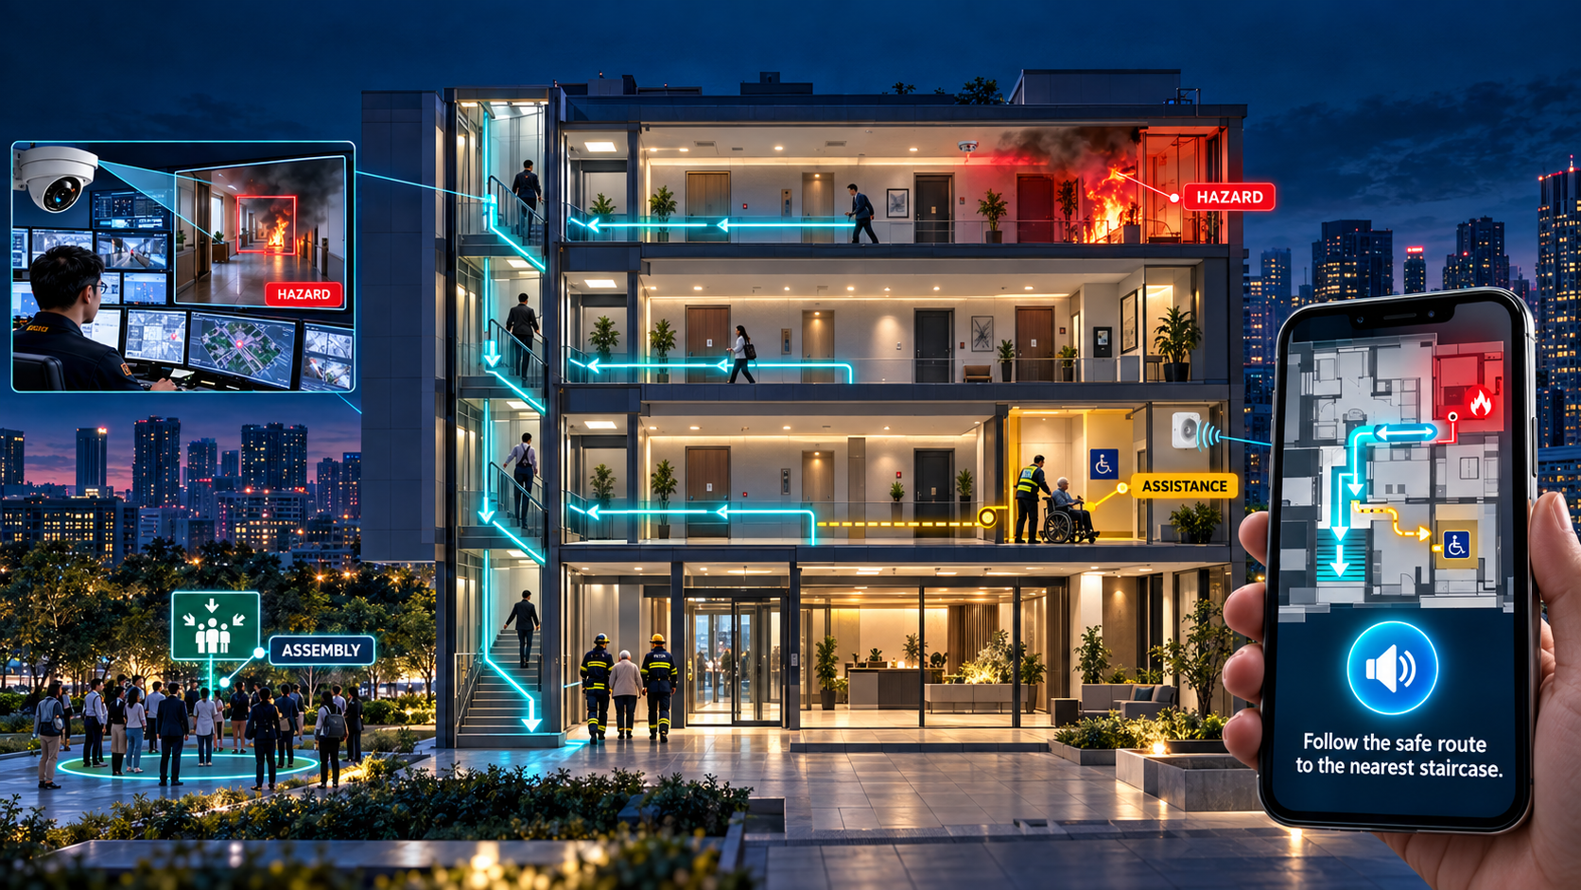
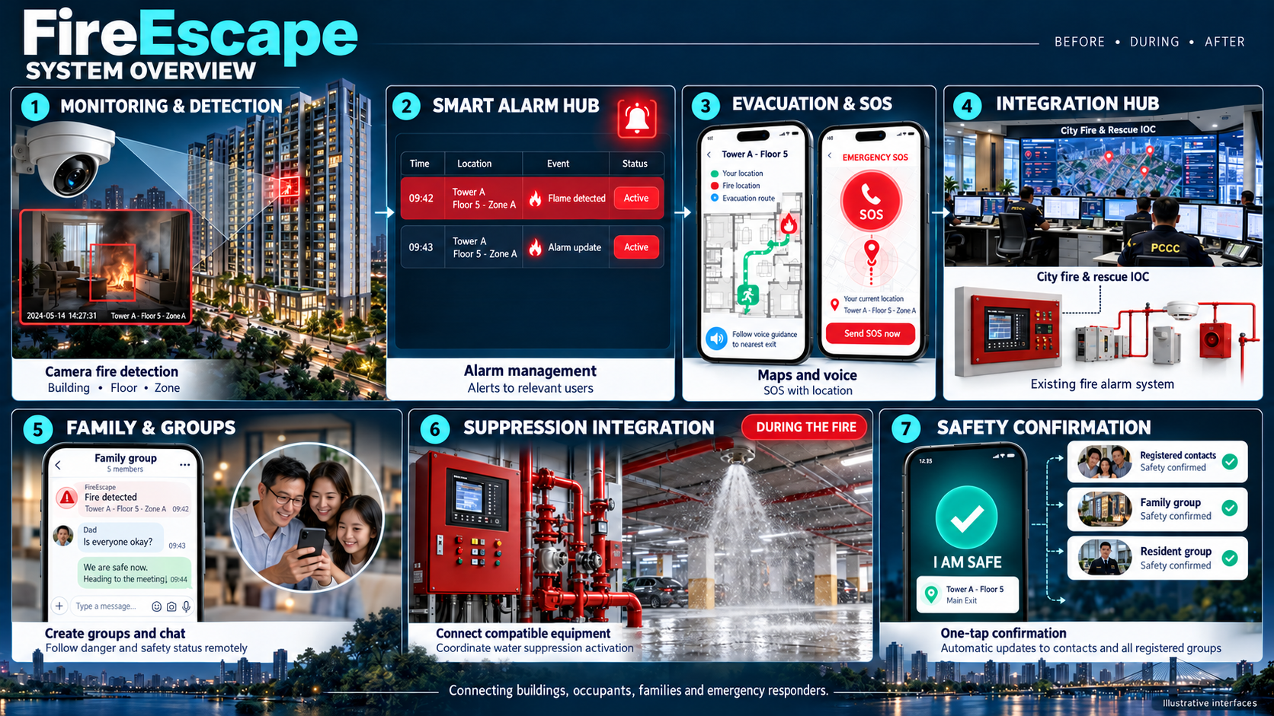
GUIDED EVACUATION
FIRE SCENARIO • Avoid hazardous areas • Step-by-step voice • Assistance for people who cannot self-evacuate
7
Notes:
Conceptual cutaway: isolate the hazardous area; people who can self-evacuate follow verified routes; people needing assistance have a suitable alternative. Arrows are illustrative. Deployment routes require qualified site validation and hazard updates. An assistance/refuge point must belong to an approved plan; it cannot be inferred from an image.
SmartAlarm design proposal — revision 1.0, 23 October 2026. Scenarios, interfaces and numerical examples are illustrative, not evidence of a deployed product. Source: the FireEscape proposal and product-owner requirements. Pictorial scenes were created with imagegen; text, flows, architecture and UI are editable PowerPoint objects.

Slide 8
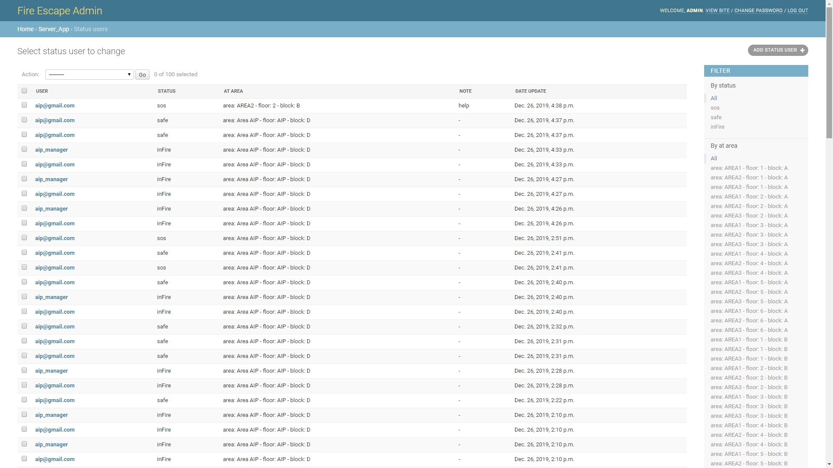
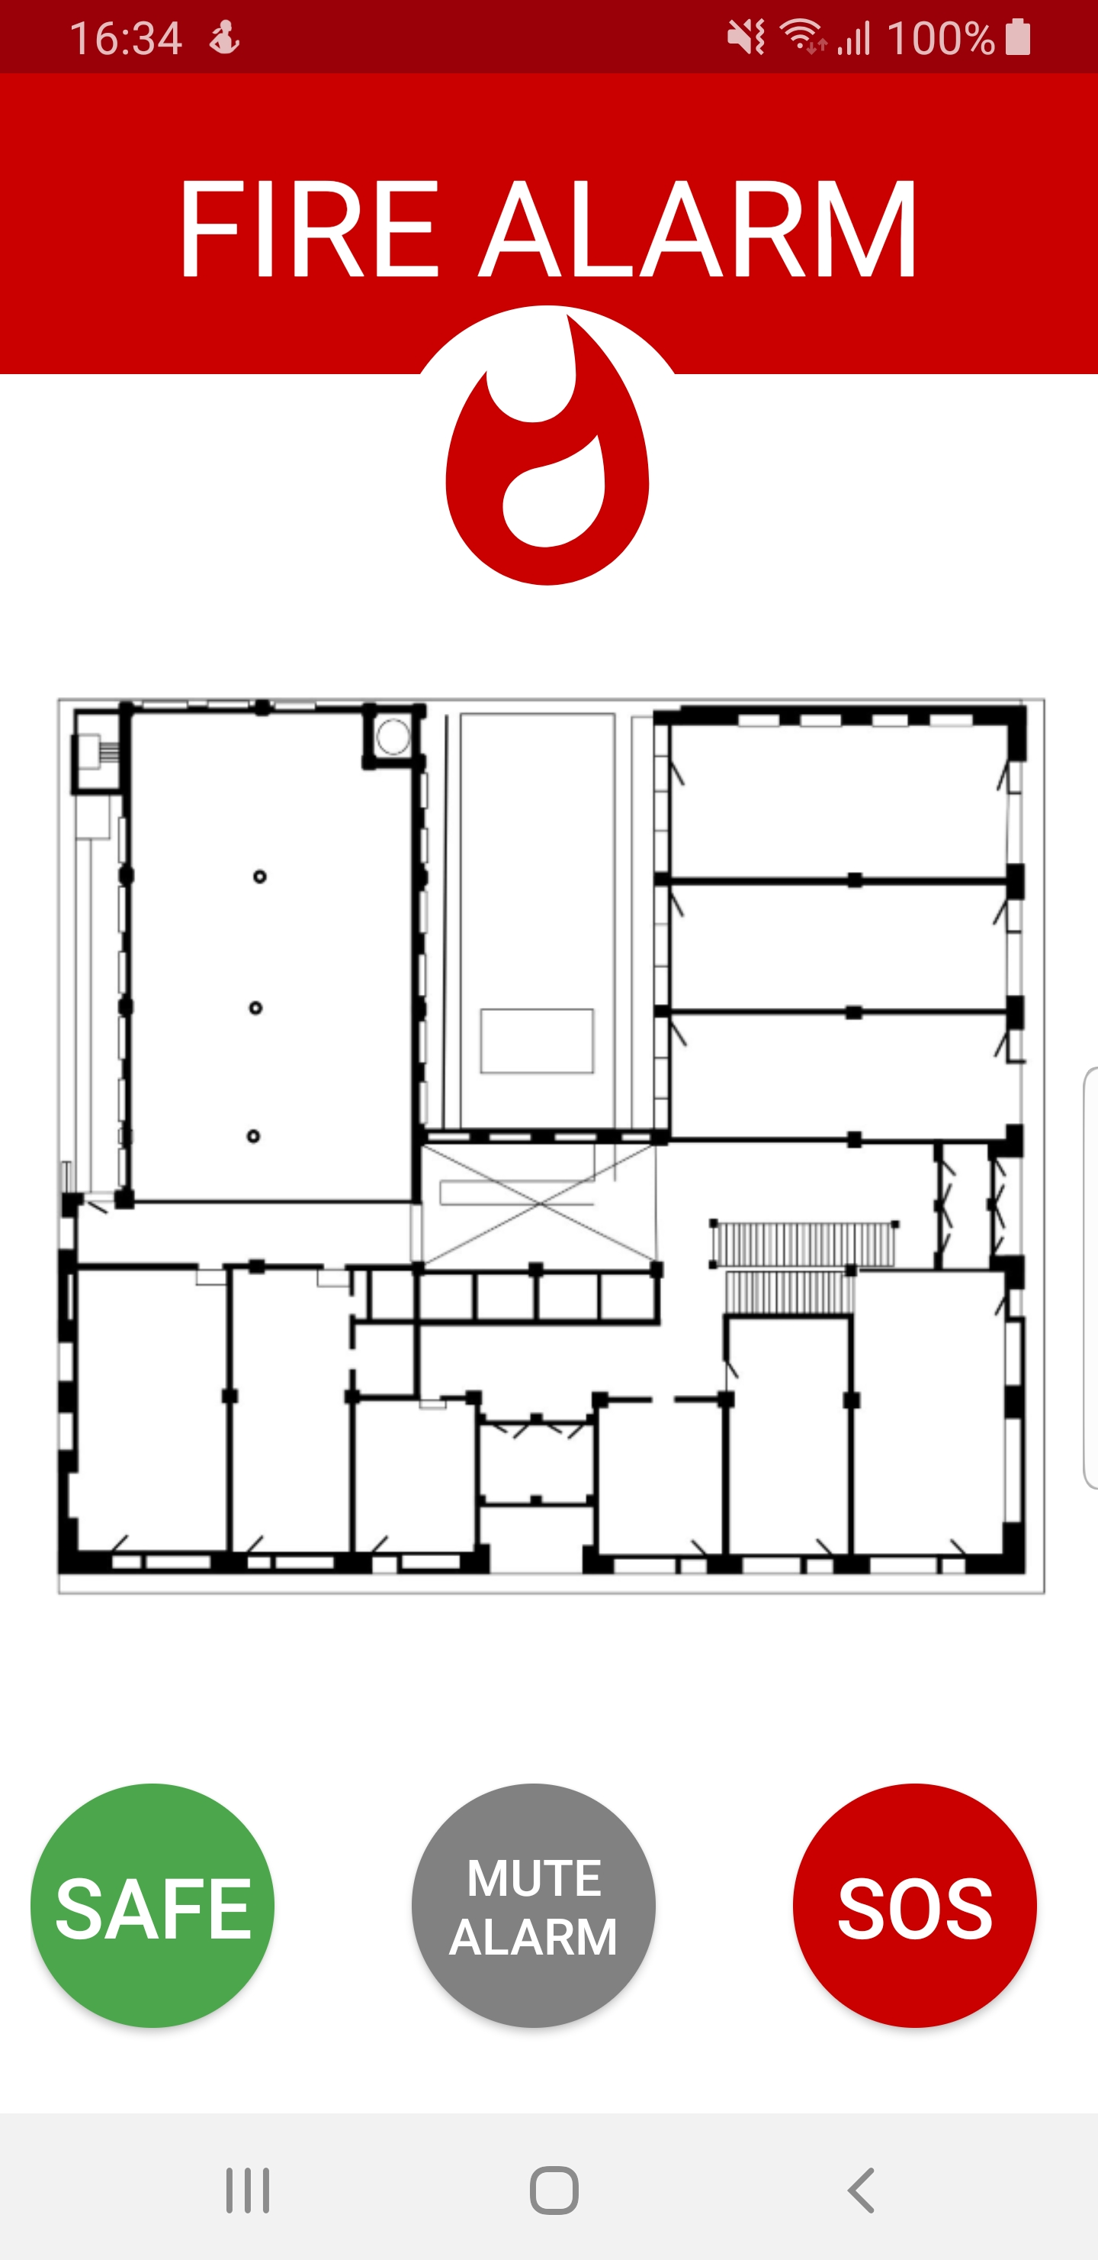
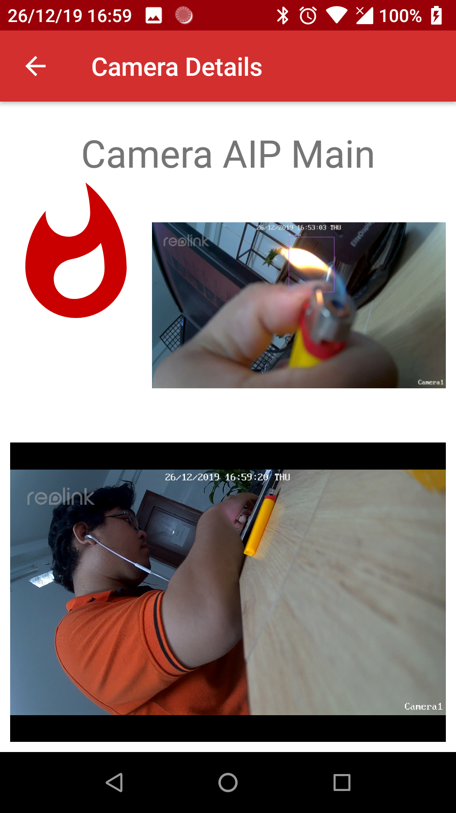
SCENARIO 01 • ACTION BY ACTION
SmartAlarm
A fire on floor 5: from signal to personal contact.
Illustrative sequence — every action is linked to the same incident.
01 / VERIFY
HAZARD AREA
Cameras and sensors mapped to floor and zone.
02 / GUIDE
Exclude hazardous routes; issue app and PA guidance.
YOU
03 / FIND PEOPLE
SOS requests plus proactive welfare checks.
EXIT A
ASSISTANCE POINT
04 / RESCUE
Teams accept tasks, update status and hand over.
Conceptual diagram • not a site-approved evacuation plan
AIPOWER | SmartAlarm solution proposal | International • Multi-industry
8
Notes:
Example states: signal_received → verified_incident → warning_issued → response_assigned → person_contacted → safe_or_handover. The illustration does not imply a measured SLA. Assess evidence freshness and location before issuing guidance or assigning a team.
SmartAlarm design proposal — revision 1.0, 23 October 2026. Scenarios, interfaces and numerical examples are illustrative, not evidence of a deployed product. Source: the FireEscape proposal and product-owner requirements. Pictorial scenes were created with imagegen; text, flows, architecture and UI are editable PowerPoint objects.

Slide 9
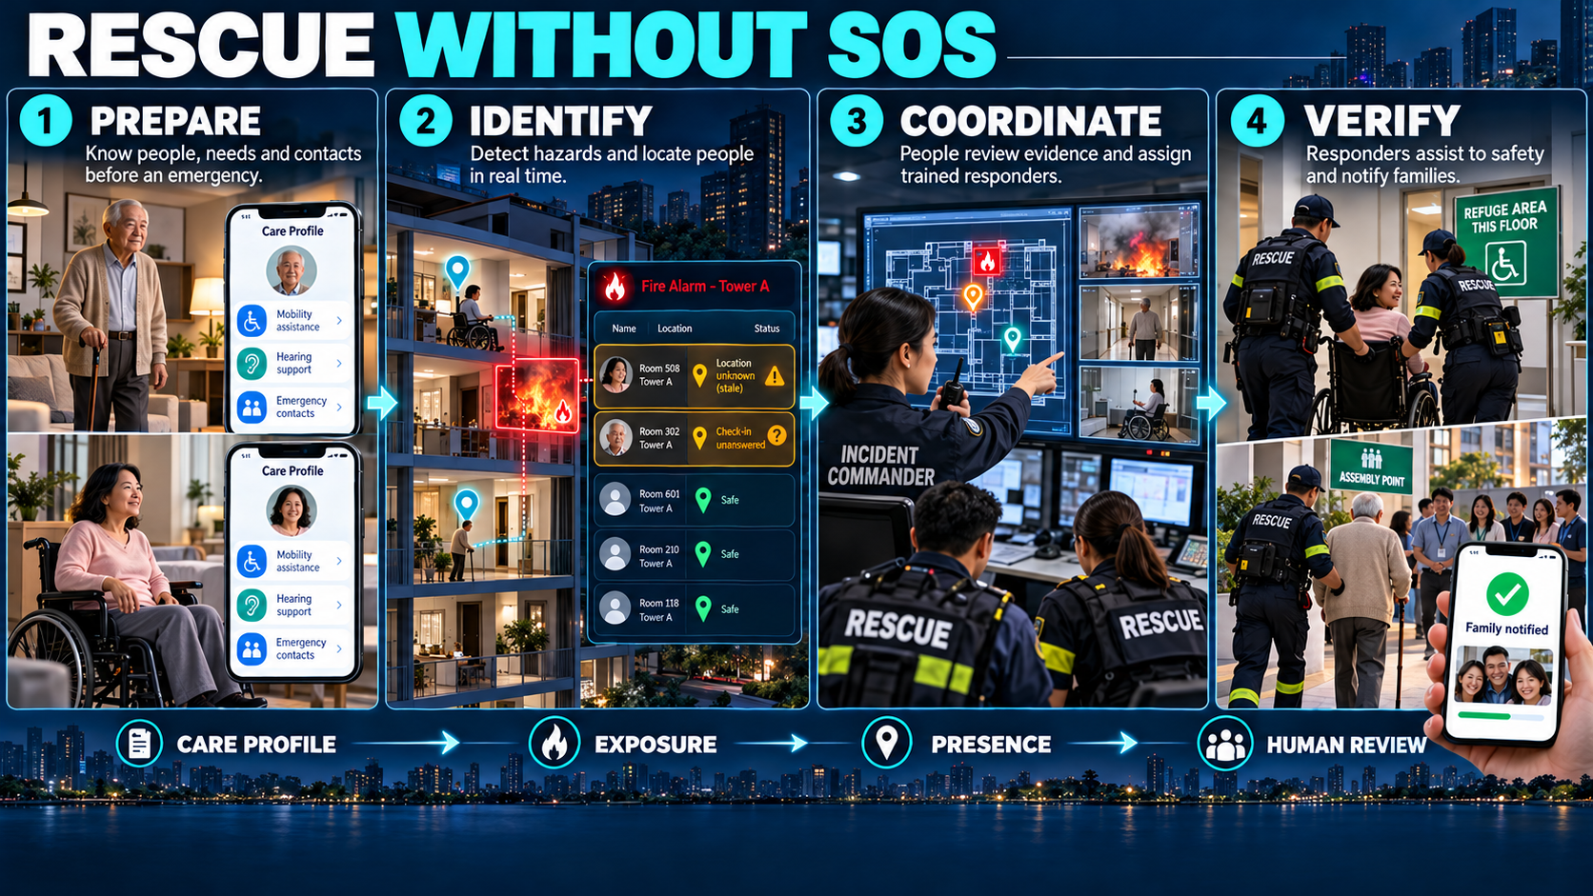
PROACTIVE RESCUE • Assistance needs + Exposure + Presence + Operator assessment
9
Notes:
An assistance case may be created without SOS when exposure and assistance needs justify a check. Uncertain data triggers verification, not a claim that a person is trapped. Age or illness alone does not determine triage. Rescue teams and incident command make decisions under the relevant professional procedures.
SmartAlarm design proposal — revision 1.0, 23 October 2026. Scenarios, interfaces and numerical examples are illustrative, not evidence of a deployed product. Source: the FireEscape proposal and product-owner requirements. Pictorial scenes were created with imagegen; text, flows, architecture and UI are editable PowerPoint objects.

Slide 10
PEOPLE PROFILES • PRIORITY ASSISTANCE
SmartAlarm
Understand assistance needs, beyond a person's name.
Profiles retain their source and sharing permissions and are used for the intended rescue purpose.
CARE PROFILE
Purposeful data
Age, mobility, hearing/vision and rescue-relevant conditions.
Minh Anh
Reasoned priority
Exposure + presence + ability to self-evacuate + condition.
Mobility assistance required
Audio guidance preferred
Emergency contact: verified
Last known location: floor 5
Data freshness: check required
Act without a tap
Call to check, involve a caregiver or dispatch a team.
Limited disclosure
Teams receive necessary details; family access follows permissions.
AIPOWER | SmartAlarm solution proposal | International • Multi-industry
10
Notes:
Functional assistance needs are separated from full medical history. Users or authorized guardians manage the profile under policy. Presence has a source, uncertainty and timestamp. A later SOS is merged into the open case rather than generating duplicate dispatch. Validate consent or another applicable processing basis in each deployment market.
SmartAlarm design proposal — revision 1.0, 23 October 2026. Scenarios, interfaces and numerical examples are illustrative, not evidence of a deployed product. Source: the FireEscape proposal and product-owner requirements. Pictorial scenes were created with imagegen; text, flows, architecture and UI are editable PowerPoint objects.

Slide 11
MULTI-SOURCE POSITIONING
SmartAlarm
Reliable location is a foundation for rescue.
Match technology to the environment; always show time, floor and confidence.
OUTDOORS
INDOORS
WHEN UNCERTAIN
GNSS / device location
Address, road and direction
Hazard areas and assembly points
QR / BLE / UWB / Wi-Fi
Building → floor → zone
On-site survey and calibration
Select a landmark
Confirm floor / location manually
Assign a verification task
LOCATION + SOURCE + ERROR + FRESHNESS
AIPOWER | SmartAlarm solution proposal | International • Multi-industry
11
Notes:
Do not infer a floor from GNSS without sufficient confidence. Residence registration does not prove presence. Indoor positioning requires surveys, reference points and site measurements; accuracy is not promised before testing. Old locations remain historical, not real-time. If heading is unreliable, provide landmark-based instructions.
SmartAlarm design proposal — revision 1.0, 23 October 2026. Scenarios, interfaces and numerical examples are illustrative, not evidence of a deployed product. Source: the FireEscape proposal and product-owner requirements. Pictorial scenes were created with imagegen; text, flows, architecture and UI are editable PowerPoint objects.

Slide 12
EVACUATION ROUTE OPTIMIZATION
SmartAlarm
The best route must be feasible and suitable.
Exclude hazards first, then optimize time, congestion and accessibility needs.
HAZARD AREA
01 EXCLUDE UNSAFE ROUTES
Fire, smoke, locked doors, blocked paths and expired information.
02 SELECT A SUITABLE ROUTE
Mobility, passage capacity, confidence and estimated travel time.
YOU
EXIT A
ASSISTANCE POINT
03 UPDATE AS CONDITIONS CHANGE
Withdraw the old route and voice; request assistance if no route remains.
AIPOWER | SmartAlarm solution proposal | International • Multi-industry
12
Notes:
Routing uses a versioned building graph and hazard overlay. Apply hard exclusions before the cost function. Constraints include accessibility, capacity, turn restrictions, hazard freshness and uncertainty. If no sufficiently reliable route exists, do not invent one: request assistance or use an approved refuge process. AI explains options; a tested routing engine calculates them. Absolute safety cannot be guaranteed in changing conditions.
SmartAlarm design proposal — revision 1.0, 23 October 2026. Scenarios, interfaces and numerical examples are illustrative, not evidence of a deployed product. Source: the FireEscape proposal and product-owner requirements. Pictorial scenes were created with imagegen; text, flows, architecture and UI are editable PowerPoint objects.

Slide 13
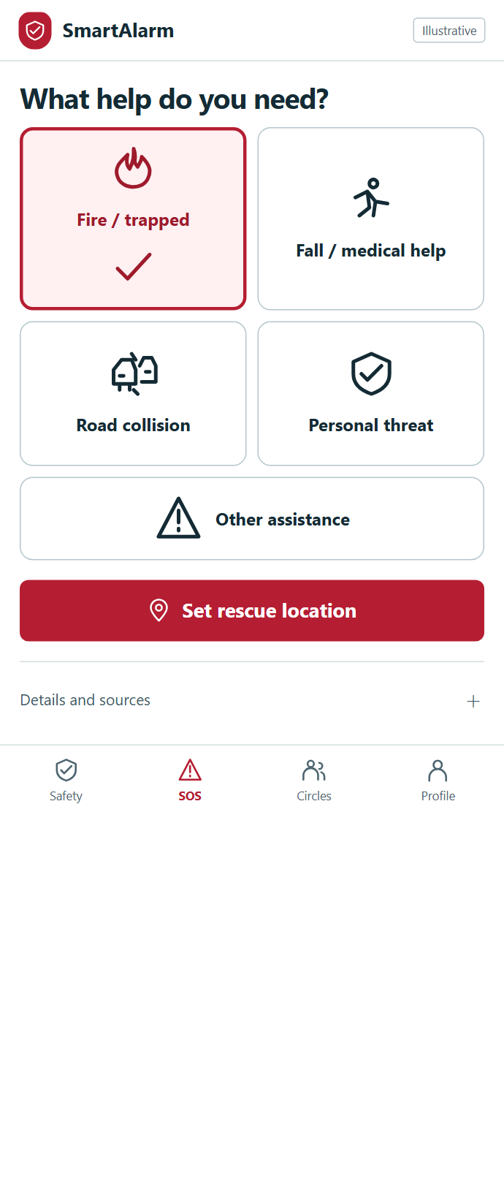
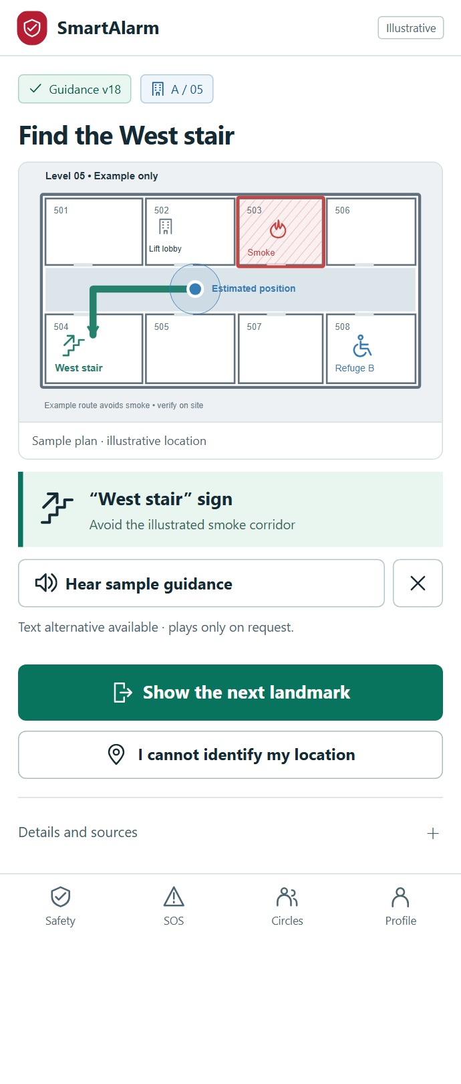
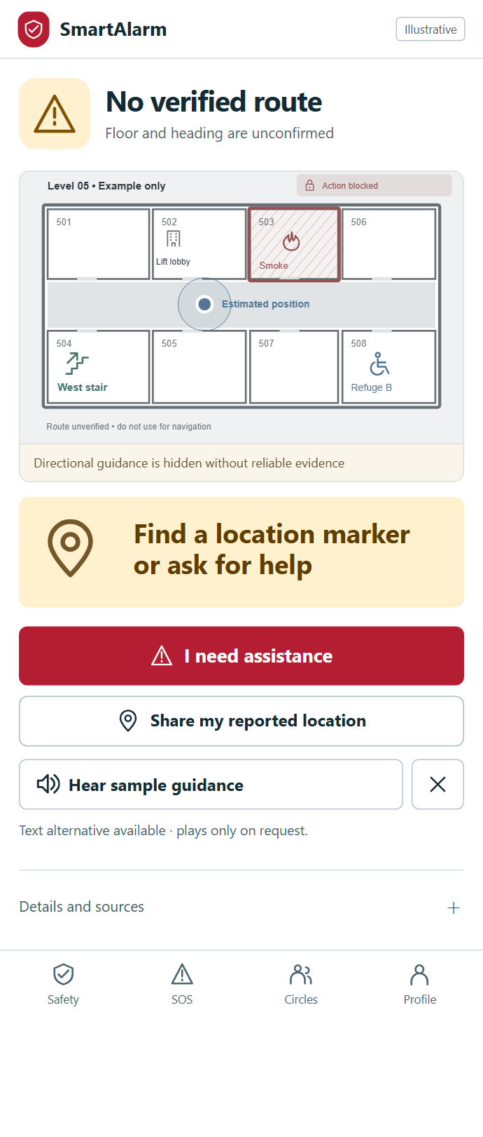
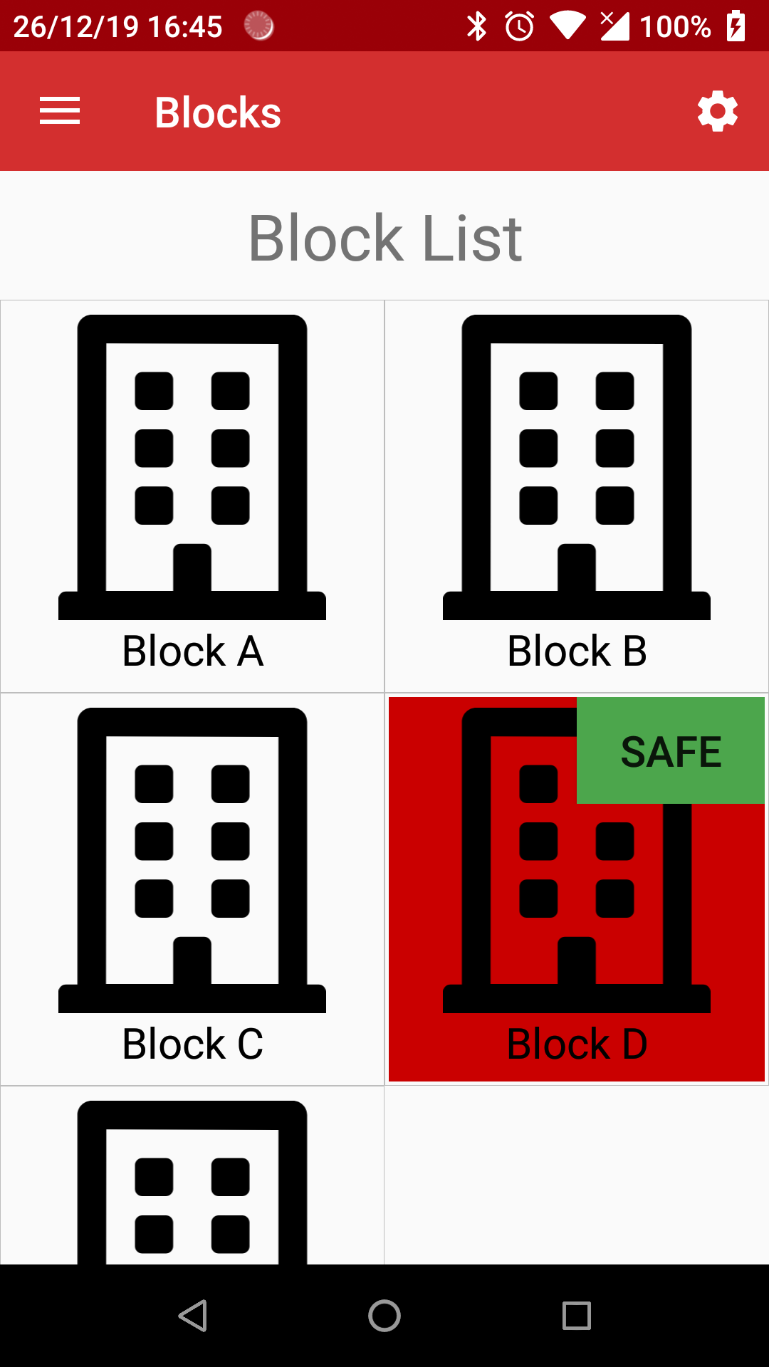
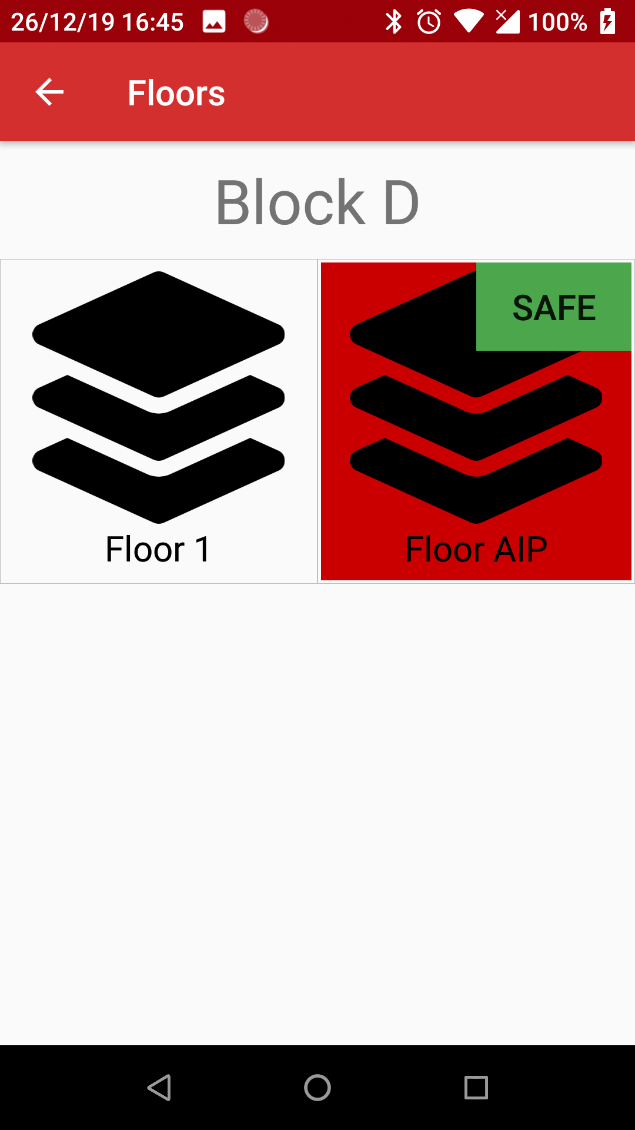
SMARTPHONE • VOICE • ACCESSIBILITY
SmartAlarm
See the next action. Hear it when needed.
Visual guidance • recognizable landmarks • assistance within reach
SOS BY PICTURE
Choose the situation without a long form.
LANDMARK GUIDANCE
Map and next action stay together.
NO VERIFIED ROUTE
Withdraw arrows; offer assistance.
AIPOWER | SmartAlarm solution proposal | International • Multi-industry
13
Notes:
Proposed UI. Turn-by-turn guidance requires suitable heading data; otherwise use landmarks. Use short instructions, controlled repetition and support for hearing/vision needs; never rely on color alone. Critical Vietnamese/English/Japanese content requires native-language and site review. Offline voice uses only content and conditions that remain valid. The three phone samples intentionally retain their demonstrated languages.
SmartAlarm design proposal — revision 1.0, 23 October 2026. Scenarios, interfaces and numerical examples are illustrative, not evidence of a deployed product. Source: the FireEscape proposal and product-owner requirements. Pictorial scenes were created with imagegen; text, flows, architecture and UI are editable PowerPoint objects.
UX revision 2: screenshots from the current local prototype. Illustrative data; no live operation or usability certification. Full catalogue:233screens; VI/EN/JA. Original function appendix retained.

Slide 14

RESCUE AUDIO • Building PA + Smartphone voice + Drone speaker + Vehicle PA — one approved message
14
Notes:
A broadcast command identifies site/zone, language, content, version, priority and expiry. Manage TTS, recordings and live microphone separately. Drone audio depends on payload and integration and remains under authorized operators. Controller acceptance differs from completed playback; playback does not prove people heard it. The platform must respect local safety-system priority.
SmartAlarm design proposal — revision 1.0, 23 October 2026. Scenarios, interfaces and numerical examples are illustrative, not evidence of a deployed product. Source: the FireEscape proposal and product-owner requirements. Pictorial scenes were created with imagegen; text, flows, architecture and UI are editable PowerPoint objects.

Slide 15
MULTICHANNEL ALERT ORCHESTRATION
SmartAlarm
One message. The right area. The right version.
Track each delivery channel and escalate when the primary channel fails.
01 / DRAFT & APPROVE
02 / DISTRIBUTE
03 / TRACK
Area, severity and language
Reviewed emergency templates
Approval by action type
App / push / SMS / contact
Building / vehicle PA
Drone by supported capability
Sent / failed / unknown
Played / interrupted
Human confirmation / escalation
Send updates and cancellations to apps and affected playback devices.
AIPOWER | SmartAlarm solution proposal | International • Multi-industry
15
Notes:
Delivery orchestration uses idempotency and channel receipts. Expired commands are not retried indefinitely. Zone audio follows arbitration, including local emergency override. Live voice requires permission, timeout and audit. Warning permissions differ from suppression-control permissions; dedicated systems retain their own interlocks and procedures.
SmartAlarm design proposal — revision 1.0, 23 October 2026. Scenarios, interfaces and numerical examples are illustrative, not evidence of a deployed product. Source: the FireEscape proposal and product-owner requirements. Pictorial scenes were created with imagegen; text, flows, architecture and UI are editable PowerPoint objects.

Slide 16
SCENARIO 02 • NATURAL DISASTERS
SmartAlarm
Area-based warnings lead to local action.
Storms, floods and widespread hazards connect warning sources, shelters and responders.
Receive
Authorized issuer; original, update and cancellation.
SHELTER
WARNING AREA
Source • validity
Assess
Affected area, people present and assistance needs.
Act
Guidance, shelters, PA and tasks.
Track
Check-ins, contact and expiry updates.
Illustrative area diagram
AIPOWER | SmartAlarm solution proposal | International • Multi-industry
16
Notes:
Disaster alerts retain issuer, identifier, area, onset/effective/expires and update/cancellation lineage; CAP 1.2 is an applicable integration standard. Official warnings are distinct from the tenant's response decisions. Shelters need capacity, accessibility and ownership information. Routes must respond to new hazards rather than continuing simply because they were previously issued.
SmartAlarm design proposal — revision 1.0, 23 October 2026. Scenarios, interfaces and numerical examples are illustrative, not evidence of a deployed product. Source: the FireEscape proposal and product-owner requirements. Pictorial scenes were created with imagegen; text, flows, architecture and UI are editable PowerPoint objects.

Slide 17
SCENARIOS 03–05 • DIFFERENT SOS INTENTS
SmartAlarm
Different situations require different responses.
SOS, automatic detection and assistance requests are routed using their context.
FALLS
ROAD ACCIDENTS
DISCREET SOS / ASSISTANCE
Wearable / sensor / self-report
App / telematics / external source
SOS button / discreet action
Check in → caregiver
→ assistance if needed
Location & road direction
→ appropriate responders
Classify the need
→ appropriate workflow
No response prompts a check; it is not a diagnosis.
The people involved and injuries may still be unknown.
Message content and audio must match the sensitivity.
AIPOWER | SmartAlarm solution proposal | International • Multi-industry
17
Notes:
The SOS taxonomy contains intent, severity, sensitivity, source and evidence. SOS types do not all imply the same emergency. Possible falls have configurable check-in timeouts and escalation. Discreet SOS must avoid audio that exposes the user. Road incidents need field access location, road direction, secondary hazards and links to local responders.
SmartAlarm design proposal — revision 1.0, 23 October 2026. Scenarios, interfaces and numerical examples are illustrative, not evidence of a deployed product. Source: the FireEscape proposal and product-owner requirements. Pictorial scenes were created with imagegen; text, flows, architecture and UI are editable PowerPoint objects.

Slide 18
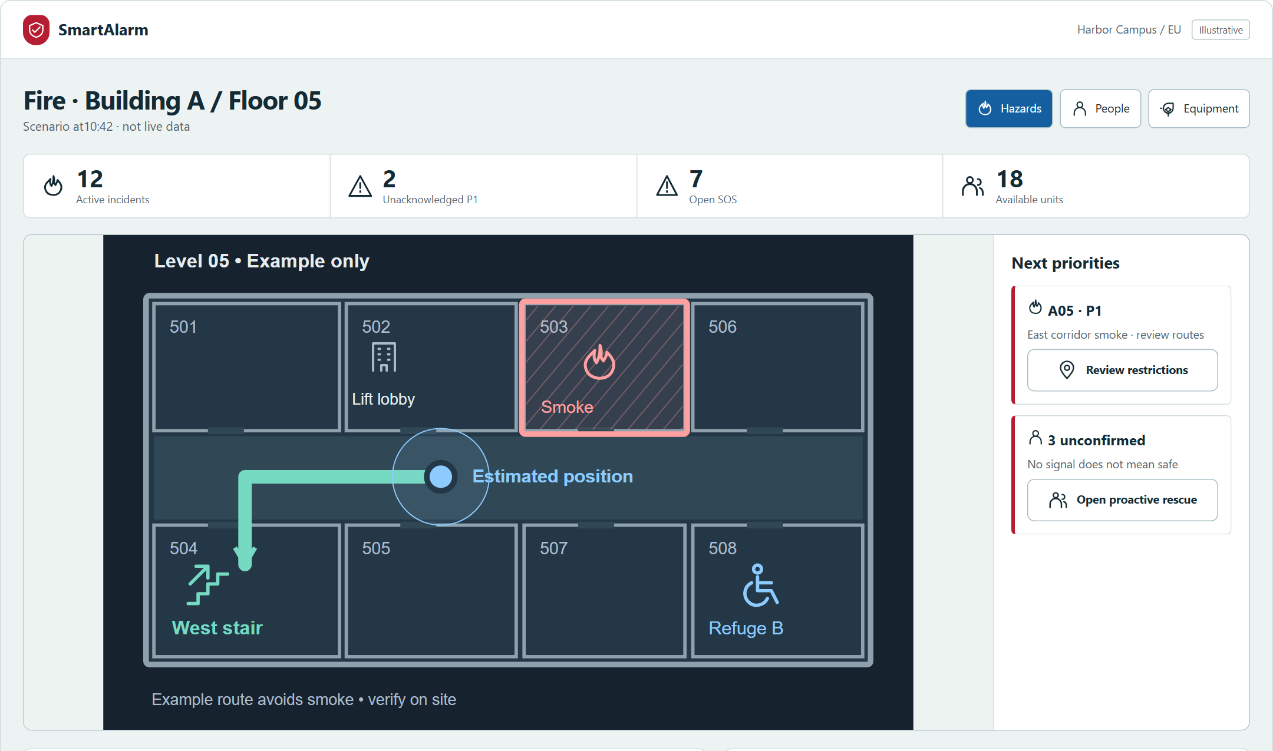
CONTROL CENTER
SmartAlarm
An operating picture with evidence and next actions.
Hazard layers • people requiring assistance • dispatch • PA • unresolved information
01 LOCATE
Hazard, person and refuge in one view.
02 PRIORITIZE
Unconfirmed people remain visible.
03 COORDINATE
Dispatch and speaker coverage link to evidence.
AIPOWER | SmartAlarm solution proposal | International • Multi-industry
18
Notes:
Proposed UI with simulated data. The command workspace connects evidence, hazards, permission-filtered care needs, personal status, missions and delivery. Actions have separate permissions. Tasks have owners and acceptance. Show uncertainty explicitly. Detailed product screens are included in the full screen specifications.
SmartAlarm design proposal — revision 1.0, 23 October 2026. Scenarios, interfaces and numerical examples are illustrative, not evidence of a deployed product. Source: the FireEscape proposal and product-owner requirements. Pictorial scenes were created with imagegen; text, flows, architecture and UI are editable PowerPoint objects.
UX revision 2: screenshots from the current local prototype. Illustrative data; no live operation or usability certification. Full catalogue:233screens; VI/EN/JA. Original function appendix retained.

Slide 19
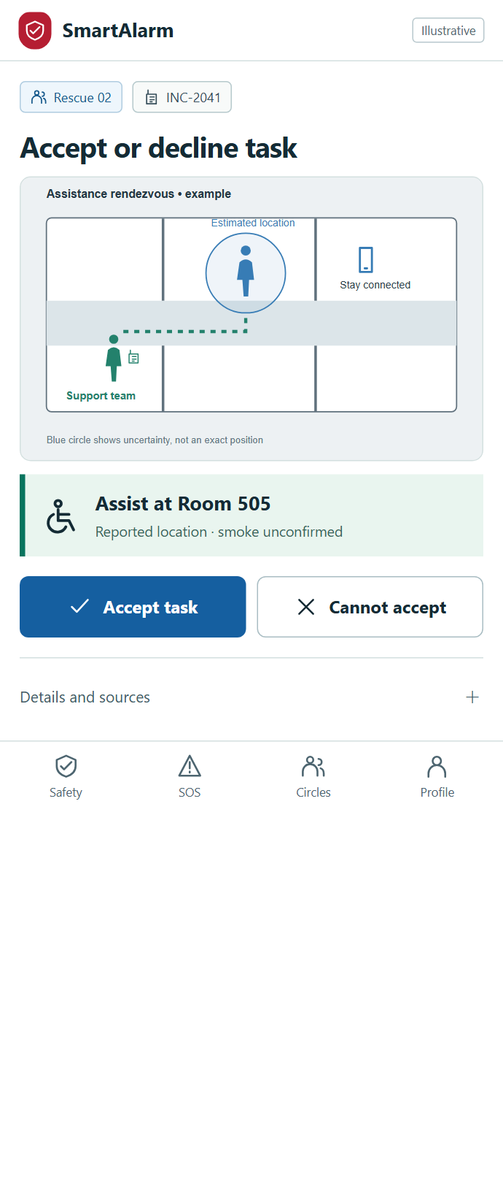
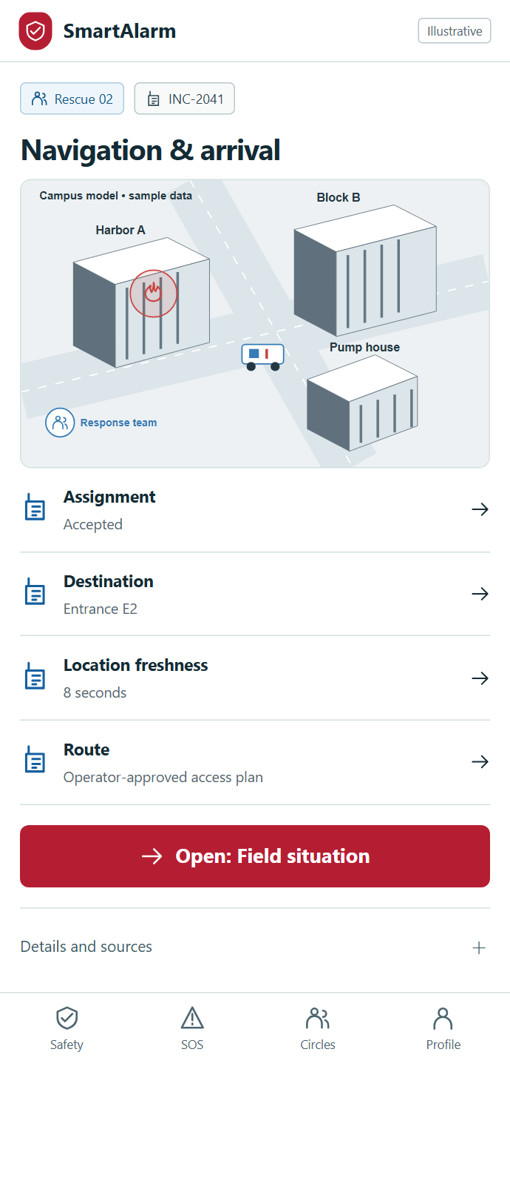
RESPONDERS • FROM ASSIGNMENT TO HANDOVER
SmartAlarm
A rescue task that can be understood at a glance.
Location • access constraints • team acceptance • field confirmation
ASSIGN → ACCEPT → APPROACH → HAND OVER
A map and short task brief help the responder identify the target and access constraints.
Acceptance is distinct from arrival. Offline updates remain queued until acknowledged.
Functional needs inform assistance; no SOS does not establish safety.
AIPOWER | SmartAlarm solution proposal | International • Multi-industry
19
Notes:
Dispatch considers capability, availability, location and coordination rights. Accepted differs from arrived, contacted, handed over and completed. Offline updates carry idempotency, source time and actor identity; resolve conflicts with command changes. Do not blindly replay outdated commands after reconnecting.
SmartAlarm design proposal — revision 1.0, 23 October 2026. Scenarios, interfaces and numerical examples are illustrative, not evidence of a deployed product. Source: the FireEscape proposal and product-owner requirements. Pictorial scenes were created with imagegen; text, flows, architecture and UI are editable PowerPoint objects.
UX revision 2: screenshots from the current local prototype. Illustrative data; no live operation or usability certification. Full catalogue:233screens; VI/EN/JA. Original function appendix retained.

Slide 20
FAMILY • GROUPS • SAFETY CONFIRMATION
SmartAlarm
A safety update reaches the right recipients.
Relatives can follow status while sensitive information remains protected.
09:42 •••
SmartAlarm
Contacts
Authorized to receive updates.
I am safe
At assembly point A
Groups
Family / residents / colleagues.
✓
Operations
Update the person; do not automatically close the incident.
Family receives status
authorized for sharing.
09:48 • Self-reported
AIPOWER | SmartAlarm solution proposal | International • Multi-industry
20
Notes:
One confirmation can notify every registered group and contact under sharing policy. This does not authorize sharing medical history or precise location. Distinguish self-reported safety from responder-confirmed safety. Incident closure follows command criteria, not the number of push messages sent.
SmartAlarm design proposal — revision 1.0, 23 October 2026. Scenarios, interfaces and numerical examples are illustrative, not evidence of a deployed product. Source: the FireEscape proposal and product-owner requirements. Pictorial scenes were created with imagegen; text, flows, architecture and UI are editable PowerPoint objects.

Slide 21
AI / LLM • REALTIME COPILOT
SmartAlarm
AI accelerates understanding, grounded in evidence.
Summarize events, compare procedures and explain options to the responsible decision-maker.
EVIDENCE
ANALYSIS
DECISION
Events & timestamps
Location & confidence
Versioned SOPs / maps
Summarize changes
Identify missing information
Recommend options & rationale
Operator assessment
Workflow authorization
Engine / device execution
If AI is unavailable, alerts, SOS, tested routing and rescue workflows continue to operate.
AIPOWER | SmartAlarm solution proposal | International • Multi-industry
21
Notes:
The LLM receives permission-filtered data, evidence IDs and a data cutoff. Responses carry citations, uncertainty and recommendations. It does not invent evacuation paths, diagnose people or issue equipment commands. Documents, camera outputs and connector content are untrusted inputs for prompt-injection protection. Use a model gateway, minimum necessary data, evaluation, audit and fallback. Real-time means event-driven updates over a defined data window, not an independent source of truth.
SmartAlarm design proposal — revision 1.0, 23 October 2026. Scenarios, interfaces and numerical examples are illustrative, not evidence of a deployed product. Source: the FireEscape proposal and product-owner requirements. Pictorial scenes were created with imagegen; text, flows, architecture and UI are editable PowerPoint objects.

Slide 22
FUNCTIONAL ARCHITECTURE • ALL IN ONE
SmartAlarm
Two hubs connect the capabilities of SmartAlarm.
Build on FireEscape's Alarm Hub + Integration Hub model for a long-term platform.
PEOPLE
Individuals • family • responders • command • administrators • partners
EXPERIENCES
Smartphone • web command • field app • portals • PA & voice
SMART ALARM HUB
INTEGRATION HUB
Event → Incident → Warning → Task → Confirmation
Positioning • Routing • Care • Proactive rescue • AI copilot
IoT • PA • cameras • drones
Fire panels • pumps • valves
Rescue robots
SHARED PLATFORM Tenant • Access • Data • Event bus • Audit • Observability • Multi-region operations
AIPOWER | SmartAlarm solution proposal | International • Multi-industry
22
Notes:
The two hubs are functional boundaries, not two individual servers. Each domain has ownership and contracts, event-driven orchestration, outbox/inbox, bounded retry, authorized DLQ/replay and schema versioning. Integration Hub isolates vendor/protocol specifics; Alarm Hub owns business state. IAM, tenancy and policy enforcement apply throughout.
SmartAlarm design proposal — revision 1.0, 23 October 2026. Scenarios, interfaces and numerical examples are illustrative, not evidence of a deployed product. Source: the FireEscape proposal and product-owner requirements. Pictorial scenes were created with imagegen; text, flows, architecture and UI are editable PowerPoint objects.

Slide 23
SMART ALARM HUB • BUSINESS CORE
SmartAlarm
From a raw signal to a unified rescue case.
Extend capabilities through clear domains, data ownership and versioned contracts.
01 EVENT
02 INCIDENT
03 RESPONSE
04 PERSON
Normalize
Deduplicate
Preserve source
Correlate
Verify
Affected area
Warn
Guide
Assign
SOS / assistance
Make contact
Confirm
Shared context
Tenant • site • person • location • time • evidence
Supporting capabilities
Route engine • care/presence • voice • collaboration • AI
Operational assurance
Durable workflows • audit • idempotency • recovery
AIPOWER | SmartAlarm solution proposal | International • Multi-industry
23
Notes:
Domains include event ingestion/correlation, incident command, SOS/accountability, dispatch, warning content, delivery, positioning, routing, care/assistance, collaboration, media/evidence and audit. State transitions have explicit conditions, permissions and side effects. Eventual consistency must not lose incident ownership; per-incident sequencing/fencing protects against competing commands.
SmartAlarm design proposal — revision 1.0, 23 October 2026. Scenarios, interfaces and numerical examples are illustrative, not evidence of a deployed product. Source: the FireEscape proposal and product-owner requirements. Pictorial scenes were created with imagegen; text, flows, architecture and UI are editable PowerPoint objects.

Slide 24
INTEGRATION HUB • RAPID CONNECTION
SmartAlarm
Add solutions through connectors, with a stable core.
Declare capabilities, adapt protocols and verify behavior before enabling operations.
Declare
Device / source • tenant/site • capability • schema version
PARTNER KIT
Connect
MQTT / HTTP / webhook / gateway • SDK or adapter
API / SDK
Schema examples
Test environment
Conformance test suite
Version management
Normalize
Identity • timestamp • quality • event and command envelopes
Verify
Dedupe • disconnection • timeout • permissions • compatibility
Operate
Health • credential rotation • replay • revoke • upgrades
AIPOWER | SmartAlarm solution proposal | International • Multi-industry
24
Notes:
A connector manifest declares capability allowlists, event/schema versions, command constraints, health/heartbeat, authentication, network and residency. Apply MQTT, CloudEvents, CAP or OGC SensorThings where suitable; do not assume universal vendor compatibility. Adapters map device semantics and require testing. Accepted does not mean completed; correlate receipts and timeouts.
SmartAlarm design proposal — revision 1.0, 23 October 2026. Scenarios, interfaces and numerical examples are illustrative, not evidence of a deployed product. Source: the FireEscape proposal and product-owner requirements. Pictorial scenes were created with imagegen; text, flows, architecture and UI are editable PowerPoint objects.

Slide 25
IOT • DRONES • EXISTING SYSTEMS
SmartAlarm
Connect each device through its proven capabilities.
Reading data, issuing warnings and controlling equipment require distinct permissions.
Cameras / sensors
Events, images, connection health and zone.
Wearables / personal devices
Possible falls, SOS and location, subject to sharing permissions.
PA / fire alarms
Status and content playback through the site controller.
Drones / vehicles
Video, telemetry and speakers; authorized pilot and mission.
IOC / partners
Incident records, tasks, status and handover.
CAPABILITY
AUTHORIZATION
EXECUTION
VERIFICATION
AIPOWER | SmartAlarm solution proposal | International • Multi-industry
25
Notes:
Drone operations require a mission owner, pilot, geofence, command authorization, loss-link behavior and manual override. PA requires zone, local priority, health and playback receipts. Fire alarms and suppression connect through compatible equipment and site procedures; the LLM is not an automatic release controller. Each market and operating environment requires deployment-specific assessment. The new physical integration section provides concrete manufacturer and standards evidence.
SmartAlarm design proposal — revision 1.0, 23 October 2026. Scenarios, interfaces and numerical examples are illustrative, not evidence of a deployed product. Source: the FireEscape proposal and product-owner requirements. Pictorial scenes were created with imagegen; text, flows, architecture and UI are editable PowerPoint objects.

Slide 26
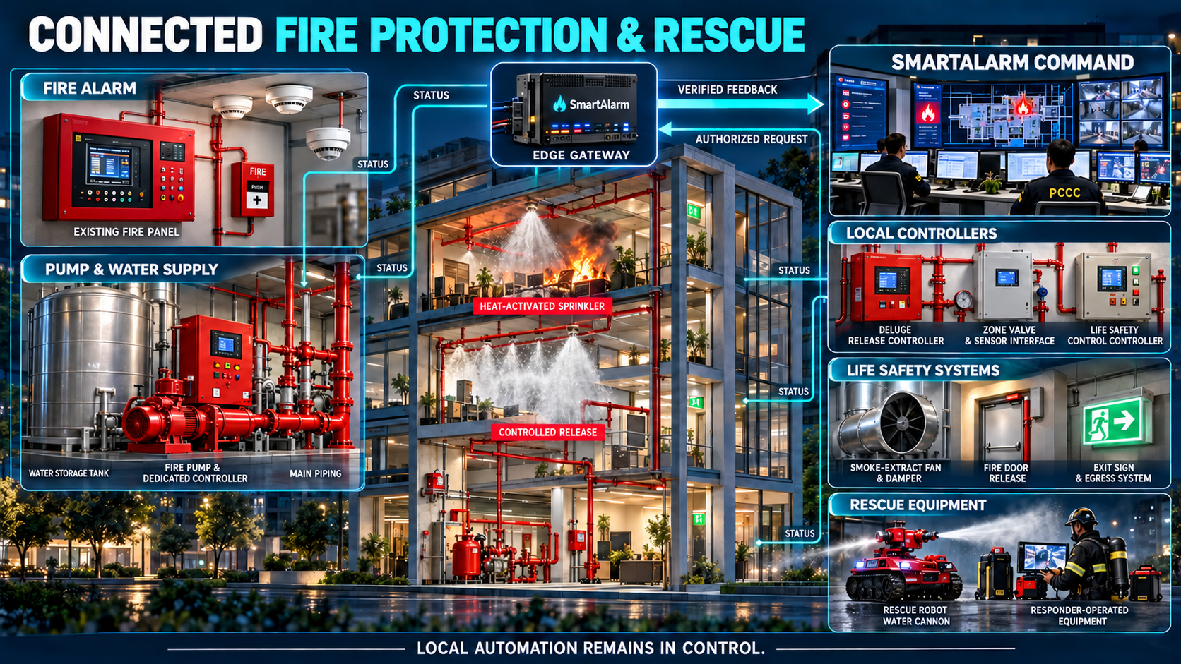
PHYSICAL FIRE PROTECTION & RESCUE • Fire panels • Pumps, valves & water discharge • Smoke control • Rescue equipment
26
Notes:
Connect existing systems through approved gateways/controllers: alarms/faults, pump status, pressure, waterflow, valve position, interlocks and local-control state. The illustration distinguishes heat-operated sprinklers from controlled-release zones. SmartAlarm adds monitoring, coordination and permitted commands; local automatic protection remains operational without cloud. Equipment imagery is conceptual, not an installation drawing or an accepted model configuration.
Sources researched 23 October 2026. See Physical-Device-Catalog, Rescue-IoT-Device-Catalog and External-Integration-Standards-Deployment for exact models, evidence, limits, RFIs and FAT/SAT acceptance. This is a proposed integration design, not installed compatibility or certification.

Slide 27
PHYSICAL EQUIPMENT • INTEGRATION SCOPE
SmartAlarm
Connect the water supply, protection systems and rescue response.
Each asset has an identity, a protected area, monitored signals and explicit control rights.
WATER & SUPPRESSION
EVACUATION SUPPORT
RESCUE EQUIPMENT
Tank • pump controller • pump
Valves / waterflow / pressure
Sprinklers • deluge / pre-action
Fire panel • emergency PA
Smoke control / dampers / doors
Emergency lighting and exit signs
Robot / controlled water monitor
Drone / vehicle / speaker
Mission, operator and feedback
Monitoring ≠ Control permission. Command accepted ≠ Physical action completed.
AIPOWER | SmartAlarm solution proposal | International • Multi-industry
27
Notes:
The asset registry covers existing equipment as well as new IoT assets. Ordinary heat-operated sprinkler heads do not expose individual cloud activation commands. Deluge/pre-action uses an approved releasing controller and cause-and-effect logic. Pumps have dedicated controllers. Doors, dampers and smoke control follow site-specific system logic. Robots/water monitors require an authorized operator, operating area and local override. Survey signal wiring, vendor gateways, physical feedback and test modes before enabling integration.
Sources researched 23 October 2026. See Physical-Device-Catalog, Rescue-IoT-Device-Catalog and External-Integration-Standards-Deployment for exact models, evidence, limits, RFIs and FAT/SAT acceptance. This is a proposed integration design, not installed compatibility or certification.

Slide 28
MANUFACTURER RESEARCH • EXISTING EQUIPMENT
SmartAlarm
Select interfaces by verified model and permitted function.
Examples checked against manufacturer documentation; installed compatibility still requires acceptance.
Siemens Cerberus PRO
Selected US BACnet gateways: monitoring; regional configurations differ.
NOTIFIER BACNET-GW-3
Supplementary status interface; not a mass-notification trigger path.
Tornatech GPX / GPD
Pump/pressure/fault maps and vendor inputs; verify write rights per firmware.
Potter PFC-4410G3
Local releasing panel and status relays. Ethernet is not proof of a release API.
Bosch PRAESENSA
Documented Open Interface; emergency use depends on configuration/certification.
Shark Robotics Colossus
Robot with water monitor; a public control API has not been established.
Research dossier: 12 device configurations, official sources, vendor RFIs and device-specific tests.
AIPOWER | SmartAlarm solution proposal | International • Multi-industry
28
Notes:
See the accompanying catalogs for model evidence and restrictions. Siemens: https://support.industry.siemens.com/cs/attachments/109789153/A6V10349679.pdf ; NOTIFIER: https://prod-edam.honeywell.com/content/dam/honeywell-edam/hbt/en-us/documents/manuals-and-guides/installation-guides/notifier-us/ba-fire-LS10014-000NF-E.pdf ; Potter: https://www.pottersignal.com/product/datasheet/5401600_PFC-4410G3.pdf . Catalogs distinguish region, firmware, license, evidence and unknowns. BACnet/Modbus support does not establish write permission; product imagery does not prove completed integration.
Sources researched 23 October 2026. See Physical-Device-Catalog, Rescue-IoT-Device-Catalog and External-Integration-Standards-Deployment for exact models, evidence, limits, RFIs and FAT/SAT acceptance. This is a proposed integration design, not installed compatibility or certification.

Slide 29
CONNECTION ARCHITECTURE • IT / OT
SmartAlarm
A controlled integration path to local controllers.
Normalize data at the edge; dedicated systems retain safety logic and interlocks.
SMARTALARM
OT DMZ / EDGE
VENDOR GATEWAY
LOCAL CONTROL
Incident / workflow
Authorization & audit
Content / tasks
mTLS / outbound
Point–zone mapping
TTL / quality / buffer
BACnet / Modbus
OPC UA / vendor API
Approved supervised I/O
Cause-and-effect
Interlocks / priority
Equipment & feedback
PHYSICAL FEEDBACK • Alarm / trouble • Pressure / waterflow • Valve position • Local/test mode
Loss of cloud must not disable local automatic protection.
AIPOWER | SmartAlarm solution proposal | International • Multi-industry
29
Notes:
Proposed architecture, not wiring instructions. Survey point lists, scaling, units, zone mapping, time/source/quality, feedback points, cause-and-effect revision, certification scope and support. Legacy OT without cryptography requires isolation and a gateway; adding mTLS upstream does not secure the legacy device itself. Do not bypass safety panels with generic relays. Unverified capabilities remain read-only. Enable control only with manufacturer evidence, site design and acceptance.
Sources researched 23 October 2026. See Physical-Device-Catalog, Rescue-IoT-Device-Catalog and External-Integration-Standards-Deployment for exact models, evidence, limits, RFIs and FAT/SAT acceptance. This is a proposed integration design, not installed compatibility or certification.

Slide 30
AUTOMATIC FIRE PROTECTION • VERIFIED OUTCOMES
SmartAlarm
Water discharge follows local logic and physical feedback.
Distinguish heat-operated sprinklers from controlled-release zones; there is no universal “on” button.
HEAT-OPERATED SPRINKLERS
DELUGE / CONTROLLED RELEASE
Heads respond to local heat.
Pump controllers retain their logic.
SmartAlarm receives alarm / flow / pressure.
Site-approved releasing controller.
Remote requests only if explicitly permitted.
Interlocks and local override remain active.
REQUEST
VALIDATE
EXECUTE
VERIFY
Zone / purpose
Rights / conditions
Dedicated controller
Flow / pressure
Uncertain outcome → UNKNOWN + reconciliation + accountable operator. No blind release retry.
AIPOWER | SmartAlarm solution proposal | International • Multi-industry
30
Notes:
Conventional sprinklers operate individually in response to heat, not cloud commands or smoke alarms. Source: https://www.usfa.fema.gov/gallery/pictographs/pictograph85.html . Releasing-system activation, abort and interlock conditions follow the approved site design; they are not universal. State: requested→validated→authorized→sent→controller_accepted→executing→effect_verified; timeout can mean unknown, not failed. Flow/pressure verifies a water effect, not that the fire is extinguished. Stop, reset and restoration require separate procedures and authority.
Sources researched 23 October 2026. See Physical-Device-Catalog, Rescue-IoT-Device-Catalog and External-Integration-Standards-Deployment for exact models, evidence, limits, RFIs and FAT/SAT acceptance. This is a proposed integration design, not installed compatibility or certification.

Slide 31
STANDARDS • SURVEY • ACCEPTANCE
SmartAlarm
From manufacturer evidence to accepted site integration.
Standards, product certification and local approval are distinct layers.
Fire / water systems
NFPA 72 / 13 / 20 / 25; EN 54 / ISO 7240 by market and applicable scope.
Interfaces & data
BACnet / Modbus / OPC UA; MQTT / CAP / CloudEvents by use case.
Security & authority
IT/OT zones, scoped IEC 62443 alignment; command rights by model/site.
01 SURVEY
02 FAT
03 SAT
04 HANDOVER
Asset / point list
Simulated faults & commands
Site feedback measurements
Owner / runbook / evidence
AIPOWER | SmartAlarm solution proposal | International • Multi-industry
31
Notes:
The standards/deployment dossier cites official sources and verified editions without claiming worldwide compliance. The research records NFPA72/13/20 editions2025, NFPA25 edition2026 and BACnet ISO16484-5:2026; a new standard edition does not establish an installed device supports it. Vendor RFIs confirm model, firmware, license, registers, read/write rights, freshness/timeouts and support. FAT/SAT exercises loss of cloud/edge, local override, wrong mapping, duplicate/expired commands, UNKNOWN outcomes, test isolation, feedback discrepancies, impairment and restoration. Field acceptance has not yet been performed.
Sources researched 23 October 2026. See Physical-Device-Catalog, Rescue-IoT-Device-Catalog and External-Integration-Standards-Deployment for exact models, evidence, limits, RFIs and FAT/SAT acceptance. This is a proposed integration design, not installed compatibility or certification.

Slide 32
PRODUCTION ARCHITECTURE • MULTI-REGION
SmartAlarm
Scale by region. Sustain the response on site.
Cloud coordinates at scale; edge retains configured and verified local capabilities.
GLOBAL CONTROL PLANE • Tenant directory • Policy • Catalog • Operations
REGIONAL CELL A
REGIONAL CELL B
SITE / EDGE
Multi-AZ services
Event bus / workflow
Regional data & evidence
Data residency boundaries
Scale by tenant / workload
Region-specific DR policy
Gateway • event buffering
Approved maps / content
Local system priority
End-to-end security / Monitoring & audit / Backup–restore / Fault & recovery exercises
AIPOWER | SmartAlarm solution proposal | International • Multi-industry
32
Notes:
Use regional-cell data planes, multiple availability zones and data residency. A global control plane does not replicate all health/location data. Apply single-writer/fencing within business scopes, durable workflows, backpressure and partitioning. Edge must not execute stale cloud commands after outages. RTO/RPO and SLO targets require sizing, benchmarking and recovery tests before contractual commitments.
SmartAlarm design proposal — revision 1.0, 23 October 2026. Scenarios, interfaces and numerical examples are illustrative, not evidence of a deployed product. Source: the FireEscape proposal and product-owner requirements. Pictorial scenes were created with imagegen; text, flows, architecture and UI are editable PowerPoint objects.

Slide 33
TRUST • PRIVACY • ACCOUNTABILITY
SmartAlarm
Sensitive data is protected by design.
Responders receive the information needed to act; access is limited and auditable.
RIGHT PERSON
RIGHT PURPOSE
AUDITABLE EVIDENCE
Role + organization + site
Current task assignment
Field-level permissions
Separate needs from medical history
Permission-based precise location
Retention and processing basis
Who viewed / changed / commanded
Reason for emergency access
Audit and post-incident review
Validate policies for the customer's market and operating model.
AIPOWER | SmartAlarm solution proposal | International • Multi-industry
33
Notes:
RBAC and ABAC cover tenant, region, site, assignment, purpose and field scope. Use encryption, secrets management, audience-bound tokens, credential rotation and least privilege. Break-glass access requires a reason, time limit, audit and review. This proposal does not claim worldwide certification or compliance; legal/security review is a defined deployment activity.
SmartAlarm design proposal — revision 1.0, 23 October 2026. Scenarios, interfaces and numerical examples are illustrative, not evidence of a deployed product. Source: the FireEscape proposal and product-owner requirements. Pictorial scenes were created with imagegen; text, flows, architecture and UI are editable PowerPoint objects.

Slide 34
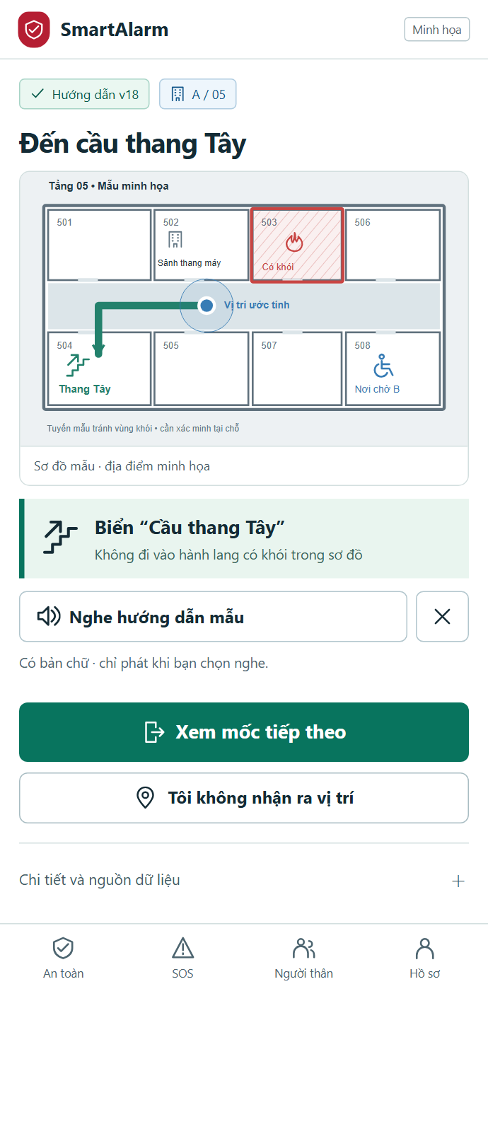
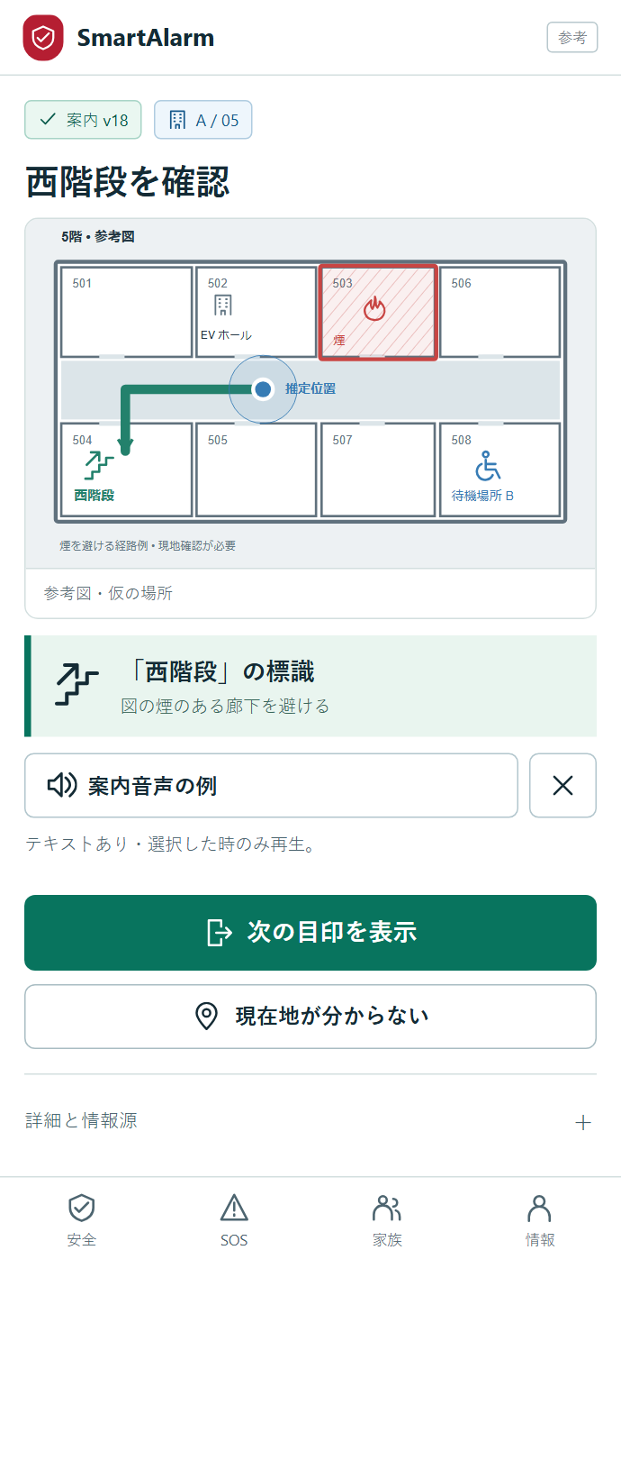
VIETNAMESE • ENGLISH • JAPANESE
SmartAlarm
Multilingual, from interfaces to rescue messages.
Language, country and time zone are independent settings.
One visual meaning.
Three languages.
Reviewed emergency content; controlled voice fallback.
VI
EN
JA
AIPOWER | SmartAlarm solution proposal | International • Multi-industry
34
Notes:
Internationalization covers plurals, time zones, units, formatting, line breaking and Japanese fonts. Critical content has locale-specific review, versions and effective dates. Test TTS pronunciation of site names; AI translation is a draft only. Missing languages use an approved, explicitly identified fallback. Do not force language from the data region. Vietnamese and Japanese examples are intentionally retained on this multilingual demonstration slide.
SmartAlarm design proposal — revision 1.0, 23 October 2026. Scenarios, interfaces and numerical examples are illustrative, not evidence of a deployed product. Source: the FireEscape proposal and product-owner requirements. Pictorial scenes were created with imagegen; text, flows, architecture and UI are editable PowerPoint objects.
UX revision 2: screenshots from the current local prototype. Illustrative data; no live operation or usability certification. Full catalogue:233screens; VI/EN/JA. Original function appendix retained.

Slide 35
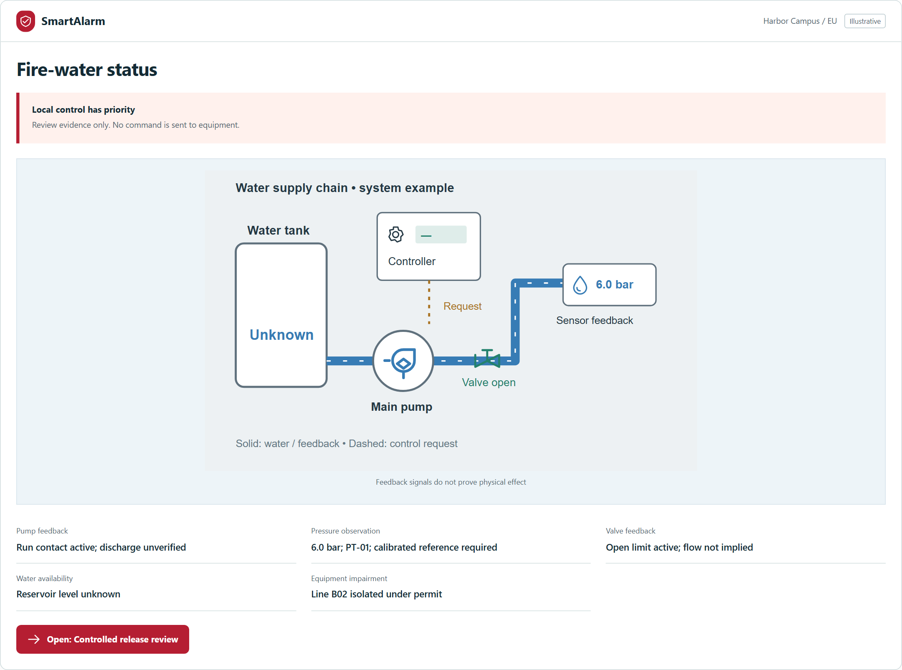
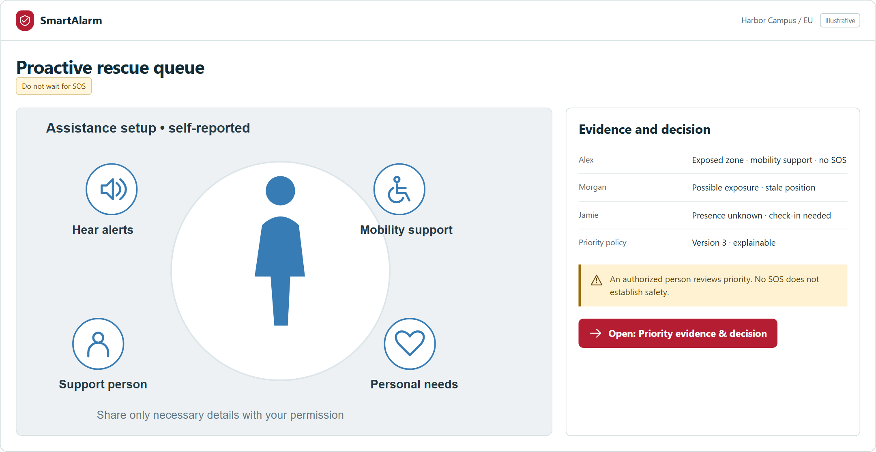
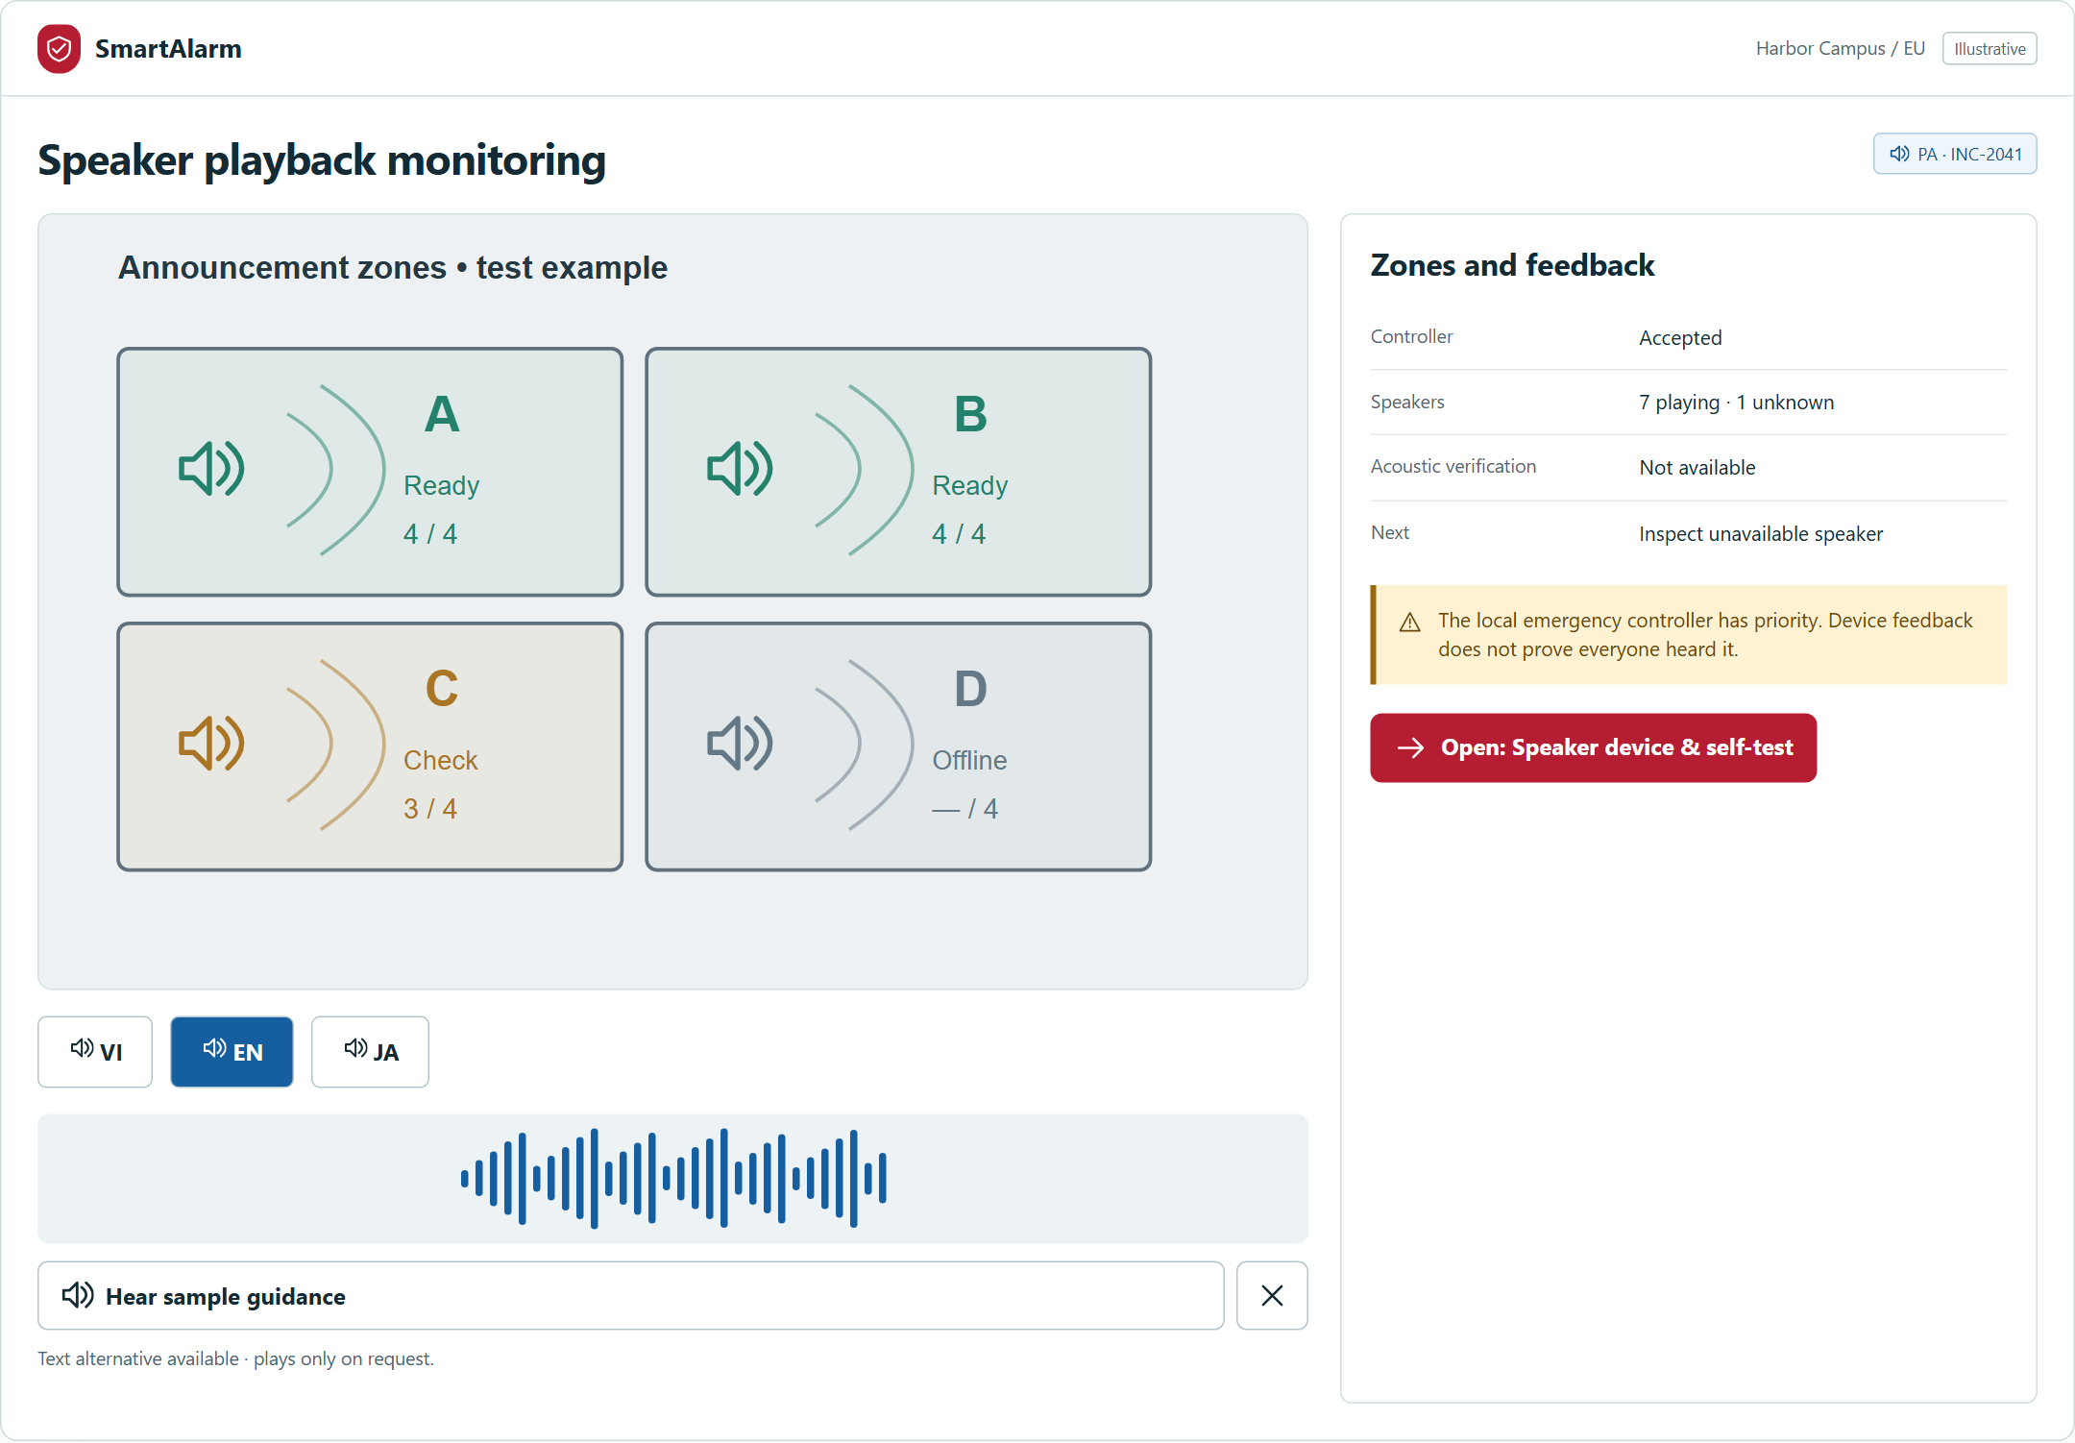
FULL PRODUCT SCOPE
SmartAlarm
241 screens, with visual patterns for each role.
Complete function appendix retained • visual specifications mapped to every screen ID
PHYSICAL SYSTEMS
PROACTIVE RESCUE
SPEAKER COVERAGE
CITIZEN / FIELD / COMMAND / CONFIGURATION • ALL 241 SCREENS: GALLERY + INTERACTIVE PROTOTYPE
AIPOWER | SmartAlarm solution proposal | International • Multi-industry
35
Notes:
The count refers to defined screen IDs, not completed software screens. This proposal selects representative scenes; the catalog and prototype contain the full set. Workflow groups and the acceptance matrix provide traceability. Actual software still requires implementation and UAT. Mockups are not an operational system. The physical integration revision adds 20 screens, bringing the catalog to 233 screens and 33 workflow groups.
SmartAlarm design proposal — revision 1.0, 23 October 2026. Scenarios, interfaces and numerical examples are illustrative, not evidence of a deployed product. Source: the FireEscape proposal and product-owner requirements. Pictorial scenes were created with imagegen; text, flows, architecture and UI are editable PowerPoint objects.
UX revision 2: screenshots from the current local prototype. Illustrative data; no live operation or usability certification. Full catalogue:233screens; VI/EN/JA. Original function appendix retained.

Slide 36
END-TO-END ACCEPTANCE
SmartAlarm
Prove scenarios, beyond individual screens.
Test people, equipment, data, actions and recovery together.
Fire & evacuation
Signal → route/voice → PA → SOS → contact → safety.
Without SOS
Assistance need → presence → check → assignment.
Widespread disaster
Official source → area → update/cancel → shelter.
Network / device failure
Edge, queues, expiry, synchronization and audit.
Access & languages
Tenant isolation, care data, VI/EN/JA, fallback and audio.
AIPOWER | SmartAlarm solution proposal | International • Multi-industry
36
Notes:
Acceptance covers rule correctness, site mapping, accessibility, human factors, load, fault injection, disaster recovery and operational exercises. Measure location accuracy, PA coverage, pronunciation and local-controller interaction at the site. Screenshot counts do not replace acceptance testing. Acceptance criteria link to documented ACs and workflows.
SmartAlarm design proposal — revision 1.0, 23 October 2026. Scenarios, interfaces and numerical examples are illustrative, not evidence of a deployed product. Source: the FireEscape proposal and product-owner requirements. Pictorial scenes were created with imagegen; text, flows, architecture and UI are editable PowerPoint objects.

Slide 37
FULL PRODUCT DELIVERY
SmartAlarm
Keep the full scope. Verify quality at every step.
Acceptance gates turn a long-term architecture into accountable operations.
01 DESIGN
02 BUILD
03 VERIFY
04 OPERATE
Operating model
Data & permissions
Equipment survey
All domains & roles
Integrations / locales
Security & automation
End-to-end UAT
Load & faults / DR
On-site exercises
Training & handover
Duty teams & support
Controlled improvement
Production architecture from day one • Full product scope • Quality gates before go-live
AIPOWER | SmartAlarm solution proposal | International • Multi-industry
37
Notes:
This is a full-product delivery plan, not a temporary demonstration architecture or a reduced product scope. Development, integration, testing and acceptance milestones govern delivery. Schedule, budget, staffing and SLA depend on sizing and the integration inventory; no unsupported dates or prices are introduced.
SmartAlarm design proposal — revision 1.0, 23 October 2026. Scenarios, interfaces and numerical examples are illustrative, not evidence of a deployed product. Source: the FireEscape proposal and product-owner requirements. Pictorial scenes were created with imagegen; text, flows, architecture and UI are editable PowerPoint objects.

Slide 38
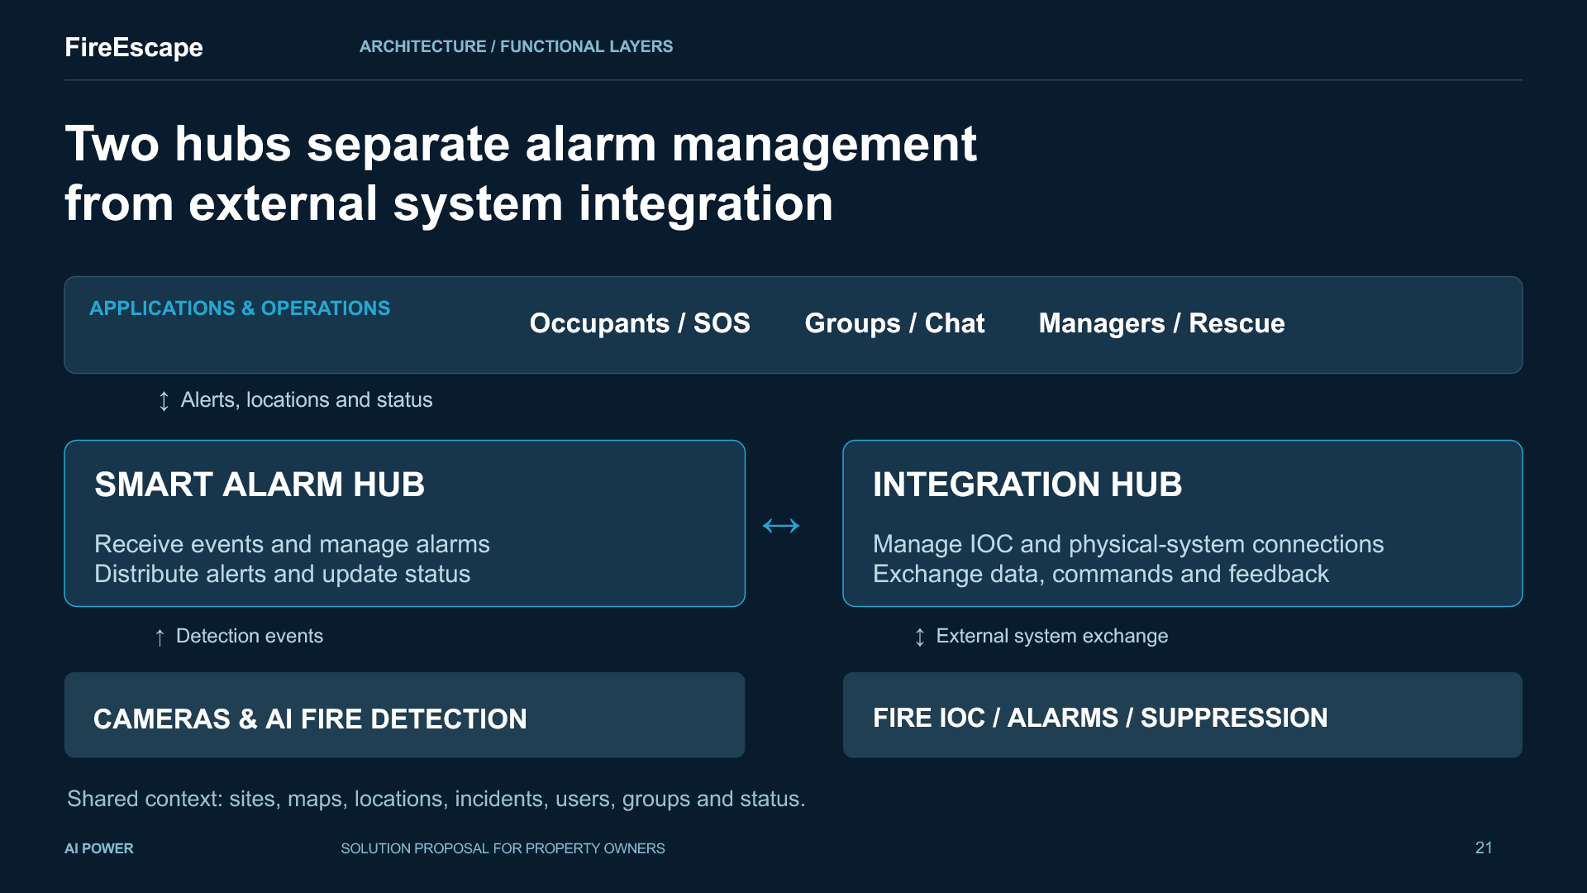
INVESTMENT VALUE • ENGAGEMENT SCOPE
SmartAlarm
Invest in measurable coordination capability.
Assess value through operational results, with clear scope and responsibilities.
Earlier awareness
Measure signal-to-verification time by incident type.
Clearer contact status
Measure task acceptance, contact and unresolved cases.
Consistent coordination
Measure message consistency, handovers and exercise outcomes.
Easier expansion
Measure integration effort, version compatibility and health.
Agree before deployment
Sites/users/devices, data regions, channels, responders and SLA.
AIPOWER | SmartAlarm solution proposal | International • Multi-industry
38
Notes:
Metrics are proposed measures, not achieved results. Establish baselines and targets through surveys. Commercial scope covers platform, infrastructure, equipment, integration, content, operations and support. ROI, damage reduction and response guarantees require measurement and agreement. Local operational decisions remain with the customer under the agreed responsibilities.
SmartAlarm design proposal — revision 1.0, 23 October 2026. Scenarios, interfaces and numerical examples are illustrative, not evidence of a deployed product. Source: the FireEscape proposal and product-owner requirements. Pictorial scenes were created with imagegen; text, flows, architecture and UI are editable PowerPoint objects.

Slide 39
PRODUCT FOUNDATION • PROPOSAL BASIS
SmartAlarm
From FireEscape to SmartAlarm: a grounded expansion.
Preserve the existing response cycle and add the capabilities requested by the product owner.
Retain
Cameras, floors/zones, maps/voice, SOS, hubs, groups and safety updates.
Extend
Multiple hazards, care/proactive rescue, PA/drones, positioning/routing and AI.
Long-term foundation
Multiple tenants/industries/regions; VI/EN/JA; security and operations.
FIRESCAPE • ORIGINAL MATERIAL
Images and interfaces illustrate the proposed solution. This deck does not claim the extensions are already deployed.
AIPOWER | SmartAlarm solution proposal | International • Multi-industry
39
Notes:
Direct source reviewed: the 34-slide FireEscape_Proposal_Expanded_EN.pptx; original source code is unavailable. The Introduction deck and video are only mentioned by that deck and have not been treated as reviewed sources. References include https://docs.oasis-open.org/emergency/cap/v1.2/CAP-v1.2.html ; https://docs.oasis-open.org/mqtt/mqtt/v5.0/mqtt-v5.0.html ; https://cloudevents.io/ ; https://www.ogc.org/standards/sensorthings/ ; https://mavlink.io/en/services/command.html ; https://www.w3.org/TR/WCAG22/ . No certification claim is made. Manufacturer evidence and standards research are included in the new integration documents.
SmartAlarm design proposal — revision 1.0, 23 October 2026. Scenarios, interfaces and numerical examples are illustrative, not evidence of a deployed product. Source: the FireEscape proposal and product-owner requirements. Pictorial scenes were created with imagegen; text, flows, architecture and UI are editable PowerPoint objects.

Slide 40
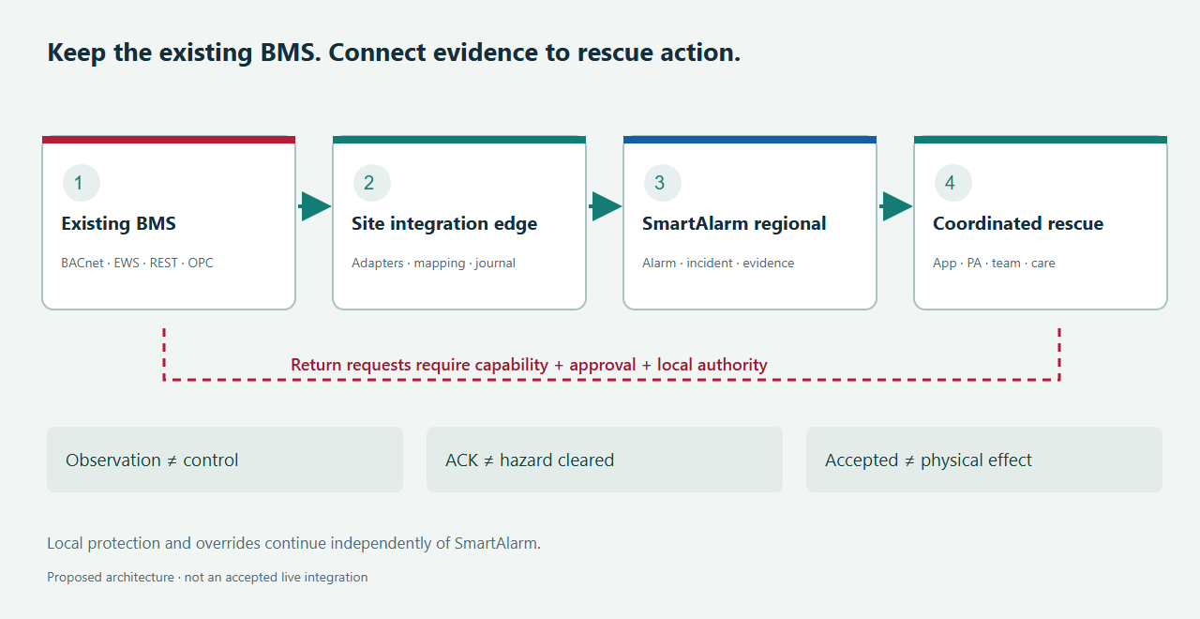
BMS / CONNECTED RESCUE
SmartAlarm
Keep the existing BMS. Connect it to rescue action.
Building information becomes evidence for command, guidance and human assistance.
UNDERSTAND
Alarms, assets, floors and zones.
COORDINATE
App, PA, teams and people needing help.
CONTROL
Authorized requests; source-backed feedback.
AIPOWER | SmartAlarm solution proposal | International • Multi-industry
40
Notes:
Production architecture for BMS integration. Connectors require implementation, version/licence verification and site acceptance. No live connection or hardware certification is claimed. See FRD, Basic/Detail Design and BMS source ledger.

Slide 41
BMS / MULTI-VENDOR
SmartAlarm
One connector platform. Product-specific profiles.
8 vendor/product families • 11 profiles • version, licence and capability qualification.
Siemens
Schneider Electric
Desigo CC / WSI
EBO / EWS + SmartConnector
Johnson Controls
Honeywell
Metasys / REST + SSE
EBI / WEBs — separate profiles
Tridium
Delta Controls
Niagara local / NDS cloud
enteliWEB / API entitlement
Automated Logic
Distech Controls
WebCTRL events / SOAP + SDK
EC-Net / Niagara OEM
A shared protocol does not establish compatibility for every operation or product version.
AIPOWER | SmartAlarm solution proposal | International • Multi-industry
41
Notes:
Production architecture for BMS integration. Connectors require implementation, version/licence verification and site acceptance. No live connection or hardware certification is claimed. See FRD, Basic/Detail Design and BMS source ledger.

Slide 42
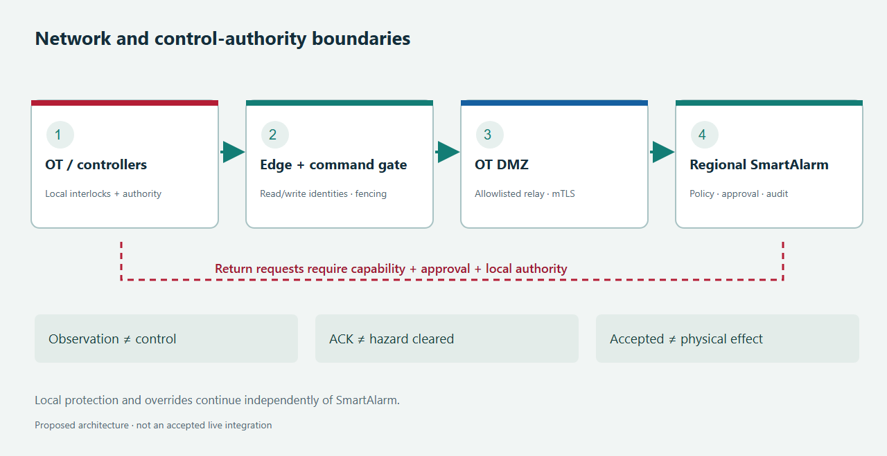
BMS / ARCHITECTURE
SmartAlarm
Separate observation from governed control.
Site gateway • OT/DMZ boundary • normalized data • regional SmartAlarm services.
Local BMS/controller authority remains. LLMs do not issue direct commands. Link loss does not prove relinquishment or safety.
AIPOWER | SmartAlarm solution proposal | International • Multi-industry
42
Notes:
Production architecture for BMS integration. Connectors require implementation, version/licence verification and site acceptance. No live connection or hardware certification is claimed. See FRD, Basic/Detail Design and BMS source ledger.

Slide 43
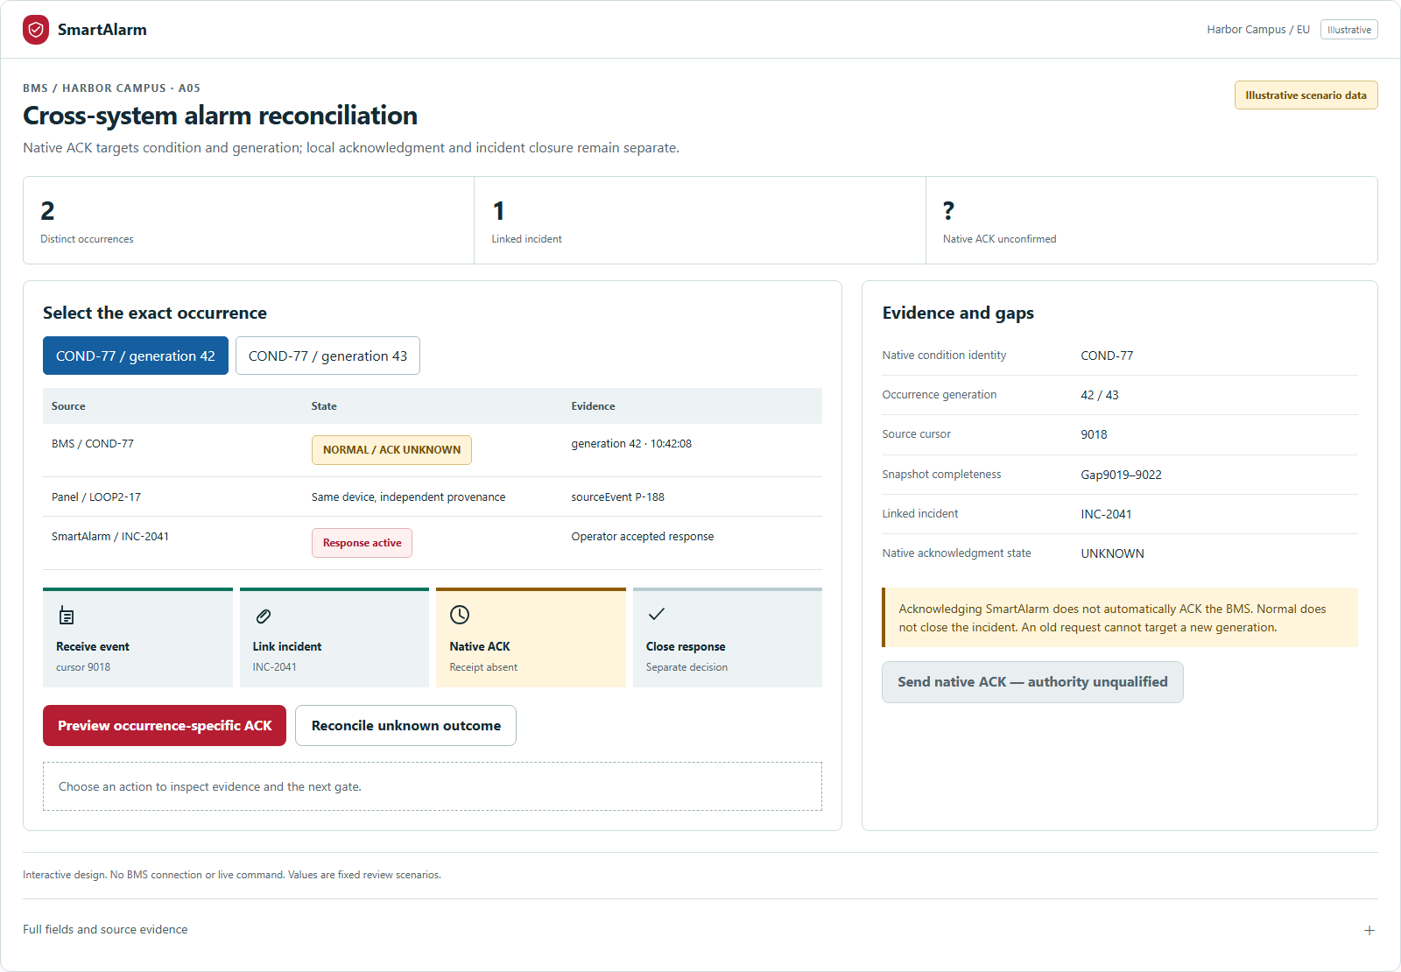
BMS / INCIDENT RESPONSE
SmartAlarm
One incident record, with multiple evidence sources.
Reconcile BMS and direct-panel feeds; retain source, timestamps, quality and acknowledgement history.
01 Receive and check freshness
02 Correlate without erasing provenance
03 Assess routes and people at risk
04 Coordinate app / PA / teams
05 Separate rescue confirmation from ACK
AIPOWER | SmartAlarm solution proposal | International • Multi-industry
43
Notes:
Production architecture for BMS integration. Connectors require implementation, version/licence verification and site acceptance. No live connection or hardware certification is claimed. See FRD, Basic/Detail Design and BMS source ledger.

Slide 44
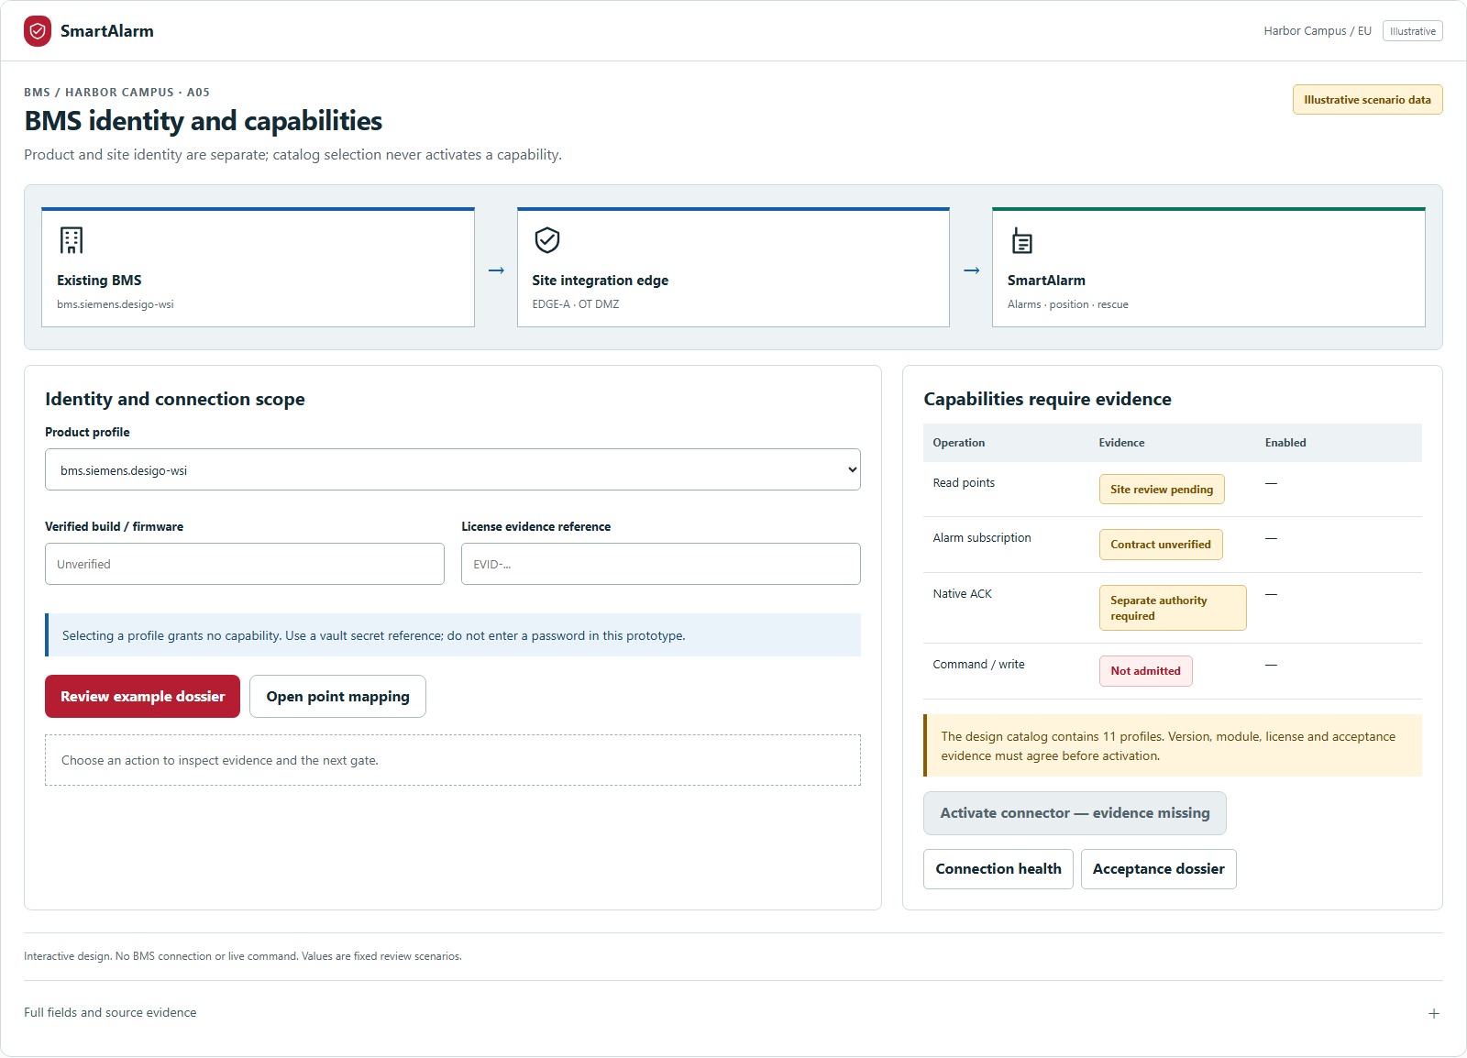
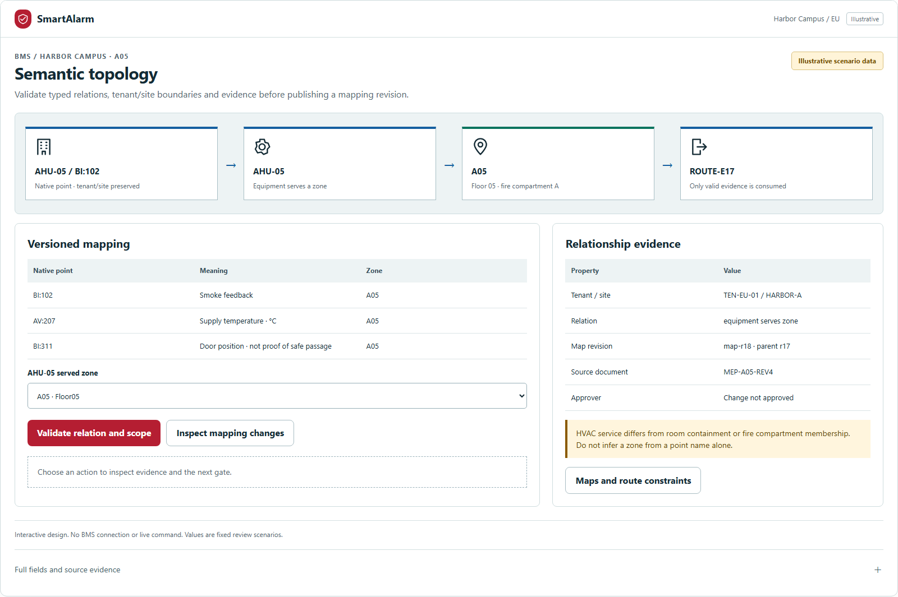
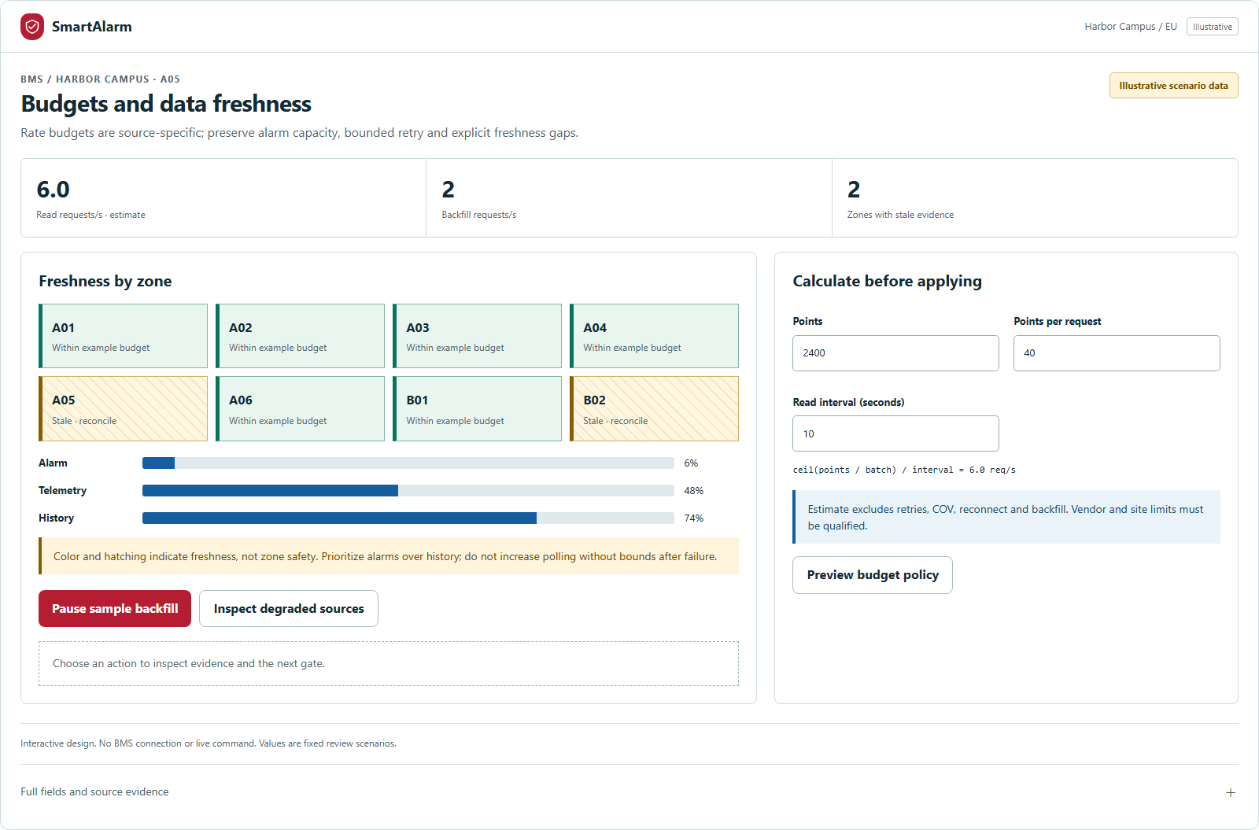
BMS / CONNECTOR LIFECYCLE
SmartAlarm
From connection to mapping and evidence-based qualification.
Versioned configuration; qualify actual capabilities before enabling permissions.
1 · Connection inventory
2 · Mapping and preview
3 · Qualification / FAT / SAT
AIPOWER | SmartAlarm solution proposal | International • Multi-industry
44
Notes:
Production architecture for BMS integration. Connectors require implementation, version/licence verification and site acceptance. No live connection or hardware certification is claimed. See FRD, Basic/Detail Design and BMS source ledger.

Slide 45
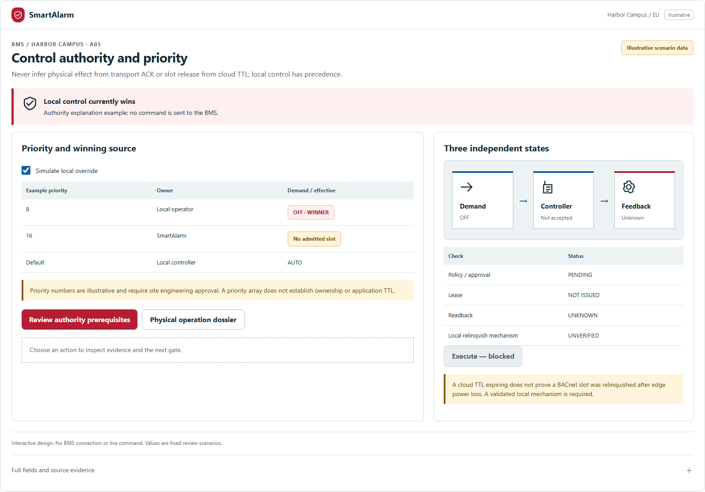
BMS / COMMAND GOVERNANCE
SmartAlarm
Receipt, execution and physical effect are separate states.
Preview impact → approval → authorized gateway → reconcile feedback.
LOCAL AUTHORITY
Overrides and interlocks take priority.
UNKNOWN OUTCOME
Reconcile; never blindly retry.
COMPLETE SCOPE
40 FR-BMS + 8 new screens.
AIPOWER | SmartAlarm solution proposal | International • Multi-industry
45
Notes:
Production architecture for BMS integration. Connectors require implementation, version/licence verification and site acceptance. No live connection or hardware certification is claimed. See FRD, Basic/Detail Design and BMS source ledger.

Slide 46
SmartAlarm
Detect. Guide. Rescue. Confirm.
Connect equipment with people —
and recognize those who need help, even without an SOS.
CONNECTED SAFETY & RESCUE / INTERNATIONAL / VI • EN • JA
Notes:
SmartAlarm is a multi-hazard safety and rescue coordination platform. The complete proposal connects architecture, experience and deployment. This revision builds on the original FireEscape presentation, retaining AIPOWER identity and relevant original imagery while adding new all-in-one illustrations and scenarios.
SmartAlarm design proposal — revision 1.0, 23 October 2026. Scenarios, interfaces and numerical examples are illustrative, not evidence of a deployed product. Source: the FireEscape proposal and product-owner requirements. Pictorial scenes were created with imagegen; text, flows, architecture and UI are editable PowerPoint objects.

Slide 47
APPENDIX · COMPLETE FUNCTIONAL INVENTORY
SmartAlarm
The complete baseline, with traceable IDs.
Beyond primary screens: business workflows, detailed functions and background processing.
37
241
312
BUSINESS WORKFLOWS
SCREEN-LEVEL FR FUNCTIONS
BACKGROUND / SYSTEM REQUIREMENTS
A · End-to-end workflows
B · Every detailed function, organized by domain
C · Background processing, integration, controls and quality requirements
AIPOWER | SmartAlarm solution proposal | International • Multi-industry
47
Notes:
This appendix enumerates the current baseline. A/B/C are overlapping traceability layers, not additive counts of distinct features. IDs map to FRD, Screen Specifications and the Acceptance Matrix. Vendor-dependent functionality remains a proposed scope subject to verification.

Slide 48
APPENDIX A · COMPLETE INVENTORY
SmartAlarm
Cross-system business workflows | 1/7
Requirement IDs trace this proposal to detailed design and acceptance criteria.
ID
FUNCTION / OUTCOME
TRACE
WF-01
Provision tenant/region, SSO/MFA, invitations and workspace access without account enumeration.
14 screens
WF-02
Manage site/floor/zone, approved plan revisions and location quality.
6 screens
WF-03
Durably ingest multi-source events with source/tenant validation, deduplication and quarantine.
5 screens
WF-04
Review evidence and create/link/split incidents while retaining audit and ownership.
7 screens
WF-05
Submit need-specific SOS with manual location, offline pending and reviewed cancellation.
10 screens
Defined design scope · Conditions, exceptions and acceptance: FRD + Screen Specifications.
AIPOWER | SmartAlarm solution proposal | International • Multi-industry
48
Notes:
WF-01: Provision tenant/region, SSO/MFA, invitations and workspace access without account enumeration.
Workflows: WF-01
Screens: A01, A02, A03, A04, A05, A06, A07, A08, A09, A10, T03, T04, X04, X08
WF-02: Manage site/floor/zone, approved plan revisions and location quality.
Workflows: WF-02
Screens: S01, S02, S03, S04, S05, X06
WF-03: Durably ingest multi-source events with source/tenant validation, deduplication and quarantine.
Workflows: WF-03
Screens: O03, I03, D02, D03, D04
WF-04: Review evidence and create/link/split incidents while retaining audit and ownership.
Workflows: WF-04
Screens: O05, O06, O07, S11, S12, S13, S14
WF-05: Submit need-specific SOS with manual location, offline pending and reviewed cancellation.
Workflows: WF-05
Screens: C05, C06, C07, C08, C09, C10, C27, C28, X01, X02
Source: baseline 1.0, complete FRD and Screen Specifications. This is a design inventory, not certification of implemented functionality.

Slide 49
APPENDIX A · COMPLETE INVENTORY
SmartAlarm
Cross-system business workflows | 2/7
Requirement IDs trace this proposal to detailed design and acceptance criteria.
ID
FUNCTION / OUTCOME
TRACE
WF-06
Check possible falls with a server timer and escalate non-response without diagnosis.
2 screens
WF-07
Report and dispatch road incidents using location, road direction and unknown injury status.
1 screens
WF-08
Process CAP/disaster advisories with issuer, mode, polygon, lineage and expiry validation.
4 screens
WF-09
Author and approve exact warning content, audience and locale versions.
4 screens
WF-10
Track per-channel delivery, authenticated callbacks, bounded retries/fallback and escalation.
6 screens
Defined design scope · Conditions, exceptions and acceptance: FRD + Screen Specifications.
AIPOWER | SmartAlarm solution proposal | International • Multi-industry
49
Notes:
WF-06: Check possible falls with a server timer and escalate non-response without diagnosis.
Workflows: WF-06
Screens: C24, C25
WF-07: Report and dispatch road incidents using location, road direction and unknown injury status.
Workflows: WF-07
Screens: C26
WF-08: Process CAP/disaster advisories with issuer, mode, polygon, lineage and expiry validation.
Workflows: WF-08
Screens: C14, C15, O28, O29
WF-09: Author and approve exact warning content, audience and locale versions.
Workflows: WF-09
Screens: O13, O14, O15, T06
WF-10: Track per-channel delivery, authenticated callbacks, bounded retries/fallback and escalation.
Workflows: WF-10
Screens: C13, O16, O17, T05, D07, C34
Source: baseline 1.0, complete FRD and Screen Specifications. This is a design inventory, not certification of implemented functionality.

Slide 50
APPENDIX A · COMPLETE INVENTORY
SmartAlarm
Cross-system business workflows | 3/7
Requirement IDs trace this proposal to detailed design and acceptance criteria.
ID
FUNCTION / OUTCOME
TRACE
WF-11
Dispatch capable teams, accept tasks atomically, update progress and hand over ownership.
17 screens
WF-12
Record sourced personal status and share with circles/contacts under consent.
12 screens
WF-13
Maintain shelters and approved guidance with versioned, expiring offline packs.
9 screens
WF-14
Enroll devices, manage certificates/health, maintain/calibrate and expose coverage gaps.
5 screens
WF-15
Control devices only within capability/interlock/TTL rules and verified outcome evidence.
2 screens
Defined design scope · Conditions, exceptions and acceptance: FRD + Screen Specifications.
AIPOWER | SmartAlarm solution proposal | International • Multi-industry
50
Notes:
WF-11: Dispatch capable teams, accept tasks atomically, update progress and hand over ownership.
Workflows: WF-11
Screens: R01, R02, R03, R04, R05, R06, R07, R08, R09, R10, R11, R12, O08, O09, O10, X10, O34
WF-12: Record sourced personal status and share with circles/contacts under consent.
Workflows: WF-12
Screens: C11, C12, C19, C20, C21, C22, C23, O11, O12, C31, C32, C33
WF-13: Maintain shelters and approved guidance with versioned, expiring offline packs.
Workflows: WF-13
Screens: C01, C02, C03, C04, C16, C17, C18, O26, O27
WF-14: Enroll devices, manage certificates/health, maintain/calibrate and expose coverage gaps.
Workflows: WF-14
Screens: S06, S07, S08, S09, S10
WF-15: Control devices only within capability/interlock/TTL rules and verified outcome evidence.
Workflows: WF-15
Screens: O18, O19
Source: baseline 1.0, complete FRD and Screen Specifications. This is a design inventory, not certification of implemented functionality.

Slide 51
APPENDIX A · COMPLETE INVENTORY
SmartAlarm
Cross-system business workflows | 4/7
Requirement IDs trace this proposal to detailed design and acceptance criteria.
ID
FUNCTION / OUTCOME
TRACE
WF-16
Plan/review drone missions with pilot authority, telemetry and local lost-link policy.
5 screens
WF-17
Manage connector lifecycle from manifest/sandbox to activation, rotation and deprecation.
14 screens
WF-18
Provide locale/timezone support, residency and verified site/country emergency contacts.
9 screens
WF-19
Apply retention/legal holds, scoped export/deletion and immutable audit.
11 screens
WF-20
Close incidents, analyze/improve response, isolate drills and acknowledge shift handovers.
30 screens
Defined design scope · Conditions, exceptions and acceptance: FRD + Screen Specifications.
AIPOWER | SmartAlarm solution proposal | International • Multi-industry
51
Notes:
WF-16: Plan/review drone missions with pilot authority, telemetry and local lost-link policy.
Workflows: WF-16
Screens: I11, I12, I13, I14, I15
WF-17: Manage connector lifecycle from manifest/sandbox to activation, rotation and deprecation.
Workflows: WF-17
Screens: I01, I02, I04, I05, I06, I07, I08, I09, I10, D01, D05, D06, D08, O33
WF-18: Provide locale/timezone support, residency and verified site/country emergency contacts.
Workflows: WF-18
Screens: T02, G05, G06, L01, L02, L03, L04, L05, L06
WF-19: Apply retention/legal holds, scoped export/deletion and immutable audit.
Workflows: WF-19
Screens: C29, C30, O30, T09, T10, T11, G07, G08, G11, G12, H11
WF-20: Close incidents, analyze/improve response, isolate drills and acknowledge shift handovers.
Workflows: WF-20
Screens: O01, O02, O04, O20, O21, O22, O23, O24, O25, T01, T07, T08, T12, T13, T14, T15, T16, T17, X03, X05, X07, X09, G01, G02, G03, G04, G09, G10, O31, O32
Source: baseline 1.0, complete FRD and Screen Specifications. This is a design inventory, not certification of implemented functionality.

Slide 52
APPENDIX A · COMPLETE INVENTORY
SmartAlarm
Cross-system business workflows | 5/7
Requirement IDs trace this proposal to detailed design and acceptance criteria.
ID
FUNCTION / OUTCOME
TRACE
WF-21
Reach people without phones through approved PA zones/content, playback, live speech and fallback.
9 screens
WF-22
Guide step-by-step using graph/hazard/accessibility constraints, replanning and SOS fallback.
10 screens
WF-23
Fuse uncertain position evidence and distinguish observed presence from registration.
4 screens
WF-24
Optimize feasible routes under hard constraints, capacity and cohort balancing.
3 screens
WF-25
Ground AI summaries/SOP checks/drafts in evidence; human review, no autonomous actuation.
4 screens
Defined design scope · Conditions, exceptions and acceptance: FRD + Screen Specifications.
AIPOWER | SmartAlarm solution proposal | International • Multi-industry
52
Notes:
WF-21: Reach people without phones through approved PA zones/content, playback, live speech and fallback.
Workflows: WF-21
Screens: P01, P02, P03, P04, P05, P06, P07, P08, P09
WF-22: Guide step-by-step using graph/hazard/accessibility constraints, replanning and SOS fallback.
Workflows: WF-22
Screens: C35, C36, C37, C38, C39, C40, S15, S16, O35, O36
WF-23: Fuse uncertain position evidence and distinguish observed presence from registration.
Workflows: WF-23
Screens: H10, Q01, Q02, Q03
WF-24: Optimize feasible routes under hard constraints, capacity and cohort balancing.
Workflows: WF-24
Screens: Q04, Q05, Q10
WF-25: Ground AI summaries/SOP checks/drafts in evidence; human review, no autonomous actuation.
Workflows: WF-25
Screens: Q06, Q07, Q08, Q09
Source: baseline 1.0, complete FRD and Screen Specifications. This is a design inventory, not certification of implemented functionality.

Slide 53
APPENDIX A · COMPLETE INVENTORY
SmartAlarm
Cross-system business workflows | 6/7
Requirement IDs trace this proposal to detailed design and acceptance criteria.
ID
FUNCTION / OUTCOME
TRACE
WF-26
Manage care profiles, caregiver authority, emergency subsets and audited access.
7 screens
WF-27
Proactively identify/prioritize assistance before SOS using presence and evidence.
3 screens
WF-28
Bind model/firmware/capability, point/zone mappings and approved cause-and-effect.
6 screens
WF-29
Supervise physical signals with provenance/freshness and independent local protection.
3 screens
WF-30
Authorize/execute permitted commands, reconcile UNKNOWN and support local takeover.
5 screens
Defined design scope · Conditions, exceptions and acceptance: FRD + Screen Specifications.
AIPOWER | SmartAlarm solution proposal | International • Multi-industry
53
Notes:
WF-26: Manage care profiles, caregiver authority, emergency subsets and audited access.
Workflows: WF-26
Screens: H01, H02, H03, H04, H05, H06, H07
WF-27: Proactively identify/prioritize assistance before SOS using presence and evidence.
Workflows: WF-27
Screens: H08, H09, H12
WF-28: Bind model/firmware/capability, point/zone mappings and approved cause-and-effect.
Workflows: WF-28
Screens: F02, F03, F04, F05, F06, F20
WF-29: Supervise physical signals with provenance/freshness and independent local protection.
Workflows: WF-29
Screens: F01, F07, F08
WF-30: Authorize/execute permitted commands, reconcile UNKNOWN and support local takeover.
Workflows: WF-30
Screens: F09, F10, F11, F12, F13
Source: baseline 1.0, complete FRD and Screen Specifications. This is a design inventory, not certification of implemented functionality.

Slide 54
APPENDIX A · COMPLETE INVENTORY
SmartAlarm
Cross-system business workflows | 7/7
Requirement IDs trace this proposal to detailed design and acceptance criteria.
ID
FUNCTION / OUTCOME
TRACE
WF-31
Isolate impairment/tests, assign compensating measures and verify restoration.
2 screens
WF-32
Maintain compatibility/certification, FAT/SAT and configuration-specific capability gates.
3 screens
WF-33
Dispatch robot/water-monitor missions with operators, limits and verified outcomes.
1 screens
Defined design scope · Conditions, exceptions and acceptance: FRD + Screen Specifications.
AIPOWER | SmartAlarm solution proposal | International • Multi-industry
54
Notes:
WF-31: Isolate impairment/tests, assign compensating measures and verify restoration.
Workflows: WF-31
Screens: F14, F18
WF-32: Maintain compatibility/certification, FAT/SAT and configuration-specific capability gates.
Workflows: WF-32
Screens: F15, F16, F17
WF-33: Dispatch robot/water-monitor missions with operators, limits and verified outcomes.
Workflows: WF-33
Screens: F19
Source: baseline 1.0, complete FRD and Screen Specifications. This is a design inventory, not certification of implemented functionality.

Slide 55
APPENDIX B · COMPLETE INVENTORY
SmartAlarm
Access | 1/2
Requirement IDs trace this proposal to detailed design and acceptance criteria.
ID
FUNCTION / OUTCOME
TRACE
FR-A01
Welcome & region: Choose your safety region; continue.
WF-01
FR-A02
Sign in: Your workspace, securely connected; sign in.
WF-01
FR-A03
Verify identity: Confirm this sign-in; verify.
WF-01
FR-A04
Workspace switcher: Choose an organization; enter workspace.
WF-01
FR-A05
Recover access: Restore access without exposing account existence; send recovery link.
WF-01
Defined design scope · Conditions, exceptions and acceptance: FRD + Screen Specifications.
AIPOWER | SmartAlarm solution proposal | International • Multi-industry
55
Notes:
FR-A01: Welcome & region: Choose your safety region; continue.
Workflows: WF-01
Screens: A01
FR-A02: Sign in: Your workspace, securely connected; sign in.
Workflows: WF-01
Screens: A02
FR-A03: Verify identity: Confirm this sign-in; verify.
Workflows: WF-01
Screens: A03
FR-A04: Workspace switcher: Choose an organization; enter workspace.
Workflows: WF-01
Screens: A04
FR-A05: Recover access: Restore access without exposing account existence; send recovery link.
Workflows: WF-01
Screens: A05
Source: baseline 1.0, complete FRD and Screen Specifications. This is a design inventory, not certification of implemented functionality.

Slide 56
APPENDIX B · COMPLETE INVENTORY
SmartAlarm
Access | 2/2
Requirement IDs trace this proposal to detailed design and acceptance criteria.
ID
FUNCTION / OUTCOME
TRACE
FR-A06
Accept invitation: Review your organization invitation; accept invitation.
WF-01
FR-A07
Permissions & consent: Choose how SmartAlarm supports you; save choices.
WF-01
FR-A08
Session & device security: Review devices with access; review session.
WF-01
FR-A09
Revoke session: End access on the selected device; revoke selected session.
WF-01
FR-A10
Profile & accessibility: Make the interface work for you; save profile.
WF-01
Defined design scope · Conditions, exceptions and acceptance: FRD + Screen Specifications.
AIPOWER | SmartAlarm solution proposal | International • Multi-industry
56
Notes:
FR-A06: Accept invitation: Review your organization invitation; accept invitation.
Workflows: WF-01
Screens: A06
FR-A07: Permissions & consent: Choose how SmartAlarm supports you; save choices.
Workflows: WF-01
Screens: A07
FR-A08: Session & device security: Review devices with access; review session.
Workflows: WF-01
Screens: A08
FR-A09: Revoke session: End access on the selected device; revoke selected session.
Workflows: WF-01
Screens: A09
FR-A10: Profile & accessibility: Make the interface work for you; save profile.
Workflows: WF-01
Screens: A10
Source: baseline 1.0, complete FRD and Screen Specifications. This is a design inventory, not certification of implemented functionality.

Slide 57
APPENDIX B · COMPLETE INVENTORY
SmartAlarm
Citizen | 1/8
Requirement IDs trace this proposal to detailed design and acceptance criteria.
ID
FUNCTION / OUTCOME
TRACE
FR-C01
Safety home: A clear next step, when it matters; view active alert.
WF-13
FR-C02
Alert detail: Fire reported in Building A; view guidance.
WF-13
FR-C03
Evacuation guidance: Use the published evacuation plan; i need assistance.
WF-13
FR-C04
Voice & accessible guidance: Read or listen to the same instruction; return to plan.
WF-13
FR-C05
SOS type: What kind of help do you need?; continue with selected need.
WF-05
Defined design scope · Conditions, exceptions and acceptance: FRD + Screen Specifications.
AIPOWER | SmartAlarm solution proposal | International • Multi-industry
57
Notes:
FR-C01: Safety home: A clear next step, when it matters; view active alert.
Workflows: WF-13
Screens: C01
FR-C02: Alert detail: Fire reported in Building A; view guidance.
Workflows: WF-13
Screens: C02
FR-C03: Evacuation guidance: Use the published evacuation plan; i need assistance.
Workflows: WF-13
Screens: C03
FR-C04: Voice & accessible guidance: Read or listen to the same instruction; return to plan.
Workflows: WF-13
Screens: C04
FR-C05: SOS type: What kind of help do you need?; continue with selected need.
Workflows: WF-05
Screens: C05
Source: baseline 1.0, complete FRD and Screen Specifications. This is a design inventory, not certification of implemented functionality.

Slide 58
APPENDIX B · COMPLETE INVENTORY
SmartAlarm
Citizen | 2/8
Requirement IDs trace this proposal to detailed design and acceptance criteria.
ID
FUNCTION / OUTCOME
TRACE
FR-C06
SOS location & details: Tell responders where to find you; review SOS.
WF-05
FR-C07
Confirm SOS: Send this request to campus command?; send SOS.
WF-05
FR-C08
SOS tracking: Your request has been received; contact assigned team.
WF-05
FR-C09
Incident conversation: Stay connected to the response team; send message.
WF-05
FR-C10
Update or cancel SOS: Update your situation; submit update.
WF-05
Defined design scope · Conditions, exceptions and acceptance: FRD + Screen Specifications.
AIPOWER | SmartAlarm solution proposal | International • Multi-industry
58
Notes:
FR-C06: SOS location & details: Tell responders where to find you; review SOS.
Workflows: WF-05
Screens: C06
FR-C07: Confirm SOS: Send this request to campus command?; send SOS.
Workflows: WF-05
Screens: C07
FR-C08: SOS tracking: Your request has been received; contact assigned team.
Workflows: WF-05
Screens: C08
FR-C09: Incident conversation: Stay connected to the response team; send message.
Workflows: WF-05
Screens: C09
FR-C10: Update or cancel SOS: Update your situation; submit update.
Workflows: WF-05
Screens: C10
Source: baseline 1.0, complete FRD and Screen Specifications. This is a design inventory, not certification of implemented functionality.

Slide 59
APPENDIX B · COMPLETE INVENTORY
SmartAlarm
Citizen | 3/8
Requirement IDs trace this proposal to detailed design and acceptance criteria.
ID
FUNCTION / OUTCOME
TRACE
FR-C11
Confirm personal safety: Let your circle know your status; confirm my safety.
WF-12
FR-C12
Safety receipt: Your safety update was saved; view delivery details.
WF-12
FR-C13
Notification inbox: Updates that need your attention; open alert.
WF-10
FR-C14
Nearby hazards: Know what is happening nearby; view hazard.
WF-08
FR-C15
Disaster advisory: Flood watch for Riverside district; view shelter information.
WF-08
Defined design scope · Conditions, exceptions and acceptance: FRD + Screen Specifications.
AIPOWER | SmartAlarm solution proposal | International • Multi-industry
59
Notes:
FR-C11: Confirm personal safety: Let your circle know your status; confirm my safety.
Workflows: WF-12
Screens: C11
FR-C12: Safety receipt: Your safety update was saved; view delivery details.
Workflows: WF-12
Screens: C12
FR-C13: Notification inbox: Updates that need your attention; open alert.
Workflows: WF-10
Screens: C13
FR-C14: Nearby hazards: Know what is happening nearby; view hazard.
Workflows: WF-08
Screens: C14
FR-C15: Disaster advisory: Flood watch for Riverside district; view shelter information.
Workflows: WF-08
Screens: C15
Source: baseline 1.0, complete FRD and Screen Specifications. This is a design inventory, not certification of implemented functionality.

Slide 60
APPENDIX B · COMPLETE INVENTORY
SmartAlarm
Citizen | 4/8
Requirement IDs trace this proposal to detailed design and acceptance criteria.
ID
FUNCTION / OUTCOME
TRACE
FR-C16
Shelters & assembly points: Find a designated assistance point; open shelter details.
WF-13
FR-C17
Shelter details: North shelter; save shelter offline.
WF-13
FR-C18
Offline safety pack: Essential information on your device; review cached plan.
WF-13
FR-C19
My circles: The people who should hear from you; open family.
WF-12
FR-C20
Circle conversation: Family; view member status.
WF-12
Defined design scope · Conditions, exceptions and acceptance: FRD + Screen Specifications.
AIPOWER | SmartAlarm solution proposal | International • Multi-industry
60
Notes:
FR-C16: Shelters & assembly points: Find a designated assistance point; open shelter details.
Workflows: WF-13
Screens: C16
FR-C17: Shelter details: North shelter; save shelter offline.
Workflows: WF-13
Screens: C17
FR-C18: Offline safety pack: Essential information on your device; review cached plan.
Workflows: WF-13
Screens: C18
FR-C19: My circles: The people who should hear from you; open family.
Workflows: WF-12
Screens: C19
FR-C20: Circle conversation: Family; view member status.
Workflows: WF-12
Screens: C20
Source: baseline 1.0, complete FRD and Screen Specifications. This is a design inventory, not certification of implemented functionality.

Slide 61
APPENDIX B · COMPLETE INVENTORY
SmartAlarm
Citizen | 5/8
Requirement IDs trace this proposal to detailed design and acceptance criteria.
ID
FUNCTION / OUTCOME
TRACE
FR-C21
Create or edit circle: Choose members and sharing rules; save circle.
WF-12
FR-C22
Circle member status: A status is a report, not a guarantee; send check-in request.
WF-12
FR-C23
Emergency contacts: Who should receive your updates?; save contacts.
WF-12
FR-C24
Care & fall detection: Configure a supported fall detector; review test alert.
WF-06
FR-C25
Possible fall check-in: A possible fall was detected; i need help now.
WF-06
Defined design scope · Conditions, exceptions and acceptance: FRD + Screen Specifications.
AIPOWER | SmartAlarm solution proposal | International • Multi-industry
61
Notes:
FR-C21: Create or edit circle: Choose members and sharing rules; save circle.
Workflows: WF-12
Screens: C21
FR-C22: Circle member status: A status is a report, not a guarantee; send check-in request.
Workflows: WF-12
Screens: C22
FR-C23: Emergency contacts: Who should receive your updates?; save contacts.
Workflows: WF-12
Screens: C23
FR-C24: Care & fall detection: Configure a supported fall detector; review test alert.
Workflows: WF-06
Screens: C24
FR-C25: Possible fall check-in: A possible fall was detected; i need help now.
Workflows: WF-06
Screens: C25
Source: baseline 1.0, complete FRD and Screen Specifications. This is a design inventory, not certification of implemented functionality.

Slide 62
APPENDIX B · COMPLETE INVENTORY
SmartAlarm
Citizen | 6/8
Requirement IDs trace this proposal to detailed design and acceptance criteria.
ID
FUNCTION / OUTCOME
TRACE
FR-C26
Road incident report: Report a road incident safely; review SOS.
WF-07
FR-C27
Discreet assistance: Request help with a quiet interface; send discreet request.
WF-05
FR-C28
My reports & history: Your previous requests; view request.
WF-05
FR-C29
Privacy & data requests: Control optional sharing; review data request.
WF-19
FR-C30
Data request receipt: Request DR-202 received; back to privacy.
WF-19
Defined design scope · Conditions, exceptions and acceptance: FRD + Screen Specifications.
AIPOWER | SmartAlarm solution proposal | International • Multi-industry
62
Notes:
FR-C26: Road incident report: Report a road incident safely; review SOS.
Workflows: WF-07
Screens: C26
FR-C27: Discreet assistance: Request help with a quiet interface; send discreet request.
Workflows: WF-05
Screens: C27
FR-C28: My reports & history: Your previous requests; view request.
Workflows: WF-05
Screens: C28
FR-C29: Privacy & data requests: Control optional sharing; review data request.
Workflows: WF-19
Screens: C29
FR-C30: Data request receipt: Request DR-202 received; back to privacy.
Workflows: WF-19
Screens: C30
Source: baseline 1.0, complete FRD and Screen Specifications. This is a design inventory, not certification of implemented functionality.

Slide 63
APPENDIX B · COMPLETE INVENTORY
SmartAlarm
Citizen | 7/8
Requirement IDs trace this proposal to detailed design and acceptance criteria.
ID
FUNCTION / OUTCOME
TRACE
FR-C31
Circle membership & invitations: Control who receives your updates; manage invitation.
WF-12
FR-C32
Invite circle member: Invite someone you trust; create invitation.
WF-12
FR-C33
Report or block conversation: Control unwanted social contact; submit report.
WF-12
FR-C34
Notification preferences: Choose channels and quiet hours; save preferences.
WF-10
FR-C35
Voice evacuation navigation: Follow reviewed steps away from the danger area; show next instruction.
WF-22
Defined design scope · Conditions, exceptions and acceptance: FRD + Screen Specifications.
AIPOWER | SmartAlarm solution proposal | International • Multi-industry
63
Notes:
FR-C31: Circle membership & invitations: Control who receives your updates; manage invitation.
Workflows: WF-12
Screens: C31
FR-C32: Invite circle member: Invite someone you trust; create invitation.
Workflows: WF-12
Screens: C32
FR-C33: Report or block conversation: Control unwanted social contact; submit report.
Workflows: WF-12
Screens: C33
FR-C34: Notification preferences: Choose channels and quiet hours; save preferences.
Workflows: WF-10
Screens: C34
FR-C35: Voice evacuation navigation: Follow reviewed steps away from the danger area; show next instruction.
Workflows: WF-22
Screens: C35
Source: baseline 1.0, complete FRD and Screen Specifications. This is a design inventory, not certification of implemented functionality.

Slide 64
APPENDIX B · COMPLETE INVENTORY
SmartAlarm
Citizen | 8/8
Requirement IDs trace this proposal to detailed design and acceptance criteria.
ID
FUNCTION / OUTCOME
TRACE
FR-C36
Navigation step & orientation: Use the WEST STAIR sign as your landmark; repeat voice instruction.
WF-22
FR-C37
Route change notification: The previous route is no longer recommended; review updated route.
WF-22
FR-C38
Position uncertain / no route: We cannot verify a route from your position; request assistance.
WF-22
FR-C39
Outdoor hazard avoidance: Leave the affected area using reviewed guidance; view next route step.
WF-22
FR-C40
Voice language & guidance settings: Choose how guidance reaches you; save guidance preferences.
WF-22
Defined design scope · Conditions, exceptions and acceptance: FRD + Screen Specifications.
AIPOWER | SmartAlarm solution proposal | International • Multi-industry
64
Notes:
FR-C36: Navigation step & orientation: Use the WEST STAIR sign as your landmark; repeat voice instruction.
Workflows: WF-22
Screens: C36
FR-C37: Route change notification: The previous route is no longer recommended; review updated route.
Workflows: WF-22
Screens: C37
FR-C38: Position uncertain / no route: We cannot verify a route from your position; request assistance.
Workflows: WF-22
Screens: C38
FR-C39: Outdoor hazard avoidance: Leave the affected area using reviewed guidance; view next route step.
Workflows: WF-22
Screens: C39
FR-C40: Voice language & guidance settings: Choose how guidance reaches you; save guidance preferences.
Workflows: WF-22
Screens: C40
Source: baseline 1.0, complete FRD and Screen Specifications. This is a design inventory, not certification of implemented functionality.

Slide 65
APPENDIX B · COMPLETE INVENTORY
SmartAlarm
Responder | 1/3
Requirement IDs trace this proposal to detailed design and acceptance criteria.
ID
FUNCTION / OUTCOME
TRACE
FR-R01
Shift & readiness: Ready for your next assignment; view assignments.
WF-11
FR-R02
Assignment inbox: Assignments for Rescue 02; open assignment.
WF-11
FR-R03
Accept or decline task: Assist person at Room 505; accept assignment.
WF-11
FR-R04
Navigation & arrival: Building A · East access; report arrival.
WF-11
FR-R05
Field situation: Floor 05 response context; open assistance record.
WF-11
Defined design scope · Conditions, exceptions and acceptance: FRD + Screen Specifications.
AIPOWER | SmartAlarm solution proposal | International • Multi-industry
65
Notes:
FR-R01: Shift & readiness: Ready for your next assignment; view assignments.
Workflows: WF-11
Screens: R01
FR-R02: Assignment inbox: Assignments for Rescue 02; open assignment.
Workflows: WF-11
Screens: R02
FR-R03: Accept or decline task: Assist person at Room 505; accept assignment.
Workflows: WF-11
Screens: R03
FR-R04: Navigation & arrival: Building A · East access; report arrival.
Workflows: WF-11
Screens: R04
FR-R05: Field situation: Floor 05 response context; open assistance record.
Workflows: WF-11
Screens: R05
Source: baseline 1.0, complete FRD and Screen Specifications. This is a design inventory, not certification of implemented functionality.

Slide 66
APPENDIX B · COMPLETE INVENTORY
SmartAlarm
Responder | 2/3
Requirement IDs trace this proposal to detailed design and acceptance criteria.
ID
FUNCTION / OUTCOME
TRACE
FR-R06
Assistance & triage record: Record observations, not diagnosis; save observation.
WF-11
FR-R07
Task status & handover: Hand over with a clear record; submit handover.
WF-11
FR-R08
Task completion: Assignment completed; back to shift.
WF-11
FR-R09
Team communications: Incident channel · INC-2041; send message.
WF-11
FR-R10
Evidence capture: Attach a field observation; queue attachment.
WF-11
Defined design scope · Conditions, exceptions and acceptance: FRD + Screen Specifications.
AIPOWER | SmartAlarm solution proposal | International • Multi-industry
66
Notes:
FR-R06: Assistance & triage record: Record observations, not diagnosis; save observation.
Workflows: WF-11
Screens: R06
FR-R07: Task status & handover: Hand over with a clear record; submit handover.
Workflows: WF-11
Screens: R07
FR-R08: Task completion: Assignment completed; back to shift.
Workflows: WF-11
Screens: R08
FR-R09: Team communications: Incident channel · INC-2041; send message.
Workflows: WF-11
Screens: R09
FR-R10: Evidence capture: Attach a field observation; queue attachment.
Workflows: WF-11
Screens: R10
Source: baseline 1.0, complete FRD and Screen Specifications. This is a design inventory, not certification of implemented functionality.

Slide 67
APPENDIX B · COMPLETE INVENTORY
SmartAlarm
Responder | 3/3
Requirement IDs trace this proposal to detailed design and acceptance criteria.
ID
FUNCTION / OUTCOME
TRACE
FR-R11
Offline outbox: Updates waiting to sync; resolve sync conflict.
WF-11
FR-R12
Resolve field conflict: A newer assignment state exists; keep note and refresh.
WF-11
Defined design scope · Conditions, exceptions and acceptance: FRD + Screen Specifications.
AIPOWER | SmartAlarm solution proposal | International • Multi-industry
67
Notes:
FR-R11: Offline outbox: Updates waiting to sync; resolve sync conflict.
Workflows: WF-11
Screens: R11
FR-R12: Resolve field conflict: A newer assignment state exists; keep note and refresh.
Workflows: WF-11
Screens: R12
Source: baseline 1.0, complete FRD and Screen Specifications. This is a design inventory, not certification of implemented functionality.

Slide 68
APPENDIX B · COMPLETE INVENTORY
SmartAlarm
Command | 1/8
Requirement IDs trace this proposal to detailed design and acceptance criteria.
ID
FUNCTION / OUTCOME
TRACE
FR-O01
Command overview: Every signal. One coordinated response; open priority incident.
WF-20
FR-O02
Live situation map: See incidents across your authorized region; open incident.
WF-20
FR-O03
Signal triage queue: Separate evidence from assumptions; inspect signal.
WF-03
FR-O04
Incident workspace: Fire · Building A / Floor 05; open dispatch.
WF-20
FR-O05
Signal evidence review: Camera and sensor evidence; create incident from signal.
WF-04
Defined design scope · Conditions, exceptions and acceptance: FRD + Screen Specifications.
AIPOWER | SmartAlarm solution proposal | International • Multi-industry
68
Notes:
FR-O01: Command overview: Every signal. One coordinated response; open priority incident.
Workflows: WF-20
Screens: O01
FR-O02: Live situation map: See incidents across your authorized region; open incident.
Workflows: WF-20
Screens: O02
FR-O03: Signal triage queue: Separate evidence from assumptions; inspect signal.
Workflows: WF-03
Screens: O03
FR-O04: Incident workspace: Fire · Building A / Floor 05; open dispatch.
Workflows: WF-20
Screens: O04
FR-O05: Signal evidence review: Camera and sensor evidence; create incident from signal.
Workflows: WF-04
Screens: O05
Source: baseline 1.0, complete FRD and Screen Specifications. This is a design inventory, not certification of implemented functionality.

Slide 69
APPENDIX B · COMPLETE INVENTORY
SmartAlarm
Command | 2/8
Requirement IDs trace this proposal to detailed design and acceptance criteria.
ID
FUNCTION / OUTCOME
TRACE
FR-O06
Create incident: Establish the incident record; create incident.
WF-04
FR-O07
Correlate or split incidents: Review possible duplicate reports; save correlation.
WF-04
FR-O08
Dispatch board: Match the task to a capable team; review assignment.
WF-11
FR-O09
Assign responder: Confirm ownership of the task; assign team.
WF-11
FR-O10
Response timeline: A shared record of decisions; review people status.
WF-11
Defined design scope · Conditions, exceptions and acceptance: FRD + Screen Specifications.
AIPOWER | SmartAlarm solution proposal | International • Multi-industry
69
Notes:
FR-O06: Create incident: Establish the incident record; create incident.
Workflows: WF-04
Screens: O06
FR-O07: Correlate or split incidents: Review possible duplicate reports; save correlation.
Workflows: WF-04
Screens: O07
FR-O08: Dispatch board: Match the task to a capable team; review assignment.
Workflows: WF-11
Screens: O08
FR-O09: Assign responder: Confirm ownership of the task; assign team.
Workflows: WF-11
Screens: O09
FR-O10: Response timeline: A shared record of decisions; review people status.
Workflows: WF-11
Screens: O10
Source: baseline 1.0, complete FRD and Screen Specifications. This is a design inventory, not certification of implemented functionality.

Slide 70
APPENDIX B · COMPLETE INVENTORY
SmartAlarm
Command | 3/8
Requirement IDs trace this proposal to detailed design and acceptance criteria.
ID
FUNCTION / OUTCOME
TRACE
FR-O11
People accountability: Know what is reported and what is unknown; open person.
WF-12
FR-O12
Person assistance detail: Alex Morgan · SOS-041; assign assistance.
WF-12
FR-O13
Compose warning: Prepare a targeted warning; preview audience.
WF-09
FR-O14
Warning preview & audience: Review message and recipients; submit for approval.
WF-09
FR-O15
Approve warning: Independent approval before broadcast; approve warning.
WF-09
Defined design scope · Conditions, exceptions and acceptance: FRD + Screen Specifications.
AIPOWER | SmartAlarm solution proposal | International • Multi-industry
70
Notes:
FR-O11: People accountability: Know what is reported and what is unknown; open person.
Workflows: WF-12
Screens: O11
FR-O12: Person assistance detail: Alex Morgan · SOS-041; assign assistance.
Workflows: WF-12
Screens: O12
FR-O13: Compose warning: Prepare a targeted warning; preview audience.
Workflows: WF-09
Screens: O13
FR-O14: Warning preview & audience: Review message and recipients; submit for approval.
Workflows: WF-09
Screens: O14
FR-O15: Approve warning: Independent approval before broadcast; approve warning.
Workflows: WF-09
Screens: O15
Source: baseline 1.0, complete FRD and Screen Specifications. This is a design inventory, not certification of implemented functionality.

Slide 71
APPENDIX B · COMPLETE INVENTORY
SmartAlarm
Command | 4/8
Requirement IDs trace this proposal to detailed design and acceptance criteria.
ID
FUNCTION / OUTCOME
TRACE
FR-O16
Delivery & escalation: Sending does not mean received; review failed deliveries.
WF-10
FR-O17
Delivery failure review: Resolve notification gaps; queue fallback.
WF-10
FR-O18
Physical command approval: Review a proposed equipment action; approve command.
WF-15
FR-O19
Physical command status: Track controller evidence; refresh command evidence.
WF-15
FR-O20
Incident closure review: Resolve outstanding obligations; close incident.
WF-20
Defined design scope · Conditions, exceptions and acceptance: FRD + Screen Specifications.
AIPOWER | SmartAlarm solution proposal | International • Multi-industry
71
Notes:
FR-O16: Delivery & escalation: Sending does not mean received; review failed deliveries.
Workflows: WF-10
Screens: O16
FR-O17: Delivery failure review: Resolve notification gaps; queue fallback.
Workflows: WF-10
Screens: O17
FR-O18: Physical command approval: Review a proposed equipment action; approve command.
Workflows: WF-15
Screens: O18
FR-O19: Physical command status: Track controller evidence; refresh command evidence.
Workflows: WF-15
Screens: O19
FR-O20: Incident closure review: Resolve outstanding obligations; close incident.
Workflows: WF-20
Screens: O20
Source: baseline 1.0, complete FRD and Screen Specifications. This is a design inventory, not certification of implemented functionality.

Slide 72
APPENDIX B · COMPLETE INVENTORY
SmartAlarm
Command | 5/8
Requirement IDs trace this proposal to detailed design and acceptance criteria.
ID
FUNCTION / OUTCOME
TRACE
FR-O21
After-action review: Learn from the response; create improvement action.
WF-20
FR-O22
Improvement action: Give follow-up work an owner; save action.
WF-20
FR-O23
Drill scheduler: Practice without contacting live recipients; open drill control.
WF-20
FR-O24
Drill control room: EXERCISE · Building A evacuation; review drill report.
WF-20
FR-O25
Shift handover: Transfer active operational responsibility; record handover.
WF-20
Defined design scope · Conditions, exceptions and acceptance: FRD + Screen Specifications.
AIPOWER | SmartAlarm solution proposal | International • Multi-industry
72
Notes:
FR-O21: After-action review: Learn from the response; create improvement action.
Workflows: WF-20
Screens: O21
FR-O22: Improvement action: Give follow-up work an owner; save action.
Workflows: WF-20
Screens: O22
FR-O23: Drill scheduler: Practice without contacting live recipients; open drill control.
Workflows: WF-20
Screens: O23
FR-O24: Drill control room: EXERCISE · Building A evacuation; review drill report.
Workflows: WF-20
Screens: O24
FR-O25: Shift handover: Transfer active operational responsibility; record handover.
Workflows: WF-20
Screens: O25
Source: baseline 1.0, complete FRD and Screen Specifications. This is a design inventory, not certification of implemented functionality.

Slide 73
APPENDIX B · COMPLETE INVENTORY
SmartAlarm
Command | 6/8
Requirement IDs trace this proposal to detailed design and acceptance criteria.
ID
FUNCTION / OUTCOME
TRACE
FR-O26
Shelter operations: Publish fresh shelter information; edit shelter.
WF-13
FR-O27
Edit shelter status: Update a designated shelter; publish update.
WF-13
FR-O28
Regional disaster feed: Review trusted public advisories; inspect advisory.
WF-08
FR-O29
CAP advisory review: Preserve the issuing authority's context; create local response.
WF-08
FR-O30
Search & audit timeline: Find an event without changing history; inspect audit entry.
WF-19
Defined design scope · Conditions, exceptions and acceptance: FRD + Screen Specifications.
AIPOWER | SmartAlarm solution proposal | International • Multi-industry
73
Notes:
FR-O26: Shelter operations: Publish fresh shelter information; edit shelter.
Workflows: WF-13
Screens: O26
FR-O27: Edit shelter status: Update a designated shelter; publish update.
Workflows: WF-13
Screens: O27
FR-O28: Regional disaster feed: Review trusted public advisories; inspect advisory.
Workflows: WF-08
Screens: O28
FR-O29: CAP advisory review: Preserve the issuing authority's context; create local response.
Workflows: WF-08
Screens: O29
FR-O30: Search & audit timeline: Find an event without changing history; inspect audit entry.
Workflows: WF-19
Screens: O30
Source: baseline 1.0, complete FRD and Screen Specifications. This is a design inventory, not certification of implemented functionality.

Slide 74
APPENDIX B · COMPLETE INVENTORY
SmartAlarm
Command | 7/8
Requirement IDs trace this proposal to detailed design and acceptance criteria.
ID
FUNCTION / OUTCOME
TRACE
FR-O31
Incident archive & reopen: Review closed incidents with full history; review reopening.
WF-20
FR-O32
Reopen incident: Record why response needs to resume; reopen incident.
WF-20
FR-O33
Federated incident sharing: Share a controlled incident projection; review partner exchange.
WF-17
FR-O34
Accessibility assistance queue: Assign support based on reported needs; assign capable unit.
WF-11
FR-O35
Hazard zones & route restrictions: Publish time-bounded movement restrictions; review guidance impact.
WF-22
Defined design scope · Conditions, exceptions and acceptance: FRD + Screen Specifications.
AIPOWER | SmartAlarm solution proposal | International • Multi-industry
74
Notes:
FR-O31: Incident archive & reopen: Review closed incidents with full history; review reopening.
Workflows: WF-20
Screens: O31
FR-O32: Reopen incident: Record why response needs to resume; reopen incident.
Workflows: WF-20
Screens: O32
FR-O33: Federated incident sharing: Share a controlled incident projection; review partner exchange.
Workflows: WF-17
Screens: O33
FR-O34: Accessibility assistance queue: Assign support based on reported needs; assign capable unit.
Workflows: WF-11
Screens: O34
FR-O35: Hazard zones & route restrictions: Publish time-bounded movement restrictions; review guidance impact.
Workflows: WF-22
Screens: O35
Source: baseline 1.0, complete FRD and Screen Specifications. This is a design inventory, not certification of implemented functionality.

Slide 75
APPENDIX B · COMPLETE INVENTORY
SmartAlarm
Command | 8/8
Requirement IDs trace this proposal to detailed design and acceptance criteria.
ID
FUNCTION / OUTCOME
TRACE
FR-O36
Guidance distribution & receipts: Keep app and speaker instructions consistent; open speaker operations.
WF-22
Defined design scope · Conditions, exceptions and acceptance: FRD + Screen Specifications.
AIPOWER | SmartAlarm solution proposal | International • Multi-industry
75
Notes:
FR-O36: Guidance distribution & receipts: Keep app and speaker instructions consistent; open speaker operations.
Workflows: WF-22
Screens: O36
Source: baseline 1.0, complete FRD and Screen Specifications. This is a design inventory, not certification of implemented functionality.

Slide 76
APPENDIX B · COMPLETE INVENTORY
SmartAlarm
Sites | 1/4
Requirement IDs trace this proposal to detailed design and acceptance criteria.
ID
FUNCTION / OUTCOME
TRACE
FR-S01
Site directory: One location model across industries; open site.
WF-02
FR-S02
Site structure: Harbor Campus / Building A; edit location.
WF-02
FR-S03
Location editor: Link physical and geographic context; save location.
WF-02
FR-S04
Floor plan editor: Publish a reviewed evacuation map; review plan publication.
WF-02
FR-S05
Plan approval & versions: Keep published guidance traceable; publish reviewed draft.
WF-02
Defined design scope · Conditions, exceptions and acceptance: FRD + Screen Specifications.
AIPOWER | SmartAlarm solution proposal | International • Multi-industry
76
Notes:
FR-S01: Site directory: One location model across industries; open site.
Workflows: WF-02
Screens: S01
FR-S02: Site structure: Harbor Campus / Building A; edit location.
Workflows: WF-02
Screens: S02
FR-S03: Location editor: Link physical and geographic context; save location.
Workflows: WF-02
Screens: S03
FR-S04: Floor plan editor: Publish a reviewed evacuation map; review plan publication.
Workflows: WF-02
Screens: S04
FR-S05: Plan approval & versions: Keep published guidance traceable; publish reviewed draft.
Workflows: WF-02
Screens: S05
Source: baseline 1.0, complete FRD and Screen Specifications. This is a design inventory, not certification of implemented functionality.

Slide 77
APPENDIX B · COMPLETE INVENTORY
SmartAlarm
Sites | 2/4
Requirement IDs trace this proposal to detailed design and acceptance criteria.
ID
FUNCTION / OUTCOME
TRACE
FR-S06
Device inventory: Know which devices can be trusted; open device.
WF-14
FR-S07
Device detail & health: CAM-A05-03; review device configuration.
WF-14
FR-S08
Provision device: Bind a device to an authorized tenant; enroll device.
WF-14
FR-S09
Camera wall: Review selected camera sources; open detection evidence.
WF-14
FR-S10
Maintenance & calibration: Keep suppression visible during maintenance; schedule maintenance.
WF-14
Defined design scope · Conditions, exceptions and acceptance: FRD + Screen Specifications.
AIPOWER | SmartAlarm solution proposal | International • Multi-industry
77
Notes:
FR-S06: Device inventory: Know which devices can be trusted; open device.
Workflows: WF-14
Screens: S06
FR-S07: Device detail & health: CAM-A05-03; review device configuration.
Workflows: WF-14
Screens: S07
FR-S08: Provision device: Bind a device to an authorized tenant; enroll device.
Workflows: WF-14
Screens: S08
FR-S09: Camera wall: Review selected camera sources; open detection evidence.
Workflows: WF-14
Screens: S09
FR-S10: Maintenance & calibration: Keep suppression visible during maintenance; schedule maintenance.
Workflows: WF-14
Screens: S10
Source: baseline 1.0, complete FRD and Screen Specifications. This is a design inventory, not certification of implemented functionality.

Slide 78
APPENDIX B · COMPLETE INVENTORY
SmartAlarm
Sites | 3/4
Requirement IDs trace this proposal to detailed design and acceptance criteria.
ID
FUNCTION / OUTCOME
TRACE
FR-S11
Rule library: Detection policies by hazard and site; edit rule.
WF-04
FR-S12
Rule editor & simulation: Test a rule against recorded events; view simulation results.
WF-04
FR-S13
Rule test & approval: Review behavioral changes before release; return rule for changes.
WF-04
FR-S14
AI model monitoring: Track detector behavior by site; open review queue.
WF-04
FR-S15
Evacuation graph editor: Build a versioned indoor and outdoor route graph; review route validation.
WF-22
Defined design scope · Conditions, exceptions and acceptance: FRD + Screen Specifications.
AIPOWER | SmartAlarm solution proposal | International • Multi-industry
78
Notes:
FR-S11: Rule library: Detection policies by hazard and site; edit rule.
Workflows: WF-04
Screens: S11
FR-S12: Rule editor & simulation: Test a rule against recorded events; view simulation results.
Workflows: WF-04
Screens: S12
FR-S13: Rule test & approval: Review behavioral changes before release; return rule for changes.
Workflows: WF-04
Screens: S13
FR-S14: AI model monitoring: Track detector behavior by site; open review queue.
Workflows: WF-04
Screens: S14
FR-S15: Evacuation graph editor: Build a versioned indoor and outdoor route graph; review route validation.
Workflows: WF-22
Screens: S15
Source: baseline 1.0, complete FRD and Screen Specifications. This is a design inventory, not certification of implemented functionality.

Slide 79
APPENDIX B · COMPLETE INVENTORY
SmartAlarm
Sites | 4/4
Requirement IDs trace this proposal to detailed design and acceptance criteria.
ID
FUNCTION / OUTCOME
TRACE
FR-S16
Route simulation & approval: Test hazards, accessibility and uncertainty; publish reviewed graph.
WF-22
Defined design scope · Conditions, exceptions and acceptance: FRD + Screen Specifications.
AIPOWER | SmartAlarm solution proposal | International • Multi-industry
79
Notes:
FR-S16: Route simulation & approval: Test hazards, accessibility and uncertainty; publish reviewed graph.
Workflows: WF-22
Screens: S16
Source: baseline 1.0, complete FRD and Screen Specifications. This is a design inventory, not certification of implemented functionality.

Slide 80
APPENDIX B · COMPLETE INVENTORY
SmartAlarm
Integrations | 1/3
Requirement IDs trace this proposal to detailed design and acceptance criteria.
ID
FUNCTION / OUTCOME
TRACE
FR-I01
Connector catalog: Connect systems through declared capabilities; configure connector.
WF-17
FR-I02
Connector setup: Create a scoped connection; test connection.
WF-17
FR-I03
Schema mapping: Map source data into a versioned event; run contract tests.
WF-03
FR-I04
Connector test console: Prove behavior before enabling traffic; enable connector.
WF-17
FR-I05
Connector health: Monitor transport and processing separately; inspect dead letters.
WF-17
Defined design scope · Conditions, exceptions and acceptance: FRD + Screen Specifications.
AIPOWER | SmartAlarm solution proposal | International • Multi-industry
80
Notes:
FR-I01: Connector catalog: Connect systems through declared capabilities; configure connector.
Workflows: WF-17
Screens: I01
FR-I02: Connector setup: Create a scoped connection; test connection.
Workflows: WF-17
Screens: I02
FR-I03: Schema mapping: Map source data into a versioned event; run contract tests.
Workflows: WF-03
Screens: I03
FR-I04: Connector test console: Prove behavior before enabling traffic; enable connector.
Workflows: WF-17
Screens: I04
FR-I05: Connector health: Monitor transport and processing separately; inspect dead letters.
Workflows: WF-17
Screens: I05
Source: baseline 1.0, complete FRD and Screen Specifications. This is a design inventory, not certification of implemented functionality.

Slide 81
APPENDIX B · COMPLETE INVENTORY
SmartAlarm
Integrations | 2/3
Requirement IDs trace this proposal to detailed design and acceptance criteria.
ID
FUNCTION / OUTCOME
TRACE
FR-I06
Dead-letter & replay: Replay only after inspecting the failure; replay event.
WF-17
FR-I07
API clients & scopes: Grant only required API access; save client.
WF-17
FR-I08
Webhook subscriptions: Deliver filtered incident updates; send test payload.
WF-17
FR-I09
Partner exchange agreements: Define cross-organization sharing; save agreement draft.
WF-17
FR-I10
IOC exchange history: Verify what a partner actually received; inspect payload.
WF-17
Defined design scope · Conditions, exceptions and acceptance: FRD + Screen Specifications.
AIPOWER | SmartAlarm solution proposal | International • Multi-industry
81
Notes:
FR-I06: Dead-letter & replay: Replay only after inspecting the failure; replay event.
Workflows: WF-17
Screens: I06
FR-I07: API clients & scopes: Grant only required API access; save client.
Workflows: WF-17
Screens: I07
FR-I08: Webhook subscriptions: Deliver filtered incident updates; send test payload.
Workflows: WF-17
Screens: I08
FR-I09: Partner exchange agreements: Define cross-organization sharing; save agreement draft.
Workflows: WF-17
Screens: I09
FR-I10: IOC exchange history: Verify what a partner actually received; inspect payload.
Workflows: WF-17
Screens: I10
Source: baseline 1.0, complete FRD and Screen Specifications. This is a design inventory, not certification of implemented functionality.

Slide 82
APPENDIX B · COMPLETE INVENTORY
SmartAlarm
Integrations | 3/3
Requirement IDs trace this proposal to detailed design and acceptance criteria.
ID
FUNCTION / OUTCOME
TRACE
FR-I11
Drone fleet: Mission readiness at a glance; plan mission.
WF-16
FR-I12
Drone mission planning: Observe the perimeter of Building A; review mission approval.
WF-16
FR-I13
Drone preflight & approval: Local authority remains with the pilot; approve mission.
WF-16
FR-I14
Drone mission telemetry: DR-01 · observation mission; review mission record.
WF-16
FR-I15
Drone mission record: Preserve mission evidence; return to fleet.
WF-16
Defined design scope · Conditions, exceptions and acceptance: FRD + Screen Specifications.
AIPOWER | SmartAlarm solution proposal | International • Multi-industry
82
Notes:
FR-I11: Drone fleet: Mission readiness at a glance; plan mission.
Workflows: WF-16
Screens: I11
FR-I12: Drone mission planning: Observe the perimeter of Building A; review mission approval.
Workflows: WF-16
Screens: I12
FR-I13: Drone preflight & approval: Local authority remains with the pilot; approve mission.
Workflows: WF-16
Screens: I13
FR-I14: Drone mission telemetry: DR-01 · observation mission; review mission record.
Workflows: WF-16
Screens: I14
FR-I15: Drone mission record: Preserve mission evidence; return to fleet.
Workflows: WF-16
Screens: I15
Source: baseline 1.0, complete FRD and Screen Specifications. This is a design inventory, not certification of implemented functionality.

Slide 83
APPENDIX B · COMPLETE INVENTORY
SmartAlarm
Administration | 1/4
Requirement IDs trace this proposal to detailed design and acceptance criteria.
ID
FUNCTION / OUTCOME
TRACE
FR-T01
Tenant overview: Operate across regions with clear boundaries; manage organization.
WF-20
FR-T02
Organization & regions: Choose residency and local defaults; save settings.
WF-18
FR-T03
Users & invitations: Review access across the organization; edit membership.
WF-01
FR-T04
Role & scope editor: Separate operational duties; save role.
WF-01
FR-T05
On-call & escalation: Escalate when acknowledgment is missing; save escalation.
WF-10
Defined design scope · Conditions, exceptions and acceptance: FRD + Screen Specifications.
AIPOWER | SmartAlarm solution proposal | International • Multi-industry
83
Notes:
FR-T01: Tenant overview: Operate across regions with clear boundaries; manage organization.
Workflows: WF-20
Screens: T01
FR-T02: Organization & regions: Choose residency and local defaults; save settings.
Workflows: WF-18
Screens: T02
FR-T03: Users & invitations: Review access across the organization; edit membership.
Workflows: WF-01
Screens: T03
FR-T04: Role & scope editor: Separate operational duties; save role.
Workflows: WF-01
Screens: T04
FR-T05: On-call & escalation: Escalate when acknowledgment is missing; save escalation.
Workflows: WF-10
Screens: T05
Source: baseline 1.0, complete FRD and Screen Specifications. This is a design inventory, not certification of implemented functionality.

Slide 84
APPENDIX B · COMPLETE INVENTORY
SmartAlarm
Administration | 2/4
Requirement IDs trace this proposal to detailed design and acceptance criteria.
ID
FUNCTION / OUTCOME
TRACE
FR-T06
Message templates & languages: Publish reviewed instructions per locale; preview template.
WF-09
FR-T07
Hazard taxonomy & playbooks: Extend categories without changing the core; save draft playbook.
WF-20
FR-T08
Playbook approval: Approve the operational sequence; publish playbook.
WF-20
FR-T09
Retention & legal holds: Apply policies by data class and region; save policy draft.
WF-19
FR-T10
Privacy request review: Review request DR-202; approve export.
WF-19
Defined design scope · Conditions, exceptions and acceptance: FRD + Screen Specifications.
AIPOWER | SmartAlarm solution proposal | International • Multi-industry
84
Notes:
FR-T06: Message templates & languages: Publish reviewed instructions per locale; preview template.
Workflows: WF-09
Screens: T06
FR-T07: Hazard taxonomy & playbooks: Extend categories without changing the core; save draft playbook.
Workflows: WF-20
Screens: T07
FR-T08: Playbook approval: Approve the operational sequence; publish playbook.
Workflows: WF-20
Screens: T08
FR-T09: Retention & legal holds: Apply policies by data class and region; save policy draft.
Workflows: WF-19
Screens: T09
FR-T10: Privacy request review: Review request DR-202; approve export.
Workflows: WF-19
Screens: T10
Source: baseline 1.0, complete FRD and Screen Specifications. This is a design inventory, not certification of implemented functionality.

Slide 85
APPENDIX B · COMPLETE INVENTORY
SmartAlarm
Administration | 3/4
Requirement IDs trace this proposal to detailed design and acceptance criteria.
ID
FUNCTION / OUTCOME
TRACE
FR-T11
Audit record: Immutable decision evidence; return to audit search.
WF-19
FR-T12
Service health & recovery: Separate degraded service from silent failure; open recovery runbook.
WF-20
FR-T13
Recovery runbook: Regional incident data recovery; record drill outcome.
WF-20
FR-T14
Usage & subscription: Capacity and commercial visibility; review capacity policy.
WF-20
FR-T15
Capacity & quota policy: Protect emergency traffic during bursts; save capacity draft.
WF-20
Defined design scope · Conditions, exceptions and acceptance: FRD + Screen Specifications.
AIPOWER | SmartAlarm solution proposal | International • Multi-industry
85
Notes:
FR-T11: Audit record: Immutable decision evidence; return to audit search.
Workflows: WF-19
Screens: T11
FR-T12: Service health & recovery: Separate degraded service from silent failure; open recovery runbook.
Workflows: WF-20
Screens: T12
FR-T13: Recovery runbook: Regional incident data recovery; record drill outcome.
Workflows: WF-20
Screens: T13
FR-T14: Usage & subscription: Capacity and commercial visibility; review capacity policy.
Workflows: WF-20
Screens: T14
FR-T15: Capacity & quota policy: Protect emergency traffic during bursts; save capacity draft.
Workflows: WF-20
Screens: T15
Source: baseline 1.0, complete FRD and Screen Specifications. This is a design inventory, not certification of implemented functionality.

Slide 86
APPENDIX B · COMPLETE INVENTORY
SmartAlarm
Administration | 4/4
Requirement IDs trace this proposal to detailed design and acceptance criteria.
ID
FUNCTION / OUTCOME
TRACE
FR-T16
Analytics & export: Measure response without hiding gaps; prepare report.
WF-20
FR-T17
Report schedule: Deliver an authorized operational report; save schedule draft.
WF-20
Defined design scope · Conditions, exceptions and acceptance: FRD + Screen Specifications.
AIPOWER | SmartAlarm solution proposal | International • Multi-industry
86
Notes:
FR-T16: Analytics & export: Measure response without hiding gaps; prepare report.
Workflows: WF-20
Screens: T16
FR-T17: Report schedule: Deliver an authorized operational report; save schedule draft.
Workflows: WF-20
Screens: T17
Source: baseline 1.0, complete FRD and Screen Specifications. This is a design inventory, not certification of implemented functionality.

Slide 87
APPENDIX B · COMPLETE INVENTORY
SmartAlarm
System states | 1/2
Requirement IDs trace this proposal to detailed design and acceptance criteria.
ID
FUNCTION / OUTCOME
TRACE
FR-X01
No connection / SOS pending: Your SOS has not reached the server; view offline outbox.
WF-05
FR-X02
Permission unavailable: Location permission is off; enter location manually.
WF-05
FR-X03
No active incidents: No active incidents in this view; review device health.
WF-20
FR-X04
Access denied: This record is outside your access scope; choose workspace.
WF-01
FR-X05
Service unavailable: This service is temporarily unavailable; open offline pack.
WF-20
Defined design scope · Conditions, exceptions and acceptance: FRD + Screen Specifications.
AIPOWER | SmartAlarm solution proposal | International • Multi-industry
87
Notes:
FR-X01: No connection / SOS pending: Your SOS has not reached the server; view offline outbox.
Workflows: WF-05
Screens: X01
FR-X02: Permission unavailable: Location permission is off; enter location manually.
Workflows: WF-05
Screens: X02
FR-X03: No active incidents: No active incidents in this view; review device health.
Workflows: WF-20
Screens: X03
FR-X04: Access denied: This record is outside your access scope; choose workspace.
Workflows: WF-01
Screens: X04
FR-X05: Service unavailable: This service is temporarily unavailable; open offline pack.
Workflows: WF-20
Screens: X05
Source: baseline 1.0, complete FRD and Screen Specifications. This is a design inventory, not certification of implemented functionality.

Slide 88
APPENDIX B · COMPLETE INVENTORY
SmartAlarm
System states | 2/2
Requirement IDs trace this proposal to detailed design and acceptance criteria.
ID
FUNCTION / OUTCOME
TRACE
FR-X06
Unsaved changes & conflict: A newer version was published; review latest version.
WF-02
FR-X07
Empty search & filter reset: No matches for these filters; reset search.
WF-20
FR-X08
Expired session: Sign in again to continue; sign in.
WF-01
FR-X09
Loading & stale data: Refreshing the situation view; return to command.
WF-20
FR-X10
Attachment rejected: This attachment could not be accepted; choose another attachment.
WF-11
Defined design scope · Conditions, exceptions and acceptance: FRD + Screen Specifications.
AIPOWER | SmartAlarm solution proposal | International • Multi-industry
88
Notes:
FR-X06: Unsaved changes & conflict: A newer version was published; review latest version.
Workflows: WF-02
Screens: X06
FR-X07: Empty search & filter reset: No matches for these filters; reset search.
Workflows: WF-20
Screens: X07
FR-X08: Expired session: Sign in again to continue; sign in.
Workflows: WF-01
Screens: X08
FR-X09: Loading & stale data: Refreshing the situation view; return to command.
Workflows: WF-20
Screens: X09
FR-X10: Attachment rejected: This attachment could not be accepted; choose another attachment.
Workflows: WF-11
Screens: X10
Source: baseline 1.0, complete FRD and Screen Specifications. This is a design inventory, not certification of implemented functionality.

Slide 89
APPENDIX B · COMPLETE INVENTORY
SmartAlarm
Platform | 1/3
Requirement IDs trace this proposal to detailed design and acceptance criteria.
ID
FUNCTION / OUTCOME
TRACE
FR-G01
Regional operations: Production cells, independently operated; inspect regional cell.
WF-20
FR-G02
Regional cell detail: EU cell · operational readiness; review recovery readiness.
WF-20
FR-G03
Disaster recovery drill: Validate recovery with recorded evidence; record drill evidence.
WF-20
FR-G04
Recovery verification: Verify data and ownership before routing; review regional operations.
WF-20
FR-G05
Tenant provisioning: Provision a production tenant boundary; review provisioning plan.
WF-18
Defined design scope · Conditions, exceptions and acceptance: FRD + Screen Specifications.
AIPOWER | SmartAlarm solution proposal | International • Multi-industry
89
Notes:
FR-G01: Regional operations: Production cells, independently operated; inspect regional cell.
Workflows: WF-20
Screens: G01
FR-G02: Regional cell detail: EU cell · operational readiness; review recovery readiness.
Workflows: WF-20
Screens: G02
FR-G03: Disaster recovery drill: Validate recovery with recorded evidence; record drill evidence.
Workflows: WF-20
Screens: G03
FR-G04: Recovery verification: Verify data and ownership before routing; review regional operations.
Workflows: WF-20
Screens: G04
FR-G05: Tenant provisioning: Provision a production tenant boundary; review provisioning plan.
Workflows: WF-18
Screens: G05
Source: baseline 1.0, complete FRD and Screen Specifications. This is a design inventory, not certification of implemented functionality.

Slide 90
APPENDIX B · COMPLETE INVENTORY
SmartAlarm
Platform | 2/3
Requirement IDs trace this proposal to detailed design and acceptance criteria.
ID
FUNCTION / OUTCOME
TRACE
FR-G06
Tenant lifecycle: Northstar · lifecycle controls; request support access.
WF-18
FR-G07
Time-bound support access: Request the smallest support scope; submit access request.
WF-19
FR-G08
Support access approval: Approve a scoped support session; approve scoped access.
WF-19
FR-G09
Release & schema compatibility: Release only compatible contracts; review release gate.
WF-20
FR-G10
Release gate & rollback: Verify behavior before promotion; record release decision.
WF-20
Defined design scope · Conditions, exceptions and acceptance: FRD + Screen Specifications.
AIPOWER | SmartAlarm solution proposal | International • Multi-industry
90
Notes:
FR-G06: Tenant lifecycle: Northstar · lifecycle controls; request support access.
Workflows: WF-18
Screens: G06
FR-G07: Time-bound support access: Request the smallest support scope; submit access request.
Workflows: WF-19
Screens: G07
FR-G08: Support access approval: Approve a scoped support session; approve scoped access.
Workflows: WF-19
Screens: G08
FR-G09: Release & schema compatibility: Release only compatible contracts; review release gate.
Workflows: WF-20
Screens: G09
FR-G10: Release gate & rollback: Verify behavior before promotion; record release decision.
Workflows: WF-20
Screens: G10
Source: baseline 1.0, complete FRD and Screen Specifications. This is a design inventory, not certification of implemented functionality.

Slide 91
APPENDIX B · COMPLETE INVENTORY
SmartAlarm
Platform | 3/3
Requirement IDs trace this proposal to detailed design and acceptance criteria.
ID
FUNCTION / OUTCOME
TRACE
FR-G11
Security incidents: Respond to platform threats; open security case.
WF-19
FR-G12
Security case & containment: Contain the source without hiding coverage gaps; record containment.
WF-19
Defined design scope · Conditions, exceptions and acceptance: FRD + Screen Specifications.
AIPOWER | SmartAlarm solution proposal | International • Multi-industry
91
Notes:
FR-G11: Security incidents: Respond to platform threats; open security case.
Workflows: WF-19
Screens: G11
FR-G12: Security case & containment: Contain the source without hiding coverage gaps; record containment.
Workflows: WF-19
Screens: G12
Source: baseline 1.0, complete FRD and Screen Specifications. This is a design inventory, not certification of implemented functionality.

Slide 92
APPENDIX B · COMPLETE INVENTORY
SmartAlarm
Developer | 1/2
Requirement IDs trace this proposal to detailed design and acceptance criteria.
ID
FUNCTION / OUTCOME
TRACE
FR-D01
Developer workspace: Build against explicit contracts; open API explorer.
WF-17
FR-D02
API explorer: POST /v1/events; run sandbox request.
WF-03
FR-D03
Sandbox request results: Inspect the complete receipt; open schema registry.
WF-03
FR-D04
Schema registry: Track compatibility before upgrading; view schema contract.
WF-03
FR-D05
Connector manifest editor: Declare capabilities explicitly; submit for conformance.
WF-17
Defined design scope · Conditions, exceptions and acceptance: FRD + Screen Specifications.
AIPOWER | SmartAlarm solution proposal | International • Multi-industry
92
Notes:
FR-D01: Developer workspace: Build against explicit contracts; open API explorer.
Workflows: WF-17
Screens: D01
FR-D02: API explorer: POST /v1/events; run sandbox request.
Workflows: WF-03
Screens: D02
FR-D03: Sandbox request results: Inspect the complete receipt; open schema registry.
Workflows: WF-03
Screens: D03
FR-D04: Schema registry: Track compatibility before upgrading; view schema contract.
Workflows: WF-03
Screens: D04
FR-D05: Connector manifest editor: Declare capabilities explicitly; submit for conformance.
Workflows: WF-17
Screens: D05
Source: baseline 1.0, complete FRD and Screen Specifications. This is a design inventory, not certification of implemented functionality.

Slide 93
APPENDIX B · COMPLETE INVENTORY
SmartAlarm
Developer | 2/2
Requirement IDs trace this proposal to detailed design and acceptance criteria.
ID
FUNCTION / OUTCOME
TRACE
FR-D06
Conformance certification: Review adapter behavior under failure; approve adapter version.
WF-17
FR-D07
Webhook delivery trace: Understand every delivery attempt; review subscription.
WF-10
FR-D08
Credential rotation: Rotate credentials without exposing secrets; create rotation request.
WF-17
Defined design scope · Conditions, exceptions and acceptance: FRD + Screen Specifications.
AIPOWER | SmartAlarm solution proposal | International • Multi-industry
93
Notes:
FR-D06: Conformance certification: Review adapter behavior under failure; approve adapter version.
Workflows: WF-17
Screens: D06
FR-D07: Webhook delivery trace: Understand every delivery attempt; review subscription.
Workflows: WF-10
Screens: D07
FR-D08: Credential rotation: Rotate credentials without exposing secrets; create rotation request.
Workflows: WF-17
Screens: D08
Source: baseline 1.0, complete FRD and Screen Specifications. This is a design inventory, not certification of implemented functionality.

Slide 94
APPENDIX B · COMPLETE INVENTORY
SmartAlarm
Localization | 1/2
Requirement IDs trace this proposal to detailed design and acceptance criteria.
ID
FUNCTION / OUTCOME
TRACE
FR-L01
Language coverage: Three languages, one product meaning; open translation workspace.
WF-18
FR-L02
Translation editor: Translate a versioned message; submit translation review.
WF-18
FR-L03
Translation review: Review terminology and emergency meaning; approve translation version.
WF-18
FR-L04
Voice & pronunciation: Keep speech aligned with reviewed text; save voice configuration.
WF-18
FR-L05
Locale fallback policy: Make missing translations visible; save language policy.
WF-18
Defined design scope · Conditions, exceptions and acceptance: FRD + Screen Specifications.
AIPOWER | SmartAlarm solution proposal | International • Multi-industry
94
Notes:
FR-L01: Language coverage: Three languages, one product meaning; open translation workspace.
Workflows: WF-18
Screens: L01
FR-L02: Translation editor: Translate a versioned message; submit translation review.
Workflows: WF-18
Screens: L02
FR-L03: Translation review: Review terminology and emergency meaning; approve translation version.
Workflows: WF-18
Screens: L03
FR-L04: Voice & pronunciation: Keep speech aligned with reviewed text; save voice configuration.
Workflows: WF-18
Screens: L04
FR-L05: Locale fallback policy: Make missing translations visible; save language policy.
Workflows: WF-18
Screens: L05
Source: baseline 1.0, complete FRD and Screen Specifications. This is a design inventory, not certification of implemented functionality.

Slide 95
APPENDIX B · COMPLETE INVENTORY
SmartAlarm
Localization | 2/2
Requirement IDs trace this proposal to detailed design and acceptance criteria.
ID
FUNCTION / OUTCOME
TRACE
FR-L06
Emergency terminology: Keep terms consistent across channels; review translation editor.
WF-18
Defined design scope · Conditions, exceptions and acceptance: FRD + Screen Specifications.
AIPOWER | SmartAlarm solution proposal | International • Multi-industry
95
Notes:
FR-L06: Emergency terminology: Keep terms consistent across channels; review translation editor.
Workflows: WF-18
Screens: L06
Source: baseline 1.0, complete FRD and Screen Specifications. This is a design inventory, not certification of implemented functionality.

Slide 96
APPENDIX B · COMPLETE INVENTORY
SmartAlarm
Public address | 1/2
Requirement IDs trace this proposal to detailed design and acceptance criteria.
ID
FUNCTION / OUTCOME
TRACE
FR-P01
Speaker zones & coverage: Reach people without a smartphone; select broadcast zones.
WF-21
FR-P02
Compose rescue announcement: Prepare an announcement for the right area; preview announcement.
WF-21
FR-P03
Preview & approve announcement: Check message, zones and playback behavior; approve sample playback.
WF-21
FR-P04
Speaker playback monitoring: Track playback separately from command receipt; inspect speaker health.
WF-21
FR-P05
Speaker device & self-test: SPK-A05-08 · playback unknown; open coverage fallback.
WF-21
Defined design scope · Conditions, exceptions and acceptance: FRD + Screen Specifications.
AIPOWER | SmartAlarm solution proposal | International • Multi-industry
96
Notes:
FR-P01: Speaker zones & coverage: Reach people without a smartphone; select broadcast zones.
Workflows: WF-21
Screens: P01
FR-P02: Compose rescue announcement: Prepare an announcement for the right area; preview announcement.
Workflows: WF-21
Screens: P02
FR-P03: Preview & approve announcement: Check message, zones and playback behavior; approve sample playback.
Workflows: WF-21
Screens: P03
FR-P04: Speaker playback monitoring: Track playback separately from command receipt; inspect speaker health.
Workflows: WF-21
Screens: P04
FR-P05: Speaker device & self-test: SPK-A05-08 · playback unknown; open coverage fallback.
Workflows: WF-21
Screens: P05
Source: baseline 1.0, complete FRD and Screen Specifications. This is a design inventory, not certification of implemented functionality.

Slide 97
APPENDIX B · COMPLETE INVENTORY
SmartAlarm
Public address | 2/2
Requirement IDs trace this proposal to detailed design and acceptance criteria.
ID
FUNCTION / OUTCOME
TRACE
FR-P06
Live rescue microphone: Announce live to approved rescue zones; review live session.
WF-21
FR-P07
Drone / vehicle speaker mission: Coordinate mobile public-address support; review mission.
WF-21
FR-P08
Audio library & TTS review: Use approved speech in every supported language; edit voice content.
WF-21
FR-P09
PA priority & arbitration: Avoid competing announcements; save arbitration policy.
WF-21
Defined design scope · Conditions, exceptions and acceptance: FRD + Screen Specifications.
AIPOWER | SmartAlarm solution proposal | International • Multi-industry
97
Notes:
FR-P06: Live rescue microphone: Announce live to approved rescue zones; review live session.
Workflows: WF-21
Screens: P06
FR-P07: Drone / vehicle speaker mission: Coordinate mobile public-address support; review mission.
Workflows: WF-21
Screens: P07
FR-P08: Audio library & TTS review: Use approved speech in every supported language; edit voice content.
Workflows: WF-21
Screens: P08
FR-P09: PA priority & arbitration: Avoid competing announcements; save arbitration policy.
Workflows: WF-21
Screens: P09
Source: baseline 1.0, complete FRD and Screen Specifications. This is a design inventory, not certification of implemented functionality.

Slide 98
APPENDIX B · COMPLETE INVENTORY
SmartAlarm
Care profiles | 1/3
Requirement IDs trace this proposal to detailed design and acceptance criteria.
ID
FUNCTION / OUTCOME
TRACE
FR-H01
My rescue assistance profile: Tell responders what support you may need; review emergency sharing.
WF-26
FR-H02
Health & assistance sharing: Share only what the response team needs; save sharing preferences.
WF-26
FR-H03
Caregiver relationships: Review who can help manage your profile; review caregiver authority.
WF-26
FR-H04
Caregiver authorization: Verify authority before granting access; approve scoped relationship.
WF-26
FR-H05
Dependent person profile: Review the assistance plan with the person; request profile update.
WF-26
Defined design scope · Conditions, exceptions and acceptance: FRD + Screen Specifications.
AIPOWER | SmartAlarm solution proposal | International • Multi-industry
98
Notes:
FR-H01: My rescue assistance profile: Tell responders what support you may need; review emergency sharing.
Workflows: WF-26
Screens: H01
FR-H02: Health & assistance sharing: Share only what the response team needs; save sharing preferences.
Workflows: WF-26
Screens: H02
FR-H03: Caregiver relationships: Review who can help manage your profile; review caregiver authority.
Workflows: WF-26
Screens: H03
FR-H04: Caregiver authorization: Verify authority before granting access; approve scoped relationship.
Workflows: WF-26
Screens: H04
FR-H05: Dependent person profile: Review the assistance plan with the person; request profile update.
Workflows: WF-26
Screens: H05
Source: baseline 1.0, complete FRD and Screen Specifications. This is a design inventory, not certification of implemented functionality.

Slide 99
APPENDIX B · COMPLETE INVENTORY
SmartAlarm
Care profiles | 2/3
Requirement IDs trace this proposal to detailed design and acceptance criteria.
ID
FUNCTION / OUTCOME
TRACE
FR-H06
Profile update & review: Keep assistance information current; submit profile update.
WF-26
FR-H07
People & assistance registry: Find people who may need proactive help; open assistance case.
WF-26
FR-H08
Proactive rescue queue: No SOS does not mean no need for help; review priority reasons.
WF-27
FR-H09
Priority evidence & decision: Review why assistance was recommended; assign proactive assistance.
WF-27
FR-H10
Presence & accountability: Distinguish presence from registration; open proactive queue.
WF-23
Defined design scope · Conditions, exceptions and acceptance: FRD + Screen Specifications.
AIPOWER | SmartAlarm solution proposal | International • Multi-industry
99
Notes:
FR-H06: Profile update & review: Keep assistance information current; submit profile update.
Workflows: WF-26
Screens: H06
FR-H07: People & assistance registry: Find people who may need proactive help; open assistance case.
Workflows: WF-26
Screens: H07
FR-H08: Proactive rescue queue: No SOS does not mean no need for help; review priority reasons.
Workflows: WF-27
Screens: H08
FR-H09: Priority evidence & decision: Review why assistance was recommended; assign proactive assistance.
Workflows: WF-27
Screens: H09
FR-H10: Presence & accountability: Distinguish presence from registration; open proactive queue.
Workflows: WF-23
Screens: H10
Source: baseline 1.0, complete FRD and Screen Specifications. This is a design inventory, not certification of implemented functionality.

Slide 100
APPENDIX B · COMPLETE INVENTORY
SmartAlarm
Care profiles | 3/3
Requirement IDs trace this proposal to detailed design and acceptance criteria.
ID
FUNCTION / OUTCOME
TRACE
FR-H11
Restricted medical record: Emergency medical subset · audited access; return to assistance.
WF-19
FR-H12
Welfare check outcome: Record contact even without an SOS; save welfare observation.
WF-27
Defined design scope · Conditions, exceptions and acceptance: FRD + Screen Specifications.
AIPOWER | SmartAlarm solution proposal | International • Multi-industry
100
Notes:
FR-H11: Restricted medical record: Emergency medical subset · audited access; return to assistance.
Workflows: WF-19
Screens: H11
FR-H12: Welfare check outcome: Record contact even without an SOS; save welfare observation.
Workflows: WF-27
Screens: H12
Source: baseline 1.0, complete FRD and Screen Specifications. This is a design inventory, not certification of implemented functionality.

Slide 101
APPENDIX B · COMPLETE INVENTORY
SmartAlarm
Intelligence | 1/2
Requirement IDs trace this proposal to detailed design and acceptance criteria.
ID
FUNCTION / OUTCOME
TRACE
FR-Q01
Positioning source health: Know where location can be trusted; inspect location quality.
WF-23
FR-Q02
Position quality & history: Alex · position is evidence, not certainty; open assistance context.
WF-23
FR-Q03
Indoor calibration editor: Align anchors to a versioned floor plan; review route graph.
WF-23
FR-Q04
Evacuation optimization: Compare feasible evacuation strategies; review route comparison.
WF-24
FR-Q05
Route comparison & decision: Understand the trade-offs before publishing; publish guidance version.
WF-24
Defined design scope · Conditions, exceptions and acceptance: FRD + Screen Specifications.
AIPOWER | SmartAlarm solution proposal | International • Multi-industry
101
Notes:
FR-Q01: Positioning source health: Know where location can be trusted; inspect location quality.
Workflows: WF-23
Screens: Q01
FR-Q02: Position quality & history: Alex · position is evidence, not certainty; open assistance context.
Workflows: WF-23
Screens: Q02
FR-Q03: Indoor calibration editor: Align anchors to a versioned floor plan; review route graph.
Workflows: WF-23
Screens: Q03
FR-Q04: Evacuation optimization: Compare feasible evacuation strategies; review route comparison.
Workflows: WF-24
Screens: Q04
FR-Q05: Route comparison & decision: Understand the trade-offs before publishing; publish guidance version.
Workflows: WF-24
Screens: Q05
Source: baseline 1.0, complete FRD and Screen Specifications. This is a design inventory, not certification of implemented functionality.

Slide 102
APPENDIX B · COMPLETE INVENTORY
SmartAlarm
Intelligence | 2/2
Requirement IDs trace this proposal to detailed design and acceptance criteria.
ID
FUNCTION / OUTCOME
TRACE
FR-Q06
AI incident copilot: A grounded summary with visible uncertainty; review AI recommendation.
WF-25
FR-Q07
AI evidence & approval: Approve an action, not a fluent paragraph; review route decision.
WF-25
FR-Q08
AI policies & model evaluation: Keep model behavior measurable; open model governance.
WF-25
FR-Q09
AI deployment governance: Publish a reviewed model and prompt version; save deployment draft.
WF-25
FR-Q10
Simulation & crowd scenarios: Test strategy without asserting real-world certainty; review route validation.
WF-24
Defined design scope · Conditions, exceptions and acceptance: FRD + Screen Specifications.
AIPOWER | SmartAlarm solution proposal | International • Multi-industry
102
Notes:
FR-Q06: AI incident copilot: A grounded summary with visible uncertainty; review AI recommendation.
Workflows: WF-25
Screens: Q06
FR-Q07: AI evidence & approval: Approve an action, not a fluent paragraph; review route decision.
Workflows: WF-25
Screens: Q07
FR-Q08: AI policies & model evaluation: Keep model behavior measurable; open model governance.
Workflows: WF-25
Screens: Q08
FR-Q09: AI deployment governance: Publish a reviewed model and prompt version; save deployment draft.
Workflows: WF-25
Screens: Q09
FR-Q10: Simulation & crowd scenarios: Test strategy without asserting real-world certainty; review route validation.
Workflows: WF-24
Screens: Q10
Source: baseline 1.0, complete FRD and Screen Specifications. This is a design inventory, not certification of implemented functionality.

Slide 103
APPENDIX B · COMPLETE INVENTORY
SmartAlarm
PhysicalSystems | 1/4
Requirement IDs trace this proposal to detailed design and acceptance criteria.
ID
FUNCTION / OUTCOME
TRACE
FR-F01
Physical systems overview: Never aggregate stale or impaired systems into a green all-clear; each zone retains its controller and observation time
WF-29
FR-F02
Controller inventory: Inventory discovery grants no write rights; bind exact model, firmware, site and interface evidence before enrollment
WF-28
FR-F03
Controller capability detail: Unknown or undocumented capability is read-only; certification and API compatibility are separate evidence
WF-28
FR-F04
Signal point mapping: Verify point polarity and meaning against wiring and witnessed tests; a valve contact is not proof of water flow
WF-28
FR-F05
Physical zone mapping: Reject ambiguous floor or cross-tenant zone mappings; require signed plan revision and site walkdown
WF-28
Defined design scope · Conditions, exceptions and acceptance: FRD + Screen Specifications.
AIPOWER | SmartAlarm solution proposal | International • Multi-industry
103
Notes:
FR-F01: Physical systems overview: Never aggregate stale or impaired systems into a green all-clear; each zone retains its controller and observation time
Workflows: WF-29
Screens: F01
FR-F02: Controller inventory: Inventory discovery grants no write rights; bind exact model, firmware, site and interface evidence before enrollment
Workflows: WF-28
Screens: F02
FR-F03: Controller capability detail: Unknown or undocumented capability is read-only; certification and API compatibility are separate evidence
Workflows: WF-28
Screens: F03
FR-F04: Signal point mapping: Verify point polarity and meaning against wiring and witnessed tests; a valve contact is not proof of water flow
Workflows: WF-28
Screens: F04
FR-F05: Physical zone mapping: Reject ambiguous floor or cross-tenant zone mappings; require signed plan revision and site walkdown
Workflows: WF-28
Screens: F05
Source: baseline 1.0, complete FRD and Screen Specifications. This is a design inventory, not certification of implemented functionality.

Slide 104
APPENDIX B · COMPLETE INVENTORY
SmartAlarm
PhysicalSystems | 2/4
Requirement IDs trace this proposal to detailed design and acceptance criteria.
ID
FUNCTION / OUTCOME
TRACE
FR-F06
Cause-and-effect matrix: Only the locally approved cause-and-effect matrix governs physical effects; cloud edits cannot silently rewrite controller logic
WF-28
FR-F07
Physical event detail: Deduplicate source sequence; retain raw evidence and distinguish alarm, supervisory, trouble, test and inferred incident
WF-29
FR-F08
Fire-water status: Pump-running, pressure, valve position and flow are independent signals; unknown water availability blocks readiness claims
WF-29
FR-F09
Controlled release review: Release is blocked without documented allowed operation, installed certification, fresh prerequisites, local permit and controller interlocks
WF-30
FR-F10
Command authorization: Bind distinct requester/approver to exact equipment, operation, parameters, zone, version and expiry; any change invalidates approval
WF-30
Defined design scope · Conditions, exceptions and acceptance: FRD + Screen Specifications.
AIPOWER | SmartAlarm solution proposal | International • Multi-industry
104
Notes:
FR-F06: Cause-and-effect matrix: Only the locally approved cause-and-effect matrix governs physical effects; cloud edits cannot silently rewrite controller logic
Workflows: WF-28
Screens: F06
FR-F07: Physical event detail: Deduplicate source sequence; retain raw evidence and distinguish alarm, supervisory, trouble, test and inferred incident
Workflows: WF-29
Screens: F07
FR-F08: Fire-water status: Pump-running, pressure, valve position and flow are independent signals; unknown water availability blocks readiness claims
Workflows: WF-29
Screens: F08
FR-F09: Controlled release review: Release is blocked without documented allowed operation, installed certification, fresh prerequisites, local permit and controller interlocks
Workflows: WF-30
Screens: F09
FR-F10: Command authorization: Bind distinct requester/approver to exact equipment, operation, parameters, zone, version and expiry; any change invalidates approval
Workflows: WF-30
Screens: F10
Source: baseline 1.0, complete FRD and Screen Specifications. This is a design inventory, not certification of implemented functionality.

Slide 105
APPENDIX B · COMPLETE INVENTORY
SmartAlarm
PhysicalSystems | 3/4
Requirement IDs trace this proposal to detailed design and acceptance criteria.
ID
FUNCTION / OUTCOME
TRACE
FR-F11
Execution feedback: Controller acceptance is not physical completion; missing independent feedback becomes unknown with no blind retry
WF-30
FR-F12
Unknown-result reconciliation: Reconcile through supported readback and qualified observation; never resend a non-idempotent release to discover the outcome
WF-30
FR-F13
Local override & handover: Local override revokes remote authority; reconnection cannot replay commands or restore a revoked lease
WF-30
FR-F14
Impairment & test mode: Test mode requires bounded isolation and compensating measures; permit expiry escalates but does not assert restoration
WF-31
FR-F15
Commissioning plan: Freeze BOM, firmware, mappings and matrix; physical tests require site permit, witnesses, isolation and local abort
WF-32
Defined design scope · Conditions, exceptions and acceptance: FRD + Screen Specifications.
AIPOWER | SmartAlarm solution proposal | International • Multi-industry
105
Notes:
FR-F11: Execution feedback: Controller acceptance is not physical completion; missing independent feedback becomes unknown with no blind retry
Workflows: WF-30
Screens: F11
FR-F12: Unknown-result reconciliation: Reconcile through supported readback and qualified observation; never resend a non-idempotent release to discover the outcome
Workflows: WF-30
Screens: F12
FR-F13: Local override & handover: Local override revokes remote authority; reconnection cannot replay commands or restore a revoked lease
Workflows: WF-30
Screens: F13
FR-F14: Impairment & test mode: Test mode requires bounded isolation and compensating measures; permit expiry escalates but does not assert restoration
Workflows: WF-31
Screens: F14
FR-F15: Commissioning plan: Freeze BOM, firmware, mappings and matrix; physical tests require site permit, witnesses, isolation and local abort
Workflows: WF-32
Screens: F15
Source: baseline 1.0, complete FRD and Screen Specifications. This is a design inventory, not certification of implemented functionality.

Slide 106
APPENDIX B · COMPLETE INVENTORY
SmartAlarm
PhysicalSystems | 4/4
Requirement IDs trace this proposal to detailed design and acceptance criteria.
ID
FUNCTION / OUTCOME
TRACE
FR-F16
Test-run evidence: Expected results cannot populate observed results; failed or unexecuted tests block release and preserve attachments
WF-32
FR-F17
Compatibility & certificate dossier: A product certificate does not certify the installation or cloud adapter; exact scope, revisions and acceptance evidence must match
WF-32
FR-F18
Maintenance & restoration: Only witnessed restoration and site approval clear impairment; time elapsed or technician closure alone cannot restore availability
WF-31
FR-F19
Rescue equipment mission: Colossus control API is unverified: dispatch to trained vendor-console operator; no cloud movement, nozzle or casualty actuation
WF-33
FR-F20
Physical connector onboarding: Connector activation starts read-only; credentials stay in vault and only signed capability policy can enable an approved write operation
WF-28
Defined design scope · Conditions, exceptions and acceptance: FRD + Screen Specifications.
AIPOWER | SmartAlarm solution proposal | International • Multi-industry
106
Notes:
FR-F16: Test-run evidence: Expected results cannot populate observed results; failed or unexecuted tests block release and preserve attachments
Workflows: WF-32
Screens: F16
FR-F17: Compatibility & certificate dossier: A product certificate does not certify the installation or cloud adapter; exact scope, revisions and acceptance evidence must match
Workflows: WF-32
Screens: F17
FR-F18: Maintenance & restoration: Only witnessed restoration and site approval clear impairment; time elapsed or technician closure alone cannot restore availability
Workflows: WF-31
Screens: F18
FR-F19: Rescue equipment mission: Colossus control API is unverified: dispatch to trained vendor-console operator; no cloud movement, nozzle or casualty actuation
Workflows: WF-33
Screens: F19
FR-F20: Physical connector onboarding: Connector activation starts read-only; credentials stay in vault and only signed capability policy can enable an approved write operation
Workflows: WF-28
Screens: F20
Source: baseline 1.0, complete FRD and Screen Specifications. This is a design inventory, not certification of implemented functionality.

Slide 107
APPENDIX C · COMPLETE INVENTORY
SmartAlarm
Background capabilities and system requirements | 1/66
Requirement IDs trace this proposal to detailed design and acceptance criteria.
ID
FUNCTION / OUTCOME
TRACE
APP-SYS-001
Signal/Event: an immutable observation from a source, with observed_at and received_at.
System-wide
APP-SYS-002
Incident: an operational record collecting evidence, with severity and an owner.
System-wide
APP-SYS-003
SOS: a request for assistance for a person/group, with its own state and an optional incident link.
System-wide
APP-SYS-004
Warning: a message issued by version and audience.
System-wide
Defined design scope · Conditions, exceptions and acceptance: FRD + Screen Specifications.
AIPOWER | SmartAlarm solution proposal | International • Multi-industry
107
Notes:
APP-SYS-001: Signal/Event: an immutable observation from a source, with observed_at and received_at.
Workflows: ALL
Screens:
APP-SYS-002: Incident: an operational record collecting evidence, with severity and an owner.
Workflows: ALL
Screens:
APP-SYS-003: SOS: a request for assistance for a person/group, with its own state and an optional incident link.
Workflows: ALL
Screens:
APP-SYS-004: Warning: a message issued by version and audience.
Workflows: ALL
Screens:
Source: baseline 1.0, complete FRD and Screen Specifications. This is a design inventory, not certification of implemented functionality.

Slide 108
APPENDIX C · COMPLETE INVENTORY
SmartAlarm
Background capabilities and system requirements | 2/66
Requirement IDs trace this proposal to detailed design and acceptance criteria.
ID
FUNCTION / OUTCOME
TRACE
APP-SYS-005
Delivery: one sending attempt through one channel.
System-wide
APP-SYS-006
Task: an assignment for a unit.
System-wide
APP-SYS-007
Personal status: a sourced statement/status, not an inference of absolute safety.
System-wide
APP-SYS-008
Command: an instruction to a device, separate from an event.
System-wide
Defined design scope · Conditions, exceptions and acceptance: FRD + Screen Specifications.
AIPOWER | SmartAlarm solution proposal | International • Multi-industry
108
Notes:
APP-SYS-005: Delivery: one sending attempt through one channel.
Workflows: ALL
Screens:
APP-SYS-006: Task: an assignment for a unit.
Workflows: ALL
Screens:
APP-SYS-007: Personal status: a sourced statement/status, not an inference of absolute safety.
Workflows: ALL
Screens:
APP-SYS-008: Command: an instruction to a device, separate from an event.
Workflows: ALL
Screens:
Source: baseline 1.0, complete FRD and Screen Specifications. This is a design inventory, not certification of implemented functionality.

Slide 109
APPENDIX C · COMPLETE INVENTORY
SmartAlarm
Background capabilities and system requirements | 3/66
Requirement IDs trace this proposal to detailed design and acceptance criteria.
ID
FUNCTION / OUTCOME
TRACE
APP-SYS-009
Signal — received → validated → correlated / quarantined / rejected — Gateway validates schema/source/tenant; invalid signals do not enter live workflows
System-wide
APP-SYS-010
Incident — new → triaging → active → contained → resolved → closed — Operator triage; supervisor closes after checklist completion; reopening requires a reason
System-wide
APP-SYS-011
Incident exception — new/triaging → dismissed; any incident not yet closed → linked — Dismissal requires a reason; linking does not delete IDs or evidence
System-wide
APP-SYS-012
SOS — submitted → acknowledged → assigned → assisting → resolved — Server receipt differs from operator ACK; responders update only assigned tasks
System-wide
Defined design scope · Conditions, exceptions and acceptance: FRD + Screen Specifications.
AIPOWER | SmartAlarm solution proposal | International • Multi-industry
109
Notes:
APP-SYS-009: Signal — received → validated → correlated / quarantined / rejected — Gateway validates schema/source/tenant; invalid signals do not enter live workflows
Workflows: ALL
Screens:
APP-SYS-010: Incident — new → triaging → active → contained → resolved → closed — Operator triage; supervisor closes after checklist completion; reopening requires a reason
Workflows: ALL
Screens:
APP-SYS-011: Incident exception — new/triaging → dismissed; any incident not yet closed → linked — Dismissal requires a reason; linking does not delete IDs or evidence
Workflows: ALL
Screens:
APP-SYS-012: SOS — submitted → acknowledged → assigned → assisting → resolved — Server receipt differs from operator ACK; responders update only assigned tasks
Workflows: ALL
Screens:
Source: baseline 1.0, complete FRD and Screen Specifications. This is a design inventory, not certification of implemented functionality.

Slide 110
APPENDIX C · COMPLETE INVENTORY
SmartAlarm
Background capabilities and system requirements | 4/66
Requirement IDs trace this proposal to detailed design and acceptance criteria.
ID
FUNCTION / OUTCOME
TRACE
APP-SYS-013
SOS cancel — submitted/acknowledged/assigned → cancellation_requested → canceled or continued processing — After dispatch, an operator decision is required; citizens cannot delete the record
System-wide
APP-SYS-014
Person status — unknown, in_danger, help_requested, self_reported_safe, responder_confirmed_assisted — Append observations with timestamp/source; may return to danger; safe does not close the incident
System-wide
APP-SYS-015
Warning — draft → review → approved → sending → active → expired / canceled — New versions require reapproval; authors cannot approve their own work when policy requires separation
System-wide
APP-SYS-016
Task — offered → accepted → en_route → on_scene → completed — Offer deadline → expired → reassign; decline requires a reason; a task has one current owner
System-wide
Defined design scope · Conditions, exceptions and acceptance: FRD + Screen Specifications.
AIPOWER | SmartAlarm solution proposal | International • Multi-industry
110
Notes:
APP-SYS-013: SOS cancel — submitted/acknowledged/assigned → cancellation_requested → canceled or continued processing — After dispatch, an operator decision is required; citizens cannot delete the record
Workflows: ALL
Screens:
APP-SYS-014: Person status — unknown, in_danger, help_requested, self_reported_safe, responder_confirmed_assisted — Append observations with timestamp/source; may return to danger; safe does not close the incident
Workflows: ALL
Screens:
APP-SYS-015: Warning — draft → review → approved → sending → active → expired / canceled — New versions require reapproval; authors cannot approve their own work when policy requires separation
Workflows: ALL
Screens:
APP-SYS-016: Task — offered → accepted → en_route → on_scene → completed — Offer deadline → expired → reassign; decline requires a reason; a task has one current owner
Workflows: ALL
Screens:
Source: baseline 1.0, complete FRD and Screen Specifications. This is a design inventory, not certification of implemented functionality.

Slide 111
APPENDIX C · COMPLETE INVENTORY
SmartAlarm
Background capabilities and system requirements | 5/66
Requirement IDs trace this proposal to detailed design and acceptance criteria.
ID
FUNCTION / OUTCOME
TRACE
APP-SYS-017
Command — requested → approved → dispatched → accepted → executing → succeeded / failed / unknown / expired — Device acceptance does not prove success; a timeout does not automatically mean physical failure
System-wide
APP-SYS-018
Physical asset: an installed, configuration-bound controller, pump, valve, releasing system, or rescue device.
System-wide
APP-SYS-019
Capability: independently approved observe/control permission for an exact operation.
System-wide
APP-SYS-020
Physical feedback: observed evidence distinct from transport/device acknowledgment.
System-wide
Defined design scope · Conditions, exceptions and acceptance: FRD + Screen Specifications.
AIPOWER | SmartAlarm solution proposal | International • Multi-industry
111
Notes:
APP-SYS-017: Command — requested → approved → dispatched → accepted → executing → succeeded / failed / unknown / expired — Device acceptance does not prove success; a timeout does not automatically mean physical failure
Workflows: ALL
Screens:
APP-SYS-018: Physical asset: an installed, configuration-bound controller, pump, valve, releasing system, or rescue device.
Workflows: ALL
Screens:
APP-SYS-019: Capability: independently approved observe/control permission for an exact operation.
Workflows: ALL
Screens:
APP-SYS-020: Physical feedback: observed evidence distinct from transport/device acknowledgment.
Workflows: ALL
Screens:
Source: baseline 1.0, complete FRD and Screen Specifications. This is a design inventory, not certification of implemented functionality.

Slide 112
APPENDIX C · COMPLETE INVENTORY
SmartAlarm
Background capabilities and system requirements | 6/66
Requirement IDs trace this proposal to detailed design and acceptance criteria.
ID
FUNCTION / OUTCOME
TRACE
APP-SYS-021
Impairment: an authorized reduction in protection requiring compensating measures and verified restoration.
System-wide
APP-SYS-022
Mission: a supervised equipment operation with local authority and handover.
System-wide
APP-SYS-023
UI label UNKNOWN maps to the existing machine state unknown; it is not a new terminal success/failure state.
System-wide
APP-SYS-024
Impairment lifecycle: requested → approved → active → restoration_pending → verified_closed; expiry without restoration stays restoration_pending and escalates.
System-wide
Defined design scope · Conditions, exceptions and acceptance: FRD + Screen Specifications.
AIPOWER | SmartAlarm solution proposal | International • Multi-industry
112
Notes:
APP-SYS-021: Impairment: an authorized reduction in protection requiring compensating measures and verified restoration.
Workflows: ALL
Screens:
APP-SYS-022: Mission: a supervised equipment operation with local authority and handover.
Workflows: ALL
Screens:
APP-SYS-023: UI label UNKNOWN maps to the existing machine state unknown; it is not a new terminal success/failure state.
Workflows: ALL
Screens:
APP-SYS-024: Impairment lifecycle: requested → approved → active → restoration_pending → verified_closed; expiry without restoration stays restoration_pending and escalates.
Workflows: ALL
Screens:
Source: baseline 1.0, complete FRD and Screen Specifications. This is a design inventory, not certification of implemented functionality.

Slide 113
APPENDIX C · COMPLETE INVENTORY
SmartAlarm
Background capabilities and system requirements | 7/66
Requirement IDs trace this proposal to detailed design and acceptance criteria.
ID
FUNCTION / OUTCOME
TRACE
APP-SYS-025
Mission lifecycle: draft → review → approved → locally_accepted → executing → completed / aborted / unknown; completion requires outcome evidence.
System-wide
APP-SYS-026
Every endpoint checks the principal, tenant membership, region, site scope, object ownership, and action permission on the server.
System-wide
APP-SYS-027
Hiding frontend buttons is not a security control.
System-wide
APP-SYS-028
Family members see only shared fields; operators see information needed for the incident; platform admins have no automatic data access.
System-wide
Defined design scope · Conditions, exceptions and acceptance: FRD + Screen Specifications.
AIPOWER | SmartAlarm solution proposal | International • Multi-industry
113
Notes:
APP-SYS-025: Mission lifecycle: draft → review → approved → locally_accepted → executing → completed / aborted / unknown; completion requires outcome evidence.
Workflows: ALL
Screens:
APP-SYS-026: Every endpoint checks the principal, tenant membership, region, site scope, object ownership, and action permission on the server.
Workflows: ALL
Screens:
APP-SYS-027: Hiding frontend buttons is not a security control.
Workflows: ALL
Screens:
APP-SYS-028: Family members see only shared fields; operators see information needed for the incident; platform admins have no automatic data access.
Workflows: ALL
Screens:
Source: baseline 1.0, complete FRD and Screen Specifications. This is a design inventory, not certification of implemented functionality.

Slide 114
APPENDIX C · COMPLETE INVENTORY
SmartAlarm
Background capabilities and system requirements | 8/66
Requirement IDs trace this proposal to detailed design and acceptance criteria.
ID
FUNCTION / OUTCOME
TRACE
APP-SYS-029
Warning approvers and command approvers have separate permissions.
System-wide
APP-SYS-030
Break-glass access requires a reason, expiry, audit, and supervisor notification; it does not bypass tenant boundaries.
System-wide
APP-SYS-031
Access to out-of-scope objects returns 404 or an error that does not disclose their existence.
System-wide
APP-SYS-032
Lists use cursor pagination, stable sorting (created_at,id), and a maximum of 100 records/page.
System-wide
Defined design scope · Conditions, exceptions and acceptance: FRD + Screen Specifications.
AIPOWER | SmartAlarm solution proposal | International • Multi-industry
114
Notes:
APP-SYS-029: Warning approvers and command approvers have separate permissions.
Workflows: ALL
Screens:
APP-SYS-030: Break-glass access requires a reason, expiry, audit, and supervisor notification; it does not bypass tenant boundaries.
Workflows: ALL
Screens:
APP-SYS-031: Access to out-of-scope objects returns 404 or an error that does not disclose their existence.
Workflows: ALL
Screens:
APP-SYS-032: Lists use cursor pagination, stable sorting (created_at,id), and a maximum of 100 records/page.
Workflows: ALL
Screens:
Source: baseline 1.0, complete FRD and Screen Specifications. This is a design inventory, not certification of implemented functionality.

Slide 115
APPENDIX C · COMPLETE INVENTORY
SmartAlarm
Background capabilities and system requirements | 9/66
Requirement IDs trace this proposal to detailed design and acceptance criteria.
ID
FUNCTION / OUTCOME
TRACE
APP-SYS-033
All mutations require validation, idempotency when creating effects, and optimistic concurrency on updates.
System-wide
APP-SYS-034
List screens provide search/filter for appropriate fields and loading/empty/error/denied states; forms provide required/invalid/conflict/unsaved states; details provide stale/not-found states.
System-wide
APP-SYS-035
Prototype data is not real telemetry.
System-wide
APP-SYS-036
Physical control additionally checks the site/controller capability, vendor permission, OT access policy, current impairment/lockout, local authority, and operation-specific approval.
System-wide
Defined design scope · Conditions, exceptions and acceptance: FRD + Screen Specifications.
AIPOWER | SmartAlarm solution proposal | International • Multi-industry
115
Notes:
APP-SYS-033: All mutations require validation, idempotency when creating effects, and optimistic concurrency on updates.
Workflows: ALL
Screens:
APP-SYS-034: List screens provide search/filter for appropriate fields and loading/empty/error/denied states; forms provide required/invalid/conflict/unsaved states; details provide stale/not-found states.
Workflows: ALL
Screens:
APP-SYS-035: Prototype data is not real telemetry.
Workflows: ALL
Screens:
APP-SYS-036: Physical control additionally checks the site/controller capability, vendor permission, OT access policy, current impairment/lockout, local authority, and operation-specific approval.
Workflows: ALL
Screens:
Source: baseline 1.0, complete FRD and Screen Specifications. This is a design inventory, not certification of implemented functionality.

Slide 116
APPENDIX C · COMPLETE INVENTORY
SmartAlarm
Background capabilities and system requirements | 10/66
Requirement IDs trace this proposal to detailed design and acceptance criteria.
ID
FUNCTION / OUTCOME
TRACE
APP-SYS-037
The UI must show monitor-only, control eligible, inhibited, stale, and UNKNOWN distinctly.
System-wide
APP-SYS-038
Engineering access does not imply incident command authority.
System-wide
APP-SYS-039
Segment OT from public networks; allowlist supported endpoints and operations, use controlled maintenance access, and retain credential/change audit.
System-wide
APP-SYS-040
Local automatic detection, pump starting, and releasing protection must not depend on cloud approval or connectivity.
System-wide
Defined design scope · Conditions, exceptions and acceptance: FRD + Screen Specifications.
AIPOWER | SmartAlarm solution proposal | International • Multi-industry
116
Notes:
APP-SYS-037: The UI must show monitor-only, control eligible, inhibited, stale, and UNKNOWN distinctly.
Workflows: ALL
Screens:
APP-SYS-038: Engineering access does not imply incident command authority.
Workflows: ALL
Screens:
APP-SYS-039: Segment OT from public networks; allowlist supported endpoints and operations, use controlled maintenance access, and retain credential/change audit.
Workflows: ALL
Screens:
APP-SYS-040: Local automatic detection, pump starting, and releasing protection must not depend on cloud approval or connectivity.
Workflows: ALL
Screens:
Source: baseline 1.0, complete FRD and Screen Specifications. This is a design inventory, not certification of implemented functionality.

Slide 117
APPENDIX C · COMPLETE INVENTORY
SmartAlarm
Background capabilities and system requirements | 11/66
Requirement IDs trace this proposal to detailed design and acceptance criteria.
ID
FUNCTION / OUTCOME
TRACE
APP-SYS-041
An admin creates a tenant with an immutable home_region; selects locale/timezone, configures SSO/MFA, and invites memberships by site.
WF-01
APP-SYS-042
Users select a workspace before entering the console.
WF-01
APP-SYS-043
Recovery returns the same message for existing and nonexistent emails to reduce enumeration.
WF-01
APP-SYS-044
Invitations are single-use, have a TTL, and enforce email/domain policy.
WF-01
Defined design scope · Conditions, exceptions and acceptance: FRD + Screen Specifications.
AIPOWER | SmartAlarm solution proposal | International • Multi-industry
117
Notes:
APP-SYS-041: An admin creates a tenant with an immutable home_region; selects locale/timezone, configures SSO/MFA, and invites memberships by site.
Workflows: WF-01
Screens: A01, A02, A03, A04, A05, A06, A07, A08, A09, A10, T03, T04, X04, X08
APP-SYS-042: Users select a workspace before entering the console.
Workflows: WF-01
Screens: A01, A02, A03, A04, A05, A06, A07, A08, A09, A10, T03, T04, X04, X08
APP-SYS-043: Recovery returns the same message for existing and nonexistent emails to reduce enumeration.
Workflows: WF-01
Screens: A01, A02, A03, A04, A05, A06, A07, A08, A09, A10, T03, T04, X04, X08
APP-SYS-044: Invitations are single-use, have a TTL, and enforce email/domain policy.
Workflows: WF-01
Screens: A01, A02, A03, A04, A05, A06, A07, A08, A09, A10, T03, T04, X04, X08
Source: baseline 1.0, complete FRD and Screen Specifications. This is a design inventory, not certification of implemented functionality.

Slide 118
APPENDIX C · COMPLETE INVENTORY
SmartAlarm
Background capabilities and system requirements | 12/66
Requirement IDs trace this proposal to detailed design and acceptance criteria.
ID
FUNCTION / OUTCOME
TRACE
APP-SYS-045
When SSO is unavailable, a controlled break-glass account is available within the appropriate tenant; MFA is not automatically bypassed.
WF-01
APP-SYS-046
AC: expired invitations are rejected; revoked roles cannot use old tokens after the proposed 60 s revocation propagation limit; switching workspaces does not display the previous tenant's cache.
WF-01
APP-SYS-047
Site admins create a country/region/site/building/floor/zone/road-segment/geofence graph.
WF-02
APP-SYS-048
Not every site must have floors.
WF-02
Defined design scope · Conditions, exceptions and acceptance: FRD + Screen Specifications.
AIPOWER | SmartAlarm solution proposal | International • Multi-industry
118
Notes:
APP-SYS-045: When SSO is unavailable, a controlled break-glass account is available within the appropriate tenant; MFA is not automatically bypassed.
Workflows: WF-01
Screens: A01, A02, A03, A04, A05, A06, A07, A08, A09, A10, T03, T04, X04, X08
APP-SYS-046: AC: expired invitations are rejected; revoked roles cannot use old tokens after the proposed 60 s revocation propagation limit; switching workspaces does not display the previous tenant's cache.
Workflows: WF-01
Screens: A01, A02, A03, A04, A05, A06, A07, A08, A09, A10, T03, T04, X04, X08
APP-SYS-047: Site admins create a country/region/site/building/floor/zone/road-segment/geofence graph.
Workflows: WF-02
Screens: S01, S02, S03, S04, S05, X06
APP-SYS-048: Not every site must have floors.
Workflows: WF-02
Screens: S01, S02, S03, S04, S05, X06
Source: baseline 1.0, complete FRD and Screen Specifications. This is a design inventory, not certification of implemented functionality.

Slide 119
APPENDIX C · COMPLETE INVENTORY
SmartAlarm
Background capabilities and system requirements | 13/66
Requirement IDs trace this proposal to detailed design and acceptance criteria.
ID
FUNCTION / OUTCOME
TRACE
APP-SYS-049
Device binding checks that the device belongs to the same tenant.
WF-02
APP-SYS-050
Floor plans have revisions, scale, exits, accessibility, and an approver.
WF-02
APP-SYS-051
Each incident stores the plan revision used.
WF-02
APP-SYS-052
Locations carry method, accuracy, and age; GPS does not automatically infer a floor.
WF-02
Defined design scope · Conditions, exceptions and acceptance: FRD + Screen Specifications.
AIPOWER | SmartAlarm solution proposal | International • Multi-industry
119
Notes:
APP-SYS-049: Device binding checks that the device belongs to the same tenant.
Workflows: WF-02
Screens: S01, S02, S03, S04, S05, X06
APP-SYS-050: Floor plans have revisions, scale, exits, accessibility, and an approver.
Workflows: WF-02
Screens: S01, S02, S03, S04, S05, X06
APP-SYS-051: Each incident stores the plan revision used.
Workflows: WF-02
Screens: S01, S02, S03, S04, S05, X06
APP-SYS-052: Locations carry method, accuracy, and age; GPS does not automatically infer a floor.
Workflows: WF-02
Screens: S01, S02, S03, S04, S05, X06
Source: baseline 1.0, complete FRD and Screen Specifications. This is a design inventory, not certification of implemented functionality.

Slide 120
APPENDIX C · COMPLETE INVENTORY
SmartAlarm
Background capabilities and system requirements | 14/66
Requirement IDs trace this proposal to detailed design and acceptance criteria.
ID
FUNCTION / OUTCOME
TRACE
APP-SYS-053
Without positioning, users can enter a location manually and send an SOS.
WF-02
APP-SYS-054
AC: plans without a reviewer cannot be published; zones with active incidents cannot be hard-deleted; routes without freshness information show “not verified” and are not presented as certainly safe.
WF-02
APP-SYS-055
Adapters check credentials, tenant binding, schema, clock skew, and payload limits, then durably store the event before issuing a receipt.
WF-03
APP-SYS-056
A duplicate key (tenant,source,event_id) returns the previous receipt.
WF-03
Defined design scope · Conditions, exceptions and acceptance: FRD + Screen Specifications.
AIPOWER | SmartAlarm solution proposal | International • Multi-industry
120
Notes:
APP-SYS-053: Without positioning, users can enter a location manually and send an SOS.
Workflows: WF-02
Screens: S01, S02, S03, S04, S05, X06
APP-SYS-054: AC: plans without a reviewer cannot be published; zones with active incidents cannot be hard-deleted; routes without freshness information show “not verified” and are not presented as certainly safe.
Workflows: WF-02
Screens: S01, S02, S03, S04, S05, X06
APP-SYS-055: Adapters check credentials, tenant binding, schema, clock skew, and payload limits, then durably store the event before issuing a receipt.
Workflows: WF-03
Screens: O03, I03, D02, D03, D04
APP-SYS-056: A duplicate key (tenant,source,event_id) returns the previous receipt.
Workflows: WF-03
Screens: O03, I03, D02, D03, D04
Source: baseline 1.0, complete FRD and Screen Specifications. This is a design inventory, not certification of implemented functionality.

Slide 121
APPENDIX C · COMPLETE INVENTORY
SmartAlarm
Background capabilities and system requirements | 15/66
Requirement IDs trace this proposal to detailed design and acceptance criteria.
ID
FUNCTION / OUTCOME
TRACE
APP-SYS-057
Late events are retained for audit, but live rules evaluate TTL by hazard.
WF-03
APP-SYS-058
Unknown sources/permissions/units/locations are quarantined.
WF-03
APP-SYS-059
Inputs support HTTPS/CloudEvents, MQTT adapters, CAP, camera metadata, wearables, telematics, and manual entry.
WF-03
APP-SYS-060
AC: replaying the same ID 100 times creates one event; two tenants using the same event ID do not collide; sources spoofing a tenant are blocked; stale events do not initiate commands.
WF-03
Defined design scope · Conditions, exceptions and acceptance: FRD + Screen Specifications.
AIPOWER | SmartAlarm solution proposal | International • Multi-industry
121
Notes:
APP-SYS-057: Late events are retained for audit, but live rules evaluate TTL by hazard.
Workflows: WF-03
Screens: O03, I03, D02, D03, D04
APP-SYS-058: Unknown sources/permissions/units/locations are quarantined.
Workflows: WF-03
Screens: O03, I03, D02, D03, D04
APP-SYS-059: Inputs support HTTPS/CloudEvents, MQTT adapters, CAP, camera metadata, wearables, telematics, and manual entry.
Workflows: WF-03
Screens: O03, I03, D02, D03, D04
APP-SYS-060: AC: replaying the same ID 100 times creates one event; two tenants using the same event ID do not collide; sources spoofing a tenant are blocked; stale events do not initiate commands.
Workflows: WF-03
Screens: O03, I03, D02, D03, D04
Source: baseline 1.0, complete FRD and Screen Specifications. This is a design inventory, not certification of implemented functionality.

Slide 122
APPENDIX C · COMPLETE INVENTORY
SmartAlarm
Background capabilities and system requirements | 16/66
Requirement IDs trace this proposal to detailed design and acceptance criteria.
ID
FUNCTION / OUTCOME
TRACE
APP-SYS-061
Versioned rules provide candidate incidents by time window, zone, hazard, and source.
WF-04
APP-SYS-062
Operators review evidence and confidence, then create or link incidents; splitting preserves audit records and source links.
WF-04
APP-SYS-063
Different hazards are not combined merely because they are nearby; cross-hazard relationships have a type (caused_by/nearby/possible_duplicate).
WF-04
APP-SYS-064
Camera detection is labeled “possible fire”; fire panel policy may immediately initiate a response through a site-approved workflow without waiting for AI.
WF-04
Defined design scope · Conditions, exceptions and acceptance: FRD + Screen Specifications.
AIPOWER | SmartAlarm solution proposal | International • Multi-industry
122
Notes:
APP-SYS-061: Versioned rules provide candidate incidents by time window, zone, hazard, and source.
Workflows: WF-04
Screens: O05, O06, O07, S11, S12, S13, S14
APP-SYS-062: Operators review evidence and confidence, then create or link incidents; splitting preserves audit records and source links.
Workflows: WF-04
Screens: O05, O06, O07, S11, S12, S13, S14
APP-SYS-063: Different hazards are not combined merely because they are nearby; cross-hazard relationships have a type (caused_by/nearby/possible_duplicate).
Workflows: WF-04
Screens: O05, O06, O07, S11, S12, S13, S14
APP-SYS-064: Camera detection is labeled “possible fire”; fire panel policy may immediately initiate a response through a site-approved workflow without waiting for AI.
Workflows: WF-04
Screens: O05, O06, O07, S11, S12, S13, S14
Source: baseline 1.0, complete FRD and Screen Specifications. This is a design inventory, not certification of implemented functionality.

Slide 123
APPENDIX C · COMPLETE INVENTORY
SmartAlarm
Background capabilities and system requirements | 17/66
Requirement IDs trace this proposal to detailed design and acceptance criteria.
ID
FUNCTION / OUTCOME
TRACE
APP-SYS-065
AC: merging does not lose SOS/tasks; splitting does not duplicate dispatch; rule changes do not rewrite history; dismissal requires a reason.
WF-04
APP-SYS-066
Users select a category or Other/Unknown; enter/update location, notes, and the number of people.
WF-05
APP-SYS-067
The emergency flow does not require a complete profile.
WF-05
APP-SYS-068
The server returns an SOS ID and received_at after commit.
WF-05
Defined design scope · Conditions, exceptions and acceptance: FRD + Screen Specifications.
AIPOWER | SmartAlarm solution proposal | International • Multi-industry
123
Notes:
APP-SYS-065: AC: merging does not lose SOS/tasks; splitting does not duplicate dispatch; rule changes do not rewrite history; dismissal requires a reason.
Workflows: WF-04
Screens: O05, O06, O07, S11, S12, S13, S14
APP-SYS-066: Users select a category or Other/Unknown; enter/update location, notes, and the number of people.
Workflows: WF-05
Screens: C05, C06, C07, C08, C09, C10, C27, C28, X01, X02
APP-SYS-067: The emergency flow does not require a complete profile.
Workflows: WF-05
Screens: C05, C06, C07, C08, C09, C10, C27, C28, X01, X02
APP-SYS-068: The server returns an SOS ID and received_at after commit.
Workflows: WF-05
Screens: C05, C06, C07, C08, C09, C10, C27, C28, X01, X02
Source: baseline 1.0, complete FRD and Screen Specifications. This is a design inventory, not certification of implemented functionality.

Slide 124
APPENDIX C · COMPLETE INVENTORY
SmartAlarm
Background capabilities and system requirements | 18/66
Requirement IDs trace this proposal to detailed design and acceptance criteria.
ID
FUNCTION / OUTCOME
TRACE
APP-SYS-069
The client displays pending when the request is only stored locally.
WF-05
APP-SYS-070
Resending uses client_request_id, TTL, and reconciled state.
WF-05
APP-SYS-071
Threat/discreet requests default to no sound and no group fan-out; ordinary assistance uses rule-based severity rather than treating every SOS as P1.
WF-05
APP-SYS-072
AC: network loss does not show “received”; resending does not create a second SOS; users who deny GPS can still enter location manually; changing category does not lose the ID.
WF-05
Defined design scope · Conditions, exceptions and acceptance: FRD + Screen Specifications.
AIPOWER | SmartAlarm solution proposal | International • Multi-industry
124
Notes:
APP-SYS-069: The client displays pending when the request is only stored locally.
Workflows: WF-05
Screens: C05, C06, C07, C08, C09, C10, C27, C28, X01, X02
APP-SYS-070: Resending uses client_request_id, TTL, and reconciled state.
Workflows: WF-05
Screens: C05, C06, C07, C08, C09, C10, C27, C28, X01, X02
APP-SYS-071: Threat/discreet requests default to no sound and no group fan-out; ordinary assistance uses rule-based severity rather than treating every SOS as P1.
Workflows: WF-05
Screens: C05, C06, C07, C08, C09, C10, C27, C28, X01, X02
APP-SYS-072: AC: network loss does not show “received”; resending does not create a second SOS; users who deny GPS can still enter location manually; changing category does not lose the ID.
Workflows: WF-05
Screens: C05, C06, C07, C08, C09, C10, C27, C28, X01, X02
Source: baseline 1.0, complete FRD and Screen Specifications. This is a design inventory, not certification of implemented functionality.

Slide 125
APPENDIX C · COMPLETE INVENTORY
SmartAlarm
Background capabilities and system requirements | 19/66
Requirement IDs trace this proposal to detailed design and acceptance criteria.
ID
FUNCTION / OUTCOME
TRACE
APP-SYS-073
An approved detector emits possible_fall; the app displays a proposed 30 s check-in with “I'm OK” and “Get help now”.
WF-06
APP-SYS-074
Without a response, the server timer continues even if the app closes, creating an operator/caregiver request according to consent.
WF-06
APP-SYS-075
An offline device produces unknown status, not a conclusion that the person fell.
WF-06
APP-SYS-076
Check-in duration is configurable by service/group, with an accessible alternative; it is not automatically used as a diagnosis.
WF-06
Defined design scope · Conditions, exceptions and acceptance: FRD + Screen Specifications.
AIPOWER | SmartAlarm solution proposal | International • Multi-industry
125
Notes:
APP-SYS-073: An approved detector emits possible_fall; the app displays a proposed 30 s check-in with “I'm OK” and “Get help now”.
Workflows: WF-06
Screens: C24, C25
APP-SYS-074: Without a response, the server timer continues even if the app closes, creating an operator/caregiver request according to consent.
Workflows: WF-06
Screens: C24, C25
APP-SYS-075: An offline device produces unknown status, not a conclusion that the person fell.
Workflows: WF-06
Screens: C24, C25
APP-SYS-076: Check-in duration is configurable by service/group, with an accessible alternative; it is not automatically used as a diagnosis.
Workflows: WF-06
Screens: C24, C25
Source: baseline 1.0, complete FRD and Screen Specifications. This is a design inventory, not certification of implemented functionality.

Slide 126
APPENDIX C · COMPLETE INVENTORY
SmartAlarm
Background capabilities and system requirements | 20/66
Requirement IDs trace this proposal to detailed design and acceptance criteria.
ID
FUNCTION / OUTCOME
TRACE
APP-SYS-077
AC: escalation continues after the app is killed; a late “I'm OK” updates the record without silently withdrawing an ongoing task; false positives retain a review reason.
WF-06
APP-SYS-078
Reports/telematics provide position, heading if available, road segment, vehicle count, and injuries=unknown.
WF-07
APP-SYS-079
Correlation distinguishes opposite traffic directions and bridge levels.
WF-07
APP-SYS-080
Users can submit a minimal quick report and add details later.
WF-07
Defined design scope · Conditions, exceptions and acceptance: FRD + Screen Specifications.
AIPOWER | SmartAlarm solution proposal | International • Multi-industry
126
Notes:
APP-SYS-077: AC: escalation continues after the app is killed; a late “I'm OK” updates the record without silently withdrawing an ongoing task; false positives retain a review reason.
Workflows: WF-06
Screens: C24, C25
APP-SYS-078: Reports/telematics provide position, heading if available, road segment, vehicle count, and injuries=unknown.
Workflows: WF-07
Screens: C26
APP-SYS-079: Correlation distinguishes opposite traffic directions and bridge levels.
Workflows: WF-07
Screens: C26
APP-SYS-080: Users can submit a minimal quick report and add details later.
Workflows: WF-07
Screens: C26
Source: baseline 1.0, complete FRD and Screen Specifications. This is a design inventory, not certification of implemented functionality.

Slide 127
APPENDIX C · COMPLETE INVENTORY
SmartAlarm
Background capabilities and system requirements | 21/66
Requirement IDs trace this proposal to detailed design and acceptance criteria.
ID
FUNCTION / OUTCOME
TRACE
APP-SYS-081
Dispatch targets configured units; without an agreement, the system does not automatically call a public emergency endpoint.
WF-07
APP-SYS-082
AC: missing injury data is accepted as unknown; one acceleration sample does not auto-confirm a collision; sensitive data goes only to the assigned team.
WF-07
APP-SYS-083
Connectors allowlist issuers and validate XML/schema, identifiers, sent, status, scope, info/area, and expiry.
WF-08
APP-SYS-084
Deduplicate sender+identifier; Update/Cancel references the previous version and must preserve lineage.
WF-08
Defined design scope · Conditions, exceptions and acceptance: FRD + Screen Specifications.
AIPOWER | SmartAlarm solution proposal | International • Multi-industry
127
Notes:
APP-SYS-081: Dispatch targets configured units; without an agreement, the system does not automatically call a public emergency endpoint.
Workflows: WF-07
Screens: C26
APP-SYS-082: AC: missing injury data is accepted as unknown; one acceleration sample does not auto-confirm a collision; sensitive data goes only to the assigned team.
Workflows: WF-07
Screens: C26
APP-SYS-083: Connectors allowlist issuers and validate XML/schema, identifiers, sent, status, scope, info/area, and expiry.
Workflows: WF-08
Screens: C14, C15, O28, O29
APP-SYS-084: Deduplicate sender+identifier; Update/Cancel references the previous version and must preserve lineage.
Workflows: WF-08
Screens: C14, C15, O28, O29
Source: baseline 1.0, complete FRD and Screen Specifications. This is a design inventory, not certification of implemented functionality.

Slide 128
APPENDIX C · COMPLETE INVENTORY
SmartAlarm
Background capabilities and system requirements | 22/66
Requirement IDs trace this proposal to detailed design and acceptance criteria.
ID
FUNCTION / OUTCOME
TRACE
APP-SYS-085
Official warnings and local responses are separate objects.
WF-08
APP-SYS-086
Expired warnings do not continue live broadcast; cancellation does not delete previously sent versions.
WF-08
APP-SYS-087
Polygons use CAP's coordinate order and are explicitly converted to GeoJSON; lat/lon must not be implicitly swapped.
WF-08
APP-SYS-088
AC: Test/Exercise does not enter the Actual flow; unauthorized issuers are quarantined; Update replaces the active version while retaining the previous one; users outside the polygon are not selected because of coordinate errors.
WF-08
Defined design scope · Conditions, exceptions and acceptance: FRD + Screen Specifications.
AIPOWER | SmartAlarm solution proposal | International • Multi-industry
128
Notes:
APP-SYS-085: Official warnings and local responses are separate objects.
Workflows: WF-08
Screens: C14, C15, O28, O29
APP-SYS-086: Expired warnings do not continue live broadcast; cancellation does not delete previously sent versions.
Workflows: WF-08
Screens: C14, C15, O28, O29
APP-SYS-087: Polygons use CAP's coordinate order and are explicitly converted to GeoJSON; lat/lon must not be implicitly swapped.
Workflows: WF-08
Screens: C14, C15, O28, O29
APP-SYS-088: AC: Test/Exercise does not enter the Actual flow; unauthorized issuers are quarantined; Update replaces the active version while retaining the previous one; users outside the polygon are not selected because of coordinate errors.
Workflows: WF-08
Screens: C14, C15, O28, O29
Source: baseline 1.0, complete FRD and Screen Specifications. This is a design inventory, not certification of implemented functionality.

Slide 129
APPENDIX C · COMPLETE INVENTORY
SmartAlarm
Background capabilities and system requirements | 23/66
Requirement IDs trace this proposal to detailed design and acceptance criteria.
ID
FUNCTION / OUTCOME
TRACE
APP-SYS-089
Authors select the incident, area/site/group, severity, languages, content, and expiry.
WF-09
APP-SYS-090
Audience preview is a snapshot of eligible recipients and exclusion reasons; an independent approver signs the version.
WF-09
APP-SYS-091
Changing content/audience after approval requires reapproval.
WF-09
APP-SYS-092
Rapid break-glass issuance requires special permission and audit; not every P1 must wait for approval if the site playbook permits preapproved templates.
WF-09
Defined design scope · Conditions, exceptions and acceptance: FRD + Screen Specifications.
AIPOWER | SmartAlarm solution proposal | International • Multi-industry
129
Notes:
APP-SYS-089: Authors select the incident, area/site/group, severity, languages, content, and expiry.
Workflows: WF-09
Screens: O13, O14, O15, T06
APP-SYS-090: Audience preview is a snapshot of eligible recipients and exclusion reasons; an independent approver signs the version.
Workflows: WF-09
Screens: O13, O14, O15, T06
APP-SYS-091: Changing content/audience after approval requires reapproval.
Workflows: WF-09
Screens: O13, O14, O15, T06
APP-SYS-092: Rapid break-glass issuance requires special permission and audit; not every P1 must wait for approval if the site playbook permits preapproved templates.
Workflows: WF-09
Screens: O13, O14, O15, T06
Source: baseline 1.0, complete FRD and Screen Specifications. This is a design inventory, not certification of implemented functionality.

Slide 130
APPENDIX C · COMPLETE INVENTORY
SmartAlarm
Background capabilities and system requirements | 24/66
Requirement IDs trace this proposal to detailed design and acceptance criteria.
ID
FUNCTION / OUTCOME
TRACE
APP-SYS-093
Machine translation is draft-only; safety content must be reviewed.
WF-09
APP-SYS-094
AC: approval of v3 does not permit sending v4; an audience ID targeting the wrong tenant is blocked; scheduled warnings recheck expiry and permissions at issuance.
WF-09
APP-SYS-095
Notifications create individual delivery attempts by recipient/channel/version; queued/submitted/provider_accepted/delivered/read/human_ack/failed/unknown remain distinct states.
WF-10
APP-SYS-096
Provider callbacks are authenticated and replay-protected.
WF-10
Defined design scope · Conditions, exceptions and acceptance: FRD + Screen Specifications.
AIPOWER | SmartAlarm solution proposal | International • Multi-industry
130
Notes:
APP-SYS-093: Machine translation is draft-only; safety content must be reviewed.
Workflows: WF-09
Screens: O13, O14, O15, T06
APP-SYS-094: AC: approval of v3 does not permit sending v4; an audience ID targeting the wrong tenant is blocked; scheduled warnings recheck expiry and permissions at issuance.
Workflows: WF-09
Screens: O13, O14, O15, T06
APP-SYS-095: Notifications create individual delivery attempts by recipient/channel/version; queued/submitted/provider_accepted/delivered/read/human_ack/failed/unknown remain distinct states.
Workflows: WF-10
Screens: C13, O16, O17, T05, D07, C34
APP-SYS-096: Provider callbacks are authenticated and replay-protected.
Workflows: WF-10
Screens: C13, O16, O17, T05, D07, C34
Source: baseline 1.0, complete FRD and Screen Specifications. This is a design inventory, not certification of implemented functionality.

Slide 131
APPENDIX C · COMPLETE INVENTORY
SmartAlarm
Background capabilities and system requirements | 25/66
Requirement IDs trace this proposal to detailed design and acceptance criteria.
ID
FUNCTION / OUTCOME
TRACE
APP-SYS-097
An ACK deadline triggers durable escalation with an owner and maximum steps.
WF-10
APP-SYS-098
Channel fallback does not automatically send private content by SMS; SMS templates are minimal and use authenticated links when needed.
WF-10
APP-SYS-099
Push notifications cannot guarantee bypassing the operating system's silent mode.
WF-10
APP-SYS-100
AC: provider acceptance does not increase the human ACK count; duplicate callbacks do not duplicate escalation; provider failures use bounded retries and alternate providers, and 429 respects retry_after.
WF-10
Defined design scope · Conditions, exceptions and acceptance: FRD + Screen Specifications.
AIPOWER | SmartAlarm solution proposal | International • Multi-industry
131
Notes:
APP-SYS-097: An ACK deadline triggers durable escalation with an owner and maximum steps.
Workflows: WF-10
Screens: C13, O16, O17, T05, D07, C34
APP-SYS-098: Channel fallback does not automatically send private content by SMS; SMS templates are minimal and use authenticated links when needed.
Workflows: WF-10
Screens: C13, O16, O17, T05, D07, C34
APP-SYS-099: Push notifications cannot guarantee bypassing the operating system's silent mode.
Workflows: WF-10
Screens: C13, O16, O17, T05, D07, C34
APP-SYS-100: AC: provider acceptance does not increase the human ACK count; duplicate callbacks do not duplicate escalation; provider failures use bounded retries and alternate providers, and 429 respects retry_after.
Workflows: WF-10
Screens: C13, O16, O17, T05, D07, C34
Source: baseline 1.0, complete FRD and Screen Specifications. This is a design inventory, not certification of implemented functionality.

Slide 132
APPENDIX C · COMPLETE INVENTORY
SmartAlarm
Background capabilities and system requirements | 26/66
Requirement IDs trace this proposal to detailed design and acceptance criteria.
ID
FUNCTION / OUTCOME
TRACE
APP-SYS-101
Dispatchers filter units by capability, availability, site authorization, and latest location.
WF-11
APP-SYS-102
ETA is only a timestamped estimate.
WF-11
APP-SYS-103
Offers have a deadline; units accept atomically using a version.
WF-11
APP-SYS-104
If nobody accepts, escalate; do not automatically mark dispatch as completed.
WF-11
Defined design scope · Conditions, exceptions and acceptance: FRD + Screen Specifications.
AIPOWER | SmartAlarm solution proposal | International • Multi-industry
132
Notes:
APP-SYS-101: Dispatchers filter units by capability, availability, site authorization, and latest location.
Workflows: WF-11
Screens: R01, R02, R03, R04, R05, R06, R07, R08, R09, R10, R11, R12, O08, O09, O10, X10, O34
APP-SYS-102: ETA is only a timestamped estimate.
Workflows: WF-11
Screens: R01, R02, R03, R04, R05, R06, R07, R08, R09, R10, R11, R12, O08, O09, O10, X10, O34
APP-SYS-103: Offers have a deadline; units accept atomically using a version.
Workflows: WF-11
Screens: R01, R02, R03, R04, R05, R06, R07, R08, R09, R10, R11, R12, O08, O09, O10, X10, O34
APP-SYS-104: If nobody accepts, escalate; do not automatically mark dispatch as completed.
Workflows: WF-11
Screens: R01, R02, R03, R04, R05, R06, R07, R08, R09, R10, R11, R12, O08, O09, O10, X10, O34
Source: baseline 1.0, complete FRD and Screen Specifications. This is a design inventory, not certification of implemented functionality.

Slide 133
APPENDIX C · COMPLETE INVENTORY
SmartAlarm
Background capabilities and system requirements | 27/66
Requirement IDs trace this proposal to detailed design and acceptance criteria.
ID
FUNCTION / OUTCOME
TRACE
APP-SYS-105
Responders transition through en_route/on_scene, record observations and handover, and complete tasks; task completion does not close the incident.
WF-11
APP-SYS-106
AC: two dispatchers cannot assign two owners to one task; offline acceptance must remain pending until server confirmation; reassignment retains the previous responder's notes as observations.
WF-11
APP-SYS-107
Safety reports store status, person, incident scope, observed_at, reporter, and location precision.
WF-12
APP-SYS-108
Fan-out reaches all eligible subscribed groups at report time, plus verified contacts; recipients are deduplicated.
WF-12
Defined design scope · Conditions, exceptions and acceptance: FRD + Screen Specifications.
AIPOWER | SmartAlarm solution proposal | International • Multi-industry
133
Notes:
APP-SYS-105: Responders transition through en_route/on_scene, record observations and handover, and complete tasks; task completion does not close the incident.
Workflows: WF-11
Screens: R01, R02, R03, R04, R05, R06, R07, R08, R09, R10, R11, R12, O08, O09, O10, X10, O34
APP-SYS-106: AC: two dispatchers cannot assign two owners to one task; offline acceptance must remain pending until server confirmation; reassignment retains the previous responder's notes as observations.
Workflows: WF-11
Screens: R01, R02, R03, R04, R05, R06, R07, R08, R09, R10, R11, R12, O08, O09, O10, X10, O34
APP-SYS-107: Safety reports store status, person, incident scope, observed_at, reporter, and location precision.
Workflows: WF-12
Screens: C11, C12, C19, C20, C21, C22, C23, O11, O12, C31, C32, C33
APP-SYS-108: Fan-out reaches all eligible subscribed groups at report time, plus verified contacts; recipients are deduplicated.
Workflows: WF-12
Screens: C11, C12, C19, C20, C21, C22, C23, O11, O12, C31, C32, C33
Source: baseline 1.0, complete FRD and Screen Specifications. This is a design inventory, not certification of implemented functionality.

Slide 134
APPENDIX C · COMPLETE INVENTORY
SmartAlarm
Background capabilities and system requirements | 28/66
Requirement IDs trace this proposal to detailed design and acceptance criteria.
ID
FUNCTION / OUTCOME
TRACE
APP-SYS-109
Each group receives status; detailed location requires specific consent.
WF-12
APP-SYS-110
Revoked memberships/consent are rechecked before delivery.
WF-12
APP-SYS-111
Group chat includes membership, abuse reporting, and individual blocking for social interaction; blocking cannot disable mandatory site warnings under the published policy.
WF-12
APP-SYS-112
AC: one contact in 3 groups does not receive 3 identical SMS messages; location consent off does not leak coordinates; a safe report does not close a building incident; unknown is not counted as safe.
WF-12
Defined design scope · Conditions, exceptions and acceptance: FRD + Screen Specifications.
AIPOWER | SmartAlarm solution proposal | International • Multi-industry
134
Notes:
APP-SYS-109: Each group receives status; detailed location requires specific consent.
Workflows: WF-12
Screens: C11, C12, C19, C20, C21, C22, C23, O11, O12, C31, C32, C33
APP-SYS-110: Revoked memberships/consent are rechecked before delivery.
Workflows: WF-12
Screens: C11, C12, C19, C20, C21, C22, C23, O11, O12, C31, C32, C33
APP-SYS-111: Group chat includes membership, abuse reporting, and individual blocking for social interaction; blocking cannot disable mandatory site warnings under the published policy.
Workflows: WF-12
Screens: C11, C12, C19, C20, C21, C22, C23, O11, O12, C31, C32, C33
APP-SYS-112: AC: one contact in 3 groups does not receive 3 identical SMS messages; location consent off does not leak coordinates; a safe report does not close a building incident; unknown is not counted as safe.
Workflows: WF-12
Screens: C11, C12, C19, C20, C21, C22, C23, O11, O12, C31, C32, C33
Source: baseline 1.0, complete FRD and Screen Specifications. This is a design inventory, not certification of implemented functionality.

Slide 135
APPENDIX C · COMPLETE INVENTORY
SmartAlarm
Background capabilities and system requirements | 29/66
Requirement IDs trace this proposal to detailed design and acceptance criteria.
ID
FUNCTION / OUTCOME
TRACE
APP-SYS-113
Operators maintain shelter status, estimated capacity, timestamp, accessibility, and valid_until.
WF-13
APP-SYS-114
Offline packs store versioned, expiring plans/guidance/contacts and do not guarantee live routes.
WF-13
APP-SYS-115
Voice uses the same approved text with a transcript and pause/replay; autoplay must not expose discreet mode.
WF-13
APP-SYS-116
Without a verified route, display only the plan and approved guidance rather than automatically drawing an optimized fire-avoidance route.
WF-13
Defined design scope · Conditions, exceptions and acceptance: FRD + Screen Specifications.
AIPOWER | SmartAlarm solution proposal | International • Multi-industry
135
Notes:
APP-SYS-113: Operators maintain shelter status, estimated capacity, timestamp, accessibility, and valid_until.
Workflows: WF-13
Screens: C01, C02, C03, C04, C16, C17, C18, O26, O27
APP-SYS-114: Offline packs store versioned, expiring plans/guidance/contacts and do not guarantee live routes.
Workflows: WF-13
Screens: C01, C02, C03, C04, C16, C17, C18, O26, O27
APP-SYS-115: Voice uses the same approved text with a transcript and pause/replay; autoplay must not expose discreet mode.
Workflows: WF-13
Screens: C01, C02, C03, C04, C16, C17, C18, O26, O27
APP-SYS-116: Without a verified route, display only the plan and approved guidance rather than automatically drawing an optimized fire-avoidance route.
Workflows: WF-13
Screens: C01, C02, C03, C04, C16, C17, C18, O26, O27
Source: baseline 1.0, complete FRD and Screen Specifications. This is a design inventory, not certification of implemented functionality.

Slide 136
APPENDIX C · COMPLETE INVENTORY
SmartAlarm
Background capabilities and system requirements | 30/66
Requirement IDs trace this proposal to detailed design and acceptance criteria.
ID
FUNCTION / OUTCOME
TRACE
APP-SYS-117
AC: a shelter past valid_until becomes unknown; missing capacity data is not shown as 0; offline plans display their age.
WF-13
APP-SYS-118
Enrollment tokens are single-use; device certificates support rotation/revocation.
WF-14
APP-SYS-119
Heartbeat thresholds depend on device class; stale/disconnected is distinct from the area's safety status.
WF-14
APP-SYS-120
Maintenance suppression has a start/end, reason, approver, and replacement coverage; blind spots are always visible.
WF-14
Defined design scope · Conditions, exceptions and acceptance: FRD + Screen Specifications.
AIPOWER | SmartAlarm solution proposal | International • Multi-industry
136
Notes:
APP-SYS-117: AC: a shelter past valid_until becomes unknown; missing capacity data is not shown as 0; offline plans display their age.
Workflows: WF-13
Screens: C01, C02, C03, C04, C16, C17, C18, O26, O27
APP-SYS-118: Enrollment tokens are single-use; device certificates support rotation/revocation.
Workflows: WF-14
Screens: S06, S07, S08, S09, S10
APP-SYS-119: Heartbeat thresholds depend on device class; stale/disconnected is distinct from the area's safety status.
Workflows: WF-14
Screens: S06, S07, S08, S09, S10
APP-SYS-120: Maintenance suppression has a start/end, reason, approver, and replacement coverage; blind spots are always visible.
Workflows: WF-14
Screens: S06, S07, S08, S09, S10
Source: baseline 1.0, complete FRD and Screen Specifications. This is a design inventory, not certification of implemented functionality.

Slide 137
APPENDIX C · COMPLETE INVENTORY
SmartAlarm
Background capabilities and system requirements | 31/66
Requirement IDs trace this proposal to detailed design and acceptance criteria.
ID
FUNCTION / OUTCOME
TRACE
APP-SYS-121
When maintenance ends, monitoring automatically resumes and is logged.
WF-14
APP-SYS-122
AC: revoked certificates cannot ingest; suppression does not continue after maintenance ends; firmware upgrades do not automatically run fleet-wide during an active incident.
WF-14
APP-SYS-123
Physical maintenance additionally follows WF-31: ending a software suppression window does not prove that physical protection has been restored; required local checks and acknowledgment remain mandatory.
WF-14
APP-SYS-124
Commands are limited to declared capabilities; parameter schema, zone, expiry, interlock, authorized approver, and local controller policy are all mandatory.
WF-15
Defined design scope · Conditions, exceptions and acceptance: FRD + Screen Specifications.
AIPOWER | SmartAlarm solution proposal | International • Multi-industry
137
Notes:
APP-SYS-121: When maintenance ends, monitoring automatically resumes and is logged.
Workflows: WF-14
Screens: S06, S07, S08, S09, S10
APP-SYS-122: AC: revoked certificates cannot ingest; suppression does not continue after maintenance ends; firmware upgrades do not automatically run fleet-wide during an active incident.
Workflows: WF-14
Screens: S06, S07, S08, S09, S10
APP-SYS-123: Physical maintenance additionally follows WF-31: ending a software suppression window does not prove that physical protection has been restored; required local checks and acknowledgment remain mandatory.
Workflows: WF-14
Screens: S06, S07, S08, S09, S10
APP-SYS-124: Commands are limited to declared capabilities; parameter schema, zone, expiry, interlock, authorized approver, and local controller policy are all mandatory.
Workflows: WF-15
Screens: O18, O19
Source: baseline 1.0, complete FRD and Screen Specifications. This is a design inventory, not certification of implemented functionality.

Slide 138
APPENDIX C · COMPLETE INVENTORY
SmartAlarm
Background capabilities and system requirements | 32/66
Requirement IDs trace this proposal to detailed design and acceptance criteria.
ID
FUNCTION / OUTCOME
TRACE
APP-SYS-125
The web interface cannot send arbitrary raw commands.
WF-15
APP-SYS-126
Gateway receipt, device accepted, executing, and verified result are separate.
WF-15
APP-SYS-127
An unknown timeout does not blindly retry a non-idempotent command.
WF-15
APP-SYS-128
Cloud actuation does not replace certified local protection loops.
WF-15
Defined design scope · Conditions, exceptions and acceptance: FRD + Screen Specifications.
AIPOWER | SmartAlarm solution proposal | International • Multi-industry
138
Notes:
APP-SYS-125: The web interface cannot send arbitrary raw commands.
Workflows: WF-15
Screens: O18, O19
APP-SYS-126: Gateway receipt, device accepted, executing, and verified result are separate.
Workflows: WF-15
Screens: O18, O19
APP-SYS-127: An unknown timeout does not blindly retry a non-idempotent command.
Workflows: WF-15
Screens: O18, O19
APP-SYS-128: Cloud actuation does not replace certified local protection loops.
Workflows: WF-15
Screens: O18, O19
Source: baseline 1.0, complete FRD and Screen Specifications. This is a design inventory, not certification of implemented functionality.

Slide 139
APPENDIX C · COMPLETE INVENTORY
SmartAlarm
Background capabilities and system requirements | 33/66
Requirement IDs trace this proposal to detailed design and acceptance criteria.
ID
FUNCTION / OUTCOME
TRACE
APP-SYS-129
Closed-head sprinklers typically activate thermally; the prototype does not assume software can open individual sprinkler heads.
WF-15
APP-SYS-130
AC: commands past TTL do not execute after reconnect; zone mismatches are rejected; acceptance without feedback remains unknown/awaiting confirmation; simulators have no live credentials.
WF-15
APP-SYS-131
WF-30 refines this command workflow for installed suppression and rescue equipment.
WF-15
APP-SYS-132
Wet-pipe monitoring, releasing-controller requests, pump requests, and mobile equipment actions remain separate capabilities; use WF-28 binding and WF-32 acceptance before enabling any control.
WF-15
Defined design scope · Conditions, exceptions and acceptance: FRD + Screen Specifications.
AIPOWER | SmartAlarm solution proposal | International • Multi-industry
139
Notes:
APP-SYS-129: Closed-head sprinklers typically activate thermally; the prototype does not assume software can open individual sprinkler heads.
Workflows: WF-15
Screens: O18, O19
APP-SYS-130: AC: commands past TTL do not execute after reconnect; zone mismatches are rejected; acceptance without feedback remains unknown/awaiting confirmation; simulators have no live credentials.
Workflows: WF-15
Screens: O18, O19
APP-SYS-131: WF-30 refines this command workflow for installed suppression and rescue equipment.
Workflows: WF-15
Screens: O18, O19
APP-SYS-132: Wet-pipe monitoring, releasing-controller requests, pump requests, and mobile equipment actions remain separate capabilities; use WF-28 binding and WF-32 acceptance before enabling any control.
Workflows: WF-15
Screens: O18, O19
Source: baseline 1.0, complete FRD and Screen Specifications. This is a design inventory, not certification of implemented functionality.

Slide 140
APPENDIX C · COMPLETE INVENTORY
SmartAlarm
Background capabilities and system requirements | 34/66
Requirement IDs trace this proposal to detailed design and acceptance criteria.
ID
FUNCTION / OUTCOME
TRACE
APP-SYS-133
Fleet adapters primarily provide telemetry/media and health.
WF-16
APP-SYS-134
A mission draft includes purpose, incident, route/geofence, altitude reference, pilot, clearance, weather check, and lost-link policy.
WF-16
APP-SYS-135
The local pilot decides deployment according to the integrated system's capabilities.
WF-16
APP-SYS-136
Approval does not mean takeoff has occurred.
WF-16
Defined design scope · Conditions, exceptions and acceptance: FRD + Screen Specifications.
AIPOWER | SmartAlarm solution proposal | International • Multi-industry
140
Notes:
APP-SYS-133: Fleet adapters primarily provide telemetry/media and health.
Workflows: WF-16
Screens: I11, I12, I13, I14, I15
APP-SYS-134: A mission draft includes purpose, incident, route/geofence, altitude reference, pilot, clearance, weather check, and lost-link policy.
Workflows: WF-16
Screens: I11, I12, I13, I14, I15
APP-SYS-135: The local pilot decides deployment according to the integrated system's capabilities.
Workflows: WF-16
Screens: I11, I12, I13, I14, I15
APP-SYS-136: Approval does not mean takeoff has occurred.
Workflows: WF-16
Screens: I11, I12, I13, I14, I15
Source: baseline 1.0, complete FRD and Screen Specifications. This is a design inventory, not certification of implemented functionality.

Slide 141
APPENDIX C · COMPLETE INVENTORY
SmartAlarm
Background capabilities and system requirements | 35/66
Requirement IDs trace this proposal to detailed design and acceptance criteria.
ID
FUNCTION / OUTCOME
TRACE
APP-SYS-137
AI detectors do not automatically issue TAKEOFF.
WF-16
APP-SYS-138
Abort/return commands require capability support and flight-stack confirmation; the UI does not promise universal cancellation.
WF-16
APP-SYS-139
AC: no approval without pilot/clearance; stale telemetry disables position-dependent commands; link loss shows unknown while local policy continues; mission evidence has hash/provenance.
WF-16
APP-SYS-140
Install manifest → configure secret reference → map → sandbox test → approve → activate → monitor → rotate/deprecate.
WF-17
Defined design scope · Conditions, exceptions and acceptance: FRD + Screen Specifications.
AIPOWER | SmartAlarm solution proposal | International • Multi-industry
141
Notes:
APP-SYS-137: AI detectors do not automatically issue TAKEOFF.
Workflows: WF-16
Screens: I11, I12, I13, I14, I15
APP-SYS-138: Abort/return commands require capability support and flight-stack confirmation; the UI does not promise universal cancellation.
Workflows: WF-16
Screens: I11, I12, I13, I14, I15
APP-SYS-139: AC: no approval without pilot/clearance; stale telemetry disables position-dependent commands; link loss shows unknown while local policy continues; mission evidence has hash/provenance.
Workflows: WF-16
Screens: I11, I12, I13, I14, I15
APP-SYS-140: Install manifest → configure secret reference → map → sandbox test → approve → activate → monitor → rotate/deprecate.
Workflows: WF-17
Screens: I01, I02, I04, I05, I06, I07, I08, I09, I10, D01, D05, D06, D08, O33
Source: baseline 1.0, complete FRD and Screen Specifications. This is a design inventory, not certification of implemented functionality.

Slide 142
APPENDIX C · COMPLETE INVENTORY
SmartAlarm
Background capabilities and system requirements | 36/66
Requirement IDs trace this proposal to detailed design and acceptance criteria.
ID
FUNCTION / OUTCOME
TRACE
APP-SYS-141
Connectors run with least privilege, outbound allowlists, quota/backpressure, and a kill switch.
WF-17
APP-SYS-142
DLQ replay requires a reason, a valid schema, and retention of the original ID; command replay is blocked by default.
WF-17
APP-SYS-143
Cross-tenant exchange requires an agreement and payload allowlist.
WF-17
APP-SYS-144
AC: adapter failures do not block direct SOS; oversized payloads return 413; incompatible major schemas are quarantined; secrets do not appear in logs/exports.
WF-17
Defined design scope · Conditions, exceptions and acceptance: FRD + Screen Specifications.
AIPOWER | SmartAlarm solution proposal | International • Multi-industry
142
Notes:
APP-SYS-141: Connectors run with least privilege, outbound allowlists, quota/backpressure, and a kill switch.
Workflows: WF-17
Screens: I01, I02, I04, I05, I06, I07, I08, I09, I10, D01, D05, D06, D08, O33
APP-SYS-142: DLQ replay requires a reason, a valid schema, and retention of the original ID; command replay is blocked by default.
Workflows: WF-17
Screens: I01, I02, I04, I05, I06, I07, I08, I09, I10, D01, D05, D06, D08, O33
APP-SYS-143: Cross-tenant exchange requires an agreement and payload allowlist.
Workflows: WF-17
Screens: I01, I02, I04, I05, I06, I07, I08, I09, I10, D01, D05, D06, D08, O33
APP-SYS-144: AC: adapter failures do not block direct SOS; oversized payloads return 413; incompatible major schemas are quarantined; secrets do not appear in logs/exports.
Workflows: WF-17
Screens: I01, I02, I04, I05, I06, I07, I08, I09, I10, D01, D05, D06, D08, O33
Source: baseline 1.0, complete FRD and Screen Specifications. This is a design inventory, not certification of implemented functionality.

Slide 143
APPENDIX C · COMPLETE INVENTORY
SmartAlarm
Background capabilities and system requirements | 37/66
Requirement IDs trace this proposal to detailed design and acceptance criteria.
ID
FUNCTION / OUTCOME
TRACE
APP-SYS-145
Use UTC for storage, IANA timezones for display/schedules, BCP47 locales, Unicode, and E.164 phone numbers according to country.
WF-18
APP-SYS-146
The UI includes RTL layout tests, pluralization, and pseudo-localization.
WF-18
APP-SYS-147
Do not hardcode one worldwide emergency number; the emergency contact registry is verified by country/site.
WF-18
APP-SYS-148
Residency covers databases, object storage, backups, logs, support, and exports; global routing does not carry raw SOS data.
WF-18
Defined design scope · Conditions, exceptions and acceptance: FRD + Screen Specifications.
AIPOWER | SmartAlarm solution proposal | International • Multi-industry
143
Notes:
APP-SYS-145: Use UTC for storage, IANA timezones for display/schedules, BCP47 locales, Unicode, and E.164 phone numbers according to country.
Workflows: WF-18
Screens: T02, G05, G06, L01, L02, L03, L04, L05, L06
APP-SYS-146: The UI includes RTL layout tests, pluralization, and pseudo-localization.
Workflows: WF-18
Screens: T02, G05, G06, L01, L02, L03, L04, L05, L06
APP-SYS-147: Do not hardcode one worldwide emergency number; the emergency contact registry is verified by country/site.
Workflows: WF-18
Screens: T02, G05, G06, L01, L02, L03, L04, L05, L06
APP-SYS-148: Residency covers databases, object storage, backups, logs, support, and exports; global routing does not carry raw SOS data.
Workflows: WF-18
Screens: T02, G05, G06, L01, L02, L03, L04, L05, L06
Source: baseline 1.0, complete FRD and Screen Specifications. This is a design inventory, not certification of implemented functionality.

Slide 144
APPENDIX C · COMPLETE INVENTORY
SmartAlarm
Background capabilities and system requirements | 38/66
Requirement IDs trace this proposal to detailed design and acceptance criteria.
ID
FUNCTION / OUTCOME
TRACE
APP-SYS-149
AC: schedules crossing DST do not send twice, using a schedule occurrence ID; long locales do not obscure CTAs; changing region is a reviewed migration, not merely editing a dropdown.
WF-18
APP-SYS-150
Data classes have retention policies, legal holds, and deletion jobs with reports.
WF-19
APP-SYS-151
Export/deletion verifies the requester, scope, and exceptions; held evidence is not deleted.
WF-19
APP-SYS-152
Audit is append-only with actor, action, object/version, reason, time, correlation, and before/after digests.
WF-19
Defined design scope · Conditions, exceptions and acceptance: FRD + Screen Specifications.
AIPOWER | SmartAlarm solution proposal | International • Multi-industry
144
Notes:
APP-SYS-149: AC: schedules crossing DST do not send twice, using a schedule occurrence ID; long locales do not obscure CTAs; changing region is a reviewed migration, not merely editing a dropdown.
Workflows: WF-18
Screens: T02, G05, G06, L01, L02, L03, L04, L05, L06
APP-SYS-150: Data classes have retention policies, legal holds, and deletion jobs with reports.
Workflows: WF-19
Screens: C29, C30, O30, T09, T10, T11, G07, G08, G11, G12, H11
APP-SYS-151: Export/deletion verifies the requester, scope, and exceptions; held evidence is not deleted.
Workflows: WF-19
Screens: C29, C30, O30, T09, T10, T11, G07, G08, G11, G12, H11
APP-SYS-152: Audit is append-only with actor, action, object/version, reason, time, correlation, and before/after digests.
Workflows: WF-19
Screens: C29, C30, O30, T09, T10, T11, G07, G08, G11, G12, H11
Source: baseline 1.0, complete FRD and Screen Specifications. This is a design inventory, not certification of implemented functionality.

Slide 145
APPENDIX C · COMPLETE INVENTORY
SmartAlarm
Background capabilities and system requirements | 39/66
Requirement IDs trace this proposal to detailed design and acceptance criteria.
ID
FUNCTION / OUTCOME
TRACE
APP-SYS-153
Do not embed tokens, raw secrets, or complete medical notes in audit records.
WF-19
APP-SYS-154
AC: precise-location access is logged; deletion does not remove held records; exports exclude other tenants; break-glass access automatically revokes at TTL expiry.
WF-19
APP-SYS-155
Closure requires an open SOS/task check, disposition of people with unknown status, partner handover, a reason, and a supervisor.
WF-20
APP-SYS-156
An “All clear” warning is a separate action.
WF-20
Defined design scope · Conditions, exceptions and acceptance: FRD + Screen Specifications.
AIPOWER | SmartAlarm solution proposal | International • Multi-industry
145
Notes:
APP-SYS-153: Do not embed tokens, raw secrets, or complete medical notes in audit records.
Workflows: WF-19
Screens: C29, C30, O30, T09, T10, T11, G07, G08, G11, G12, H11
APP-SYS-154: AC: precise-location access is logged; deletion does not remove held records; exports exclude other tenants; break-glass access automatically revokes at TTL expiry.
Workflows: WF-19
Screens: C29, C30, O30, T09, T10, T11, G07, G08, G11, G12, H11
APP-SYS-155: Closure requires an open SOS/task check, disposition of people with unknown status, partner handover, a reason, and a supervisor.
Workflows: WF-20
Screens: O01, O02, O04, O20, O21, O22, O23, O24, O25, T01, T07, T08, T12, T13, T14, T15, T16, T17, X03, X05, X07, X09, G01, G02, G03, G04, G09, G10, O31, O32
APP-SYS-156: An “All clear” warning is a separate action.
Workflows: WF-20
Screens: O01, O02, O04, O20, O21, O22, O23, O24, O25, T01, T07, T08, T12, T13, T14, T15, T16, T17, X03, X05, X07, X09, G01, G02, G03, G04, G09, G10, O31, O32
Source: baseline 1.0, complete FRD and Screen Specifications. This is a design inventory, not certification of implemented functionality.

Slide 146
APPENDIX C · COMPLETE INVENTORY
SmartAlarm
Background capabilities and system requirements | 40/66
Requirement IDs trace this proposal to detailed design and acceptance criteria.
ID
FUNCTION / OUTCOME
TRACE
APP-SYS-157
Drills require environment+mode isolation in the broker, credentials, and recipient directory; a banner alone is insufficient.
WF-20
APP-SYS-158
Reports separate transport latency, operator latency, and response latency; samples with missing data explicitly state their denominator.
WF-20
APP-SYS-159
AC: safety check-ins do not close incidents; drills do not call live webhooks/actuators; shift handovers have incoming acknowledgment; reports are deidentified when the user lacks PII permission.
WF-20
APP-SYS-160
Bind the installed regional model, serial number, firmware, gateway, license, vendor permission, and compatibility dossier before activating an adapter.
WF-28
Defined design scope · Conditions, exceptions and acceptance: FRD + Screen Specifications.
AIPOWER | SmartAlarm solution proposal | International • Multi-industry
146
Notes:
APP-SYS-157: Drills require environment+mode isolation in the broker, credentials, and recipient directory; a banner alone is insufficient.
Workflows: WF-20
Screens: O01, O02, O04, O20, O21, O22, O23, O24, O25, T01, T07, T08, T12, T13, T14, T15, T16, T17, X03, X05, X07, X09, G01, G02, G03, G04, G09, G10, O31, O32
APP-SYS-158: Reports separate transport latency, operator latency, and response latency; samples with missing data explicitly state their denominator.
Workflows: WF-20
Screens: O01, O02, O04, O20, O21, O22, O23, O24, O25, T01, T07, T08, T12, T13, T14, T15, T16, T17, X03, X05, X07, X09, G01, G02, G03, G04, G09, G10, O31, O32
APP-SYS-159: AC: safety check-ins do not close incidents; drills do not call live webhooks/actuators; shift handovers have incoming acknowledgment; reports are deidentified when the user lacks PII permission.
Workflows: WF-20
Screens: O01, O02, O04, O20, O21, O22, O23, O24, O25, T01, T07, T08, T12, T13, T14, T15, T16, T17, X03, X05, X07, X09, G01, G02, G03, G04, G09, G10, O31, O32
APP-SYS-160: Bind the installed regional model, serial number, firmware, gateway, license, vendor permission, and compatibility dossier before activating an adapter.
Workflows: WF-28
Screens: F02, F03, F04, F05, F06, F20
Source: baseline 1.0, complete FRD and Screen Specifications. This is a design inventory, not certification of implemented functionality.

Slide 147
APPENDIX C · COMPLETE INVENTORY
SmartAlarm
Background capabilities and system requirements | 41/66
Requirement IDs trace this proposal to detailed design and acceptance criteria.
ID
FUNCTION / OUTCOME
TRACE
APP-SYS-161
Import and independently review point addresses, semantic states, units/scaling, site/zone associations, and cause-and-effect revisions.
WF-28
APP-SYS-162
Distinguish wet-pipe, pre-action/deluge, pump, and mobile rescue assets.
WF-28
APP-SYS-163
Unknown capability defaults to monitor-only; onboarding cannot create control authority.
WF-28
FR-PHY-01
FR-PHY-01: retain the exact equipment/interface identity and approved evidence revision.
WF-28
Defined design scope · Conditions, exceptions and acceptance: FRD + Screen Specifications.
AIPOWER | SmartAlarm solution proposal | International • Multi-industry
147
Notes:
APP-SYS-161: Import and independently review point addresses, semantic states, units/scaling, site/zone associations, and cause-and-effect revisions.
Workflows: WF-28
Screens: F02, F03, F04, F05, F06, F20
APP-SYS-162: Distinguish wet-pipe, pre-action/deluge, pump, and mobile rescue assets.
Workflows: WF-28
Screens: F02, F03, F04, F05, F06, F20
APP-SYS-163: Unknown capability defaults to monitor-only; onboarding cannot create control authority.
Workflows: WF-28
Screens: F02, F03, F04, F05, F06, F20
FR-PHY-01: FR-PHY-01: retain the exact equipment/interface identity and approved evidence revision.
Workflows: WF-28
Screens: F02, F03, F04, F05, F06, F20
Source: baseline 1.0, complete FRD and Screen Specifications. This is a design inventory, not certification of implemented functionality.

Slide 148
APPENDIX C · COMPLETE INVENTORY
SmartAlarm
Background capabilities and system requirements | 42/66
Requirement IDs trace this proposal to detailed design and acceptance criteria.
ID
FUNCTION / OUTCOME
TRACE
FR-PHY-02
FR-PHY-02: validate point and zone mapping against physical labels and reject cross-tenant, duplicate, or unresolved mappings.
WF-28
FR-PHY-03
FR-PHY-03: version the cause-and-effect and read/control capability contracts; changes require impact review and reacceptance where affected.
WF-28
APP-SYS-167
AC: an unbound firmware or license change suspends dependent control; a wrong-zone mapping cannot be activated; wet-pipe heads are not offered as individually controllable outputs.
WF-28
APP-SYS-168
Ingest manufacturer-supported panel, pump, valve, release, waterflow, power, and link states with provenance and quality.
WF-29
Defined design scope · Conditions, exceptions and acceptance: FRD + Screen Specifications.
AIPOWER | SmartAlarm solution proposal | International • Multi-industry
148
Notes:
FR-PHY-02: FR-PHY-02: validate point and zone mapping against physical labels and reject cross-tenant, duplicate, or unresolved mappings.
Workflows: WF-28
Screens: F02, F03, F04, F05, F06, F20
FR-PHY-03: FR-PHY-03: version the cause-and-effect and read/control capability contracts; changes require impact review and reacceptance where affected.
Workflows: WF-28
Screens: F02, F03, F04, F05, F06, F20
APP-SYS-167: AC: an unbound firmware or license change suspends dependent control; a wrong-zone mapping cannot be activated; wet-pipe heads are not offered as individually controllable outputs.
Workflows: WF-28
Screens: F02, F03, F04, F05, F06, F20
APP-SYS-168: Ingest manufacturer-supported panel, pump, valve, release, waterflow, power, and link states with provenance and quality.
Workflows: WF-29
Screens: F01, F07, F08
Source: baseline 1.0, complete FRD and Screen Specifications. This is a design inventory, not certification of implemented functionality.

Slide 149
APPENDIX C · COMPLETE INVENTORY
SmartAlarm
Background capabilities and system requirements | 43/66
Requirement IDs trace this proposal to detailed design and acceptance criteria.
ID
FUNCTION / OUTCOME
TRACE
APP-SYS-169
Preserve controller alarm priority and local protection when cloud/edge is unavailable.
WF-29
APP-SYS-170
Separate demand, motor running, release output, valve position, waterflow, and confirmed field observations.
WF-29
APP-SYS-171
Missing or stale values remain unknown; do not turn a link fault into a safe indication.
WF-29
FR-PHY-04
FR-PHY-04: store source/receive time, source address, unit, quality, mapping revision, and raw evidence reference for each observation.
WF-29
Defined design scope · Conditions, exceptions and acceptance: FRD + Screen Specifications.
AIPOWER | SmartAlarm solution proposal | International • Multi-industry
149
Notes:
APP-SYS-169: Preserve controller alarm priority and local protection when cloud/edge is unavailable.
Workflows: WF-29
Screens: F01, F07, F08
APP-SYS-170: Separate demand, motor running, release output, valve position, waterflow, and confirmed field observations.
Workflows: WF-29
Screens: F01, F07, F08
APP-SYS-171: Missing or stale values remain unknown; do not turn a link fault into a safe indication.
Workflows: WF-29
Screens: F01, F07, F08
FR-PHY-04: FR-PHY-04: store source/receive time, source address, unit, quality, mapping revision, and raw evidence reference for each observation.
Workflows: WF-29
Screens: F01, F07, F08
Source: baseline 1.0, complete FRD and Screen Specifications. This is a design inventory, not certification of implemented functionality.

Slide 150
APPENDIX C · COMPLETE INVENTORY
SmartAlarm
Background capabilities and system requirements | 44/66
Requirement IDs trace this proposal to detailed design and acceptance criteria.
ID
FUNCTION / OUTCOME
TRACE
FR-PHY-05
FR-PHY-05: supervise freshness/link health using approved device/site thresholds and expose coverage gaps and compensating measures.
WF-29
FR-PHY-06
FR-PHY-06: correlate without suppressing local protective actions; deduplicate transport replay while retaining state transitions and restoration evidence.
WF-29
APP-SYS-175
AC: stale pump-running data is visibly uncertain; pressure alone does not confirm discharge; loss of cloud leaves local automatic protection available; duplicate telemetry does not create duplicate incidents.
WF-29
APP-SYS-176
Only a site-accepted, explicitly control-capable operation may create a physical request.
WF-30
Defined design scope · Conditions, exceptions and acceptance: FRD + Screen Specifications.
AIPOWER | SmartAlarm solution proposal | International • Multi-industry
150
Notes:
FR-PHY-05: FR-PHY-05: supervise freshness/link health using approved device/site thresholds and expose coverage gaps and compensating measures.
Workflows: WF-29
Screens: F01, F07, F08
FR-PHY-06: FR-PHY-06: correlate without suppressing local protective actions; deduplicate transport replay while retaining state transitions and restoration evidence.
Workflows: WF-29
Screens: F01, F07, F08
APP-SYS-175: AC: stale pump-running data is visibly uncertain; pressure alone does not confirm discharge; loss of cloud leaves local automatic protection available; duplicate telemetry does not create duplicate incidents.
Workflows: WF-29
Screens: F01, F07, F08
APP-SYS-176: Only a site-accepted, explicitly control-capable operation may create a physical request.
Workflows: WF-30
Screens: F09, F10, F11, F12, F13
Source: baseline 1.0, complete FRD and Screen Specifications. This is a design inventory, not certification of implemented functionality.

Slide 151
APPENDIX C · COMPLETE INVENTORY
SmartAlarm
Background capabilities and system requirements | 45/66
Requirement IDs trace this proposal to detailed design and acceptance criteria.
ID
FUNCTION / OUTCOME
TRACE
APP-SYS-177
Validate actor authority, incident/site/zone, approved parameter envelope, current physical readiness, local interlocks, command expiry, and the policy's independent approval requirements.
WF-30
APP-SYS-178
Site/controller authority prevails.
WF-30
APP-SYS-179
The system never assumes that BACnet/Modbus writes, a relay, or a network ACK authorizes or proves suppression.
WF-30
APP-SYS-180
AI cannot originate autonomous release/start/motion actions.
WF-30
Defined design scope · Conditions, exceptions and acceptance: FRD + Screen Specifications.
AIPOWER | SmartAlarm solution proposal | International • Multi-industry
151
Notes:
APP-SYS-177: Validate actor authority, incident/site/zone, approved parameter envelope, current physical readiness, local interlocks, command expiry, and the policy's independent approval requirements.
Workflows: WF-30
Screens: F09, F10, F11, F12, F13
APP-SYS-178: Site/controller authority prevails.
Workflows: WF-30
Screens: F09, F10, F11, F12, F13
APP-SYS-179: The system never assumes that BACnet/Modbus writes, a relay, or a network ACK authorizes or proves suppression.
Workflows: WF-30
Screens: F09, F10, F11, F12, F13
APP-SYS-180: AI cannot originate autonomous release/start/motion actions.
Workflows: WF-30
Screens: F09, F10, F11, F12, F13
Source: baseline 1.0, complete FRD and Screen Specifications. This is a design inventory, not certification of implemented functionality.

Slide 152
APPENDIX C · COMPLETE INVENTORY
SmartAlarm
Background capabilities and system requirements | 46/66
Requirement IDs trace this proposal to detailed design and acceptance criteria.
ID
FUNCTION / OUTCOME
TRACE
FR-PHY-07
FR-PHY-07: reject monitor-only or undocumented operations server-side and at the edge; preserve the approved request and command-policy version.
WF-30
FR-PHY-08
FR-PHY-08: enforce TTL, unique request ID, duplicate-effect prevention, and bounded delivery; do not replay expired requests after reconnect or blindly retry non-idempotent actions.
WF-30
FR-PHY-09
FR-PHY-09: distinguish transport receipt, device acceptance, execution, and physical feedback; evaluate success only against operation-specific approved evidence.
WF-30
FR-PHY-10
FR-PHY-10: display UNKNOWN for missing/conflicting outcomes; assign reconciliation to a named operator and support local override and acknowledged manual handover without erasing history.
WF-30
Defined design scope · Conditions, exceptions and acceptance: FRD + Screen Specifications.
AIPOWER | SmartAlarm solution proposal | International • Multi-industry
152
Notes:
FR-PHY-07: FR-PHY-07: reject monitor-only or undocumented operations server-side and at the edge; preserve the approved request and command-policy version.
Workflows: WF-30
Screens: F09, F10, F11, F12, F13
FR-PHY-08: FR-PHY-08: enforce TTL, unique request ID, duplicate-effect prevention, and bounded delivery; do not replay expired requests after reconnect or blindly retry non-idempotent actions.
Workflows: WF-30
Screens: F09, F10, F11, F12, F13
FR-PHY-09: FR-PHY-09: distinguish transport receipt, device acceptance, execution, and physical feedback; evaluate success only against operation-specific approved evidence.
Workflows: WF-30
Screens: F09, F10, F11, F12, F13
FR-PHY-10: FR-PHY-10: display UNKNOWN for missing/conflicting outcomes; assign reconciliation to a named operator and support local override and acknowledged manual handover without erasing history.
Workflows: WF-30
Screens: F09, F10, F11, F12, F13
Source: baseline 1.0, complete FRD and Screen Specifications. This is a design inventory, not certification of implemented functionality.

Slide 153
APPENDIX C · COMPLETE INVENTORY
SmartAlarm
Background capabilities and system requirements | 47/66
Requirement IDs trace this proposal to detailed design and acceptance criteria.
ID
FUNCTION / OUTCOME
TRACE
APP-SYS-185
AC: ACK without required feedback cannot become succeeded; duplicate/expired requests produce no new effect; loss of feedback opens reconciliation; local override blocks conflicting remote control.
WF-30
APP-SYS-186
An authorized impairment identifies equipment, affected zones, time window, reason, owner, compensating protection, and the local test/lockout arrangement.
WF-31
APP-SYS-187
Keep test and production credentials, routes, and outputs distinct; a UI banner is insufficient.
WF-31
APP-SYS-188
Expiry prompts restoration verification and escalation rather than claiming protection has returned.
WF-31
Defined design scope · Conditions, exceptions and acceptance: FRD + Screen Specifications.
AIPOWER | SmartAlarm solution proposal | International • Multi-industry
153
Notes:
APP-SYS-185: AC: ACK without required feedback cannot become succeeded; duplicate/expired requests produce no new effect; loss of feedback opens reconciliation; local override blocks conflicting remote control.
Workflows: WF-30
Screens: F09, F10, F11, F12, F13
APP-SYS-186: An authorized impairment identifies equipment, affected zones, time window, reason, owner, compensating protection, and the local test/lockout arrangement.
Workflows: WF-31
Screens: F14, F18
APP-SYS-187: Keep test and production credentials, routes, and outputs distinct; a UI banner is insufficient.
Workflows: WF-31
Screens: F14, F18
APP-SYS-188: Expiry prompts restoration verification and escalation rather than claiming protection has returned.
Workflows: WF-31
Screens: F14, F18
Source: baseline 1.0, complete FRD and Screen Specifications. This is a design inventory, not certification of implemented functionality.

Slide 154
APPENDIX C · COMPLETE INVENTORY
SmartAlarm
Background capabilities and system requirements | 48/66
Requirement IDs trace this proposal to detailed design and acceptance criteria.
ID
FUNCTION / OUTCOME
TRACE
APP-SYS-189
Local safety ownership remains explicit during shift handover.
WF-31
FR-PHY-11
FR-PHY-11: require approved impairment and physical isolation/lockout evidence before relevant tests; block unauthorized production commands while preserving agreed local protection arrangements.
WF-31
FR-PHY-12
FR-PHY-12: close an impairment only after required physical state checks, restoration evidence, and responsible-person acknowledgment; track overdue restoration and residual gaps.
WF-31
APP-SYS-192
AC: a simulated test cannot reach a live output; expiration without verification remains impaired/awaiting restoration; maintenance handover has an incoming owner.
WF-31
Defined design scope · Conditions, exceptions and acceptance: FRD + Screen Specifications.
AIPOWER | SmartAlarm solution proposal | International • Multi-industry
154
Notes:
APP-SYS-189: Local safety ownership remains explicit during shift handover.
Workflows: WF-31
Screens: F14, F18
FR-PHY-11: FR-PHY-11: require approved impairment and physical isolation/lockout evidence before relevant tests; block unauthorized production commands while preserving agreed local protection arrangements.
Workflows: WF-31
Screens: F14, F18
FR-PHY-12: FR-PHY-12: close an impairment only after required physical state checks, restoration evidence, and responsible-person acknowledgment; track overdue restoration and residual gaps.
Workflows: WF-31
Screens: F14, F18
APP-SYS-192: AC: a simulated test cannot reach a live output; expiration without verification remains impaired/awaiting restoration; maintenance handover has an incoming owner.
Workflows: WF-31
Screens: F14, F18
Source: baseline 1.0, complete FRD and Screen Specifications. This is a design inventory, not certification of implemented functionality.

Slide 155
APPENDIX C · COMPLETE INVENTORY
SmartAlarm
Background capabilities and system requirements | 49/66
Requirement IDs trace this proposal to detailed design and acceptance criteria.
ID
FUNCTION / OUTCOME
TRACE
APP-SYS-193
Maintain a configuration-specific dossier of manufacturer documents, interface permissions, regional listings/limitations, point maps, electrical/hydraulic dependencies, approved cause-and-effect, FAT, SAT, commissioning, calibration, and operator training.
WF-32
APP-SYS-194
Manufacturer research and simulator results are not field acceptance.
WF-32
APP-SYS-195
No whole-system certification is inferred from a component listing.
WF-32
FR-PHY-13
FR-PHY-13: track document revision, provenance, reviewer, expiry where applicable, and acceptance scope per model/firmware/site/capability.
WF-32
Defined design scope · Conditions, exceptions and acceptance: FRD + Screen Specifications.
AIPOWER | SmartAlarm solution proposal | International • Multi-industry
155
Notes:
APP-SYS-193: Maintain a configuration-specific dossier of manufacturer documents, interface permissions, regional listings/limitations, point maps, electrical/hydraulic dependencies, approved cause-and-effect, FAT, SAT, commissioning, calibration, and operator training.
Workflows: WF-32
Screens: F15, F16, F17
APP-SYS-194: Manufacturer research and simulator results are not field acceptance.
Workflows: WF-32
Screens: F15, F16, F17
APP-SYS-195: No whole-system certification is inferred from a component listing.
Workflows: WF-32
Screens: F15, F16, F17
FR-PHY-13: FR-PHY-13: track document revision, provenance, reviewer, expiry where applicable, and acceptance scope per model/firmware/site/capability.
Workflows: WF-32
Screens: F15, F16, F17
Source: baseline 1.0, complete FRD and Screen Specifications. This is a design inventory, not certification of implemented functionality.

Slide 156
APPENDIX C · COMPLETE INVENTORY
SmartAlarm
Background capabilities and system requirements | 50/66
Requirement IDs trace this proposal to detailed design and acceptance criteria.
ID
FUNCTION / OUTCOME
TRACE
FR-PHY-14
FR-PHY-14: gate production capability activation on signed required tests and approvals; equipment, firmware, mapping, or policy changes trigger impact assessment and invalidate affected acceptance until revalidated.
WF-32
APP-SYS-198
AC: missing SAT blocks production control even after simulator PASS; an unrelated site's certificate cannot satisfy the gate; changed firmware leaves unaffected read capabilities available only if their contract remains valid.
WF-32
APP-SYS-199
A mission binds the actual supported robot or water-monitor interface, purpose, incident, qualified operator, operating area, route/no-go zones, water/energy supply, telemetry freshness, and lost-link/local-emergency policy.
WF-33
APP-SYS-200
Observe-only equipment remains observe-only.
WF-33
Defined design scope · Conditions, exceptions and acceptance: FRD + Screen Specifications.
AIPOWER | SmartAlarm solution proposal | International • Multi-industry
156
Notes:
FR-PHY-14: FR-PHY-14: gate production capability activation on signed required tests and approvals; equipment, firmware, mapping, or policy changes trigger impact assessment and invalidate affected acceptance until revalidated.
Workflows: WF-32
Screens: F15, F16, F17
APP-SYS-198: AC: missing SAT blocks production control even after simulator PASS; an unrelated site's certificate cannot satisfy the gate; changed firmware leaves unaffected read capabilities available only if their contract remains valid.
Workflows: WF-32
Screens: F15, F16, F17
APP-SYS-199: A mission binds the actual supported robot or water-monitor interface, purpose, incident, qualified operator, operating area, route/no-go zones, water/energy supply, telemetry freshness, and lost-link/local-emergency policy.
Workflows: WF-33
Screens: F19
APP-SYS-200: Observe-only equipment remains observe-only.
Workflows: WF-33
Screens: F19
Source: baseline 1.0, complete FRD and Screen Specifications. This is a design inventory, not certification of implemented functionality.

Slide 157
APPENDIX C · COMPLETE INVENTORY
SmartAlarm
Background capabilities and system requirements | 51/66
Requirement IDs trace this proposal to detailed design and acceptance criteria.
ID
FUNCTION / OUTCOME
TRACE
APP-SYS-201
Approval is not movement or discharge.
WF-33
APP-SYS-202
The local operator determines deployment and remains able to take over according to the vendor-supported design; no universal stop/return function is promised.
WF-33
FR-PHY-15
FR-PHY-15: require mission-specific authority, capability evidence, operating envelope, and readiness checks; separate movement, aiming, and water discharge permissions.
WF-33
FR-PHY-16
FR-PHY-16: record telemetry and action feedback, enforce approved lost-link behavior locally, and provide acknowledged manual handover and outcome evidence; never infer rescue completion from command acceptance.
WF-33
Defined design scope · Conditions, exceptions and acceptance: FRD + Screen Specifications.
AIPOWER | SmartAlarm solution proposal | International • Multi-industry
157
Notes:
APP-SYS-201: Approval is not movement or discharge.
Workflows: WF-33
Screens: F19
APP-SYS-202: The local operator determines deployment and remains able to take over according to the vendor-supported design; no universal stop/return function is promised.
Workflows: WF-33
Screens: F19
FR-PHY-15: FR-PHY-15: require mission-specific authority, capability evidence, operating envelope, and readiness checks; separate movement, aiming, and water discharge permissions.
Workflows: WF-33
Screens: F19
FR-PHY-16: FR-PHY-16: record telemetry and action feedback, enforce approved lost-link behavior locally, and provide acknowledged manual handover and outcome evidence; never infer rescue completion from command acceptance.
Workflows: WF-33
Screens: F19
Source: baseline 1.0, complete FRD and Screen Specifications. This is a design inventory, not certification of implemented functionality.

Slide 158
APPENDIX C · COMPLETE INVENTORY
SmartAlarm
Background capabilities and system requirements | 52/66
Requirement IDs trace this proposal to detailed design and acceptance criteria.
ID
FUNCTION / OUTCOME
TRACE
APP-SYS-205
AC: missing vendor-supported control or operator blocks dispatch of physical actions; stale position blocks dependent aiming/motion; link loss shows UNKNOWN and the approved local policy; a handover retains responsibility and evidence.
WF-33
NFR-01
NFR-01 — Production regional core 99.95% monthly — Synthetic + server metrics; include dependency failures affecting users
System-wide
NFR-02
NFR-02 — Ingest p95 ≤ 2 s; fan-out enqueue p95 ≤ 5 s — Load of 100 event/s steady, 1,000 event/s for 60 s; 10,000 recipients/incident; metadata payload ≤ 64 KB
System-wide
NFR-03
NFR-03 — Priority fairness — P1 reserved queues; tenant noisy-neighbor test; bulk telemetry must not block SOS
System-wide
Defined design scope · Conditions, exceptions and acceptance: FRD + Screen Specifications.
AIPOWER | SmartAlarm solution proposal | International • Multi-industry
158
Notes:
APP-SYS-205: AC: missing vendor-supported control or operator blocks dispatch of physical actions; stale position blocks dependent aiming/motion; link loss shows UNKNOWN and the approved local policy; a handover retains responsibility and evidence.
Workflows: WF-33
Screens: F19
NFR-01: NFR-01 — Production regional core 99.95% monthly — Synthetic + server metrics; include dependency failures affecting users
Workflows: ALL
Screens:
NFR-02: NFR-02 — Ingest p95 ≤ 2 s; fan-out enqueue p95 ≤ 5 s — Load of 100 event/s steady, 1,000 event/s for 60 s; 10,000 recipients/incident; metadata payload ≤ 64 KB
Workflows: ALL
Screens:
NFR-03: NFR-03 — Priority fairness — P1 reserved queues; tenant noisy-neighbor test; bulk telemetry must not block SOS
Workflows: ALL
Screens:
Source: baseline 1.0, complete FRD and Screen Specifications. This is a design inventory, not certification of implemented functionality.

Slide 159
APPENDIX C · COMPLETE INVENTORY
SmartAlarm
Background capabilities and system requirements | 53/66
Requirement IDs trace this proposal to detailed design and acceptance criteria.
ID
FUNCTION / OUTCOME
TRACE
NFR-04
NFR-04 — Multi-AZ target RPO 0 for committed records, RTO ≤ 15 minutes — Kill primary, verify durable commit and failover; commit only after testing
System-wide
NFR-05
NFR-05 — Regional disaster RPO ≤ 5 minutes, RTO ≤ 60 minutes — Restore/cold-region drill within residency policy; immutable backup restore
System-wide
NFR-06
NFR-06 — WCAG 2.2 AA target — Keyboard, screen reader, zoom, contrast, and error announcements; no certification claim yet
System-wide
NFR-07
NFR-07 — Web interactive p95 ≤ 3 s on the reference network — 4G simulation, representative low-end device; map loads separate from core content
System-wide
Defined design scope · Conditions, exceptions and acceptance: FRD + Screen Specifications.
AIPOWER | SmartAlarm solution proposal | International • Multi-industry
159
Notes:
NFR-04: NFR-04 — Multi-AZ target RPO 0 for committed records, RTO ≤ 15 minutes — Kill primary, verify durable commit and failover; commit only after testing
Workflows: ALL
Screens:
NFR-05: NFR-05 — Regional disaster RPO ≤ 5 minutes, RTO ≤ 60 minutes — Restore/cold-region drill within residency policy; immutable backup restore
Workflows: ALL
Screens:
NFR-06: NFR-06 — WCAG 2.2 AA target — Keyboard, screen reader, zoom, contrast, and error announcements; no certification claim yet
Workflows: ALL
Screens:
NFR-07: NFR-07 — Web interactive p95 ≤ 3 s on the reference network — 4G simulation, representative low-end device; map loads separate from core content
Workflows: ALL
Screens:
Source: baseline 1.0, complete FRD and Screen Specifications. This is a design inventory, not certification of implemented functionality.

Slide 160
APPENDIX C · COMPLETE INVENTORY
SmartAlarm
Background capabilities and system requirements | 54/66
Requirement IDs trace this proposal to detailed design and acceptance criteria.
ID
FUNCTION / OUTCOME
TRACE
NFR-08
NFR-08 — Offline durable outbox and stale visibility — Airplane mode, app kill, reconnect, clock skew, and reassignment conflict
System-wide
NFR-09
NFR-09 — Security isolation — Tenant/object permission tests, upload validation, credential revocation, audit coverage
System-wide
NFR-10
NFR-10 — Backward compatibility — API/event contract tests; additive minor changes; parallel major versions with sunset
System-wide
APP-SYS-216
Reference loads are engineering targets, not measured benchmarks.
System-wide
Defined design scope · Conditions, exceptions and acceptance: FRD + Screen Specifications.
AIPOWER | SmartAlarm solution proposal | International • Multi-industry
160
Notes:
NFR-08: NFR-08 — Offline durable outbox and stale visibility — Airplane mode, app kill, reconnect, clock skew, and reassignment conflict
Workflows: ALL
Screens:
NFR-09: NFR-09 — Security isolation — Tenant/object permission tests, upload validation, credential revocation, audit coverage
Workflows: ALL
Screens:
NFR-10: NFR-10 — Backward compatibility — API/event contract tests; additive minor changes; parallel major versions with sunset
Workflows: ALL
Screens:
APP-SYS-216: Reference loads are engineering targets, not measured benchmarks.
Workflows: ALL
Screens:
Source: baseline 1.0, complete FRD and Screen Specifications. This is a design inventory, not certification of implemented functionality.

Slide 161
APPENDIX C · COMPLETE INVENTORY
SmartAlarm
Background capabilities and system requirements | 55/66
Requirement IDs trace this proposal to detailed design and acceptance criteria.
ID
FUNCTION / OUTCOME
TRACE
APP-SYS-217
Media uploads use object storage separately from the critical event pipeline.
System-wide
APP-SYS-218
NFRs apply to the product to be built; the static prototype does not demonstrate that these requirements are met.
System-wide
NFR-11
NFR-11 — Local automatic protection independent of cloud/edge availability — Witness cloud/link/adapter failure without inhibiting the approved local protection sequence
System-wide
NFR-12
NFR-12 — Configuration-specific telemetry/feedback timing and quality — Signed freshness, delivery, and feedback deadlines per device/site; measure separately; UNKNOWN on deadline violation
System-wide
Defined design scope · Conditions, exceptions and acceptance: FRD + Screen Specifications.
AIPOWER | SmartAlarm solution proposal | International • Multi-industry
161
Notes:
APP-SYS-217: Media uploads use object storage separately from the critical event pipeline.
Workflows: ALL
Screens:
APP-SYS-218: NFRs apply to the product to be built; the static prototype does not demonstrate that these requirements are met.
Workflows: ALL
Screens:
NFR-11: NFR-11 — Local automatic protection independent of cloud/edge availability — Witness cloud/link/adapter failure without inhibiting the approved local protection sequence
Workflows: ALL
Screens:
NFR-12: NFR-12 — Configuration-specific telemetry/feedback timing and quality — Signed freshness, delivery, and feedback deadlines per device/site; measure separately; UNKNOWN on deadline violation
Workflows: ALL
Screens:
Source: baseline 1.0, complete FRD and Screen Specifications. This is a design inventory, not certification of implemented functionality.

Slide 162
APPENDIX C · COMPLETE INVENTORY
SmartAlarm
Background capabilities and system requirements | 56/66
Requirement IDs trace this proposal to detailed design and acceptance criteria.
ID
FUNCTION / OUTCOME
TRACE
NFR-13
NFR-13 — OT and command isolation — Prove monitor-only enforcement, denied writes, least privilege, maintenance access control, and no test-to-live path
System-wide
NFR-14
NFR-14 — Configuration-specific physical assurance — Complete provenance and signed required FAT/SAT; changes invalidate affected capability acceptance
System-wide
APP-SYS-223
These physical NFRs do not substitute software latency targets for physical response or hydraulic performance.
System-wide
APP-SYS-224
Device/site timing and pass criteria must be approved before tests, and results must identify firmware, hardware, and operating conditions.
System-wide
Defined design scope · Conditions, exceptions and acceptance: FRD + Screen Specifications.
AIPOWER | SmartAlarm solution proposal | International • Multi-industry
162
Notes:
NFR-13: NFR-13 — OT and command isolation — Prove monitor-only enforcement, denied writes, least privilege, maintenance access control, and no test-to-live path
Workflows: ALL
Screens:
NFR-14: NFR-14 — Configuration-specific physical assurance — Complete provenance and signed required FAT/SAT; changes invalidate affected capability acceptance
Workflows: ALL
Screens:
APP-SYS-223: These physical NFRs do not substitute software latency targets for physical response or hydraulic performance.
Workflows: ALL
Screens:
APP-SYS-224: Device/site timing and pass criteria must be approved before tests, and results must identify firmware, hardware, and operating conditions.
Workflows: ALL
Screens:
Source: baseline 1.0, complete FRD and Screen Specifications. This is a design inventory, not certification of implemented functionality.

Slide 163
APPENDIX C · COMPLETE INVENTORY
SmartAlarm
Background capabilities and system requirements | 57/66
Requirement IDs trace this proposal to detailed design and acceptance criteria.
ID
FUNCTION / OUTCOME
TRACE
APP-SYS-225
Run complete Fire, Disaster, Fall, Road, discreet SOS, and generic assistance flows; test duplicates, late data, out-of-order data, expiry, network partitions, unauthorized tenants, quota saturation, provider failures, and restore.
System-wide
APP-SYS-226
For physical/drone integrations, simulator PASS does not replace on-site acceptance.
System-wide
APP-SYS-227
The detailed matrix is in Acceptance-Matrix.csv.
System-wide
APP-SYS-228
Screen-level acceptance is in Screen-Specifications.md and linked to each mockup ID.
System-wide
Defined design scope · Conditions, exceptions and acceptance: FRD + Screen Specifications.
AIPOWER | SmartAlarm solution proposal | International • Multi-industry
163
Notes:
APP-SYS-225: Run complete Fire, Disaster, Fall, Road, discreet SOS, and generic assistance flows; test duplicates, late data, out-of-order data, expiry, network partitions, unauthorized tenants, quota saturation, provider failures, and restore.
Workflows: ALL
Screens:
APP-SYS-226: For physical/drone integrations, simulator PASS does not replace on-site acceptance.
Workflows: ALL
Screens:
APP-SYS-227: The detailed matrix is in Acceptance-Matrix.csv.
Workflows: ALL
Screens:
APP-SYS-228: Screen-level acceptance is in Screen-Specifications.md and linked to each mockup ID.
Workflows: ALL
Screens:
Source: baseline 1.0, complete FRD and Screen Specifications. This is a design inventory, not certification of implemented functionality.

Slide 164
APPENDIX C · COMPLETE INVENTORY
SmartAlarm
Background capabilities and system requirements | 58/66
Requirement IDs trace this proposal to detailed design and acceptance criteria.
ID
FUNCTION / OUTCOME
TRACE
APP-SYS-229
The physical gate additionally executes PHY-01–PHY-16 and AC-F01–AC-F20, checks every FR-PHY-01–FR-PHY-16 requirement, and requires the approved physical test arrangement and authorized site team.
System-wide
APP-SYS-230
Acceptance-Matrix.csv contains 65 cross-system and 241 screen cases (298 total).
System-wide
APP-SYS-231
Designed cases are not execution evidence.
System-wide
APP-SYS-232
Supplier support, physical permits, local operator readiness, and signed FAT/SAT are dependencies for enabling production control; missing evidence leaves the relevant capability unavailable or monitor-only.
System-wide
Defined design scope · Conditions, exceptions and acceptance: FRD + Screen Specifications.
AIPOWER | SmartAlarm solution proposal | International • Multi-industry
164
Notes:
APP-SYS-229: The physical gate additionally executes PHY-01–PHY-16 and AC-F01–AC-F20, checks every FR-PHY-01–FR-PHY-16 requirement, and requires the approved physical test arrangement and authorized site team.
Workflows: ALL
Screens:
APP-SYS-230: Acceptance-Matrix.csv contains 65 cross-system and 233 screen cases (298 total).
Workflows: ALL
Screens:
APP-SYS-231: Designed cases are not execution evidence.
Workflows: ALL
Screens:
APP-SYS-232: Supplier support, physical permits, local operator readiness, and signed FAT/SAT are dependencies for enabling production control; missing evidence leaves the relevant capability unavailable or monitor-only.
Workflows: ALL
Screens:
Source: baseline 1.0, complete FRD and Screen Specifications. This is a design inventory, not certification of implemented functionality.

Slide 165
APPENDIX C · COMPLETE INVENTORY
SmartAlarm
Background capabilities and system requirements | 59/66
Requirement IDs trace this proposal to detailed design and acceptance criteria.
ID
FUNCTION / OUTCOME
TRACE
APP-SUP-01
Orchestrate PA using exact message/zone digest, priority, repeat and expiry; arbitrate competing zone leases.
WF-21
APP-SUP-02
Separate controller ACK, buffering/playing/completed and acoustic evidence; faults create coverage gaps/fallback.
WF-21
APP-SUP-03
Live mic needs explicit action, approved zones, short-lived tokens, indicators, heartbeat and timeout stop.
WF-21
APP-SUP-04
Media gateway bridges WebRTC to supported vendor protocols; isolate OT and cache checksummed/versioned audio.
WF-21
Defined design scope · Conditions, exceptions and acceptance: FRD + Screen Specifications.
AIPOWER | SmartAlarm solution proposal | International • Multi-industry
165
Notes:
APP-SUP-01: Orchestrate PA using exact message/zone digest, priority, repeat and expiry; arbitrate competing zone leases.
Workflows: WF-21
Screens: P01, P02, P03, P04, P05, P06, P07, P08, P09
APP-SUP-02: Separate controller ACK, buffering/playing/completed and acoustic evidence; faults create coverage gaps/fallback.
Workflows: WF-21
Screens: P01, P02, P03, P04, P05, P06, P07, P08, P09
APP-SUP-03: Live mic needs explicit action, approved zones, short-lived tokens, indicators, heartbeat and timeout stop.
Workflows: WF-21
Screens: P01, P02, P03, P04, P05, P06, P07, P08, P09
APP-SUP-04: Media gateway bridges WebRTC to supported vendor protocols; isolate OT and cache checksummed/versioned audio.
Workflows: WF-21
Screens: P01, P02, P03, P04, P05, P06, P07, P08, P09
Source: baseline 1.0, complete FRD and Screen Specifications. This is a design inventory, not certification of implemented functionality.

Slide 166
APPENDIX C · COMPLETE INVENTORY
SmartAlarm
Background capabilities and system requirements | 60/66
Requirement IDs trace this proposal to detailed design and acceptance criteria.
ID
FUNCTION / OUTCOME
TRACE
APP-SUP-05
Preserve local fire priority; scope stop to one broadcast; never replay expired messages after reconnect.
WF-21
APP-SUP-06
Validate floor/heading quality; uncertain position uses landmarks/SOS, never invented left/right guidance.
WF-22
APP-SUP-07
Exclude forbidden/blocked/unknown-critical edges and expired destinations; accessibility is a hard constraint.
WF-22
APP-SUP-08
Dijkstra/A* selects feasible routes only; penalties never bypass exclusions; no path means assistance/refuge.
WF-22
Defined design scope · Conditions, exceptions and acceptance: FRD + Screen Specifications.
AIPOWER | SmartAlarm solution proposal | International • Multi-industry
166
Notes:
APP-SUP-05: Preserve local fire priority; scope stop to one broadcast; never replay expired messages after reconnect.
Workflows: WF-21
Screens: P01, P02, P03, P04, P05, P06, P07, P08, P09
APP-SUP-06: Validate floor/heading quality; uncertain position uses landmarks/SOS, never invented left/right guidance.
Workflows: WF-22
Screens: C35, C36, C37, C38, C39, C40, S15, S16, O35, O36
APP-SUP-07: Exclude forbidden/blocked/unknown-critical edges and expired destinations; accessibility is a hard constraint.
Workflows: WF-22
Screens: C35, C36, C37, C38, C39, C40, S15, S16, O35, O36
APP-SUP-08: Dijkstra/A* selects feasible routes only; penalties never bypass exclusions; no path means assistance/refuge.
Workflows: WF-22
Screens: C35, C36, C37, C38, C39, C40, S15, S16, O35, O36
Source: baseline 1.0, complete FRD and Screen Specifications. This is a design inventory, not certification of implemented functionality.

Slide 167
APPENDIX C · COMPLETE INVENTORY
SmartAlarm
Background capabilities and system requirements | 61/66
Requirement IDs trace this proposal to detailed design and acceptance criteria.
ID
FUNCTION / OUTCOME
TRACE
APP-SUP-09
Withdraw hazard-cut routes immediately; replan with hysteresis, cancel old TTS; stale cache uses approved procedures.
WF-22
APP-SUP-10
Align vi/en/ja text/voice, lexicon, pronunciation, transcript and visual/haptic alternatives.
WF-22
APP-SUP-11
Route API returns LOCATION_UNCERTAIN/NO_VERIFIED_ROUTE when unverified; arrival never automatically marks safe.
WF-22
APP-SUP-12
Ingest GNSS/QR/NFC/BLE/UWB/Wi-Fi/manual by capability/permission, calibration and coordinate frame.
WF-23
Defined design scope · Conditions, exceptions and acceptance: FRD + Screen Specifications.
AIPOWER | SmartAlarm solution proposal | International • Multi-industry
167
Notes:
APP-SUP-09: Withdraw hazard-cut routes immediately; replan with hysteresis, cancel old TTS; stale cache uses approved procedures.
Workflows: WF-22
Screens: C35, C36, C37, C38, C39, C40, S15, S16, O35, O36
APP-SUP-10: Align vi/en/ja text/voice, lexicon, pronunciation, transcript and visual/haptic alternatives.
Workflows: WF-22
Screens: C35, C36, C37, C38, C39, C40, S15, S16, O35, O36
APP-SUP-11: Route API returns LOCATION_UNCERTAIN/NO_VERIFIED_ROUTE when unverified; arrival never automatically marks safe.
Workflows: WF-22
Screens: C35, C36, C37, C38, C39, C40, S15, S16, O35, O36
APP-SUP-12: Ingest GNSS/QR/NFC/BLE/UWB/Wi-Fi/manual by capability/permission, calibration and coordinate frame.
Workflows: WF-23
Screens: H10, Q01, Q02, Q03
Source: baseline 1.0, complete FRD and Screen Specifications. This is a design inventory, not certification of implemented functionality.

Slide 168
APPENDIX C · COMPLETE INVENTORY
SmartAlarm
Background capabilities and system requirements | 62/66
Requirement IDs trace this proposal to detailed design and acceptance criteria.
ID
FUNCTION / OUTCOME
TRACE
APP-SUP-13
Fuse floor hypotheses/outliers/motion/quality; never average floors or discard provenance on correction.
WF-23
APP-SUP-14
Separate registered/expected/observed/last-seen/absent/unknown presence; beacon loss never means absent/safe.
WF-23
APP-SUP-15
Produce one primary and up to two alternatives with reasons/assumptions/validity; diversify bottlenecks where feasible.
WF-24
APP-SUP-16
Balance cohorts/capacity using uncertain occupancy/throughput; regional strategy changes need operator approval.
WF-24
Defined design scope · Conditions, exceptions and acceptance: FRD + Screen Specifications.
AIPOWER | SmartAlarm solution proposal | International • Multi-industry
168
Notes:
APP-SUP-13: Fuse floor hypotheses/outliers/motion/quality; never average floors or discard provenance on correction.
Workflows: WF-23
Screens: H10, Q01, Q02, Q03
APP-SUP-14: Separate registered/expected/observed/last-seen/absent/unknown presence; beacon loss never means absent/safe.
Workflows: WF-23
Screens: H10, Q01, Q02, Q03
APP-SUP-15: Produce one primary and up to two alternatives with reasons/assumptions/validity; diversify bottlenecks where feasible.
Workflows: WF-24
Screens: Q04, Q05, Q10
APP-SUP-16: Balance cohorts/capacity using uncertain occupancy/throughput; regional strategy changes need operator approval.
Workflows: WF-24
Screens: Q04, Q05, Q10
Source: baseline 1.0, complete FRD and Screen Specifications. This is a design inventory, not certification of implemented functionality.

Slide 169
APPENDIX C · COMPLETE INVENTORY
SmartAlarm
Background capabilities and system requirements | 63/66
Requirement IDs trace this proposal to detailed design and acceptance criteria.
ID
FUNCTION / OUTCOME
TRACE
APP-SUP-17
Keep simulations separate from observed hazards; show assumptions and ETA intervals/confidence, not false precision.
WF-24
APP-SUP-18
AI retrieves approved SOPs and returns structured evidence/cutoff/uncertainty; unsupported claims cannot instruct.
WF-25
APP-SUP-19
AI only compares planner routes read-only; no graph edits, warning approval, commands, diagnosis or incident closure.
WF-25
APP-SUP-20
Policy proxy blocks injection/excess scope; regional models use minimal health data and redacted logs, no chain-of-thought.
WF-25
Defined design scope · Conditions, exceptions and acceptance: FRD + Screen Specifications.
AIPOWER | SmartAlarm solution proposal | International • Multi-industry
169
Notes:
APP-SUP-17: Keep simulations separate from observed hazards; show assumptions and ETA intervals/confidence, not false precision.
Workflows: WF-24
Screens: Q04, Q05, Q10
APP-SUP-18: AI retrieves approved SOPs and returns structured evidence/cutoff/uncertainty; unsupported claims cannot instruct.
Workflows: WF-25
Screens: Q06, Q07, Q08, Q09
APP-SUP-19: AI only compares planner routes read-only; no graph edits, warning approval, commands, diagnosis or incident closure.
Workflows: WF-25
Screens: Q06, Q07, Q08, Q09
APP-SUP-20: Policy proxy blocks injection/excess scope; regional models use minimal health data and redacted logs, no chain-of-thought.
Workflows: WF-25
Screens: Q06, Q07, Q08, Q09
Source: baseline 1.0, complete FRD and Screen Specifications. This is a design inventory, not certification of implemented functionality.

Slide 170
APPENDIX C · COMPLETE INVENTORY
SmartAlarm
Background capabilities and system requirements | 64/66
Requirement IDs trace this proposal to detailed design and acceptance criteria.
ID
FUNCTION / OUTCOME
TRACE
APP-SUP-21
Evaluate grounding/injection/leakage/unsafe action/locale/abstention before promotion; review feedback before training.
WF-25
APP-SUP-22
AI timeouts cannot block alarms/SOS/dispatch; streaming text cannot reach PA before validation/approval.
WF-25
APP-SUP-23
Separate identity from functional-needs profiles; preserve source/review/consent; self-report is not medically verified.
WF-26
APP-SUP-24
Verify guardians/caregivers with revocable field scopes; dispatchers/responders receive only necessary emergency subsets.
WF-26
Defined design scope · Conditions, exceptions and acceptance: FRD + Screen Specifications.
AIPOWER | SmartAlarm solution proposal | International • Multi-industry
170
Notes:
APP-SUP-21: Evaluate grounding/injection/leakage/unsafe action/locale/abstention before promotion; review feedback before training.
Workflows: WF-25
Screens: Q06, Q07, Q08, Q09
APP-SUP-22: AI timeouts cannot block alarms/SOS/dispatch; streaming text cannot reach PA before validation/approval.
Workflows: WF-25
Screens: Q06, Q07, Q08, Q09
APP-SUP-23: Separate identity from functional-needs profiles; preserve source/review/consent; self-report is not medically verified.
Workflows: WF-26
Screens: H01, H02, H03, H04, H05, H06, H07
APP-SUP-24: Verify guardians/caregivers with revocable field scopes; dispatchers/responders receive only necessary emergency subsets.
Workflows: WF-26
Screens: H01, H02, H03, H04, H05, H06, H07
Source: baseline 1.0, complete FRD and Screen Specifications. This is a design inventory, not certification of implemented functionality.

Slide 171
APPENDIX C · COMPLETE INVENTORY
SmartAlarm
Background capabilities and system requirements | 65/66
Requirement IDs trace this proposal to detailed design and acceptance criteria.
ID
FUNCTION / OUTCOME
TRACE
APP-SUP-25
Audit health access and scoped/time-bound/reasoned break-glass; social circles cannot see medical notes/impairments.
WF-26
APP-SUP-26
Build candidates from presence/impact/needs/no confirmation; uncertain presence triggers welfare checks, not asserted location.
WF-27
APP-SUP-27
Explain priority by exposure/ability/isolation/route/contact/confidence; exclude wealth/nationality and age alone.
WF-27
APP-SUP-28
Deduplicate ProactiveCase by incident/person/policyVersion; later SOS links the case without duplicate dispatch.
WF-27
Defined design scope · Conditions, exceptions and acceptance: FRD + Screen Specifications.
AIPOWER | SmartAlarm solution proposal | International • Multi-industry
171
Notes:
APP-SUP-25: Audit health access and scoped/time-bound/reasoned break-glass; social circles cannot see medical notes/impairments.
Workflows: WF-26
Screens: H01, H02, H03, H04, H05, H06, H07
APP-SUP-26: Build candidates from presence/impact/needs/no confirmation; uncertain presence triggers welfare checks, not asserted location.
Workflows: WF-27
Screens: H08, H09, H12
APP-SUP-27: Explain priority by exposure/ability/isolation/route/contact/confidence; exclude wealth/nationality and age alone.
Workflows: WF-27
Screens: H08, H09, H12
APP-SUP-28: Deduplicate ProactiveCase by incident/person/policyVersion; later SOS links the case without duplicate dispatch.
Workflows: WF-27
Screens: H08, H09, H12
Source: baseline 1.0, complete FRD and Screen Specifications. This is a design inventory, not certification of implemented functionality.

Slide 172
APPENDIX C · COMPLETE INVENTORY
SmartAlarm
Background capabilities and system requirements | 66/66
Requirement IDs trace this proposal to detailed design and acceptance criteria.
ID
FUNCTION / OUTCOME
TRACE
APP-SUP-29
Escalate non-response without confirming injury; location corrections retain evidence/audit and trigger reevaluation.
WF-27
Defined design scope · Conditions, exceptions and acceptance: FRD + Screen Specifications.
AIPOWER | SmartAlarm solution proposal | International • Multi-industry
172
Notes:
APP-SUP-29: Escalate non-response without confirming injury; location corrections retain evidence/audit and trigger reevaluation.
Workflows: WF-27
Screens: H08, H09, H12
Source: baseline 1.0, complete FRD and Screen Specifications. This is a design inventory, not certification of implemented functionality.

Slide 173
BMS APPENDIX / COMPLETE INVENTORY
SmartAlarm
BMS · Business workflows · 1/1
Trace directly to FRD, Detail Design, Screen Specifications and connector profiles.
WF-34
BMS onboarding and mapping approval
WF-35
BMS alarm intake and reconciliation
WF-36
Governed acknowledgement and command requests
WF-37
Connector operation, upgrade and handover
Implementation design scope; vendor capabilities and physical effects require site acceptance.
AIPOWER | SmartAlarm solution proposal | International • Multi-industry
173
Notes:
Production architecture for BMS integration. Connectors require implementation, version/licence verification and site acceptance. No live connection or hardware certification is claimed. See FRD, Basic/Detail Design and BMS source ledger.

Slide 174
BMS APPENDIX / COMPLETE INVENTORY
SmartAlarm
BMS · Every additional screen · 1/2
Trace directly to FRD, Detail Design, Screen Specifications and connector profiles.
FR-BMS01
BMS identity and capabilities
FR-BMS02
Semantic topology
FR-BMS03
Cross-system alarm reconciliation
FR-BMS04
Control authority and priority
Implementation design scope; vendor capabilities and physical effects require site acceptance.
AIPOWER | SmartAlarm solution proposal | International • Multi-industry
174
Notes:
Production architecture for BMS integration. Connectors require implementation, version/licence verification and site acceptance. No live connection or hardware certification is claimed. See FRD, Basic/Detail Design and BMS source ledger.

Slide 175
BMS APPENDIX / COMPLETE INVENTORY
SmartAlarm
BMS · Every additional screen · 2/2
Trace directly to FRD, Detail Design, Screen Specifications and connector profiles.
FR-BMS05
Point drift and impact
FR-BMS06
Budgets and data freshness
FR-BMS07
Edge recovery and handover
FR-BMS08
Exchange tracing and loop control
Implementation design scope; vendor capabilities and physical effects require site acceptance.
AIPOWER | SmartAlarm solution proposal | International • Multi-industry
175
Notes:
Production architecture for BMS integration. Connectors require implementation, version/licence verification and site acceptance. No live connection or hardware certification is claimed. See FRD, Basic/Detail Design and BMS source ledger.

Slide 176
BMS APPENDIX / COMPLETE INVENTORY
SmartAlarm
BMS · Every detailed function · 1/10
Trace directly to FRD, Detail Design, Screen Specifications and connector profiles.
FR-BMS-01
Site BMS inventory. Activation requires build, interface and evidence.
FR-BMS-02
Capability-specific access. Read, history, ACK and commands have separate server permissions.
FR-BMS-03
Bounded discovery. Scan approved scope only; cancellable; alarm intake remains available.
FR-BMS-04
Point and object import. Preview row errors, duplicate IDs and encoding; commit a revision.
Implementation design scope; vendor capabilities and physical effects require site acceptance.
AIPOWER | SmartAlarm solution proposal | International • Multi-industry
176
Notes:
Production architecture for BMS integration. Connectors require implementation, version/licence verification and site acceptance. No live connection or hardware certification is claimed. See FRD, Basic/Detail Design and BMS source ledger.

Slide 177
BMS APPENDIX / COMPLETE INVENTORY
SmartAlarm
BMS · Every detailed function · 2/10
Trace directly to FRD, Detail Design, Screen Specifications and connector profiles.
FR-BMS-05
Unit and semantic mapping. Golden fixtures verify scale, enums, types and byte order.
FR-BMS-06
Equipment and zone topology. Distinguish room, HVAC zone, fire compartment and route edge.
FR-BMS-07
Mapping publication and impact review. Show dependencies and approve revisions; rollback does not undo physical effects.
FR-BMS-08
Observation quality and freshness. Zero differs from missing; late data cannot overwrite newer observations.
Implementation design scope; vendor capabilities and physical effects require site acceptance.
AIPOWER | SmartAlarm solution proposal | International • Multi-industry
177
Notes:
Production architecture for BMS integration. Connectors require implementation, version/licence verification and site acceptance. No live connection or hardware certification is claimed. See FRD, Basic/Detail Design and BMS source ledger.

Slide 178
BMS APPENDIX / COMPLETE INVENTORY
SmartAlarm
BMS · Every detailed function · 3/10
Trace directly to FRD, Detail Design, Screen Specifications and connector profiles.
FR-BMS-09
Subscriptions and polling. Renew/reconcile lost subscriptions; polling follows measured budgets.
FR-BMS-10
History and investigation. Preserve UTC, timezone, gaps and raw/interpolated distinctions.
FR-BMS-11
Native alarm lifecycle. Active, ACK, confirmed and suppressed are independent; unsupported=null.
FR-BMS-12
Priority and severity mapping. Do not invert priority numbers globally; test per source.
Implementation design scope; vendor capabilities and physical effects require site acceptance.
AIPOWER | SmartAlarm solution proposal | International • Multi-industry
178
Notes:
Production architecture for BMS integration. Connectors require implementation, version/licence verification and site acceptance. No live connection or hardware certification is claimed. See FRD, Basic/Detail Design and BMS source ledger.

Slide 179
BMS APPENDIX / COMPLETE INVENTORY
SmartAlarm
BMS · Every detailed function · 4/10
Trace directly to FRD, Detail Design, Screen Specifications and connector profiles.
FR-BMS-13
Correlation and provenance. A BMS mirror and direct panel feed are not independent evidence.
FR-BMS-14
Controlled external ACK. Target the correct occurrence/version; failed receipt remains pending.
FR-BMS-15
Observe external acknowledgement. Preserve source actor; ACK does not close the rescue incident.
FR-BMS-16
Publish incident summaries to BMS. Approved namespace, minimal data and anti-echo; no medical records.
Implementation design scope; vendor capabilities and physical effects require site acceptance.
AIPOWER | SmartAlarm solution proposal | International • Multi-industry
179
Notes:
Production architecture for BMS integration. Connectors require implementation, version/licence verification and site acceptance. No live connection or hardware certification is claimed. See FRD, Basic/Detail Design and BMS source ledger.

Slide 180
BMS APPENDIX / COMPLETE INVENTORY
SmartAlarm
BMS · Every detailed function · 5/10
Trace directly to FRD, Detail Design, Screen Specifications and connector profiles.
FR-BMS-17
Operator alarm grouping. Retain raw events and grouping counts; unacknowledged P1 remains visible.
FR-BMS-18
Maintenance and suppression. Require reason, owner and expiry; elapsed maintenance does not prove restoration.
FR-BMS-19
BMS evidence for evacuation. Stale door/fan/lift evidence lowers confidence or withdraws guidance.
FR-BMS-20
Proactive rescue. Combine needs and fresh presence; occupancy counts are not identities.
Implementation design scope; vendor capabilities and physical effects require site acceptance.
AIPOWER | SmartAlarm solution proposal | International • Multi-industry
180
Notes:
Production architecture for BMS integration. Connectors require implementation, version/licence verification and site acceptance. No live connection or hardware certification is claimed. See FRD, Basic/Detail Design and BMS source ledger.

Slide 181
BMS APPENDIX / COMPLETE INVENTORY
SmartAlarm
BMS · Every detailed function · 6/10
Trace directly to FRD, Detail Design, Screen Specifications and connector profiles.
FR-BMS-21
Approved PA and app response. Do not wait for an LLM; echo/history cannot repeat broadcasts.
FR-BMS-22
Control impact preview. Show target, owner, priority, preconditions and affected zones.
FR-BMS-23
Approved commands with expiry. Parameter changes invalidate approval; local override retains priority.
FR-BMS-24
Priority lease and relinquishment. Use permitted slots only; never clear an unproven foreign slot.
Implementation design scope; vendor capabilities and physical effects require site acceptance.
AIPOWER | SmartAlarm solution proposal | International • Multi-industry
181
Notes:
Production architecture for BMS integration. Connectors require implementation, version/licence verification and site acceptance. No live connection or hardware certification is claimed. See FRD, Basic/Detail Design and BMS source ledger.

Slide 182
BMS APPENDIX / COMPLETE INVENTORY
SmartAlarm
BMS · Every detailed function · 7/10
Trace directly to FRD, Detail Design, Screen Specifications and connector profiles.
FR-BMS-25
Physical outcome reconciliation. Separate transport receipt, controller report and independent feedback.
FR-BMS-26
Timeout and unknown outcomes. Do not resend unknown effects; query/read back first.
FR-BMS-27
Local override and handover. Do not restore old commands on reconnect; assign cleanup ownership.
FR-BMS-28
Durable journal and offline operation. Do not ACK before durable commit; local protection remains independent.
Implementation design scope; vendor capabilities and physical effects require site acceptance.
AIPOWER | SmartAlarm solution proposal | International • Multi-industry
182
Notes:
Production architecture for BMS integration. Connectors require implementation, version/licence verification and site acceptance. No live connection or hardware certification is claimed. See FRD, Basic/Detail Design and BMS source ledger.

Slide 183
BMS APPENDIX / COMPLETE INVENTORY
SmartAlarm
BMS · Every detailed function · 8/10
Trace directly to FRD, Detail Design, Screen Specifications and connector profiles.
FR-BMS-29
HA and single writer. Fence at the actual dispatch point; standby cannot write.
FR-BMS-30
Alarm resynchronization after gaps. Uncertain snapshot/cursor exposes gaps; one page cannot clear missing alarms.
FR-BMS-31
Schema drift and upgrades. Rename preserves identity; type/unit changes quarantine affected capabilities.
FR-BMS-32
License, certificate and account lifecycle. Test rotation; revocation blocks privileges; never log secrets.
Implementation design scope; vendor capabilities and physical effects require site acceptance.
AIPOWER | SmartAlarm solution proposal | International • Multi-industry
183
Notes:
Production architecture for BMS integration. Connectors require implementation, version/licence verification and site acceptance. No live connection or hardware certification is claimed. See FRD, Basic/Detail Design and BMS source ledger.

Slide 184
BMS APPENDIX / COMPLETE INVENTORY
SmartAlarm
BMS · Every detailed function · 9/10
Trace directly to FRD, Detail Design, Screen Specifications and connector profiles.
FR-BMS-33
Data- and zone-aware health. Online gateway does not hide stale points; alarm latency is measured separately.
FR-BMS-34
Capacity, backfill and retention. Per-BMS quotas; historian work cannot starve alarm queues.
FR-BMS-35
Actual and exercise isolation. Simulation never sends real ACK/writes; commissioning has a separate plan.
FR-BMS-36
Configuration-specific FAT/SAT. Sign off per capability; passing reads does not authorize commands.
Implementation design scope; vendor capabilities and physical effects require site acceptance.
AIPOWER | SmartAlarm solution proposal | International • Multi-industry
184
Notes:
Production architecture for BMS integration. Connectors require implementation, version/licence verification and site acceptance. No live connection or hardware certification is claimed. See FRD, Basic/Detail Design and BMS source ledger.

Slide 185
BMS APPENDIX / COMPLETE INVENTORY
SmartAlarm
BMS · Every detailed function · 10/10
Trace directly to FRD, Detail Design, Screen Specifications and connector profiles.
FR-BMS-37
Support and forensic export. Timeline includes revisions/sources; redact secrets and health data.
FR-BMS-38
Evidence-based BMS AI assistance. LLM reads scoped, sourced evidence; it never controls directly.
FR-BMS-39
Tenant/site isolation and residency. Repeated native IDs remain isolated; cross-site access uses authorized projections.
FR-BMS-40
Controlled retirement and handover. Review open alarms/leases, hand over, revoke, verify and retain audit.
Implementation design scope; vendor capabilities and physical effects require site acceptance.
AIPOWER | SmartAlarm solution proposal | International • Multi-industry
185
Notes:
Production architecture for BMS integration. Connectors require implementation, version/licence verification and site acceptance. No live connection or hardware certification is claimed. See FRD, Basic/Detail Design and BMS source ledger.

Slide 186
BMS APPENDIX / COMPLETE INVENTORY
SmartAlarm
BMS · Every connector profile · 1/3
Trace directly to FRD, Detail Design, Screen Specifications and connector profiles.
CON-BMS-01
bms.alc.webctrl-events — version/licence-specific profile; activate capabilities after qualification.
CON-BMS-02
bms.alc.webctrl-soap-sdk — version/licence-specific profile; activate capabilities after qualification.
CON-BMS-03
bms.delta.enteliweb — version/licence-specific profile; activate capabilities after qualification.
CON-BMS-04
bms.distech.ecnet-niagara — version/licence-specific profile; activate capabilities after qualification.
Implementation design scope; vendor capabilities and physical effects require site acceptance.
AIPOWER | SmartAlarm solution proposal | International • Multi-industry
186
Notes:
Production architecture for BMS integration. Connectors require implementation, version/licence verification and site acceptance. No live connection or hardware certification is claimed. See FRD, Basic/Detail Design and BMS source ledger.

Slide 187
BMS APPENDIX / COMPLETE INVENTORY
SmartAlarm
BMS · Every connector profile · 2/3
Trace directly to FRD, Detail Design, Screen Specifications and connector profiles.
CON-BMS-05
bms.honeywell.ebi-api — version/licence-specific profile; activate capabilities after qualification.
CON-BMS-06
bms.honeywell.webs-niagara — version/licence-specific profile; activate capabilities after qualification.
CON-BMS-07
bms.jci.metasys-rest — version/licence-specific profile; activate capabilities after qualification.
CON-BMS-08
bms.schneider.ebo-ews — version/licence-specific profile; activate capabilities after qualification.
Implementation design scope; vendor capabilities and physical effects require site acceptance.
AIPOWER | SmartAlarm solution proposal | International • Multi-industry
187
Notes:
Production architecture for BMS integration. Connectors require implementation, version/licence verification and site acceptance. No live connection or hardware certification is claimed. See FRD, Basic/Detail Design and BMS source ledger.

Slide 188
BMS APPENDIX / COMPLETE INVENTORY
SmartAlarm
BMS · Every connector profile · 3/3
Trace directly to FRD, Detail Design, Screen Specifications and connector profiles.
CON-BMS-09
bms.siemens.desigo-wsi — version/licence-specific profile; activate capabilities after qualification.
CON-BMS-10
bms.tridium.nds-cloud — version/licence-specific profile; activate capabilities after qualification.
CON-BMS-11
bms.tridium.niagara-local — version/licence-specific profile; activate capabilities after qualification.
Implementation design scope; vendor capabilities and physical effects require site acceptance.
AIPOWER | SmartAlarm solution proposal | International • Multi-industry
188
Notes:
Production architecture for BMS integration. Connectors require implementation, version/licence verification and site acceptance. No live connection or hardware certification is claimed. See FRD, Basic/Detail Design and BMS source ledger.

