Slide 1
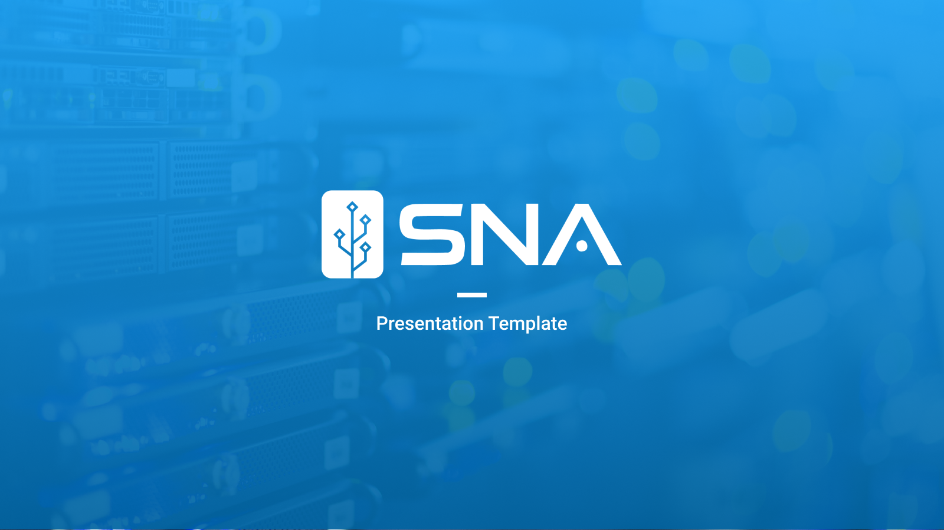
Treemap
Presentor: Truong Ho

Slide 2

Content
01
02
03
04
05
06
07
What is TDD?
How to perform TDD Test
Why test?
Different kinds of test
Tools for testing
What to test?
What not to test?

Slide 3
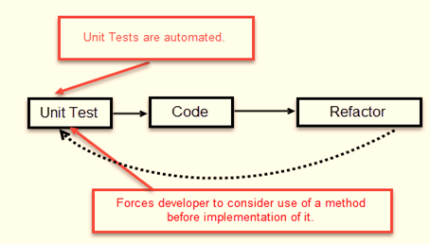
01 - What is TDD(Test Driven Development)?
Write test before writing code
Test fail before code is written

Slide 4
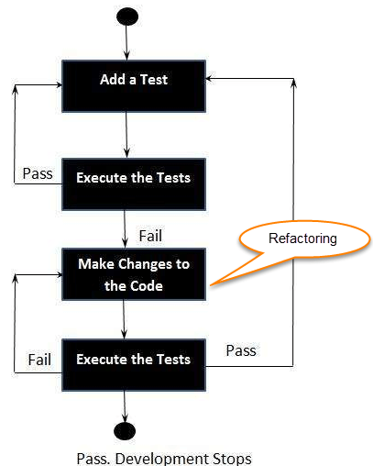
02 – How to perform TDD Test?

Slide 5
02 – Why test?
Get a error if you break code
Save Time
Think about possible
issues & bugs
Integrate into build workflow
Break up complex
dependencies
Improve your code

Slide 6
03 – Different kinds of test
Frequency
Unit Test
Integration Tests
End to End (E2E) Test
Complexity

Slide 7
04 – Tool for testing
Test Runner
Assertion Library
Headless Browser
Unit + Integration
Unit + Integration
e2e
Execute your tests, summarize results
Define testing logic, conditions, expectations
Simulates browser
interaction
Jest
Puppeteer

Slide 8
05 – What to test?
Test render logic
It must render – component render without error
Test the output – render the correct thing
Test the states/props
Test the events
Test redux
Actions
Action Creators is correct
Reducers
Initial state is correct
When state change return expected result

Slide 9
05 – What not to test?
Third party libraries
Do not test implementation details such as names of functions and variables

