Slide 1

Treemap
Presentor: Truong Ho

Slide 2

Content
01
02
Introduction
Implement with d3

Slide 3

01
What is Treemap?
Why do we need Treemap?
Treemaps’ Downsides
Introduction

Slide 4
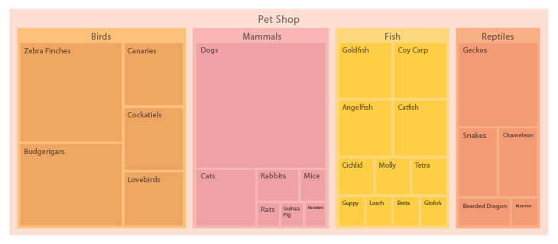
01 - What is Treemap?
Treemaps are an alternative way of visualising the hierarchical structure of a Tree Diagram while also displaying quantities for each category via area size. Each category is assigned a rectangle area with their subcategory rectangles nested inside of it.

Slide 5
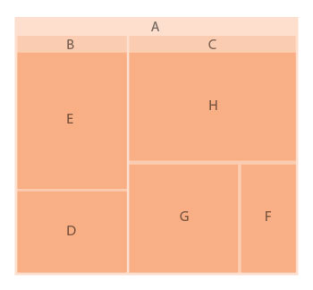
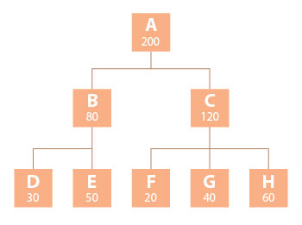
01 – Why do we need Treemap?
Save space on screen
Quick overview of the structure

