Slide 1
Hacking Homelessness
Homeless Fund

Slide 2
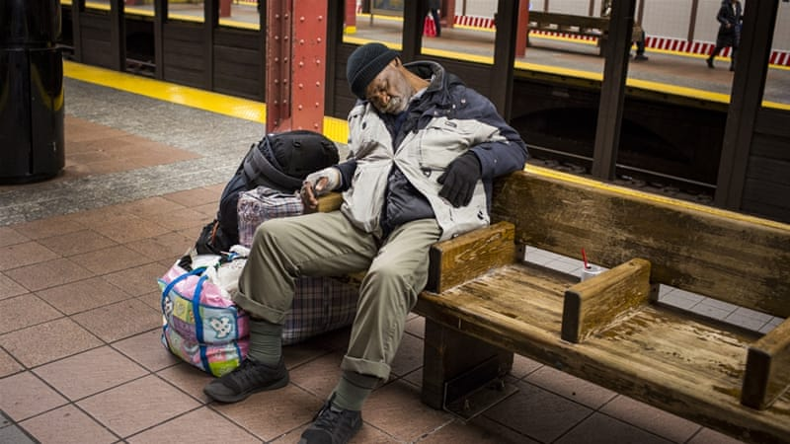
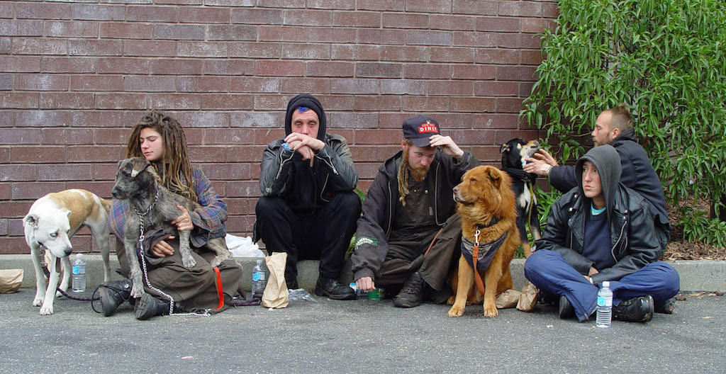
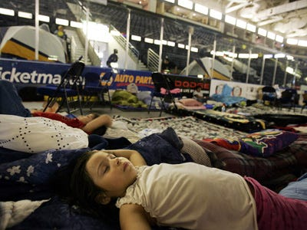
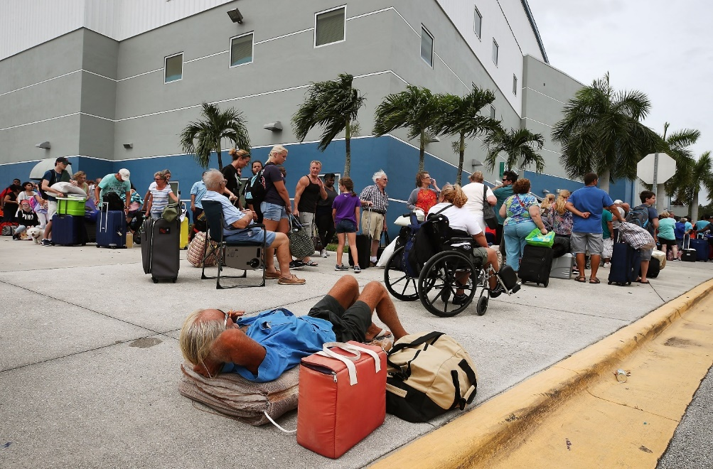
Facts
150 million
2% of the world population
1,6 billion people run the risk of living without permanent housing
30%
San Francisco population is homeless
91.000 in New York and more than 31.000 in Florida

Slide 3

Why are they homeless?
Reasons for homelessness include shortages of affordable housing, privatization of civic services, investment speculation in housing, unplanned and rapid urbanization, as well as poverty, unemployment, and family breakdown.
Increasing living costs and other expense when buying/ renting houses lead lots of people become unable to afford a permanent shelter.
Low education, unemployment, illnesses, disasters also make them change their shelters
Children below the working age, immigrants who are not assigned support from the government budget
Ex-prisoners who are released back to the society, the addicts
Let us do our bit for a sustainable tomorrow

Slide 4
Help the homeless better access basic daily human necessities
Distribution places are usually confined to certain places
The cons of traditional fund
Accessible to a few certain areas
Insecurity, unfairness in distribution may affect the distribution process
Inflation that makes the government budget go to waste
Every person needs food, water, personal commodities, clothes for daily survival. It will be unimaginable awful if those necessities are provided only once per week. Provision of such necessities should instead take place everyday until they can reach a better condition.
The distribution takes place under the risk of violence and insecurity. The homeless have to wait in queues and some jump the queues struggling for the food.
Why not let them use the donated money to directly make the purchase themselves?

Slide 5
Scope of action
Urban zones with high density of stores, supermarkets.
Solutions are not limited to the organizations in the US. Anywhere that makes sure preconditions are satisfied is enough.
The homeless who are considered in shortage of shelter and food by the government/ certain organizations.
Non-profit organizations that need an application for managing, making donations for the homeless
Preconditions
Technology transfer location
Target
Operational unit

Slide 6
The technology solution
Offer support in accessing daily necessities
Donator
Homeless
Government
Store
Develop a system which is publicized so that anyone can track the data if they want to.
Find the right solution for the homeless and maintain with low operation costs
Make more profits from large number of homeless people purchasing necessities
When payment is activated, the money is automatically transferred from the fund right into the store manager accounts.
Can easily make donation
Can know for sure that the money is used for the right purpose
Can easily follow the activities related to the fund resources
Purchase necessities daily with the fund money from anywhere in the country
Treated in fairness

Slide 7
Operation
Distributes resources for the homeless
Homeless Fund
The homeless can make direct purchase at stores etc
Let us do our bit for a sustainable tomorrow, where millions no longer have to live without the basic necessities of life such as food, clothing, and shelter. We hope to develop an honest and open relationship with the public
The homeless can obtain the necessities for daily survival
Stores can make more profits
The purpose is one that is exclusively, and unambiguously, charitable
Donator, government budget

Slide 8
The technologies applied in the application
A
Block chain : activities taken place on the blockchain network are all clear, safe from any attempts to change and ensure low operation costs
B
Technologies
Smart contract: Automatically executes the transactions without the need for a trusted third party to hold the money and sign off on the transaction
C
Website: all activities will take place online so that everyone can follow to make donation, take part in auctions. They are all held by the government and trustable organizations
D
App : support the homeless in payments at stores

Slide 9
Main function
Organization/ Government | Make lists of the target homeless for the donation fund | Web
 | Set up fund-raising campaigns | Web
 | Set up auction for fund-raising | Web
 | Distribute the fund resources to the homeless | Smart contract (block chain)
 | Update the homeless purchasing proof to the public (the internet) | Block chain
 | Update auctions activities information to the public (the internet) | Block chain
Donator / User | Donate for homeless fund | Block chain
 | Make bids in auction, send money for the homeless fund after the auction | Smart contract (block chain)
 | Check homeless fund’s activities | Web
The homeless | Make payment for the necessities purchased at convenience stores etc within the fund’s (daily) limit | App / Card
For the time being, some are just mock functions to support such main functions as donating, auction and fund distribution

Slide 10
THANK YOU

