Slide 1
infoERP
PIMS DASHBOARD
PIMS Dashboard – User Guide
For Dashboard Viewer & Data Manager
October 2026

Slide 2
Introduction – PIMS Dashboard
Purpose: This guide walks through the PIMS Management Dashboard end to end — the public-facing views any visitor can browse, and the Data Entry screens used to feed each report.
Audience: Executives and stakeholders who monitor company and site performance, and Site Managers / Data Managers who maintain monthly progress, revenue, cost, outsourcing and cash-flow data.
Scope: Main Dashboard (company-wide KPIs) → Construction Project Dashboard → Service Project Dashboard → Data Entry for Construction sites → Data Entry for Service sites.
Access: The Main Dashboard and project dashboards are read-only and require no login. Data Entry screens are accessed per site via the left-hand site tree, after logging in with a Data Manager account.
Navigation: Use the left panel to pick a site (Construction / Service / TCC / DE HEIM). Use Exchange Rate (USD / KRW / VND) and Unit (USD / K USD) at the top of every screen to change the display currency.
infoERP
PIMS Dashboard

Slide 3
1
Dashboard Viewer - Main Dashboard

Slide 4
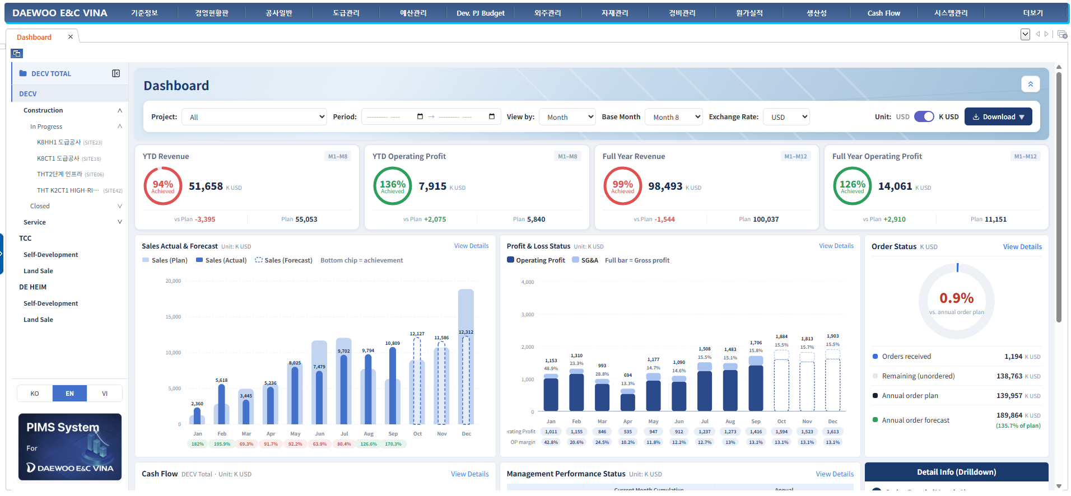
Main Dashboard: Filters & Summary KPIs
Description
1
2
Settings:
Select Project, Period / Base Month, View by (Month), Exchange Rate and Unit (USD or K USD to refresh all cards and charts.
Download: export the current dashboard.
3 KPI Summary:
YTD Revenue, YTD Operating Profit (both Month 1 – Base Month)
Full Year Revenue and Full Year Operating Profit (Month 1 – 12)
Source: Imported Excel Data
3
infoERP
infoERP
PIMS Dashboard

Slide 5
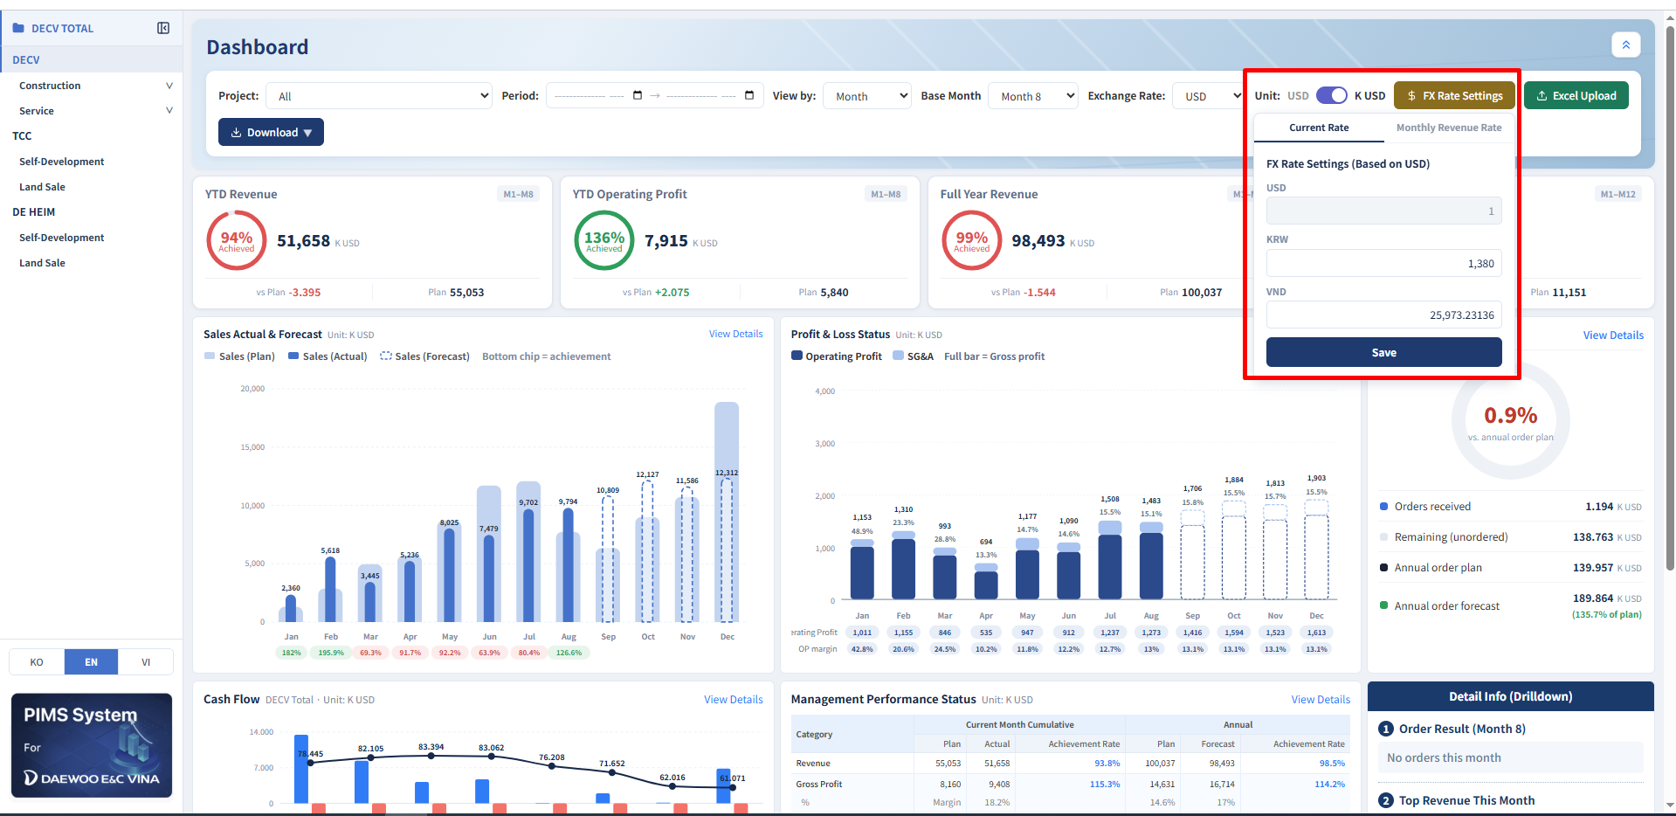
Main Dashboard: FX Rate Settings – Current Rate
Description
1
1. FX Rate Settings
Open the Current Rate panel to set exchange rates for dashboard conversion.
2. Set Exchange Rates
Enter KRW & VND rates per 1 USD → click Save to apply across the dashboard.
2
infoERP
PIMS Dashboard

Slide 6
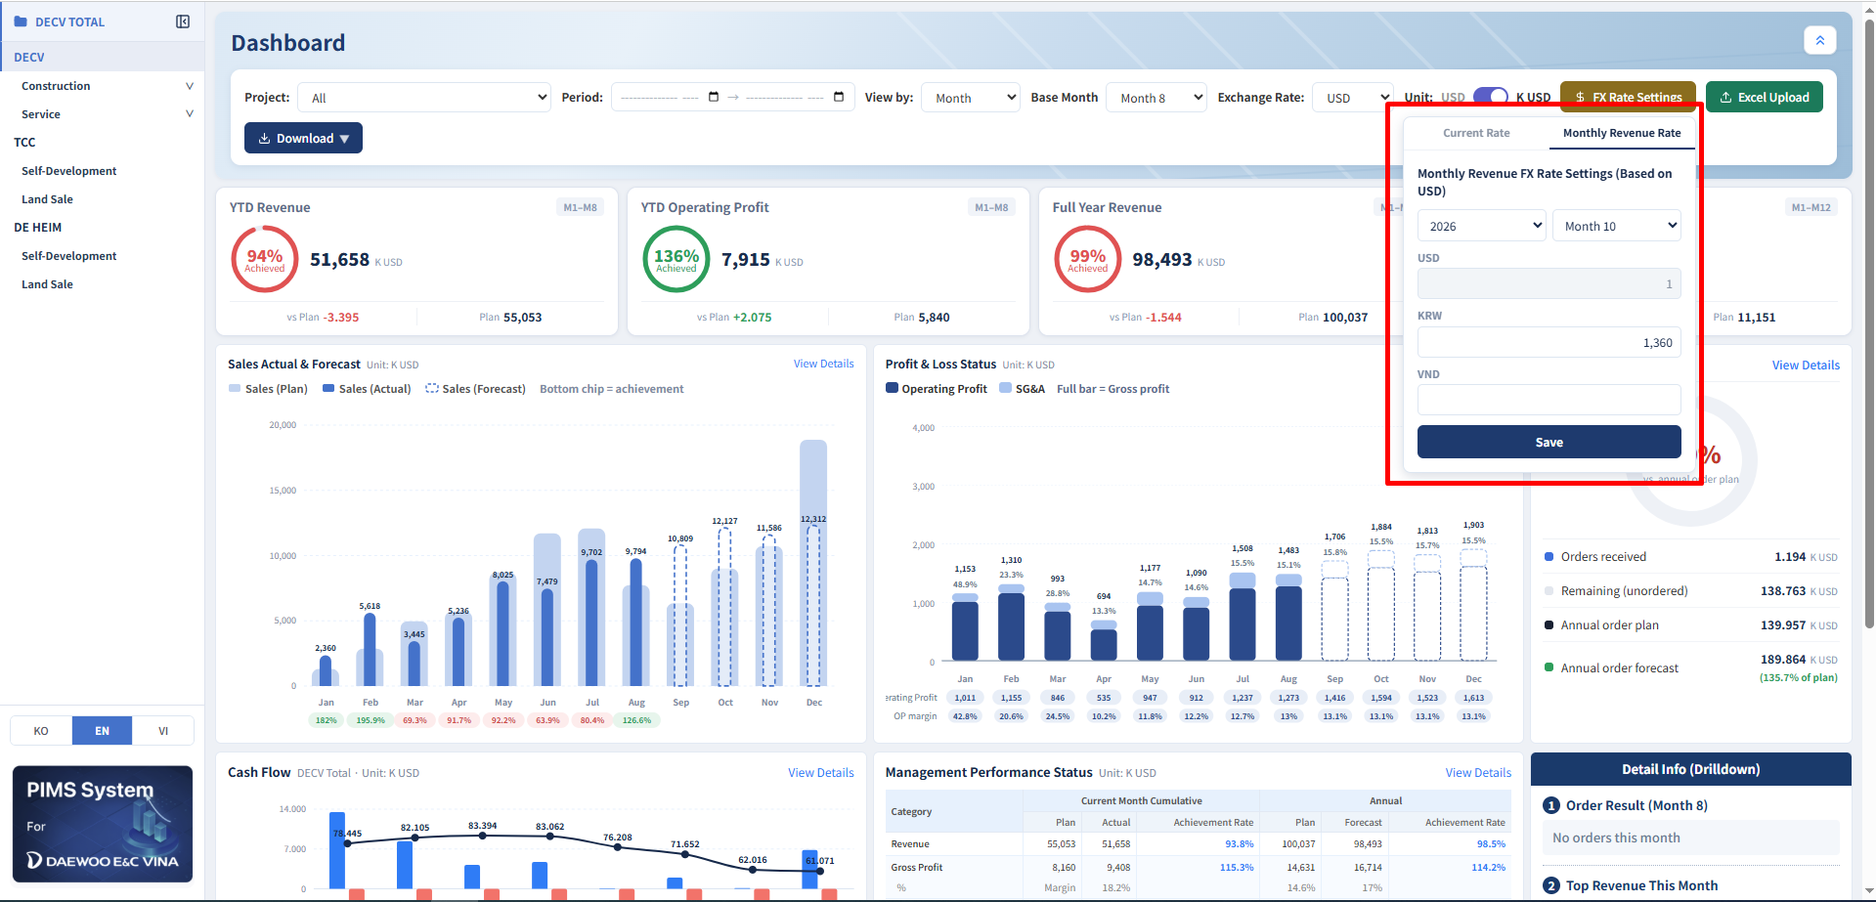
Main Dashboard: FX Rate Settings – Monthly Revenue Rate
Description
1
1. Monthly Revenue Rate
Set a specific KRW / VND exchange rate by Year & Month for monthly revenue conversion.
2. Set Monthly Rate
Select Year / Month → enter KRW & VND rates → Save.
The dashboard uses the monthly rate when defined.
2
infoERP
PIMS Dashboard

Slide 7
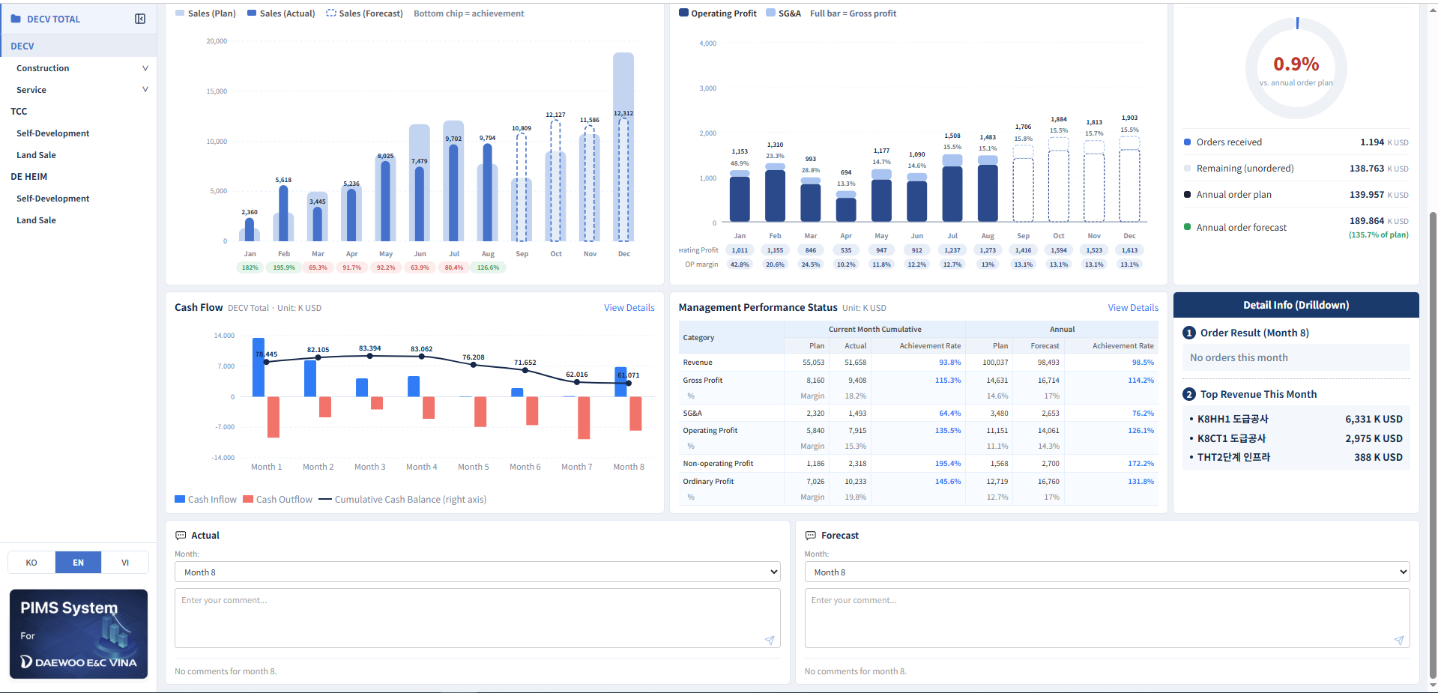
Main Dashboard: Charts & Drilldown
Description
1
2
3
Sales Actual & Forecast
Sales (Plan), Sales (Actual) and Sales (Forecast): Imported Excel Data.
Achievement % = Plan ÷ Actual/Forecast
View Details for the monthly breakdown.
Profit & Loss Status:
Operating Profit + SG&A: Imported Excel Data.
stacked as Gross Profit per month, with OP margin % below.
View Details for the monthly breakdown.
Order Status:
Orders received vs. Annual plan/forecast.
Orders received (Cumulative), Annual plan/forecast: Imported Excel Data
4 Cash Flow:
Cash In/Out, Cumulative Balance: Data Entry → 8. Monthly Cash Flow.
View Details for the monthly breakdown.
4
infoERP
PIMS Dashboard

Slide 8
Main Dashboard: Charts & Drilldown
Description
Management Performance Status
Source: Data Entry → 2. Monthly Revenue → Cost Plan/Actual and Budget Execution Status
View Details for the monthly breakdown.
Detail Info (Drilldown):
Displays this month’s Order Result and Top Revenue sites. Actual / Forecast comment boxes record monthly notes.
1
2
infoERP
PIMS Dashboard

Slide 9
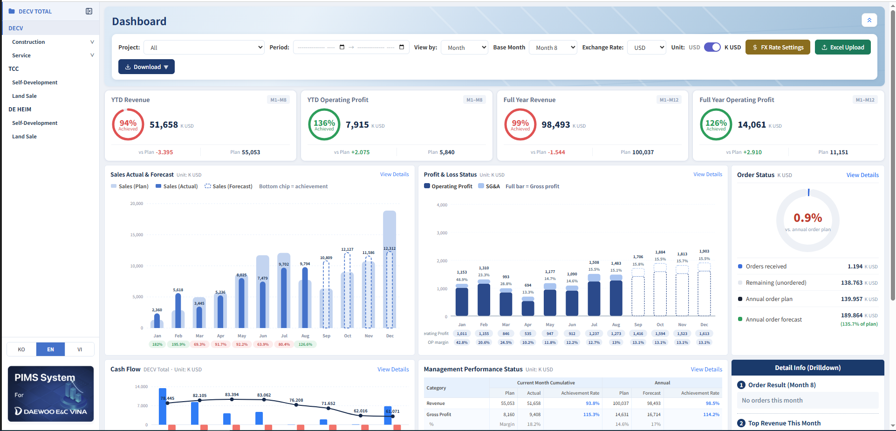
Construction Dashboard & Service Dashboard
Description
1
2
1 Construction & Service Dashboard
Displays the Main Dashboard KPI/chart layout filtered by Construction or Service sites. Select the group header in the left tree, not an individual site.
2 Compare Construction-only or Service-only performance before drilling into a site. Filters (Project, Period, Exchange Rate, Unit) work as on the Main Dashboard.
infoERP
PIMS Dashboard

Slide 10
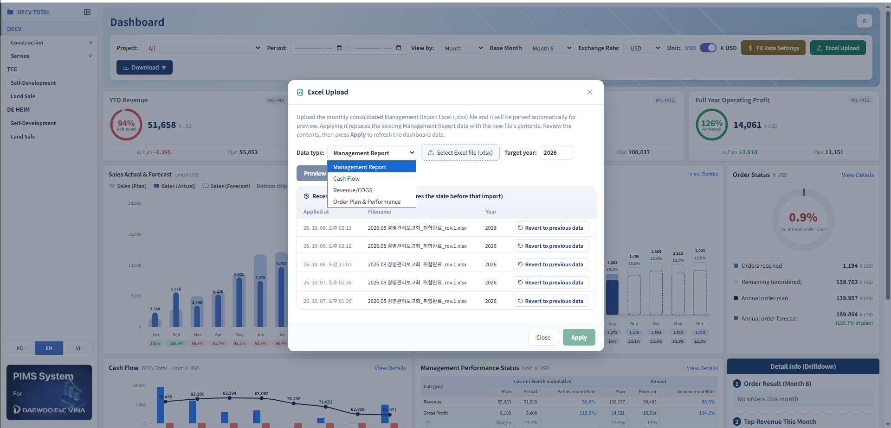
Main Dashboard: Excel Upload
Description
1 Click Excel Upload, pick Data type (Management Report, Cash Flow, Revenue/COGS or Order Plan & Performance), Target year, then select the .xlsx file.
2 File is auto-parsed for Preview; click Apply to refresh the dashboard with the new data.
3 Recent Uploads lists prior imports (time, filename); Revert to previous data rolls back to before that import.
1
2
3
infoERP
PIMS Dashboard

Slide 11
2
Dashboard Viewer - Project Dashboard - Construction

Slide 12
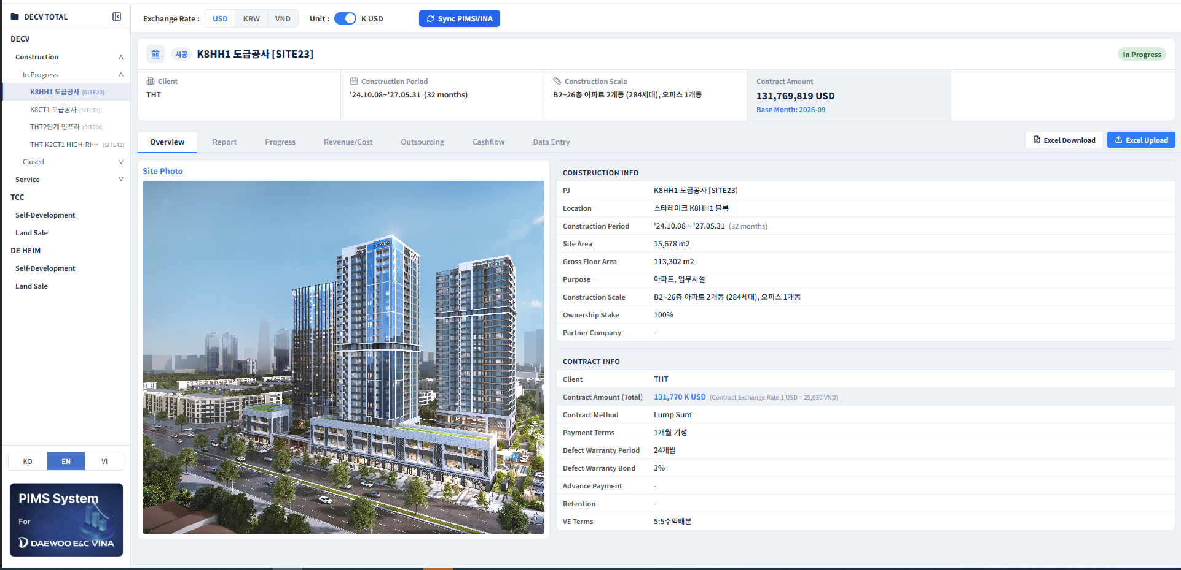
Overview
2
5
1
Description
1 Select a construction site in the left tree to view its dashboard. Header shows Client, Construction Period, Construction Scale, Contract Amount and Status.
2 Exchange Rate (USD/KRW/VND) and Unit (USD/K USD): apply across Overview, Report, Progress, Revenue/Cost, Outsourcing, Cashflow and Data Entry.
Site Photo & Construction Info :
- Site Photo: PIMSVINA Sync
Construction Info: Data Entry → 0. Overview
Contract Info: Data Entry → 0. Overview
Sync PIMSVINA refreshes project data from the source system.
3
4
infoERP
PIMS Dashboard

Slide 13
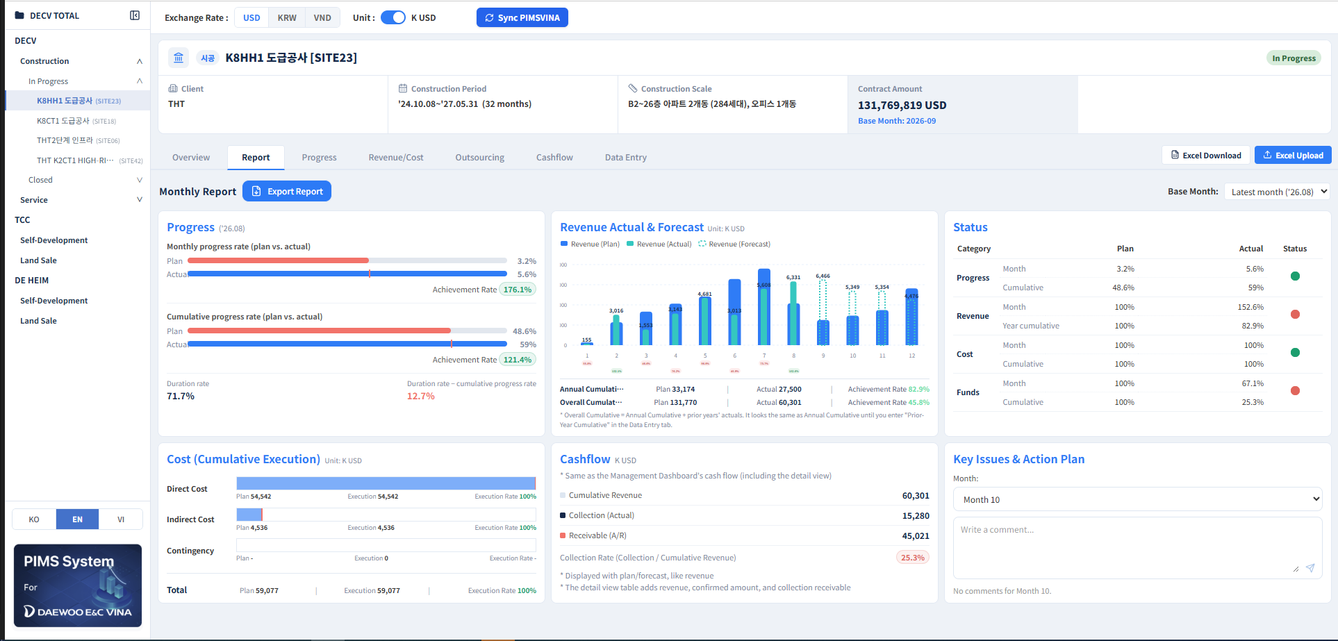
Report
Description
1 Report tab: monthly executive summary. Pick Base Month, click Export Report for a shareable file.
Progress:
Monthly/Cumulative Progress: Data Entry → 1. Monthly Progress.
Rate = Actual ÷ Plan * 100%
Duration rate = elapsed time ÷ total period, plus gap vs. cumulative progress.
Revenue Actual & Forecast:
Monthly Revenue (Plan/Actual/Forecast): Data Entry → 2. Monthly Revenue → Plan, Actual, Forecast
Annual Accumulative: Accumulated revenue from January to the current month
Overall Accumulative: Accumulated revenue from project inception to the current month.
1
2
3
infoERP
PIMS Dashboard

Slide 14
Report
Description
1 Status: traffic-lights Progress/Revenue/Cost (month & year). Cost (Cumulative Execution): Direct, Indirect, Contingency.
Progress: Data Entry → 1. Monthly Progress
Revenue:
Cost: Get the Execution rate data from the Cost tab below.
Cashflow:
The traffic light indicator displays the status of the items; hovering the mouse over it reveals the reason.
Cost (cumulative Execution):
- Source: Data Entry → 6. Budget Execution Status
- Execution rate = Execution ÷ Plan * 100%.
Cashflow:
Cumulative Revenue = Actual Overall Cumulative
Collection (Actual):
Receivable
1
2
3
infoERP
PIMS Dashboard

Slide 15
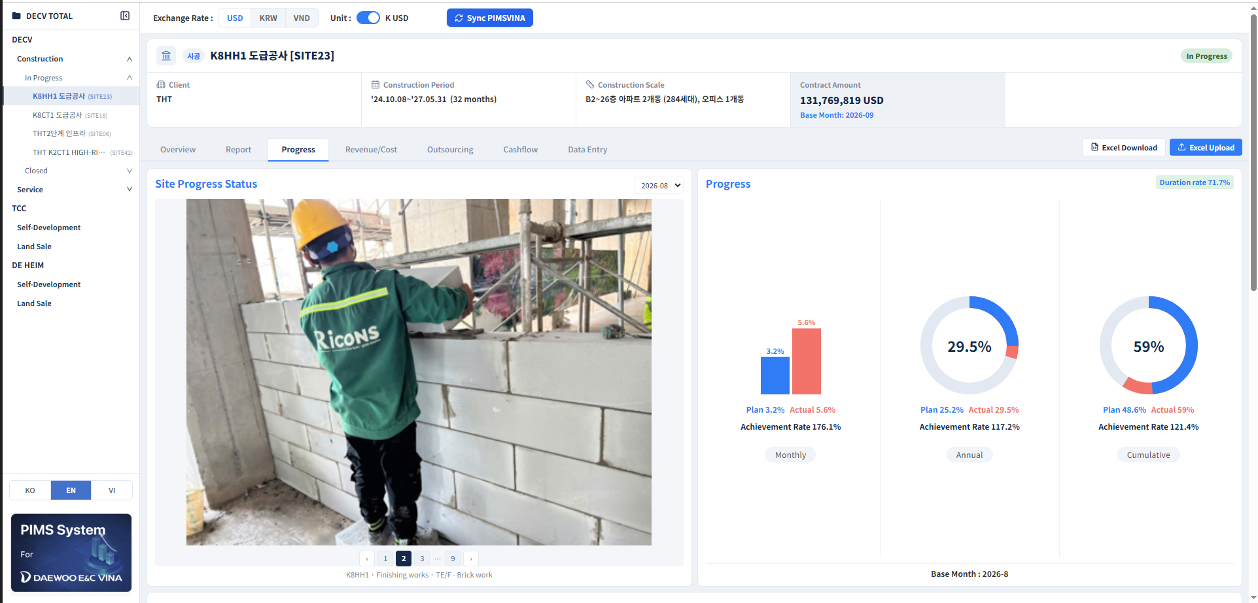
Progress
Description
Site Progress Status
Displays monthly photos synced from PIMSVINA, with pagination to view multiple photos for the selected month.
2. Progress
- Donuts Three donuts show Monthly, Annual and Cumulative Progress, each comparing Plan vs. Actual with Achievement Rate. - - Source: Data Entry → 1. Monthly Progress.
1
2
infoERP
PIMS Dashboard

Slide 16
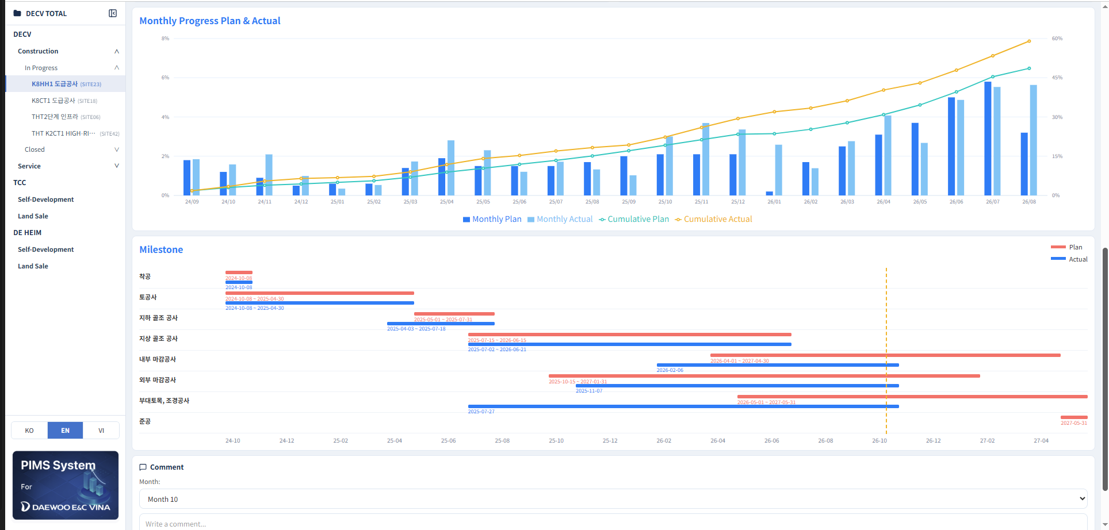
Progress: Monthly Trend & Milestones
Description
1
Monthly Progress Plan & Actual:
Monthly Plan/Actual as bars, Cumulative Plan/Actual as lines, across the full period.
Source: Data Entry → 1. Monthly Progress.
Milestone:
Displays each phase’s Plan/Actual date ranges on a timeline, with a vertical marker for the current reference month.
Source: Data Entry → 3. Milestone
3 Comment (filtered by month): progress notes for the period.
2
3
infoERP
PIMS Dashboard

Slide 17
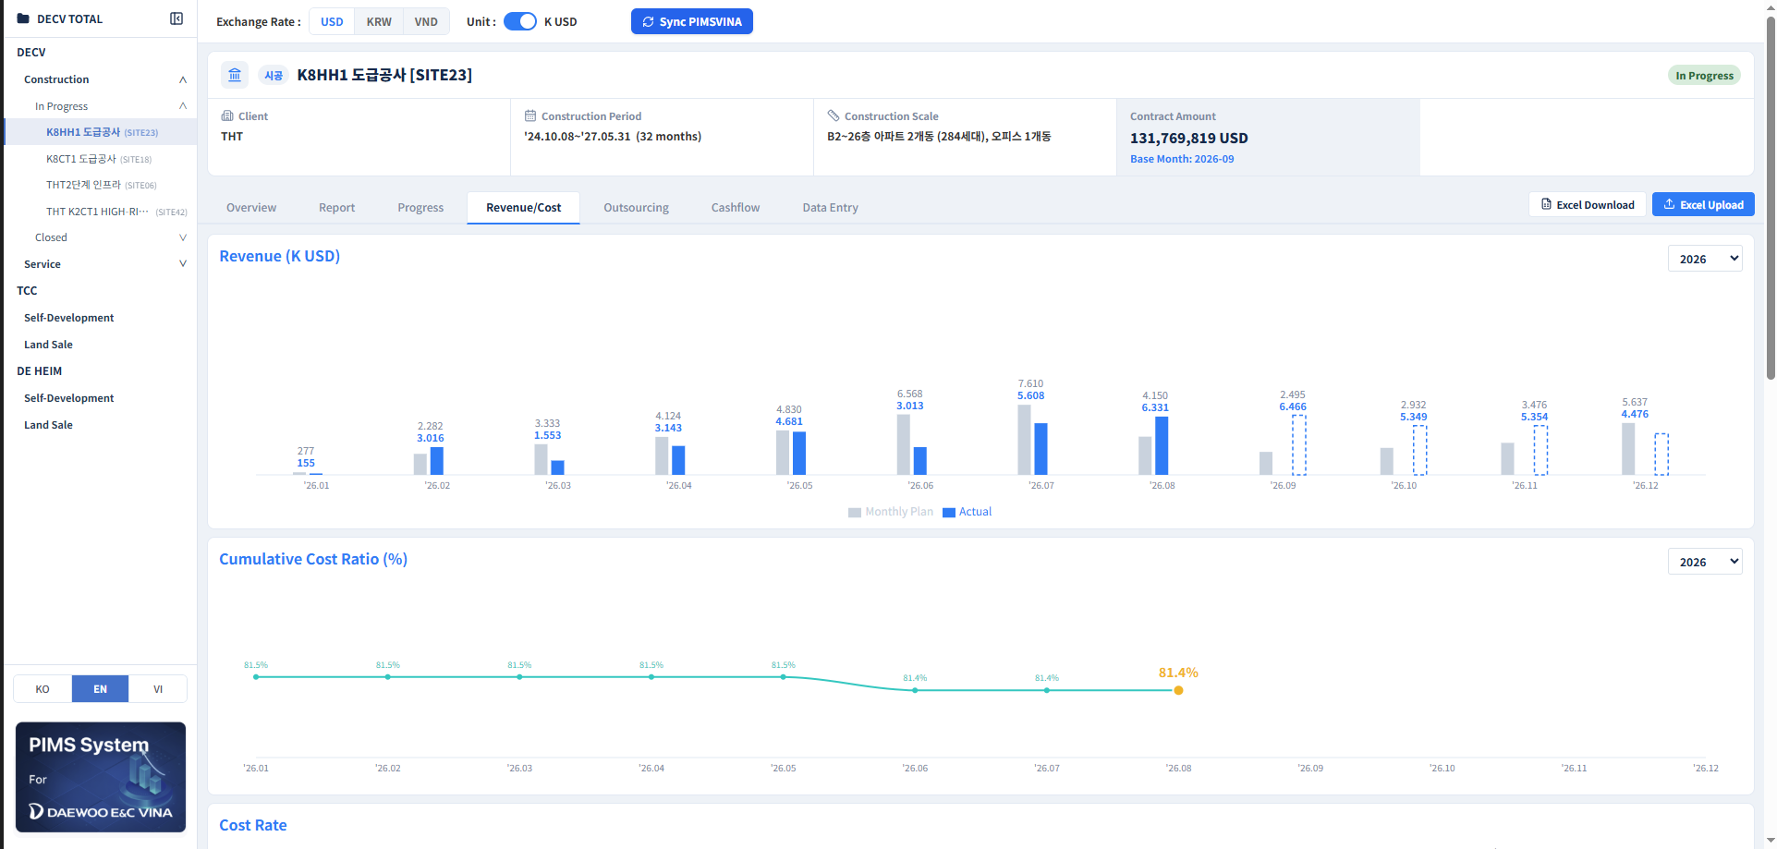
Revenue/Cost
Description
Revenue (K USD):
Shows monthly Plan vs. Actual for the selected year. Dashed bars indicate forecast months not yet closed.
Source: Data Entry → 2. Monthly Revenue → Plan, Actual, Forecast
Cumulative Cost Ratio (%)
Shows the cost-to-revenue trend across the year, with the latest value highlighted
Source: Data Entry → 5. Cost Rate → Estimated Completion Cost Rate → Ratio
3 Year selector on each chart switches fiscal year.
1
3
2
infoERP
PIMS Dashboard

Slide 18
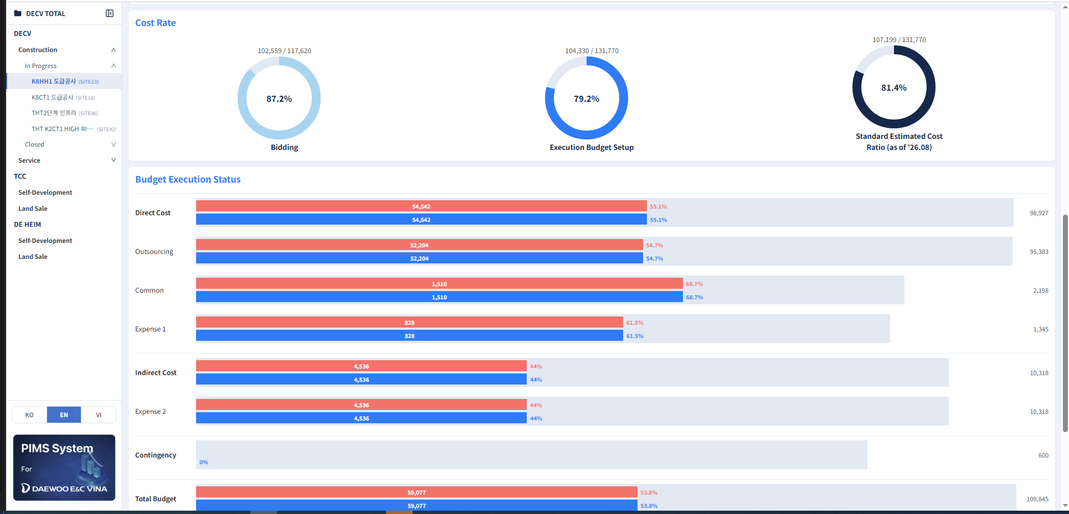
Revenue/Cost: Cost Rate & Budget Execution
1
Description
Cost Rate:
Bidding: Data Entry → 2. Monthly Revenue → Bidding
Execution Budget Setup: Data Entry → 2. Monthly Revenue → Execution Budget Setup
Standard Estimated Cost Ratio = Cost ÷ Contract Amount, figures below.
Budget Execution Status:
Shows total budget by category (Direct Cost, Outsourcing, Common, Expense 1, Indirect Cost, Expense 2 and Contingency), with an Exec. Plan vs. Actual bar showing Exec. Rate and the remaining amount for each category.
Source: Data Entry → 6. Budget Execution Status
2
infoERP
PIMS Dashboard

Slide 19
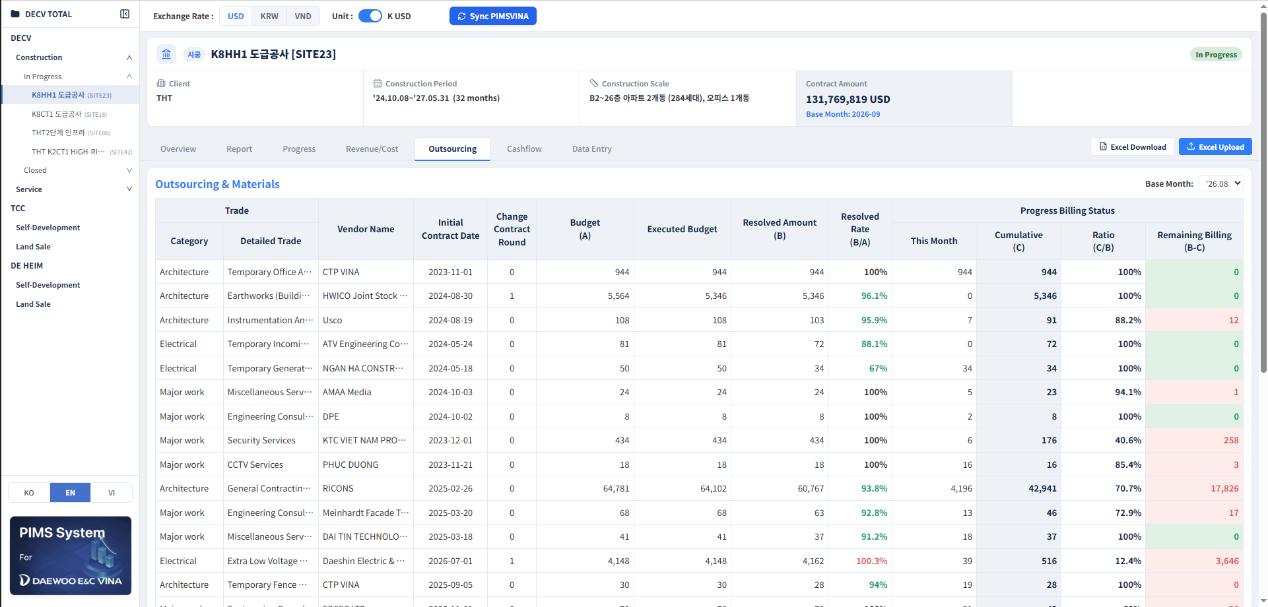
Outsourcing
Description
Outsourcing & Materials
1 Lists each subcontract/material order with Trade (Category/Detailed Trade), Vendor Name, Initial Contract Date and Change Contract Round.
Source: Data Entry → 7. Outsourcing/Materials
Budget (A), Executed Budget, Resolved Amount (B):
Source: Data Entry → 7. Outsourcing/Materials
Resolved Rate = B/A, over 100% flagged red.
Progress Billing Status:
This Month, Cumulative (C): Data Entry → 7. Outsourcing/ Materials
Ratio = C/B, Remaining Billing = B−C per vendor
Base month selectable top right.
1
2
3
infoERP
PIMS Dashboard

Slide 20
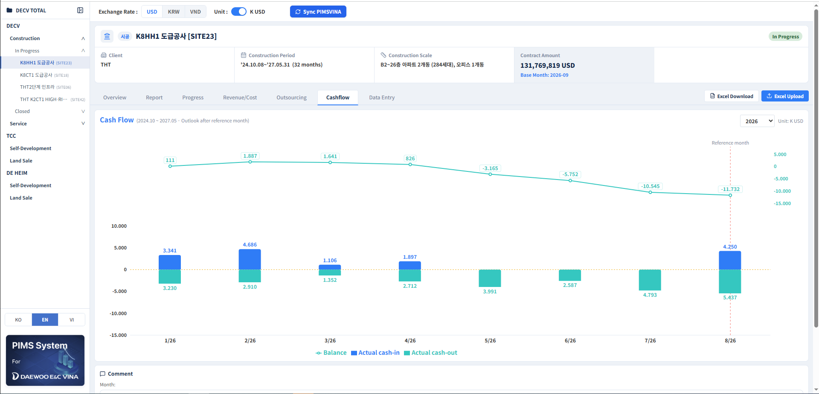
Cashflow
Description
Cash Flow:
Shows actual cash-in/out as bars and the running Balance as a line across the full period. A dashed Reference Month marker separates actuals from outlook.
Source: Data Entry → 8. Monthly Cash Flow.
2 Year selector (top right) focuses on one year; hover for exact monthly figures.
1
2
infoERP
PIMS Dashboard

Slide 21
3
Data Manager – Main Dashboard

Slide 22
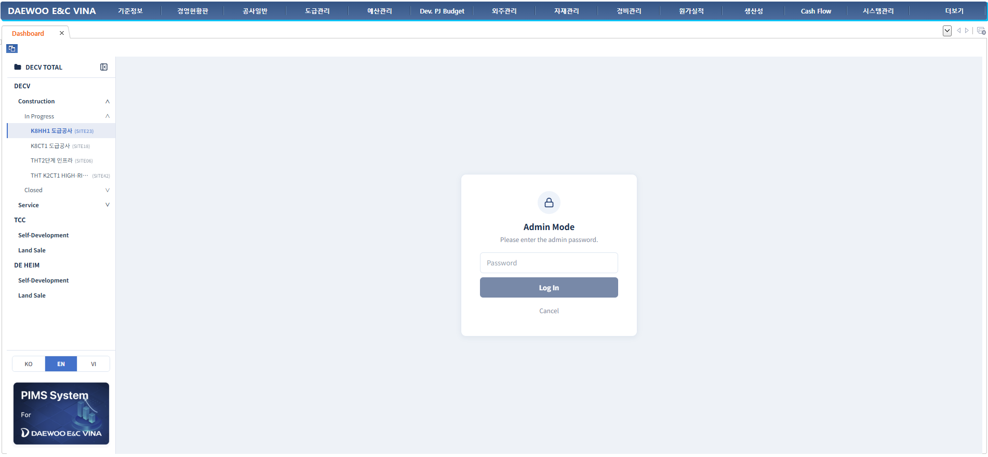
Login & Data Manager Access
Description
1 Login:
Requires a Data Manager/Site Manager account; log in to PIMS to unlock the site tree and Data Entry tab.
1
infoERP
PIMS Dashboard

Slide 23
Main Dashboard: Filters & Summary KPIs
Description
1
4
2
3
5
Settings:
Select Project, Period / Base Month, View by (Month), Exchange Rate and Unit (USD or K USD to refresh all cards and charts.
2 Excel Upload: import a new monthly report.
3 Download: export the current dashboard.
4 FX Rate Settings: review or edit the exchange rates used for conversion.
5 KPI Summary:
YTD Revenue, YTD Operating Profit (both Month 1 – Base Month)
Full Year Revenue and Full Year Operating Profit (Month 1 – 12)
Source: Imported Excel Data
infoERP
infoERP
PIMS Dashboard

Slide 24
4
Data Manager – Data Entry – Construction

Slide 25
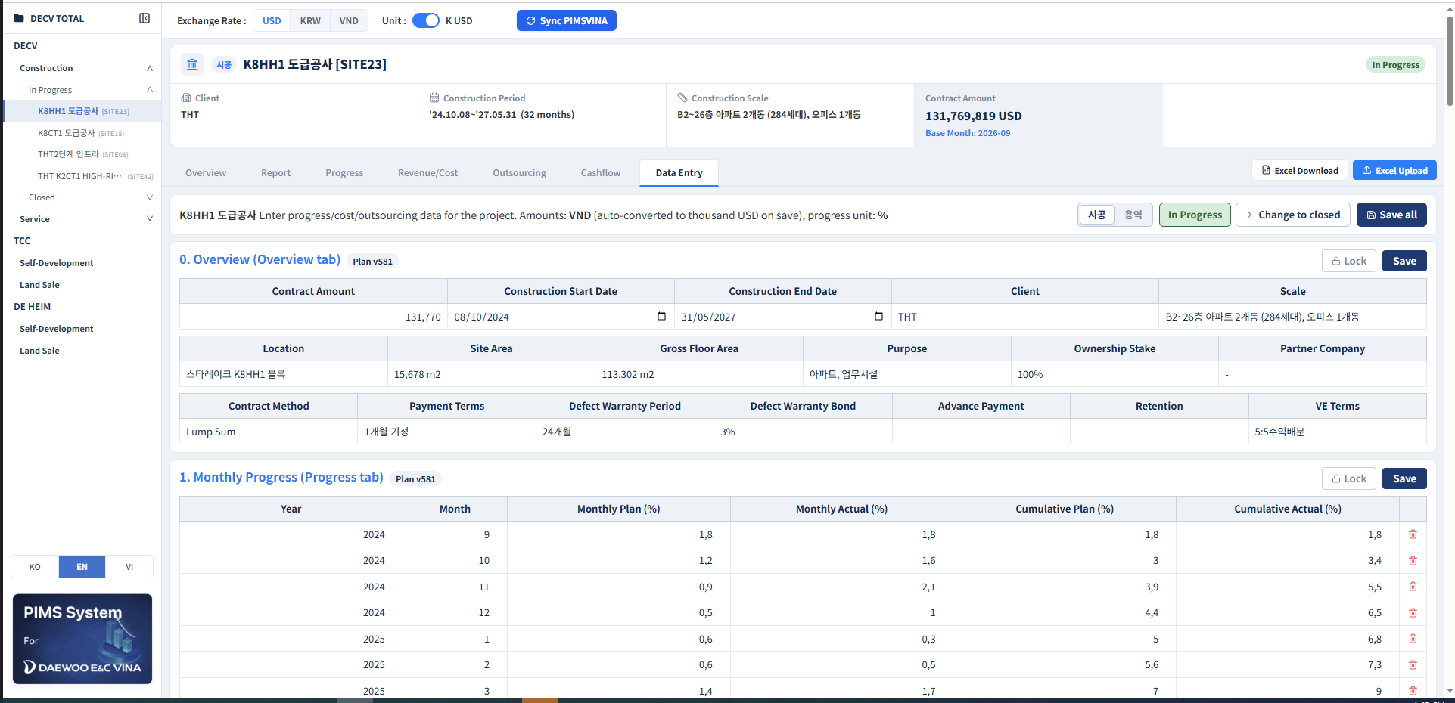
Data Entry: Overview & Monthly Progress
Description
Scope selection: Pick the site from the left tree, then choose 시공 (Construction) or 용역 (Service) to switch Data Entry cards shown.
Status control: In Progress / Change to closed control marks a finished site closed, moving it between the In Progress/Closed lists in the tree.
Save behavior: Each card has its own Save, plus Save all at top; Lock toggle freezes a card once its plan is finalized.
1
2
3
infoERP
PIMS Dashboard

Slide 26
Data Entry: Overview & Monthly Progress
Description
1 0. Overview (Overview tab):
Contract Amount, Construction Start/End Date: PIMVINA Sync
Source: Common > Construction Overview > Register Construction Overview > Tab Construction Period > Contract Amount, Actual Start Date - Actual Final Completion / Expected Final Completion Date
Remaining fields: Manual entry
2 1. Monthly Progress (Progress tab):
Monthly Plan (%): Manual entry
Monthly Actual (%) = (1(each month)/(2-3))*100%
Source: 1. Sum total column input By Month(1-12)
2. Sum column Execution Budget > Amount
3. Request Execution Resolution(Site) sum column Execution Budget minus sum column Implementation
Cumulative Plan (%), Cumulative Actual (%): cumulative calculation by month
3 Each card shows its source Plan version and a Lock toggle once finalized.
1
3
2
infoERP
PIMS Dashboard

Slide 27
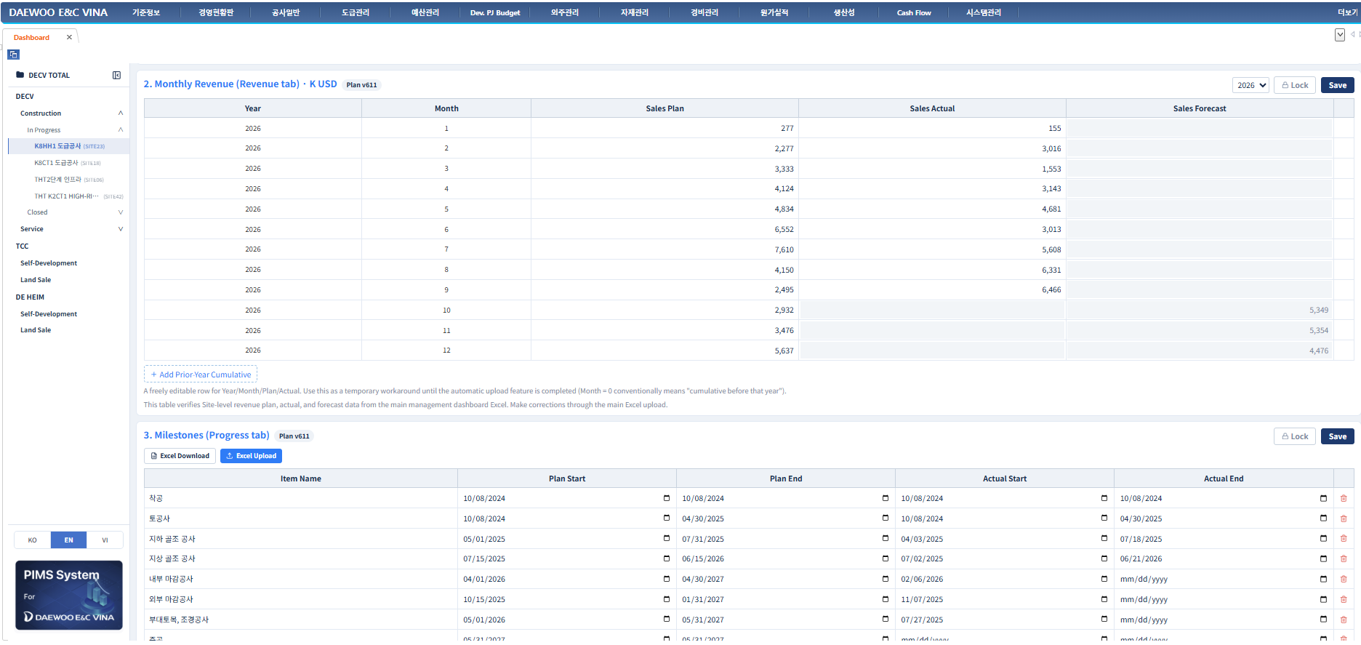
Data Entry: Monthly Revenue & Milestones
Description
1
2. Monthly Revenue (Revenue tab, K USD):
Sales Plan and Actual/Forecast by Year/Month: Imported Excel Data
Add Prior-Year Cumulative adds a free row for cumulative revenue before the current year (Month = 0).
2 Source for the Report tab’s Revenue Actual & Forecast chart; corrections go through Excel upload, not here.
3. Milestones (Progress tab):
Plan/Actual Start/End dates per item
Source: Manual Entry
Excel Download/Upload for bulk edit,
Add: Add milestone.
2
3
infoERP
PIMS Dashboard

Slide 28
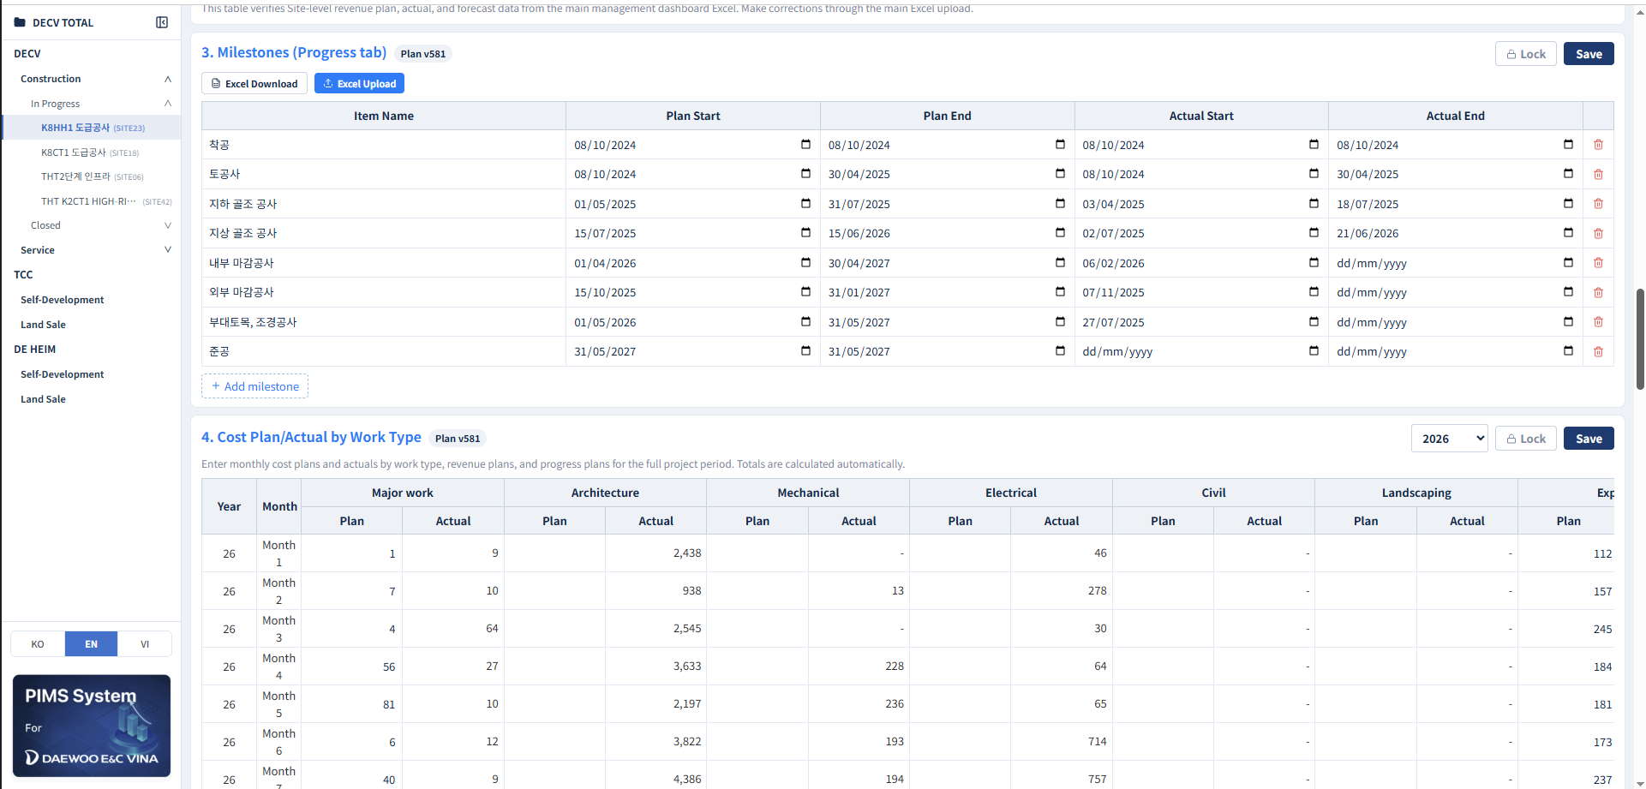
Data Entry: Cost Plan/Actual by Work Type
Description
4. Cost Plan/Actual by Work Type:
Monthly Plan/Actual cost per work type (Major work, Architecture, Mechanical, Electrical, Civil, Landscaping, Expense 1/2, etc.) for the selected year.
Source: derived from 7: Outsourcing/Materials (Outsourcing tab), based on the Trade Group category.
2 Totals roll up into Report and Revenue/Cost cost figures; year selector (top right) switches fiscal years.
1
2
infoERP
PIMS Dashboard

Slide 29
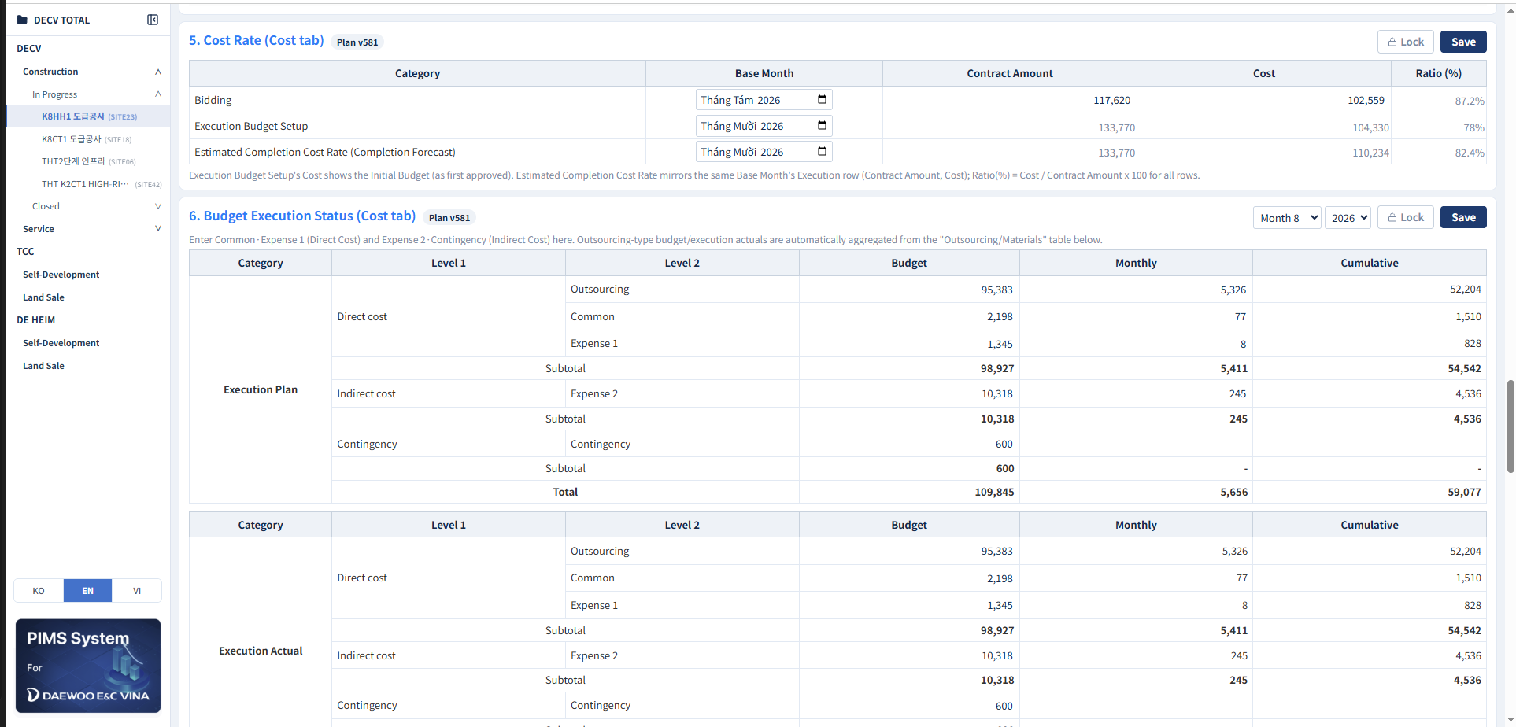
Data Entry: Cost Rate & Budget Execution Status
Description
1
5. Cost Rate (Cost tab):
Bidding: Manual Entry
Execution Budget Setup, Estimated Completion Cost Rate:
Source: Cost > Settlement ratio cost > Settlement Cost Ratio > Row in column month > Business Budget, Contract Amount, Gross Profit Ratio
Ratio (%) = Cost ÷ Contract Amount.
6. Budget Execution Status (Cost tab):
Execution Plan:
Budget: PIMSVINA - Cost > Cost Performance > Cost Input Status by Execution Details > Budget
Monthly: Manual Entry
Execution Actual:
Budget: PIMSVINA - Cost > Cost Performance > Cost Input Status by Execution Details > Budget
Monthly: PIMSVINA - Cost > Cost Performance > Cost Input Status by Execution Details
-Row Direct Cost > Common Work, Expense I, Outsoucre (data not in Common Work, Expense I)
- Row Indirect Cost > Expense II- Row Contingency > Contingency
2
infoERP
PIMS Dashboard

Slide 30
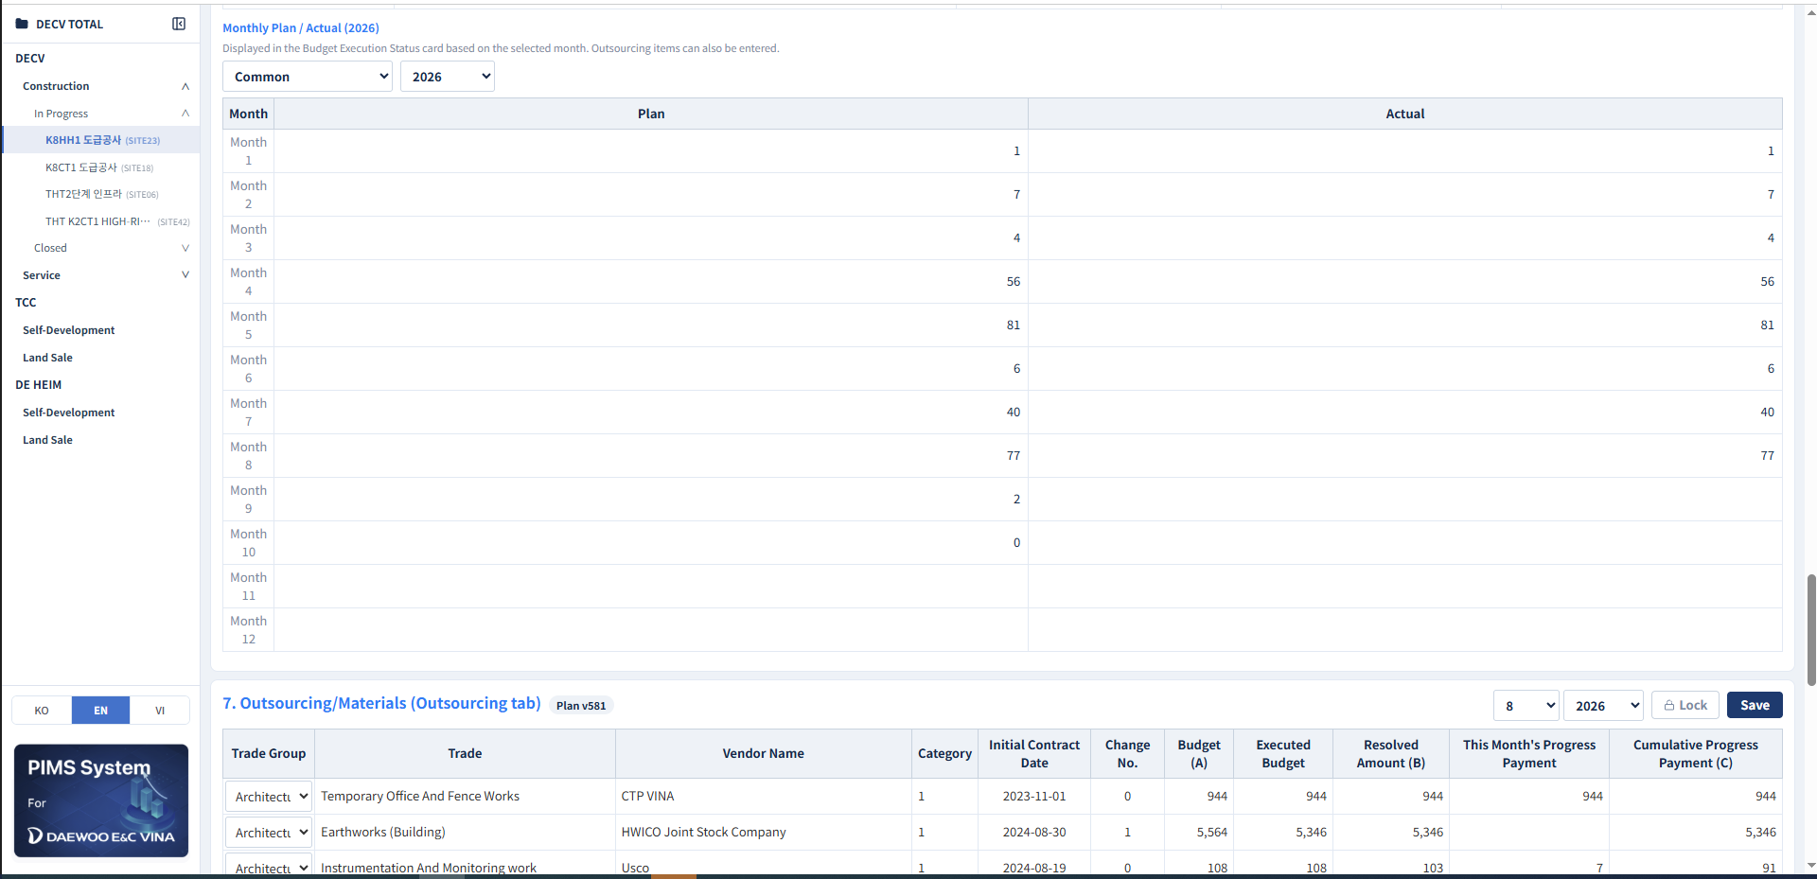
Data Entry: Monthly Plan/Actual & Outsourcing
Description
1
Monthly Plan/Actual (year):
- Data sourced from 6: Budget Execution Status (Cost tab), based on the filter.
7. Outsourcing/Materials (Outsourcing tab):
Budget (A), Executed Budget, Resolved Amount (B):
Sub-Contracting > Request Execution Resolution (Site) > Request Execution Resolution(Site) > Execution Budget, Operational Budget, Implementation Amount
This Month's Progress Payment, Cumulative Progress Payment (C)):
Sub-Contracting > Implementation Progress Payment(Site) > Interim Payment Status
Tab This Month column 당월기성금액 (B)
Tab All column Progress Payment > Amount (B)
3 Select Month/Year (top right) before entering progress payments, then Save.
2
3
infoERP
PIMS Dashboard

Slide 31
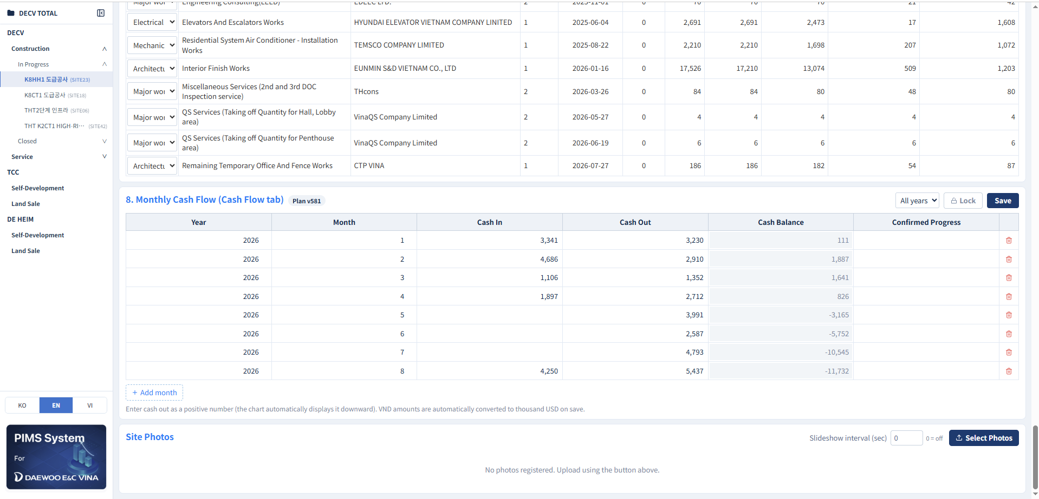
Data Entry: Outsourcing, Cash Flow & Site Photos
Description
8. Monthly Cash Flow (Cash Flow tab):
Cash In/Out: PIMVINA Sync
Cash Flow > Report > Cash Flow Report > Income > month (1-12)Outcome > month (1-12)
Cash Balance = Cash In – Cash Out
Confirmed Progress: Manual Entry
Site Photos:
Select Photos to upload
Slideshow interval (seconds) auto-rotates, 0 disables.
1
2
infoERP
PIMS Dashboard

Slide 32
5
Data Manager – Project Dashboard – Service

Slide 33
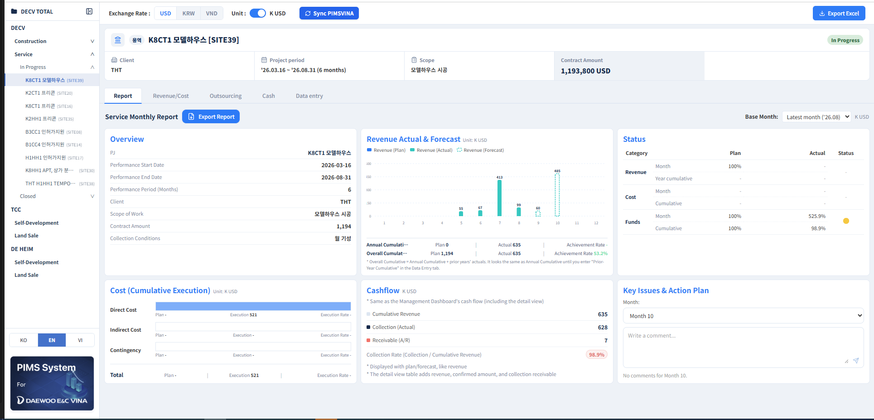
Report
Description
1
Select a service site from the left tree
- header shows Client, Scope of work : Input from tab DataEntry
- Project period, Contract Amount : Sync from Pimsvina Sync
Report mirrors Construction’s layout minus Progress:
- Overview: Data Entry → 0. Overview
- Revenue Actual & Forecast: Data Entry → 2. Monthly Revenue (Revenue tab) (Revenue/Cost/Funds)
- Cost (Cumulative Execution): Data Entry → 4. Budget Execution Status (Budget Execution tab)
- Cashflow: Data Entry → 6. Monthly Cash Flow (Cash Flow tab)
- Key Issues & Action Plan: Manual Input
3 Export Report:
- Base Month selector and Comment box (by month) work as on a Construction site.
3
2
infoERP
PIMS Dashboard

Slide 34
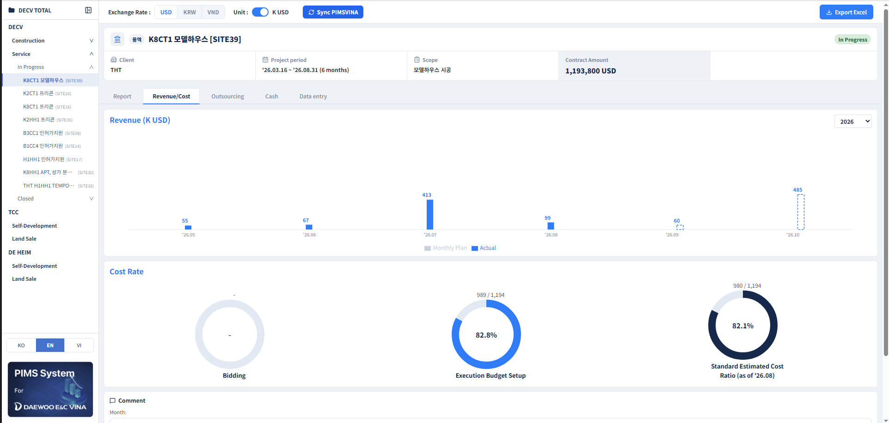
Revenue/Cost
Description
Revenue (K USD):
Shows monthly Plan vs. Actual for the selected year. Dashed bars indicate forecast months not yet closed.
Source: Data Entry → 2. Monthly Revenue → Plan, Actual, Forecast
Cumulative Cost Ratio (%)
Shows the cost-to-revenue trend across the year, with the latest value highlighted
Source: Data Entry → 1. Contract Amount & Cost→ Estimated Completion Cost Rate → Ratio
3 Input comment.
1
2
3
infoERP
PIMS Dashboard

Slide 35
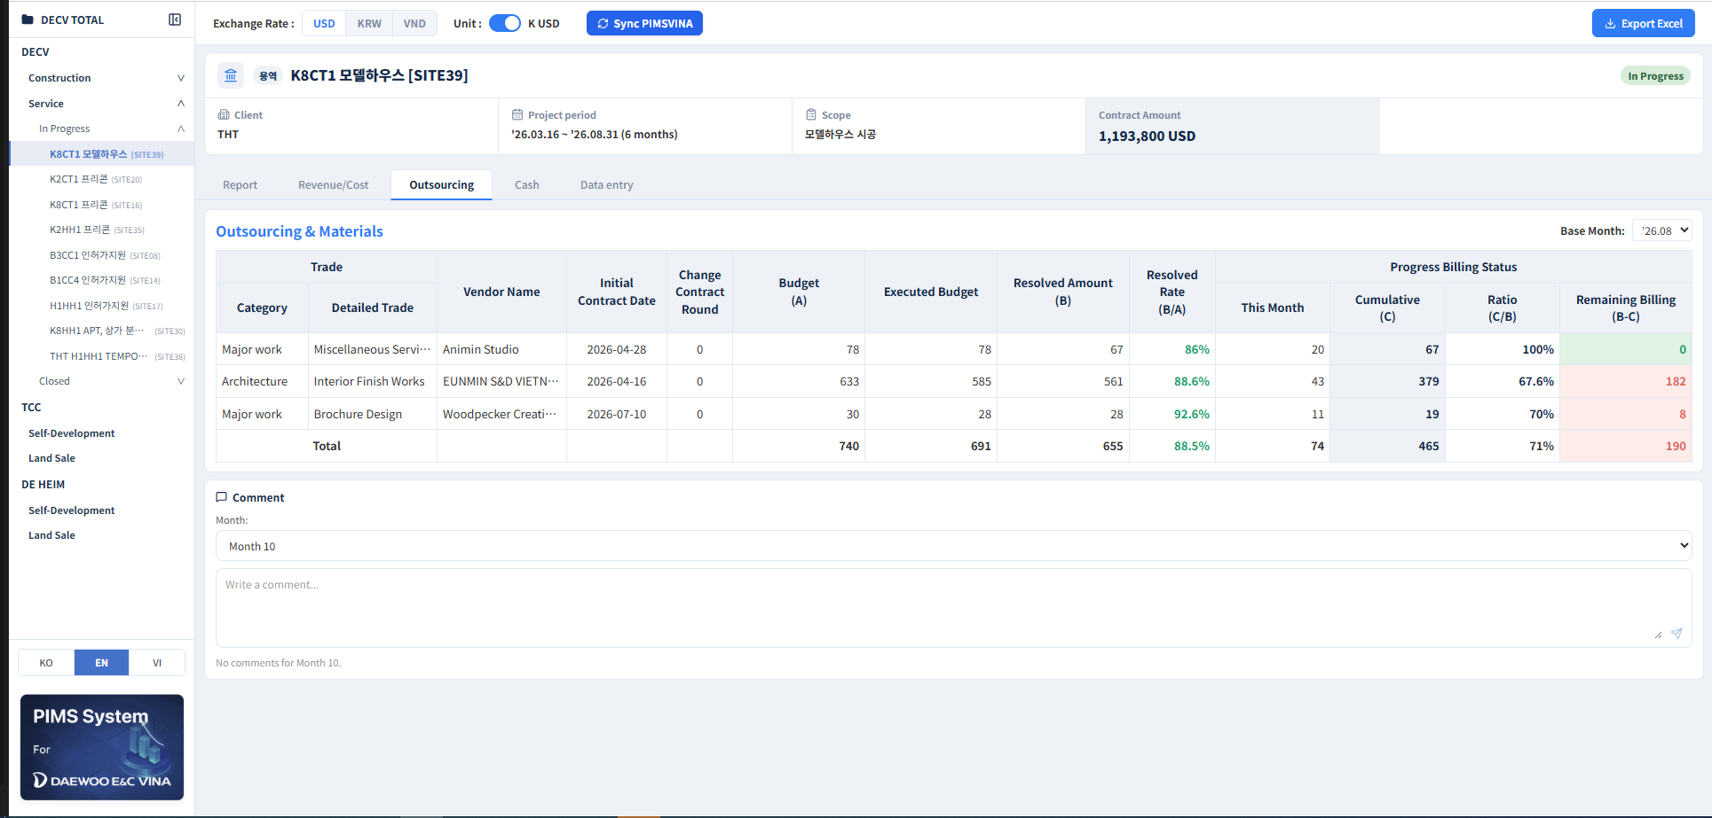
Outsourcing
Description
Outsourcing & Materials
1 Lists each subcontract/material order with Trade (Category/Detailed Trade), Vendor Name, Initial Contract Date and Change Contract Round.
Source: Data Entry → 5. Outsourcing/Materials
Budget (A), Executed Budget, Resolved Amount (B):
Source: Data Entry → 5. Outsourcing/Materials
Resolved Rate = B/A, over 100% flagged red.
Progress Billing Status:
This Month, Cumulative (C): Data Entry → 5. Outsourcing/ Materials
Ratio = C/B, Remaining Billing = B−C per vendor
Base month selectable top right.
1
2
3
infoERP
PIMS Dashboard

Slide 36
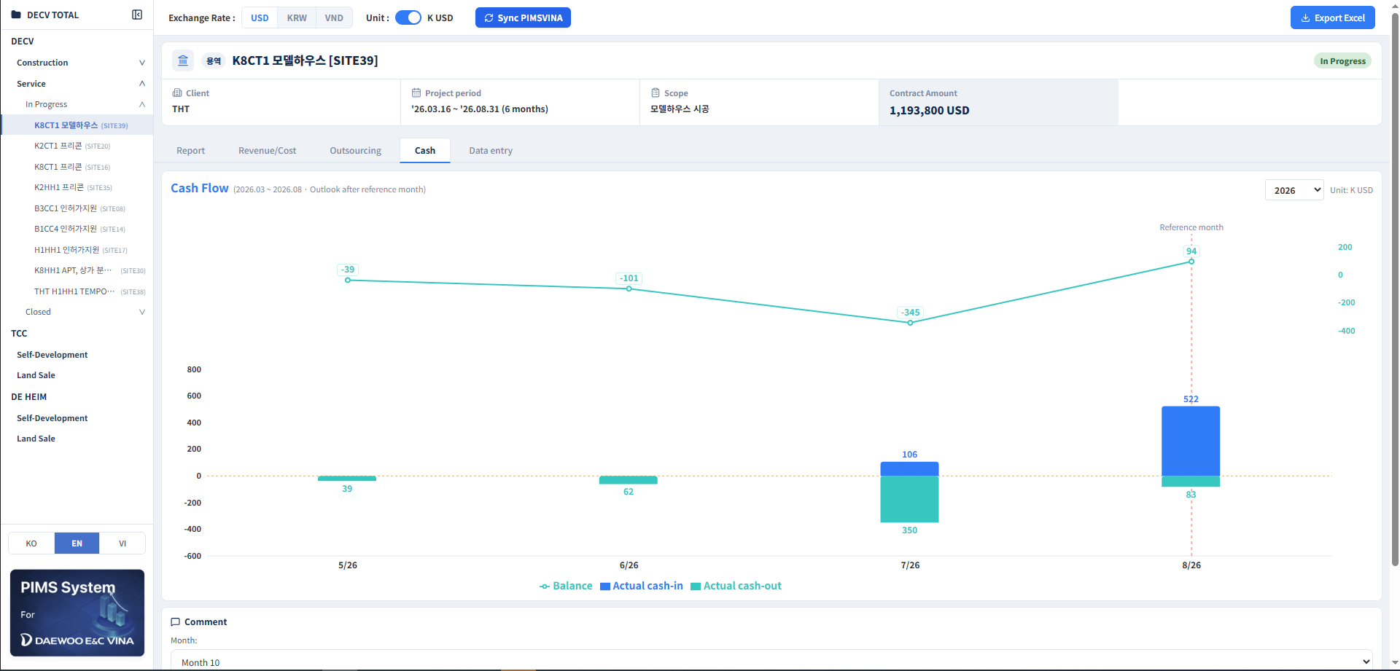
Cash
Description
1
Cash Flow:
Shows actual cash-in/out as bars and the running Balance as a line across the full period. A dashed Reference Month marker separates actuals from outlook.
Source: Data Entry → 6. Monthly Cash Flow.
2 Year selector (top right) focuses on one year; hover for exact monthly figures.
2
infoERP
PIMS Dashboard

Slide 37
6
Data Manager – Data Entry – Service

Slide 38
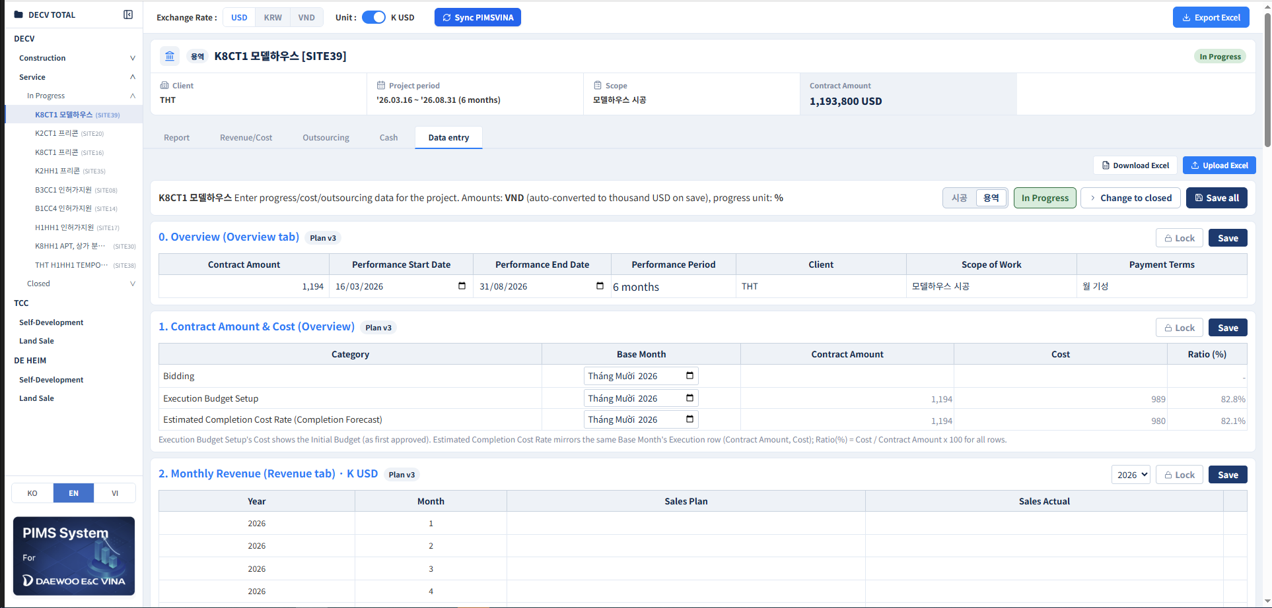
Data Entry: Overview, Contract Amount & Cost, Revenue
Description
1 0. Overview (Overview tab):
Contract Amount, Construction Start/End Date: PIMVINA Sync
Source: Common > Construction Overview > Register Construction Overview > Tab Construction Period > Contract Amount, Actual Start Date - Actual Final Completion / Expected Final Completion Date
Remaining fields: Manual entry
2 1. Monthly Progress (Progress tab):
Monthly Plan (%): Manual entry
Monthly Actual (%) = (1(each month)/(2-3))*100%
Source: 1. Sum total column input By Month(1-12)
2. Sum column Execution Budget > Amount
3. Request Execution Resolution(Site) sum column Execution Budget minus sum column Implementation
Cumulative Plan (%), Cumulative Actual (%): cumulative calculation by month
3 2. Monthly Revenue (Revenue tab, K USD): Sales Plan/Actual by Year/Month; feeds the Report tab’s Revenue Actual & Forecast chart.
1
2
3
infoERP
PIMS Dashboard

Slide 39
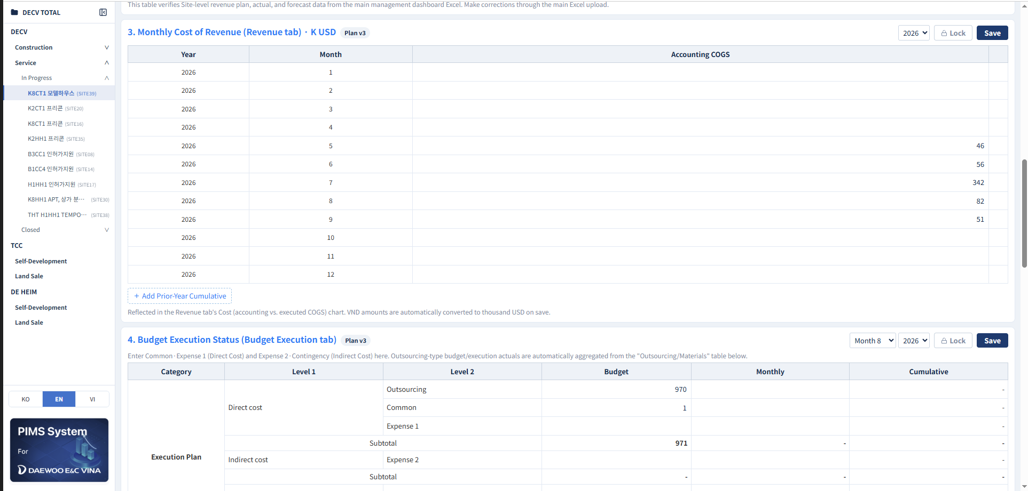
Data Entry: Monthly Cost of Revenue & Budget Execution
1
Description
3. Monthly Cost of Revenue (Revenue tab, K USD):
Accounting COGS by Year/Month: Imported Excel Data.
Add Prior-Year Cumulative as on the Revenue card.
VND auto-converts to K USD on save.
2 4. Budget Execution Status (Budget Execution tab): Common, Expense 1 (Direct Cost), Expense 2 (Indirect Cost) Budget/Monthly/Cumulative by Month/Year; Outsourcing rows auto-aggregate from the table below.
2
infoERP
PIMS Dashboard

Slide 40
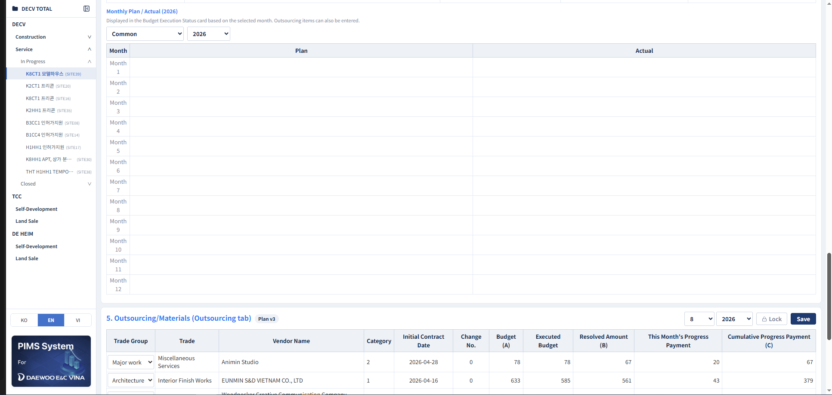
Data Entry: Monthly Plan/Actual & Outsourcing
1
Description
Monthly Plan/Actual (year):
- Data sourced from 6: Budget Execution Status (Cost tab), based on the filter.
7. Outsourcing/Materials (Outsourcing tab):
Budget (A), Executed Budget, Resolved Amount (B):
Sub-Contracting > Request Execution Resolution (Site) > Request Execution Resolution(Site) > Execution Budget, Operational Budget, Implementation Amount
This Month's Progress Payment, Cumulative Progress Payment (C)):
Sub-Contracting > Implementation Progress Payment(Site) > Interim Payment Status
Tab This Month column 당월기성금액 (B)
Tab All column Progress Payment > Amount (B)
2
infoERP
PIMS Dashboard

Slide 41
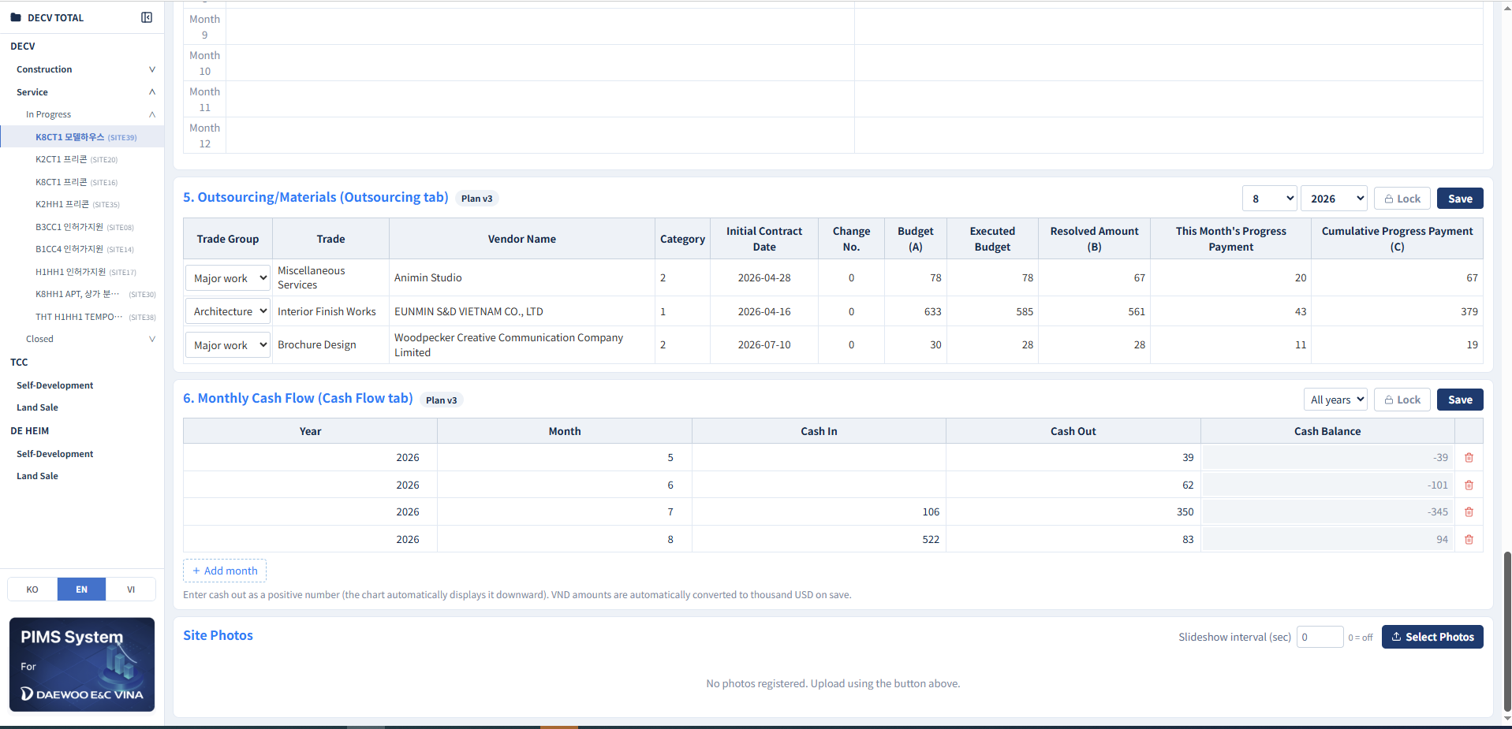
Data Entry: Outsourcing, Cash Flow & Site Photos
Description
8. Monthly Cash Flow (Cash Flow tab):
Cash In/Out: PIMVINA Sync
Cash Flow > Report > Cash Flow Report > Income > month (1-12)Outcome > month (1-12)
Cash Balance = Cash In – Cash Out
Confirmed Progress: Manual Entry
Site Photos:
Select Photos to upload
Slideshow interval (seconds) auto-rotates, 0 disables.
1
2
3
infoERP
PIMS Dashboard

Slide 42
Thank you!
infoERP
PIMS Dashboard – User Guide

