Slide 1
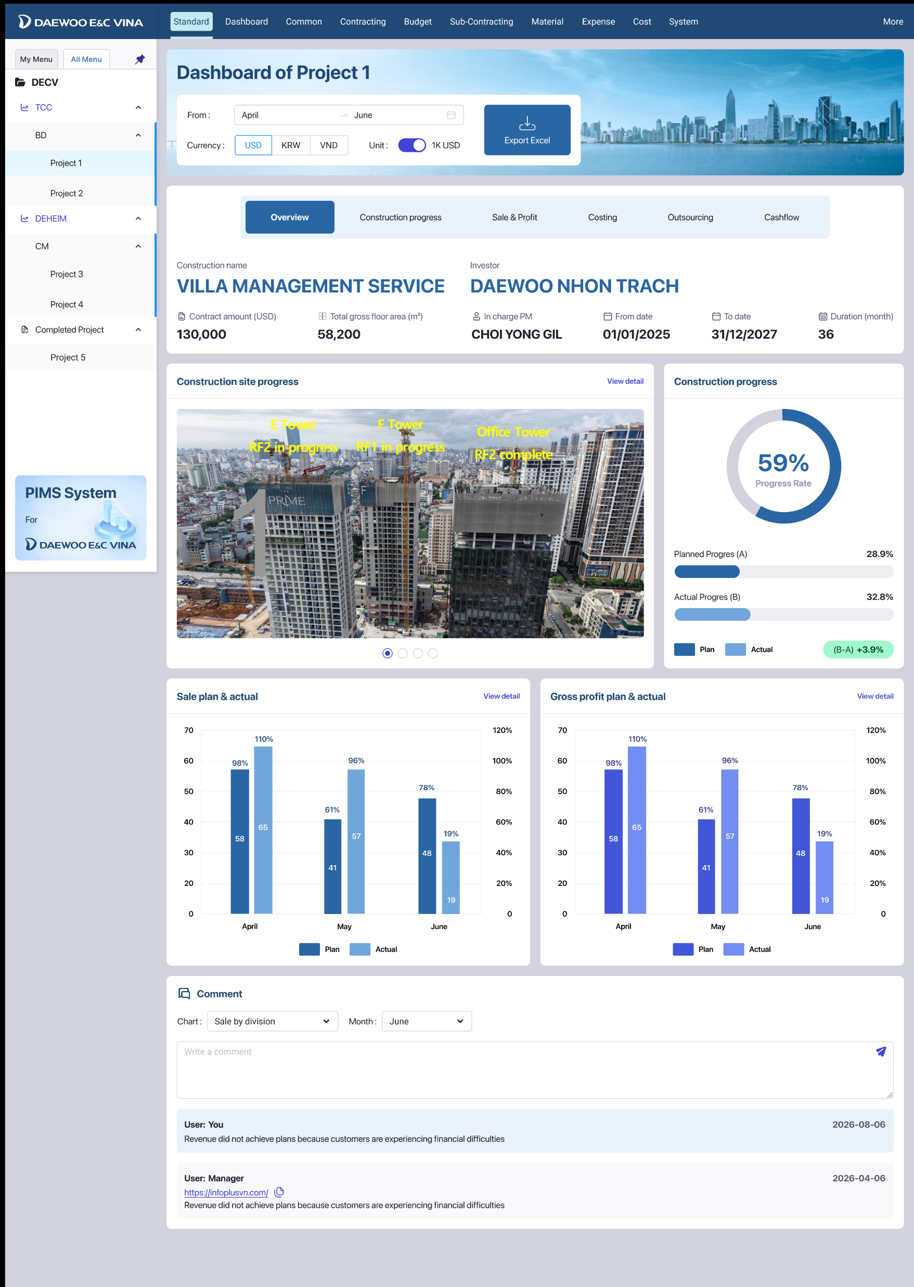
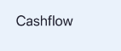
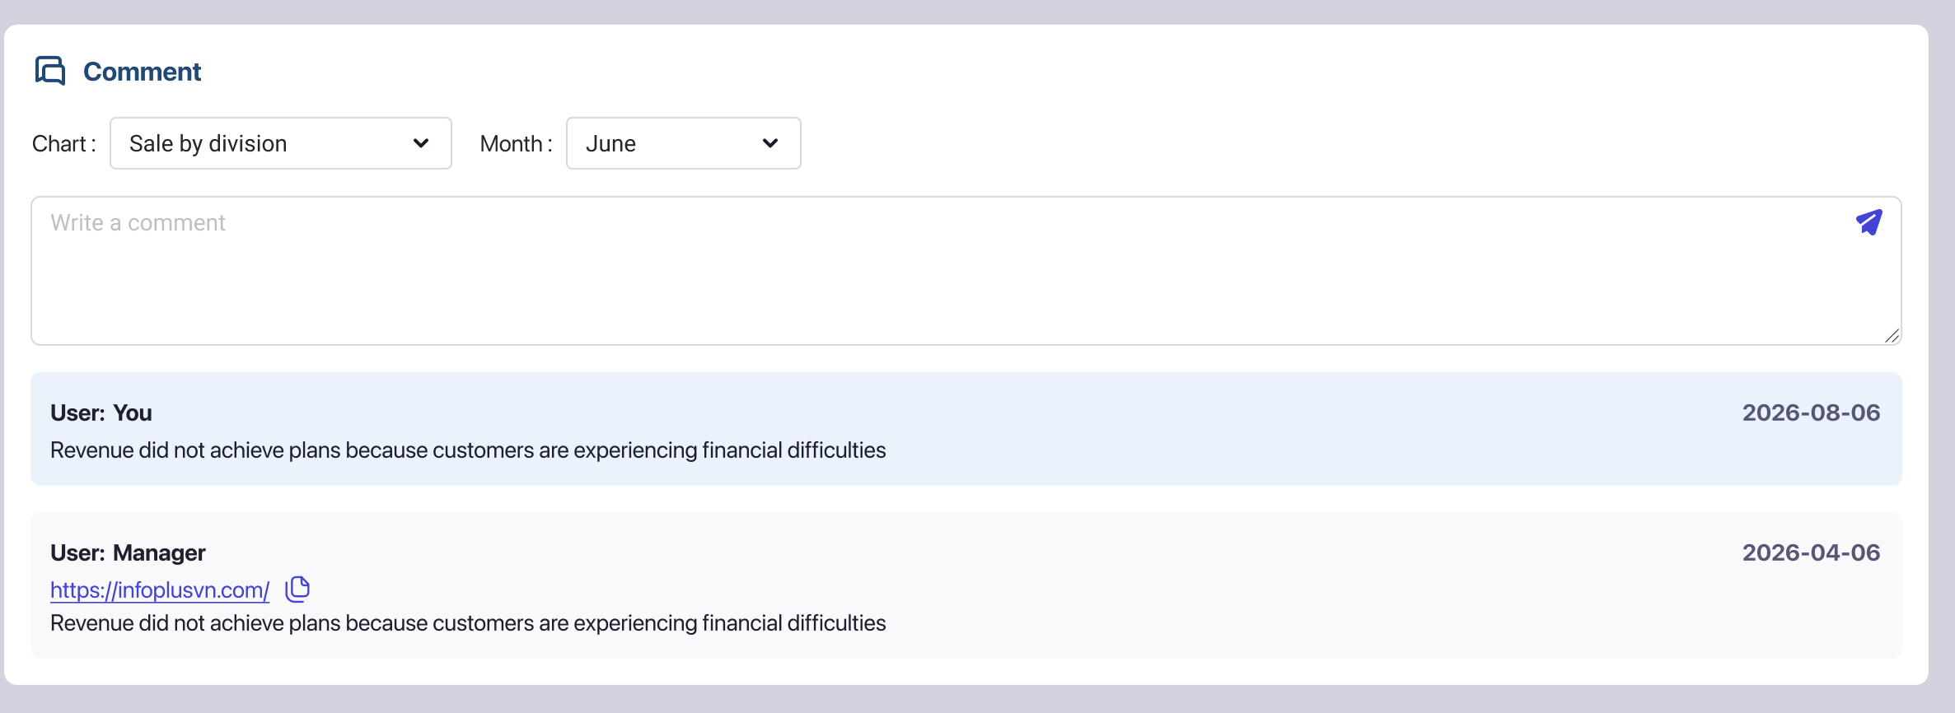
Project : K8HH1 precon service
수행기간 : ’00.00.00~’00.00.00 (00개월)
작성 기준 : 6월 말
overview
발주처 : 0000000
도급액 : 0,000,000
수행내용 : 인허가, 프리콘 보고서 제출
Sale & Profit
Budget Execution Status
Cash
Budget Execution
Revenue
1,194
1,194
2,477
Total Excution : 00.0%
Outsourcing
330
330
27.6%
27.6%
35.2%
258
Achievement Rate
Achievement Rate
45.3%
00
00
00
1,207
60
00
977
99
Annual Target Achievement
Total Revenue Achievement
Direct Cost
Expense 2
Contingency
Revenue
Confirmed
(A)
Collection
(B)
Outstanding
(A)-(B)

Slide 2
overview
Monthly Revenue
3,000
Sale & Cost
누계
Budget Execution
258
Outsourcing
‘26.04
‘26.05
‘26.06
Cost
회계 매출원가
회계 매출원가 누계
집행 매출원가 (WIP)
집행 매출원가 (WIP) 누계
258
60
30
34
26
‘26.04
‘26.05
‘26.06

Slide 3
overview
Budget Execution Status
Sale & Profit
Direct Cost
99
30.3%
1,239
Budget Execution
Outsourcing
Indirect Cost
99
45.3%
258
Salary
80.8%
Walfare
12.1%
Service
50.3%
Others
Contingency
60
Sum
977
45.3%
3,980

Slide 4
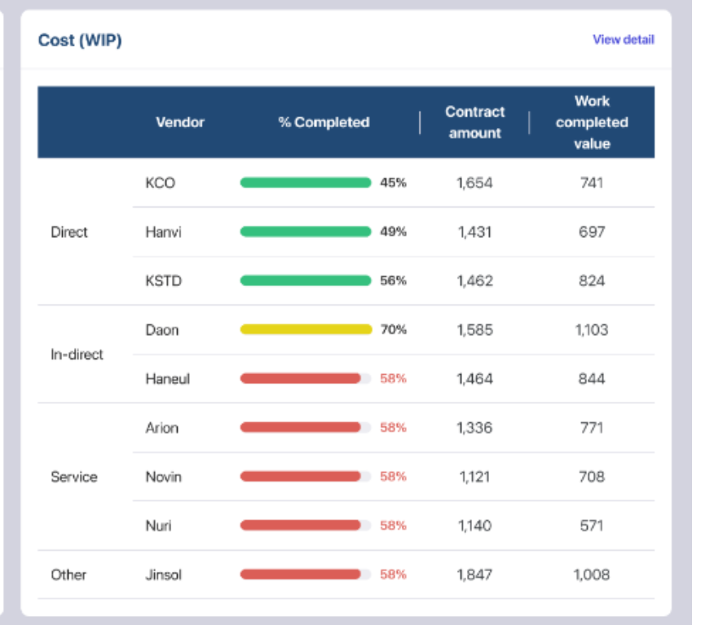
공종 | 업체명 | 구분 | 최초 계약일 | 변경 계약 차수 | 예산 (A) | 결의금액 (B) | 결의율 (A/B) | 기성현황
 |  |  |  |  |  |  |  | 이번달 | 누계 (C) | 비율 (C/B)
Environment Design | Sein | 용역 | ‘24.12.31 |  | 00,000,000 | 00,000,000 |  | 00,000 | 000,000 | 00.0%
Landscpae Design | Sein | 용역 | ‘24.12.31 |  | 00,000,000 | 00,000,000 |  | 00,000 | 000,000 | 00.0%
Interior Design | Sein | 용역 | ‘24.12.31 |  | 00,000,000 | 00,000,000 |  | 00,000 | 000,000 | 00.0%
BIM | Sein | 외주 | ‘24.12.31 |  | 00,000,000 | 00,000,000 |  | 00,000 | 000,000 | 00.0%
QS | Sein | 외주 | ‘24.12.31 |  | 00,000,000 | 00,000,000 |  | 00,000 | 000,000 | 00.0%
Structure | Sein | 외주 | ‘24.12.31 |  | 00,000,000 | 00,000,000 |  | 00,000 | 000,000 | 00.0%
LEED | Sein | 외주 | ‘24.12.31 |  | 00,000,000 | 00,000,000 |  | 00,000 | 000,000 | 00.0%
합계 |  |  |  |  |  | 000,000,000 |  | 000,000,000 | 000,0000,000,000 | 00.0%
overview
Sale & Cost
Budget Execution
Outsourcing

Slide 5
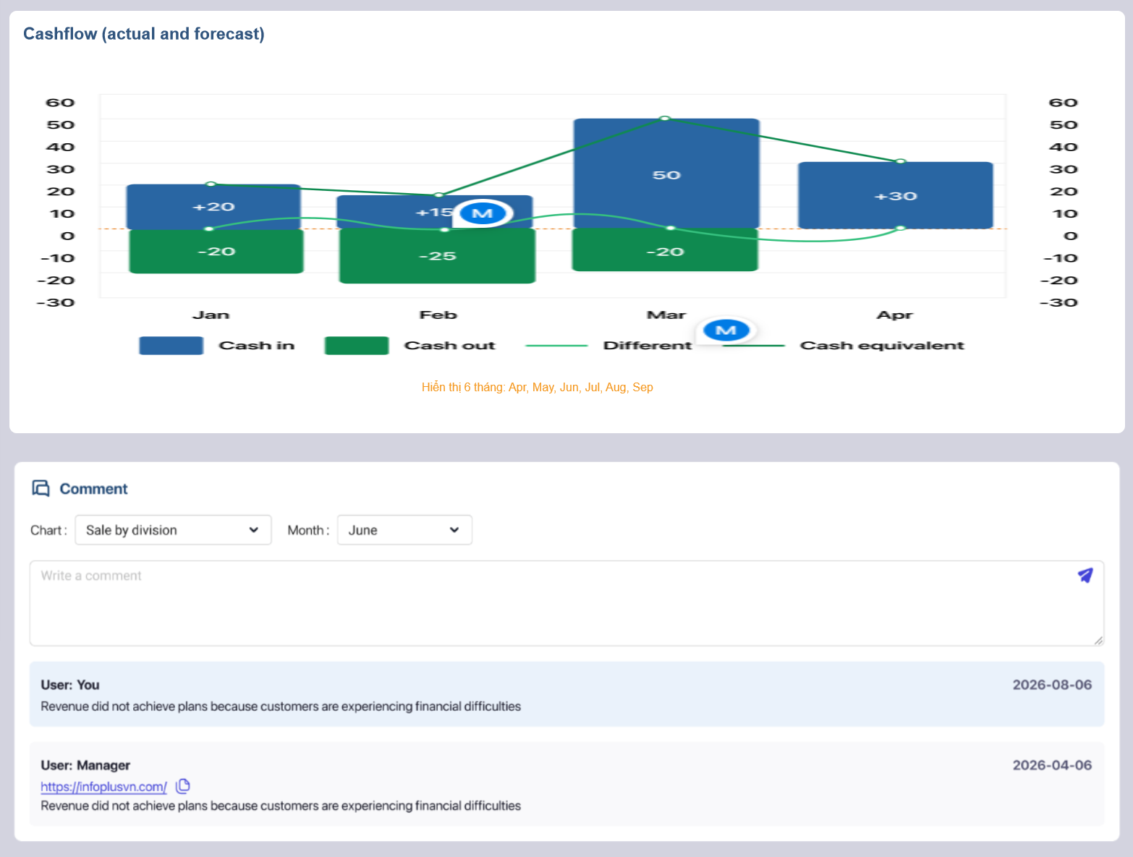
overview
Sale & Cost
Budget Execution
Outsourcing
Cashflow

