Slide 1
infoERP
PIMS DASHBOARD
PIMS Dashboard – User Guide
For Dashboard Viewer & Data Manager
October 2026

Slide 2
Introduction – PIMS Dashboard
Purpose: This guide walks through the PIMS Management Dashboard end to end — the public-facing views any visitor can browse, and the Data Entry screens used to feed each report.
Audience: Executives and stakeholders who monitor company and site performance, and Site Managers / Data Managers who maintain monthly progress, revenue, cost, outsourcing and cash-flow data.
Scope: Main Dashboard (company-wide KPIs) → Construction Project Dashboard → Service Project Dashboard → Data Entry for Construction sites → Data Entry for Service sites.
Access: The Main Dashboard and project dashboards are read-only and require no login. Data Entry screens are accessed per site via the left-hand site tree, after logging in with a Data Manager account.
Navigation: Use the left panel to pick a site (Construction / Service / TCC / DE HEIM). Use Exchange Rate (USD / KRW / VND) and Unit (USD / K USD) at the top of every screen to change the display currency.
infoERP
PIMS Dashboard

Slide 3
1
Main Dashboard

Slide 4
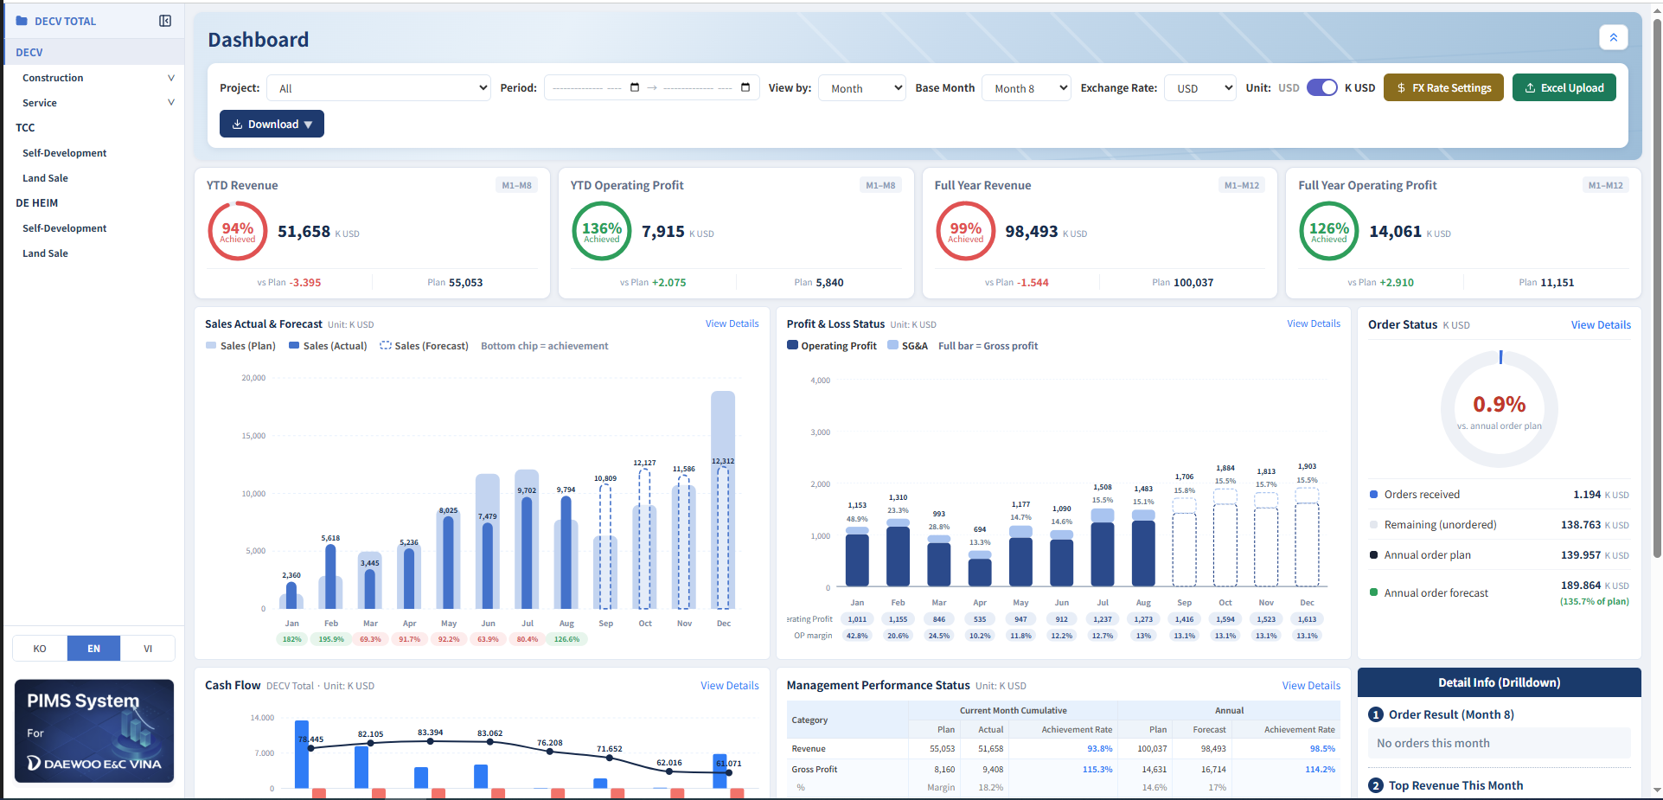
Main Dashboard: Filters & Summary KPIs
Description
1
4
2
3
5
Settings:
Select Project, Period / Base Month, View by (Month), Exchange Rate and Unit (USD or K USD to refresh all cards and charts.
2 Excel Upload: import a new monthly report.
3 Download: export the current dashboard.
4 FX Rate Settings: review or edit the exchange rates used for conversion.
5 KPI Summary:
YTD Revenue, YTD Operating Profit (both Month 1 – Base Month)
Full Year Revenue and Full Year Operating Profit (Month 1 – 12)
Source: Imported Excel Data
infoERP
infoERP
PIMS Dashboard

Slide 5
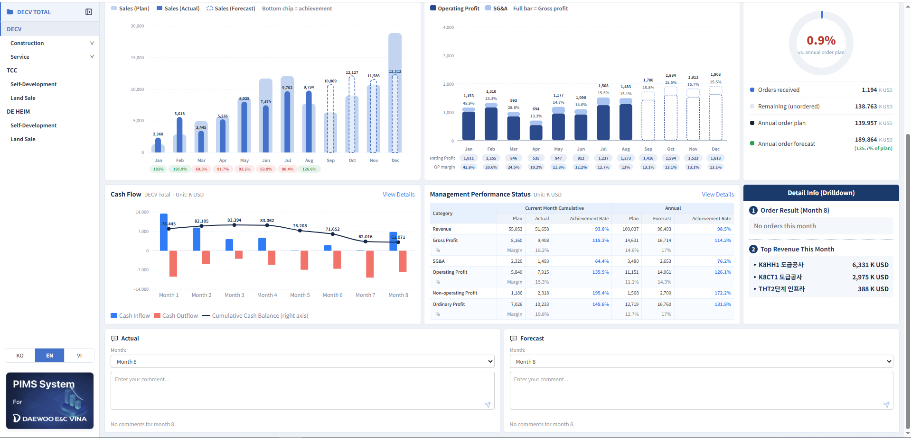
Main Dashboard: Charts & Drilldown
Description
1
2
3
Sales Actual & Forecast
Sales (Plan), Sales (Actual) and Sales (Forecast): Imported Excel Data
Achievement % = Plan ÷ Actual/Forecast
View Details for the monthly breakdown.
2 Profit & Loss Status stacks Operating Profit and SG&A to show the full Gross Profit bar per month, with OP margin % below.
3 Order Status (donut) tracks Orders received against the Annual order plan and forecast; Cash Flow plots Cash Inflow / Outflow with Cumulative Cash Balance on the line. View Details is available on Sales Actual & Forecast, Profit & Loss Status and Cash Flow, each opening the monthly-level breakdown.
4 Management Performance Status compares Plan vs. Actual vs. Forecast for Revenue, Gross Profit, SG&A, Operating Profit and Ordinary Profit for both the current month and the full year; every figure is aggregated company-wide from each site’s Monthly Revenue, Cost Plan/Actual and Budget Execution Status entries recorded in Data Entry.
5 Detail Info (Drilldown) lists this month’s Order Result and Top Revenue sites; Actual / Forecast comment boxes record monthly notes per month.
4
5
infoERP
PIMS Dashboard

Slide 6
Construction Dashboard & Service Dashboard
Description
1
2
1 Between the Main Dashboard and an individual project, the left-hand tree offers a Construction and a Service level — click either group header (not a specific site) to see the same KPI / chart layout as the Main Dashboard, scoped to only that group’s sites.
2 Use this level to compare Construction-only or Service-only performance before drilling into one site’s Project Dashboard; all filters (Project, Period, Exchange Rate, Unit) behave exactly as on the Main Dashboard.
infoERP
PIMS Dashboard

Slide 7
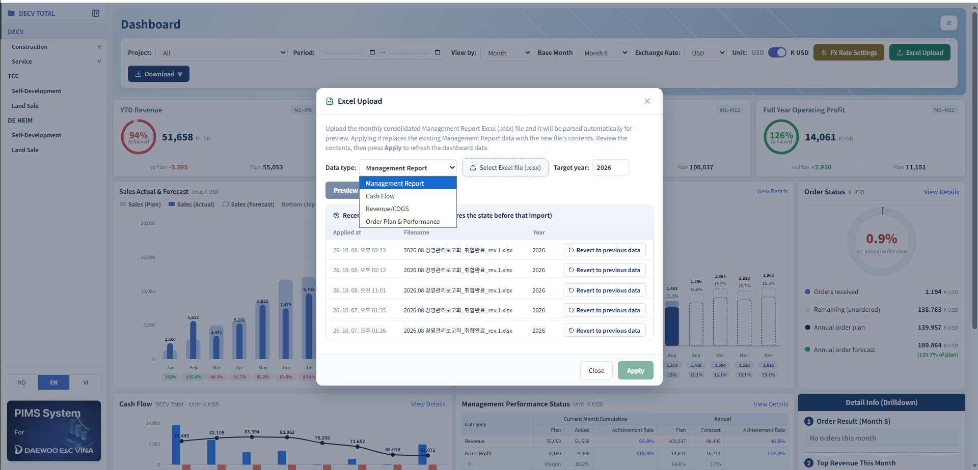
Main Dashboard: Excel Upload
Description
1 Click Excel Upload, choose a Data type (Management Report, Cash Flow, Revenue/COGS, or Order Plan & Performance) and Target year, then Select Excel file (.xlsx).
2 The file is parsed automatically for Preview before anything is applied — review the parsed content, then click Apply to refresh the dashboard with the new data.
3 Recent Uploads lists every prior import with its applied time and filename; use Revert to previous data on any row to roll the dashboard back to the state just before that import.
1
2
3
infoERP
PIMS Dashboard

Slide 8
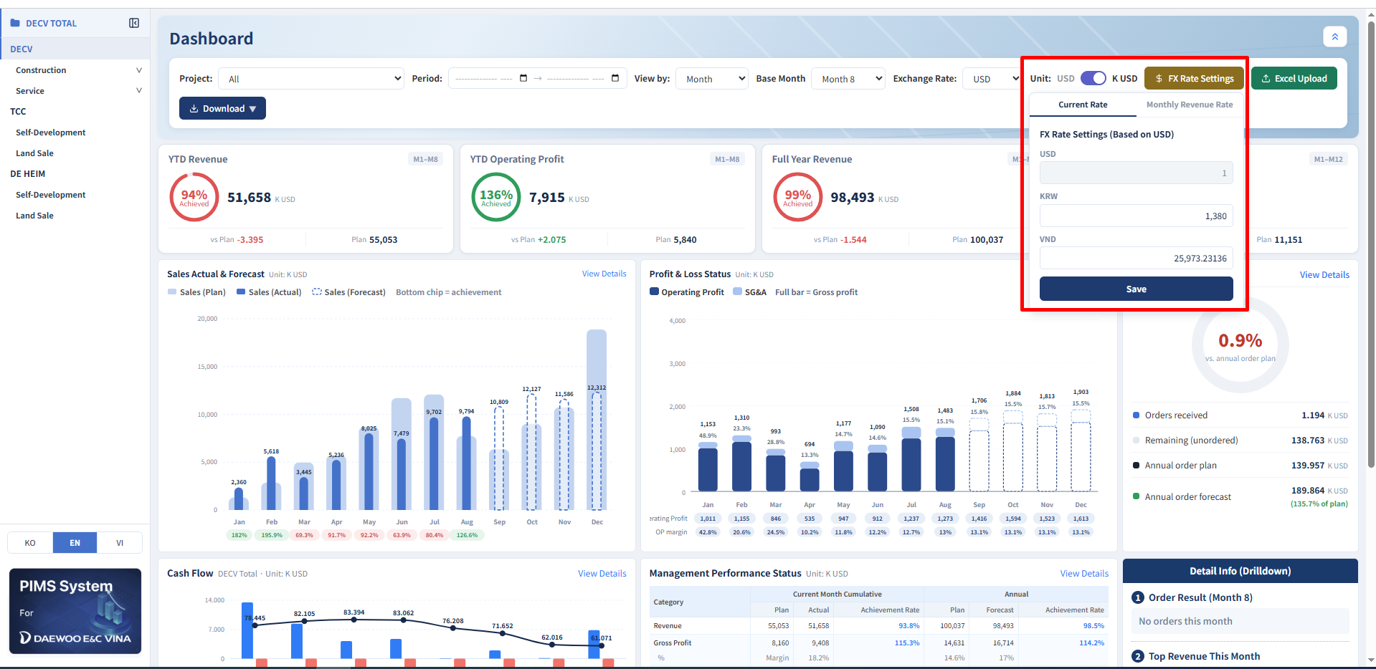
Main Dashboard: FX Rate Settings – Current Rate
Description
1
1. FX Rate Settings
Open the Current Rate panel to set exchange rates for dashboard conversion.
2. Set Exchange Rates
Enter KRW & VND rates per 1 USD → click Save to apply across the dashboard.
2
infoERP
PIMS Dashboard

Slide 9
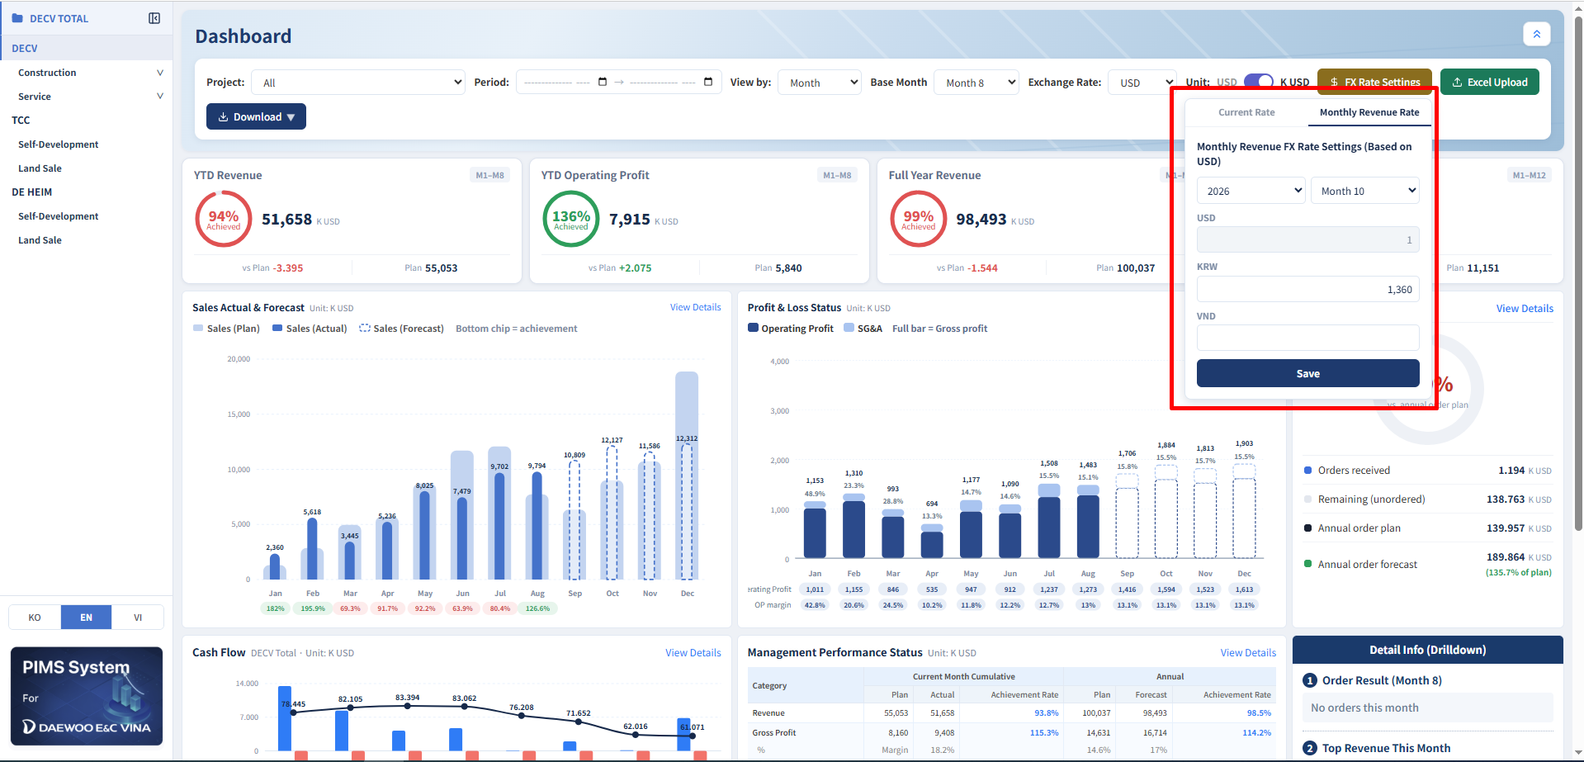
Main Dashboard: FX Rate Settings – Monthly Revenue Rate
Description
1
2
1. Monthly Revenue Rate
Set a specific KRW / VND exchange rate by Year & Month for monthly revenue conversion.
2. Set Monthly Rate
Select Year / Month → enter KRW & VND rates → Save.
The dashboard uses the monthly rate when defined.
infoERP
PIMS Dashboard

Slide 10
2
Project Dashboard – Construction

Slide 11
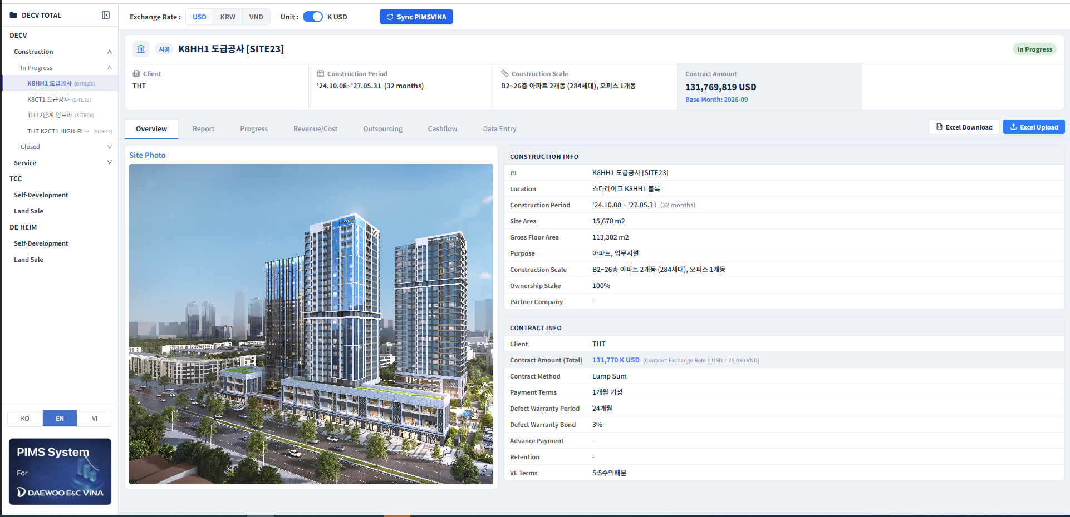
Overview
2
1
5
Description
3
1 Select a construction site from the left tree (e.g. K8HH1 도급공사 [SITE23]) to open its project dashboard; the header always shows Client, Construction Period, Construction Scale, Contract Amount and Status.
2 Exchange Rate (USD / KRW / VND) and Unit (USD / K USD) sit above every tab of the site and apply to all of its screens — Overview, Report, Progress, Revenue/Cost, Outsourcing, Cashflow and Data Entry.
3 Site Photo displays the latest registered image; Construction Info lists Location, Site Area, Gross Floor Area, Purpose, Ownership Stake and Partner Company.
4 Contract Info lists Client, Contract Amount (with the contract exchange rate), Contract Method, Payment Terms, Defect Warranty Period / Bond, Advance Payment, Retention and VE Terms.
5 Click Sync PIMSVINA at any time to refresh the project data from the source system.
4
infoERP
PIMS Dashboard

Slide 12
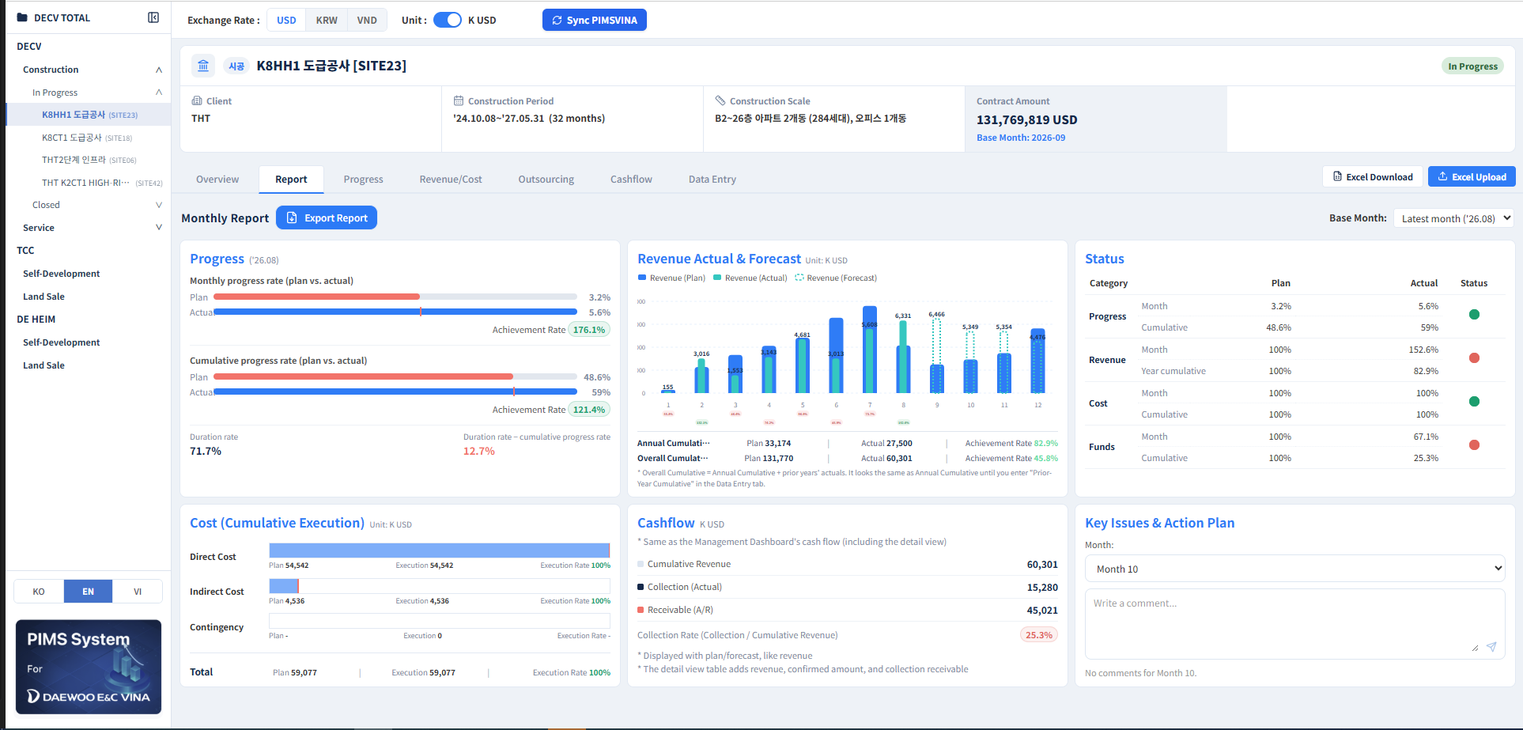
Report
Description
1
1 The Report tab is the monthly executive summary for the site. Pick the Base Month, then click Export Report for a shareable file.
2 Progress shows the monthly and cumulative progress rate (Plan vs. Actual) with achievement %, plus the Duration rate (elapsed construction time / total period) and the gap between duration and cumulative progress.
3 Revenue Actual & Forecast charts monthly Revenue (Plan / Actual / Forecast) with Annual Cumulative and Overall Cumulative totals and their achievement rates.
4 Status traffic-lights Progress, Revenue and Cost for the month and year cumulative; Cost (Cumulative Execution) breaks out Direct Cost, Indirect Cost and Contingency; Cashflow shows Collection Rate against cumulative revenue; Key Issues & Action Plan carries the monthly comment.
2
3
4
infoERP
PIMS Dashboard

Slide 13
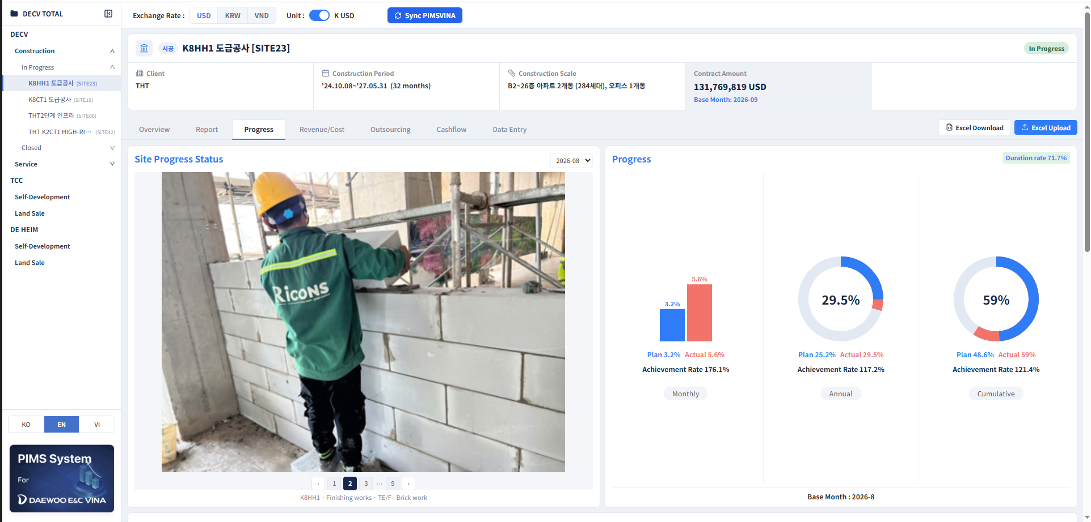
Progress
Description
1
1 The Progress tab opens with the Site Progress Status photo for the selected month (use the month filter and photo pager below it) alongside the Duration rate chip.
2 Three donut charts summarize Monthly, Annual and Cumulative progress, each showing Plan vs. Actual and its Achievement Rate.
2
infoERP
PIMS Dashboard

Slide 14
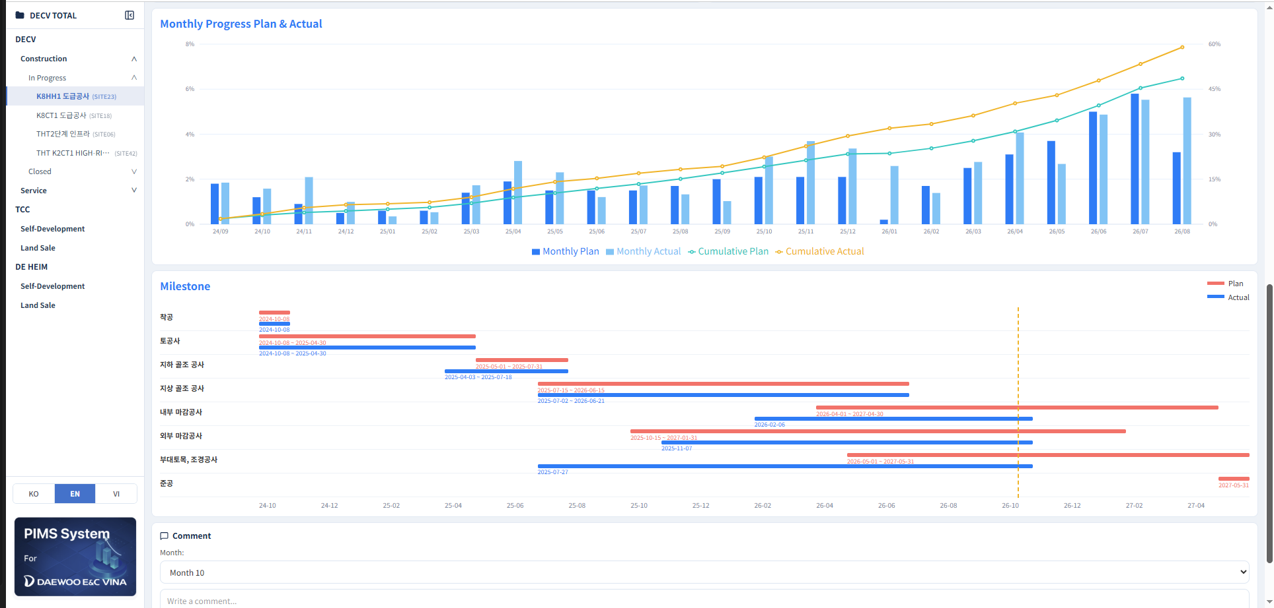
Progress: Monthly Trend & Milestones
Description
1 Monthly Progress Plan & Actual charts Monthly Plan / Monthly Actual as bars with Cumulative Plan / Cumulative Actual as lines across the full construction period.
2 Milestone lists each construction phase (착공, 토공사, 지하/지상 골조 공사, 내·외부 마감공사, 준공 …) with Plan and Actual date ranges on a timeline; a vertical marker shows the current reference month.
3 Use the Comment box at the bottom (filtered by month) to record progress notes for that period.
2
1
3
infoERP
PIMS Dashboard

Slide 15
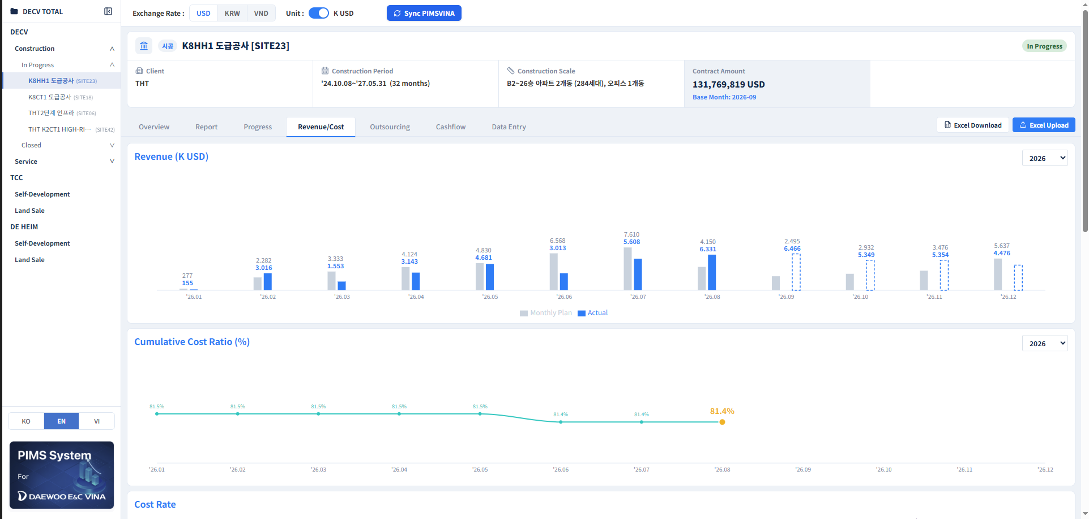
Revenue/Cost
Description
1
3
1 Revenue (K USD) charts the Monthly Plan against Actual for the selected year, with dashed bars marking forecast months not yet closed.
2 Cumulative Cost Ratio (%) trends the cost-to-revenue ratio across the year on a single line, with the latest value highlighted.
3 Use the year selector on each chart to review a different fiscal year.
2
infoERP
PIMS Dashboard

Slide 16
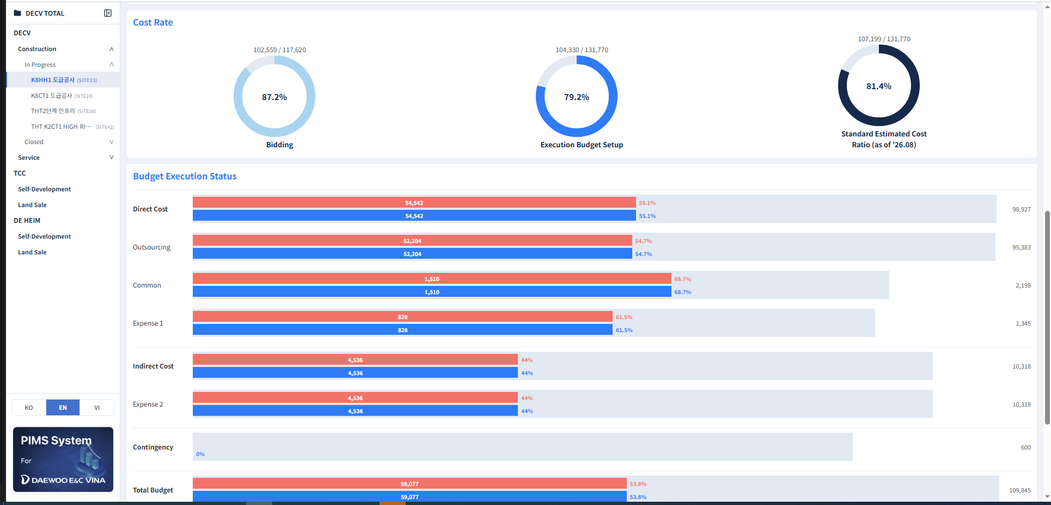
Revenue/Cost: Cost Rate & Budget Execution
1
Description
1 Cost Rate shows three donuts — Bidding, Execution Budget Setup and Standard Estimated Cost Ratio — each as Cost / Contract Amount with the underlying figures below.
2 Budget Execution Status breaks the total budget into Direct Cost, Outsourcing, Common, Expense 1, Indirect Cost, Expense 2 and Contingency, each with an Exec. Plan vs. Actual (Exec. Rate) bar and the remaining amount on the right.
2
infoERP
PIMS Dashboard

Slide 17
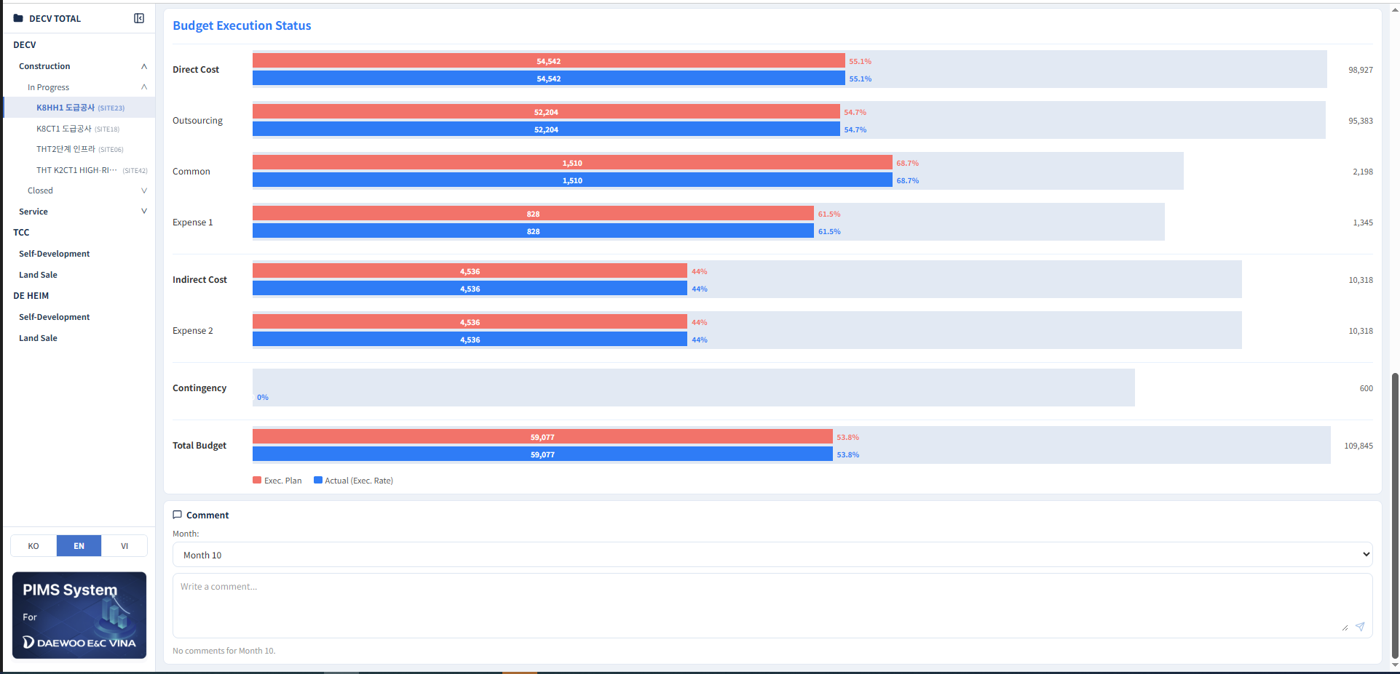
Revenue/Cost: Budget Execution Status (detail)
Description
1 Scroll down for the full Budget Execution Status table and the Total Budget row, which sums Direct Cost + Indirect Cost + Contingency against Plan and Actual.
2 Use the Comment box below the table (filtered by month) to log notes on cost execution for the period.
1
2
infoERP
PIMS Dashboard

Slide 18
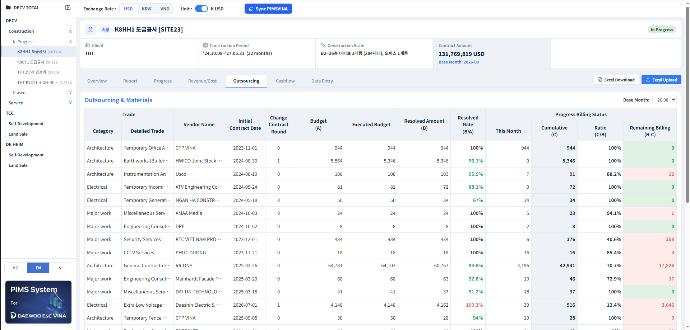
Outsourcing
Description
1
2
3
1 Outsourcing & Materials lists every subcontract and material order for the site: Trade (Category / Detailed Trade), Vendor Name, Initial Contract Date and Change Contract Round.
2 Budget (A), Executed Budget and Resolved Amount (B) track the contract value through change orders; Resolved Rate (B/A) flags contracts that exceed 100% in red.
3 Progress Billing Status shows This Month, Cumulative (C), Ratio (C/B) and Remaining Billing (B−C) per vendor, with the base month selectable at the top right.
infoERP
PIMS Dashboard

Slide 19
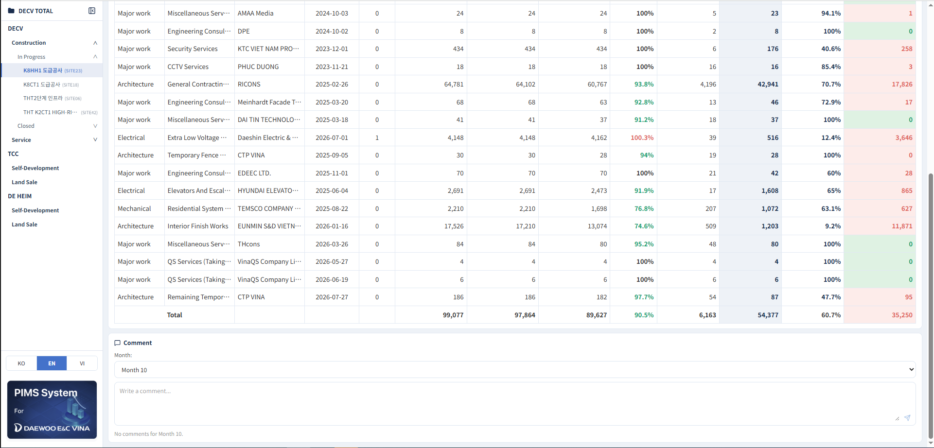
Outsourcing (continued) & Total
Description
1 Scroll the table to review every vendor line; the Total row at the bottom sums Budget, Executed Budget, Resolved Amount, This Month, Cumulative and Remaining Billing across all contracts for the site.
2 Use the Comment box below the table (filtered by month) to record outsourcing notes for that period.
1
2
infoERP
PIMS Dashboard

Slide 20
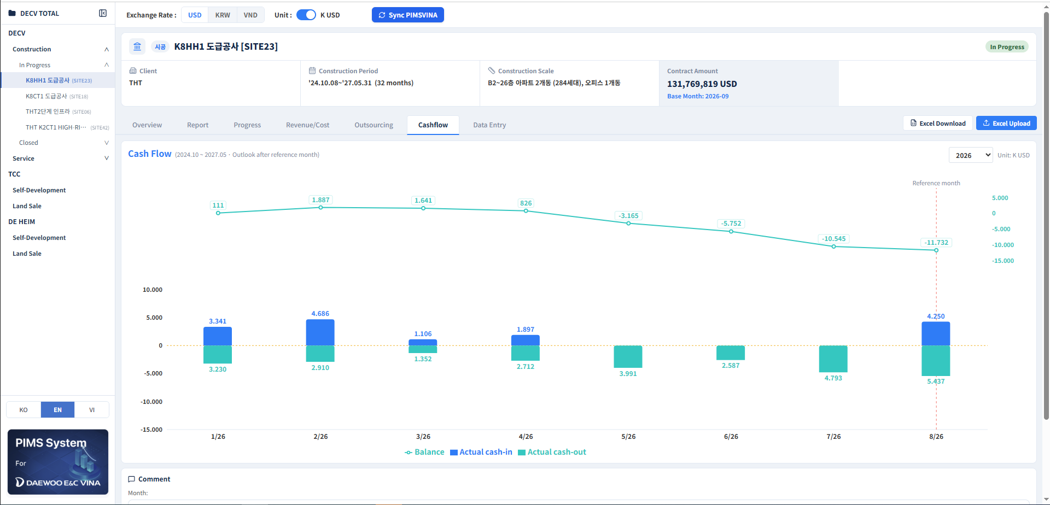
Cashflow
Description
1
2
1 Cash Flow plots the full construction period (start to end) as Actual cash-in and cash-out bars with the running Balance line; a dashed Reference month marker shows where actuals end and the outlook begins.
2 Use the year selector (top right) to focus on a single year within the overall timeline; hover any bar or point for the exact monthly figure.
infoERP
PIMS Dashboard

Slide 21
3
Data Entry – Construction

Slide 22
Login & Data Manager Access
Login: Data Entry screens require a Data Manager (or Site Manager) account. Log in to PIMS with your company account before the left-hand site tree and Data Entry tab become available.
Scope selection: After login, pick the site from the left tree, then choose “시공” (Construction) or “용역” (Service) to switch which set of Data Entry cards is shown for that site.
Status control: Use the In Progress / Change to closed control on the Data Entry tab to mark a site as closed once it is finished — this also affects which project list (In Progress vs. Closed) the site appears under in the left tree.
Save behavior: Each numbered card has its own Save button, plus a Save all shortcut at the top; use the Lock toggle on a card to freeze it against further edits once its plan is finalized.
infoERP
PIMS Dashboard

Slide 23
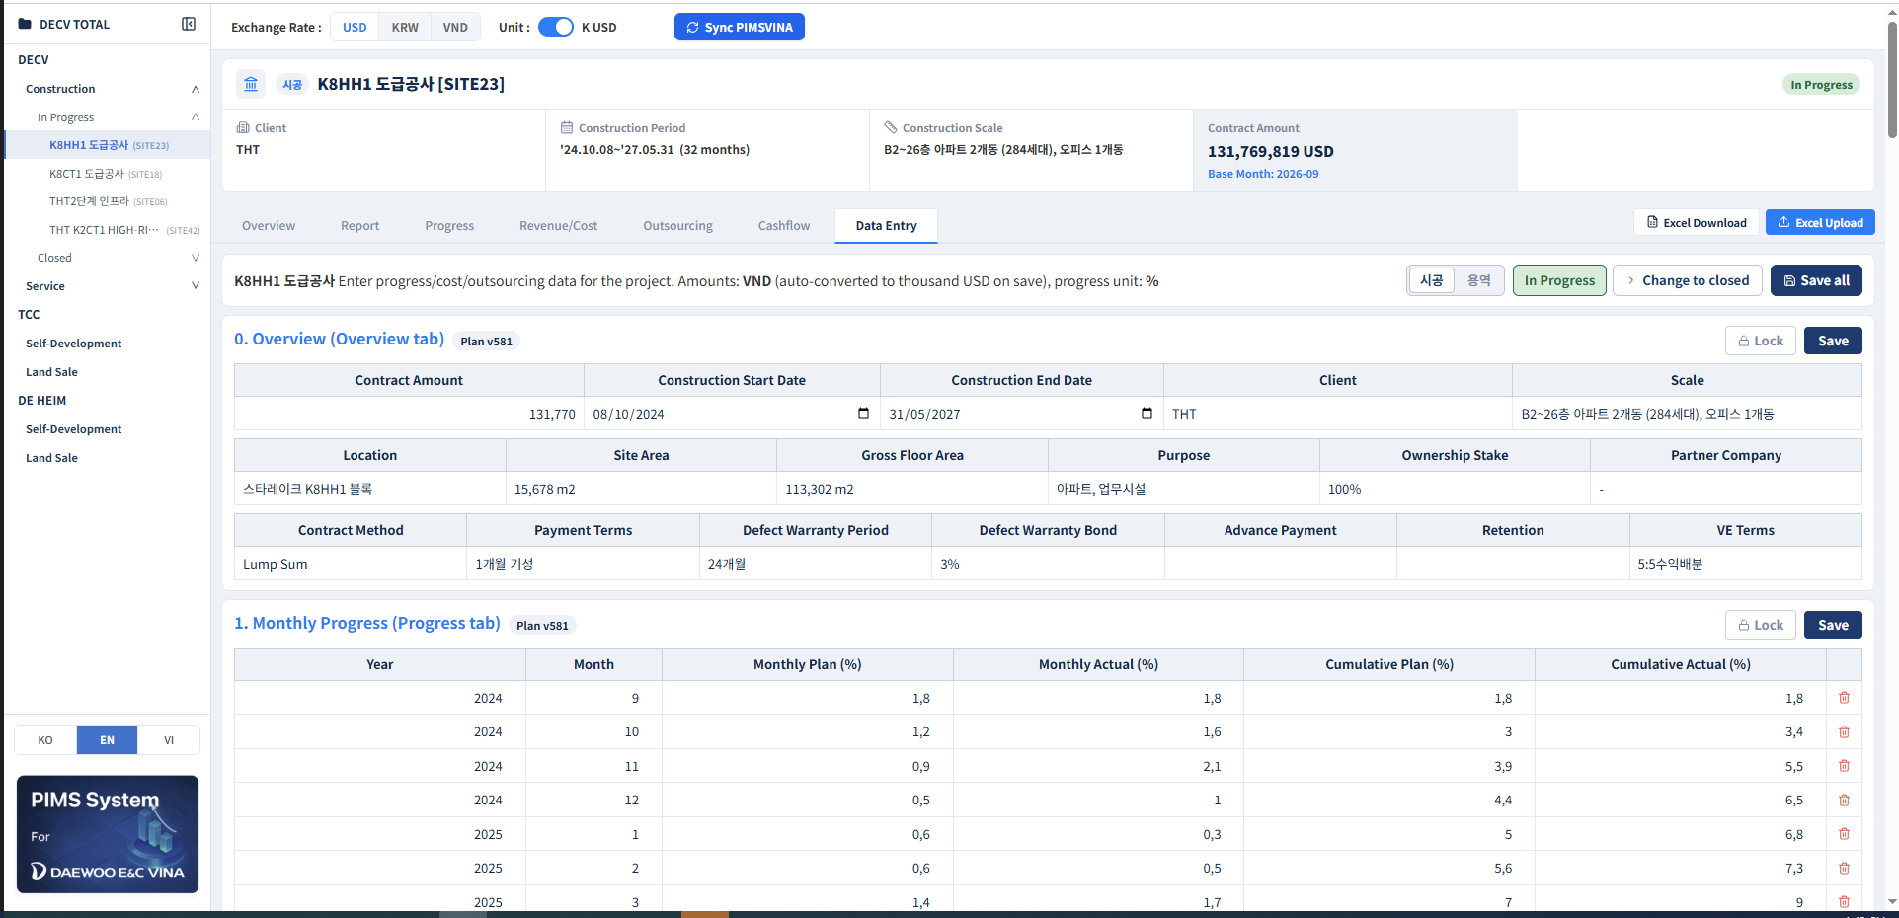
Data Entry: Overview & Monthly Progress
Description
1
1 Open the site’s Data Entry tab, choose 시공 (Construction) or 용역 (Service) scope and the site status (In Progress / Change to closed), then edit each numbered card and click its own Save (or Save all at the top).
2 0. Overview (Overview tab): Contract Amount, Construction Start/End Date, Client, Scale, Location, Site Area, Gross Floor Area, Purpose, Ownership Stake, Partner Company, Contract Method, Payment Terms, Defect Warranty Period/Bond, Advance Payment, Retention and VE Terms.
3 1. Monthly Progress (Progress tab): Year, Month, Monthly Plan (%), Monthly Actual (%), Cumulative Plan (%) and Cumulative Actual (%) feed the Progress donuts and trend chart.
4 Each card shows its source Plan version (e.g. “Plan v581”) and a Lock toggle to prevent further edits once finalized.
2
4
3
infoERP
PIMS Dashboard

Slide 24
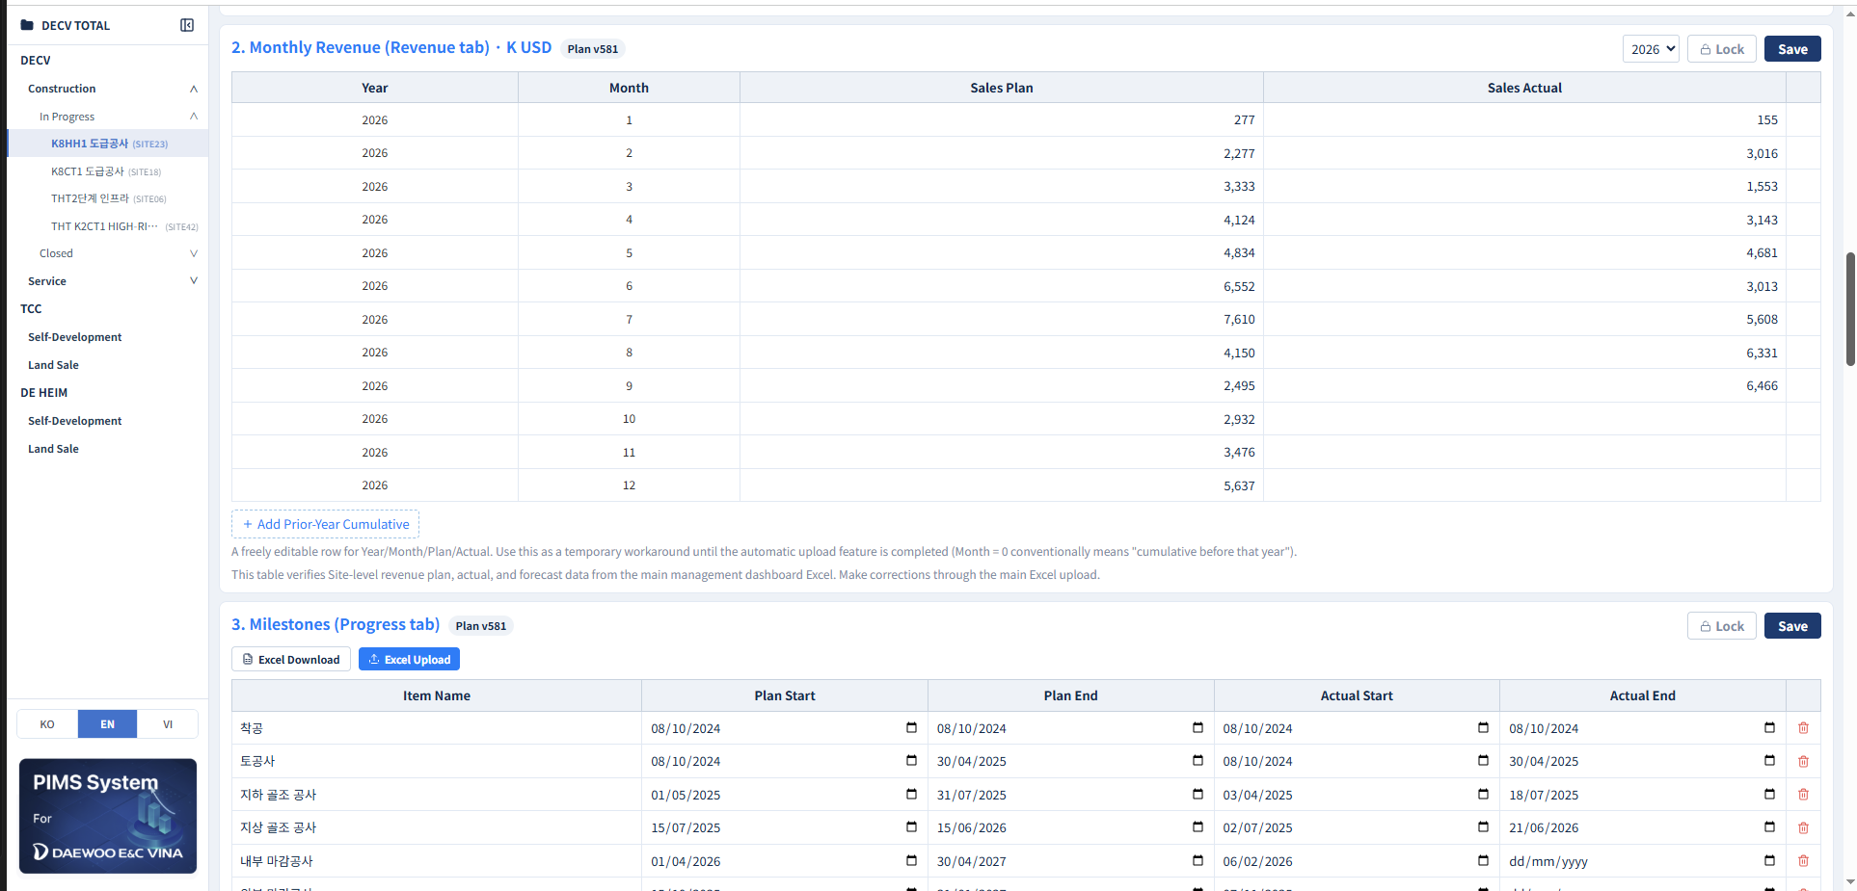
Data Entry: Monthly Revenue & Milestones
1
Description
1 2. Monthly Revenue (Revenue tab, K USD): enter Sales Plan and Sales Actual by Year / Month; use + Add Prior-Year Cumulative for a free Year/Month/Plan/Actual row representing cumulative revenue before the current year (Month = 0 convention).
2 This table is the source for the Report tab’s Revenue Actual & Forecast chart — corrections should go through the main Excel upload, not this screen, per the on-screen note.
3 3. Milestones (Progress tab): add rows with Plan Start/End and Actual Start/End dates per milestone item; use Excel Download / Excel Upload to bulk edit, or + Add milestone for a new row.
2
3
infoERP
PIMS Dashboard

Slide 25
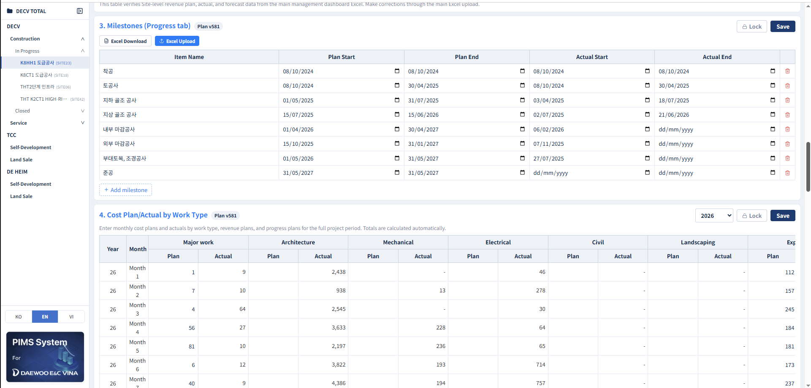
Data Entry: Cost Plan/Actual by Work Type
Description
1 4. Cost Plan/Actual by Work Type: enter monthly Plan and Actual cost for each work type — Major work, Architecture, Mechanical, Electrical, Civil, Landscaping, Expense 1/2 and more — for the selected year.
2 Totals here roll up into the Report and Revenue/Cost tabs’ cost figures; use the year selector at the top right to switch fiscal years.
1
2
infoERP
PIMS Dashboard

Slide 26
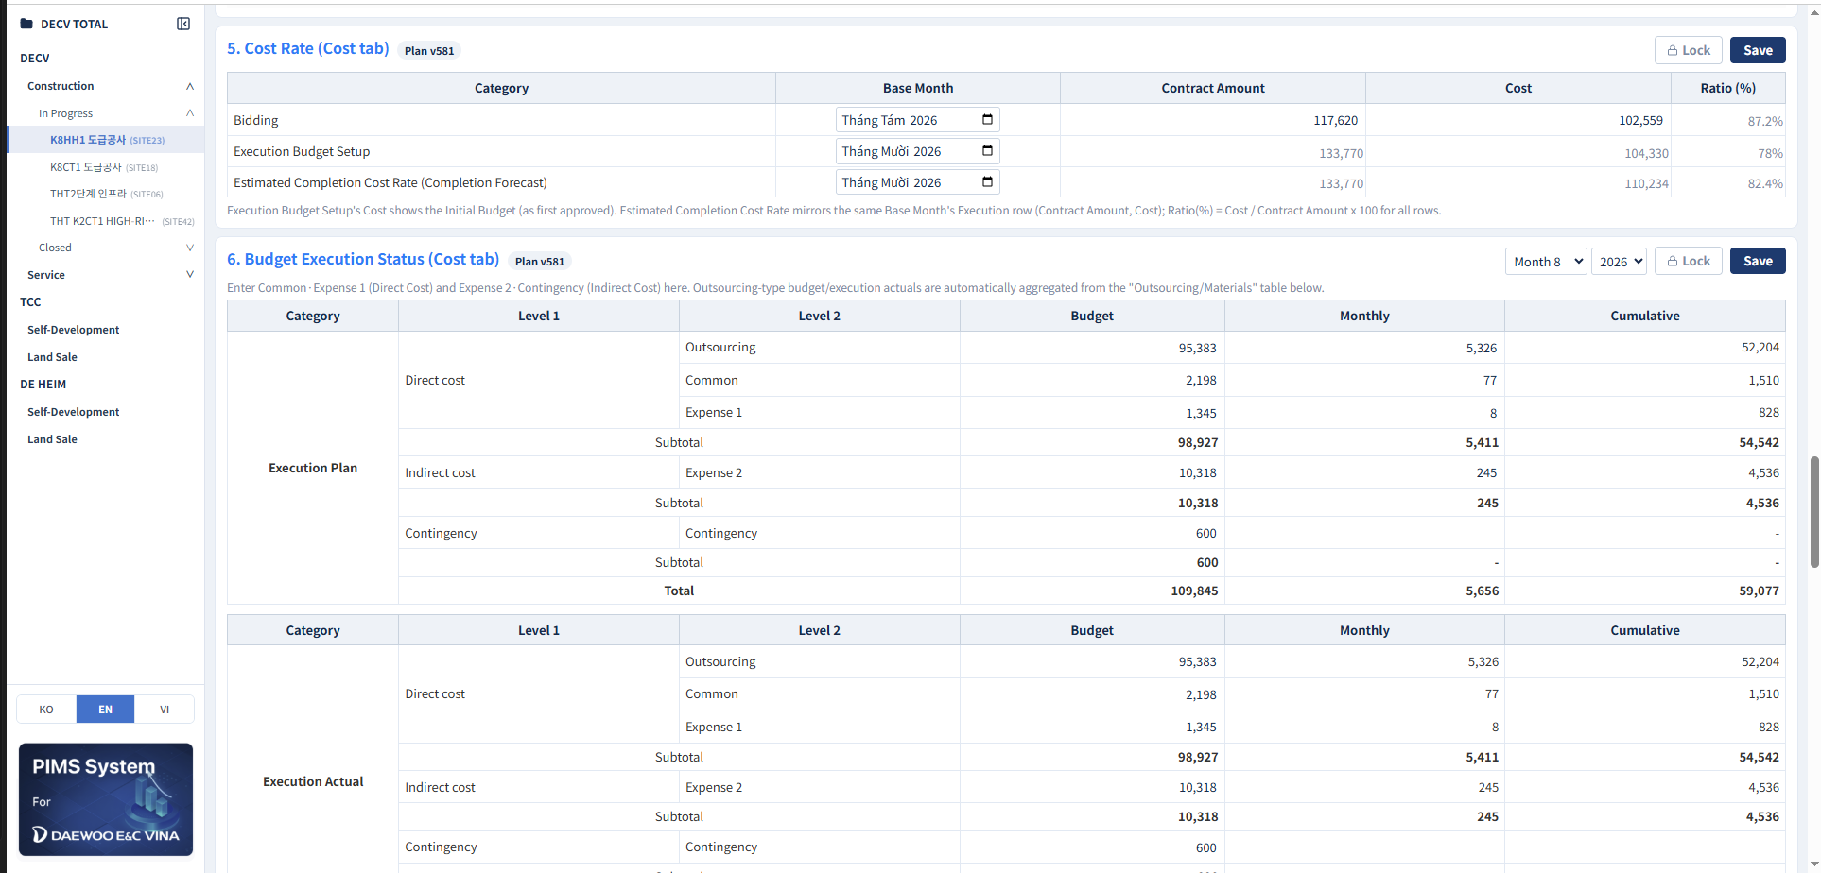
Data Entry: Cost Rate & Budget Execution Status
Description
2
1
1 5. Cost Rate (Cost tab): set the Base Month, Contract Amount and Cost for Bidding, Execution Budget Setup and Estimated Completion Cost Rate; Ratio (%) is auto-calculated as Cost / Contract Amount.
2 Execution Budget Setup’s Cost is the initial approved budget; Estimated Completion Cost Rate mirrors the same Base Month’s Execution figures.
3 6. Budget Execution Status (Cost tab): enter Common, Expense 1 (Direct Cost) and Expense 2 / Contingency (Indirect Cost) Budget, Monthly and Cumulative values for the selected Month / Year; Outsourcing-type rows are auto-aggregated from the Outsourcing/Materials table below — no manual entry needed there.
3
infoERP
PIMS Dashboard

Slide 27
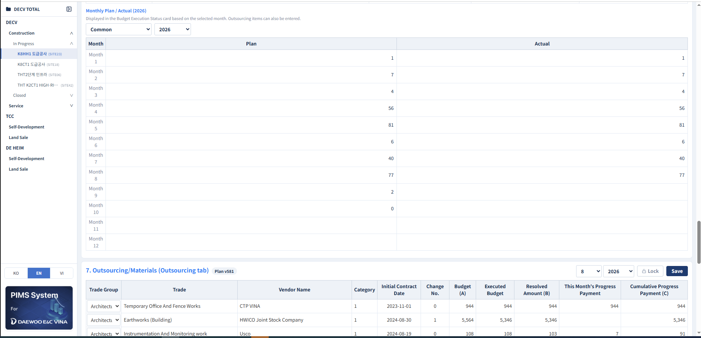
Data Entry: Monthly Plan/Actual & Outsourcing
Description
1 Monthly Plan / Actual (year): pick a category (e.g. Common) and year to enter the month-by-month Plan and Actual figures that feed the Budget Execution Status card above.
2 7. Outsourcing/Materials (Outsourcing tab): one row per vendor contract — Trade Group, Trade, Vendor Name, Category, Initial Contract Date, Change No., Budget (A), Executed Budget, Resolved Amount (B), This Month’s Progress Payment and Cumulative Progress Payment (C).
3 Select the Month / Year at the top right before entering progress payments for that period, then Save.
2
1
3
infoERP
PIMS Dashboard

Slide 28
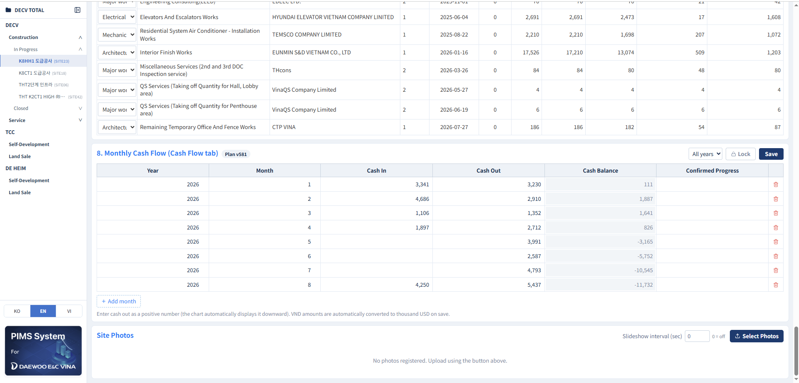
Data Entry: Outsourcing, Cash Flow & Site Photos
Description
1 Continue entering outsourcing rows as needed; totals from this table automatically populate the Outsourcing tab and the Budget Execution Status card.
2 8. Monthly Cash Flow (Cash Flow tab): enter Year, Month, Cash In, Cash Out (as a positive number — the chart displays it downward) and Confirmed Progress; Cash Balance is calculated automatically and VND amounts convert to thousand USD on save. Use + Add month for a new row.
3 Site Photos: use Select Photos to upload images for the site; set a Slideshow interval (seconds) to auto-rotate them, or 0 to disable.
2
1
3
infoERP
PIMS Dashboard

Slide 29
4
Project Dashboard – Service

Slide 30
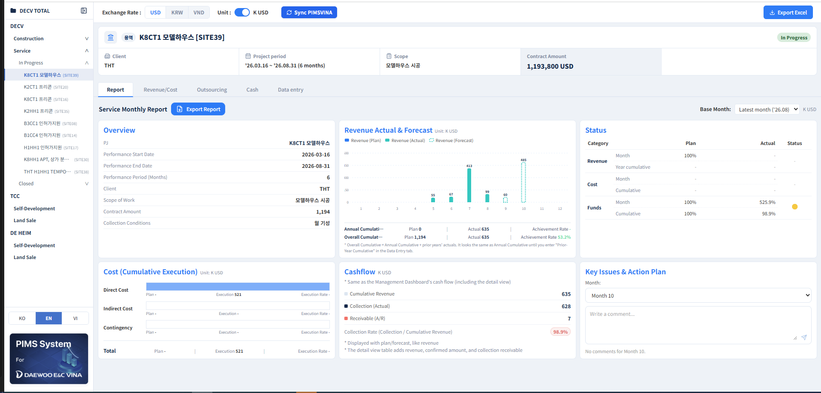
Report
Description
1
1 Select a service site from the left tree (e.g. K8CT1 모델하우스 [SITE39]); the header shows Client, Project period, Scope of work and Contract Amount.
2 Report mirrors the Construction site’s report layout without the Progress section: Overview, Revenue Actual & Forecast, Status (Revenue / Cost / Funds), Cost (Cumulative Execution), Cashflow and Key Issues & Action Plan.
3 Use Export Report, the Base Month selector and the Comment box (by month) exactly as on a construction site’s Report tab.
3
2
infoERP
PIMS Dashboard

Slide 31
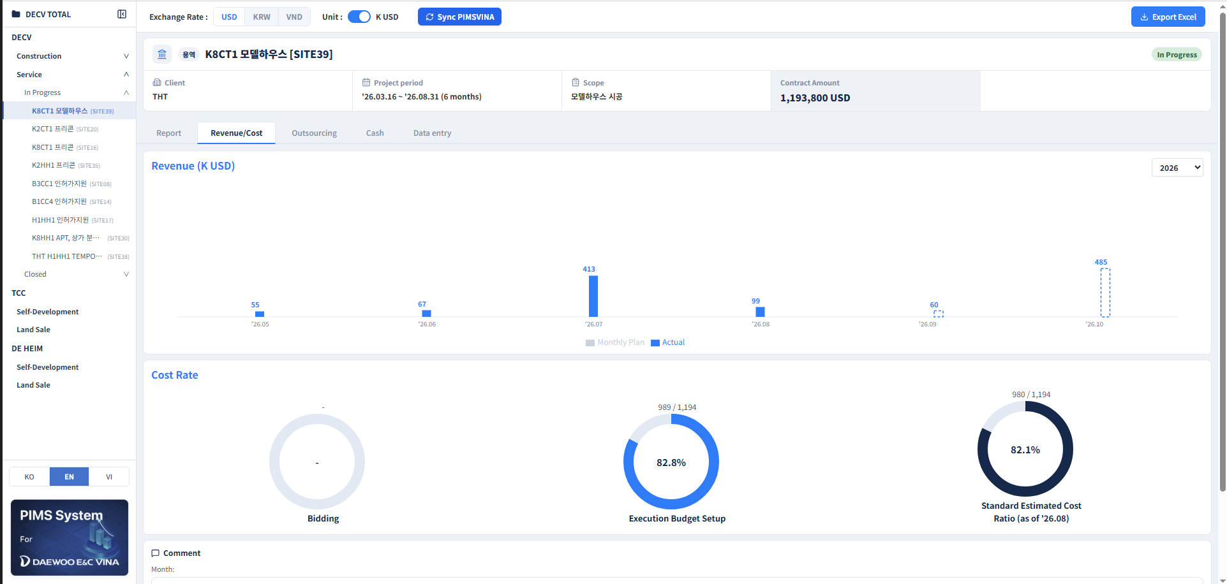
Revenue/Cost
Description
1
1 Revenue (K USD) charts Monthly Plan against Actual for the selected year, with dashed bars for upcoming forecast months.
2 Cost Rate shows three donuts — Bidding, Execution Budget Setup and Standard Estimated Cost Ratio — as Cost / Contract Amount, identical in structure to a Construction site’s Cost Rate card.
3 Use the Comment box below (filtered by month) to record revenue/cost notes for the period.
2
3
infoERP
PIMS Dashboard

Slide 32
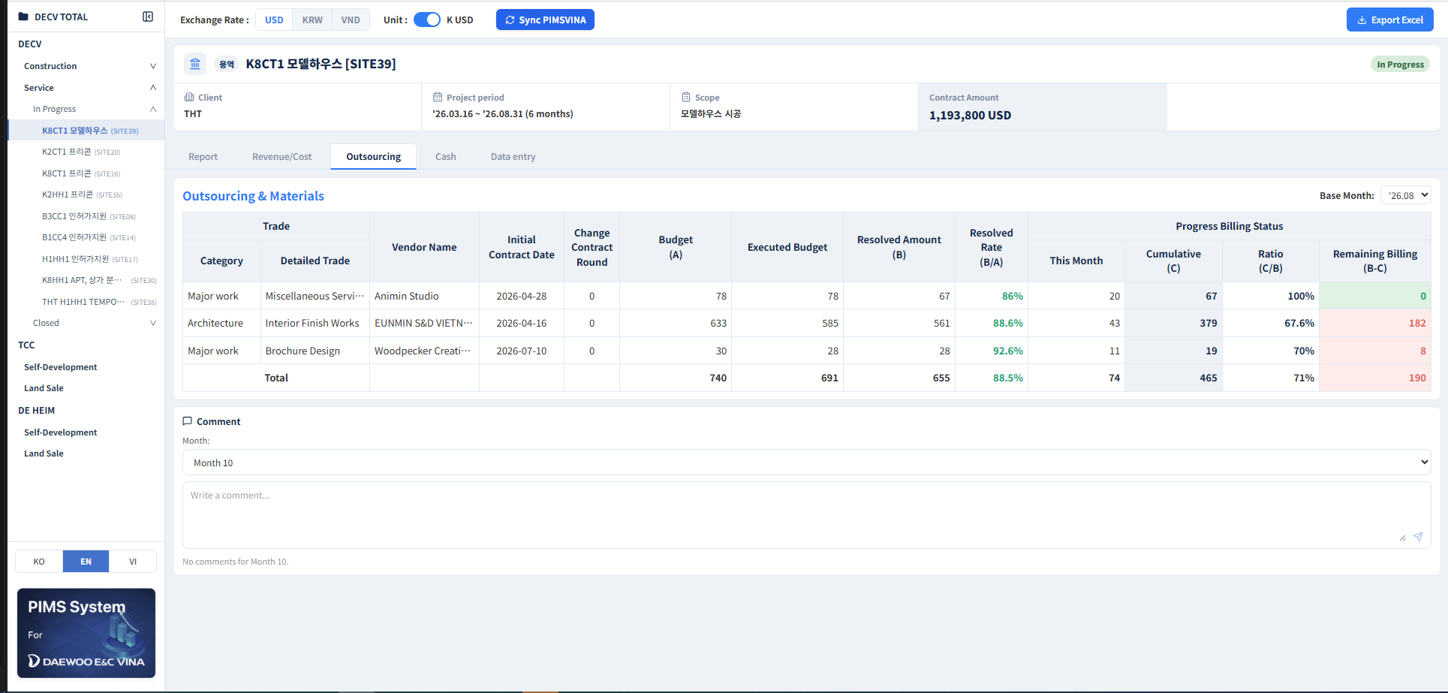
Outsourcing
Description
1
2
1 Outsourcing & Materials lists each vendor contract for the service site with the same columns as Construction: Category / Detailed Trade, Vendor Name, Initial Contract Date, Change Contract Round, Budget (A), Executed Budget, Resolved Amount (B), Resolved Rate (B/A).
2 Progress Billing Status shows This Month, Cumulative (C), Ratio (C/B) and Remaining Billing (B−C); the Total row sums every column across all vendors for the site.
infoERP
PIMS Dashboard

Slide 33
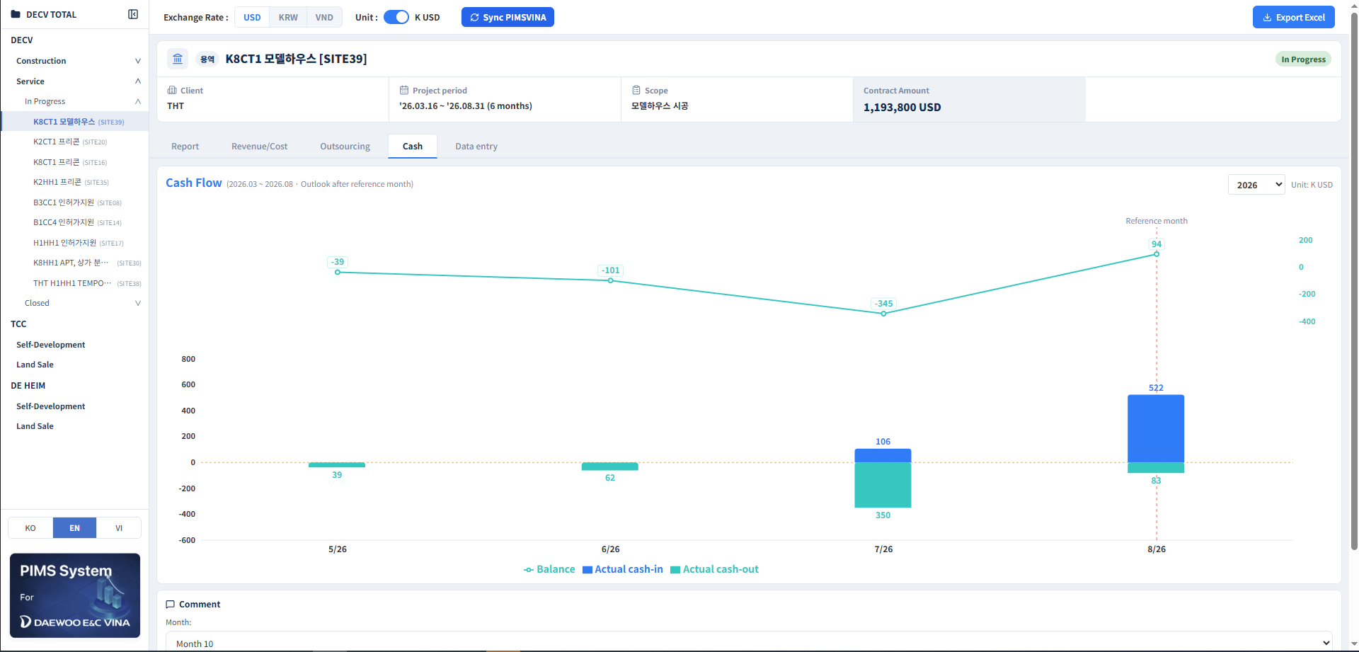
Cash
Description
1
2
1 Cash Flow plots the service engagement period as Actual cash-in / cash-out bars with the running Balance line and a dashed Reference month marker, exactly as on a Construction site.
2 Use the year selector at the top right to focus on a single year, and the Comment box below (filtered by month) for notes.
infoERP
PIMS Dashboard

Slide 34
5
Data Entry – Service

Slide 35
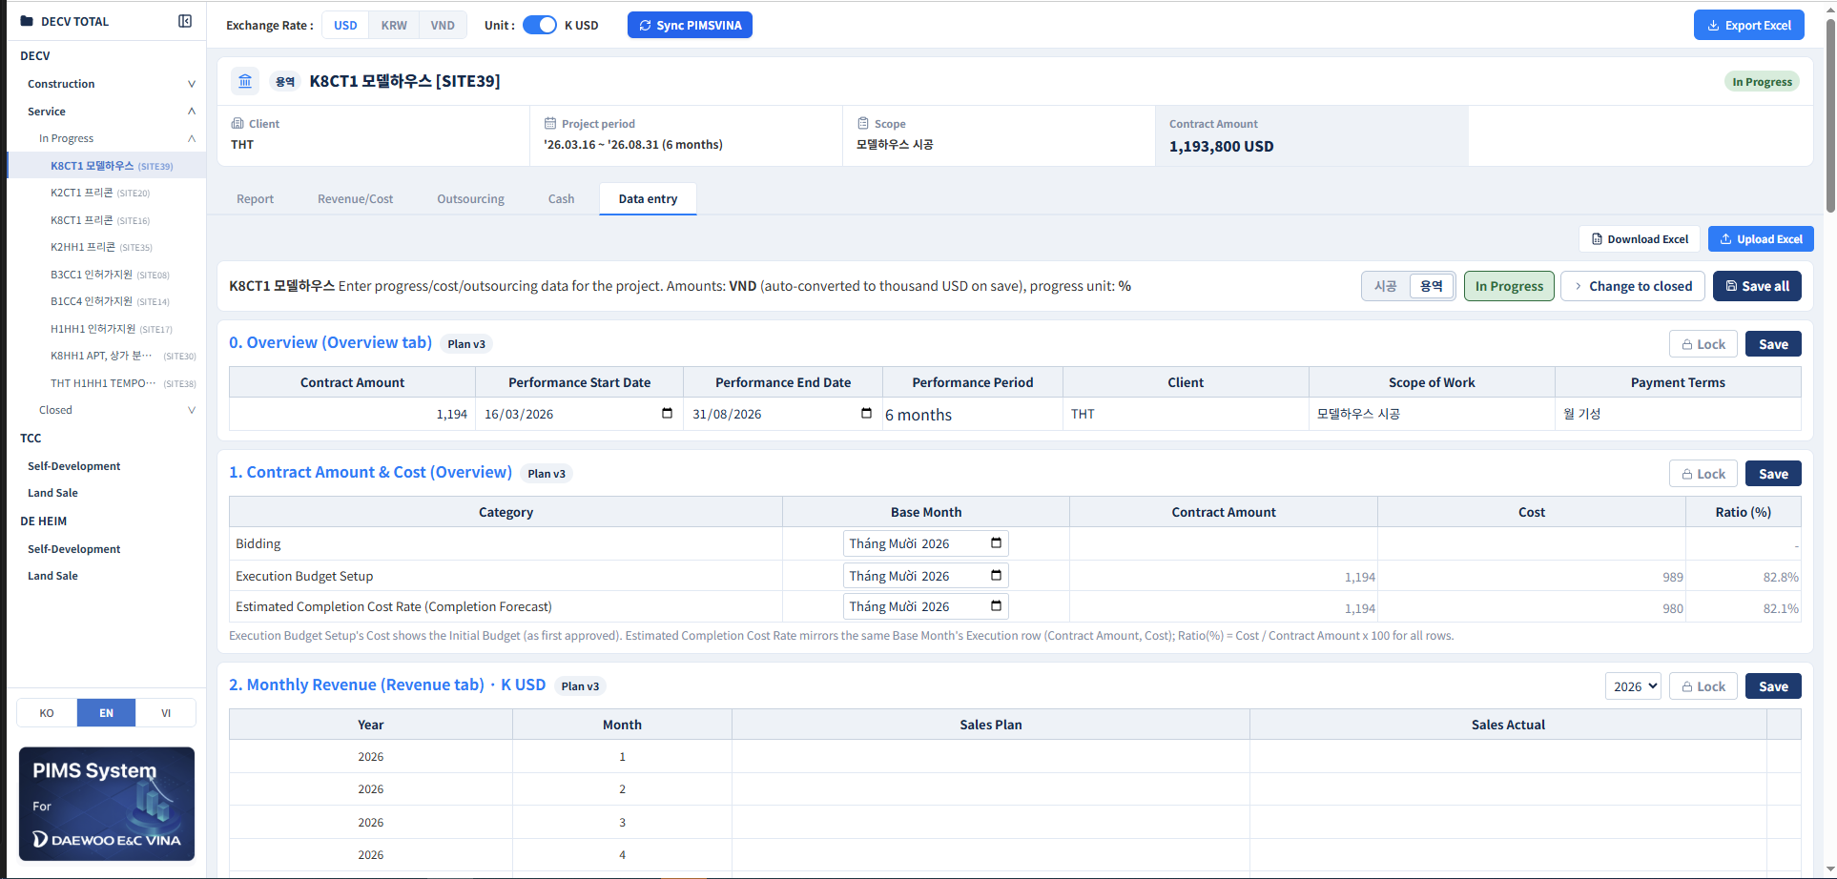
Data Entry: Overview, Contract Amount & Cost, Revenue
Description
1 0. Overview (Overview tab): Contract Amount, Performance Start/End Date, Performance Period, Client, Scope of Work and Payment Terms.
2 1. Contract Amount & Cost (Overview): Base Month, Contract Amount and Cost for Bidding, Execution Budget Setup and Estimated Completion Cost Rate, with Ratio (%) auto-calculated — the service equivalent of the Construction site’s Cost Rate card.
3 2. Monthly Revenue (Revenue tab, K USD): enter Sales Plan and Sales Actual by Year / Month; this feeds the Report tab’s Revenue Actual & Forecast chart.
2
1
3
infoERP
PIMS Dashboard

Slide 36
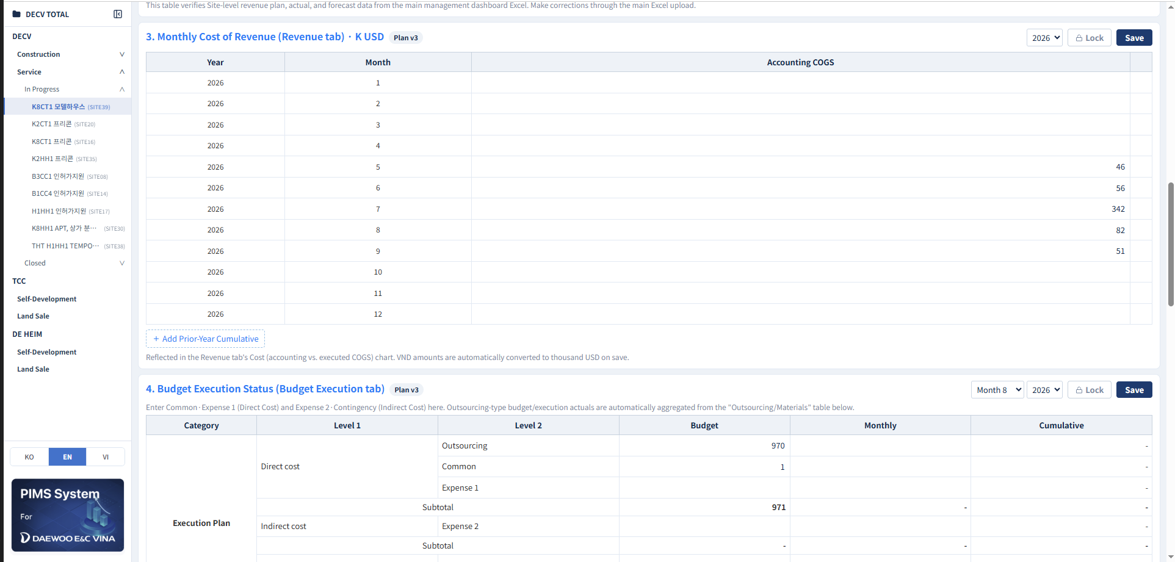
Data Entry: Monthly Cost of Revenue & Budget Execution
1
Description
1 3. Monthly Cost of Revenue (Revenue tab, K USD): enter Accounting COGS by Year / Month; use + Add Prior-Year Cumulative the same way as on the Revenue card. VND amounts auto-convert to thousand USD on save.
2 4. Budget Execution Status (Budget Execution tab): enter Common, Expense 1 (Direct Cost) and Expense 2 (Indirect Cost) Budget / Monthly / Cumulative for the selected Month / Year; Outsourcing-type rows aggregate automatically from the Outsourcing/Materials table below.
2
infoERP
PIMS Dashboard

Slide 37
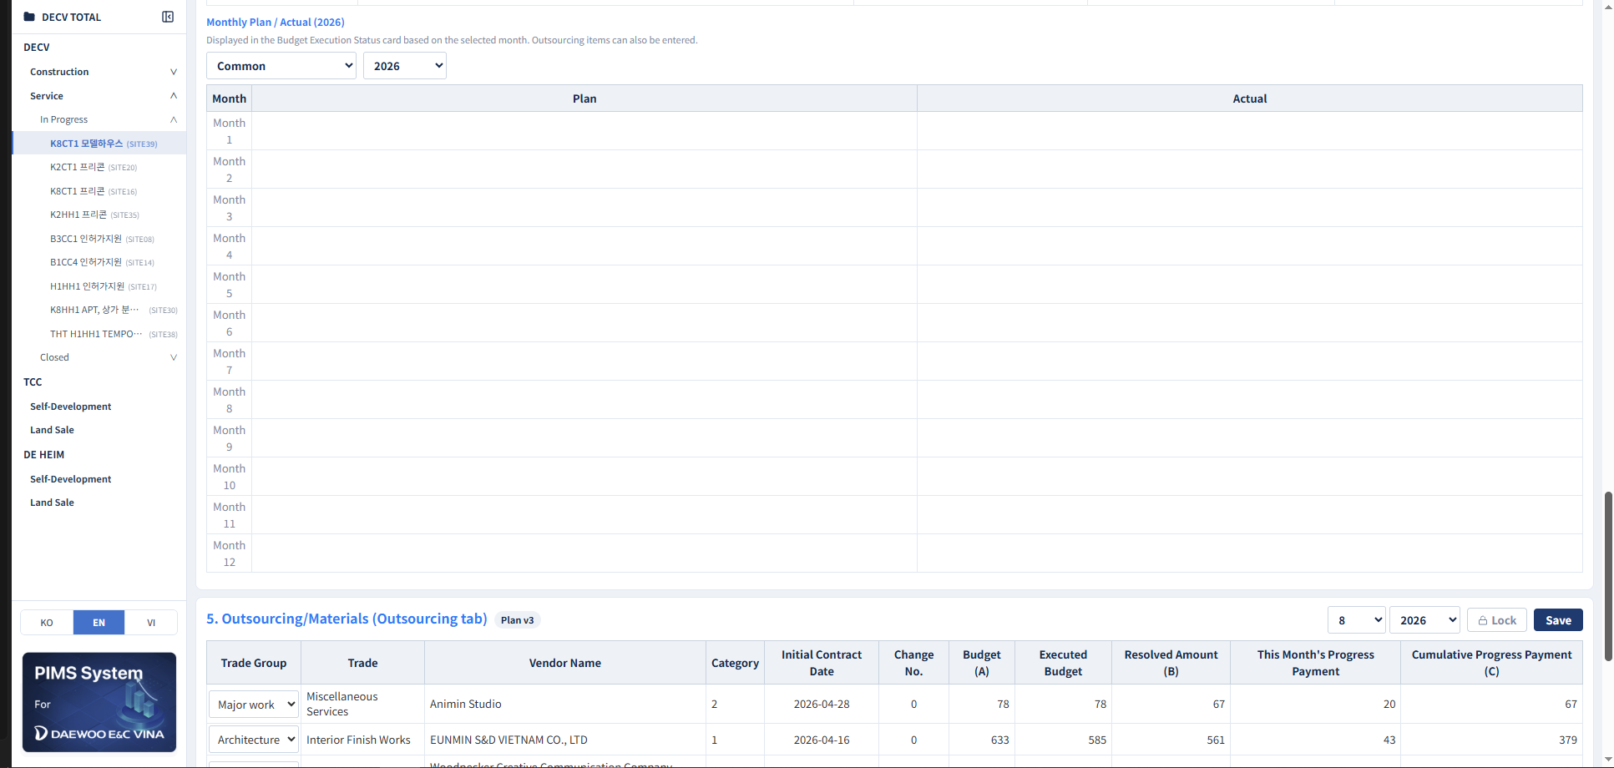
Data Entry: Monthly Plan/Actual & Outsourcing
1
Description
1 Monthly Plan / Actual (year): pick a category (e.g. Common) and year to enter month-by-month Plan and Actual figures feeding Budget Execution Status above.
2 5. Outsourcing/Materials (Outsourcing tab): one row per vendor — Trade Group, Trade, Vendor Name, Category, Initial Contract Date, Change No., Budget (A), Executed Budget, Resolved Amount (B), This Month’s Progress Payment and Cumulative Progress Payment (C); select the Month / Year first, then Save.
2
infoERP
PIMS Dashboard

Slide 38
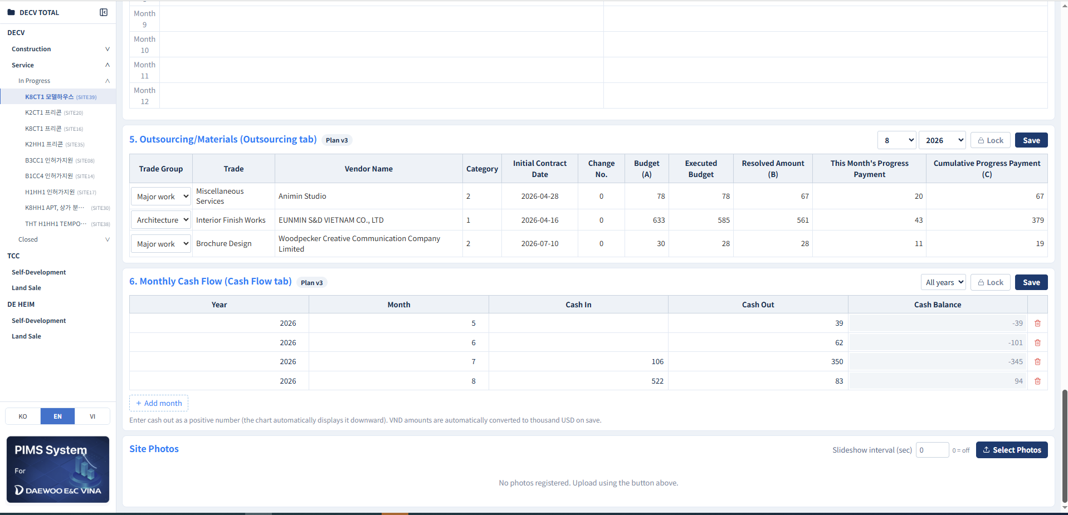
Data Entry: Outsourcing, Cash Flow & Site Photos
Description
1 Continue entering outsourcing rows as needed; totals automatically populate the service site’s Outsourcing tab and Budget Execution Status card.
2 6. Monthly Cash Flow (Cash Flow tab): enter Year, Month, Cash In, Cash Out (as a positive number) and Confirmed Progress; Cash Balance calculates automatically and VND converts to thousand USD on save. Use + Add month for a new row.
3 Site Photos: use Select Photos to upload images for the service site.
2
1
3
infoERP
PIMS Dashboard

Slide 39
Thank you!
infoERP
PIMS Dashboard – User Guide

